Slide 1
Z3 Internals
Nikolaj Bjørner, Microsoft Research, RiSE
Clemens Eisenhofer, TU Wien
POPL tutorials, January 14, 2023

Slide 2
Overview
x
s

Slide 3
The usual z3 intro slides

Slide 4
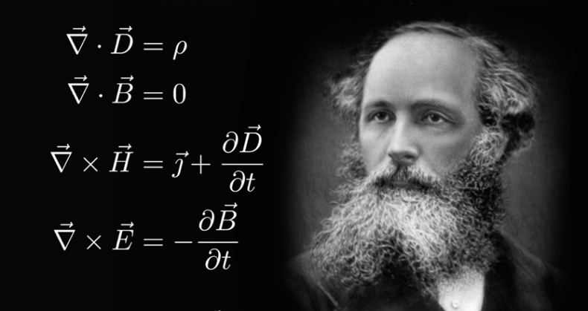
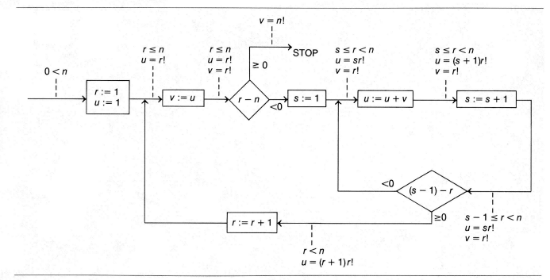
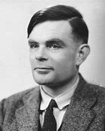


Logic: The Calculus of Computation
Invariants
Differential, Integral Calculus
Logic
Dynamics, Conduction,..
Matlab, Mathemetica, Simulink
Computation
Claim: Practically all modern program analysis tools involve solving logical formulas

Slide 5
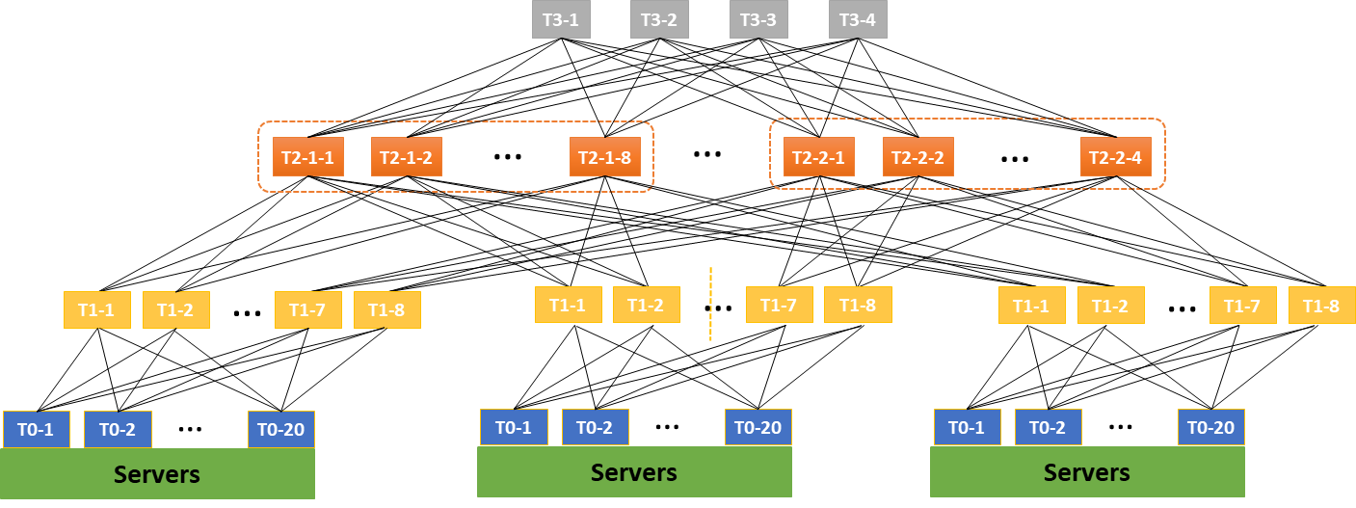

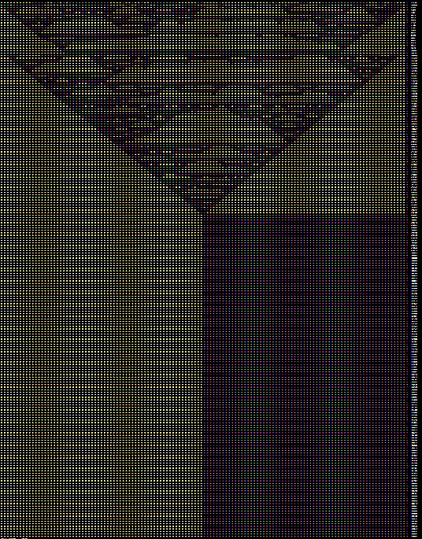
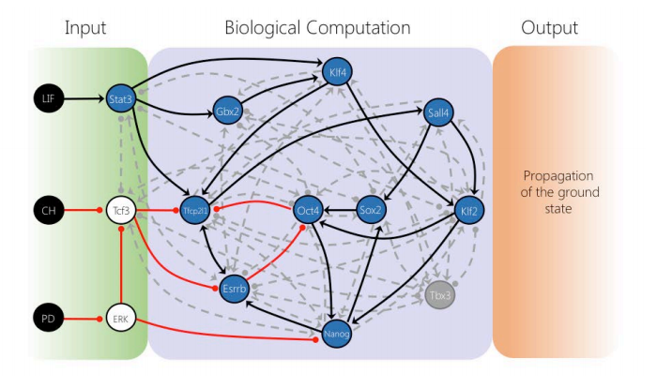

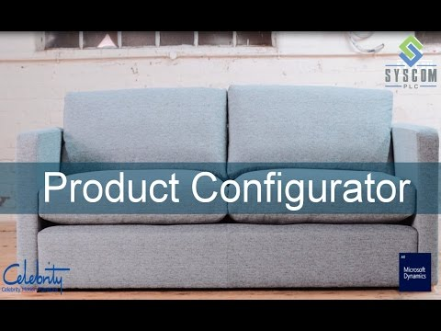

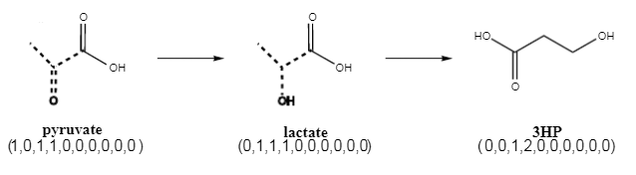

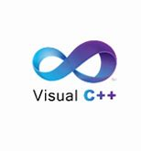
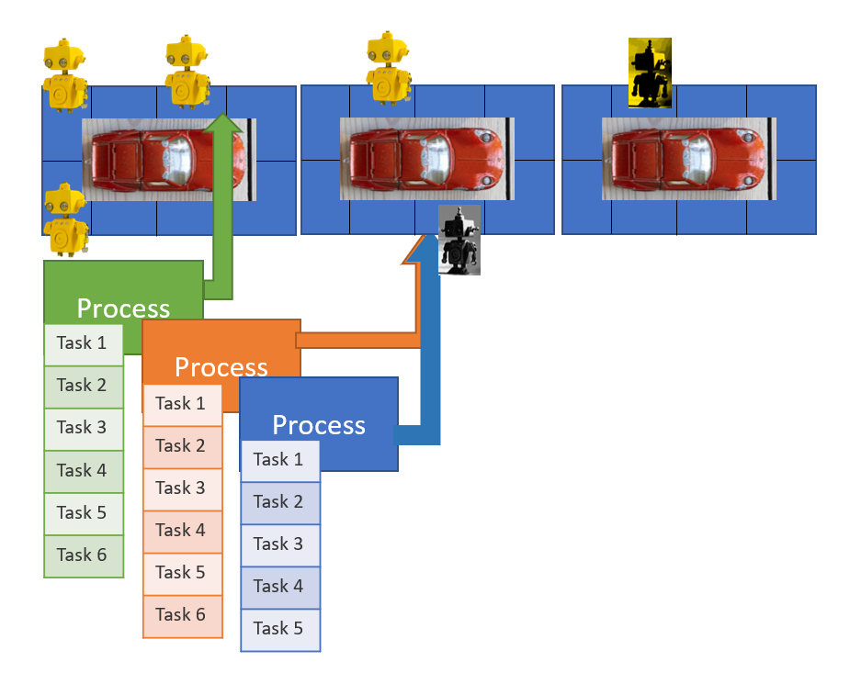



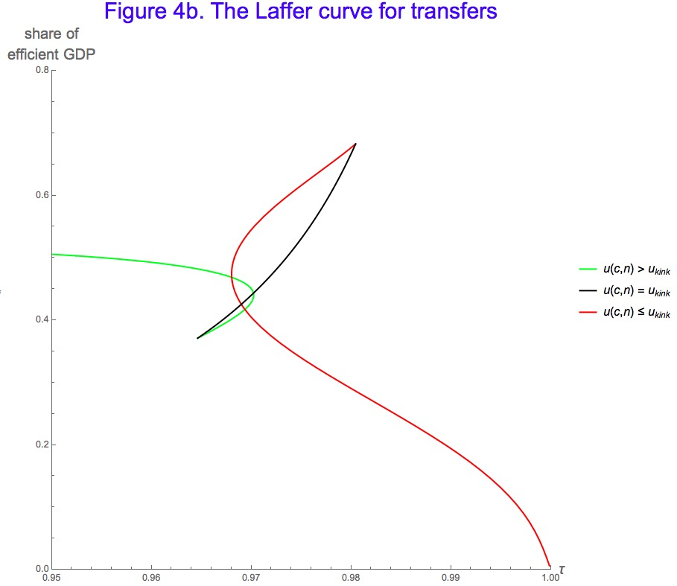
for Software +…
Azure Network
Verification
Verifying C
Compiler
Quantum
Compilation
Biological
Computations
Verified Crypto
Libraries & Protocols
Dynamics
AX
SVACE
Static Analysis Engines
Artificial
Life
Security Risk Detection
Smart Contract
Verification
ALIVE2
Translation Validation
for LLVM & Visual C++
Axiomatic
Economics
Assembly Line
Optimization

Slide 6
Efficiency
Scale
Technology Landscape
Propositional
Satisfiability Solving
SAT
Breakthroughs in 2000s
Cheap local Inferences
Garbage collect useless clauses
Hardware Design
Automation
Breakthroughs late 2000s
SAT + global inferences +
global propagators
Mixed Integer
Programming
MIP
Breakthroughs in 1960s
Harnessed since 1990s
LP: global Inferences
IP: Cuts, Branch and Bound
Satisfiability Modulo Theories
Operations
Research
CP-SAT
SMT
Z3
Constraint
Programming
Software Development +…
CP
Breakthroughs since 1990s
Powerful domain-tailored
global propagators
Expressive Power

Slide 7
Material
z3 on github – https://github.com/z3prover/z3
Tutorial document - https://z3prover.github.io/papers/z3internals.html
Online tutorial - https://microsoft.github.io/z3guide

Slide 8
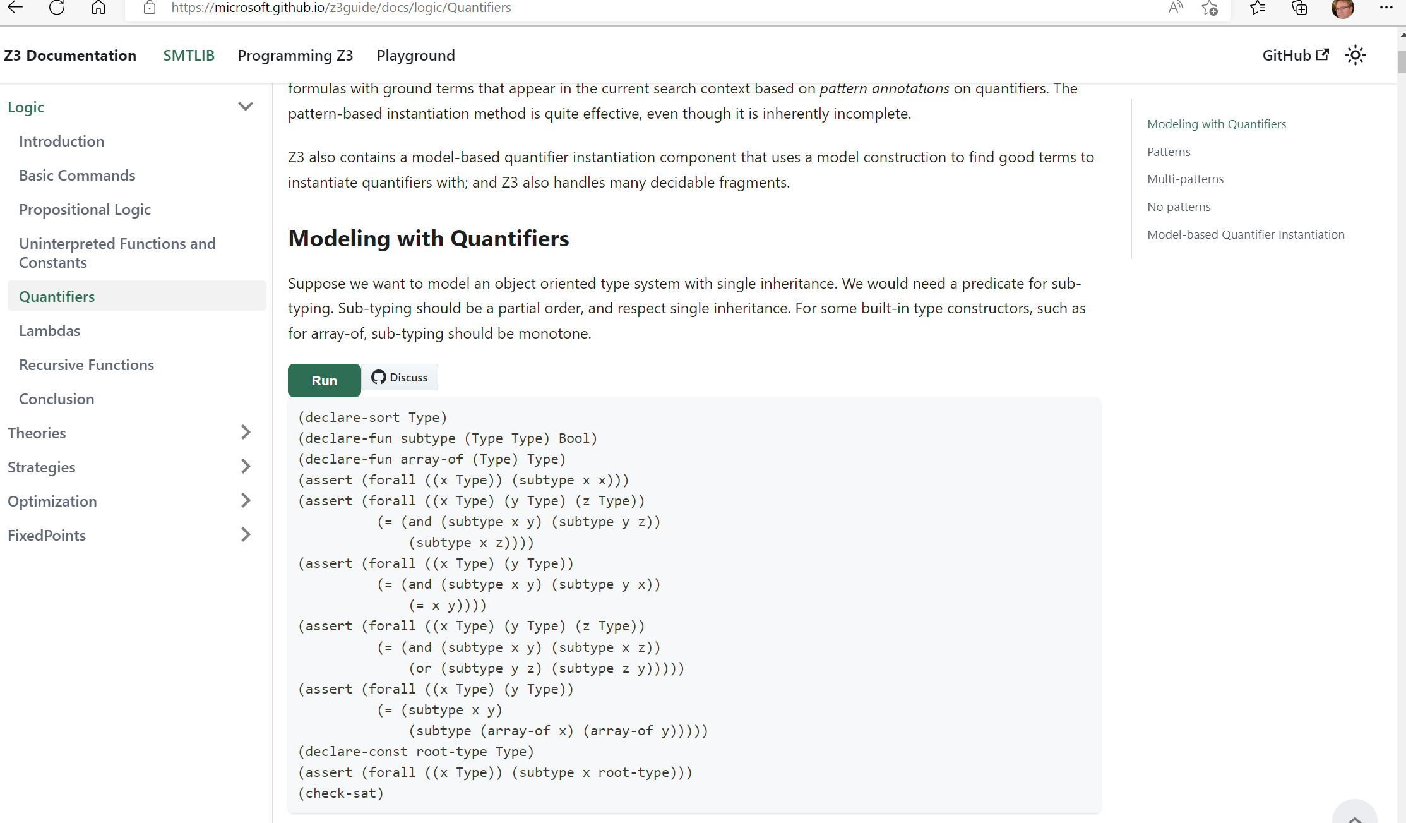

Slide 9
What to expect when expecting a z3 internals tutorial?

Slide 10
What users may want to learn
How can I tune formulas to be solved by Z3?
How can I have Z3 provide feedback on solving?
What features of Z3 should I use for solving formulas?
how can I determine which strategies apply to my formulas?
Can I control the output of Z3
models (to be diverse, random)?

Slide 11
What a developer likes to talk about
Solvers
Algorithms
Data-structures
Logic features
Proof systems
Heuristics
Anatomy of Congruence Closure
How do solvers interact (with the core)?
How do solvers implement search?

Slide 12
Tutorial format
Understand Core Concepts
Understand where to dig further
Use cases shaped by anecdotes

Slide 13
Interfacing with Z3
A Quiz and some Answers

Slide 14
Formulating Formulas for Z3
Capturing Finite domains as propositional theories
SAT
BV = SAT or SAT + equality propagation
PB = SAT + cardinality + weighted Boolean inequalities
Symmetries
Programming With Quantifiers

Slide 15
Controlling Search
SAT engine control
Variable phases
Sat.threads, parallel.enable
Lookahead Solving
Ackermann reduction
Arithmetic and finite domains

Slide 16
Retrieving Information
Model, Core, Proof
Clausal Proof Logs, Trace
API Log, SMT log, Lemma log

Slide 17
Tactics

Slide 18
Solver Engines

Slide 19
Core Decision Procedures

Slide 20
Data-structure Internals

Slide 21
Models

Slide 22
Certificates

Slide 23
Quantifiers

