Slide 1
Z3 Internals
Nikolaj Bjørner, Microsoft Research, RiSE
Clemens Eisenhofer, TU Wien
POPL tutorials, January 14, 2023

Slide 2
Overview
x
s

Slide 3
The usual z3 intro slides

Slide 4
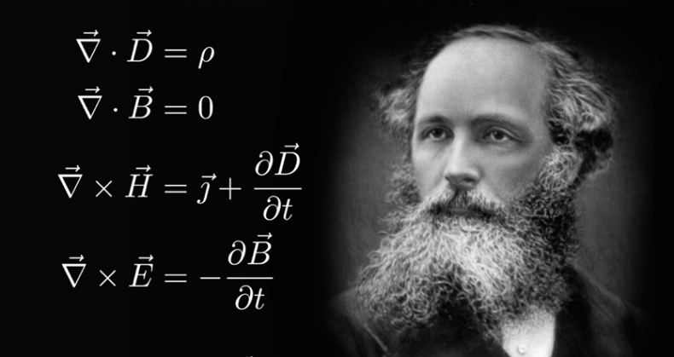
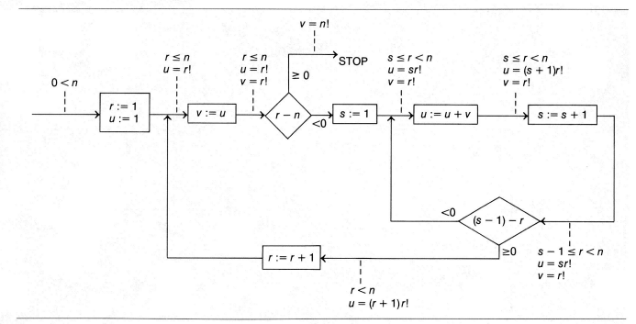
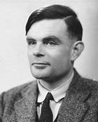


Logic: The Calculus of Computation
Invariants
Differential, Integral Calculus
Logic
Dynamics, Conduction,..
Matlab, Mathemetica, Simulink
Computation
Claim: Practically all modern program analysis tools involve solving logical formulas

Slide 5
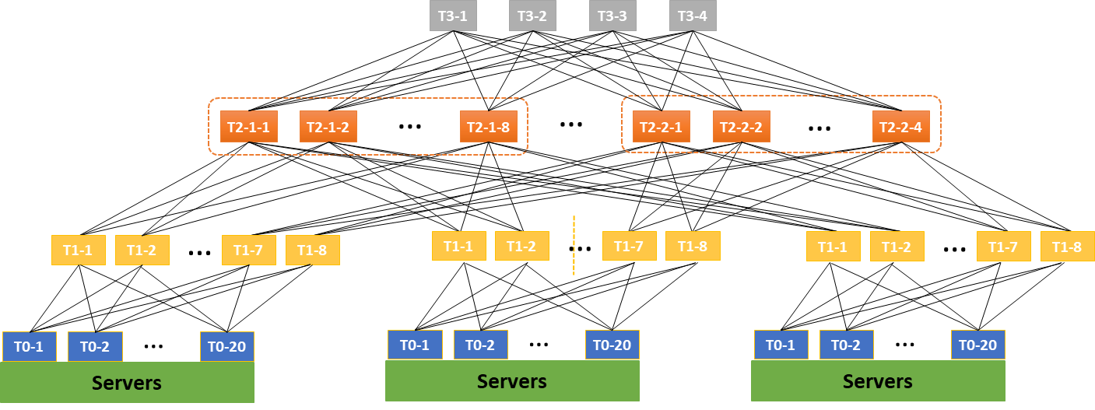

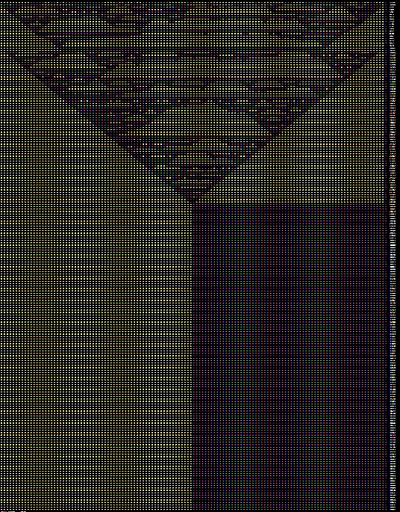
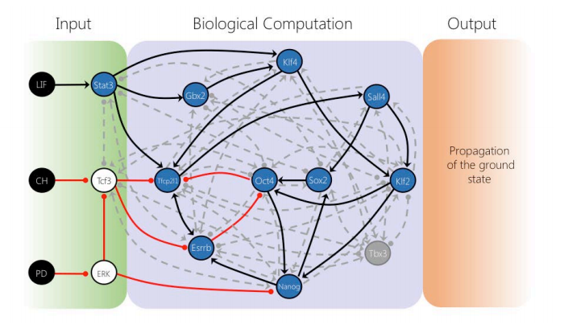

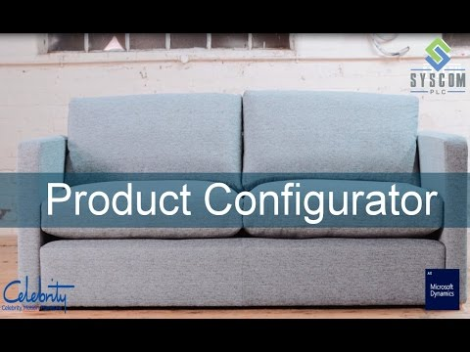

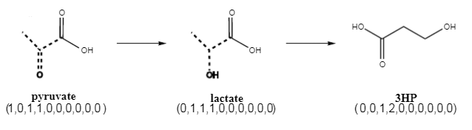

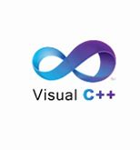
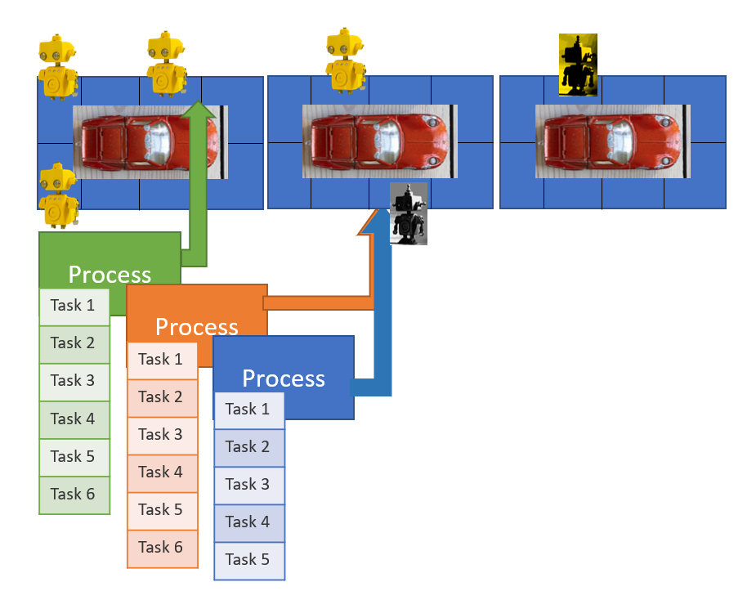



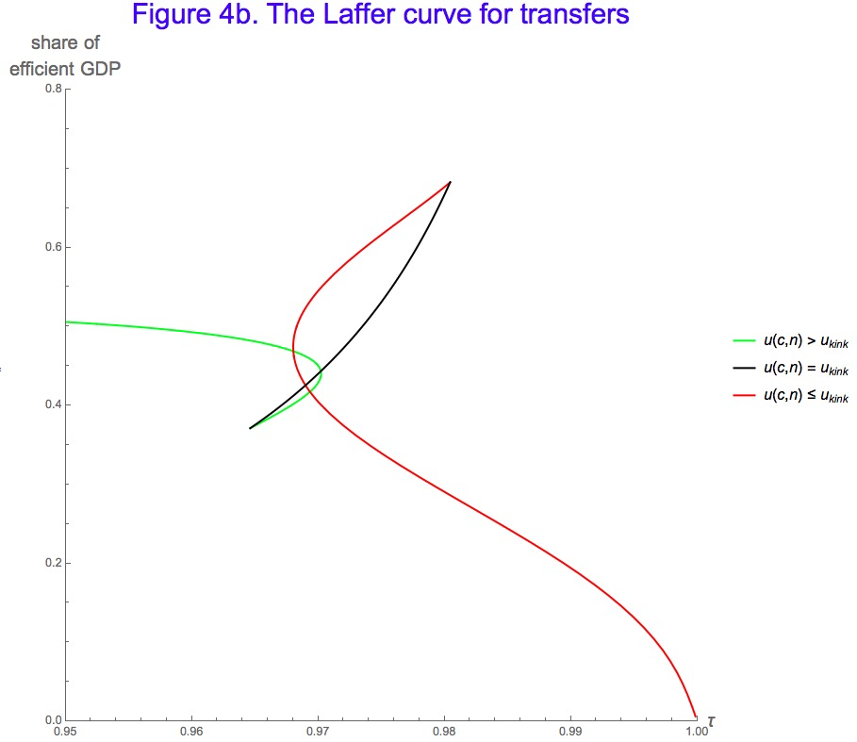
for Software +…
Azure Network
Verification
Verifying C
Compiler
Quantum
Compilation
Biological
Computations
Verified Crypto
Libraries & Protocols
Dynamics
AX
SVACE
Static Analysis Engines
Artificial
Life
Security Risk Detection
Smart Contract
Verification
ALIVE2
Translation Validation
for LLVM & Visual C++
Axiomatic
Economics
Assembly Line
Optimization

Slide 6
Efficiency
Scale
Technology Landscape
Propositional
Satisfiability Solving
SAT
Breakthroughs in 2000s
Cheap local Inferences
Garbage collect useless clauses
Hardware Design
Automation
Breakthroughs late 2000s
SAT + global inferences +
global propagators
Mixed Integer
Programming
MIP
Breakthroughs in 1960s
Harnessed since 1990s
LP: global Inferences
IP: Cuts, Branch and Bound
Satisfiability Modulo Theories
Operations
Research
CP-SAT
SMT
Z3
Constraint
Programming
Software Development +…
CP
Breakthroughs since 1990s
Powerful domain-tailored
global propagators
Expressive Power

Slide 7
Material
z3 on github – https://github.com/z3prover/z3
Tutorial document - https://z3prover.github.io/papers/z3internals.html
Online tutorial - https://microsoft.github.io/z3guide

Slide 8
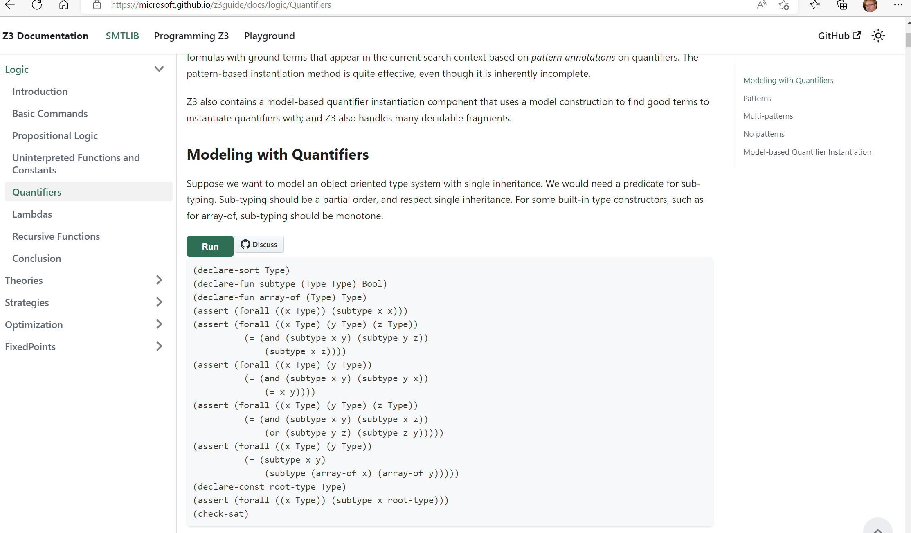

Slide 9
What to expect when expecting a z3 internals tutorial?

