Slide 1
SMT Solving Fundamentals
Nikolaj Bjørner, Microsoft Research, RiSE
TU Wien, 2025
A Laura Kovacs guest lecture production

Slide 2
Satisfiability Modulo Theories (SMT)
Is formula ϕ satisfiable modulo theory T ?
SMT solvers have specialized algorithms for T

Slide 3

CDCL(T)
Theory
Solvers
SMT
SAT
Equality + UF
Arithmetic
Bit-vectors
…
Case Analysis

Slide 4

Elements of Solving
Satisfiability Preserving Pre/in-processing
Search
Encoding and re-encoding
can also be considered an
element of solving loop.

Slide 5
Search Engines
CDCL(T) SPACER NLSAT QSAT

Slide 6

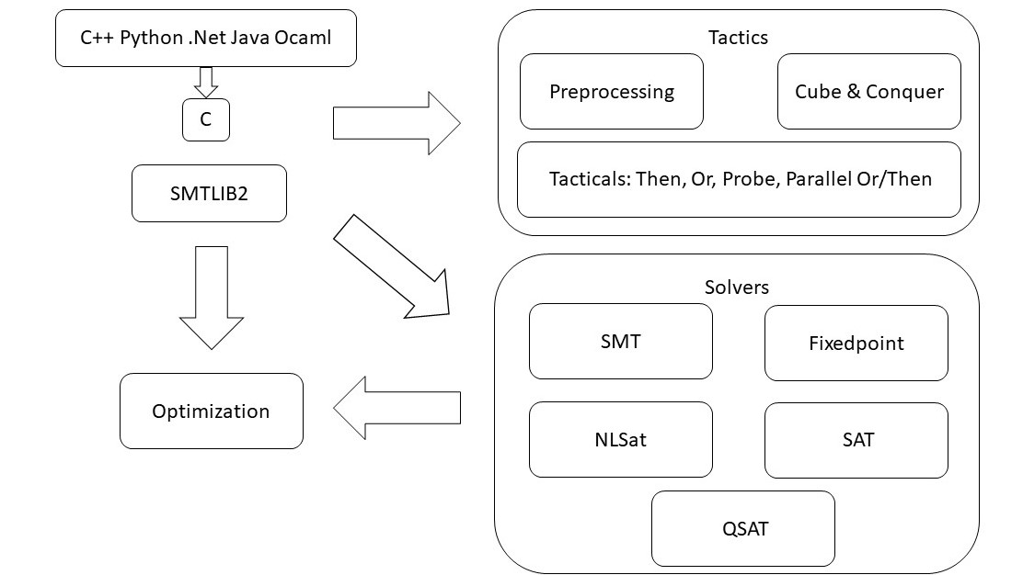
overview

Slide 7







CDCL(T)
x ≥ 0, y = x + 1, (y > 2 ∨ y < 1)
$$α$$
$$p1, p2, (p3  p4)$$
Strengthen
($¬p_{1}∨¬p_{2}∨¬p_{4})$
SAT
Block
$$p1, p2, ➢p3, p4$$
$$p1, p2, p4$$
$$γ$$
$$α$$
Theory Conflict
x ≥ 0, y = x + 1, y ≤ 1, y < 1
x ≥ 0, y = x + 1, y < 1

Slide 8


CDCL(T) – Main State Variables
Search State
$$⟨M;F⟩$$
$$⟨M;F;C⟩$$
Conflict State
F – set of clauses
Split into irredundant and redundant clauses.
Redundant clauses can be garbage collected.
2 literal watch list and binary clause optimization
M – a trail of assigned literals
C – a conflict clause

Slide 9
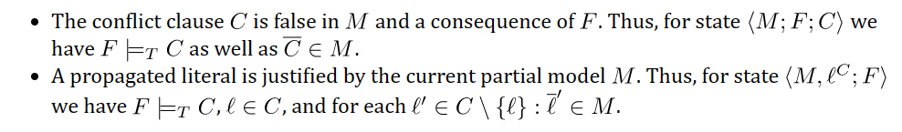

CDCL(T) - Invariants
M
F
$$C$$

Slide 10
CDCL(T) – Dual Model/Proof search
Backjump
Models
literal assignments
Proofs
Conflict Clauses
Conflict Resolution
Propagate

Slide 11
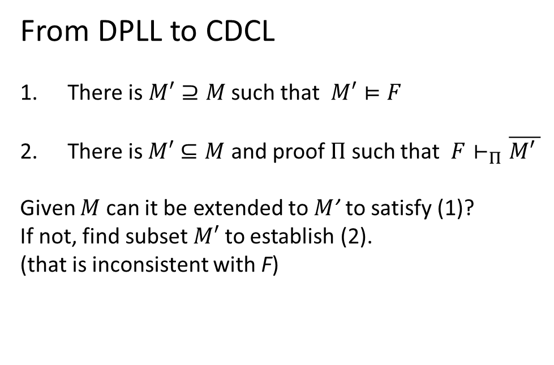
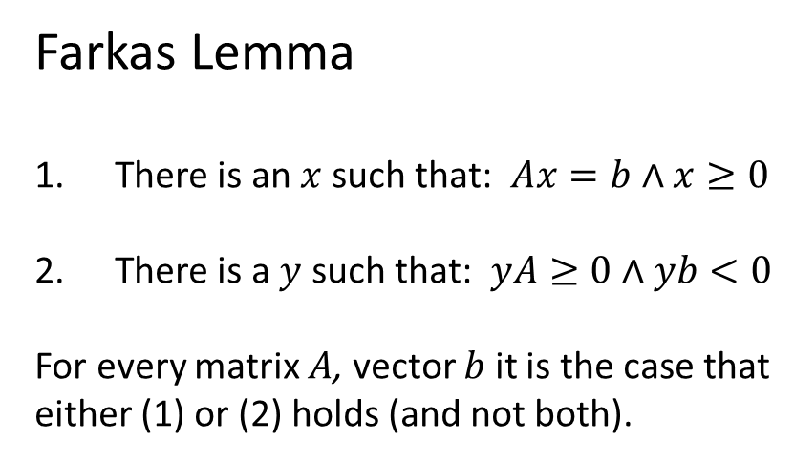
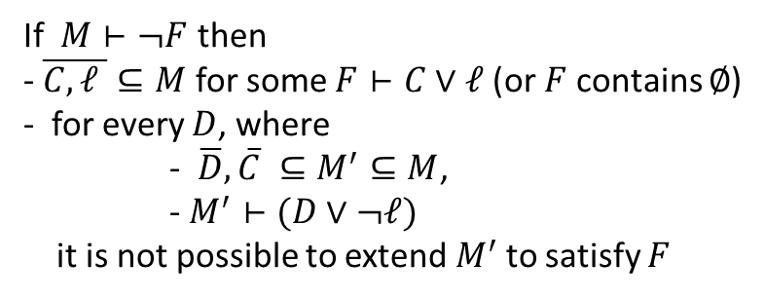
Dichotomy – Proofs and Models
Farkas Lemma
There is an $x$ such that: $Ax=b∧x≥0$
There is a $y$ such that: $yA≥0∧yb<0$
For every matrix $A$, vector $b$ it is the case that
either (1) or (2) holds (and not both).
From DPLL to CDCL
There is $M′⊇M$ such that $M′⊨F$
There is$M′⊆M$ and proof $Π$ such that $F⊢_{Π}\overline{M\text{′} }$
Given $M$ can it be extended to $M$’ to satisfy (1)?
If not, find subset $M′$ to establish (2).
(that is inconsistent with F)
Corollary
Conflict learning (resolution)
extends F by clauses that block shorter models
If $M⊢¬F$ then
- $\overline{C,ℓ }⊆M$ for some $F⊢C∨ℓ$ (or $F$ contains $∅$)
- for every $D$, where
- $\overline{D},\overline{C} ⊆M^{′}⊆M$,
- $M^{′}⊢(D∨¬ℓ)$
it is not possible to extend${ M}^{′}$ to satisfy $F$

Slide 12
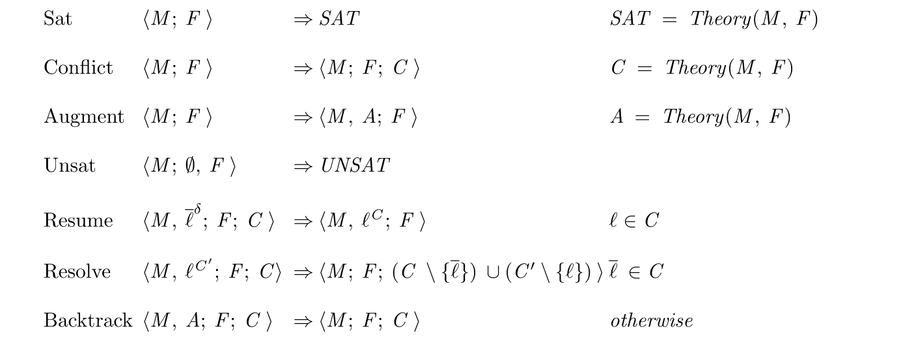
CDCL(T) as inference rules

Slide 13
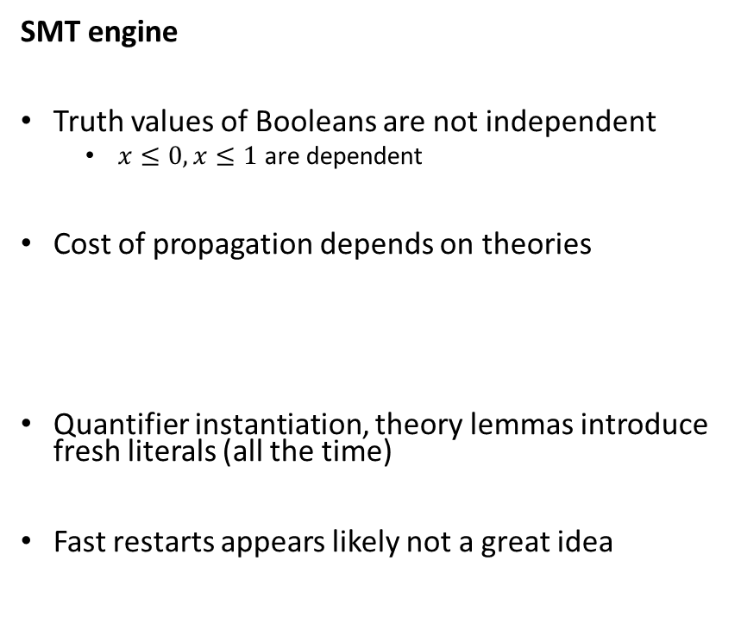
CDCL(T) – SAT vs SMT
SAT engine
Truth assignment is symmetric for Boolean variables
Probing (for failed literals)
L is failed if asserting L & F infers false by unit propagation.
Cost of propagation controlled by clause watch list
Boolean Variables are fixed during search
“Fast restart” introduced to prioritize variables used in conflicts
SMT engine
Truth values of Booleans are not independent
$x≤0, x≤1$ are dependent
Cost of propagation depends on theories
Quantifier instantiation, theory lemmas introduce fresh literals (all the time)
Fast restarts appears likely not a great idea

Slide 14
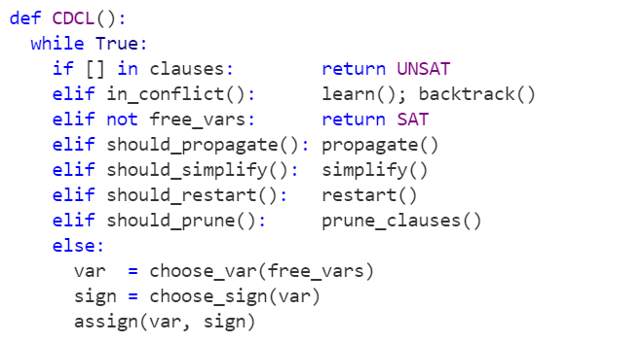
CDCL – CaDiCaL loop

Slide 15
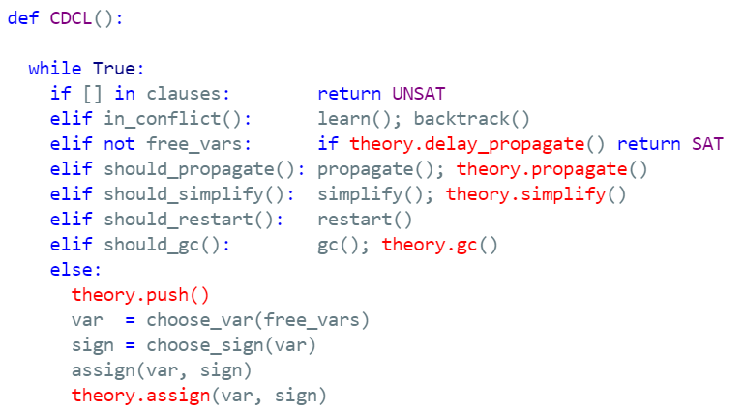
CDCL(T)

Slide 16
Solver Internals

Slide 17
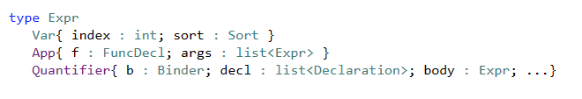

Terms and Formulas
de Bruijn index
Terms are hash-consed
let t = App(f,args) let t’ = termTable[t] mkApp(f, args) = if t’ = nil then termTable[t]$←t$; t else t’

Slide 18
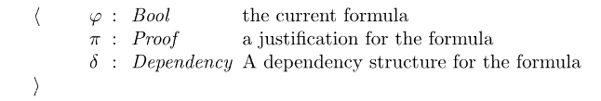
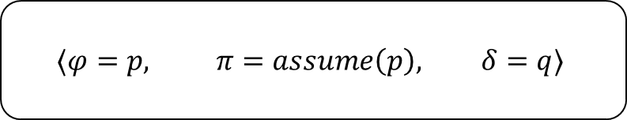
Assertion Internals
(assert (! p :named q))
SMT2 file
assert_and_track(p, q);
API
$$⟨φ=p, π=assume\left(p\right), δ=q⟩$$
Pre-processing simplification
Tactics
Core uses
dependencies
Solver
Transformed Assertions
Proof uses justifications

Slide 19
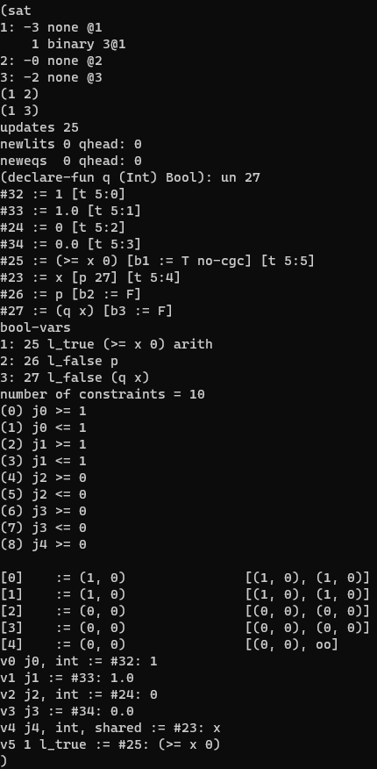

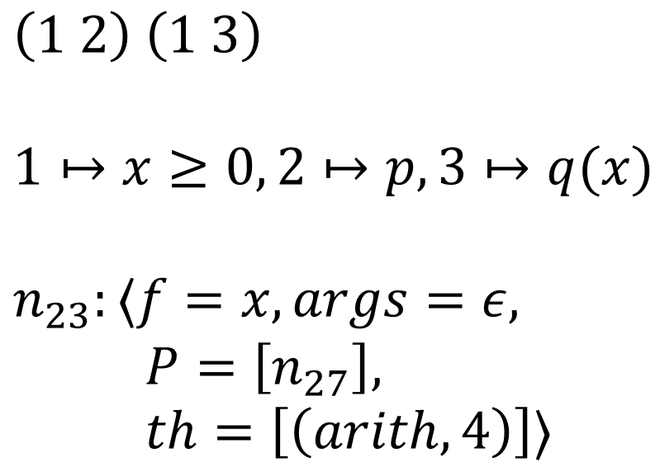
From Assertions to Solver State
$$x≥0 ∨ (p∧q\left(x\right))$$
Clauses
$\left(1 2\right) \left(1 3\right)$
$1↦x≥0, 2↦p, 3↦q(x)$
$n_{23}:⟨f=x,args=ε,$ $P=\left[n_{27}\right],$ $th=\left[\left(arith, 4\right)\right]⟩$
bool_var2expr
expr2enode
z3 search.smt2 /tr:euf tactic.default_tactic=smt sat.smt=true

Slide 20






Core $↔$ Solver interface
CDCL
EUF Core
Solver
$n_{23}:⟨f=x,args=ε,$ $P=\left[n_{27}\right],$ $th=\left[\left(arith, 4\right)\right]⟩$
$n_{25}:⟨≥, args=ε,$ $$boolVar=1, \\ th=[\left(arith,5\right)]$$
$$assigned\left(ℓ@1\right)$$
$$propagate\left(x≥0@5, Explain\right)$$
Dispatch Theory Solver
$$propagate\left(ℓ, Explain\right)$$
$$propagate\left(n≃n′, Explain\right)$$
Does not participate in congruence closure
Theory variable

Slide 21
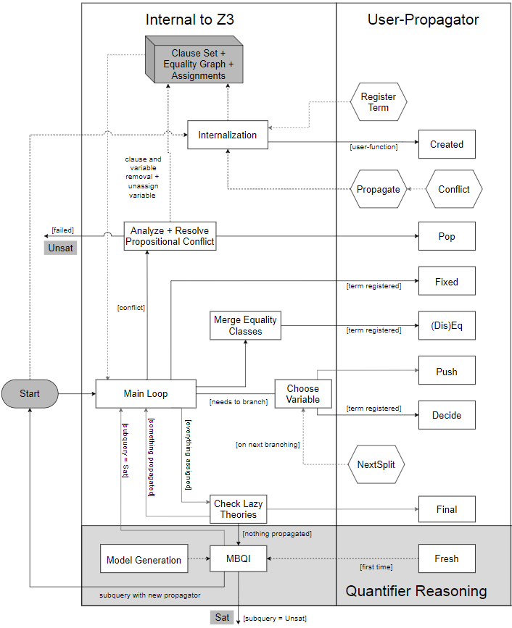
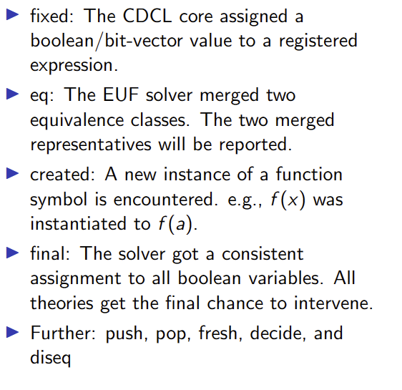
Custom Theories

Slide 22


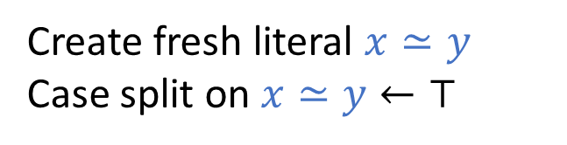

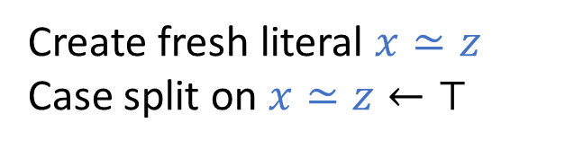
Model-based Theory Combination
$$x=f\left(z\right), f\left(x\right)≃f\left(y\right), 0≤x≤1, 0≤y≤1, z=y −1$$
$x= ⋆_{1}y= ⋆_{2}z= ⋆_{3}$ $x=1, y=1, z=0$
$f\left(⋆_{1}\right)= ⋆_{1}f\left(⋆_{2}\right)= ⋆_{2}f\left(⋆_{3}\right)=⋆_{1}$
Create fresh literal $x≃y$
Case split on $x≃y←⊤$
Conflict, backtrack $x≠y$
$$x=f\left(z\right), f\left(x\right)≃f\left(y\right), 0≤x≤1, 0≤y≤1, z=y −1,x≠y$$
Create fresh literal $x≃z$
Case split on $x≃z←⊤$
$$x≃z$$
$x=0 y=1, z=0$
$x= ⋆_{1}y= ⋆_{2}z= ⋆_{1}$
$f\left(⋆_{1}\right)= ⋆_{1}f\left(⋆_{2}\right)= ⋆_{2}$

Slide 23

Relevancy Filtering
Purpose: expose only subset of literal assignments to T solvers
Reason: Delays introduction of terms for T-and quantifier instantiation
Idea: Simulate tableau reasoning on top of CDCL
$$(\left(a∧b\right)∨c)$$
$\left(\left(a∧b\right)∨c\right) (¬\left(a∧b\right)∨a)$ $\left(¬\left(a∧b\right)∨b\right)$ $\left(\left(a∧b\right)∨¬a∨¬b\right)$
Root clause
Definition clauses
Scenario 1: c is assigned to T, root clause is satisfied. Atoms $\left(a∧b\right), a, b$ are never set relevant
Scenario 2: c is assigned to F, $\left(a∧b\right)$ is assigned T. Atoms $a, b$ are marked relevant (and propagated to T)
smt.relevancy={0,1,2} (least to most use of relevancy filter)

Slide 24
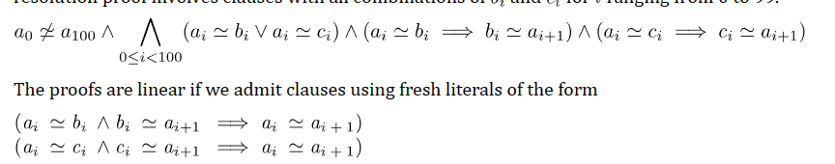

Ackermann reductions
smt.dack.threshold = 10, smt.dack.eq = false

Slide 25
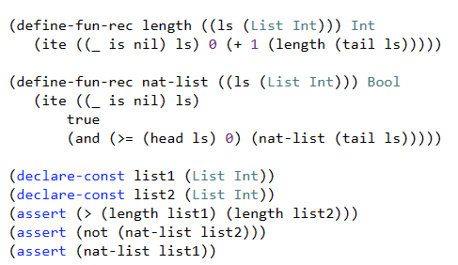
Iterative Deepening
Assume ((_ is nil) list1) ((_ is nil) list2)
Unsat core: ((_ is nil) list1)
Assume ((_ is nil) (tail list1)) ((_ is nil) list2)
Unsat core: ((_ is nil) list2)
Assume ((_ is nil) (tail list1)) ((_ is nil) (tail list2))
Unsat core: ((_ is nil) (tail list1))
Assume ((_ is nil) (tail (tail list1))) ((_ is nil) (tail list2))
SAT

Slide 26
Pre-processing Rewriting Simplification
For Finite Sets

Slide 27

Finite Set Algebraic Simplification rules
$S∩∅→ ∅$
$S∪T→T∪S$ if code($T)<$ code($S)$
$x∈\left\{ y \right\}→x=y$

Slide 28
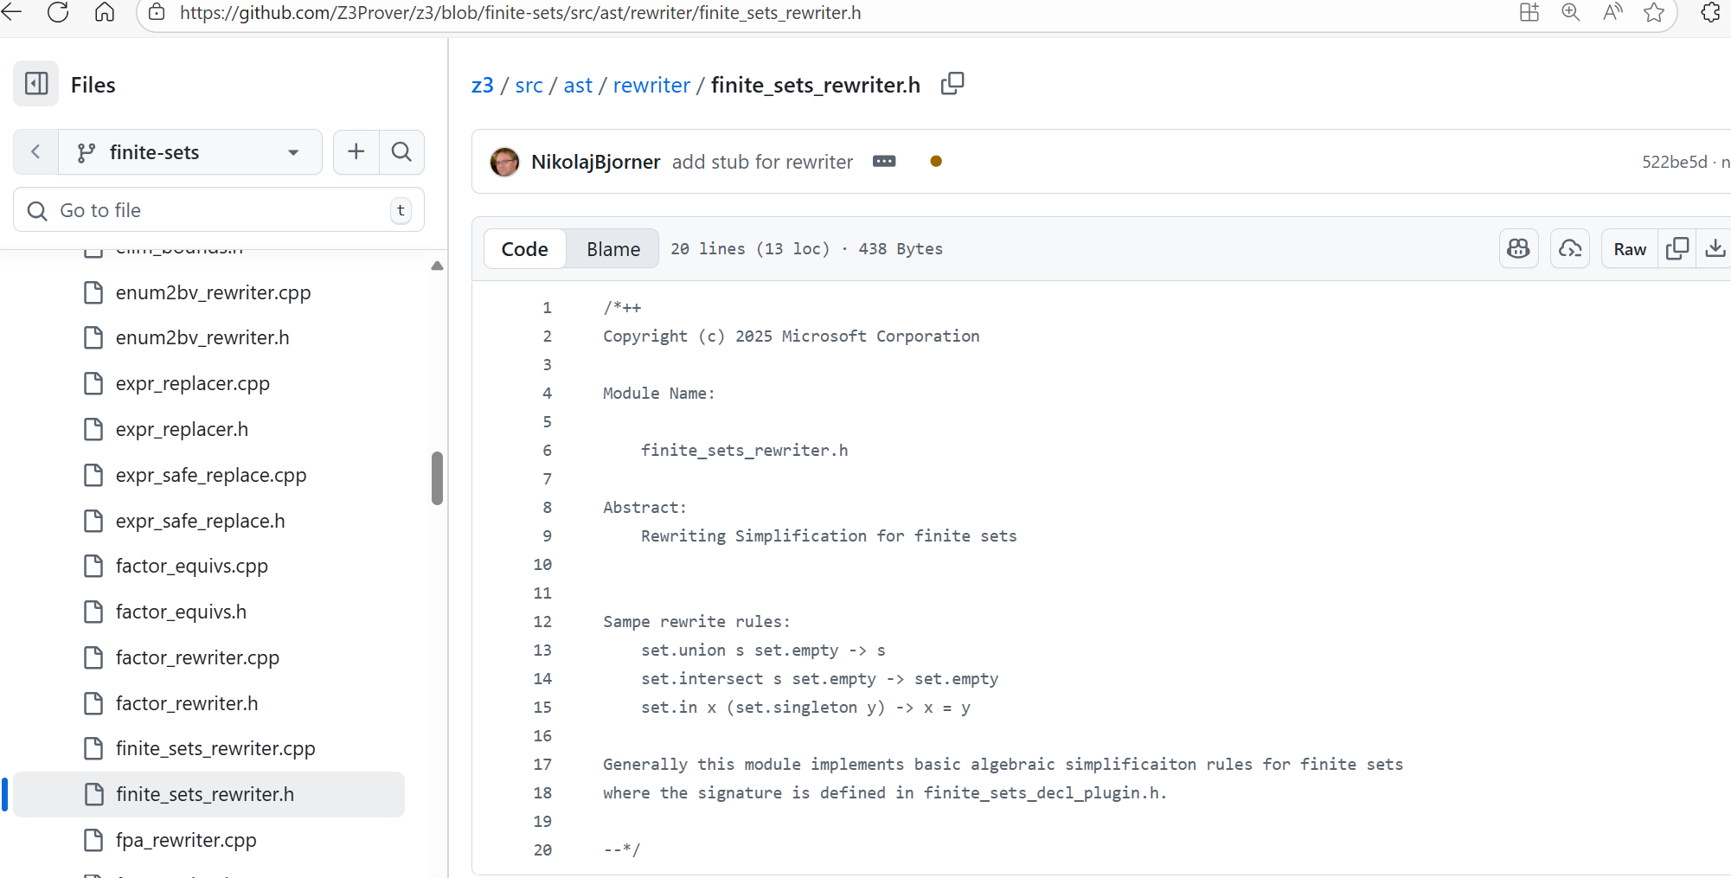
Finite Sets Rewriter

Slide 29
Let’s be lazy, but not too lazy, but verify
Ask copilot to produce rewrite rules and implementation
Axiomatize finite sets for a 3-4 variables. Enumerate terms and mine for equalities.
Q: how would you address the following?
Correctness of simplification rules and code.
Adequacy of simplification rules? Do they cover useful cases, what could be covered.

Slide 30
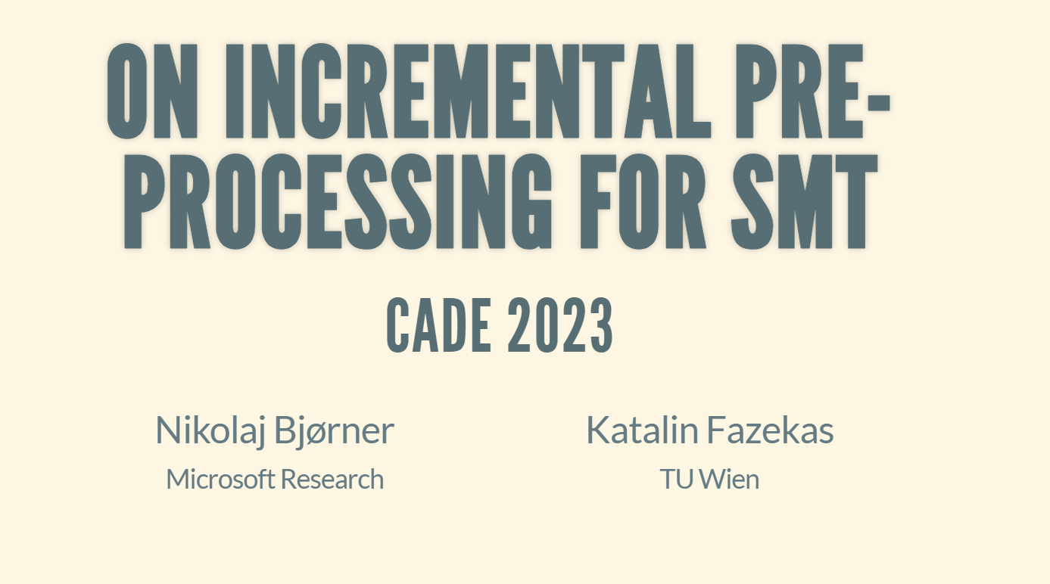
Pre-processing Global Simplification
For Finite Sets

Slide 31
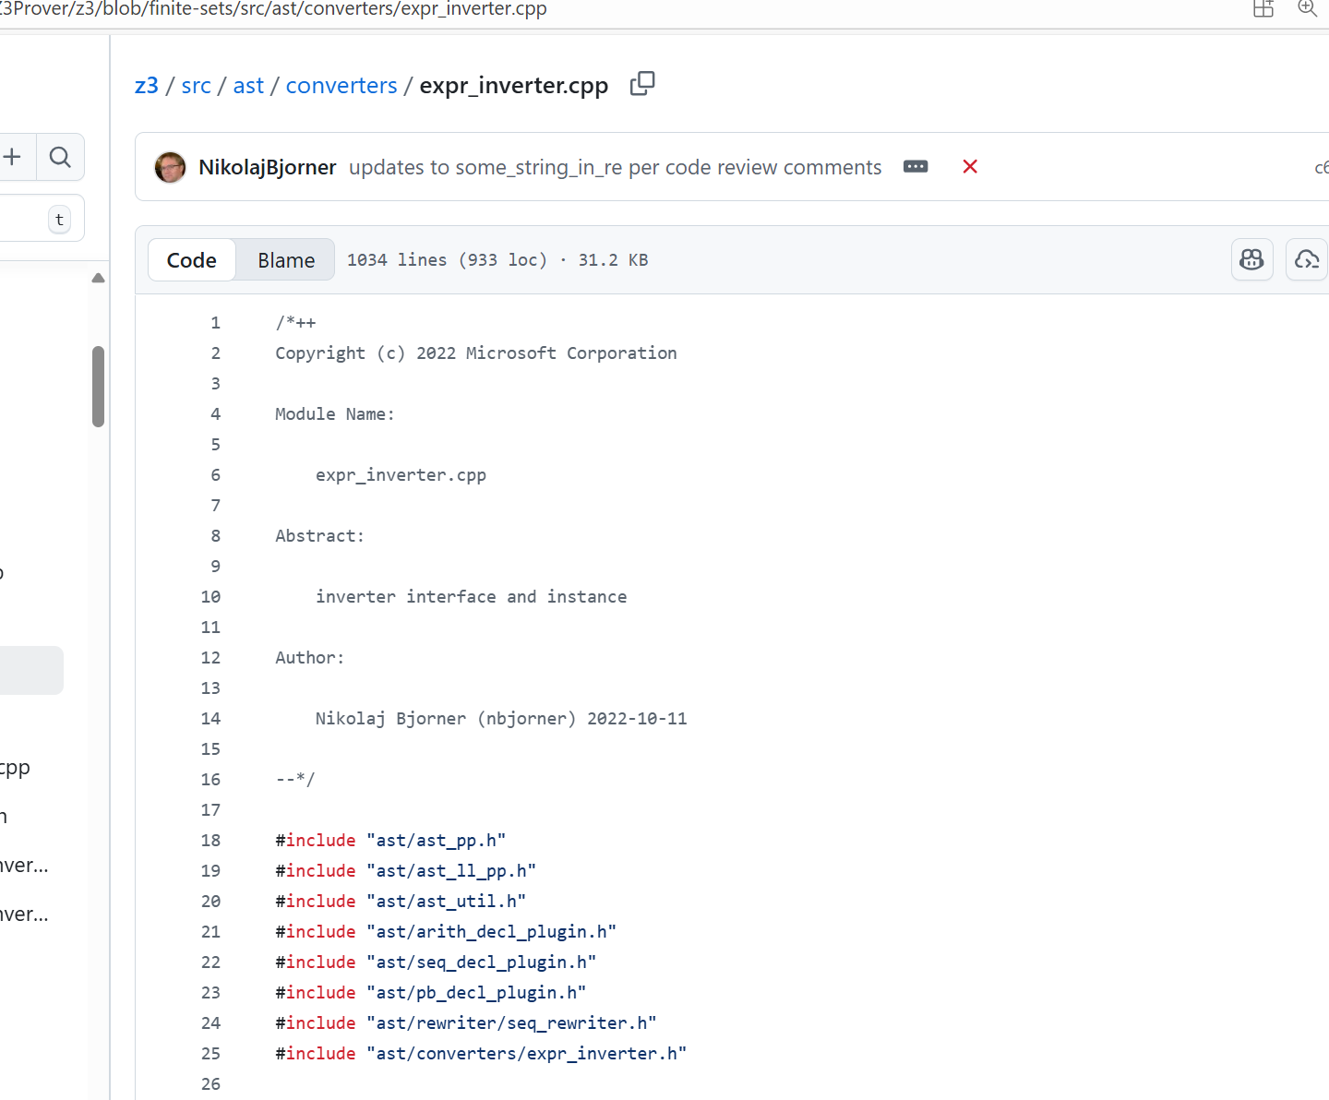
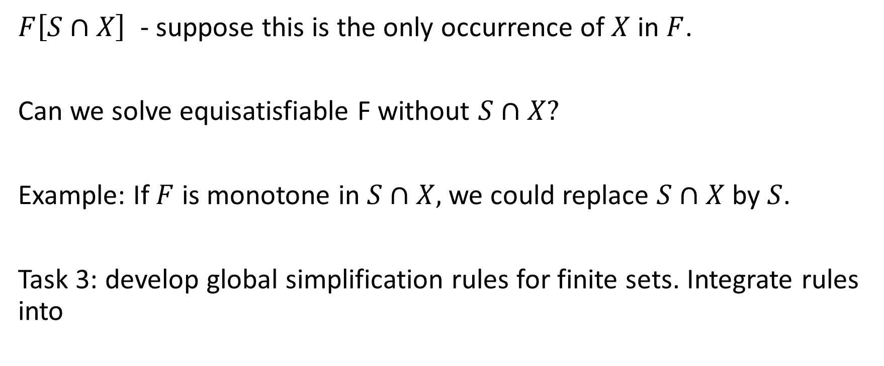
Global Simplification
$F\left[S∩X\right]$ - suppose this is the only occurrence of $X$ in $F$.
Can we solve equisatisfiable F without $S∩X?$
Example: If $F$ is monotone in $S∩X,$we could replace $S∩X$ by $S$.
Task 3: develop global simplification rules for finite sets. Integrate rules into

