Slide 1
Core Theories
Nikolaj Bjørner, Microsoft Research, RiSE
TU Wien 2025
A Laura Kovacs guest-lecture production

Slide 2

CDCL(T)
Theory
Solvers
SMT
SAT
Equality + UF
Arithmetic
Bit-vectors
…
Case Analysis

Slide 3
Core Decision Procedures

Slide 4
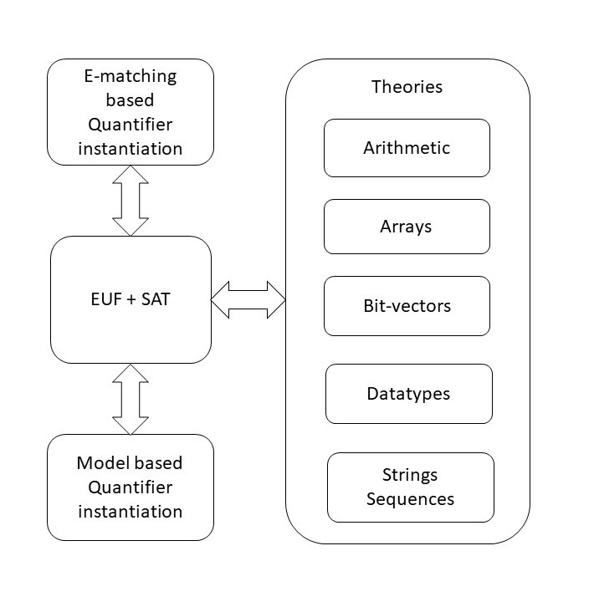

overview

Slide 5
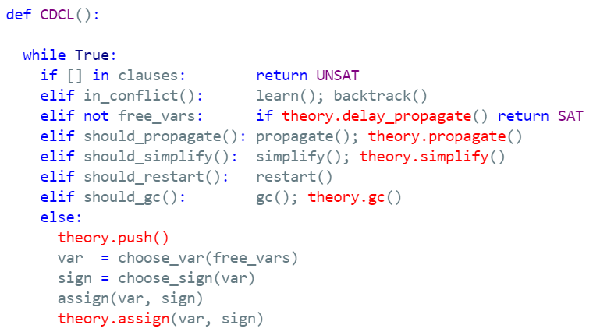
CDCL(T)

Slide 6
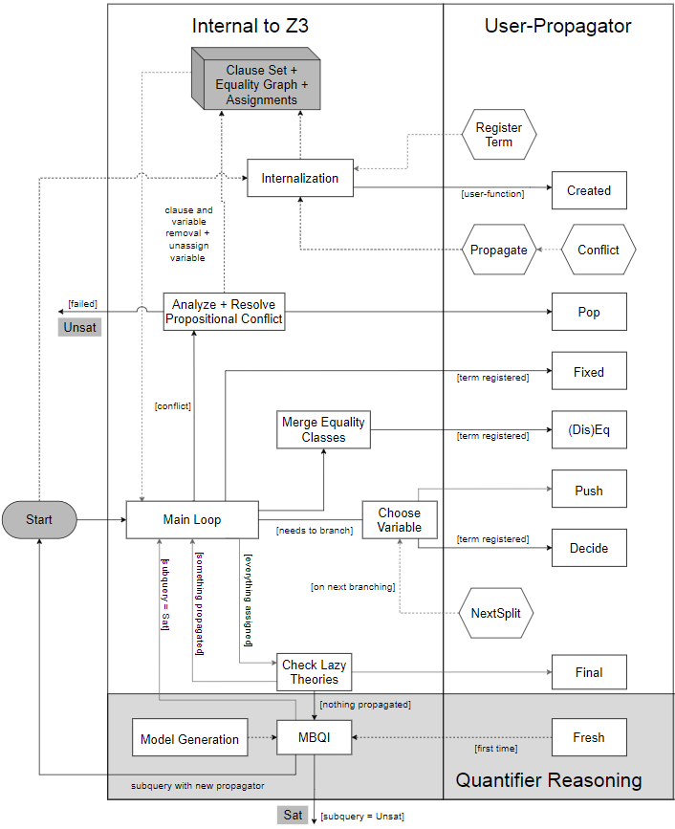
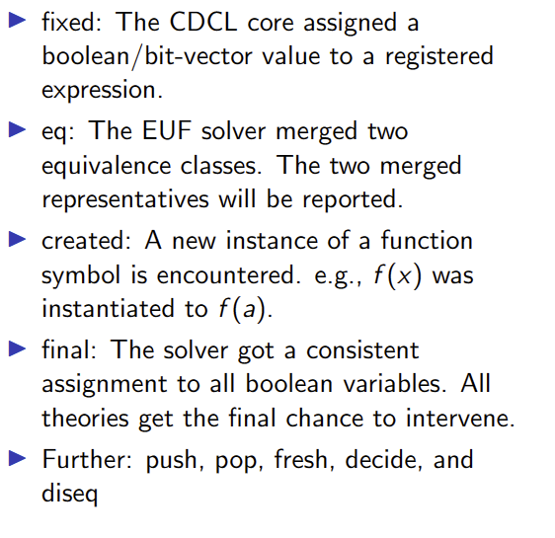
Custom Theories

Slide 7
Classification
Arrays
Finite Domains
ADTs
EUF
Arithmetic
Hybrid
str.len, bv2nat
User-Propagator

Slide 8
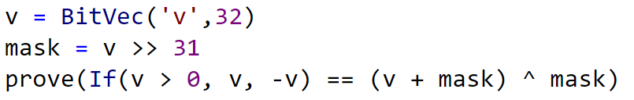
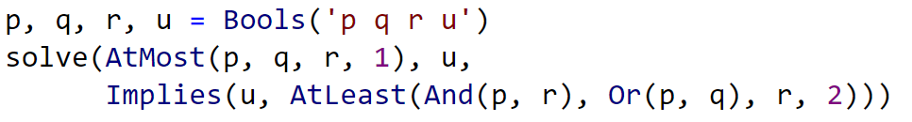
Finite Domain Theories

Slide 9
Finite Domains and CDCL(T)
Compile to SAT Compile to SAT + E Word level

Slide 10
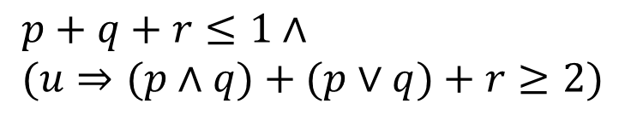
Finite Domains and CDCL(T)
$$p+q+r≤1∧ \\ (u⇒(p∧q)+(p∨q)+r≥2)$$
Compile to CDCL
Compile to CDCL + PB propagation

Slide 11
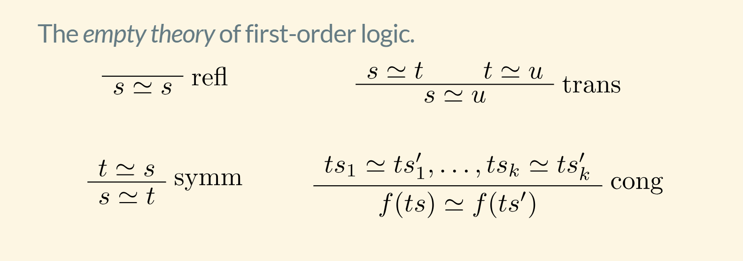
EUF

Slide 12
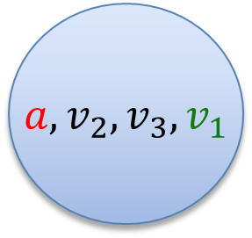
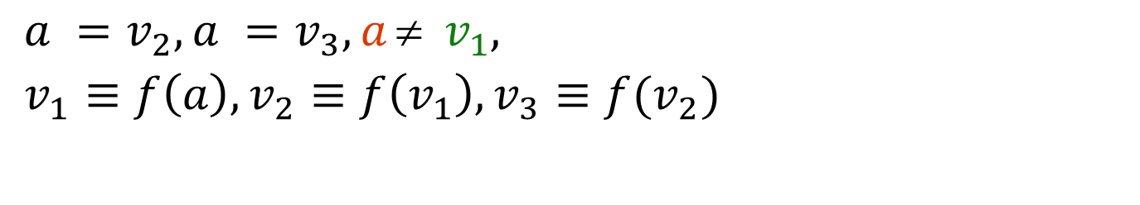
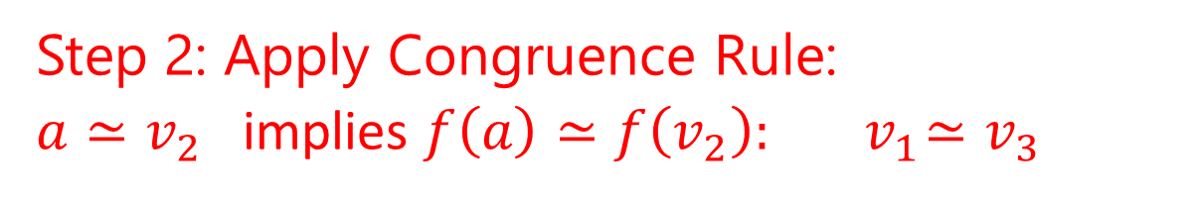
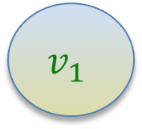
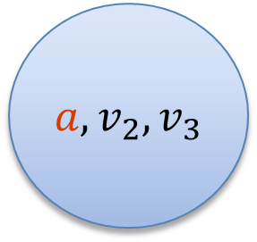
EUF
$$a = f(f(a)), a = f(f(f(a))), a  f(a)$$
Produce Proofs
Incremental Updates
Propagate Literals
$a =v_{2}, a =v_{3}, a  v_{1},$
$v_{1}≡f\left(a\right), v_{2}≡f\left(v_{1}\right), v_{3}≡f(v_{2})$
$a, v_{2}, v_{3}$
$$v_{1}$$
Union Find
Step 1: Equivalence classes from equalities
$a, v_{2}, v_{3}, v_{1}$
Step 2: Apply Congruence Rule:
$a≃v_{2}$ implies $f\left(a\right)≃f\left(v_{2}\right):{ v}_{1}≃v_{3}$
E-graph

Slide 13
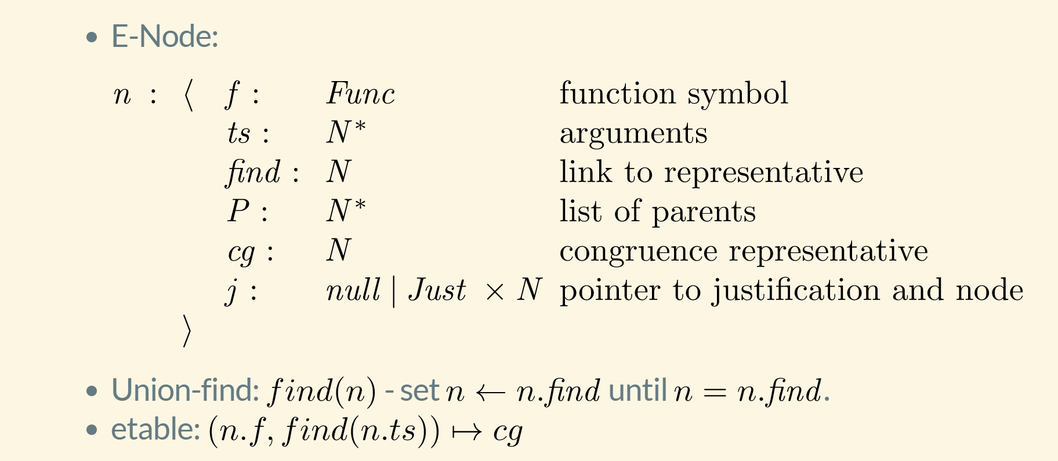
EUF – data-structure

Slide 14






EUF – union-find w. path compression, siblings
Z3 uses path compression to ensure roots are within a single hop of find
Maintain separate singly linked cyclic list of siblings
$$a≃f(c)$$
$$b≃c$$
$$c≃f(c)$$
a
a
b
b
$$b≃c$$
$$a≃f(c)$$
f(b)
f(b)
f(c)
f(c)
c
c
$$cc:f(b)≃f(c)$$

Slide 15
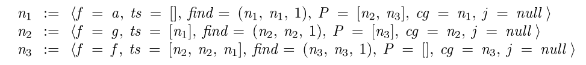

EUF - internalize
$$f(g\left(a\right), g\left(a\right), a)$$
Terms are “hash-consed”
Roots are initialized to self
etable: $[a↦n_{1},g\left(\left[n_{1}\right]\right)↦n_{2}, f\left(\left[n_{2},n_{2},n_{1}\right]\right)↦n_{3}]$

Slide 16
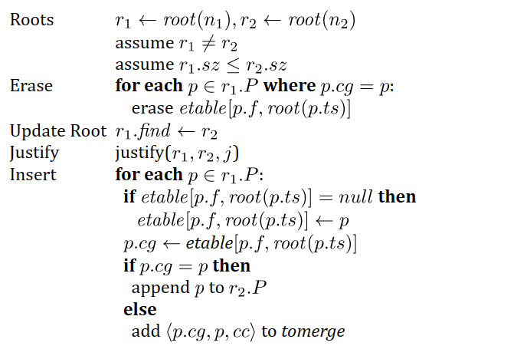
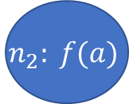
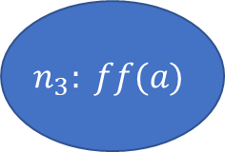

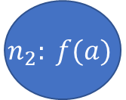



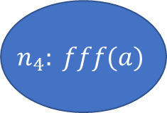
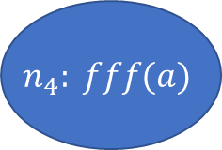

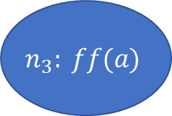
EUF - merge
$$a = f(f(a)), a = f(f(f(a))), a  f(a)$$
$$n_{2}: f(a)$$
$$n_{3}: ff(a)$$
$$n_{4}: fff(a)$$
$$n_{1}:a$$
$${merge(n}_{1},n_{3})$$
$etable\left[f,n_{1}\right]←null$ (since $n_{2}∈n_{1}.P)$
$$n_{1}.find←n_{3}$$
$$n_{2}: f(a)$$
$$n_{3}: ff(a)$$
$$n_{4}: fff(a)$$
$$n_{1}:a$$
($n_{2}∈n_{1}.P)$
$n_{2}.cg←etable[f, {root(n}_{1})]=$ $n_{4}$
$add \left\langle n_{2},n_{4}\right\rangle$ to tomerge

Slide 17


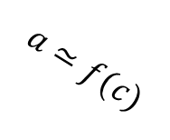



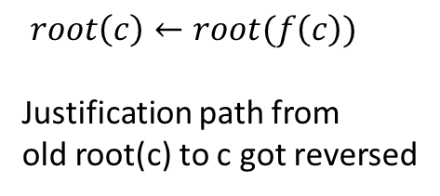


EUF - Justifications
a
b
Union – find link
$$a≃f(c)$$
$$b≃c$$
Justification link
f(b)
f(c)
c
$$cc:f(b)≃f(c)$$
a
After merge
$$c≃f(c)$$
b
$$a≃f(c)$$
$root\left(c\right)←root(f\left(c\right))$
Justification path from
old root(c) to c got reversed
$$b≃c$$
f(b)
f(c)
$$cc:f(b)≃f(c)$$
c
$$c≃f(c)$$

Slide 18

EUF - internals
Nodes from Boolean literals contain fields:
value : { true, false, undef}
boolVar : a number referring to Boolean variable as known by SAT solver
Equality nodes are special: When n1, n2 are merged, the parent n5 is equality, value = false -> conflict
$$a  f(a)$$
$n_{5}=⟨≃, [n_{1},n_{2}], \left(n_{5},n_{5},1\right), P=ε, cg=n_{5},j=nil, value=false, boolVar=27⟩$

Slide 19
EUF – internals: equalities and values
Values: If a node comes from a term that denotes a value (5, 42, 2/3, cons(1,nil)), it is always a root
When two roots with terms based on different values are merged -> conflict
Who reasons about equalities of Booleans? EUF vs. CDCL
E-nodes based on Bool do by default not merge with other nodes.
Default is overridden if E-node occurs under a non-connective.
E-graph propagates equalities to theories and Booleans to SAT
$n_{5}=\left\langle ≃, \left[n_{1},n_{2}\right], \left(n_{5},n_{5},1\right), P=ε, cg=n_{5},j=nil, value=undef, boolVar=27\right\rangle$
$n_{1}.find←n_{2}$ -> value is set to true and assignment to boolVar 27 is propagated to CDCL core

Slide 20


Arrays
Reducible | reduce to base theories
Compile into EUF
UNSAT

Slide 21

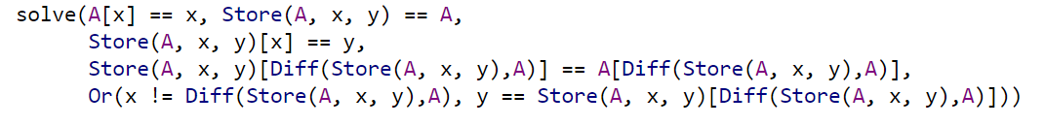
Arrays
Reducible | reduce to base theories
Convert EUF solution to
solution over arrays
Compile into EUF

Slide 22
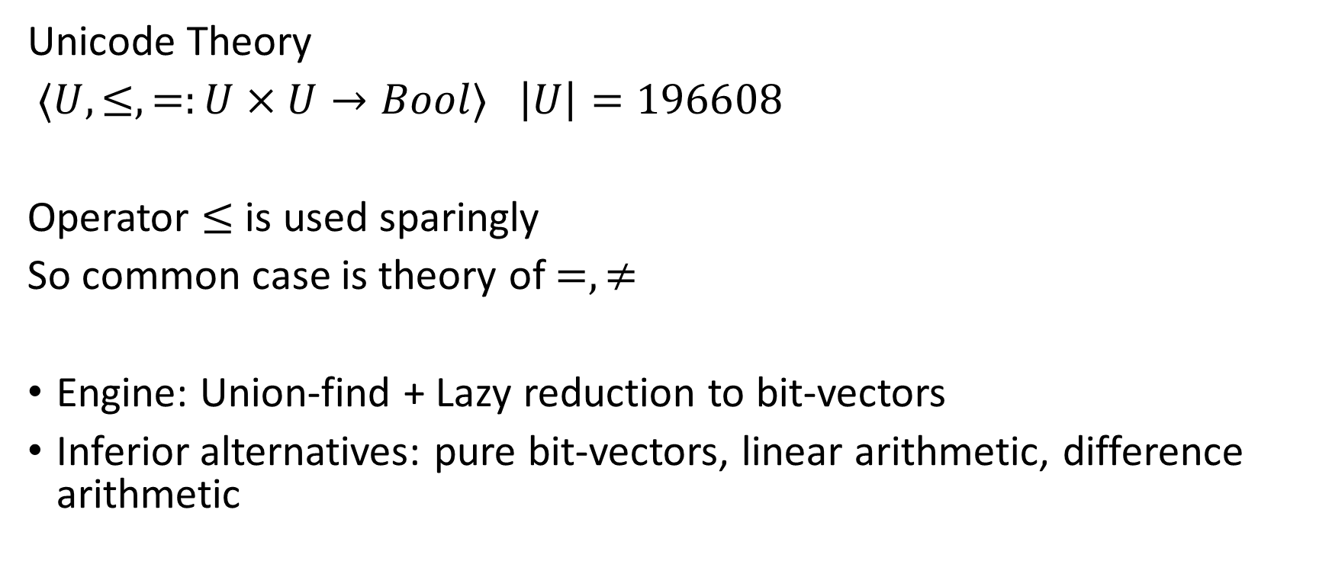
A Solver for Unicode Characters
Unicode Theory
$⟨U, ≤,=:U×U→Bool⟩$ $\left|U\right|=196608$
Operator $≤$ is used sparingly
So common case is theory of $=,≠$
Engine: Union-find + Lazy reduction to bit-vectors
Inferior alternatives: pure bit-vectors, linear arithmetic, difference arithmetic

Slide 23

A Solver for $⟨U, ≤,=:U×U→Bool⟩$ $\left|U\right|=196608$
Equality
Union Find
a
b
c
d
e
s
t
a = b, b = c, d = e, b = s, d = t, a≠ e, a≠ s
a,b,c,s
d,e,t

Slide 24
A Solver for $⟨U, ≤,=:U×U→Bool⟩$ $\left|U\right|=196608$
Equality
Union Find
a
b
c
d
‘e’
s
‘t’
a = b, b = c, d = ‘e’, b = s, d = ‘t’, a≠ e
a,b,c,s
d,’e’,’t’

Slide 25



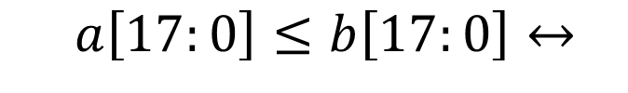
A Solver for $⟨U, ≤,=:U×U→Bool⟩$ $\left|U\right|=196608$
$$a≤b$$
Inequality
Bit-blasting
$\left(a\left[17\right]→b\left[17\right]\right)$
$∧\left(\begin{aligned}(a\left[17\right]↔b\left[17\right])→ \\ a\left[16:0\right]≤b\left[16:0\right]\end{aligned}\right)$
$$a\left[17:0\right]≤b\left[17:0\right]↔$$
$$⋮$$
$$a\left[0:0\right]≤b\left[0:0\right]↔\left(a\left[0\right]→b\left[0\right]\right)$$

Slide 26
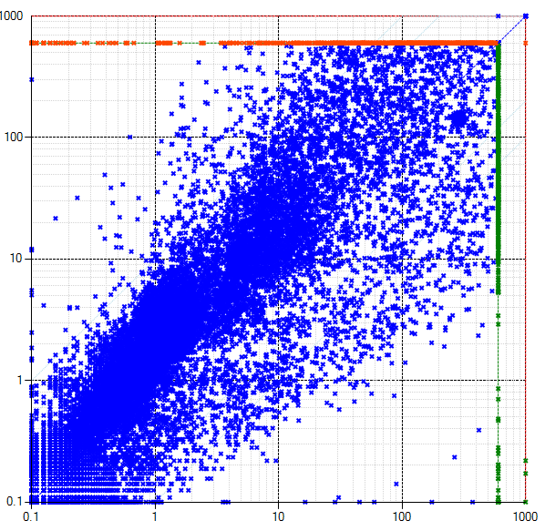


A Solver for $⟨U, ≤,=:U×U→Bool⟩$ $\left|U\right|=196608$
Combining two views
$$a=b$$
$$a≤b$$
Equality View
Bit-Blast View
$$⟨U, ≤,=:U×U→Bool, bv2char :Bool^{18}→U,$$
$$\left[0\right]:U→Bool, \left[1\right]:U→Bool, …, \left[17\right]:U→Bool⟩$$
This solver
$$bv2char\left(a\left[17\right], …, a\left[0\right]\right)=a$$
Bit-vector solver

Slide 27
Custom Theories

Slide 28
Finite Sets
Let us develop a solver for finite sets

Slide 29
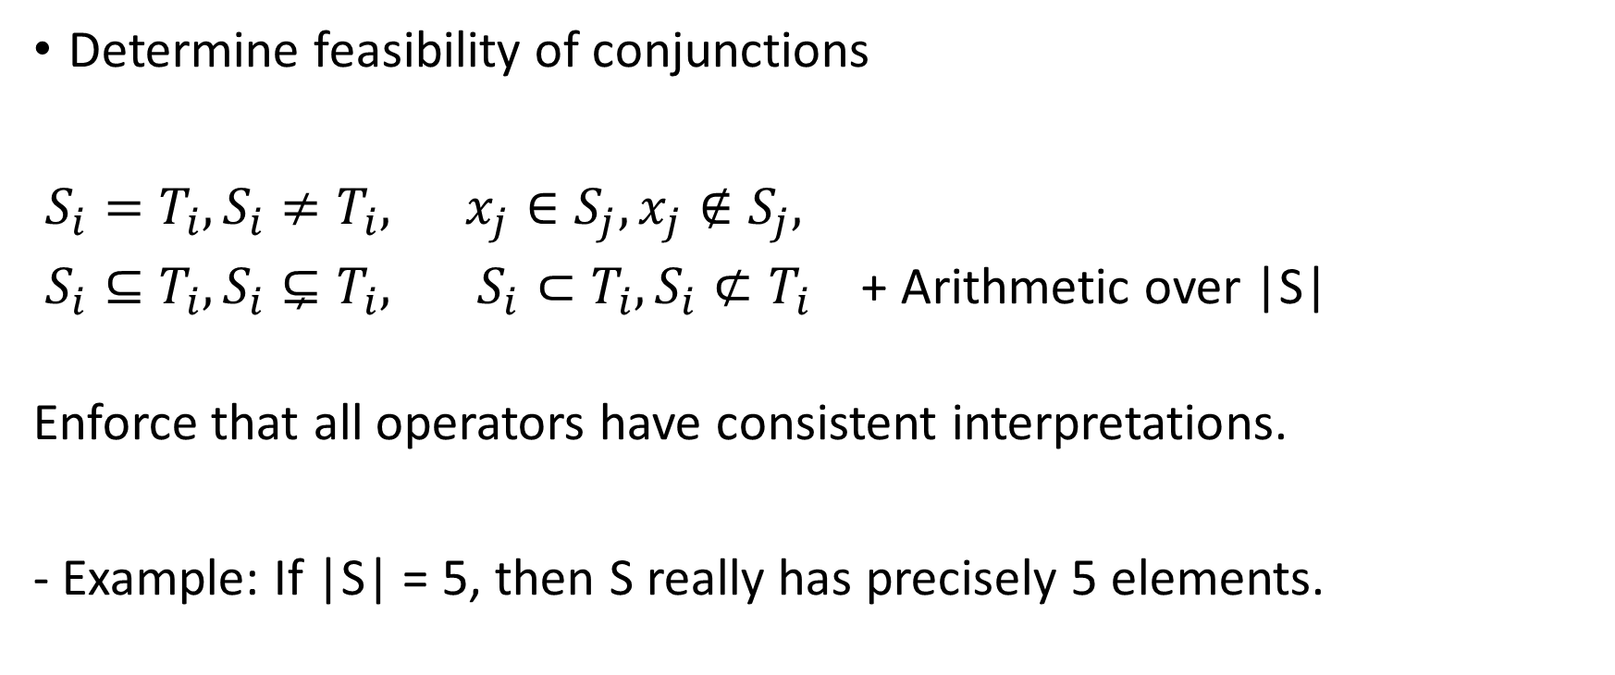
Core functionality
Determine feasibility of conjunctions
$S_{i}=T_{i}, S_{i}≠T_{i}, x_{j}∈S_{j}, x_{j}∉S_{j},$
$S_{i}⊆T_{i}, S_{i}⊊T_{i}, S_{i}⊂T_{i}, S_{i}⊄T_{i}$ + Arithmetic over |S|
Enforce that all operators have consistent interpretations.
- Example: If |S| = 5, then S really has precisely 5 elements.

Slide 30
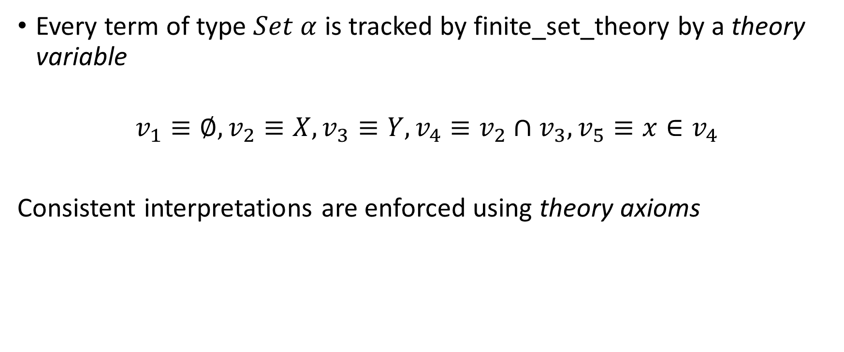
Representation
Every term of type $Set α$ is tracked by finite_set_theory by a theory variable
$$v_{1}≡∅, v_{2}≡X, v_{3}≡Y, v_{4}≡v_{2}∩v_{3}, v_{5}≡x∈v_{4}$$
Consistent interpretations are enforced using theory axioms

Slide 31
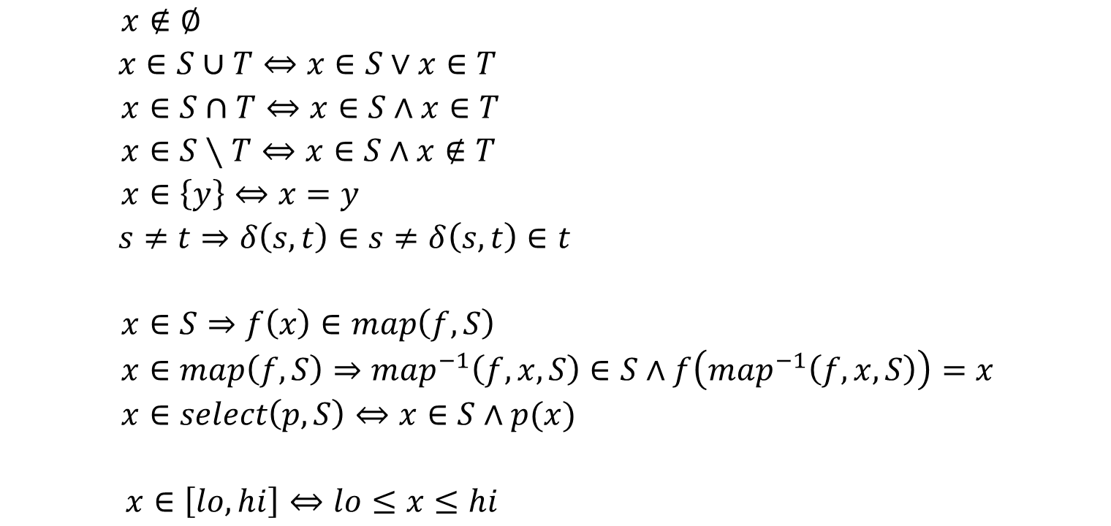
Theory Axioms
$x∉∅$
$x∈S∪T⇔x∈S∨x∈T$
$x∈S∩T⇔x∈S∧x∈T$
$x∈S∖T⇔x∈S∧x∉T$
$x∈\left\{y\right\}⇔x=y$
$s≠t⇒δ\left(s, t\right)∈s≠δ\left(s,t\right)∈t$
$x∈S⇒f\left(x\right)∈map\left(f, S\right)$
$x∈map\left(f, S\right)⇒map^{−1}\left(f, x, S\right)∈S∧f\left(map^{−1}\left(f, x, S\right)\right)=x$
$x∈select\left(p, S\right)⇔x∈S∧p(x)$
$x∈\left[lo, hi\right]⇔lo≤x≤hi$
Base
Filters
Range

Slide 32
Minimality
Express map using select

Slide 33
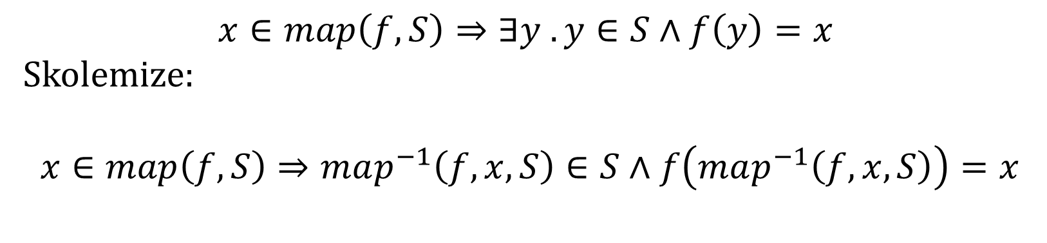

Use Built-in functions for existential axioms
$$s≠t⇒∃x . x∈s≠x∈t$$
Skolemize: $$s≠t⇒δ\left(s, t\right)∈s≠δ\left(s,t\right)∈t$$
$$x∈map\left(f, S\right)⇒∃y . y∈S∧f\left(y\right)=x$$
Skolemize:
$$x∈map\left(f, S\right)⇒map^{−1}\left(f, x, S\right)∈S∧f\left(map^{−1}\left(f, x, S\right)\right)=x$$

Slide 34
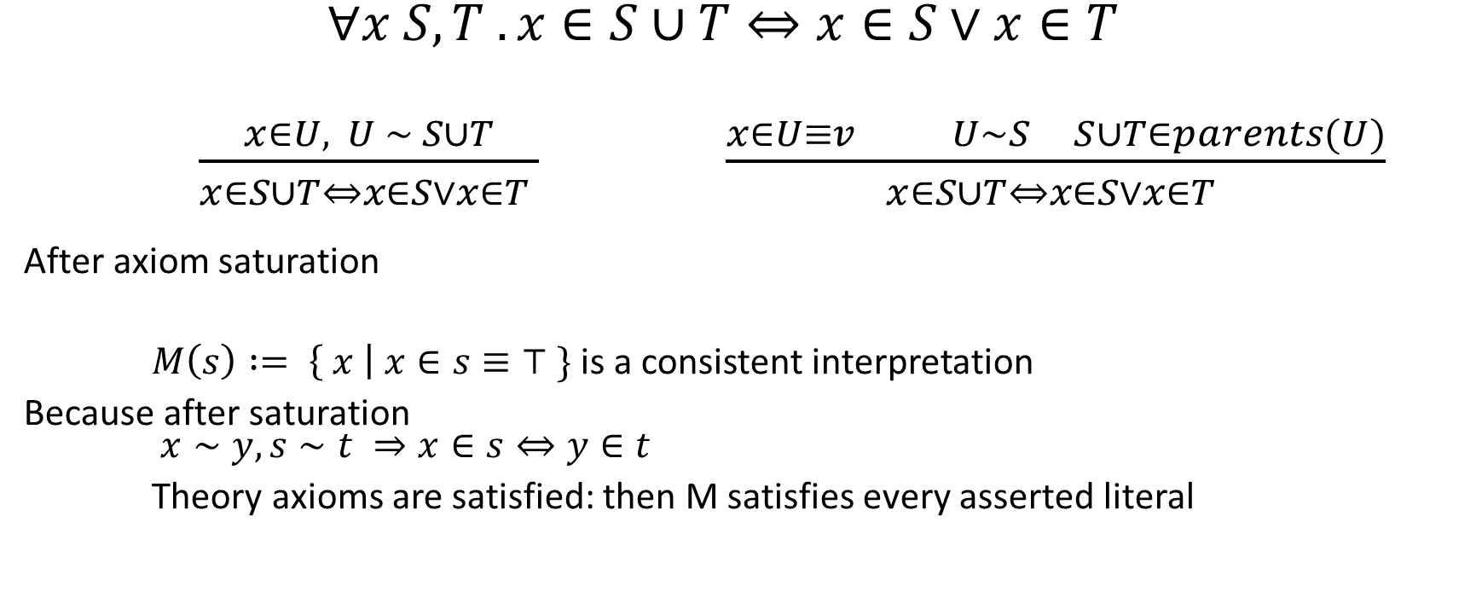
Theory Axiom Saturation – for Base
$∀x S, T . x∈S∪T⇔x∈S∨x∈T$
$\frac{x∈U, U \sim S∪T}{x∈S∪T⇔x∈S∨x∈T }$ $\frac{x∈U≡v U∼S S∪T∈parents(U)}{x∈S∪T⇔x∈S∨x∈T }$
After axiom saturation
$M\left(s\right) := \left\{ x \right| x∈s≡⊤ \}$is a consistent interpretation
Because after saturation $x∼y, s∼t ⇒x∈s⇔y∈t$
Theory axioms are satisfied: then M satisfies every asserted literal

Slide 35
Model Construction and Saturation
We will build model M such that
For variables x, y that are shared: M(x) = M(y) iff x ~ y
M(s) = { M(x) | (set.in x s) ~ true }
Base Claim: Saturation with respect to ~ and axioms for Base ensures this
x ~ y, (set.in y (set.union s t)) is an atom then (set.in x (set.union s t)) iff (or (set.in x s) (set.in x t))

Slide 36
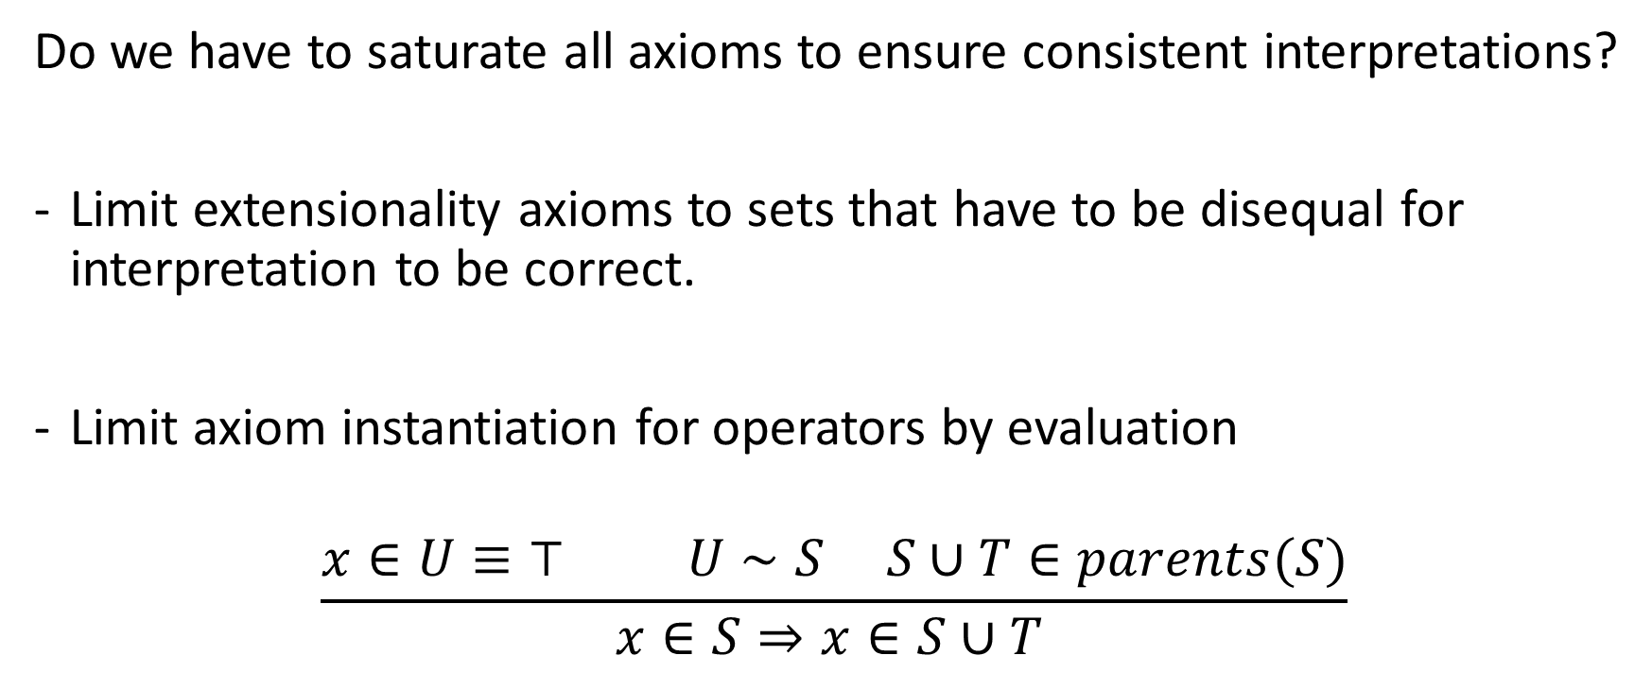
Frugal Axiom Saturation
Do we have to saturate all axioms to ensure consistent interpretations?
Limit extensionality axioms to sets that have to be disequal for interpretation to be correct.
Limit axiom instantiation for operators by evaluation
$$\frac{x∈U≡⊤ U∼S S∪T∈parents(S)}{x∈S⇒x∈S∪T }$$

Slide 37
Hidden Axiom Saturation
Option 1:
assert axioms to the CDCL(T) core directly.
Prefer unit propagation eagerly
Defer axioms with new unassigned literals lazily
Option 2:
Propagate axioms inside of the Finite Set theory solver
Resolve conflicts within the theory solver before telling CDCL(T) core what the conflicts are

Slide 38
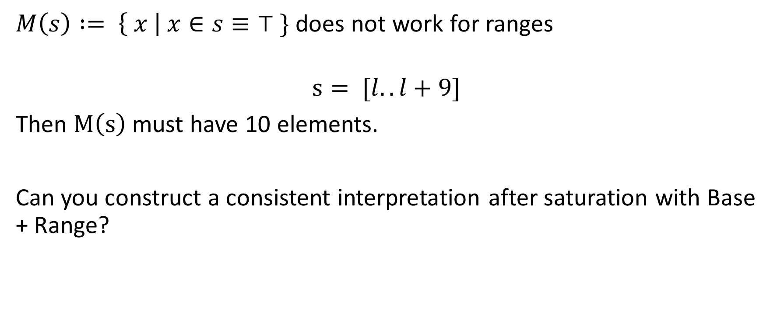
Consistent Interpretations for Ranges
$M\left(s\right) := \left\{ x \right| x∈s≡⊤ \}$does not work for ranges
$$s= [l..l+9]$$
Then $M\left(s\right)$must have 10 elements.
Can you construct a consistent interpretation after saturation with Base + Range?

Slide 39
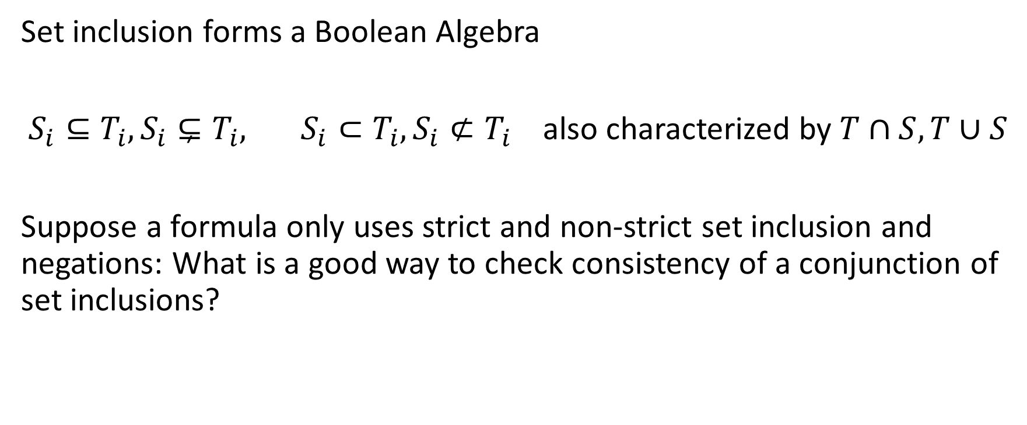
Boolean Algebras
Set inclusion forms a Boolean Algebra
$S_{i}⊆T_{i}, S_{i}⊊T_{i}, S_{i}⊂T_{i}, S_{i}⊄T_{i}$ also characterized by $T∩S, T∪S$
Suppose a formula only uses strict and non-strict set inclusion and negations: What is a good way to check consistency of a conjunction of set inclusions?

Slide 40
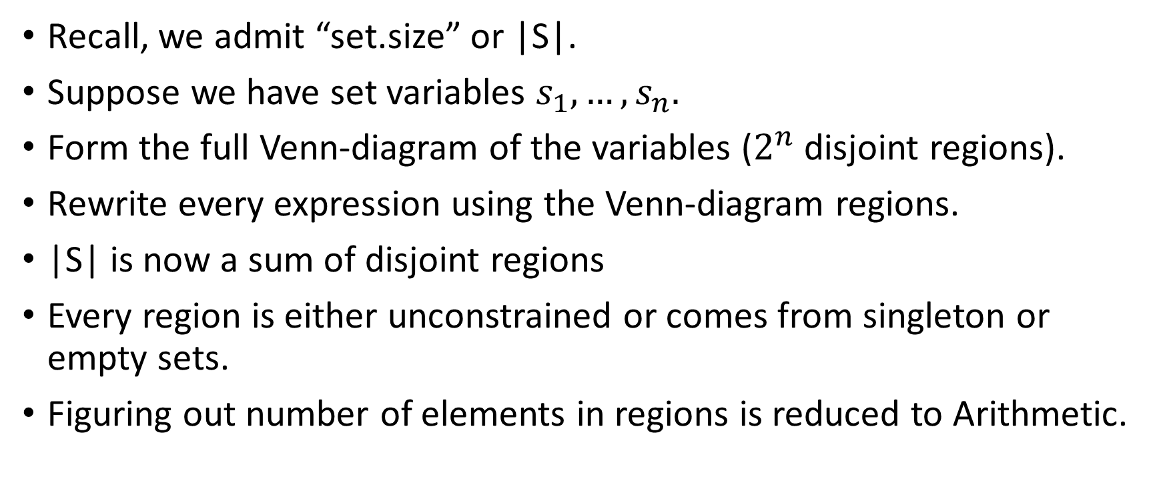
BAPA – Boolean Algebra Presburger Arithmetic
Recall, we admit “set.size” or |S|.
Suppose we have set variables $s_{1},…,s_{n}.$
Form the full Venn-diagram of the variables ($2^{n}$disjoint regions).
Rewrite every expression using the Venn-diagram regions.
|S| is now a sum of disjoint regions
Every region is either unconstrained or comes from singleton or empty sets.
Figuring out number of elements in regions is reduced to Arithmetic.

Slide 41

BAPA
Regions that matter.
Do we really have to consider all regions over $s_{1},…,s_{n}?$
Disjoint regions on demand:
$|S∪T|$
$S∪T=(S∖T)∪(S∩T)∪(T∖S)$
$\left|S∪T\right|=\left|S∖T\right|+\left|S∩T\right|+|T∖S|$

