Slide 1
Satisfiability Modulo Theories
Nikolaj Bjørner
Microsoft Research
Marktoberdorf
August 12 & 13, 2015

Slide 2
Lectures
Mon: An Introduction to SMT with Z3
Wed: Algorithmic underpinnings of SAT/SMT
Thu: Theories, Solvers and Applications
Fri: Topics: Horn Clauses, Quantifiers, Optimization

Slide 3
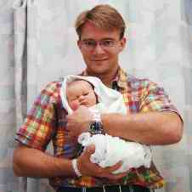
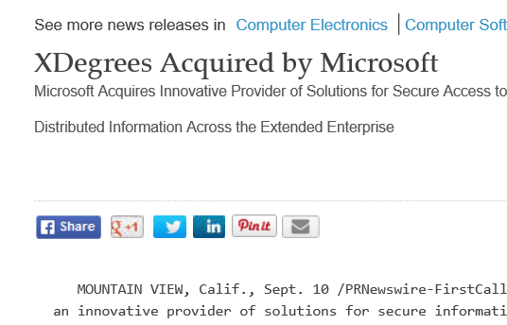

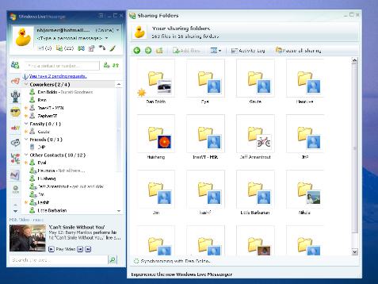


… a brief bio
90’s: DTU, DIKU, Stanford
This is me a week before fixing my thesis topic Decision Procedures (STeP)
Late 90’s: Kestrel Institute
Early 2000s: XDegrees (file sharing startup)
2002-06: Core Windows DFSR/RDC
2006: MSR: Z3, Network Verification
SecGuru

Slide 4
Plan
SMT in a nutshell
SMT solving walkthrough by example
Selected Theory solvers
Equalities
Arrays
Arithmetic
Combining Solvers

Slide 5
Satisfiability Modulo Theories (SMT)
Is formula ϕ satisfiable modulo theory T ?
SMT solvers have specialized algorithms for T

Slide 6
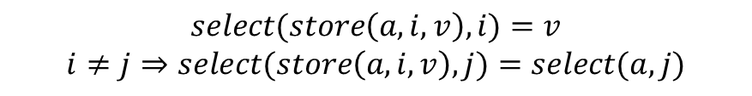
Satisfiability Modulo Theories (SMT)
$$x+2=y⇒f\left(select\left(store\left(a,x,3\right),y−2\right)\right)=f(y−x+1)$$
Array Theory
Arithmetic
Uninterpreted Functions
$$select(store\left(a,i,v\right),i)=v$$
$$i≠j⇒select(store\left(a,i,v\right),j)=select(a,j)$$

Slide 7

SMT: Basic Architecture
SAT
Theory
Solvers
SMT
Equality + UF
Arithmetic
Bit-vectors
…
Case Analysis

Slide 8
SAT + Theory solvers
Basic Idea
x ≥ 0, y = x + 1, (y > 2 ∨ y < 1)
Abstract (aka “naming” atoms)
p₁, p₂, (p₃ ∨ p₄)
p₁ ≡ (x ≥ 0), p₂ ≡ (y = x + 1),
p₃ ≡ (y > 2), p₄ ≡ (y < 1)

Slide 9
SAT + Theory solvers
Basic Idea
x ≥ 0, y = x + 1, (y > 2 ∨ y < 1)
Abstract (aka “naming” atoms)
p₁, p₂, (p₃ ∨ p₄)
p₁ ≡ (x ≥ 0), p₂ ≡ (y = x + 1),
p₃ ≡ (y > 2), p₄ ≡ (y < 1)
SAT
Solver

Slide 10
SAT + Theory solvers
Basic Idea
x ≥ 0, y = x + 1, (y > 2 ∨ y < 1)
Abstract (aka “naming” atoms)
p₁, p₂, (p₃ ∨ p₄)
p₁ ≡ (x ≥ 0), p₂ ≡ (y = x + 1),
p₃ ≡ (y > 2), p₄ ≡ (y < 1)
SAT
Solver
Assignment
p₁, p₂, ¬p₃, p₄

Slide 11
SAT + Theory solvers
Basic Idea
x ≥ 0, y = x + 1, (y > 2 ∨ y < 1)
Abstract (aka “naming” atoms)
p₁, p₂, (p₃ ∨ p₄)
p₁ ≡ (x ≥ 0), p₂ ≡ (y = x + 1),
p₃ ≡ (y > 2), p₄ ≡ (y < 1)
SAT
Solver
Assignment
p₁, p₂, ¬p₃, p₄
x ≥ 0, y = x + 1,
¬(y > 2), y < 1

Slide 12
SAT + Theory solvers
Basic Idea
x ≥ 0, y = x + 1, (y > 2 ∨ y < 1)
Abstract (aka “naming” atoms)
p₁, p₂, (p₃ ∨ p₄)
p₁ ≡ (x ≥ 0), p₂ ≡ (y = x + 1),
p₃ ≡ (y > 2), p₄ ≡ (y < 1)
SAT
Solver
Assignment
p₁, p₂, ¬p₃, p₄
x ≥ 0, y = x + 1,
¬(y > 2), y < 1
Unsatisfiable
x ≥ 0, y = x + 1, y < 1
Theory
Solver

Slide 13
SAT + Theory solvers
Basic Idea
x ≥ 0, y = x + 1, (y > 2 ∨ y < 1)
Abstract (aka “naming” atoms)
p₁, p₂, (p₃ ∨ p₄)
p₁ ≡ (x ≥ 0), p₂ ≡ (y = x + 1),
p₃ ≡ (y > 2), p₄ ≡ (y < 1)
SAT
Solver
Assignment
p₁, p₂, ¬p₃, p₄
x ≥ 0, y = x + 1,
¬(y > 2), y < 1
New Lemma
¬p₁∨¬p₂∨¬p₄
Unsatisfiable
x ≥ 0, y = x + 1, y < 1
Theory
Solver

Slide 14
SAT + Theory solvers
New Lemma
¬p₁∨¬p₂∨¬p₄
Unsatisfiable
x ≥ 0, y = x + 1, y < 1
Theory
Solver
AKA
Theory conflict

Slide 15
SAT/SMT solving using DPLL(T)/CDCL

Slide 16
Mile High: Modern SAT/SMT search
Backjump
Models
literal assignments
Proofs
Conflict Clauses
Conflict Resolution
Propagate

Slide 17
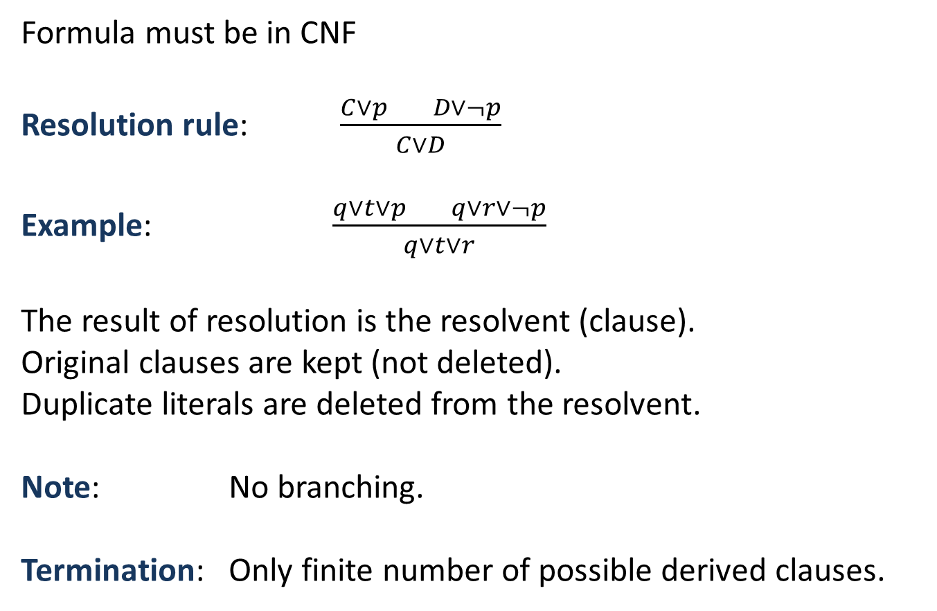
Resolution
Formula must be in CNF
Resolution rule: $\frac{C∨p D∨¬p}{C∨D}$
Example: $\frac{q∨t∨p q∨r∨¬p}{q∨t∨r}$
The result of resolution is the resolvent (clause).
Original clauses are kept (not deleted).
Duplicate literals are deleted from the resolvent.
Note: No branching.
Termination: Only finite number of possible derived clauses.

Slide 18
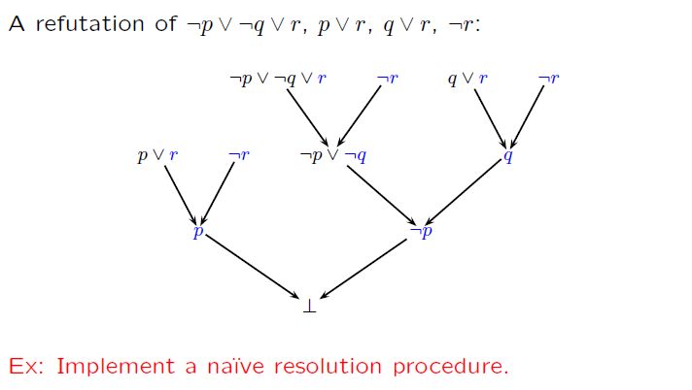
Resolution (example)

Slide 19
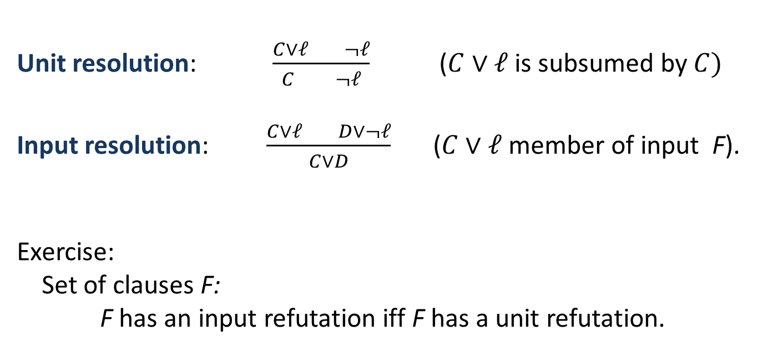
Unit & Input Resolution
Unit resolution: $\frac{C∨ℓ ¬ℓ}{C ¬ℓ}$ ($C∨ℓ$is subsumed by $C)$
Input resolution: $\frac{C∨ℓ D∨¬ℓ}{C∨D}$ ($C∨ℓ$ member of input F).
Exercise:
Set of clauses F: F has an input refutation iff F has a unit refutation.

Slide 20
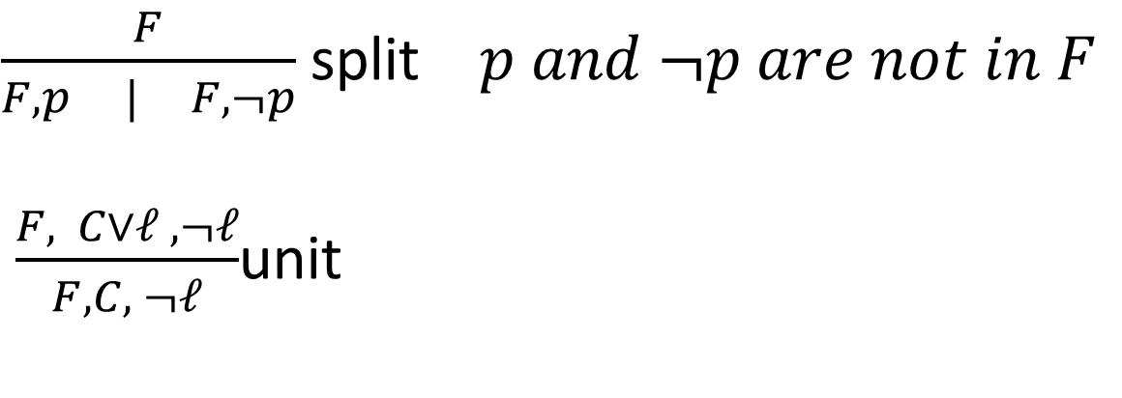
DPLL
DPLL: David Putnam Logeman Loveland = Unit resolution + split rule.
$\frac{F}{F,p | F, ¬p}$ split $p and ¬p are not in F$
$\frac{F, C∨ℓ , ¬ℓ}{F, C, ¬ℓ}$unit
Ingredient of most efficient SAT solvers

Slide 21
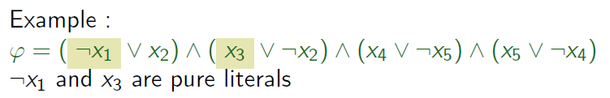
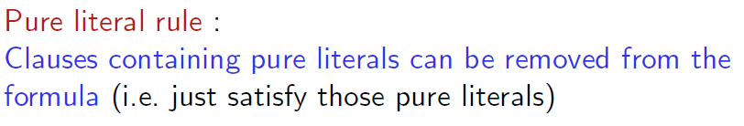

Pure Literals
A literal is pure if only occurs positively or negatively.

Slide 22
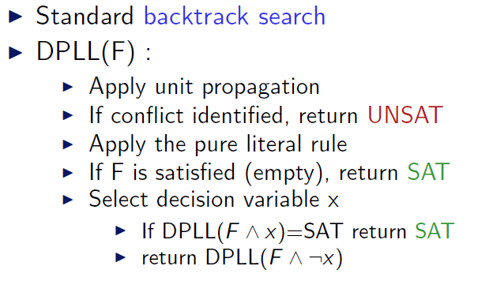
DPLL (as a procedure)

Slide 23
DPLL
M | F
Partial model
Set of clauses

Slide 24
DPLL
Guessing
p | p ∨ q, ¬q ∨ r
p, ¬q | p ∨ q, ¬q ∨ r

Slide 25
DPLL
Deducing
p | p ∨ q, ¬p ∨ s
p, s| p ∨ q, ¬p ∨ s

Slide 26
DPLL
Backtracking
p, ¬s, q | p ∨ q, s ∨ q, ¬p∨ ¬q
p, s | p ∨ q, s ∨ q, ¬p∨ ¬q

Slide 27
Modern DPLL
Non-chronological backtracking (backjumping)
Lemma learning
and
Efficient indexing (two-watch literal)
…

Slide 28
CDCL – Conflict Directed Clause Learning
Lemma learning
¬t, p, q, s | t ∨ ¬p ∨ q, ¬q ∨ s, ¬p∨ ¬s
¬t, p, q, s | t ∨ ¬p ∨ q, ¬q ∨ s, ¬p∨ ¬s |¬p∨ ¬s
¬t, p, q, s | t ∨ ¬p ∨ q, ¬q ∨ s, ¬p∨ ¬s |¬p∨ ¬q
¬t, p, q, s | t ∨ ¬p ∨ q, ¬q ∨ s, ¬p∨ ¬s |¬p∨ t

Slide 29
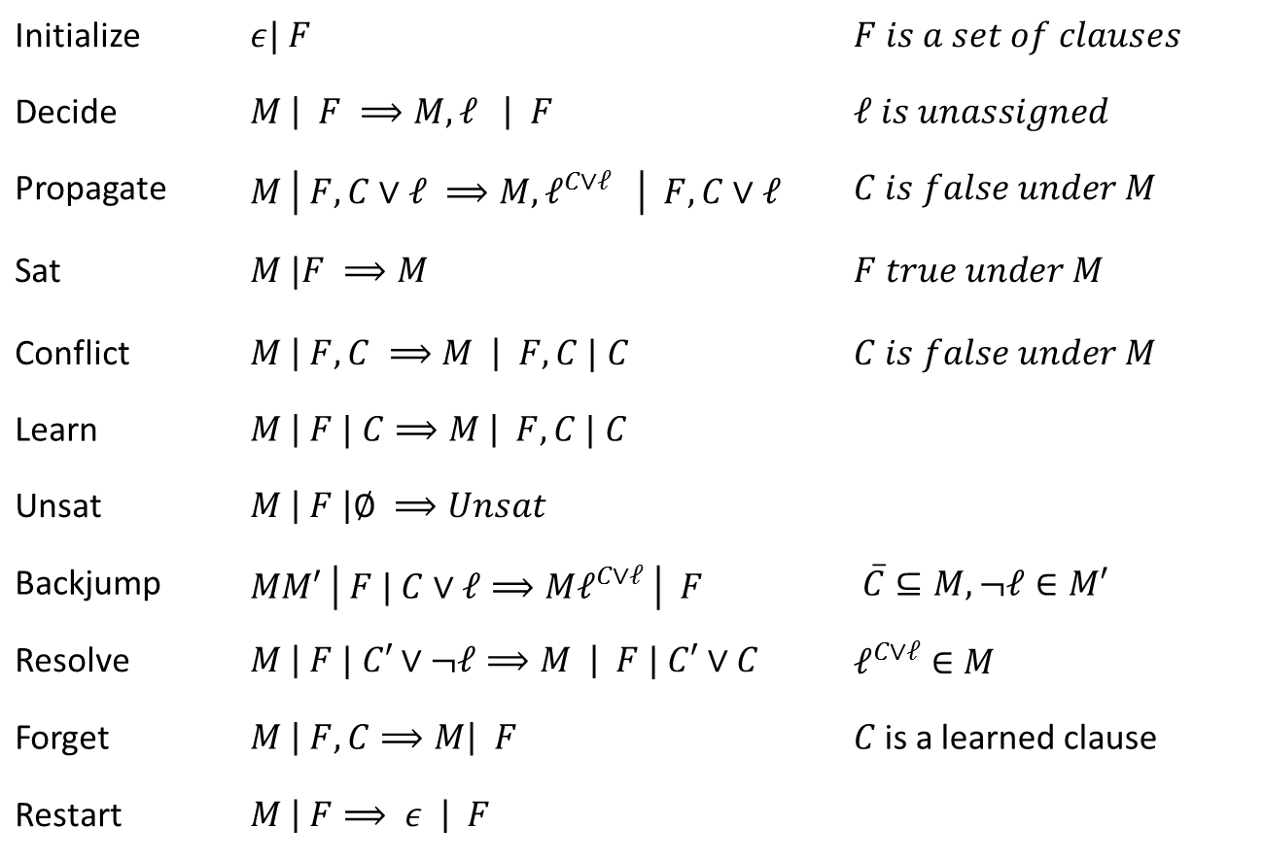
Core Engine in Z3: Modern DPLL/CDCL
“It took me a year to understand the Mini-SAT FUIP code”
Mate Soos to
Niklas Sörenson
over ice-cream in Trento
Initialize | $ε| F$ | $F is a set of clauses$
Decide | $M \left| F ⟹M, ℓ \right| F$ | $ℓ is unassigned$
Propagate | $M \left| F, C∨ℓ ⟹M, ℓ^{C∨ℓ} \right| F,C∨ℓ$ | $C is false under M$
Sat | $M |F ⟹M$ | $F true under M$
Conflict | $M \left| F, C ⟹M \right| F,C | C$ | $C is false under M$
Learn | $M \left| F | C⟹M \right| F, C | C$
Unsat | $M \left| F \right|∅ ⟹Unsat$
Backjump | $MM′ \left| F | C∨ℓ⟹Mℓ^{C∨ℓ} \right| F$ | $\overline{C}⊆M, ¬ℓ∈M′$
Resolve | $M \left| F | C′∨¬ℓ⟹M \right| F | C′∨C$ | $ℓ^{C∨ℓ}∈M$
Forget | $M \left| F, C⟹M\right| F$ | $C$is a learned clause
Restart | $M \left| F⟹ ε \right| F$
Model
Proof
We will now motivate the CDCL algorithm
as a cooperative procedure between model and proof search
Conflict
Resolution
[Nieuwenhuis, Oliveras, Tinelli J.ACM 06] customized

Slide 30
Mile High: Modern SAT/SMT search
Backjump
Models
literal assignments
Proofs
Conflict Clauses
Conflict Resolution
Propagate

Slide 31
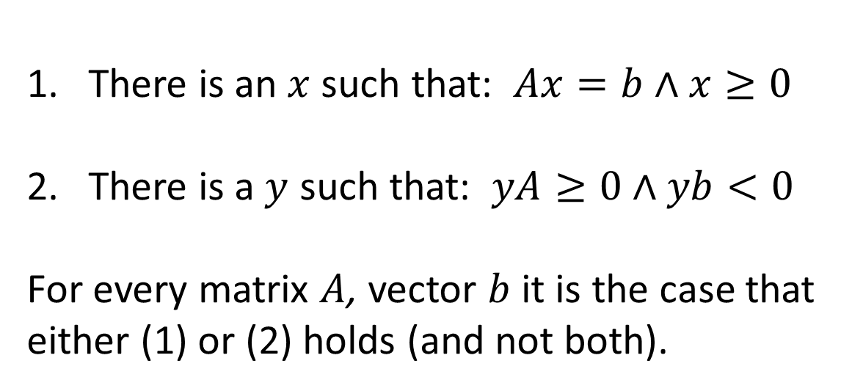
The Farkas Lemma Dichotomy
There is an $x$ such that: $Ax=b∧x≥0$
There is a $y$ such that: $yA≥0∧yb<0$
For every matrix $A$, vector $b$ it is the case that
either (1) or (2) holds (and not both).

Slide 32
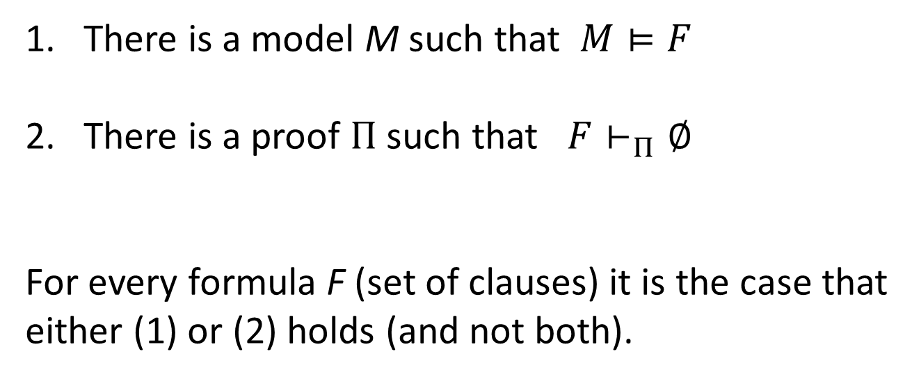
A Dichotomy of Models and Proofs
There is a model M such that $M⊨F$
There is a proof $Π$ such that $F⊢_{Π}∅$
For every formula F (set of clauses) it is the case that
either (1) or (2) holds (and not both).

Slide 33
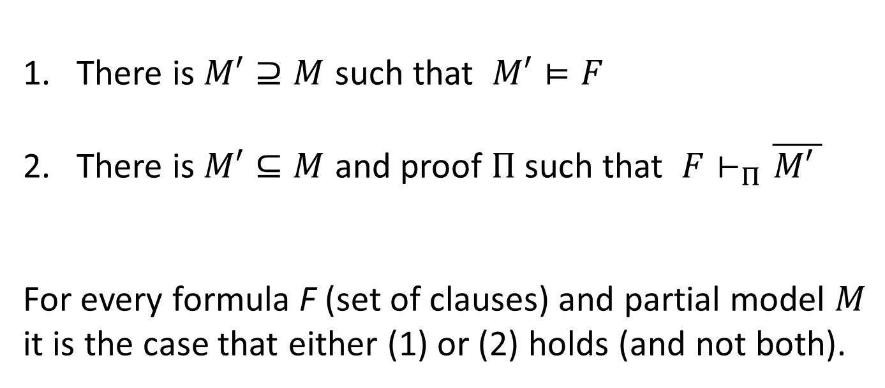
A Dichotomy of Models and Proofs
There is $M′⊇M$ such that $M′⊨F$
There is $M′⊆M$ and proof $Π$ such that $F⊢_{Π}\overline{M\text{′} }$
For every formula F (set of clauses) and partial model $M$
it is the case that either (1) or (2) holds (and not both).

Slide 34
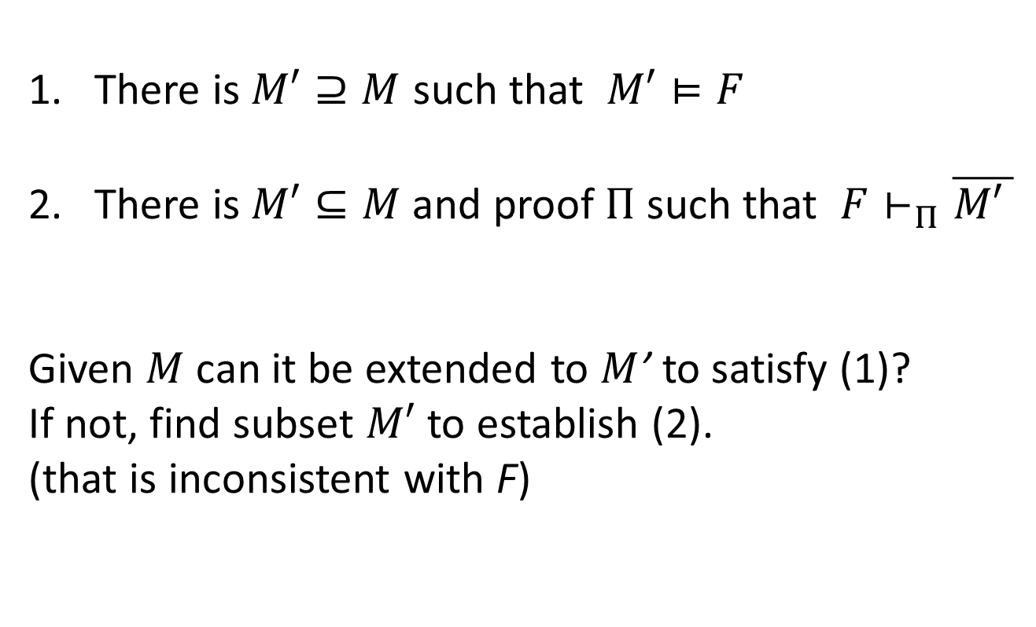
A Dichotomy of Models and Proofs
There is $M′⊇M$ such that $M′⊨F$
There is$M′⊆M$ and proof $Π$ such that $F⊢_{Π}\overline{M\text{′} }$
Given $M$ can it be extended to $M$’ to satisfy (1)?
If not, find subset $M′$ to establish (2).
(that is inconsistent with F)

Slide 35
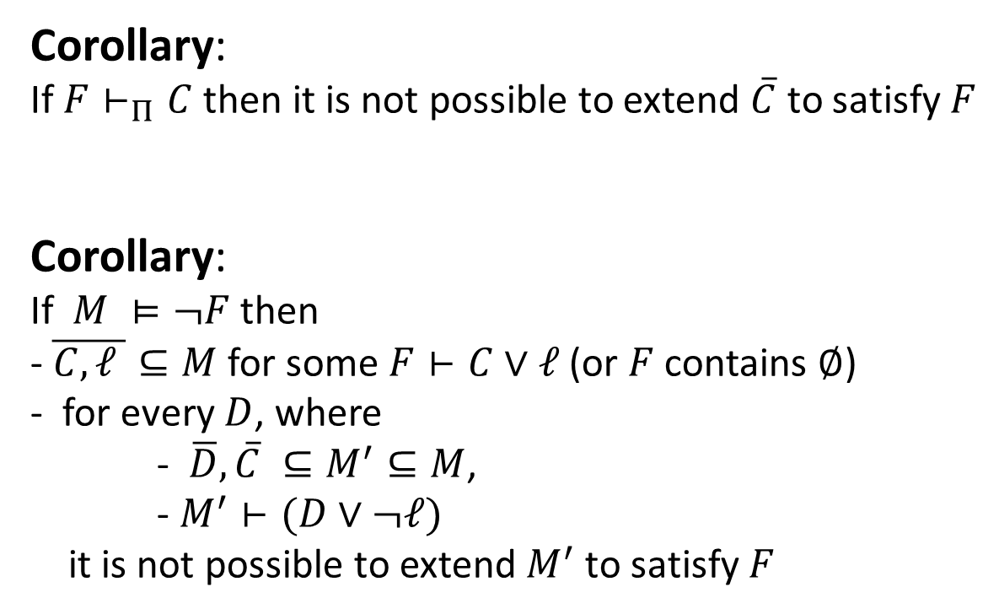
A Dichotomy of Models and Proofs
Corollary:
If $F⊢_{Π}C$ then it is not possible to extend $\overline{C}$ to satisfy $F$
Corollary:
If $M ⊨¬F$ then
- $\overline{C,ℓ }⊆M$ for some $F⊢C∨ℓ$ (or $F$ contains $∅$)
- for every $D$, where
- $\overline{D},\overline{C} ⊆M^{′}⊆M$,
- $M^{′}⊢(D∨¬ℓ)$
it is not possible to extend${ M}^{′}$ to satisfy $F$

Slide 36

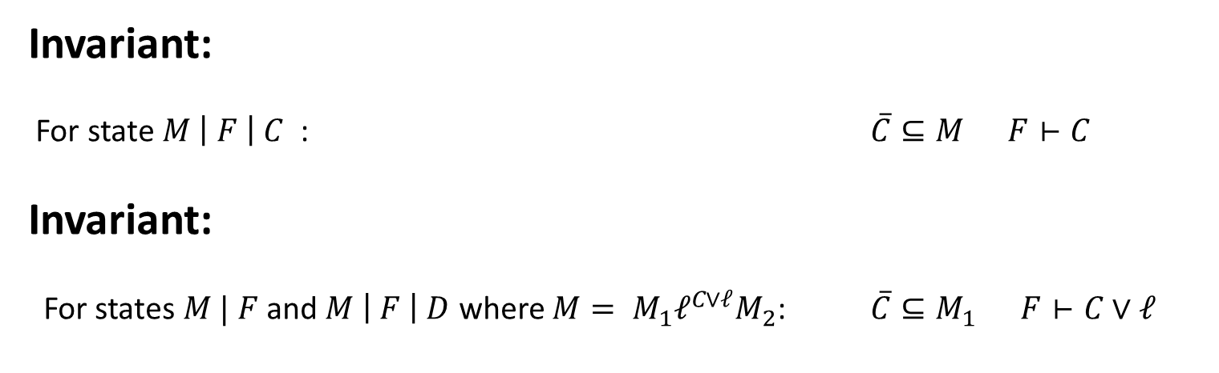
CDCL Search – Data structures
Partial Model:
Sequence of literals
Decision lits:
case splits
Propagation lits:
only one case
makes sense.
Formula:
set of clauses
$$M | F$$
Proof: Implicit
Consequences added to F
Invariant:
For state $M \left| F \right| C$ : $\overline{C}⊆M F⊢C$
Invariant:
For states $M | F$and $M \left| F \right| D$ where ${M= M}_{1}ℓ^{C∨ℓ}M_{2}$: $\overline{C}⊆M_{1} F⊢C∨ℓ$

Slide 37
CDCL steps
Initialize | $ε| F$ | $F is a set of clauses$
No model candidate has been fixed

Slide 38
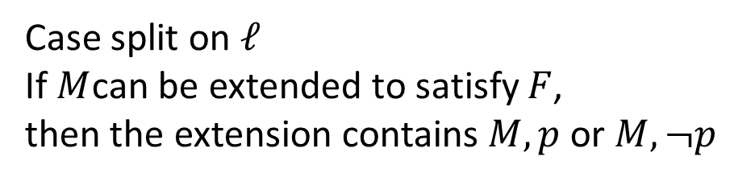
CDCL steps
Decide | $M \left| F ⟹M, ℓ \right| F$ | $ℓ is unassigned$
Case split on $ℓ$
If $M$can be extended to satisfy $F$,
then the extension contains $M, p$ or $M, ¬p$

Slide 39
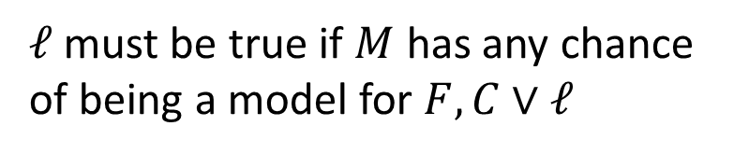
CDCL steps
Propagate | $M \left| F, C∨ℓ ⟹M, ℓ^{C∨ℓ} \right| F,C∨ℓ$ | $C is false under M$
$ℓ$ must be true if $M$ has any chance
of being a model for $F, C∨ℓ$

Slide 40
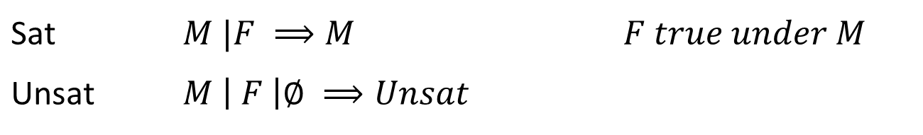
CDCL steps
Sat | $M |F ⟹M$ | $F true under M$
Unsat | $M \left| F \right|∅ ⟹Unsat$

Slide 41
CDCL steps
Conflict | $M \left| F, C ⟹M \right| F,C | C$ | $C is false under M$
$C$ is a sufficient explanation why $M$ is not a model of $F$

Slide 42
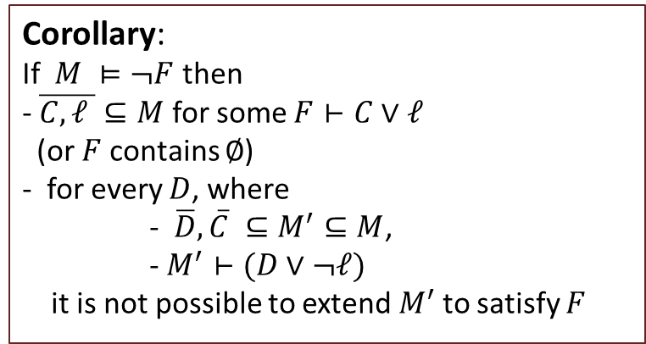
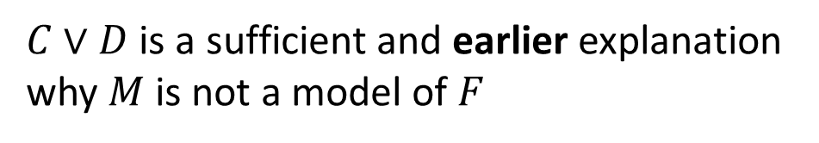
CDCL steps
Resolve | $M \left| F | C∨¬ℓ⟹M \right| F | C∨D$ | $ℓ^{D∨ℓ}∈M$
Recall
Corollary:
If $M ⊨¬F$ then
- $\overline{C,ℓ }⊆M$ for some $F⊢C∨ℓ$ (or $F$ contains $∅$)
- for every $D$, where
- $\overline{D},\overline{C} ⊆M^{′}⊆M$,
- $M^{′}⊢(D∨¬ℓ)$
it is not possible to extend${ M}^{′}$ to satisfy $F$
$C∨D$ is a sufficient and earlier explanation
why $M$ is not a model of $F$

Slide 43
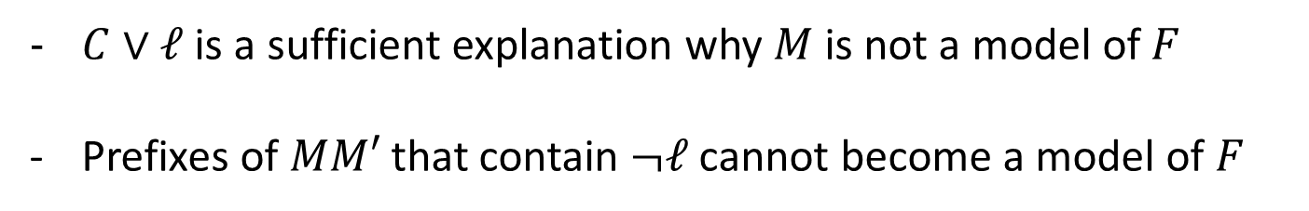
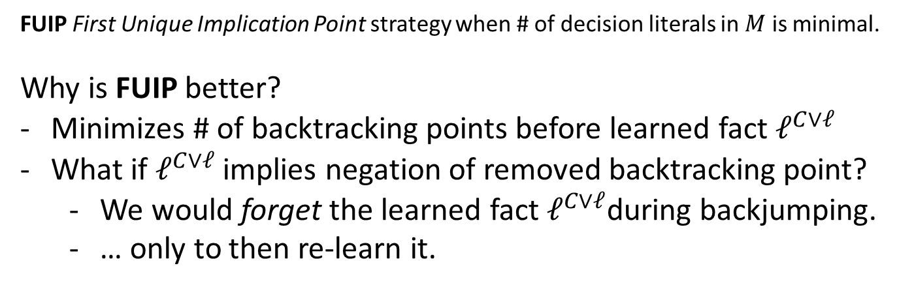
CDCL steps
Backjump | $MM′ \left| F | C∨ℓ⟹Mℓ^{C∨ℓ} \right| F$ | $\overline{C}⊆M, ¬ℓ∈M′$
$C∨ℓ$ is a sufficient explanation why $M$ is not a model of $F$
Prefixes of $MM′$ that contain $¬ℓ$ cannot become a model of $F$
FUIP First Unique Implication Point strategy when # of decision literals in $M$ is minimal.
Why is FUIP better?
Minimizes # of backtracking points before learned fact $ℓ^{C∨ℓ}$
What if $ℓ^{C∨ℓ}$ implies negation of removed backtracking point?
We would forget the learned fact $ℓ^{C∨ℓ}$during backjumping.
… only to then re-learn it.

Slide 44
CDCL steps
Learn | $M \left| F | C⟹M \right| F, C | C$
Re-use proof step for later: build DAG proof instead of TREE proof

Slide 45

CDCL steps
Forget | $M \left| F, C⟹M\right| F$ | $C$is a learned clause
Don’t forget to forget:
Learned clauses could turn out to be useless.
They could hog resources
Blocked Clause Elimination:
- Remove clauses that will not be used in proofs

Slide 46
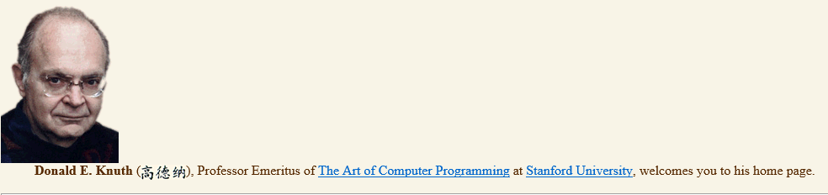
CDCL steps
Restart | $M \left| F⟹ ε \right| F$
Avoid getting trapped in one part of search space.
Restart with increased delay:
$$S_{1},S_{2},…. =1,1,2,1,1,2,4,1,1,2,1,1,2,4,8,1,1,2,1,1,2,4,1,1,2,4,8,1,…$$
[Reluctant doubling sequence: Luby, Sinclair, Zuckerman, IPL 47]
Generating
function
[Art .. chapter
on SAT]
$$\left(u_{n+1}, v_{n+1}\right)=\left(u_{n}\& −u_{n}?\left(u_{n}+1,1\right):\left(u_{n}, 2v_{n}\right)\right).$$

Slide 47
Modern DPLL - tuning
Restart frequency
Why is restarting good?
Efficient replay trick for frequent restart
Which variable to split on
Which branch to explore first
Which lemmas to learn
Blocked clause elimination
Cache binary propagations
This is just scratching the surface

Slide 48
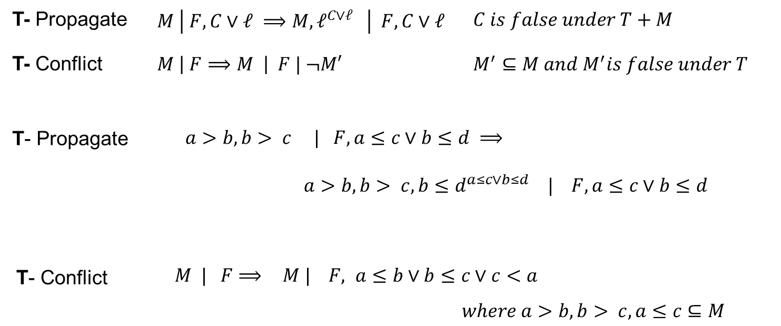
DPLL(T) solver interaction

Slide 49
MCSat [Jojanovich, de Moura] (Cotton, McMillan, Nieuwenhuis, Voronkov,,…)
Trail
x + y + z > 0 | -x + y + z < 0 | x = 0 | y = 0
Search
Trail: values guessed for sub-terms
Propagate values, derive consequences
Conflict resolution: Detect, backjump, learn
Forget, restart, indexing,…
T-Solvers
MCSAT
Generalization
Craig Interpolant
x + y + z > 0 | -x + y + z < 0 | x = 0 | y = 0
Arithmetic
Solver
x + y + z > 0 | -x + y + z < 0 | x > 0
Conflict: z > 0, z < 0
x > 0 is “explained” by the clause $x + y + z > 0∧ −x + y + z < 0⇒ x > 0$

Slide 50
Theory SOlvers

Slide 51
Conceptually
Claim: main approaches search for resolution proofs (+ cutting planes) or model
Eager vs. Lazy compilation to SAT
Integration with SAT solver state machine
Compositionality: Each solver by itself
Search Controlled by SAT Engine vs. Theory Solver

Slide 52
Equalities and Uninterpreted FUnctions

Slide 53
Theory of Equality
a = b, b = c, d = e, b = s, d = t, a ≠ e, c ≠ s
a
b
c
d
e
s
t
union
union
a,b,c,s
d,e,t
find(c) = find(s)

Slide 54
Theory of Equality
a = b, b = c, d = e, b = s, d = t, a ≠ e
a
b
c
d
e
s
t
union
union
a,b,c,s
♦₁
♦₂
M(a) = M(b) =
M(c) = M(s) = ♦₁
M(d) = M(e) =
M(t) = ♦₂
d,e,t

Slide 55
Theory of Equality: Functions
a = b, b = c, d = e, b = s, d = t, f(a, g(d)) ≠ f(b, g(e))
“Naming” subterms
a = b, b = c, d = e, b = s, d = t, v₃ ≠ v₄
v₁ ≡ g(d), v₂ ≡ g(e), v₃ ≡ f(a, v₁) , v₄ ≡ f(b, v₂)
a,b,c,s
d,e,t
v₁
v₂
v₃
v₄
Congruence Rule:
x₁ = y₁, …, x_{n} = y_{n} implies f(x₁, …, x_{n}) = f(y₁, …, y_{n})

Slide 56
Theory of Equality: Functions
a = b, b = c, d = e, b = s, d = t, f(a, g(d)) ≠ f(b, g(e))
“Naming” subterms
a = b, b = c, d = e, b = s, d = t, v₃ ≠ v₄
v₁ ≡ g(d), v₂ ≡ g(e), v₃ ≡ f(a, v₁) , v₄ ≡ f(b, v₂)
a,b,c,s
d,e,t
v₁,v₂
v₃,v₄
Congruence Rule:
x₁ = y₁, …, x_{n} = y_{n} implies f(x₁, …, x_{n}) = f(y₁, …, y_{n})

Slide 57
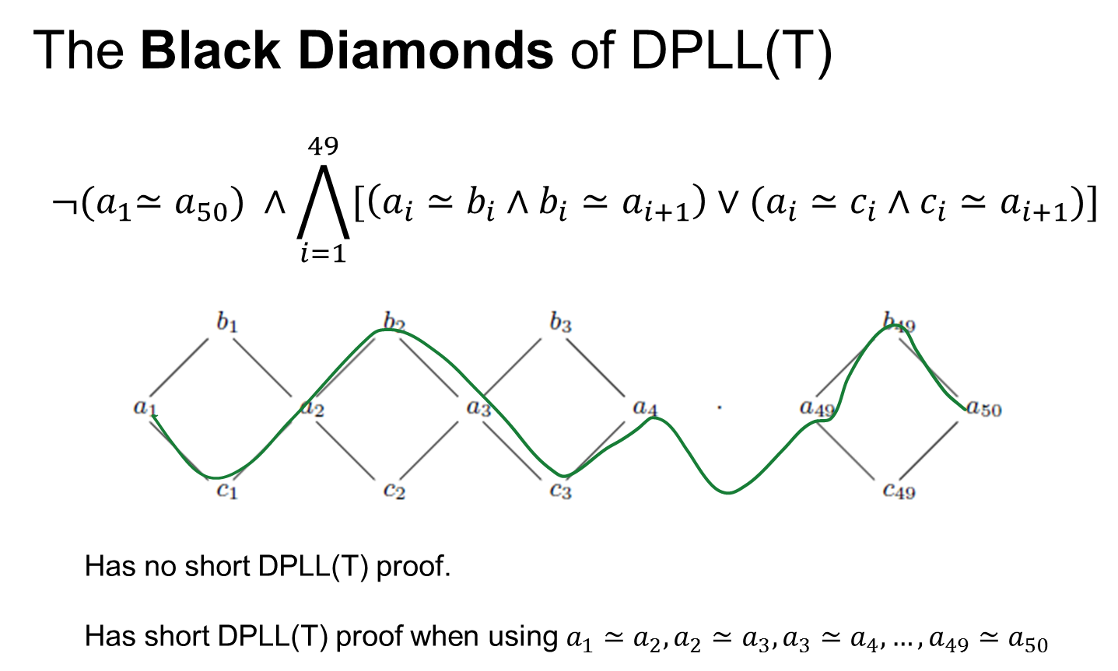

Slide 58
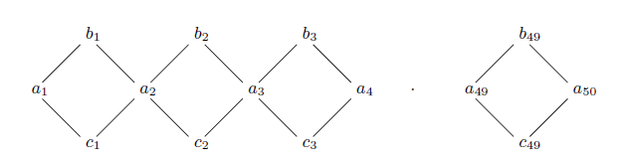

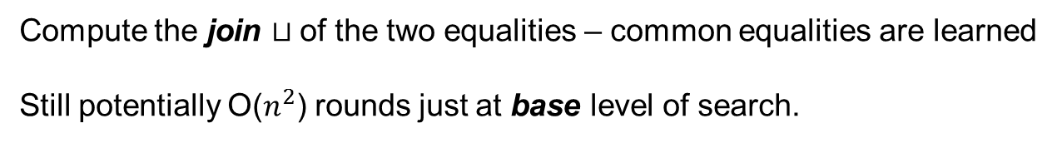
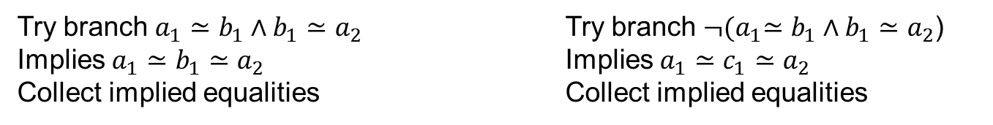
Approach #1: DPLL($⊔$)
Try branch $a_{1}≃b_{1}∧b_{1}≃a_{2}$ Try branch ${¬(a}_{1}≃b_{1}∧b_{1}≃a_{2}$)
Implies $a_{1}≃b_{1}≃a_{2}$ Implies $a_{1}≃c_{1}≃a_{2}$
Collect implied equalities Collect implied equalities
Compute the join $⊔$of the two equalities – common equalities are learned
Still potentially O($n^{2}$) rounds just at base level of search.
[B, Dutertre, de Moura 08]

Slide 59
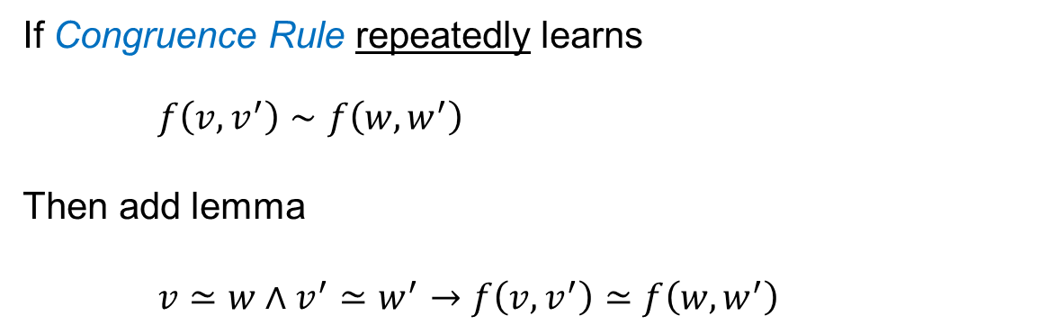
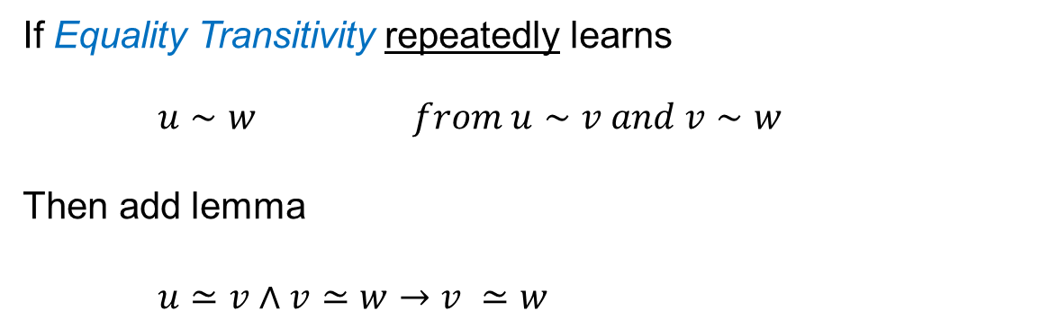
Approach #2: simulate paramodulation
Dynamic Ackerman Reduction
If Congruence Rule repeatedly learns $f\left(v,v^{′}\right)∼f\left(w,w^{′}\right)$
Then add lemma
$v≃w∧v^{′}≃w^{′}→f\left(v,v^{′}\right)≃f\left(w,w^{′}\right)$
Dynamic Ackerman Reduction with Transitivity
If Equality Transitivity repeatedly learns $u∼w from u∼v and v∼w$
Then add lemma
$u≃v∧v≃w→v ≃w$
[B, de Moura 13, handbook of tractability]

Slide 60
Arrays

Slide 61

Arrays
Arrays as applicative maps: $A:Index⇒Elem$
Select: _[_]: $\left(Index⇒Elem\right)×Index→Elem$
Extensionality:
$\left(∀i . A\left[i\right]=B\left[i\right]\right) implies A=B$
$A\left[δ(A,B)\right]=B\left[δ(A,B)\right] implies A=B$
Derived operations:
store$\left(A,i,v\right)≔λ j. if i=j then v else A[j]$
K$\left(v\right)≔λ j. v$
map$\left(f,A,B\right)≔λ j. f(A\left[j\right],B\left[j\right])$

Slide 62
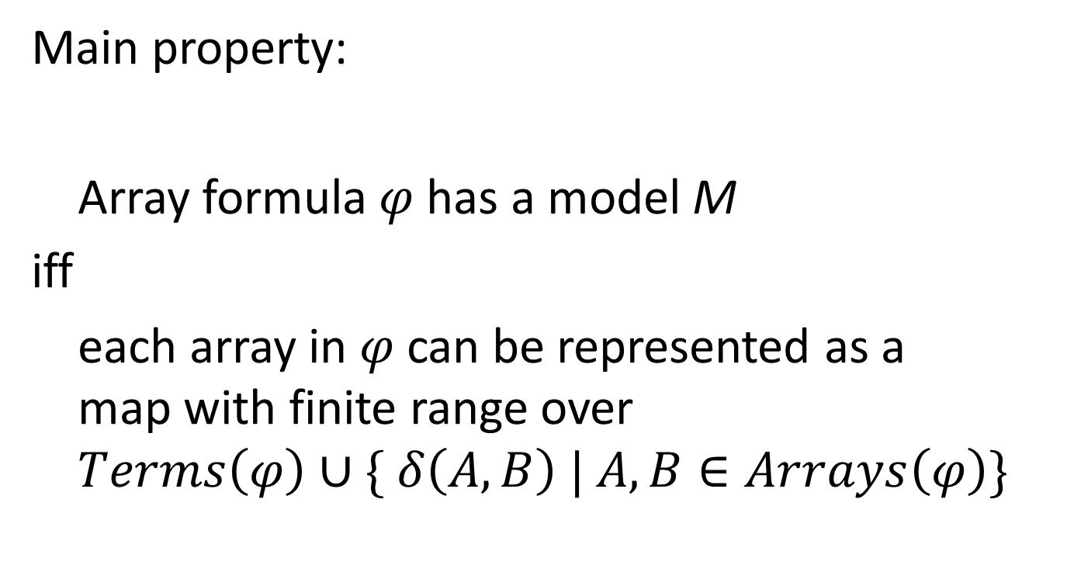
Arrays as Local Theories
Main property:
Array formula $φ$has a model M
iff
each array in $φ$ can be represented as a map with finite range over
$$Terms\left(φ\right)∪\{ δ\left(A,B\right) | A,B∈Arrays\left(φ\right)\}$$

Slide 63
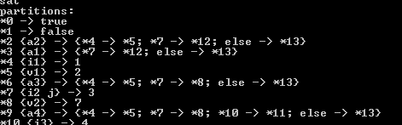
Reduction to uninterpreted functions
Use saturation rules to reduce arrays to the theory of un-interpreted functions
Extract models for arrays as finite graphs

Slide 64
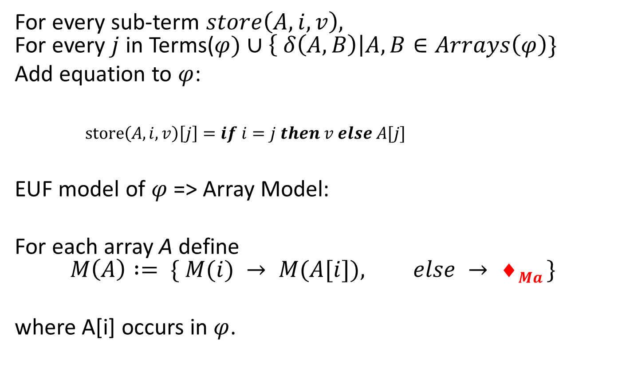
Closure for store
For every sub-term $store\left(A,i,v\right),$ For every $j$ in Terms($φ)∪\left\{ δ\left(A,B\right)\right|A,B∈Arrays\left(φ\right)\}$
Add equation to $φ$:
$store\left(A,i,v\right)\left[j\right]=if i=j then v else A[j]$
EUF model of $φ$=> Array Model:
For each array A define $$M\left(A\right) := \{ M(i) → M(A[i]), else → ◻Ma \}$$
where A[i] occurs in $φ$.

Slide 65
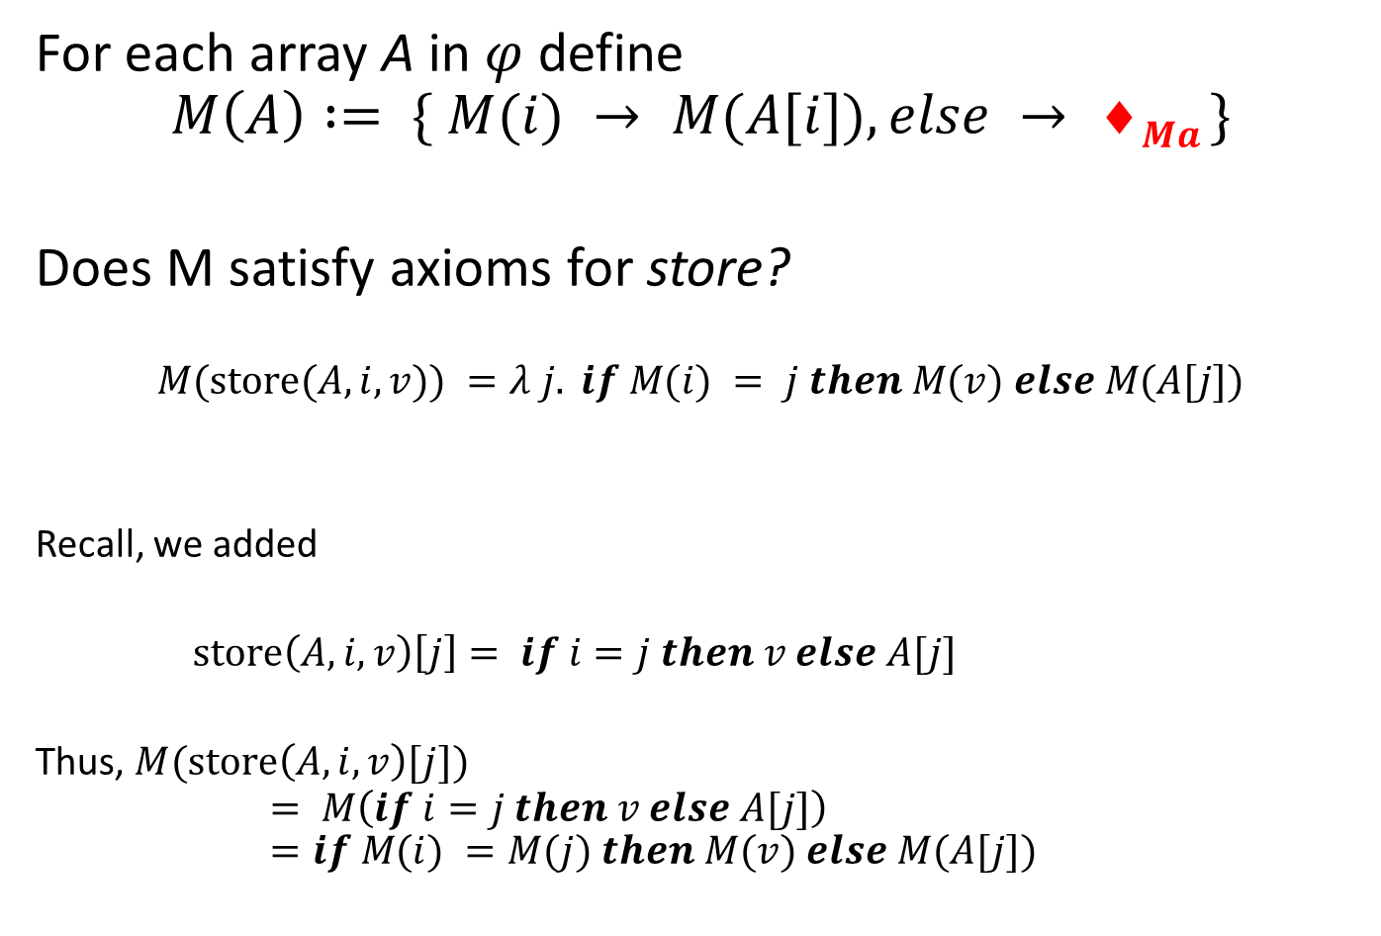
Deciding store
For each array A in $φ$define $$M\left(A\right) := \{ M(i) → M(A[i]), else → ◻Ma \}$$
Does M satisfy axioms for store?
$$M(store(A,i,v)) =λ j. if M(i) = j then M(v) else M(A[j])$$
Recall, we added
$store\left(A,i,v\right)\left[j\right]= if i=j then v else A[j]$
Thus, $M(store\left(A,i,v\right)[j])$ $= M\left(if i=j then v else A[j]\right)$ $=if M(i) =M(j) then M(v) else M(A[j])$

Slide 66
Arrays and Efficiency
Adding axioms for all indices is expensive
Store and extensionality axioms introduce branching
Selectively add axioms on demand
Boolector: Dual propagation to delay adding axioms
Z3: relevancy propagation

Slide 67
Arithmetic

Slide 68
Some Arithmetical Theories
Presburger/Buchi Arithmetic
Real non-linear Arithmetic
Mixed Integer Linear Arithmetic
Real non-linear Arithmetic
Integer Linear Arithmetic
Real Linear Arithmetic
Pseudo Booleans
Horn Inequalities
3x + 2y < z + 4
TVPI Differences
2x - 3y < 3
UTVPI
x + y < 3, x –z <2
Unit Differences
x – y < 4

Slide 69
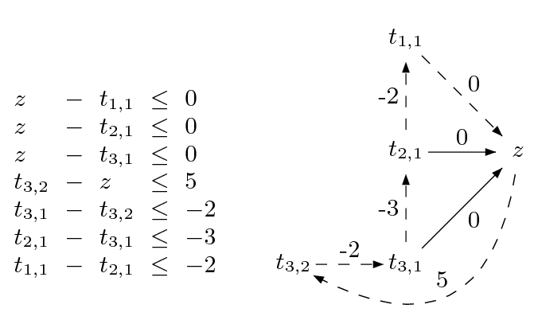
Difference Logic
Chasing negative cycles!
Algorithms based on Bellman-Ford (O(mn)).

Slide 70
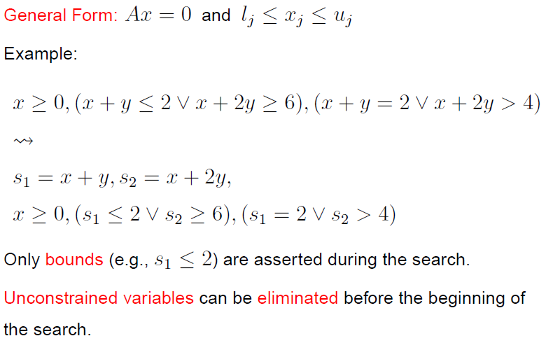
Linear Real Arithmetic

Slide 71
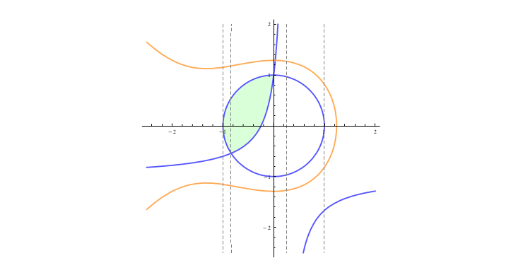

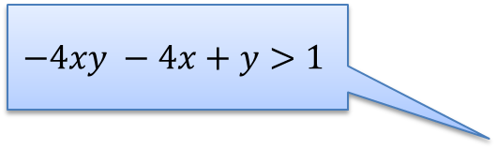
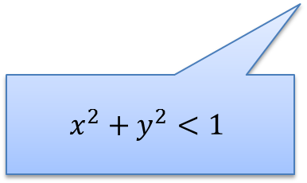
Efficiently ∃R reduction to CAD
A key idea: Use partial solution to guide the search
Feasible Region
$$x^{3}+2x^{2}+3y^{2}−5<0$$
$$−4xy −4x+y>1$$
x = 0.5
Extract small core
$$x^{2}+y^{2}<1$$
Dejan Jojanovich & Leonardo de Moura, IJCAR 2012

Slide 72
Bit-Vectors

Slide 73
Bit-vector arithmetic
Two approaches
SAT reduction (Boolector, CVC, MathSAT, STP, , Yices, Z3, …)
Circuit encoding of bit-wise predicates.
Bit-wise operations as circuits
Circuit encoding of adders, multipliers.
Custom modules
SWORD [Wille, Fey, Groe, Eggersgl, Drechsler 07]
Pre-Chaff specialized engine [Huang, Chen 01, Barrett 98]

Slide 74
Encoding circuits to SAT - addition
1
0
1
0
1
1
out = xor(x, y, c)
c’ = (x∧y) ∨ (x∧c) ∨ (y∧c)
c[0] = 0
c’[N-2:0] = c[N-1:1]
+
0
1
1
0
0
1
out_{i} ↔ xor(x_{i}, y_{i}, c_{i} )
c_{i+1} ↔ (x_{i}∧y_{i}) ∨ (x_{i}∧c_{i}) ∨ (y_{i}∧c_{i})
c₀ ↔ 0
FA
FA
FA
FA
FA
FA
0
0
0
1
0
0
(x_{i}∧y_{i} ∧c_{i} → out_{i}) ∧ (out_{i}→ x_{i}∨ y_{i} ∨ c_{i}) ∧
(x_{i}∧ c_{i} → out_{i} ∨ y_{i} ) ∧ (out_{i} ∧ y_{i} ∧ c_{i} → x_{i}) ∧
(c_{i} → out_{i} ∨ x_{i} ∨ y_{i} ) ∧ (out_{i} ∧ x_{i} ∧ c_{i} → y_{i}) ∧
(y_{i} → out_{i} ∨ x_{i} ∨ c_{i} ) ∧ (out_{i} ∧ x_{i} ∧ y_{i} → c_{i}) ∧
(x_{i}∧y_{i} → c_{i+1}) ∧ (c_{i+1} → x_{i}∨ y_{i} ) ∧
(x_{i}∧c_{i} → c_{i+1}) ∧ (c_{i+1} → x_{i}∨ c_{i} ) ∧
(y_{i}∧c_{i} → c_{i+1}) ∧ (c_{i+1} → y_{i}∨ c_{i} ) ∧
¬c₀

Slide 75
Encoding circuits to SAT - multiplication
a₀∧b₃
a₀∧b₂
a₀∧b₁
a₀∧b₀
O(n²) clauses
SAT solving time increases exponentially. Similar for BDDs.
[Bryant, MC25, 08]
Brute-force enumeration + evaluation faster
for 20 bits.
[Matthews, BPR 08]
HA
a₁∧b₂
HA
a₁∧b₁
HA
a₁∧b₀
FA
a₂∧b₁
FA
a₂∧b₀
FA
a₃∧b₀
out₃
out₂
out₁
out₀
Bit-wise operations
Fixed size

Slide 76
Large/Parametric size
Bit-vector addition is expressible
As a state machine:
out = xor(x, y, c)
c’ = (x∧y)∨(x∧c) ∨ (y∧c)
c[0] = 0
c’[N-2:0] = c[N-1:1]
(set-logic QF_BV)
(declare-fun x () (_ BitVec 1000000))
(declare-fun y () (_ BitVec 1000000))
(assert (distinct (bvadd x y) (bvadd y x))
Parametric, non-fixed size:
PSPACE complete fragments. [Pichora 03]
Large fixed-size:
QF_BV, QF_UFBV are NEXPTIME complete.
[Fröhlich, Kovásznai, Biere,
SMT’12,13,CSR’13]
1
0
1
0
1
1
+
0
1
1
0
0
1
FA
FA
FA
FA
FA
FA
0
0
0
1
0
0

Slide 77
Other Theories
Algebraic Data-types
Monoids (strings) and Sequences
Sets, Multi-sets
Monadic Theories, Automata
Aggregates, Cardinalities, #SAT/#SMT
Constraint domains
Theories and Quantifiers:
QBF, DQBF, EPR, QBV, Horn, Essentially Uninterpreted,

Slide 78
Combining THeories

Slide 79
Combining Theories
In practice, we need a combination of theories.
b + 2 = c and f(read(write(a,b,3), c-2)) ≠ f(c-b+1)
A theory is a set (potentially infinite) of first-order sentences.
Main questions:
Is the union of two theories T1 ∪ T2 consistent?
Given a solvers for T1 and T2, how can we build a solver for
T1 ∪ T2?

Slide 80
A Combination History
Foundations
Efficiency using rewriting
1979 Nelson, Oppen - Framework
1996 Tinelli & Harindi. N.O Fix
2000 Barrett et.al N.O + Rewriting
2002 Zarba & Manna. “Nice” Theories
2004 Ghilardi et.al. N.O. Generalized
1984 Shostak. Theory solvers
1996 Cyrluk et.al Shostak Fix #1
1998 B. Shostak with Constraints
2001 Rueß & Shankar Shostak Fix #2
2004 Ranise et.al. N.O + Superposition
2001: Moskewicz et.al. Efficient DPLL made guessing cheap
2006 Bruttomesso et.al. Delayed Theory Combination
2007 de Moura & B. Model-based Theory Combination
… 2015 Ringeissen, 2013 Jovanovic, 2007 Ganesh, overlapping, polite, shiny, etc.

Slide 81
Disjoint Theories
Two theories are disjoint if they do not share function/constant and predicate symbols.
= is the only exception.
Example:
The theories of arithmetic and arrays are disjoint.
Arithmetic symbols: {0, -1, 1, -2, 2, …, +, -, *, >, <, ≥, ≤}
Array symbols: { read, write }

Slide 82
Purification
It is a different name for our “naming” subterms procedure.
b + 2 = c, f(read(write(a,b,3), c-2)) ≠ f(c-b+1)
b + 2 = c, v₆ ≠ v₇
v₁ ≡ 3, v₂ ≡ write(a, b, v₁), v₃ ≡ c-2, v₄ ≡ read(v₂, v₃),
v₅ ≡ c-b+1, v₆ ≡ f(v₄), v₇ ≡ f(v₅)

Slide 83
Purification
It is a different name for our “naming” subterms procedure.
b + 2 = c, f(read(write(a,b,3), c-2)) ≠ f(c-b+1)
b + 2 = c, v₆ ≠ v₇
v₁ ≡ 3, v₂ ≡ write(a, b, v₁), v₃ ≡ c-2, v₄ ≡ read(v₂, v₃),
v₅ ≡ c-b+1, v₆ ≡ f(v₄), v₇ ≡ f(v₅)
b + 2 = c, v₁ ≡ 3, v₃ ≡ c-2, v₅ ≡ c-b+1,
v₂ ≡ write(a, b, v₁), v₄ ≡ read(v₂, v₃),
v₆ ≡ f(v₄), v₇ ≡ f(v₅), v₆ ≠ v₇

Slide 84
Stably Infinite Theories
A theory is stably infinite if every satisfiable QFF is satisfiable in an infinite model.
EUF and arithmetic are stably infinite.
Bit-vectors are not.

Slide 85
Important Result
The union of two consistent, disjoint, stably infinite theories is consistent.

Slide 86
Convexity
A theory T is convex iff
for all finite sets S of literals and
for all a₁ = b₁∨ … ∨ a_{n} = b_{n}
S implies a₁ = b₁∨ … ∨ a_{n} = b_{n}
iff
S implies a_{i} = b_{i} for some 1 ≤ i ≤ n

Slide 87
Convexity: Results
Every convex theory with non trivial models is stably infinite.
All Horn equational theories are convex.
formulas of the form s₁ ≠ r₁∨ … ∨ s_{n} ≠ r_{n} ∨ t = t’
Linear rational arithmetic is convex.

Slide 88
Convexity: Negative Results
Linear integer arithmetic is not convex
1 ≤ a ≤ 2, b = 1, c = 2 implies a = b ∨ a = c
Nonlinear arithmetic
a² = 1, b = 1, c = -1 implies a = b ∨ a = c
Theory of bit-vectors
Theory of arrays
c₁ = read(write(a, i, c₂), j), c₃ = read(a, j)
implies c₁ = c₂ ∨ c₁ = c₃

Slide 89
Combination of non-convex theories
EUF is convex (O(n log n))
IDL is non-convex (O(nm))
EUF ∪ IDL is NP-Complete
Reduce 3CNF to EUF ∪ IDL
For each boolean variable p_{i} add 0 ≤ a_{i} ≤ 1
For each clause p₁ ∨ ¬p₂ ∨ p₃ add
f(a₁, a₂, a₃) ≠ f(0, 1, 0)

Slide 90
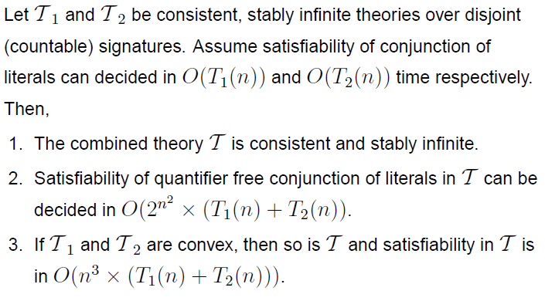
Nelson-Oppen Combination

Slide 91
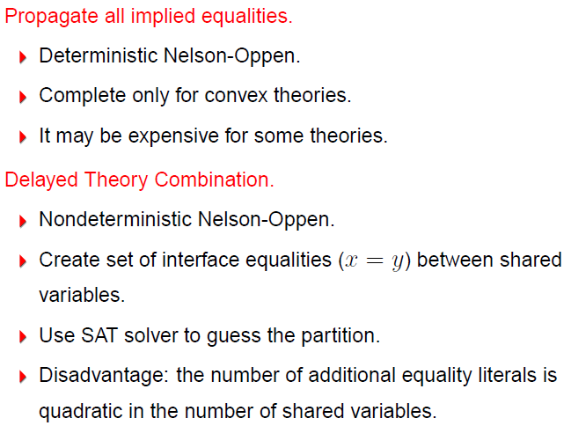
Combining Procedures in Practice

Slide 92
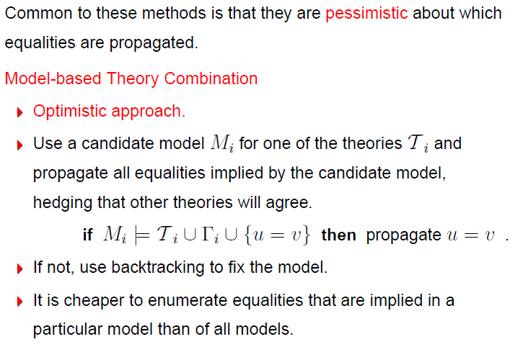
Combining Procedures in Practice

Slide 93

Example

Slide 94

Example

Slide 95
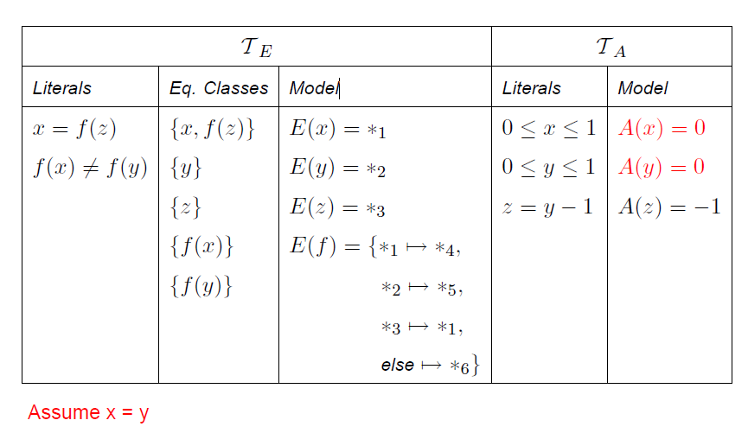
Example

Slide 96
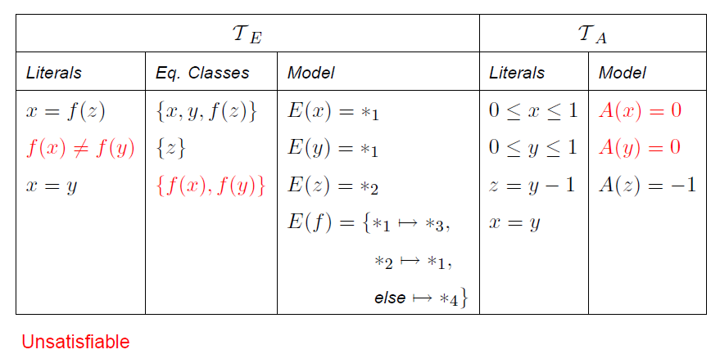
Example

Slide 97
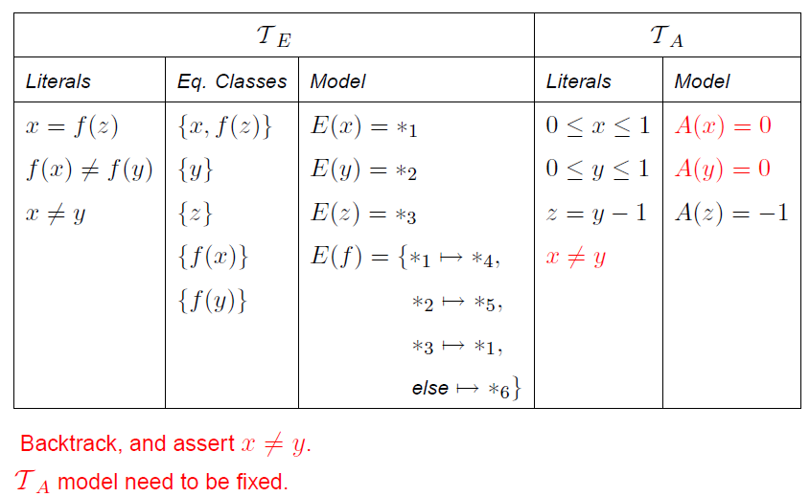
Example

Slide 98

Example

Slide 99

Example

Slide 100

Example

Slide 101

Example

Slide 102
Summary
Main SMT solvers apply CDCL style refinement search of models & proofs.
Efficient SMT solvers rely on propagation and filters to control theory reasoning (instantiating theory axioms).
Combining solvers rely on compositional glue (e.g., by sharing equalities).

