Slide 1
International University - VNU - HCM
Automatic Document Segmentation and Summarization using NLP
Presented by Lương Trí Vỹ

Slide 2
Overview
01
Objective
04
Evaluation
02
Related works
05
Future work
03
Methodology
06
Conclusion

Slide 3
Objectives
Objective 1
Create a application that to segment & summarize a paper automatically.
Objective 2
Find a method to decrease execution time & increase quality of the text summary.

Slide 4
Related Work

Slide 5
Text Segmentation
Problems
Variety of format
Images
Equations
Approaches
Parse PDFs using tool libraries -> Failed
Use GROBID -> More feasible

Slide 6
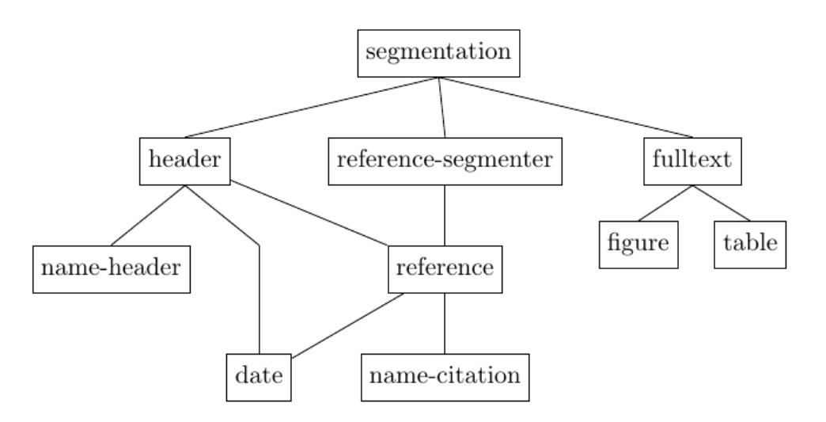
GROBID
A machine learning model
Use of a cascade of sequence labeling model

Slide 7
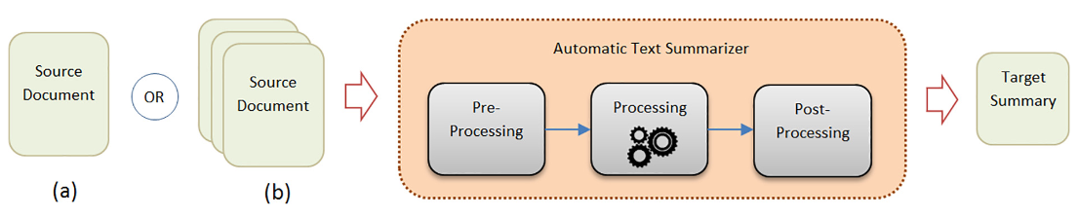
Text Summarization
Two general classification
Extractive text summarization
Abstractive text summarization
Methods
Apply statistical / machine learning methods to compress the content of the provided text.

Slide 8
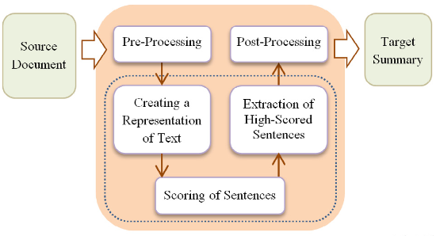
Extractive Text Summarization
Description
Reuse important sentences from the same paragraph to construct the summary.
Rank sentences through a variety of methods

Slide 9
TextRank
Overview
A graph-based, extractive summarization method.
Process
Build a text graph
Rank each text through many iteration
Choose top sentences as summary
Notes:
Must add how it rank sentences

Slide 10
Latent Semantic Analysis
Overview
A graph-based, extractive summarization method.
Process
Create a matrix of sentences and word token
Compute term frequency
Notes:
Have not construct

Slide 11
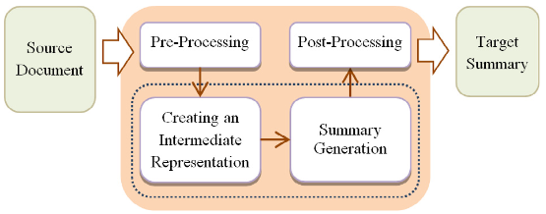
Abtractive Text Summarization
Description
Able to construct a summary using words that are not part of the paragraph.
Turn input into an intermediate form to generate a summary

Slide 12
Pre-trained models
Description
Deep learning models trained on a large dataset.
Can be used as is or fine-tuned to specific needs.
Make use of transfer learning .
Easily accessible through Hugging Face
Notes:
Transfer learning is the basis in which pretrained model can be utilized easily while skipping the training phase entirely or fine-tuning it to a specific needs
Hugging Face is a catalog of freely available pre-trained models

Slide 13
Pre-trained models
Model name | Text Summarization | BART Large CNN | Stable LM 2 1.6B
Creator | Falcon AI | Facebook | Stability AI
Base model | T5 | BART | Stable LM 2 1.6B
Parameter count | 60M | 406M | 1.6B
Token limit | 1024 | 1024 | 2048
Notes:
Add a table of models comparison here

Slide 14
Methodologies

Slide 15
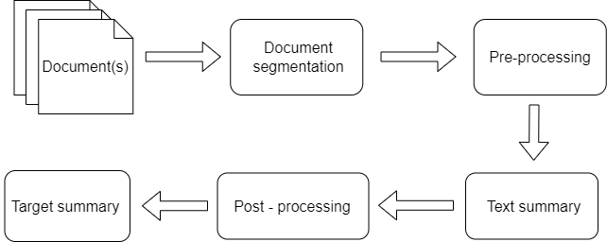
System Design

Slide 16
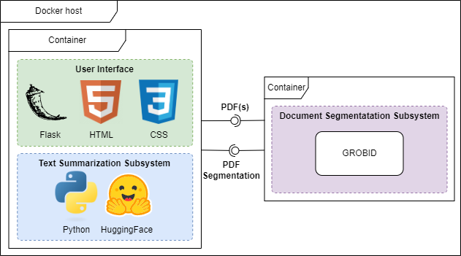
System Design
Notes:
Also explain which process is part of which container

Slide 17
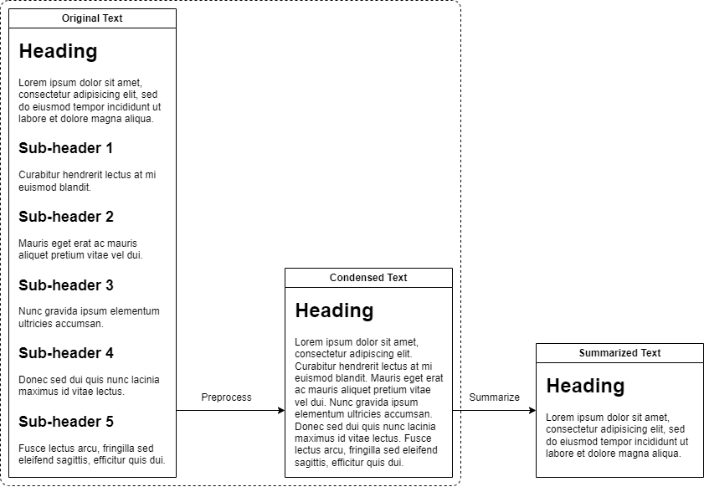
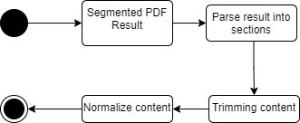
Pre-processing
Notes:
Connect parse result into sections blocks into the dotted line

Slide 18
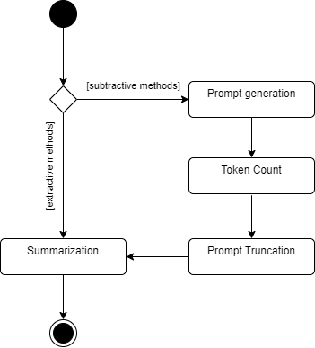
Text Summarization
Prompt
“Summarize the following segment in 1 sentence: {input}”

Slide 19
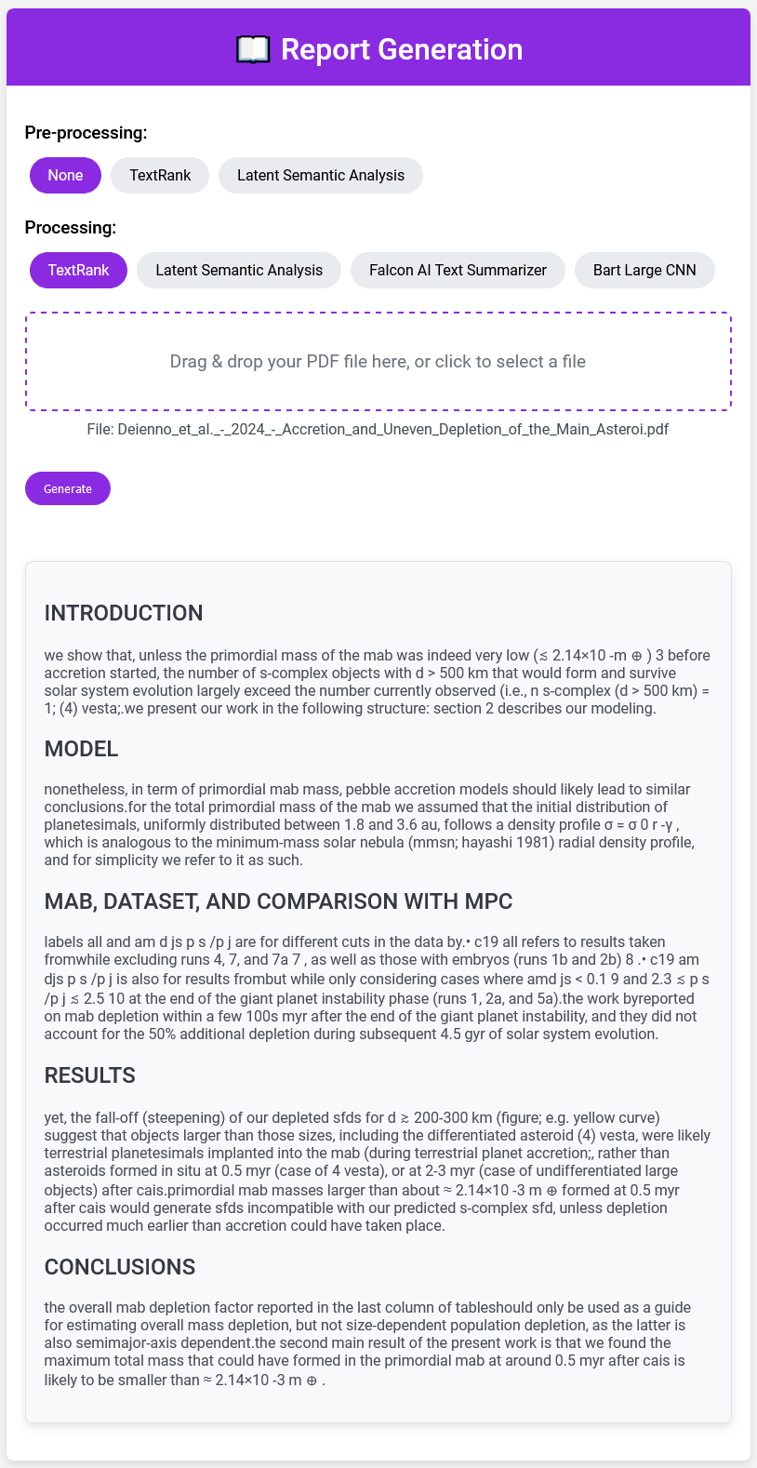
User Interface

Slide 20
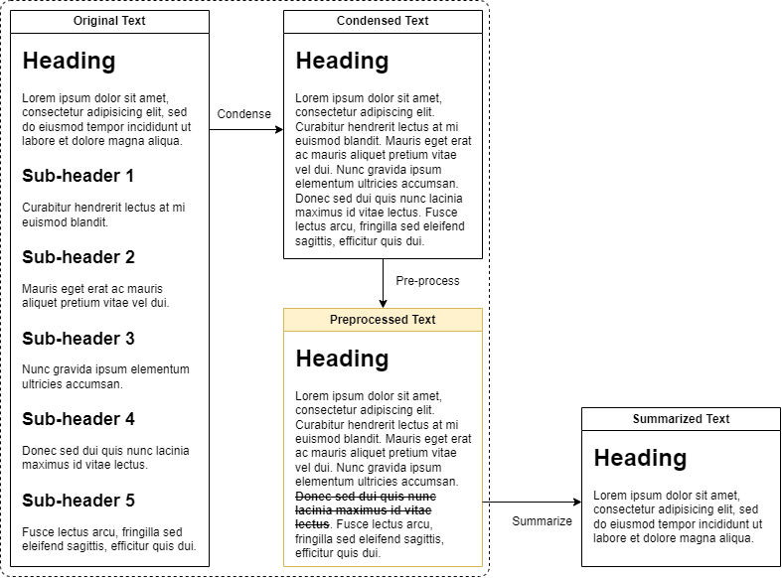
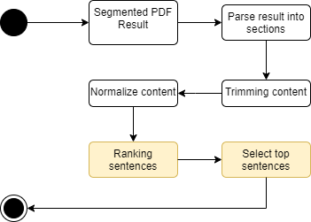
Extractive methods for Pre-processing

Slide 21
Evaluation

Slide 22
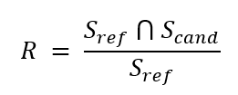
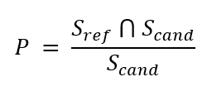
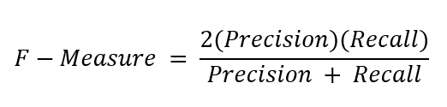
Evaluation method
Description
ROUGE-1: F-Measure for 1-gram
ROUGE-2: F-Measure for 2-gram
ROUGE-L: F-Measure for longest matching sequence

Slide 23
Evaluation method
Dataset
Environment Setting
Randomly chosen from Arvix.
Each paper belongs to a category.
Summarize each section manually.
Total of 10 papers
Full list can be view in paper.
CPU: AMD Ryzen 5 5500.
RAM: 16GB
Notes:
Find all categories

Slide 24
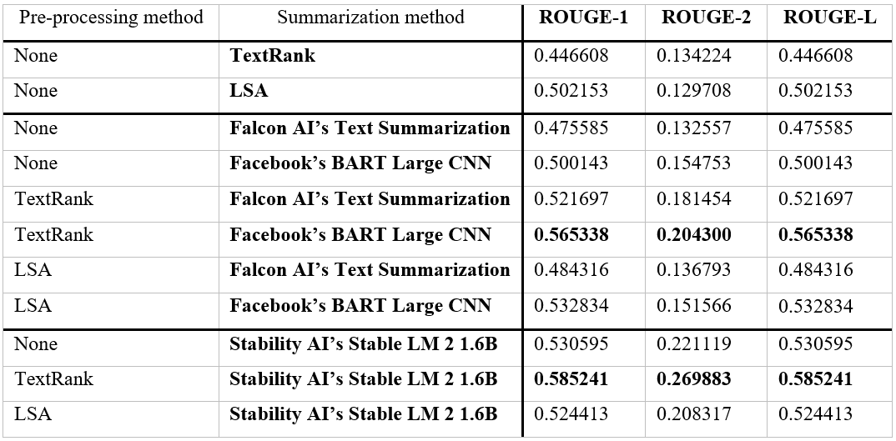
Result
Notes:
Add charts

Slide 25
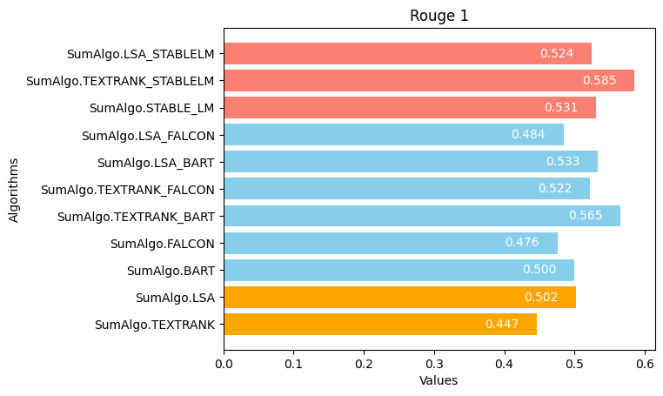
Result

Slide 26
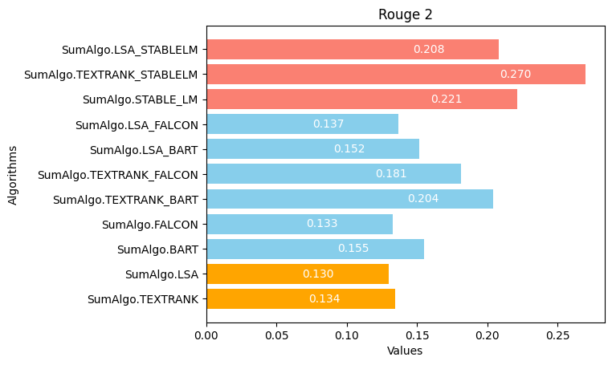
Result

Slide 27

Result

Slide 28
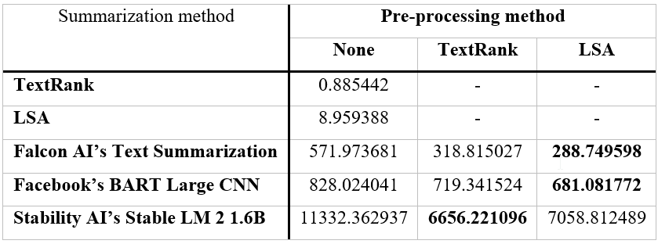
Execution time
(Measured in Seconds)

Slide 29
Future work

Slide 30
Improve application
Fine-tune pre-trained models
Develop a new model specifically for the current task
Improve application to support better user experience.

Slide 31
Improve application
Fine-tune pre-trained models
Develop a new model specifically for the current task
Improve application to support cloud hosting.

Slide 32
Conclusion
Successfully create an application that automatically segment and summarize a paper.
Improve current system, improving efficiency and quality

