Slide 1

International University - VNU - HCM
Automatic Document Segmentation and Summarization using NLP
Presented by Lương Trí Vỹ
Advisor: Dr. Nguyễn Thị Thanh Sang

Slide 2
Overview
01
Objectives
05
Future work
02
Related works
06
Conclusion
03
Methodology
07
Demo
04
Evaluation
08
Reference

Slide 3
Objectives
Objective 1
Create a application that to segment & summarize a paper automatically.
Objective 2
Find a method to decrease execution time & increase quality of the text summary.

Slide 4
Related Work

Slide 5
Text Segmentation
Problems
Variety of format
Images
Equations
Approaches
Parse PDFs using tool libraries -> Failed
Use GROBID -> More feasible

Slide 6
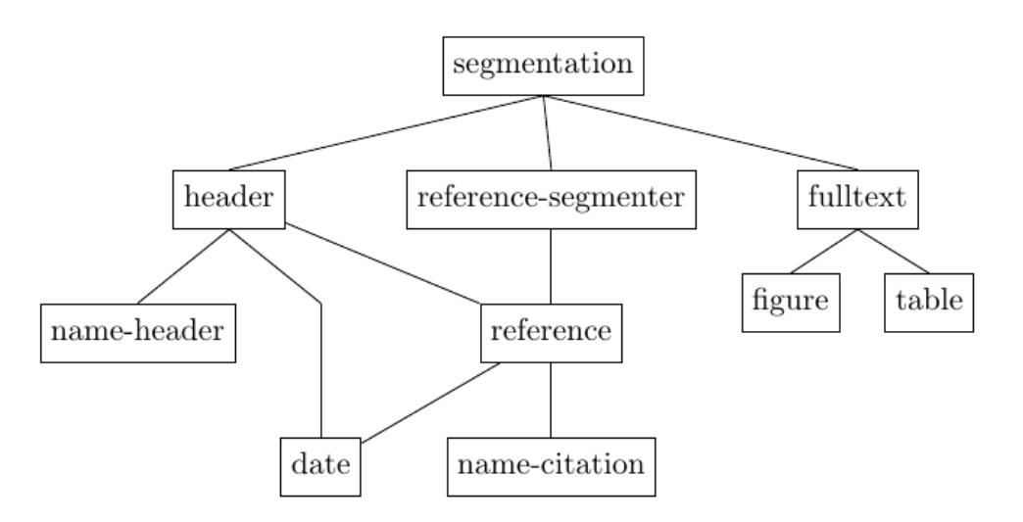
GROBID
A machine learning model
Use of a cascade of sequence labeling model

Slide 7
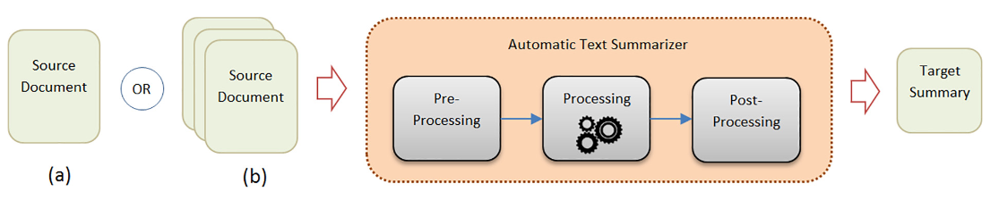
Text Summarization
Two general classification
Extractive text summarization
Abstractive text summarization
Methods
Apply statistical / machine learning methods to compress the content of the provided text.

Slide 8
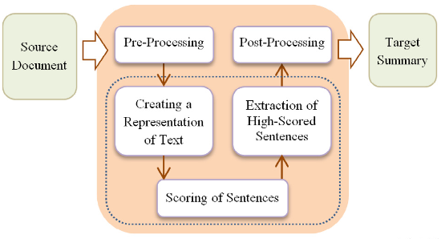
Extractive Text Summarization
Description
Reuse important sentences from the same paragraph to construct the summary.
Rank sentences through a variety of methods
Methods
TextRank
Latent Semantic Analysis

Slide 9
TextRank
Overview
A graph-based, extractive summarization method.
Inspired by the PageRank algorithm
Process
Graph Construction
Edge Weighting
Node Ranking
Keyword Extraction
Text Summarization
Notes:
OVERVIEW
TextRank is an unsupervised graph-based ranking algorithm for Natural Language Processing (NLP), particularly for keyword extraction and text summarization. It is inspired by the PageRank algorithm used by Google to rank web pages. Here's a detailed explanation of how TextRank works:
PROCESS:
1. Graph Construction:
A graph is constructed where each node represents a word or sentence (depending on the task).
For keyword extraction, nodes are words, and edges represent co-occurrence within a window of nn words.
For text summarization, nodes are sentences, and edges represent similarity scores (e.g., cosine similarity) between sentences.
2. Edge Weighting:
Edges between nodes are weighted based on the co-occurrence of words or the similarity of sentences.
3. Ranking Nodes:
The PageRank algorithm is applied to the graph, which assigns a ranking score to each node based on its connections and the weights of these connections.
The formula used in TextRank is similar to PageRank:
4. Keyword Extraction:
For keyword extraction, the top-ranked words are selected as keywords.
5. Text Summarization:
For text summarization, the top-ranked sentences are selected to form the summary.

Slide 10
Latent Semantic Analysis
Overview
Use relationship between a documents and the terms they contain to reveal the latent structures.
Process
Construct Term-document Matrix
Apply Singular Value Decomposition
Reduce Dimensions
Compute sentence ranking
Summarize text
Notes:
Latent Semantic Analysis (LSA) is a technique in natural language processing and information retrieval for analyzing relationships between a set of documents and the terms they contain. LSA uses singular value decomposition (SVD) to reduce the dimensions of the term-document matrix, revealing latent structures in the data. Here’s a detailed explanation:
Key Concepts of LSA
Term-Document Matrix:
This is a matrix where rows represent terms (words) and columns represent documents. The entries in the matrix are typically the frequency of the terms in the documents.
Example:
lua
| | Doc1 | Doc2 | Doc3 |
|------|------|------|------|
| Term1| 2 | 0 | 1 |
| Term2| 1 | 3 | 0 |
| Term3| 0 | 2 | 1 |
Singular Value Decomposition (SVD):
SVD decomposes the term-document matrix AA into three matrices: UU, ΣΣ, and VTVT.
A=UΣVTA=UΣVT
UU (left singular vectors) represents the term-concept matrix.
ΣΣ (singular values) is a diagonal matrix representing the importance of each concept.
VTVT (right singular vectors) represents the document-concept matrix.
Dimensionality Reduction:
By keeping only the top kk singular values and corresponding vectors, we reduce the dimensions of the matrices. This step captures the most significant concepts and reduces noise.
The reduced matrices are UkUk​, ΣkΣk​, and VkTVkT​.
Ak=UkΣkVkTAk​=Uk​Σk​VkT​
This reduced matrix AkAk​ represents the documents and terms in a lower-dimensional semantic space.
Process of LSA
Construct Term-Document Matrix:
Create a matrix where each row is a term and each column is a document. Entries are the frequency of terms in documents or weighted frequencies (like TF-IDF).
Apply SVD:
Decompose the term-document matrix into three matrices: UU, ΣΣ, and VTVT.
Reduce Dimensions:
Keep only the top kk singular values and corresponding vectors to form reduced matrices UkUk​, ΣkΣk​, and VkTVkT​.
Transform to Latent Semantic Space:
The reduced matrices represent the terms and documents in a new latent semantic space where similar terms and documents are closer to each other.

Slide 11
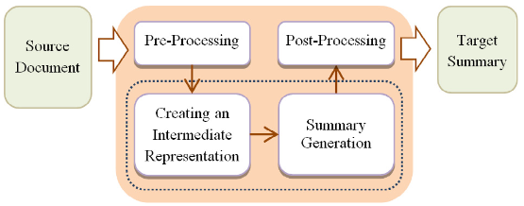
Abtractive Text Summarization
Description
Able to construct a summary using words that are not part of the paragraph.
Turn input into an intermediate form to generate a summary

Slide 12
Pre-trained models
Description
Deep learning models trained on a large dataset.
Can be used as is or fine-tuned to specific needs.
Make use of transfer learning .
Easily accessible through Hugging Face
Notes:
Transfer learning is the basis in which pretrained model can be utilized easily while skipping the training phase entirely or fine-tuning it to a specific needs
Hugging Face is a catalog of freely available pre-trained models

Slide 13
Pre-trained models
Model name | Text Summarization | BART Large CNN | Stable LM 2 1.6B
Creator | Falcon AI | Facebook | Stability AI
Base model | T5 | BART | Stable LM 2 1.6B
Parameter count | 60M | 406M | 1.6B
Token limit | 1024 | 1024 | 2048
Notes:
Add a table of models comparison here

Slide 14
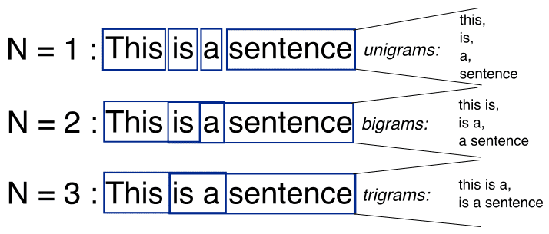
N-Gram
Description
A continuous sequence of n items from text or sentence.
Unigram: 1-gram
Bigram: 2-gram
Trigram: 3-gram
Notes:
Transfer learning is the basis in which pretrained model can be utilized easily while skipping the training phase entirely or fine-tuning it to a specific needs
Hugging Face is a catalog of freely available pre-trained models

Slide 15
Methodologies

Slide 16
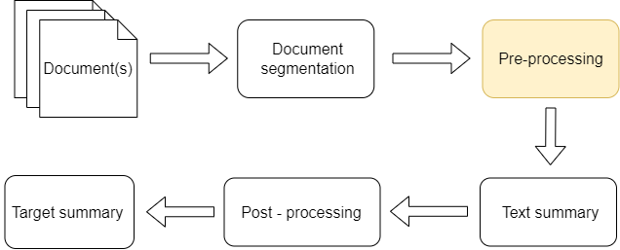
System Design

Slide 17
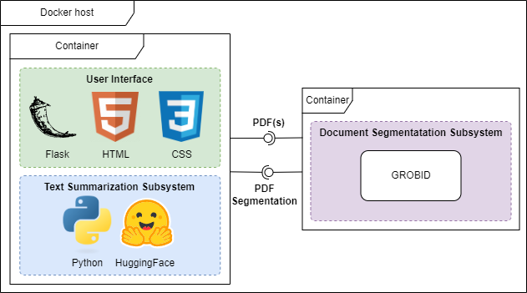
System Design
Notes:
Also explain which process is part of which container

Slide 18
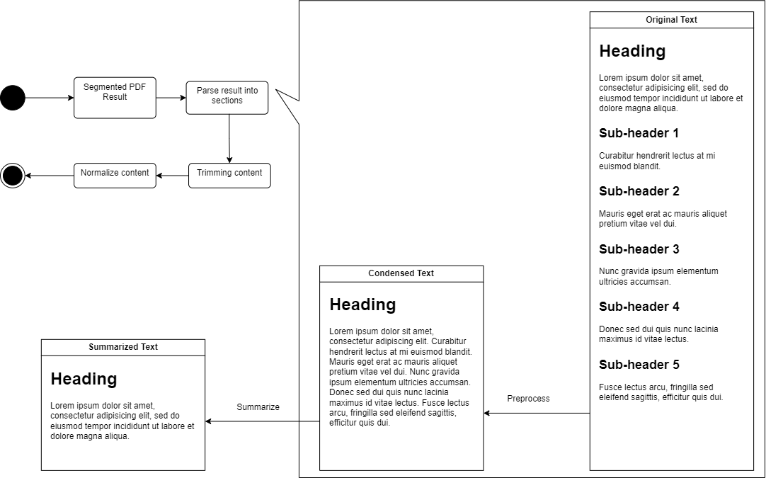
Pre-processing
Notes:
Connect parse result into sections blocks into the dotted line

Slide 19
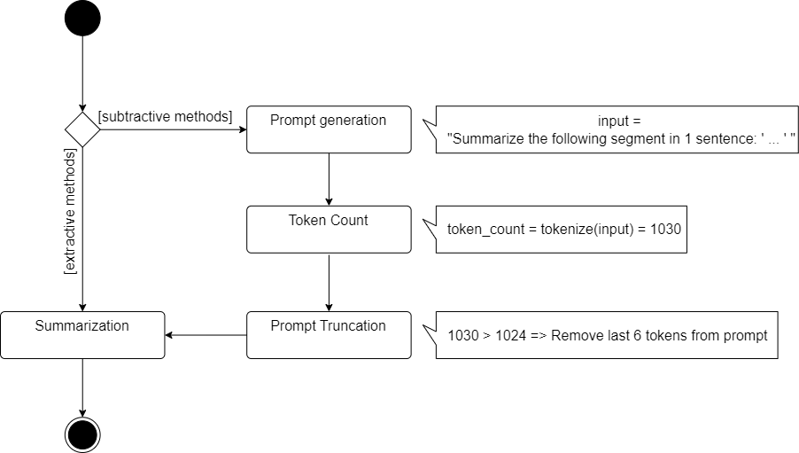
Text Summarization
Prompt
“Summarize the following segment in 1 sentence: {input}”

Slide 20
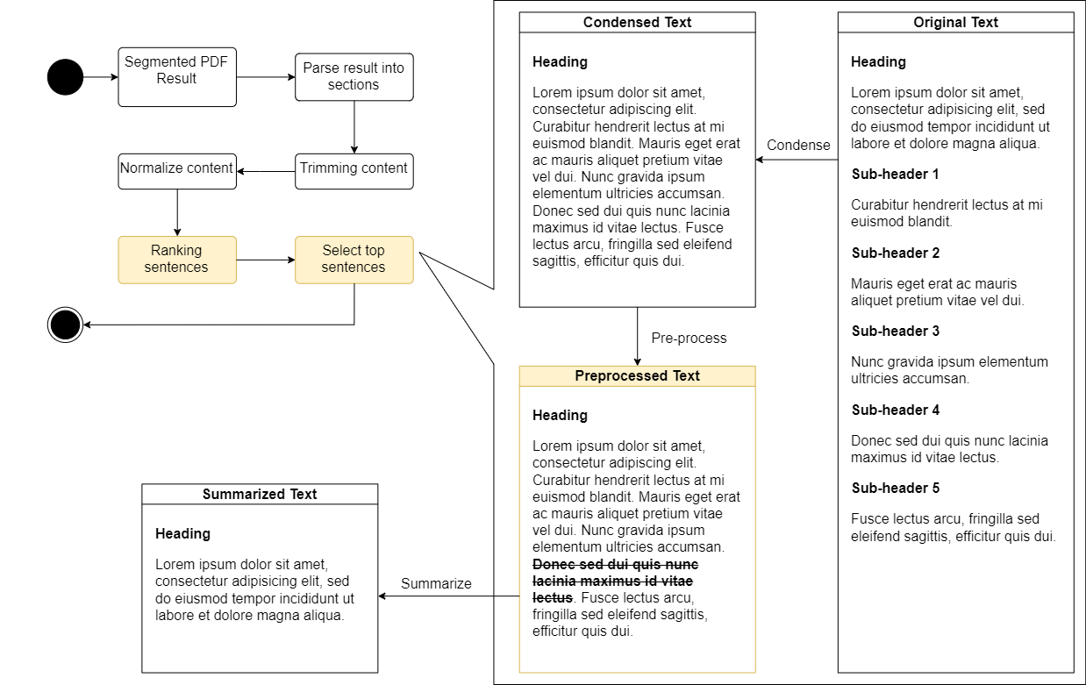
Extractive methods for Pre-processing

Slide 21
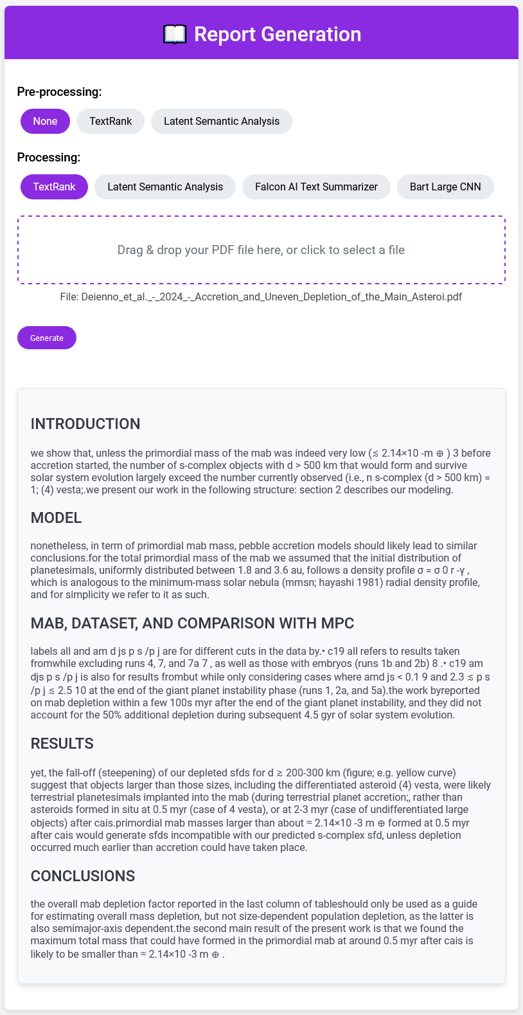
User Interface

Slide 22
Evaluation

Slide 23
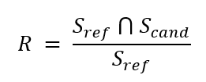
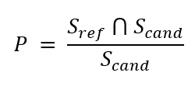
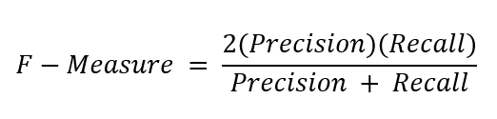
Evaluation method
Description
ROUGE-1: F-Measure for 1-gram
ROUGE-2: F-Measure for 2-gram
ROUGE-L: F-Measure for longest matching sequence

Slide 24
Evaluation method
Dataset
Environment Setting
Randomly chosen from Arvix.
Each paper belongs to a category.
Summarize each section manually.
Total of 10 papers
Average number of page: 26.3
CPU: AMD Ryzen 5 5500.
RAM: 16GB
Notes:
Find all categories

Slide 25
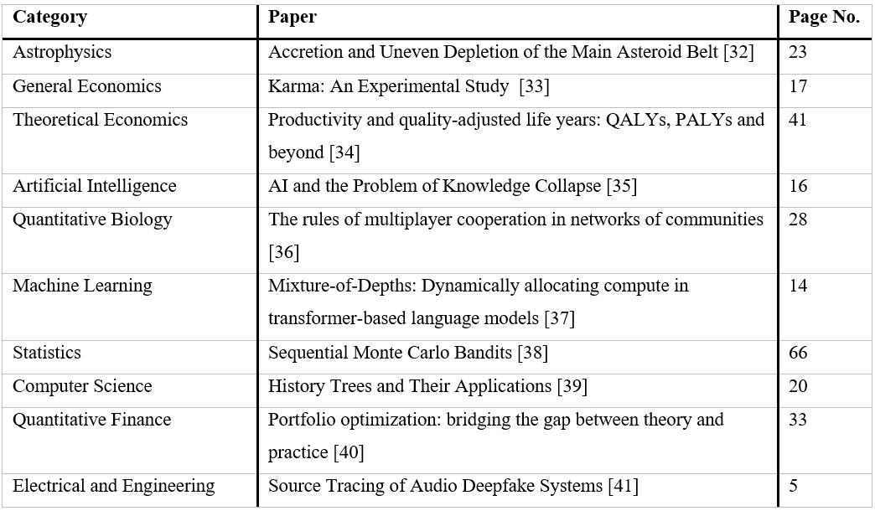
Evaluation method

Slide 26
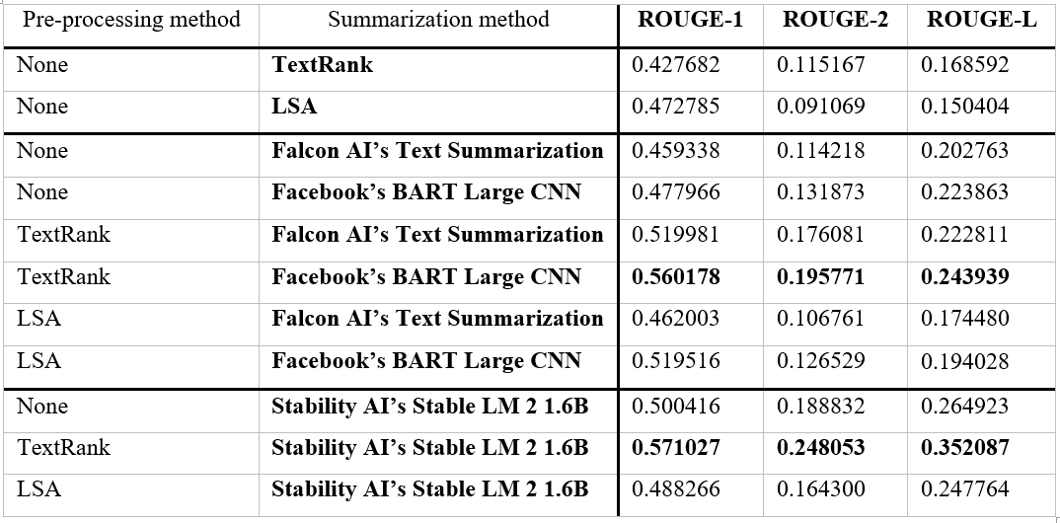
Results
Notes:
Add charts

Slide 27
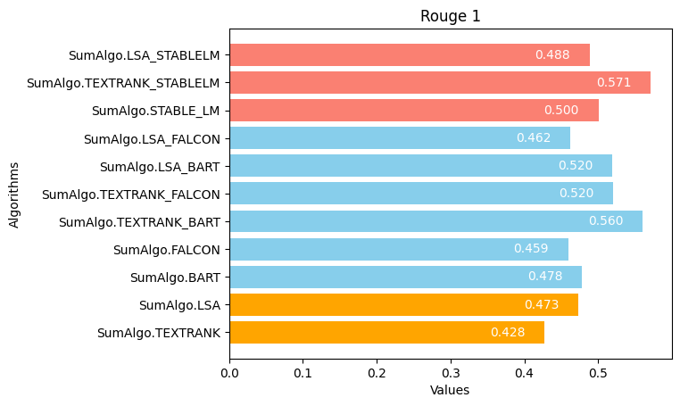
Result

Slide 28
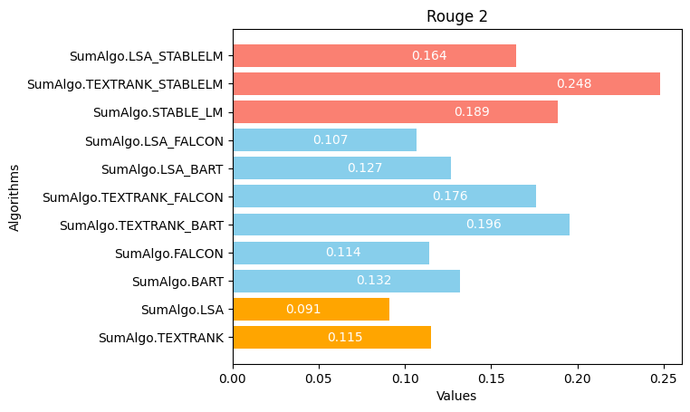
Result

Slide 29
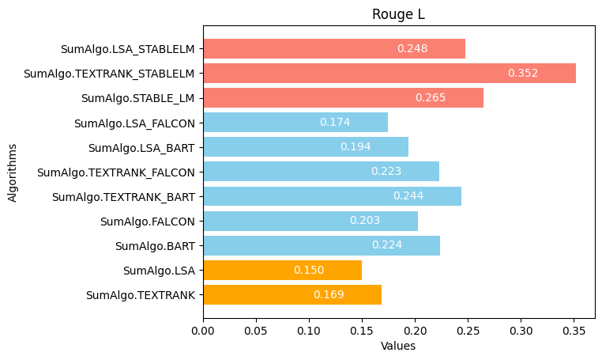
Result

Slide 30
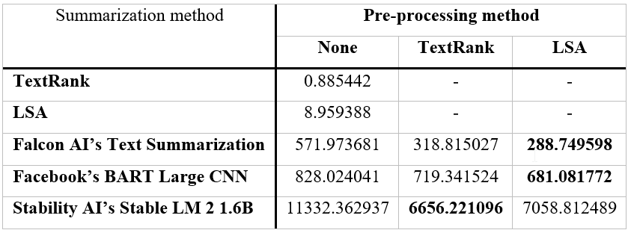
Execution time
(Measured in Seconds)

Slide 31
Future work

Slide 32
Improve application
Fine-tune pre-trained models
Develop a new model specifically for the current task
Improve application to support cloud hosting.

Slide 33
Conclusion
Successfully create an application that automatically segment and summarize a paper.
Improve current system, improving efficiency and quality

Slide 34
Demo

Slide 35
References
P. Lopez, “GROBID: Combining Automatic Bibliographic Data Recognition and Term Extraction for Scholarship Publications,” in Research and Advanced Technology for Digital Libraries, M. Agosti, J. Borbinha, S. Kapidakis, C. Papatheodorou, and G. Tsakonas, Eds., Berlin, Heidelberg: Springer, 2009, pp. 473–474. doi: 10.1007/978-3-642-04346-8_62.
W. S. El-Kassas, C. R. Salama, A. A. Rafea, and H. K. Mohamed, “Automatic text summarization: A comprehensive survey,” Expert Syst. Appl., vol. 165, p. 113679, Mar. 2021, doi: 10.1016/j.eswa.2020.113679
X. Han et al., “Pre-Trained Models: Past, Present and Future.” arXiv, Aug. 11, 2021. doi: 10.48550/arXiv.2106.07139.
T. Wolf et al., “Transformers: State-of-the-Art Natural Language Processing,” in Proceedings of the 2020 Conference on Empirical Methods in Natural Language Processing: System Demonstrations, Q. Liu and D. Schlangen, Eds., Online: Association for Computational Linguistics, Oct. 2020, pp. 38–45. doi: 10.18653/v1/2020.emnlp-demos.6.

Slide 36
Thank you

