Slide 1
Project 6 File System
INF-2201 Operating System Fundamentals Spring 2023
Department of Computer Science UiT – The Arctic University of Norway

Slide 2
File system
Implement simple UNIX-like file system
Abstractions:
Directories and files (instead of just blocks like before)
Features:
Naming and creation of files and directories
open(), close(), mkdir(), and rmdir() syscalls and shell commands
File access with read(), write(), and seek()
stat() command
Notably absent:
Permissions for directory and file access
User management
Anything “advanced” for good performance

Slide 3
File System Structure
Data blocks and inodes
Data blocks
Contain raw file and directory contents
Inodes
Used to structure data blocks into file and directory abstractions.
Metadata.

Slide 4
Inodes
File and directory metadata!
Inode: data structure for book-keeping, “describing” a file or directory.
Contents:
List of blocks on disk holding file/directory content
Link count (for hard links)
File size
What does this mean for inodes describing directories? (Design review)
Other metadata (owner, mode, timestamps, …)

Slide 5
Inode Structure
Block lists: direct and indirect
Our project:
Single level
Multi-level is extra credits

Slide 6
Possible Disk Layout
Boot Block + kernel (Our OS == entire image)
Super Block
Inode Blocks
Block Allocation Bitmap
Data Blocks

Slide 7
Superblock
Contains information about the FS on the disk
Size of FS
Number of inodes
Number of data blocks
Where inodes start, where data blocks start, etc …

Slide 8
What you have to do
System call to initialize file system module
fs_init()
System calls to access file system
mkfs: Create a file system on a disk
open: Create or open a file
link, unlink: create/remove a hard link
close, read, write, lseek: file access
mkdir, chdir, rmdir: directory stuff
stat: information about a file or directory

Slide 9
Formatting: fs_mkfs()
Make a file system:
Write superblock
Mark inodes and data blocks as “free”
Create root directory
Initialize file descriptor table
Note you should not make a file system each time you boot

Slide 10
fs_init() vs fs_mkfs()
What needs to be done:
fs_init(): related to OS
Takes care of OS-wise FS related initialization.
Check if file system exists, and if not call fs_mkfs()
Mount file system.
fs_mkfs(): related to the FS on disk
Initialization of the FS itself.
How to tell what to put where?
Think what will happen if you have two disks in your system.
When to initialize the (global) inode table?
When to set bitmaps and inodes to be free?
When to set “current directory” inode for processes?

Slide 11
File creation and deletion
fs_open(), fs_link(), fs_unlink()
open: create a new file if it does not exist
link: hard link to a file
Create a link to an existing file
Hard vs soft link?
unlink: delete a file if link count == 0
Also delete directory entry

Slide 12
File Access
open: open existing file (allocate file descriptor)
read: read bytes from open file
write: write bytes to open file
lseek: change position in file
close: free file descriptor

Slide 13
Directories
Like a file: list of files and directories
Name to inode number mapping
Can read it like a file
Use existing file I/O functions to do directory manipulation
Avoid duplicate efforts internally
Always has at least 2 entries:
“.” – current directory
“..” – parent directory

Slide 14
Directories (implementation)
mkdir: make a directory
Create an entry in parent directory
Create two directory entries in the new directory (“.” and “..”)
rmdir: remove directory if empty
chdir: change the current directory
For relative path names

Slide 15
Example: mkdir()
int fs_mkdir(char *file_name)
{
if (file_name exists) return ERROR;
/* allocate data block */
/* allocate inode */
/* set directory entries for “.” and “..” */
/* set inode entries appropriately */
/* update parent */
return SUCCESS;
}

Slide 16
Absolute pathnames
Do we need to support absolute pathnames?
When I am in “/foo”, do I need to support chdir /bar/tmp
Yes, but it is almost the same as supporting relative paths!
Only difference: which inode to start at:
Absolute path: start at root inode
Relative path: start at current working directory
Hint: test first character in path
If “/”, then path is absolute
Else, it is relative
Extra hint:
Advance string pointer beyond first “/” if absolute path, before resolving path.

Slide 17
Removing a directory
Do we need to support recursive directory removal?
i.e. remove all the subdirectories and files contained in the parent directory?
No, you don’t need to.
OK to just return error if directory to be removed is non-empty.

Slide 18
Extra Credits
Implement file system caching
Define cache data structures
Modify system calls such that cache is checked before disk data structures.
Implement the LRU replacement policy
Implement a flush operation (fs_flush())
Implement a consistent cache
Data on disk should always be in a consistent state
What if the system crashed during a flush?
In what order must meta-data and data blocks be written to disk?

Slide 19
Extra Credits
Two-level (or even higher-level) block lists in inodes.
Support bigger file sizes than just 4KB
Implement programs (and kernel) as files
“load plane” instead of “load 1”
How can you start a kernel whose image in in a file (anywhere on the disk”?

Slide 20
File system check
File system check function is useful for debugging (but not a requirement nor extra credit).
Verify integrity of:
Superblock magic number
Block allocations
Inode allocations
Bitmaps
Directory content
…

Slide 21
Doing the assignment
Mostly under Linux environment
Use a file to simulate a disk (“make” it, then copy the image file to “floppy.image” whenever you need a new blank one)
Code is provided (*_sim files)
“make p6sh” to build, “./p6sh” to run
Should be able to move right over to our OS
Do not use any glibc functions in your code (of course)
Shell supports
System calls for file system
Commands like “ls”, “cat foo”, …
~1000 lines of code to be written
Comment it well!!!!

Slide 22
Testing
You should write your own test cases
Create a file that uses fs functionality
Submit these with your code
Use existing functions already in shell
Remember to use error codes in fs_error.h! It will not be enough returning -1 on failure
You probably want to use unit tests and Linux debugging tools
How you have tested the code should be included in the report

Slide 23
Design Review
Describe:
File system disk layout
Super block structure/content
Inode data structure on disk and in memory
Handling of open files in the OS
Free block data structure and management
How to implement link/unlink
File cache design (for extra credits)
Inode free block list design (extra credits)
How to store kernel and processes as files, and how to load a kernel from a file on system start (extra credits)

Slide 24
Design review, code, and report
As for P1-P5

Slide 25
Hand-in
As for P2 and P4

Slide 26
File Systems in Linux

Slide 27
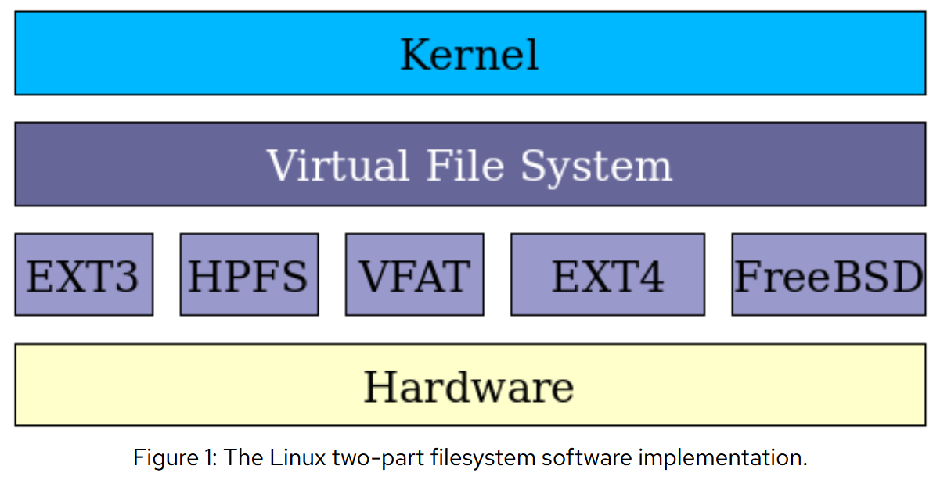

Slide 28
Ext2
Similar to what you’re developing.
File system is organized in block groups Each block group has…
A copy of the super block
Contains info about block groups
Block bitmap
Inode bitmap
Inode table
Data blocks
Group descriptor
Contains info about bitmaps, inodes, and data blocks

Slide 29
Ext2 FS layout
…
Boot
Block group 0
Block group N-1
Super- block
Group descriptor
Block bitmap
inode bitmap
inode table
Data blocks

Slide 30
Ext2 inodes
One inode per file/directory
A directory is just a special kind of file, where file content is table of directory entries.
Inodes have 15 block pointers.
12 direct-pointers
one 1-level indirect
one 2-level indirect
one 3-level indirect
Indirect block contains 256 block pointers (if 1KB blocks).
Max file size = 16GB.

Slide 31
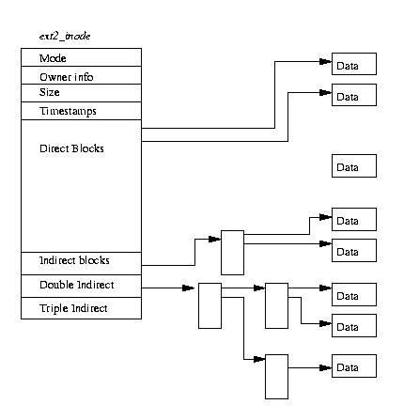
Ext2 inodes

Slide 32
Ext2 consistency and persistence
How to prevent data loss and ensure consistent FS in face of failures.
Flush each data block to disk as soon as it is created?
High latency from random access (seek operations are expensive on HDDs)
Delay writes?
May lose data
Solution: journaling (ext3)

Slide 33
Ext3
Same core data structures as ext2.
Journaling
Journal = “log” that describes FS operations in sequential order
Written sequentially – less seek overhead
Data blocks are updated eventually.
3 types of journaling
Journal (data + metadata written to journal)
Ordered (metadata written to journal)
But data must be written before metadata is committed
Writeback (metadata written to journal)
Better directory indexing
Htree structure
4KB blocks
16TB max FS size
2TB max file size

Slide 34
Ext4
Mainly improvements for flexibility/performance.
An ext3 file system can be mounted as ext4 “as-is”.
Support for larger FS and larger files.
1EB max FS size
16TB max file size
Extents
Speed-up handling of large files.
Inode block pointer can point to n consecutive blocks instead of just 1 block.
Multiblock allocator
Ext3 allocator can only allocate on block at a time.
Speedup and optimize allocation placement policy.
Delayed allocation of disk blocks
Caching
Journal checksumming
Protect against HW failure (corruption).

