Slide 1
Project 1
Boot-up Mechanism
INF-2201 Operating System Fundamentals
Spring 2023
Department of Computer Science
UiT The Arctic University of Norway

Slide 2
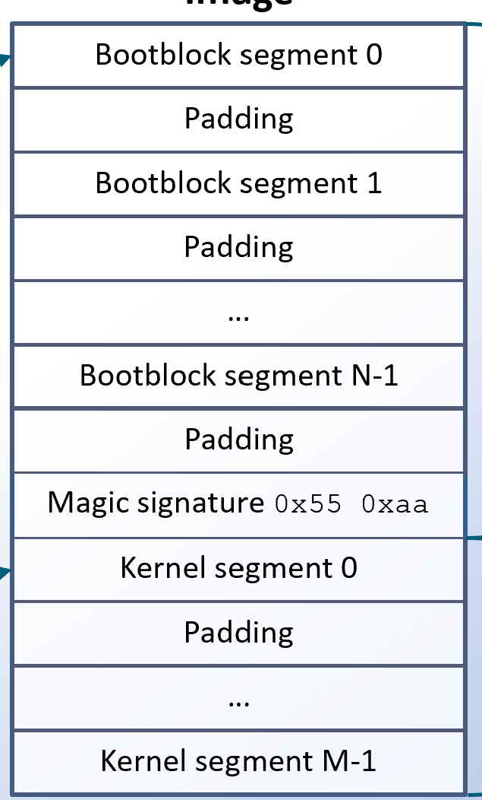
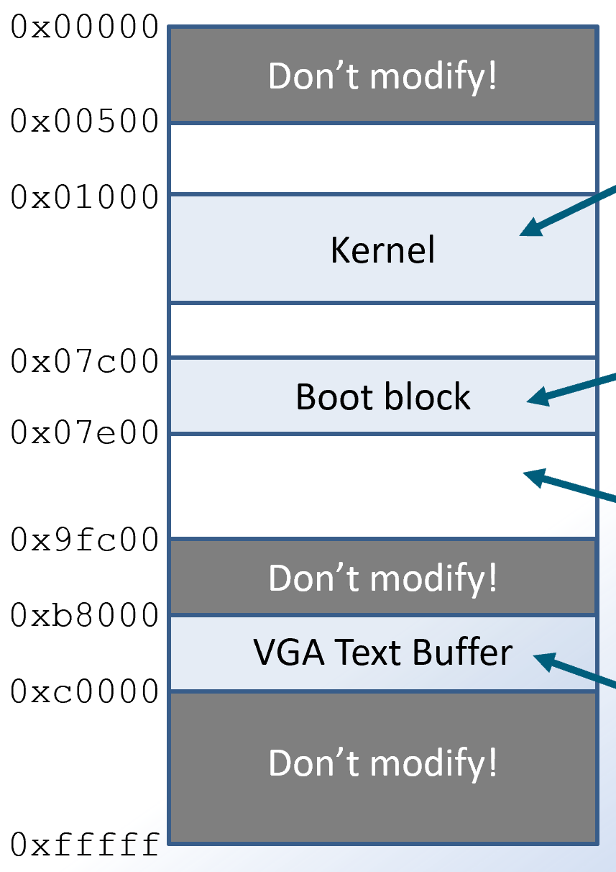
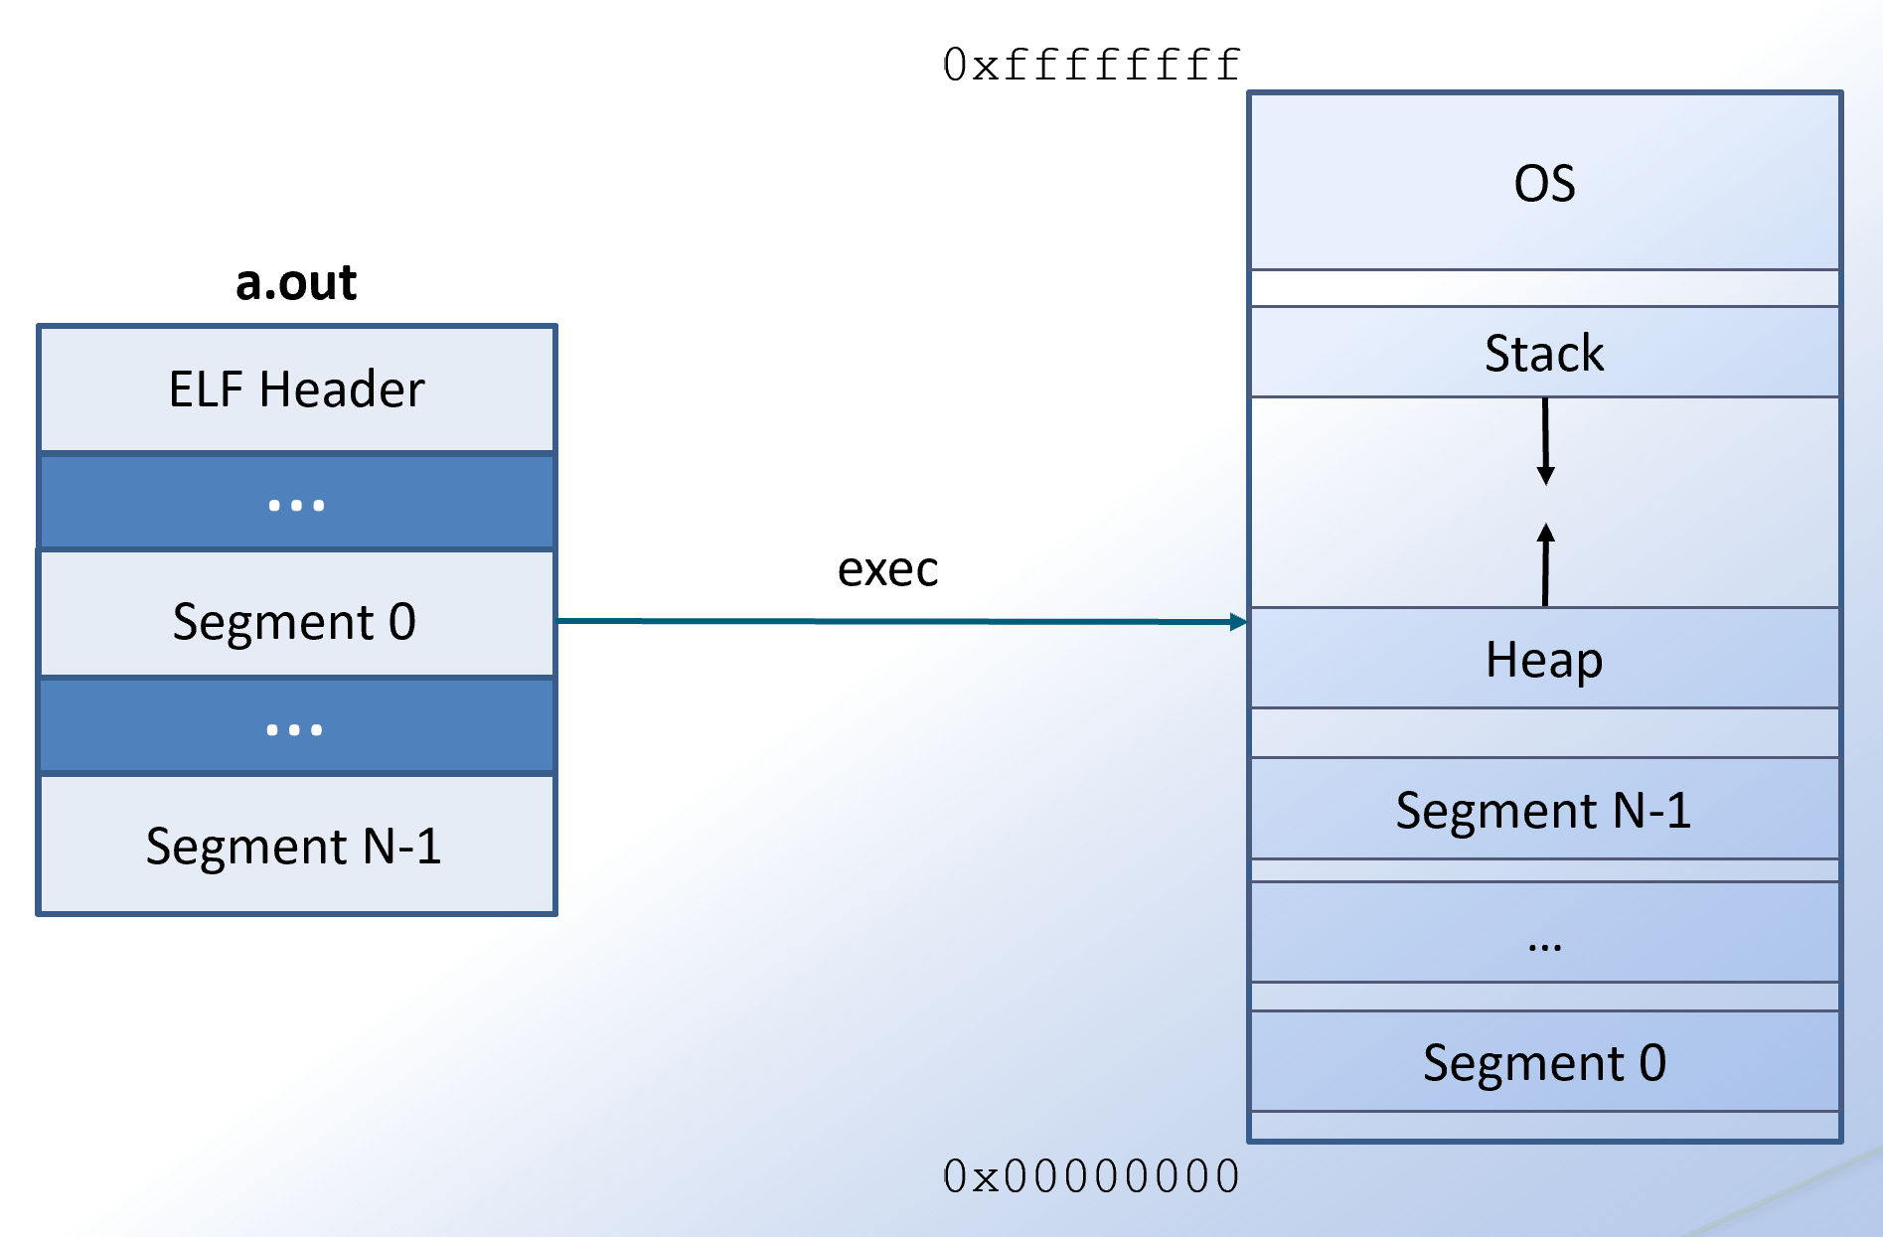
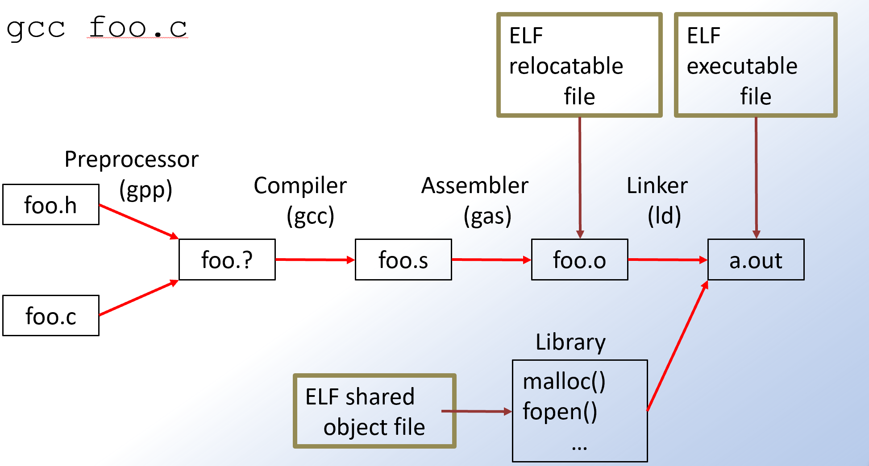
Overview
Create a bootable medium (USB disk) that loads a small «OS kernel».
To achieve this, you need to:
Write a boot block that loads and transfers control to the kernel.
Write a «createimage» utility that extracts code and data from compiled binary files to produce a raw, bootable image that can be written to a USB disk.

Slide 3
What happens when we turn on the pc?
PSU (power supply unit) performs self-tests and asserts the Power Good signal after all voltage outputs have stabilized.
The Power Good signal line is connected to the CPU’s timer chip, which controls the reset line to the CPU.
The timer chip will constantly send a reset signal to the CPU until the Power Good signal is received.
CPU starts running after being reset.
CPU operates in 16-bit Real Mode.
Most registers get well-defined values.
The CPU will execute the instruction at the memory address of the reset vector (hardcoded address 0xfffffff0).
The motherboard ensures that the instruction at 0xfffffff0 is a jump to address 0xf0000, which is the start of a 64KB memory location mapped to the BIOS ROM (containing a start-up program).

Slide 4
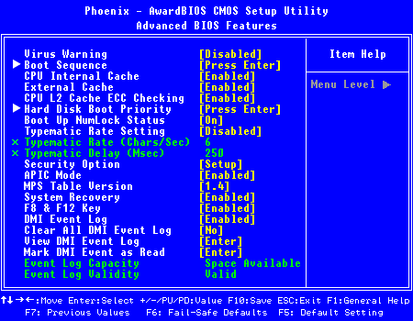
BIOS
«That blue screen with the configuration options?»
Not quite…
This is the CMOS setup program – an interface for configuring the BIOS.

Slide 5
BIOS
The “Basic Input-Output System” is the motherboard’s firmware.
Stored on a non-volatile ROM chip.
Traditionally a CMOS chip, today typically EEPROM.
Responsible for detecting and initializing hardware.
Provides a service interface for interacting with hardware.

Slide 6
BIOS start-up program
Power-On Self-Test (POST) is executed.
Initialize and test hardware!
If POST fails, computer is halted with error.

Slide 7
Power-On Self-Test (1)
Detect and test available RAM.
If the PC was “warm booted”, memory test may be skipped.
Detect CPU type and speed, verify cache memory and CPU registers.
Detect keyboard.
Test CMOS and verify ROM BIOS checksum.

Slide 8
Power-On Self-Test (2)
Detect and initialize adapters
Devices may provide their own ROM BIOS programs, which must be invoked by the system BIOS.
Identified in memory by a specific signature as two first bytes: 0x55 0xaa.
ROMs are aligned to 2KB boundaries.
Initialize video adapters and test video memory.
Execute VGA ROM BIOS that is located by scanning 2KB blocks within memory area 0xc0000–0xc7fff.
Locate and execute general purpose ROMs of other devices, mapped into the expansion area 0xc8000–0xdffff.
Locate and execute (if found) BIOS Extension ROM within
0xe0000–0xeffff.
Initialize logical devices with label, I/O address, and interrupt request line (IRQ).
Detect and configure PnP devices.
Display configuration information on screen.

Slide 9
BIOS boot sequence
After POST, BIOS will search for a bootable medium.
E.g. hard drive, USB, CD-ROM, (or floppy!).
CMOS stores boot sequence – which devices to test in what order.
BIOS looks for a valid boot sector.
512 bytes of data at known location (dependent on device) that is terminated with 0x55 0xaa as last two bytes.
For floppies and hard drives, the boot sector is the first sector on disk
(LBA 0 / CHS 0,0,1).
(For CDs/DVDs, the boot sector is the 18th sector – LBA 17).
If BIOS finds a valid boot sector, it is copied into memory and executed!
This means that valid instruction code must be present at the very start of the boot sector!

Slide 10
BIOS bootstrapping
RAM
Boot Device
0x00000
Occupied
Boot block
0x00500
0x07c00
Boot block
Boot sector is copied by BIOS from boot device to memory address 0x07c00.
Other data
0x07e00
0x9fc00
Then, BIOS transfers control to boot block!
Occupied
Now what?
0xfffff
Notes:
10

Slide 11
Boot block
Boot block is responsible for loading the kernel!
That is…
Doing necessary initialization (what initialization?).
Copying the sectors containing the kernel code and data from the boot device to memory (how do we know how many sectors?).
Transfer control to the kernel code.
It must be written in assembly!
It cannot use any Linux standard library functions!
It must operate in 16-bit Real Mode (at least initially…)
Now, what is this «Real Mode»?

Slide 12
Real Mode
Real mode is the 16-bit legacy mode in which all x86 family processors operate after being reset (for backwards compatibility).
Features:
1 MB memory in total! (20-bit linear address space)
Memory segmentation (16-bit logical addressing)
BIOS services are available through software interrupts ☺
Makes life easy when dealing with nasty hardware with attitude!
Note that even though Real Mode is a 16-bit mode, you can still use 32-bit GPRs¹!
¹GPRs = General Purpose Registers

Slide 13
Real Mode Memory Segmentation (1)
So, we have a 20 bit linear address space, but it’s only 16-bit logically addressable!
Whaaat…?!?
Segmentation – addressing is done within a segment.
Segment = a limited address subspace.
Logical memory addressing is relative to the linear base address of the segment (instead of always being relative to 0x0).
A Real Mode segment is defined by a 16-bit segment selector, stored in a segment register. This selector is the 16 MSB of the 20-bit segment base.
Logical memory addresses are 16-bit positive offsets to the base address of a segment.
A segment thus spans 64KB ( bytes).
Logical address range 0x0000 – 0xffff as offsets relative to a segment base.

Slide 14
Real Mode Memory Segmentation (2)
RAM
0x00000
Segment base address
16-bit memory addresses are offsets to some segment base
64 KB addressable memory relative to segment
0xfffff

Slide 15
Real Mode Memory Segmentation (3)
Segmented memory addresses are denoted segment:offset.
E.g. 0x0000:0xabcd, 0x0100:0x0000, 0x0def:0x1234
How linear addresses are computed:
Offset is positive (zero-extended to 20-bit, not sign-extended).
Linear addresses correspond to physical addresses.
16-bit segment selector
16-bit logical address
20-bit linear address
20-bit segment base

Slide 16
Real Mode Memory Segmentation (4)
Examples
0x0000:0xabcd = 0x0abcd
0x0100:0x0000 = 0x01000
0x0def:0x1234 = 0x0f124
Test yourself
Can 0xabcde be addressed relative to segment with selector 0xabd0?
No, because 0xabcde < base address 0xabd00.
Can 0xea9bf be addressed relative to segment with selector 0xda9c?
Yes, 0xda9c:0xffff = 0xea9bf.
Can 0x4bd93 be addressed relative to segment with selector 0x3bc9?
No, because 0x4bd93 is outside of range 0x3bc90–0x4bc8f, addressable relative to selector 0x3bc9.

Slide 17
Real Mode Memory Segmentation (5)
Segment registers
CS, DS, ES, FS, GS, SS
Code segment
CS is code segment selector.
Used (only) by instruction pointer (IP).
CS:IP addresses the instruction being fetched.
As with IP, CS cannot be set directly, but it can be set indirectly by doing a long jump (ljmp CS, IP).
Example:
ljmp $0x2000, $0x0002 # CS = 0x2000, IP = 0x0002
# Next instruction is 0x2000:0x0002 = 0x20002
#<0x20002>:
jmp $0x0009 # CS = 0x2000, IP = 0x0009
# Next instruction is 0x2000:0x0009 = 0x20009

Slide 18
Real Mode Memory Segmentation (6)
Data segments
DS is data segment selector.
Used by default for most data accesses other than stack.
For example
movw (%ax), %bx
corresponds to
BX = memory[DS << 4 + AX]
That is, (%ax) is actually %ds:(%ax).
It is also possible to use any of the other segment selectors – ES, FS and GS – instead of DS, by explicitly specifying the desired selector in the instruction.
For example
movw %es:(%ax), %bx

Slide 19
Real Mode Memory Segmentation (7)
Stack segment
SS is stack segment selector.
Used (only) by stack pointer (SP) and base pointer (BP).
SS:SP is the linear address of the “top of the stack”.
SS:BP is the linear address of the stack frame.
The maximum stack size is limited by the segment size.
Example:
pushw %ax
corresponds to
subl $2, %sp
movw %ax, %ss:(%sp)

Slide 20
Real Mode Memory Segmentation (8)
Assigning values to segment selectors
…cannot be done directly. The value must be passed through a register!
For example
movw $0xabcd, %es
is invalid, whereas
movw $0xabcd, %bx
movw %bx, %es
is allowed.
Remember that CS can only be set implicitly by a far jump, far call (or similar).

Slide 21
BIOS bootstrapping revisited
RAM
Boot Device
0x00000
Occupied
Boot block
0x00500
0x07c00
Boot block
Other data
Boot sector is copied by BIOS from boot device to memory address 0x07c00.
Kernel
0x07e00
0x9fc00
BIOS does a far jump to 0x07c0:0x0000, then it’s up to you!
This area should contain a kernel that we want to load!
Occupied
But where can we put it in RAM, and how do we do it?
0xfffff
Notes:
21

Slide 22
Real mode memory map (not to scale)
0x00000
Real Mode IVT RAM
0x00400
Don’t modify this!
BIOS Data Area RAM
0x00500
29.75 KiB Free RAM
0x07c00
The boot sector is copied by the BIOS from the boot device!
Boot block
0x07e00
607.5 KiB Free RAM
0x9fc00
Extended BDA RAM
Don’t modify this!
0xa0000
VGA RAM
Determines what is displayed on screen!
0xc0000
Video BIOS ROM
0xc8000
H/W ROM
Don’t modify this!
0xf0000
BIOS ROM
0xfffff
Notes:
22

Slide 23
Memory map simplified (not to scale)
0x00000
The kernel code and data shall be copied from the boot device to memory address 0x01000!
Don’t modify!
0x00500
0x01000
Kernel
The boot sector contains the code (written by you) for copying the kernel into memory and transferring control to it!
0x07c00
Boot block
0x07e00
0x9fc00
We also need a stack, and it should be placed somewhere around here…
Don’t modify!
0xb8000
VGA Text Buffer
0xc0000
We can write to the VGA text buffer to change the characters displayed on the screen and their color attributes.
Don’t modify!
0xfffff
Notes:
23

Slide 24
Loading the kernel
We know where the kernel begins on boot device!
The boot block is the first sector, and it occupies exactly one sector.
Kernel starts at the second sector (LBA 1 / CHS 0,0,2).
The BIOS will help us transfer sectors from a hard drive to RAM.
You need to read up on BIOS software interrupts, INT 0x13 and CHS addressing (use Google, Wikipedia, osdev.org, etc.)
Make sure to save initial value of DL register, as it contains boot drive number when control is given to bootblock, which is later needed as argument to BIOS functions.
How do we know how large the kernel is?
We write the size (number of sectors) to a pre-determined location in the boot block (this will be done by the createimage utility).

Slide 25
bootblock.S
.equ … # Corresponds to defines in C
.text # Code segment
.globl _start # The entry point must be global
.code16 # 16-bit code (Real Mode)
.org 0x0 # Code starts at address 0x0
_start: # Entry point, logical address 0x0
jmp beyondReservedSpace # <-- How many bytes is this instruction?
kernelSize:
.word 0
beyondReservedSpace:
# Rest of code
16 bits = sizeof(short int). The kernel size is written to this location by createimage. In the assembly code, you can dereference the data at this location as (kernelSize).

Slide 26
Bootblock – summary
~100 lines of assembly code (and comments).
GNU assembly: AT&T syntax.
No standard library available.
16-bit Real Mode.
You need to:
Setup data segment for boot block.
(Code segment is already set to 0x07c0 by BIOS).
Setup stack segment and stack.
Copy kernel to 0x01000.
Setup data segment for kernel.
Long jump to kernel.
ljmp $KERNEL_SEGMENT, $KERNEL_OFFSET
That’s it! ☺
Make sure to comment your assembly code extensively!

Slide 27
How to create the bootable image (1)
First, we compile the boot block and the kernel separately, using the GNU compiler toolchain.

Slide 28
What happens when we compile a C program using gcc?
$ gcc foo.c
ELF
relocatable
file
ELF
executable
file
Preprocessor
(gpp)
Compiler
(gcc)
Assembler
(gas)
Linker
(ld)
foo.h
foo.?
foo.s
foo.o
a.out
foo.c
Library
malloc()
fopen()
…
ELF shared
object file

Slide 29
Loading an ELF executable (Linux)
0xffffffff
OS
a.out
Stack
ELF Header
…
exec
Segment 0
Heap
…
Segment N-1
Segment N-1
…
Segment 0
0x00000000

Slide 30
ELF format
ELF = Executable and Linkable Format.
Object file format on Linux.
Contains
Raw instruction code and data segments (not to be confused with Real Mode memory segments).
Address of where in RAM each segment should be loaded.
Other stuff like import/export symbol tables, metadata, etc.
You have to read up on parts of the ELF specification!
Available in git repo.

Slide 31
How to create the bootable image (2)
First, we compile the boot block and the kernel separately, using the GNU compiler tool chain.
Then we must parse the produced ELF files to extract code/data segments, and write these to an image file.
Finally, the contents of the image file are copied as raw data to the USB disk.

Slide 32
How to create the bootable image (3)
Bootblock
Image
ELF Header
Bootblock segment 0
…
Padding
Segment 0
Bootblock segment 1
…
Padding
Boot sector,
exactly 512 bytes
Segment N-1
…
Bootblock segment N-1
Kernel
Padding
ELF Header
Magic signature 0x55 0xaa
…
Kernel segment 0
Segment 0
Padding
Kernel
…
…
Segment M-1
Kernel segment M-1

Slide 33
How to locate and copy ELF segments
Read the ELF header to find size and file offset of Program Header Table.
Each entry in the Program Header Table contains information about one segment.
File offset
Size
Memory address
Make sure the segments are padded correctly when written to image file.

Slide 34
Createimage
Syntax:
createimage [--extended] <bootblock> <file1> [<file2> ...]
Notice that even though we only will use the createimage utility with boot block + a single file (kernel) in the first assignment, the implementation must be generic and support an arbitrary number (>= 1) of files in addition to boot block.
How should the files be positioned/padded?
Hint: how are data loaded from disk to RAM?

Slide 35
createimage.c – summary
~200 lines of C code.
Createimage is a Linux utility, so you can use any standard libraries you want.
Use Elf32_Ehdr and Elf32_Phdr data structures provided by elf.h.
Use fseek() and fread() to read the data.
Example:
Elf32_Ehdr hdr;
FILE *fp = fopen(filename, "rb");
int ret = fread(&hdr, sizeof(Elf32_Ehdr), 1, fp);
Write code and data segments to image file.
Write magic signature 0x55 0xaa to end of first sector of image file.
Write kernel size to the memory area in the image file corresponding to (kernelSize) in the boot block.

Slide 36
Design review
For each assignment you are required to give a short presentation of how you are solving it!
Need not be formal – just you and TA!
Come prepared!
We recommend you bring notes on paper or screen
You must have figured out all details before the design review
You must show us convincingly that you can solve the assignment
Pass / No Pass grading

Slide 37
Some questions for the design review
What if boot block needs to be larger than 512 bytes?
What if kernel is larger than 54 sectors (and hence needs the memory where the boot block resides)?
How does CHS addressing work?
How do we know the number of tracks, sectors and heads?
How do we navigate the ELF file to locate the segments?
How do we write segments to image file with regards to position and padding?
How do we write several files to image file with regards to position and padding?
How do we know how large the kernel code/data is?
Where in the image file should we write the kernel size?
When and why must we set the DS segment?
What should the kernel DS be set to?
What should the stack segment and GPRs be set to?

Slide 38
Bochs
You can use the bochs emulator for development.
TA’s will help set it up for you.

Slide 39
Code – Formalities
Code must run properly after being compiled on the provided test computers
Doesn’t matter if it compiles on your machine, if we can’t get it to work on the provided test computers
Don’t look at other people’s code
Write structured “clean” code
Unstructured code will count negatively
Don’t look at other people’s code
Comment your code properly
Uncommented code will very likely not be taken into consideration when evaluating your assignment
Show that you know what you’re doing
Don’t look at other people’s code

Slide 40
Report
Code comments should cover most (implementation) details.
Max 4 pages.

Slide 41
Hand-in – Formalities
Hand-in will be done using GitHub
You will receive a link which creates a private repository containing pre code
Your latest pushed commit at deadline will be graded
So remember to push, push, push!
No extensions will be granted, or late submissions accepted
Unless reason for late submission is documented, e.g. on medical grounds!

Slide 42

Feedback on your assignment
Some numbers:
64 students
4 TA’s
1-2 persons grading all assignments (x3)
You should rely on your TA for feedback
How do I know my solution is correct?
Can you add some unit tests/ assertions to you code?
Does it run the provided test cases (processes)?
Can you change some parameters to stress-test your code?
What would you like someone else to check?
➔Ask TAs

Slide 43
Word of advice
Start in time (ASAP)!
Read the assignment text and precept carefully!
Read and understand the pre-code before writing your own code!
Read the assignment text and precept multiple times!

