Slide 1
Project 3 Preemptive Scheduling
INF-2201 Operating System Fundamentals Spring 2023
Department of Computer Science University of Tromsø

Slide 2
Overview
You will implement an OS that schedules threads and processes preemptively.
Implement synchronization primitives that work with preemption
Re-implement locks
Condition variables
Semaphores
Reusable barriers
Concurrent programming
Implement a fair solution to the dining philosophers problem
Extra credits
Priority scheduling
Pthreads implementation of dining philosophers

Slide 3
Previous operating system
Non-preemptive multiprogramming kernel
System calls by calling a function in the kernel
Processor executes in protected mode
All processes run in ring 0
Synchronization (locks) only for kernel threads
For non-preemptive kernel

Slide 4
New operating system
Preemptive multiprogramming kernel
System calls via software interrupts
Processor executes in protected mode
Processes will still run in ring 0
Synchronization primitives that work with preemption (but still only for kernel threads)
Locks
Semaphores
Condition variables
Barriers

Slide 5
Three types of interrupts
Hardware interrupts (external interrupts)
Example: system timer interrupt
Software interrupts (INT instructions)
Example: (real-mode) BIOS calls
Software exceptions

Slide 6
Hardware support for interrupts
CPU
Memory
Interrupt description
table register (IDTR)
Interrupt descriptor
Interrupt
descriptor table
Interrupt descriptor
Interrupt descriptor
Interrupt enable flag
Interrupt handler
INT
Signal
INT
Instruction
Interrupts from devices
Interrupt mask register
Executing program
Programmable Interrupt Controller (PIC)
(for hardware interrupts only)

Slide 7
What does the CPU do when an interrupt occurs from ring 0?
Get interrupt descriptor address
Make privilege checks
Push EFLAGS, CS, and EIP on stack
Clear EFLAGS[IF] (and EFLAGS[TF])
Load CS:EIP from interrupt descriptor
Jumps to interrupt handler

Slide 8
And then?
The interrupt handler executes.
If interrupt came from PIC (if it was a hardware interrupt), the handler must send an end-of-interrupt (EOI) signal to the PIC.
Because PIC sets a bit in its In-Service Register (ISR), corresponding to the hardware interrupt vector, to block consecutive interrupts on that vector until handler completes.
EOI clears interrupt vector bit in ISR.
In other words, if you forget to clear EOI, you will only get one interrupt from each hardware vector …ever!
To return from interrupt handler, execute IRET instruction
Pops CS, EIP and EFLAGS.
When restoring CS:EIP

Slide 9
Pseudo-C template of an interrupt handler
void irqX(void)
{
/* save context of interrupted thread/process */
…
/* do the work */
…
/* restore context of interrupted thread/process */
…
/* restore EIP, CS and EFLAGS */
asm volatile(“iret”);
}
Remember: if this is a H/W interrupt handler, you also need to issue EOI: outb(0x20, 0x20);

Slide 10
Preemptive Scheduling
Most of it is already setup for you
Setup system timer interrupt so that an interrupt will be generated on IRQ line 0 every 10 milliseconds (given in kernel.c).
You may want to change this value for debugging and testing.
You need to implement the code for the timer interrupt handler in entry.S.
Switch between user and kernel stack
Save and restore the context
Modify yield(), lock_acquire(), lock_release(), etc. to deal with preemptive scheduling.
Critical regions (enter_critical(), leave_critical() in entry.S

Slide 11
Synchronization primitives
Semaphores, barriers, and condition variables with semantics as discussed in lectures
Also check how this is done in Pthreads
The template for code you need to write is in thread.c.
You will also need to re-implement locks (like in P2), but this time make sure that they can be used in a preemptive context (avoid race conditions).
You have to design data structures for semaphores, barriers and condition variables.
Empty structures are defined in thread.h.

Slide 12
Dining philosophers
Precode comes with a solution using semaphores
Three philsophers: Caps, Num and Scroll
Watch the keyboard LEDs.
But this solution is not fair.
Favors Caps (why?)
Come up with and implement a solution that is “fair”
Every philosopher can eat for the same amount of time
Document your solution

Slide 13
Barriers (1)
A barrier is a synchronization mechanism where several threads can be “realigned”, that is, once they leave the barrier, they will all be in the same stage of execution.
An n-barrier works by blocking threads calling barrier_wait(), then unblocks all the threads when the nth thread calls barrier_wait().

Slide 14
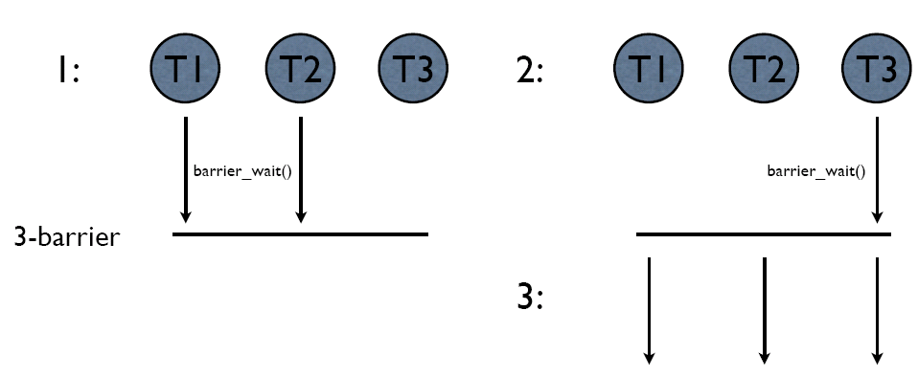
Barriers (2)
0: barrier_init(3)

Slide 15
Barriers (3)
Beware of race conditions!
What happens when one thread manages to call barrier_wait() a second time before all the other threads have been unblocked

Slide 16
Extra Credits
Priority scheduling
Process 1 calls set_priority()
Modify scheduler()
Dining philosophers implemented using Pthreads
You will do this in Linux!
You need to create the source files and Makefile (there is no pre-code)
Refer to online documentation for Pthreads details

Slide 17
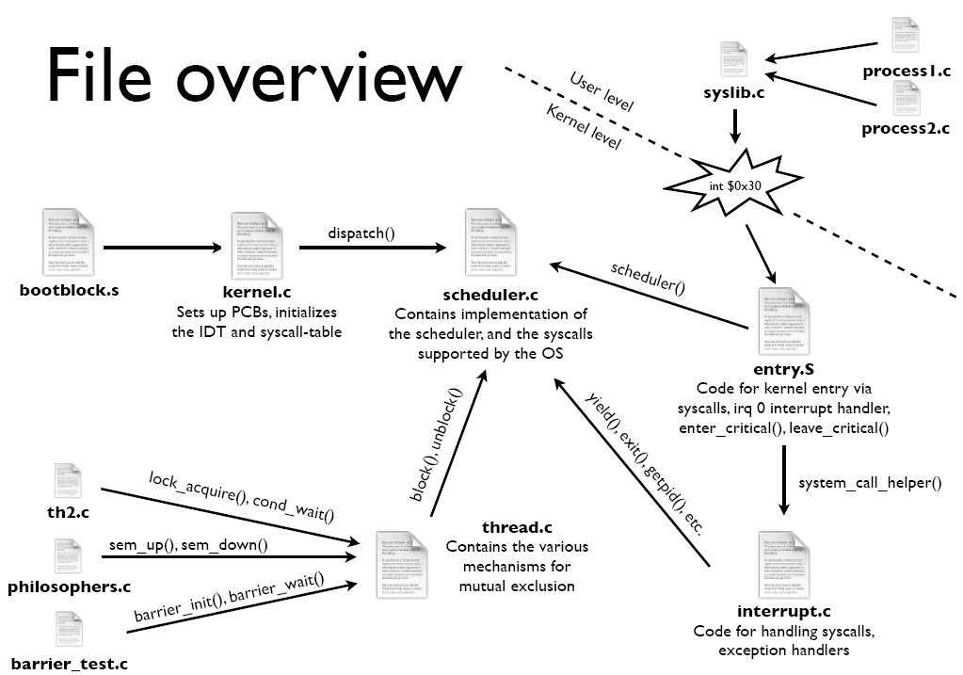

Slide 18
Where to start?
Do the preemptive-multitasking bit first!
Once that is done…
Complete the locks
Semaphores
Condition variables
Barriers
Remember, all synchronization primitives must work with preemption present!
Finally, work on the dining philosophers problem
You really should learn how to use these mechanism in Pthreads

Slide 19
Design review, code, report, hand-in
Same as for P1
…using GitHub

