Slide 1
Project 4
IPC and Process Management
INF-2201 Operating System Fundamentals
Department of Computer Science
University of Tromsø

Slide 2
Project 3
Kernel with preemptive scheduling.
System calls via interrupts.
Processes run in ring 0.
Processes are statically allocated and loaded at boot time.
“Low level” synchronization primitives.
Interrupts are disabled to avoid race conditions.

Slide 3
Project 4
Process isolation (done in pre-code).
Processes are moved to ring 3.
Each process is given a separate, virtual address space.
Process management.
Processes will be loaded on demand from disk.
(Next project: on demand paging from disk).
Support for keyboard interrupts.
So we can specify which process to load.
Inter-process communication (IPC).
Message passing using mailboxes.
Reduce critical sections with interrupts disabled.
Use of spinlocks.

Slide 4
Mailbox – Bounded buffer
Multiple producers
Put data into the buffer
Multiple consumers
Remove data from the buffer
Blocking operations
Sender blocks if not enough space.
Receiver blocks if no message.
✉
✉
✉
✉
✉
✉
✉
✉
✉
✉
✉
✉
✉
✉
Buffer
Fixed size
FIFO
Messages have variable size

Slide 5
Mailbox – Implementation
Buffer management.
Circular buffer: head and tail pointers.
Bounded buffer problem (producer/consumer).
Use locks and condition variables to solve this problem as shown in class.
Hint: you could use Linux for debugging.
Pthreads provides condition variables (man pthread_cond_wait, pthread_cond_signal,…)

Slide 6
Mailbox
The function mbox_open() takes a key as argument and returns an id for the mailbox, which is used in all the subsequent mbox calls.
Similar to file descriptor from standard C open() function.
You cannot designate the recipient of a message—whichever process that opens a mailbox can read messages from it.
Receiver cannot designate how many bytes to receive, it will receive a message as a whole which contains whatever number of bytes the sender sends.

Slide 7
Keyboard – Overview
How the keyboard interacts with OS
When a key is pressed, keyboard controller stores scan code in an internal buffer and generates USB hardware interrupts (setup to call the putchar() function).
Interrupt handler is called. It talks to the hardware and reads the scan code back.
If SHIFT/CTRL/ALT modifiers are pressed, some internal states are changed.
The handler converts the scan code (that may be modified by SHIFT/CTRL/ALT) into an ASCII character.

Slide 8
Keyboard – Implementation
Bounded buffer problem (producer/consumer).
So use a mailbox.
But, there are some variants.
Single or multiple producers?
Well, it depends on how you look at it…
Single producer, in the sense that only putchar() is producer.
Multiple producers, in the sense that interrupt calling putchar() can execute in context of multiple processes.
You have to find out how to approach this problem.
Single or multiple consumers?
More than one process could use keyboard.
But each scan code is only sent to a single process (first come, first serve), which is typically the shell process.
Producer cannot block! Discard character if buffer is full.
Why?

Slide 9
Keyboard – Subtle points
Producer should not be blocked.
Solution: check and send message only if mailbox is not full, otherwise discard it.
Make use of mbox_stat() function.
What if a process being interrupted by keyboard interrupt is currently calling getchar()?
Why is this a problem?
Solution: Disable interrupt. But where?
Design review question. You have been warned ☺

Slide 10
Keyboard
Cannot allow keyboard interrupt while getchar() is receiving message.
Reason: The IRQ handler runs within the current_running’s context, because we don’t have separate kernel thread to handle IRQ.
getchar() {
}
putchar() {
}
mbox_recv() {
lock_acquire(&l);
}
mbox_stat() {
lock_acquire(&l);
}
no context switching here
Keyboard
interrupt

Slide 11
Reducing interrupt disabling
Disable interrupts only when necessary.
Motivation
Otherwise, could lose hardware events
For instance, keyboard or timer
Where to reduce
Very little we can do with scheduler.c
Switching stacks, manipulating ready queue.
Thread.c
Locks, condition variables

Slide 12
Reducing interrupt disabling (2)
Alternative to interrupt disabling
Use spinlock to guarantee atomicity
spinlock_acquire(int *l) { while (!TAS(l)) yield(); }
spinlock_release(int *l) { *l = 0; }
TAS(x): atomic test-and-set
One spinlock per lock / condition variable
typedef struct {
int spinlock;
struct pcb *waiting;
int status;
} lock;

Slide 13
Using spinlocks – An example
Code from project 3:
void lock_acquire (lock_t *l)
{
CRITICAL_SECTION_BEGIN;
if (l->status == UNLOCKED) {
l->status = LOCKED;
} else {
block(&l->waiting);
}
CRITICAL_SECTION_END;
}
Using spinlock
void lock_acquire(lock_t *l)
{
spinlock_acquire(&l->spinlock);
if (l->status == LOCKED) {
block(&l->waiting, &l->spinlock);
} else {
l->status = LOCKED;
spinlock_release(&l->spinlock);
}
}
The function block() now takes an extra argument – spinlock.
Release the spinlock in block().

Slide 14
Process management
In P3, our OS loads programs from the boot disk at startup. Everything runs in the same address space.
To support dynamic loading, we must have the following:
Separate address space for each process
A simple file system format describing how processes reside on a disk
A memory manager
This is done for you in the precode

Slide 15
Process management (2)
readdir() just loads the process directory sector, it does not have to know the meaning of that directory, the shell will parse it.
loadproc() does the following:
Allocate memory for code/data plus STACK_SIZE
Read code/data from disk
Call create_process() with the base address and size of your memory block.

Slide 16
Separate address space
Each process has its own CS and DS segment selector, and the program always starts at address 0x1000000 (but address space spans entire 4GB).
Segmenting and paging setup is done for you
You will implement virtual memory with paging and swapping next time.

Slide 17
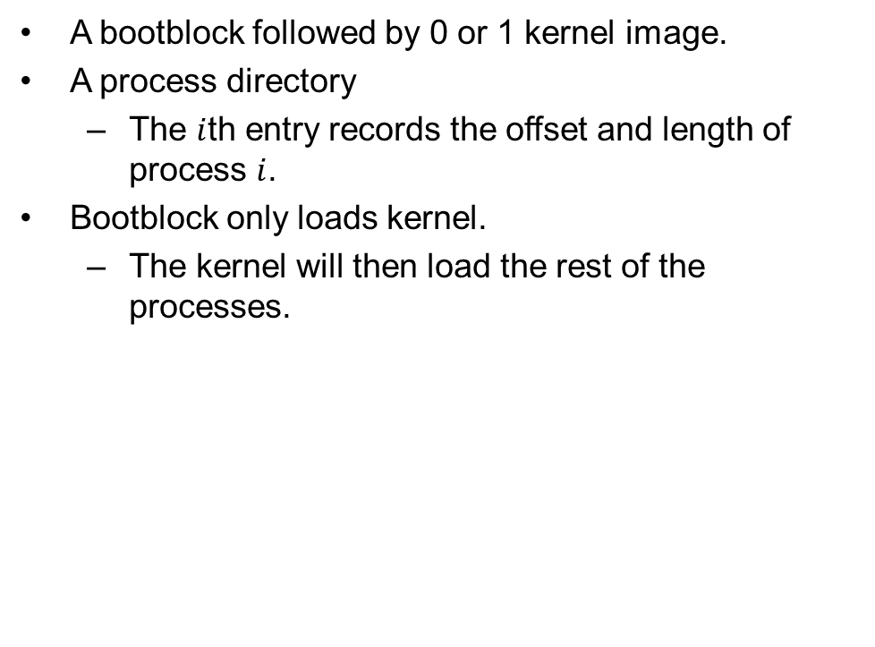
Simple file system
Bootblock
Kernel,
or nothing (program disk)
os_size
Process directory
Process 1
Process 2
Process n

Slide 18
Memory manager (memory.c)
alloc_memory() allocates a requested size of memory from the available memory pool.
free_memory() frees a memory block (it does nothing right now).
Do more (extra credit):
Do a better job here, actually free a block, and implement some sophisticated algorithm such as Buddy or Best Fit.

Slide 19
USB storage device interface
The usb/ folder contains all USB code.
The header file scsi.h contains prototypes for reading/writing blocks:
USB initialization is done in kernel_start() in kernel.c
scsi_read() reads one 512 byte block from the storage device into a given buffer. The buffer address is a non-paged physical address.
scsi_write() writes one 512 byte block to the storage device.
This is the same interface you will use in the next assignment – virtual memory.

Slide 20
Loading a program
Read the process directory, and find the offset and length of the process.
Allocate enough memory to hold the code/data plus 8K user stack
Allocate and initialize a PCB including:
Allocate new CS/DS selectors
Allocate user/kernel stack
Insert it into the ready queue
Most of the things are done for you

Slide 21
Runtime memory layout
0x00000
The user stack is allocated in a process’ own address space.
Kernel stack is allocated in kernel’s address space.
BIOSes and bootblock
0x08000
Kernel
0x40000
Kernel stacks
0x80000
0x9fc00
Don’t modify!
0xb8000
VGA Text Buffer
Contains code/data and user stack for each process.
0xc0000
Don’t modify!
0x100000
Memory pool
0x200000
0x1000000
Process virtual
address space

Slide 22
Extra Credits
Memory deallocation when process exits or gets killed.
Better allocation algorithm
ps command
kill command
suspend/resume a process

Slide 23
Do more
A cool game, e.g. Tetris, Breakout, …
Possible to make games both in text-mode and
VGA graphics mode
A better shell

Slide 24
Memory allocation (extra credit)
Must allocate memory block aligned to page boundary (0x1000, 4K)
Memory pool starts at 0x100000 and ends at 0x1FFFFF
i.e. 1M-2M

Slide 25
Kill command
You might want to add another state of process, that is, KILLED.
You might also want to add a field to PCB counting how many resources this process has acquired.
Increment/decrement the counter when acquiring/releasing resources.
To kill a process
Mark the state as KILLED
If the scheduler encounters a process that is marked KILLED and has acquired 0 resources, then really kill it (release all the memory), otherwise keep running it.

Slide 26
ps command
To do this, you might need to add additional system calls to your OS
Define SYSCALL_FOO in common.h, and also modify SYSCALL_COUNT.
Add INIT_SYSCALL(SYSCALL_FOO,foo,n) in kernel_start() function of kernel.c, where foo is the function name and n is the number of arguments it takes.
Add prototype of foo() to syslib.h, and add foo() to syslib.c. It simply calls invokeSyscall(SYSCALL_FOO, arg1, arg2, arg3). See syslib.c for examples. (This is the stub for user processes).
Implement your foo() function in some .c file, say kernel.c, add prototype to appropriate .h file. If you create new source files, you also need to modify the Makefile yourself.

Slide 27
Some notes
Make sure that your required feature works, and then save the 4 required files. If you want to do a lot of extra credit works, you might need to modify a lot of files besides those 4.
When you are in doubt, check the processes, shell, and threads to see how the system calls are supposed to work.

Slide 28
Practicalities
You get a finished version of everything
Can be used to test parts of your implementation independently
Special Makefile targets:
ipc
pm
int

Slide 29
Design review, code, report, hand-in
As for P2 and P3

