Slide 1

Project 2: Non-preemptive Scheduling
INF-2201 Operating System Fundamentals
Spring 2023

Slide 2
Overview
In P1 you implemented a boot loader
But the OS kernel was very minimalistic
Here you implement a simple OS kernel
You can (but are not required to) use the code you wrote in P1

Slide 3
Kernel
Multitasking support
Non-preemptive scheduling
A running process/thread has to relinquish control explicitly by:
Yielding
Exiting
Blocking on a lock

Slide 4
Processes and Threads
Processes, threads and the kernel share the same flat address space
But how do they differ?
And how do they differ from Linux Threads and Processes?
No real protection
Separate address spaces later

Slide 5
Protected Mode
Kernel runs in protected mode
Setup done in boot loader
Everything runs at highest CPU privilege level (ring 0)
More about protected mode in colloquium groups

Slide 6
Tasks
Initialization
Process Control Block (PCB)
Context switching
System call mechanism
Stacks
Synchronization
Assembly / inline assembly
Performance measurements
Design review

Slide 7
Initialization
Initialization
Setup the required data structures for processes and threads
No dynamic loading
Everything set at startup

Slide 8
Process Control Block (PCB)
In kernel.h
What should be in the PCB?
pid?
is_thread?
stack?
next, previous PCB?
Anything else?
What is in the Linux PCB? Or Windows PCB?
⇒ Describe this in the design review!

Slide 9
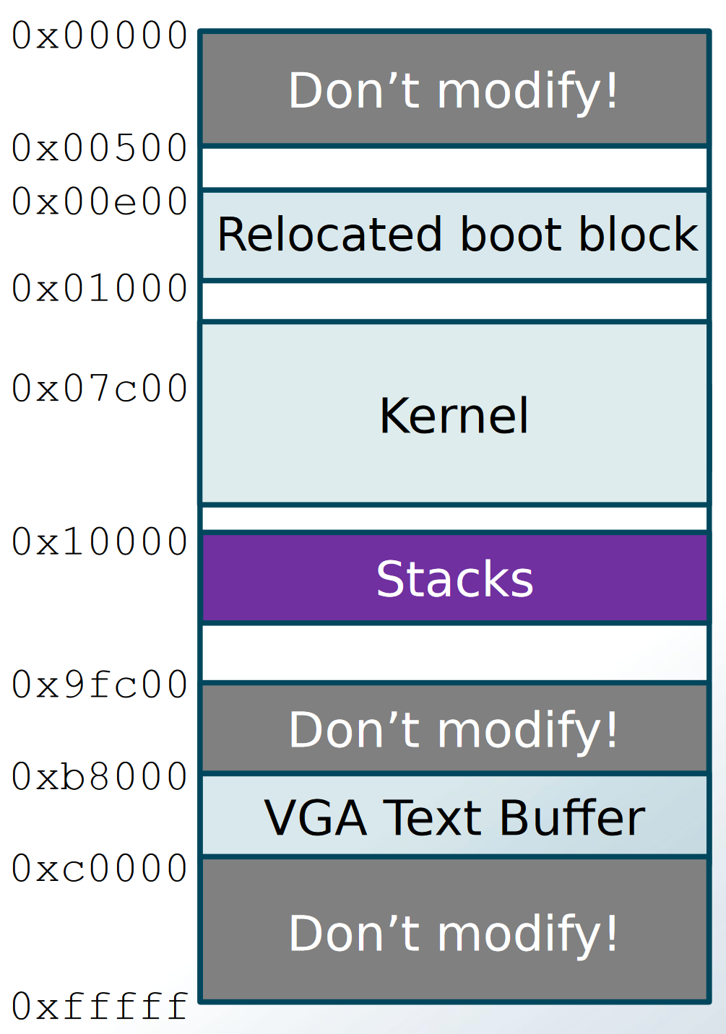
Stacks
How many stacks?
2 per process, 1 per thread
Why?
Where to put them in memory?
Upper limit: 0x9fc00
Suggestion: between 0x10000 and 0x20000
Stack size?
8KB should be fine.
Memory layout (not to scale)

Slide 10
Scheduler
Simple non-preemptive scheduling
IS round-robin good enough?
How to do blocking and unblocking?
⇒ Design review!

Slide 11
Context Switch Procedure
How to switch between processes and threads?
They must call yield() explicitly (non-preemptive)
In next project: time slice expires (preemptive)
What to save?
GPRs?
More?
Where to save it?
Stack?
PCB?
⇒ Design review!

Slide 12
System Call Mechanism
How does a process get services from the kernel?
This assignment: a special function call using a single entry “jump table”
Later: interrupt/trap mechanism
Why cannot system calls be implemented as ordinary function calls?
Is our approach better?

Slide 13
System Call Mechanism
At runtime, load the address of kernel_entry() into memory location 0xf00
Already done in pre-code
Prototype: void kernel_entry(int fn);
Define this in syslib.h #define ENTRY_POINT ((void (**)()) 0xf00)
Pointer to pointer to function with non-defined argument list returning void
...at address 0xf00
Declare the following in syslib.c static void (**entry_point) () = ENTRY_POINT;
entry_point has address 0xf00, and *entry_point is the address of our kernel entry point function
*entry_point = kernel_entry; (done in kernel.c)
Macro for invoking syscall: #define SYSCALL(i) ((*entry_point)(i))

Slide 14
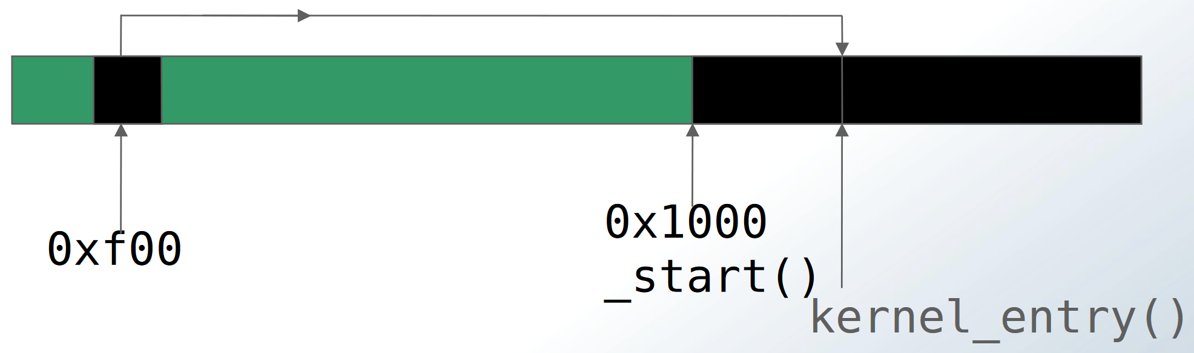
kernel_entry() in memory
The kernel sets the memory at address 0xf00 to the address of the kernel_entry() function. The user process can then read the memory at 0xf00 to learn where the kernel_entry() function is located in memory.

Slide 15
Synchronization
Locks are only used by threads
Many threads can try to acquire a lock
Need to maintain queue of threads waiting for a lock
Where?
lock_acquire()
Check lock
Got lock? Great!
If not, block itself
lock_init(), lock_release()

Slide 16
Measure Context Switch Time
What to measure and how (methodology)
⇒ Design review
Do measurements
Get results
Report and discuss results in report

Slide 17
Extra Credit 1 – time
Implement something similar to the Unix command “time”
Measure time spent in user mode and kernel mode
Get an A+ grade
..or a TA job next year?

Slide 18
Extra Credit 2 and 3 – more threads and processes
Add a new thread to your kernel
Add a new process to your OS

Slide 19
Design review
For each assignment you are required to give a design report for you plan to implement the solution
Note! describe it at the “design level”
Not a formal presentation - just you and your TA
You should be prepared
Have something to show during the design review
Only oral presentation is not acceptable
You need to convince the TA that you understand the project
The design review is a mandatory “assignment”:
Pass / no-pass grading

Slide 20
Possible topics for design review
What’s in the PCB? Why is it there?
How will you implement locks? What about process queues?
Where should context be saved?
What is the context (what must be saved?)
What is the difference between processes and threads?
In this assignment?
How do “our” processes and threads differ from “normal” processes and threads?
How many stacks per process? And why?
How many stacks per thread? And why?
Non-preemptive vs preemptive scheduling; What is similar? What is different?

Slide 21
Code
Comment your code
Give a high-level overview of what the code does
Especially important when dealing with hardware, entry points, and synchronization/ blocking
Comments are part of the grading
Test your code
Don’t cheat

Slide 22
Report
Maximum 4 pages
Give an overview of how you solved each task
including extra credits
Describe how you have tested your code
and known bugs/ issues
Describe the methodology, results, and conclusions for your performance measurements

Slide 23
Handin
This is an exam, so there is a strict deadline
Extensions only for valid and preapproved reasons
Wiseflow for handin
PDF of your report
Zip file with source code (remember to make clean before ziping)
Add your name, GitHub username, and email to the report

Slide 24
Hints - Flat Address Space
The bootblock code:
Switches to protected mode
Sets up the CS, DS, SS, and extra segment registers
You can use the entire memory by utilizing registers like EAX
Do NOT modify the segment registers
You have access to the first 1MB of memory
Actually, you have access to a 32-bit address space, but we won’t use memory > 1MB limit in this assignment)
Including the video-memory area (VGA text buffer @ 0xb8000)
Make sure your code, data, and stacks do not overwrite “important” memory areas (see the memory map)

Slide 25
Hints - Threads and Processes
Your OS will have processes and threads
Threads are linked with the kernel
Processes are separate executable files
Note: they all end up together in the same image file
Processes need a special way to call functions in the kernel
Threads can just call kernel functions directly
In a more advanced OS, there are many other differences between threads in the kernel and processes

Slide 26
Hints – Synchronization
The synchronization primitives can only be used by threads within the kernel
The two functions block() and unblock() are to be used by the synchronization code
Blocking a process is not specific to locks, but is a general purpose service that the kernel should support

