Slide 1


SoulChain
-Articles & Videos recommendation system
supervised by :
Mme Imane BELLA
Presented to :
Mr Karim Amor
Mr Jamal BENHAMOU
Mr. TAMTAOUI Ahmed

Slide 2
Articles & Videos recommender system
By ZAZA Zakaria

Slide 3
Recap
Always relevant
generate Data
autonomous
Notes:
Y

Slide 4
How does it work ?
Person
Indeed jobs extraction
Job offers treatment
Recommendation
Interests
prof
Extract relevant relative job offers
Up to 3000 job offers by interest
Via web scraping with beautifulsoup
Didue relevant skills to that interest
Via NLP with NLTK & WordNet
Recommend articles and courses related to each skill
Via Google CSE API

Slide 5
New architecture
Person
Interests
prof
Indeed jobs extraction
Job offers treatment
Recommendation
URLs
Articles analysis
Analyse the output articles
Via newspaper3k

Slide 6
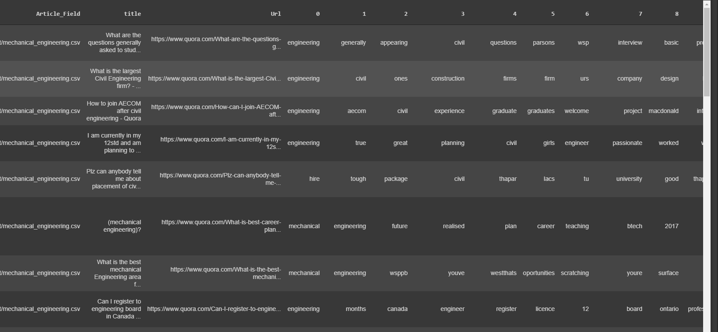

Slide 7
How does it work ?
Person
Interests
prof
Indeed jobs extraction
Job offers treatment
Recommendation
URLs
Users dataset
How ?
Articles dataset
For testing I generated a dummy dataset
Via Numpy & Pandas
Target :
Explicit rating
Implicite feedback
Collaborative learning:
Collaborative filtering
-> Reinforcement learning & Cartesian product.
Analyse the output articles
Via newspaper3k & numpy

Slide 8
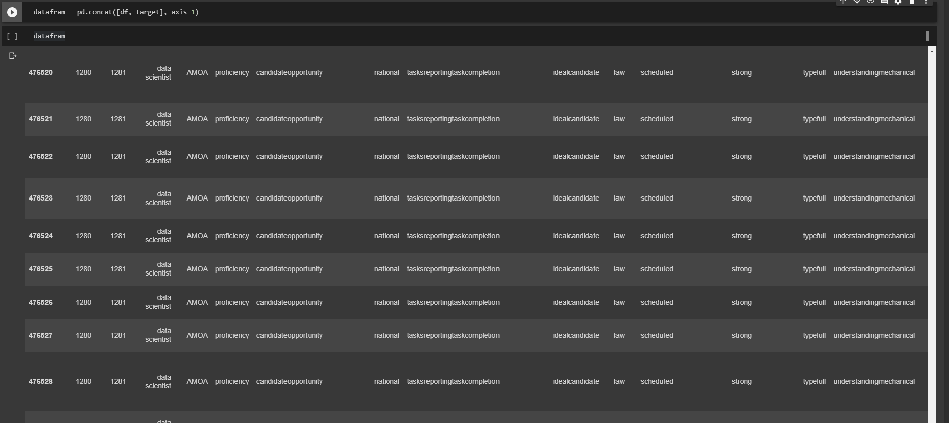

Slide 9
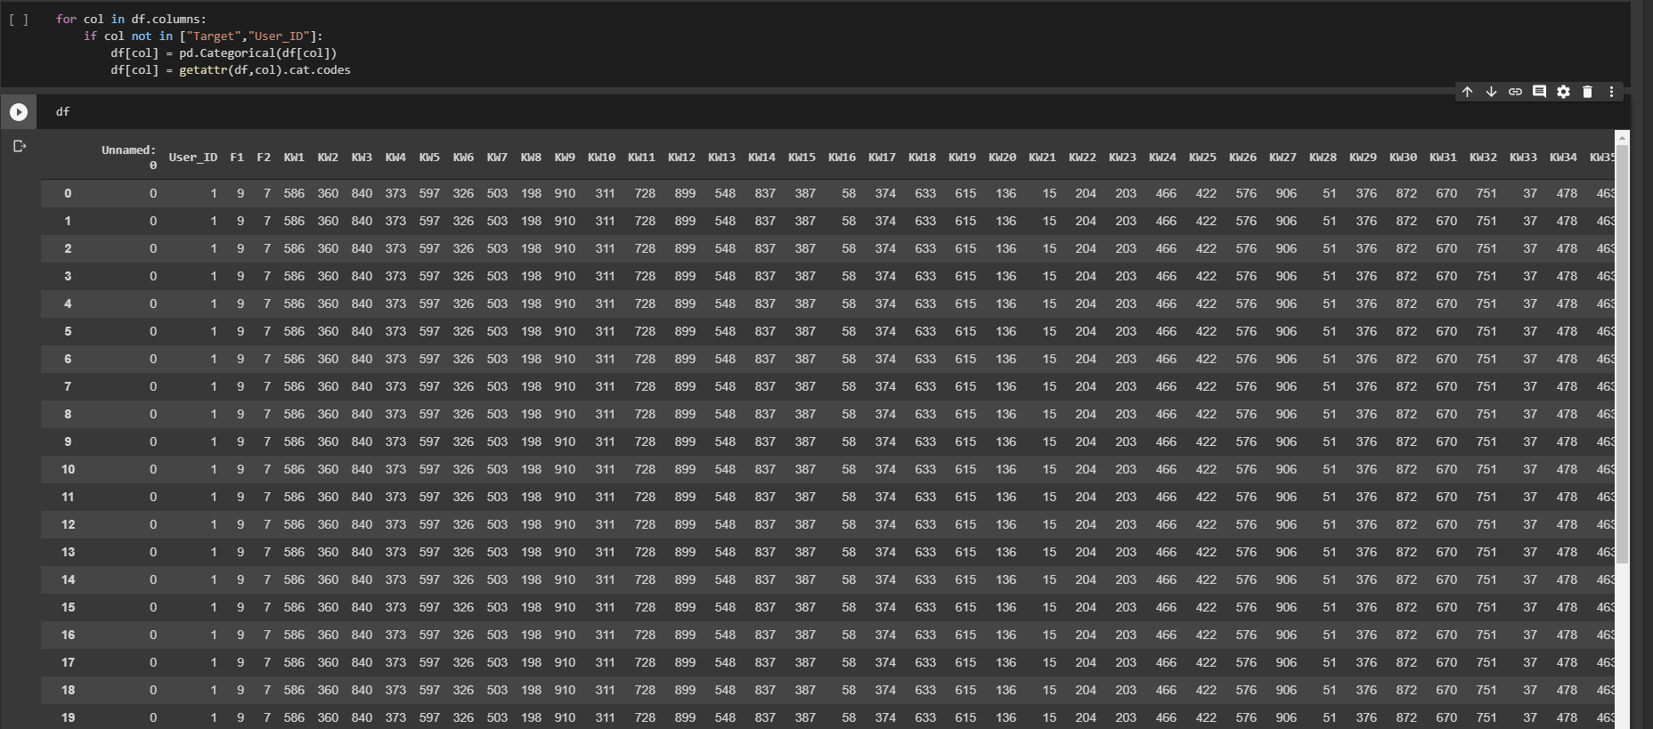

Slide 10
Target update
-> Inference ML with TensorFlow.js on state-of-the-art models:
-Polyvore : Node-wise Graph NN 78,13% accuracy
-Click-through Rate Prediction --
-xDeepFM : Combining Explicit & Implicit Interaction 84,00% accuracy
-> No need for a Chatbot
->Privacy friendly, with PRE-encription
->Per user

Slide 11
Final Architecture
Person
Interests
prof
Indeed jobs extraction
Job offers treatment
Recommendation
URLs
Users dataset
data pre-processing
Articles dataset
Target update
Autonomous
Flexible
Always relevant
Explicit, implicit
Collaborative
Easy to manupilate
Dataset
Dataset

Slide 12
Traitement objectifs
« Get the juice of the juice »
« At the right time »
« For every one »

Slide 13
How does it work ?
Predictive Model
using Tensorflow & Keras
Pre-Recommendation process
UX feedback with tensorFlow.js
Client
def get_compiled_model():
model = tf.keras.Sequential([
tf.keras.layers.Dense(10, activation='relu'),
tf.keras.layers.Dense(10, activation='relu'),
tf.keras.layers.Dense(1, activation='sigmoid')
])
model.compile(optimizer='adam',
loss='binary_crossentropy',
metrics=['accuracy'])
return model
Use
Dataset
Update
Target Update
Content Update

Slide 14
PreRecommendation
Article
Video
Information
If input.type() is article
→ return Text_summarizer(input)
else if input.type() is video
→ return Video_summarizer(input)
BertSumExt: Text Summarizatiohn with Pretrained Encoders
TvSum :methode CSNet, Discriminative Feature Learning for Unsuperviser Video Summarization

Slide 15
ALL in one
Users
Interests
prof
Indeed jobs extraction
Job offers treatment
Recommendation
URLs
Users dataset
data pre-processing
Articles dataset
Dataset
Target Update
Content Update
update
Client
Predictive NN Model
Pre-Recommendation process
Use
UX feedback

Slide 16
ALL in one
Person
Interests
prof
Indeed jobs extraction
Job offers treatment
Recommendation
URLs
Users dataset
data pre-processing
Articles dataset
Dataset
Target Update
Content Update
update
Client
Predictive NN Model
Pre-Recommendation process
Use
UX feedback

Slide 17
THANK YOU

