Slide 1

Information And Communication Technologies And Technologies Related To TIC
University of Sciences and Technology HOUARI
BOUMEDIENE
Presented by :
Mr : ZAAF Mohamed Ishak
Notes:
University of Sciences and Technology HOUARI
BOUMEDIENE

Slide 2
TABLE OF CONTENTS
Introduction
What is TIC
Definition
Etymology
(TIC) vs (IT)
The technologies included in TIC
What Is the Internet?
Key features of the internet
Types of Internet Services
Search engine
Definition
Types Of Search Engines In The Internet World
Most Popular Search Engines

Slide 3
Avantages of TIC Technologies And Tools
Technological capacity
Aims & Objective
Disadvantages of TIC
Conclusion

Slide 4
Introduction

Slide 5
Information technology “evolved in the 1970s. Its basic concept, however, can be traced to the world war II alliance of the military and industry in the development of electronics, computer and information theory. After the 1940s, the military remained the major source of research and development funding for the expansion of automation to replace manpower with machine power.

Slide 6
What is TIC:
TIC is Hardware and Software that enable society to create, collect, consolidate and communicate information in a multimedia format and for various purposes.
The term TIC includes any communication device or application, encompassing, radio, TV, cellular phones, computers and network, hardware and software, satellite systems and so on, as well as the various services and application associated with them.
TIC is playing a vital role in the current and future development of society and nation.

Slide 7
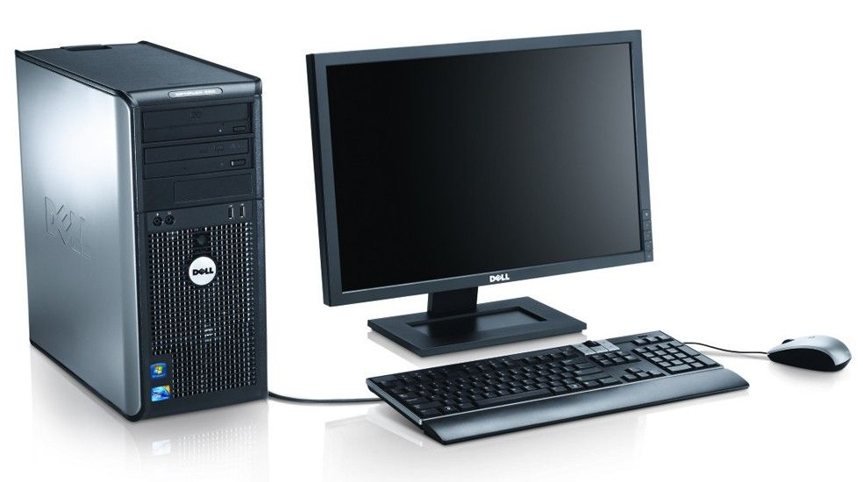
Definitions:
According to the Encyclopedia of Computer Science, “Information Communication Technology (TIC) is an imprecise term frequently fundamental to broad areas of technologies and associated with the use of computers and communications”.
According to UNESCO “TIC is a scientific, technological and engineering discipline and management techniques used in handling information and application and social, economical and cultural matters”.

Slide 8
Etymology
The phrase "information and communication technologies" has been used by academic researchers since the 1980s. The abbreviation " TIC " became popular after it was used in a report to the UK government by Dennis Stevenson in 1997, and then in the revised National Curriculum for England, Wales and Northern Ireland in 2000.
However, in 2012, the Royal Society recommended that the use of the term " TIC " should be discontinued in British schools "as it has attracted too many negative connotations".
From 2014, the National Curriculum has used the word computing, which reflects the addition of computer programming into the curriculum.

Slide 9
(TIC) vs. (IT):
The acronym (TIC) is sometimes used synonymously with IT.
However, (TIC) is generally used to represent a more comprehensive list of all components related to computer and digital technologies.
IT is more about managing the technologies related to information, and its various technical aspects, including software, hardware, and networking. IT management does not include considerations of telecommunications devices and technologies while (TIC) does.
IT can be considered a subset of (TIC).

Slide 10
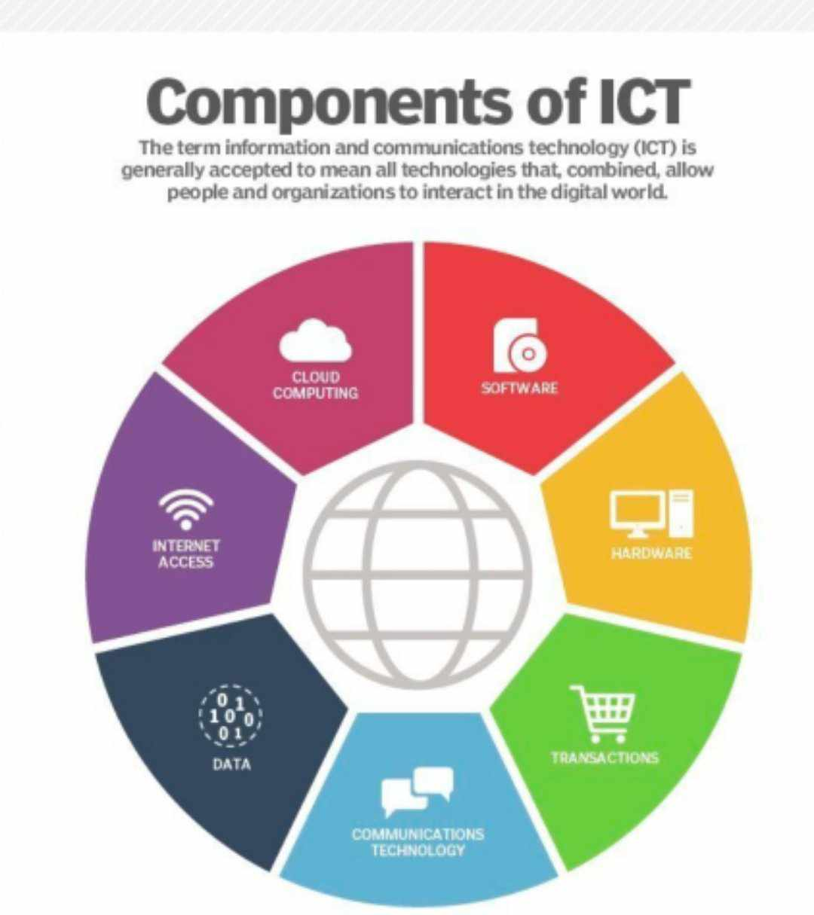
The technologies included in TIC
Any technology, infrastructure like computers, laptops, printers, scanners, software programs, data projectors, and interactive teaching box, component, or device that enables communications, data sharing, and global connectivity between humans and between humans and machines is included in the umbrella term TIC.

Slide 11
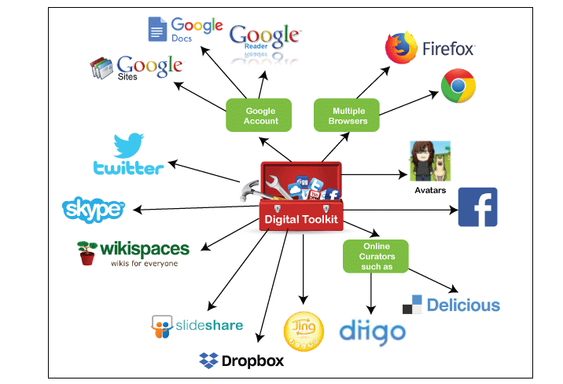
ICT Tools

Slide 12
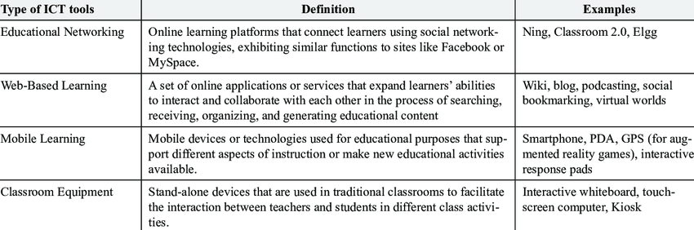
This table identifie some type of ICT Tools.

Slide 13
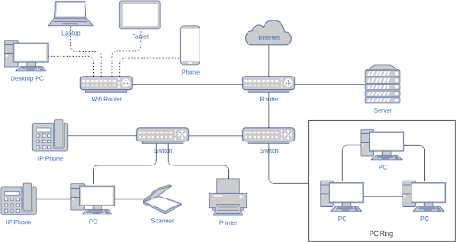
What Is the Internet?
The internet is a global network of interconnected computers, servers, phones, and smart appliances that communicate with each other using the transmission control protocol (TCP) standard to enable a fast exchange of information and files, along with other types of services.

Slide 14
Key features of the internet
Globally available
Easy to use
Compatible with other types of media
Affordable
Flexible

Slide 15
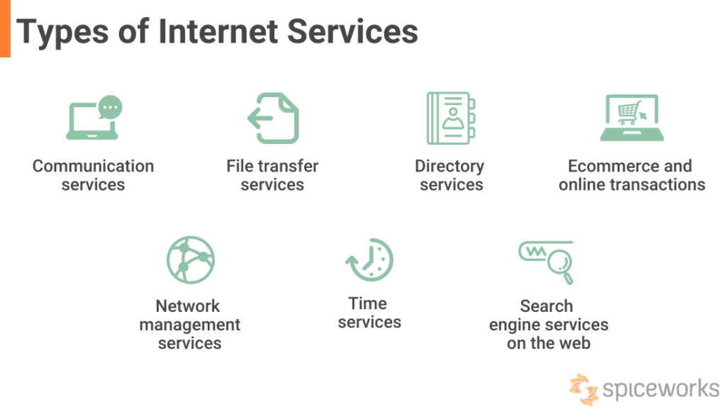
Types of Internet Services

Slide 16
Search engine
Definition:
A search engine is a software program that helps people find the
information they are looking for online using keywords or phrases.
Search engines are able to return results quickly—even with millions of websites online—by scanning the Internet continuously and indexing every page they find.

Slide 17
Types Of Search Engines In The Internet World
1. General Search Engines
2. Vertical Search Engine
3. Hybrid Search Engine
4. Meta Search Engine
5. Web Search Engines
6. Image Search Engines
7. Video Search Engines

Slide 18
Most Popular Search Engines
Google is the largest and most popular search engine, handling over 3 billion daily searches.
Bing is Microsoft’s search engine, handling around 2.5 billion daily searches.
Yahoo is the third largest search engine, handling around 1 billion daily searches.

Slide 19
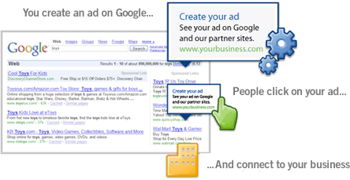
GOOGLE’S PRODUCTS AND SERVICES

Slide 20
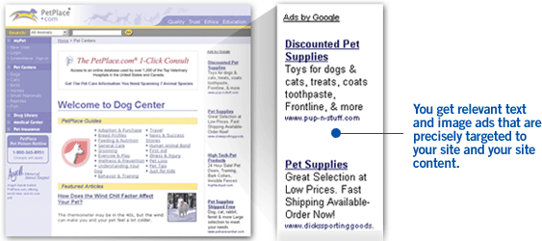
GoogleAdSense

Slide 21
Google Toolbar Plug-in for Web Browser

Slide 22
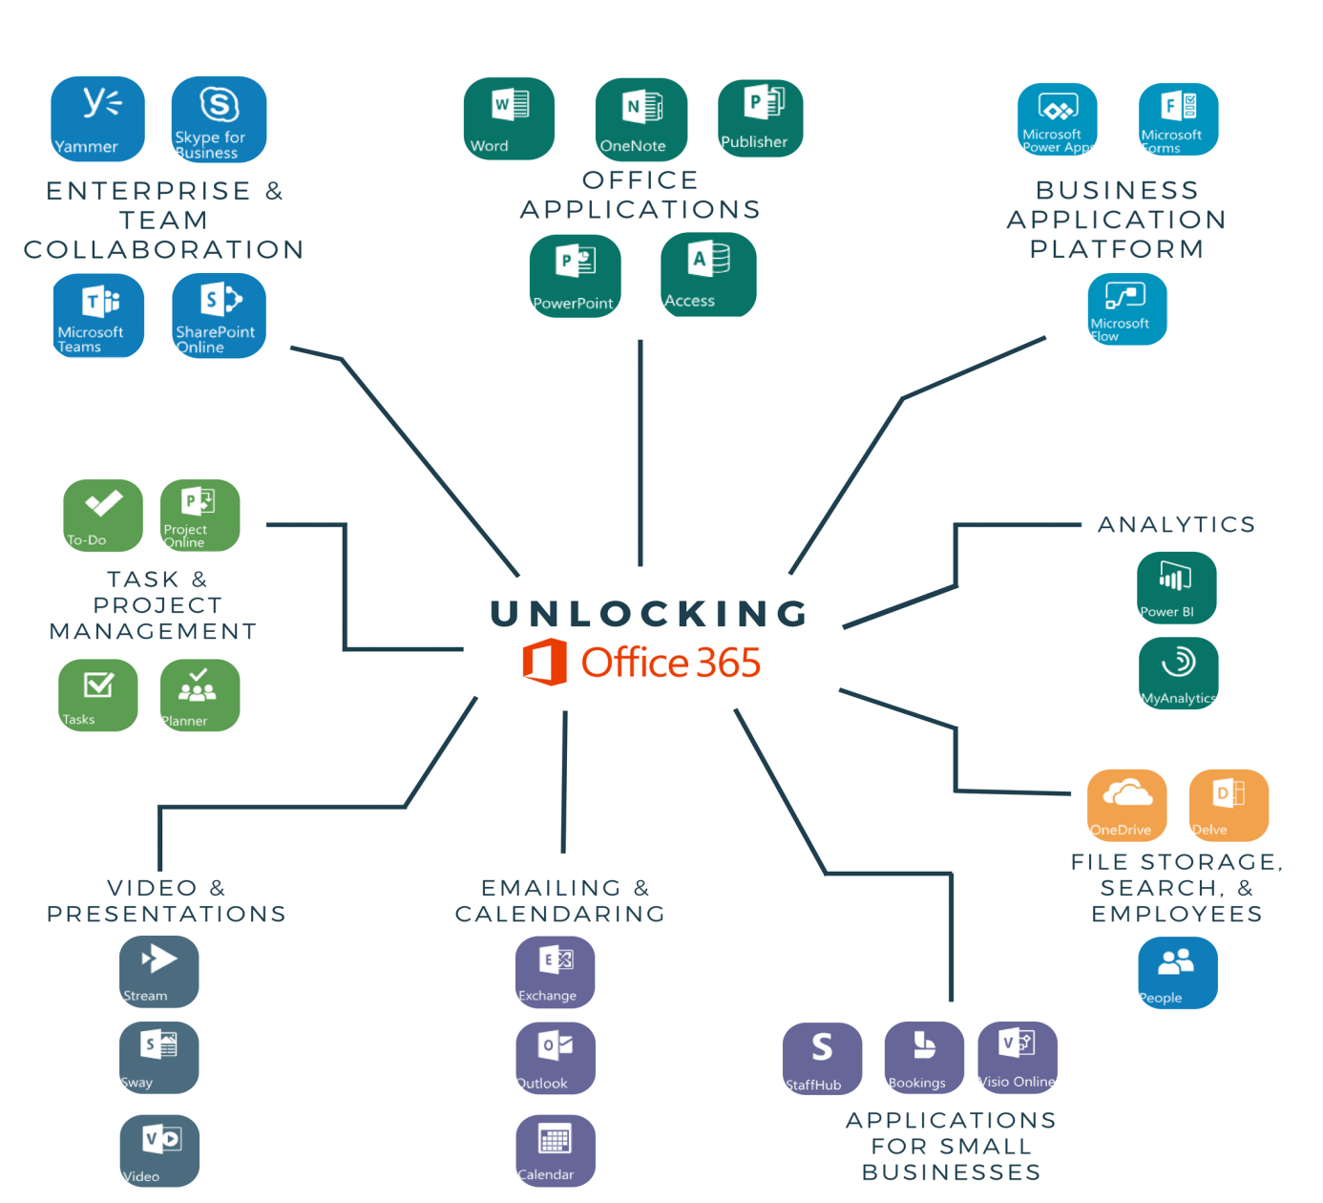
Microsoft Tools and services

Slide 23
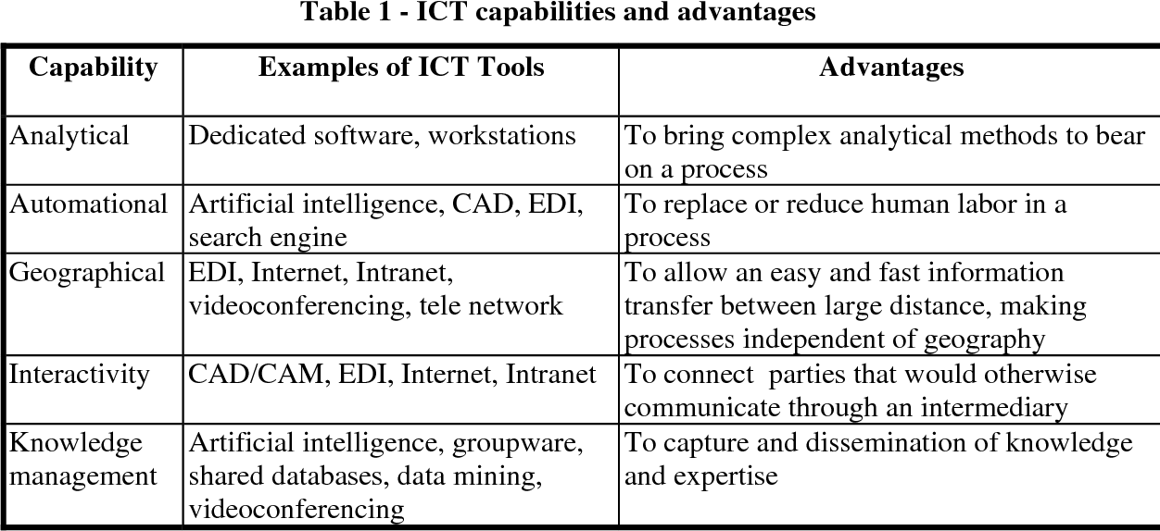
Avantages of TIC Technologies And Tools
Provide the facility for easy student management
Direct classroom teaching
Improved modes of communication
Eco-friendly-Eliminate the usage of paper
Direct classroom teaching
Minimize cost and saves time
Improved data and information security

Slide 24
Technological capacity
The world's technological capacity to store information grew from 2.6 (optimally compressed) exabytes in 1986 to 15.8 in 1993, over 54.5 in 2000, and to 295 (optimally compressed) exabytes in 2007, and some 5 zetta bytes in 2014.
The world's technological capacity to receive information through one-way broadcast networks was 432 exabytes of (optimally compressed) information in 1986, 715 (optimally compressed) exabytes in 1993, 1.2 (optimally compressed) zettabytes in 2000, and 1.9 zettabytes in 2007.
The world's effective capacity to exchange information through two-way telecommunication networks was 281 petabytes of (optimally compressed) information in 1986, 471 petabytes in 1993, 2.2 (optimally compressed) exabytes in 2000, 65 (optimally compressed) exabytes in 2007 and some 100 exabytes in 2014.

Slide 25
Aims & Objective
(TIC) has become, within a very short time, one of the basic building blocks of modern society. Many countries now regard understanding TIC and mastering the basic skills and concepts of TIC as part of the core of education, alongside reading, writing and numeracy.
UNESCO aims to ensure that all countries, both developed and developing, have access to the best educational facilities necessary to prepare young people to play full roles in modern society and to contribute to a knowledge nation.
Because of the fundamental importance of TIC in the task of schools today, UNESCO has previously published books in this area as a practical means of helping Member States: for example, Informatics for Secondary Education: A Curriculum for Schools (1994) and Informatics for Primary Education (2000).
Rapid developments in TIC now demand a completely new document in place of the first of these publications.

Slide 26

Disadvantages of TIC
Blackmail :
Using the internet to threaten to cause damage with the intent to extort from any person any money or other thing of value.

Slide 27
Unemployment:
Using the computer instead of human resources employers are save huge amount of money but employees are losing their jobs as not needed anymore.
Privacy:
Information technology may have made communication fast and more convenient, it has also brought along privacy problem. From cellphone signal interception to email hacking, about their once private information becoming public knowledge.
Computer virus:
worms, Trojan, malware, spam any or all can chaos and disrupt our daily lives.

Slide 28
Conclusion

Slide 29
Information and communication Technology (TIC) tools and techniques utilization has been spread widely in every work of human being and all kinds of organizations.
TIC has improved the library services than traditional one and now become the demand of the users as well as organization to fulfill the necessary requirements on time.
With the use of TIC, library professionals role has been change totally. The provision and the use of information and communication technology is a part and parcel of the entire system, to the student, information and professional and the institution. Communication for technology provides those who have communication challenges a way of expressing their wants and needs. People of all age and abilities can use and benefit from using communication technology.
Communication technology helps people easily communicate to other and makes life more convenient. Although communication brings a lot of benefits. So, people must responsible while using the communication technology properly.

