Slide 1
Zadify
Zach Durtschi
March 14, 2013

Slide 2
Application Summary
Motivational Tool
Goals and Rewards
Monster Mode

Slide 3
Why ZADIFY?
Android Development – Mono
Observed Lack of Motivation
Gamification of Tasks

Slide 4
DEMO

Slide 5
Motivation
Positive Reinforcement

Slide 6
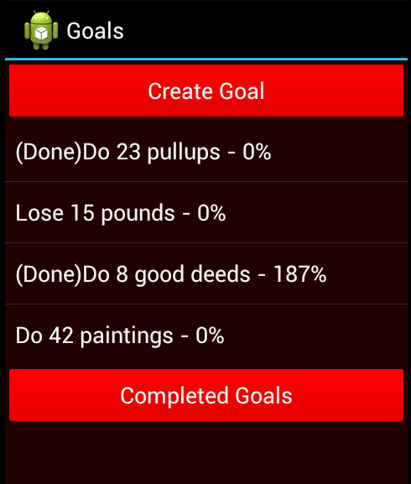
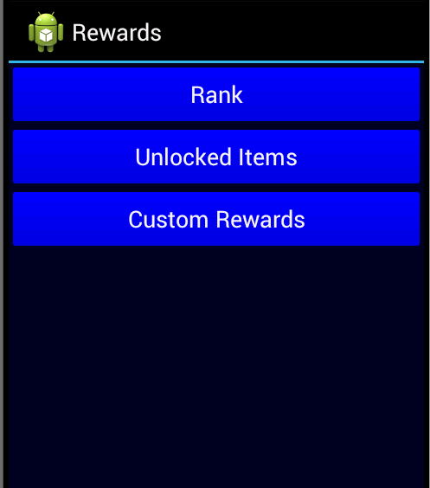
Motivation
Red
Blue

Slide 7
Challenges
Web Service Complications
Motivation
Android Activity Lifecycle
Mono for Android Emulator

Slide 8
Future
Facebook/Social
Graphics
More Motivation

Slide 9
Questions?

