Slide 1
Automatic Detection of Paediatric Congenital Heart Diseases (CHDs) from Phonocardiogram (PCG) Signals BSc Final Year Project (Research-based)
Project Supervisor: Dr. Sayed Waqar Shah
Co-Supervisor: Dr. Muhammad Salman Khan
Group Members | Reg No
Muhammad Zeeshan | 18PWELE5298
Fazal e Haq | 18PWELE5351
Zafar Ahmad | 18PWELE5359
Muhammad Haris | 18PWELE5367

Slide 2
Contents
Introduction
Statistics (Local and Global)
The Problem Statement
Aims and Objectives
Scope/Significance of the Study
Research Methodology
Results, Challenges and Issues
GUI (Graphical User Interface)
Conclusion
Future Work/Direction

Slide 3
Introduction
Heart diseases is one the major cause of death both in adults and paeds [1].
These diseases may be presented by birth (Congenital heart diseases CHD’s), or acquired after birth at any age (acquired heart disease), for instance Stenosis of heart valves by Calcium Storage, leakage of valves etc
Congenital heart defect (CHDs) results when the heart, or blood vessels near the heart, don’t develop normally before birth.
Doctors and medical specialists diagnose them using different medical devices including Stethoscope (on primary scale) and echocardiogram machine (as a Standard)[3].
The recorded PCG signals contains useful information that tell about heart functions.

Slide 4
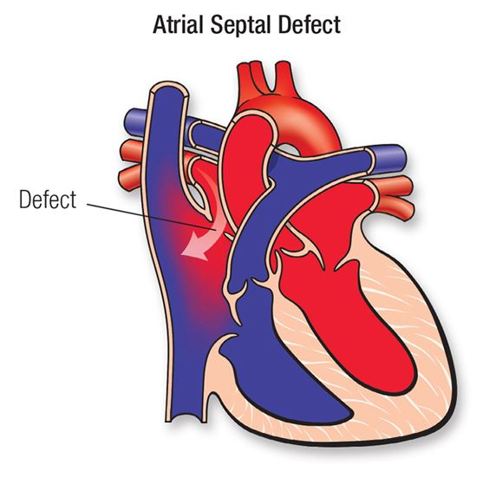
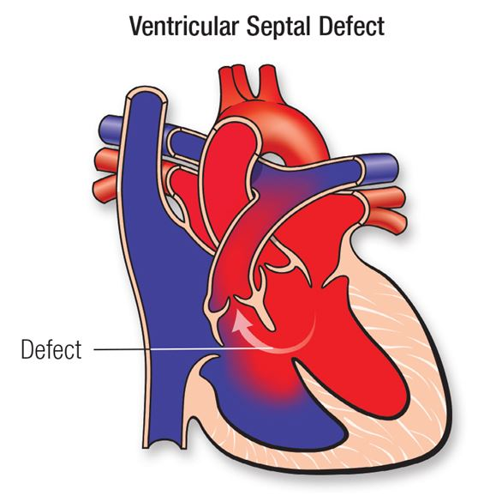
Congenital heart defect (CHDs)

Slide 5
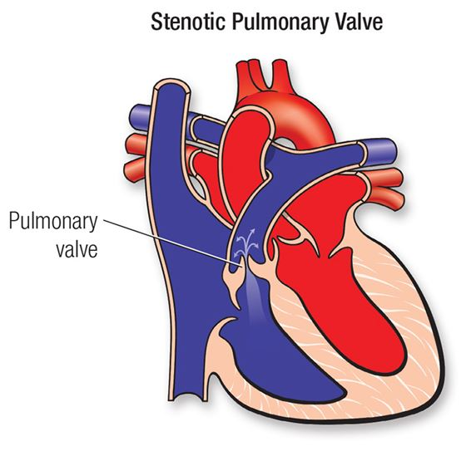
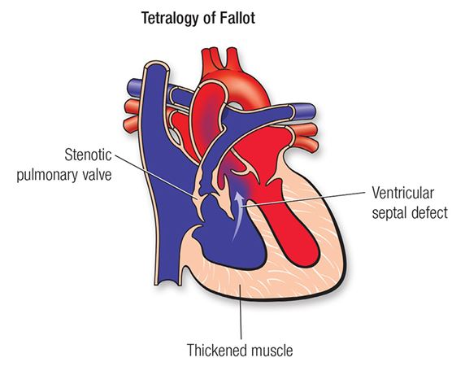
Continue

Slide 6
Global Associated Statistics
According to the research of Michigan University, Congenital heart disease is the most common birth defect and occurs in about 1 in 100 babies [9].
Similarly, Tetralogy of Fallot (TOF) is the most common cyanotic congenital heart defect [13].
Almost 75% of the developing countries are affected by heart diseases [4].
The annual direct and indirect costs of heart failure are estimated to exceed $33 billion annually in the United States [5].
A study in 2015 estimated 320,000 deaths and 33 million prevalent cases from Rheumatic heart disease worldwide [6].
According to a study 32.6% CAD was misdiagnosed [7] and in the preliminary evaluation of children with VSD, the diagnostic error reached approximately 6% of cases [8].

Slide 7
Problem Statement
The current diagnostic system is expensive.
In manual auscultation, proper time and experience of doctor needs to detect a heart disease precisely and accurately is very delicate.
It is particularly advantageous to enhance the system by bringing the cutting-edge AI based model that should enhance the current diagnostic system for healthcare.

Slide 8
Research objectives
Phonocardiogram Signal Enhancement: Signal Preprocessing, Filtering.
To develop an AI based model for binary classification of normal and abnormal heart sounds.
To explain and interpret the decision made by the model.
To evaluate and compare the performance of the proposed model with other competing models.

Slide 9
Scope/Significance of the Study
Early detection of CHDs to save lives if the proposed methodology is adopted at primary healthcare units.
The tools used in this algorithm development could be utilized in other one dimensional signal analysis.
Further research in this area will help in understanding of CHDs, local distribution of different types CHDs in Peshawar.

Slide 10
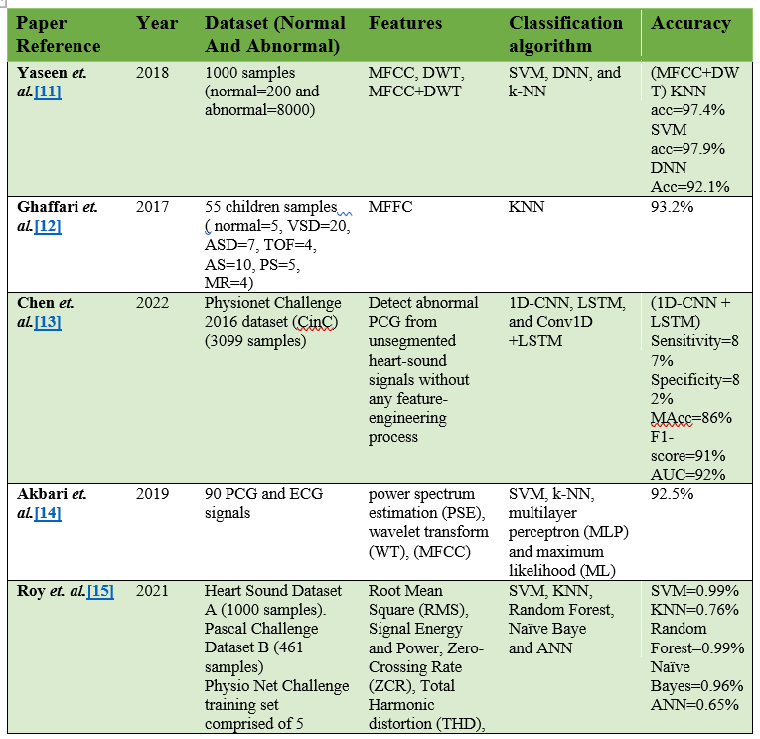
Literature Review

Slide 11
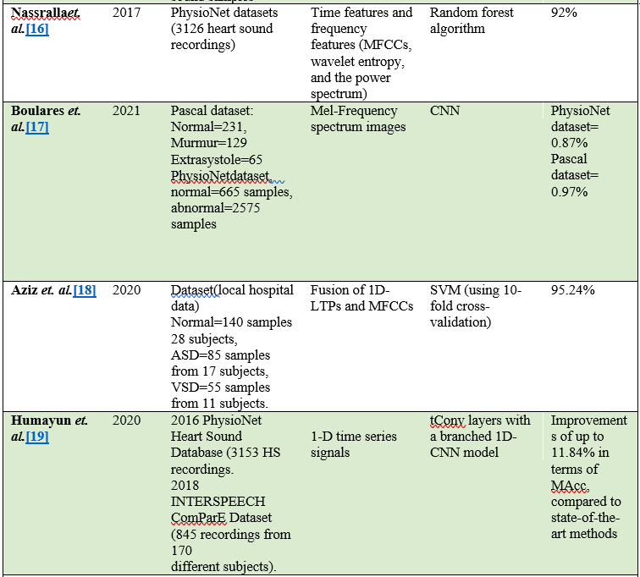
Literature Review

Slide 12
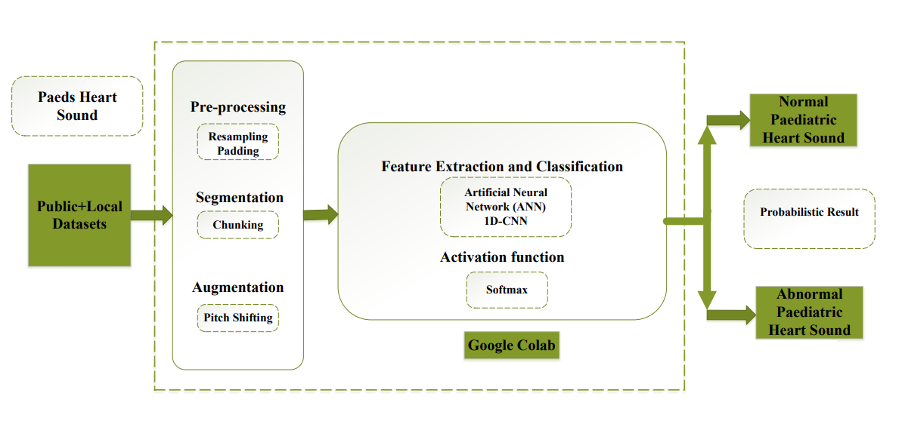
Research Methodology

Slide 13
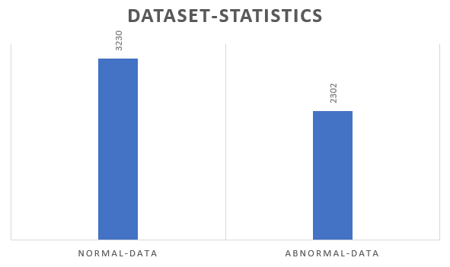
Dataset

Slide 14
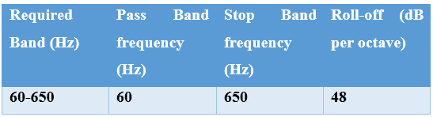
Data Pre-Processing
Filtering: The ambient noise usually falls in the low-frequency region between 0 and 50 Hz. Similarly, when something rubs with the ground or a baby cry, then this noise falls in the frequency region above 800 Hz. So, a Bandpass filter was needed.

Slide 15
Continue…
Resampling:
The local data was collected at the sampling rate of 8000 Hz. However, the publicly available data was sampled at 44.1 kHz, so we resampled all the data to 8000 Hz.
Chunking and Padding:
The data used for the proposed research was not sufficient for keeping the importance of AI results on the medical side, so the dataset was chunked to 4 seconds per sample. Hundreds of audio samples were not the multiple of 4, so we used a technique that is called padding

Slide 16
Continue…
Data Augmentation:
We have an insufficient dataset, then we can create synthetic data of slightly improved parameters such a process is called Data Augmentation. There are multiple approaches that researchers used for their purposes, such as Pitch-Shifting, Time Stretching, Time compressing, etc.
Pitch-Shifting:
This technique is often used to change the high-frequency component in an audio signal. Heart sound has S1 and S2 spikes which have high amplitude and high frequency, so using this technique will increase the S1 and S2 spikes to some higher frequency magnitude.

Slide 17
Feature Extraction and Classification
A convolution 1D algorithm was used for this research.
However, algorithm selection is based on the purpose, data type, accuracy, precision, sensitivity, and specificity requirements.
The local dataset used for this proposed study was noisy, and this low-frequency noise is persistent.
A study has shown that 1D CNN has good results on noisy data using audio signals.

Slide 18
Softmax activation function
The Softmax is a function often used in AI, ML, and DL models that converts a real number into the probability of K possible outcomes in generalized form
Softmax converts the last results to normalized distributed for probabilistic results and it is based on Luce’s choice axiom.

Slide 19
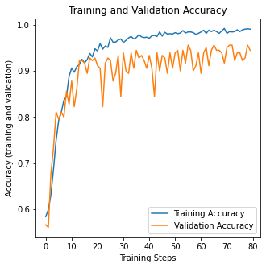
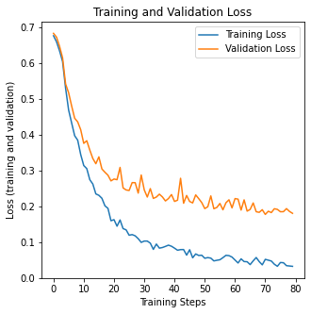
Results, Challenges and Issues
Initial Results
Figure shows the Training and Validation Accuracy Figure shows the Training and Validation Loss

Slide 20
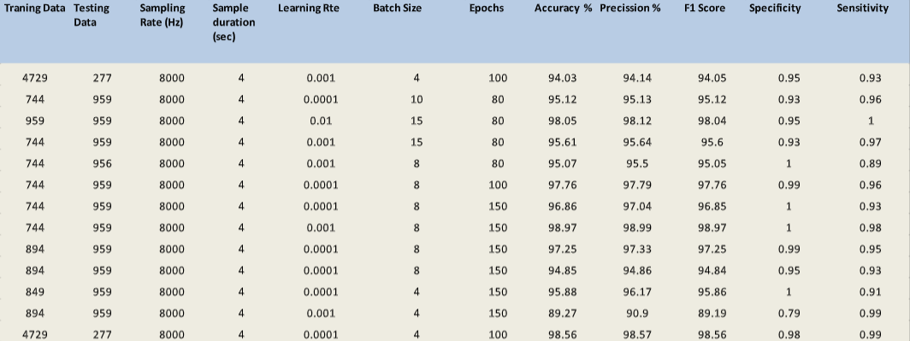
Experimental results
Table shows different test results.

Slide 21
Mean result
Table shows the Mean of the first 12 results.
Accuracy (%) | Precision (%) | F1 Score (%) | Specificity | Sensitivity
95.73 | 96.22 | 95.72 | 0.96 | 0.95

Slide 22
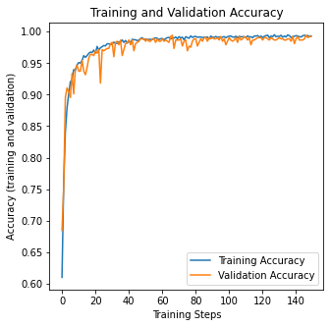
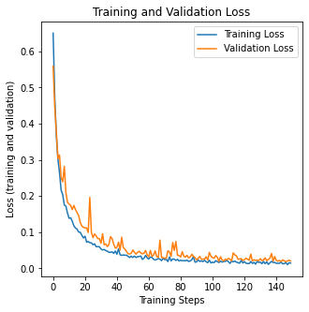
Final result
Figure shows the Accuracy (training and validation) Figure shows the Loss (training and validation)

Slide 23
Final result
After Pitch-shifting of the dataset.
Table shows the final test results
Accuracy (%) | Precision (%) | F1 Score (%) | Specificity | Sensitivity
98.56 | 98.56 | 98.55 | 0.99 | 0.98

Slide 24
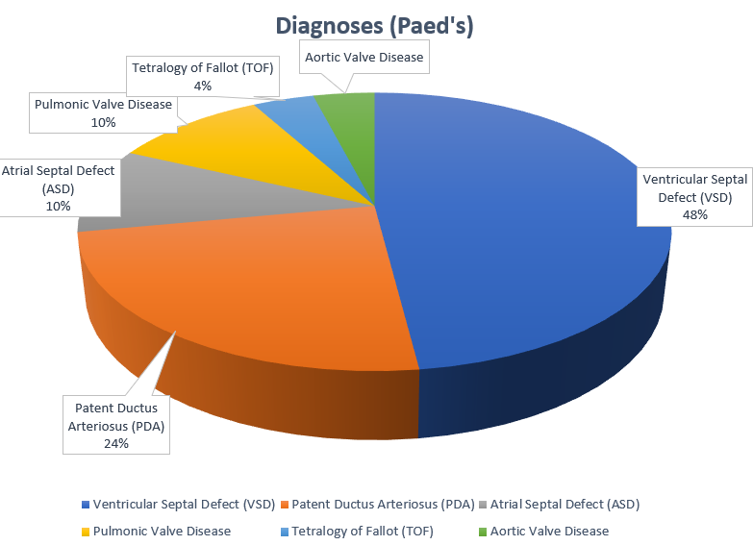
Statistics (From Local Data 143 Heart Signals)

Slide 25
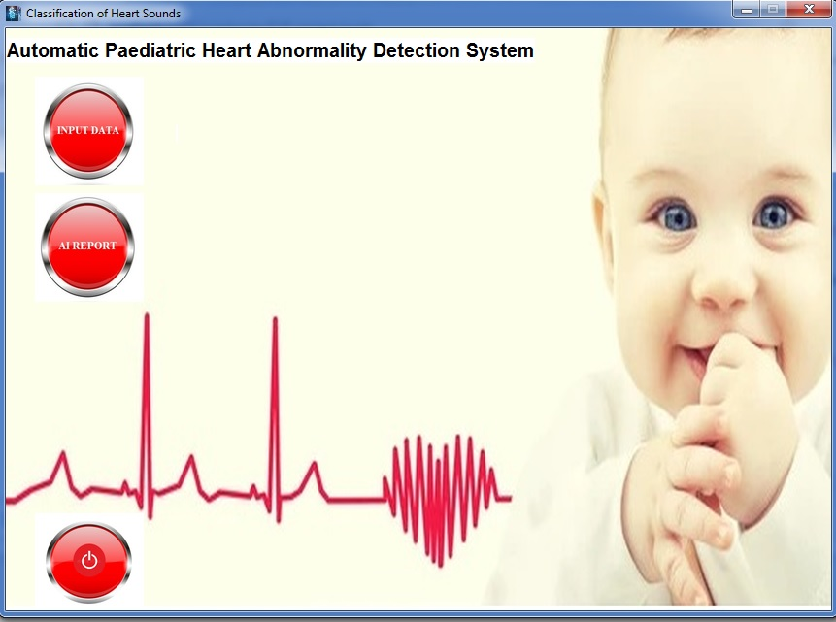
GUI (Graphical User Interface)

Slide 26
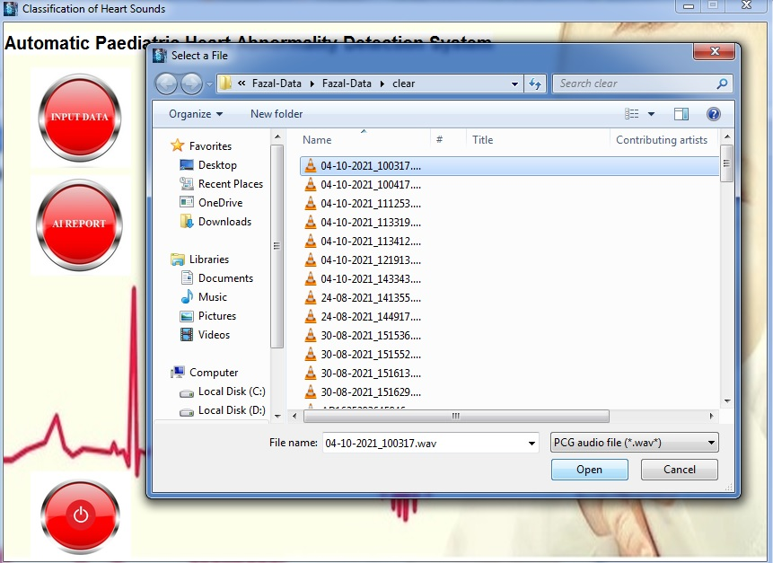
Continue…

Slide 27
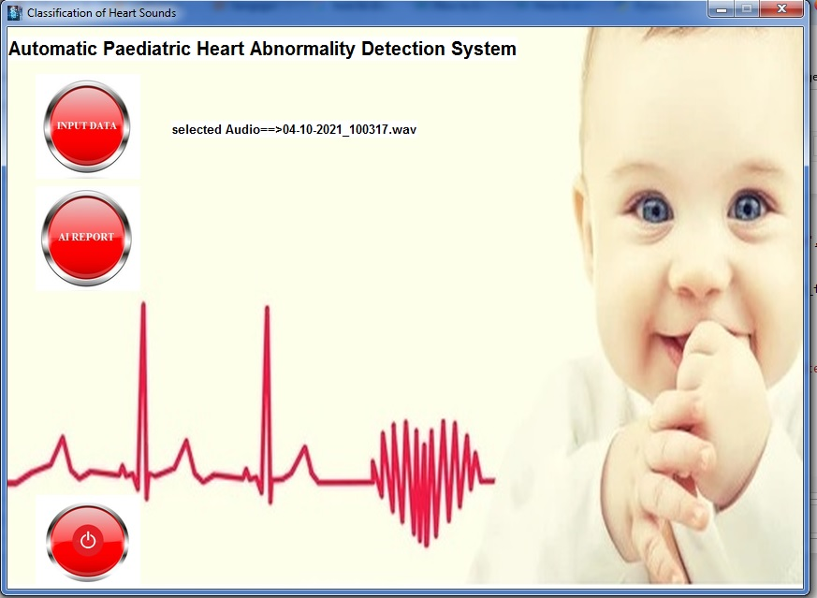
Continue…

Slide 28
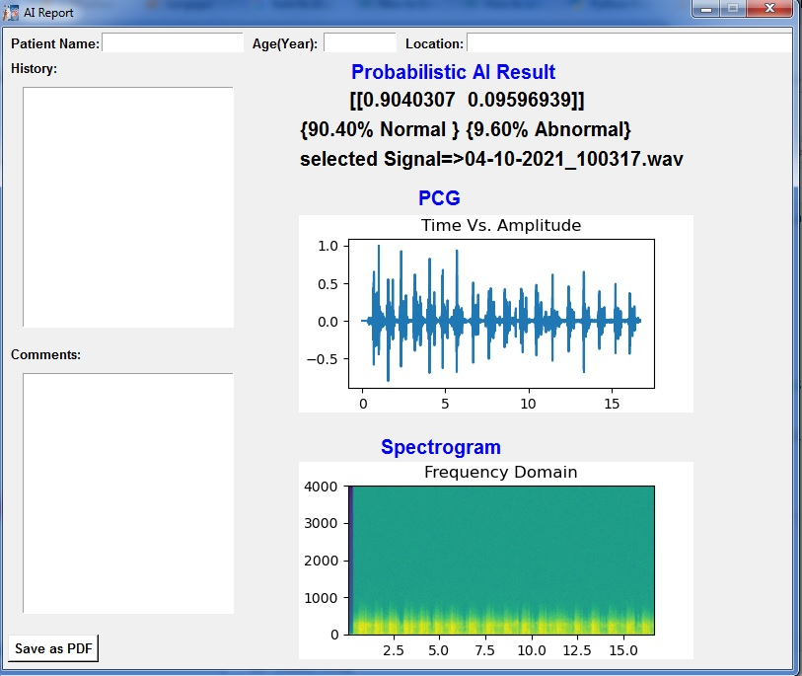
Continue…

Slide 29
Challenges and Issues
Insufficient Data
The available local data was very noisy
The most suitable chunk time

Slide 30
How we tackle those challenges?
5.1.1 Insufficient Data: This issue was hard and crucial because AI model needs large amount of data. There are various techniques that can be used for synthetic data creation and in this study pitch-shifting is used and its selection was based on the data sensitivity and result requirements.
5.1.2 The available local data was very noisy: The most difficult challenge was the ambient noise in the signal that effected the overall model performance, so the effective strategies that were brought into action in this proposed study a). all the data was thoroughly listened and removed the unnecessary data files, b). After that the signals were then passed through a band pass filter having the specification shown in the table (4.1).
5.1.3 The most suitable chunk time: The recorded signals were of different time frame, so it was necessary to chunks all the data in one time frame, but how many seconds? This was one of the vital questions that is must be referred to medical experts, after confirmation the chunks time was decided to be 4 seconds.

Slide 31
Conclusion
This proposed study presents a novel algorithm for abnormality detection of PCG signal and classifying the signal into two classes; a binary classification.
In this research study, we presented the effectiveness and flexibility of the proposed method using a combination of local and public dataset of normal and abnormal PCG signals.
We further assessed the robustness of the proposed method with data augmentation method, chunking, padding, pitch-shifting and compare the performance with the initial results.
Evaluation results show that the method achieves accuracy 0f 98.56%, precision of 98.56%, and F1-score of 98.55%, sensitivity of 0.98 and specificity of 0.99.

Slide 32
Future work and direction
Due to the less amount of Paediatric data, this study was designed only for binary classification normal and abnormal detection.
In future, when there is large amount of local data, this study can be extended to Paediatric multiclass classification.

Slide 33
Limitation
Although the system looks like it will hopefully enhance the traditional diagnostic system, however it still requires the knowledge and experience of medical experts.
We believe that with the advancement of computer computational power it will make it easy for scientists and engineers to completely automate the process.

Slide 34
Questions and Discussion
Questions are openly welcome
Any Point still need clarification
Any useful suggestion

Slide 35
References
[1] Berraih, S.A. and Debbal, S.M.E.A., 2021. Severity cardiac analysis using the Higher-order spectra. Applied Mathematics and Computation, 409, p.126389.
[2] Milani, M.G.M., Abas, P.E., De Silva, L.C. and Nanayakkara, N.D., 2021. Abnormal heart sound classification using phonocardiography signals. Smart Health, 21, p.100194.
[3] Khan, F.A., Abid, A. and Khan, M.S., 2020. Automatic heart sound classification from segmented/unsegmented phonocardiogram signals using time and frequency features. Physiological measurement, 41(5), p.055006.
[4] S. Latif et al., “Mobile technologies for managing non-communicable diseases in developing countries,” in Mobile applications and solutions for social inclusion, IGI Global, 2018, pp. 261–287.
[5] W. Rosamond et al., Heart disease and stroke statistics - 2007 Update: A report from the American Heart Association Statistics Committee and Stroke Statistics Subcommittee, vol. 115, no. 5. 2007. doi: 10.1161/CIRCULATIONAHA.106.179918.
[6] A. G. Hellebo, L. J. Zuhlke, D. A. Watkins, and O. Alaba, “Health system costs of rheumatic heart disease care in South Africa,” BMC Public Health, vol. 21, no. 1, p. 1303, 2021, doi: 10.1186/s12889-021-11314-6.
[7] A. Sadighi et al., “Rate and associated factors of transient ischemic attack misdiagnosis,” eNeurologicalSci, vol. 15, no. May, p. 100193, 2019, doi: 10.1016/j.ensci.2019.100193.
[8] F. Amaral and J. A. Granzotti, “Initial diagnostic errors in children suspected of having heart disease. Prevalence and long-term consequences,” Arq. Bras. Cardiol., vol. 81, no. 2, pp. 148–155, 2003, doi: 10.1590/s0066-782x2003001000004.

Slide 36
Continue
[9] S. K. Randhawa and M. Singh, “Classification of Heart Sound Signals Using Multi-modal Features,” Procedia Comput. Sci., vol. 58, pp. 165–171, 2015, doi: 10.1016/j.procs.2015.08.045.
[10] Yaseen, G. Y. Son, and S. Kwon, “Classification of heart sound signal using multiple features,” Appl. Sci., vol. 8, no. 12, 2018, doi: 10.3390/app8122344.
[11] M. Ghaffari, M. Ashourian, E. A. Ince, and H. Demirel, “Phonocardiography signal processing for automatic diagnosis of ventricular septal defect in newborns and children,” Proc. - 9th Int. Conf. Comput. Intell. Commun. Networks, CICN 2017, vol. 2018-Janua, pp. 62–66, 2018, doi: 10.1109/CICN.2017.8319357.
[12] D. Chen et al., “Automatic Classification of Normal–Abnormal Heart Sounds Using Convolution Neural Network and Long-Short Term Memory,” Electron., vol. 11, no. 8, 2022, doi: 10.3390/electronics11081246.
[13] Chelu, A., Williams, S.G., Keavney, B.D. et al. Joint analysis of functionally related genes yields further candidates associated with Tetralogy of Fallot. J Hum Genet (2022). https://doi.org/10.1038/s10038-022-01051-y

