Slide 1


Decoding
Success:
Key Drivers of Board & Card Game Campaigns on Kickstarter
By: Fatima Ammar - Zahraa Alrosani - Zahra Khalaf - Ghufran Alhayki

Slide 2
Problem Statement:
Kickstarter is exploring a consulting service to help board game creators improve their campaign success. Many campaigns fail due to uninformed decisions. This analysis aims to extract clear, data-driven recommendations to support future projects.

Slide 3
 | 1
 | 2
 | 3
Aim’s:
Identify the key factors influencing the success of board and card game campaigns on Kickstarter.
Analyze the effects of launch timing, campaign duration, funding goals, reward tier pricing, backer engagement.
Provide actionable recommendations for board game creators to improve campaigns and increase success.

Slide 4
Overview:
552
261
210
Total Number of Projects
Total Number of Projects
Number of Successful Project
Number of Failed Project
8.68K
40.92
358.77
Average of Project’s Goal
Average of Project’s Duration
Average of Successful Project’s Backers

Slide 5
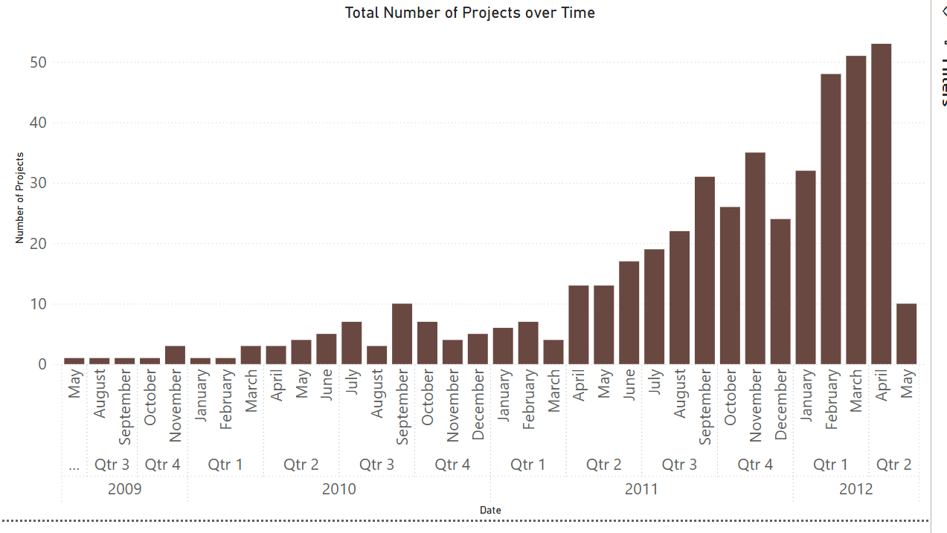
Lunch Timing:

Slide 6
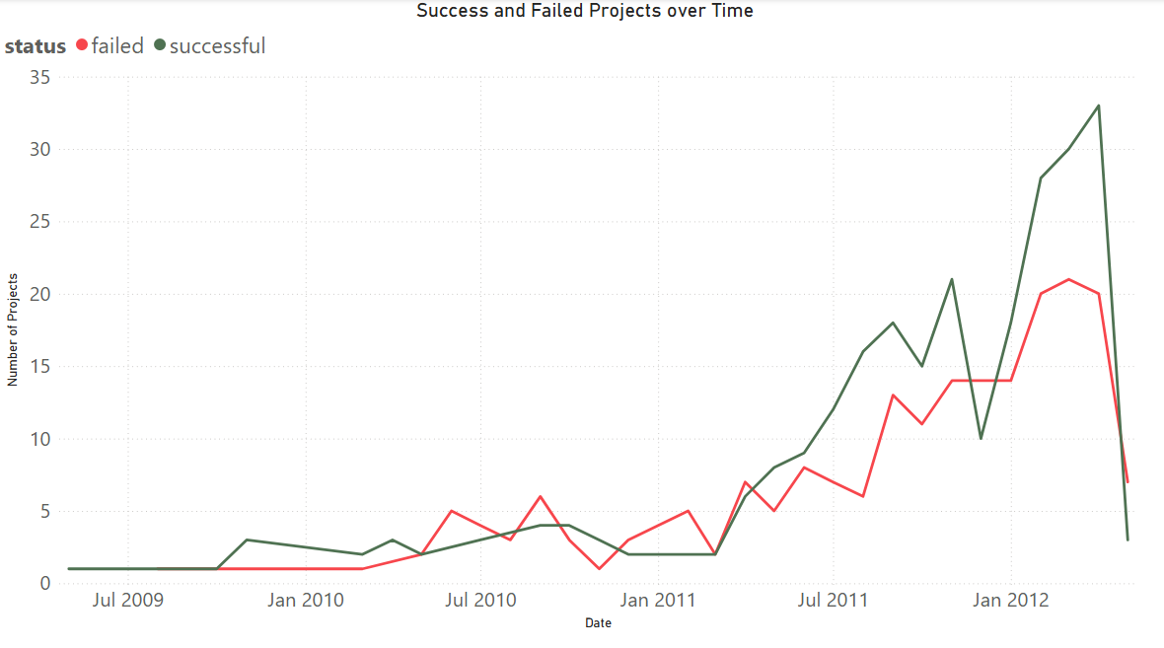
Lunch Timing:

Slide 7
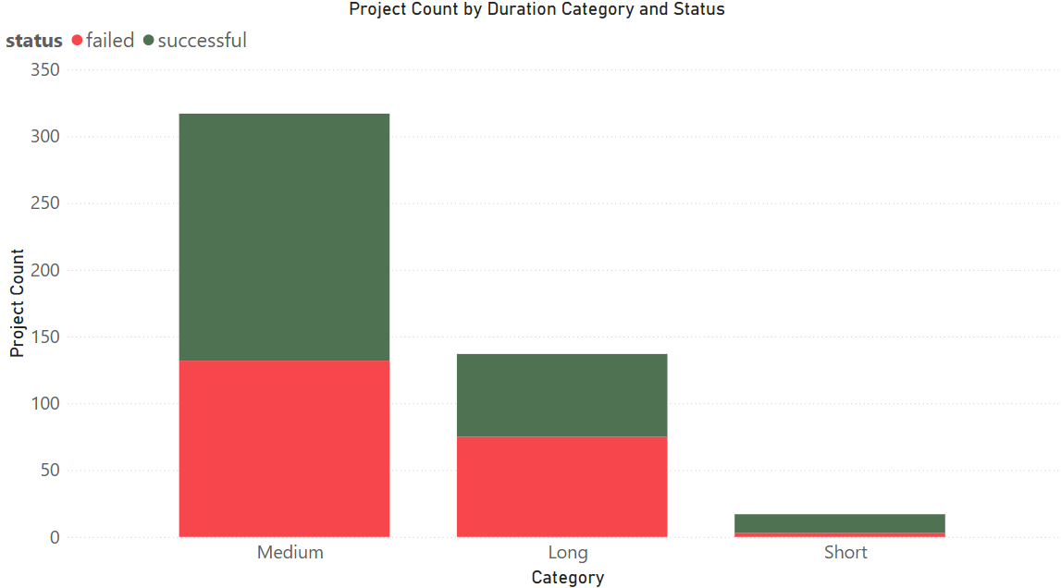
Campaign Duration:

Slide 8
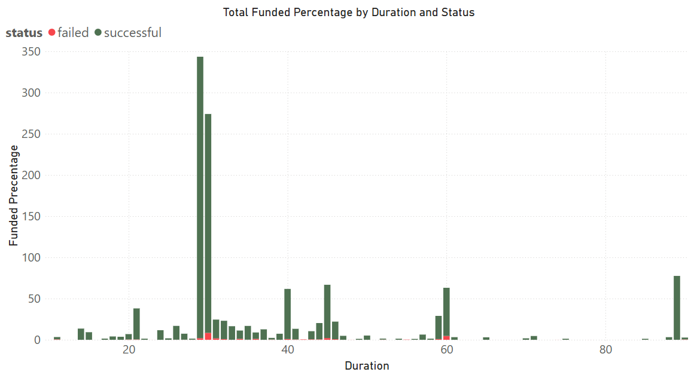
Campaign Duration:

Slide 9
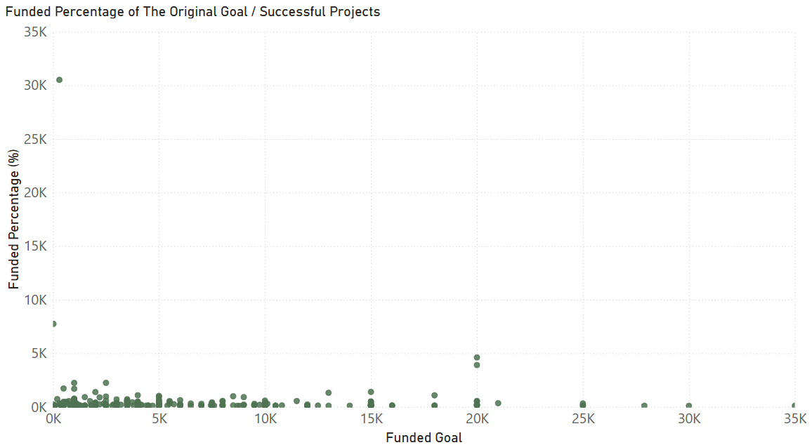
Funding Goals:

Slide 10
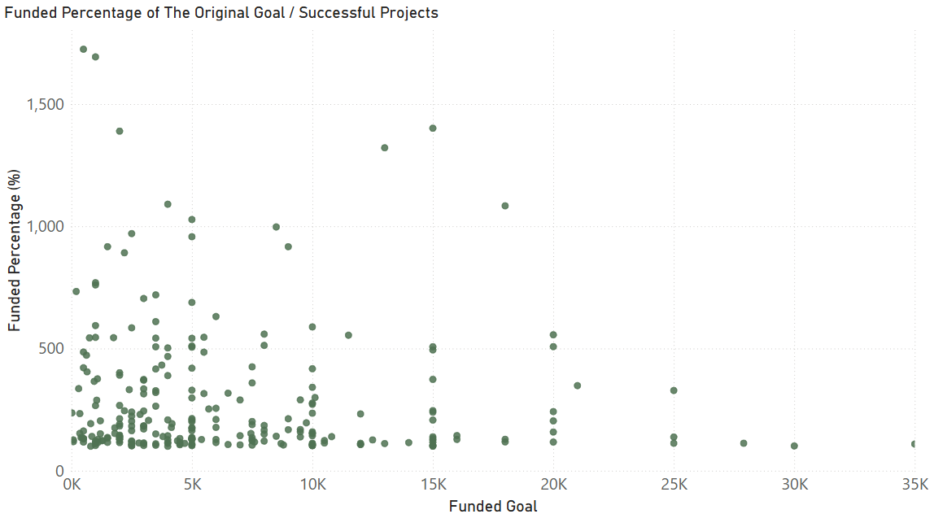
Funding Goals:

Slide 11
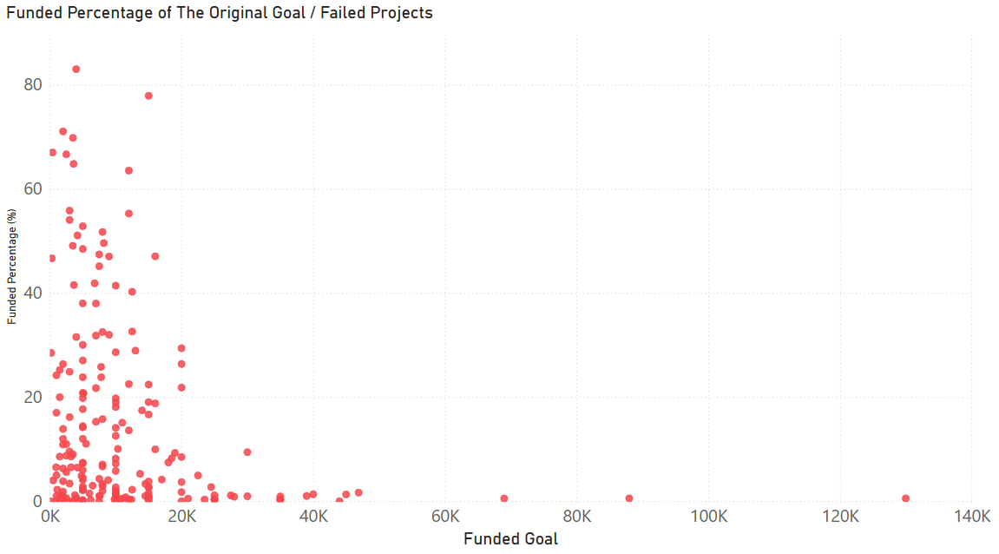
Funding Goals:

Slide 12
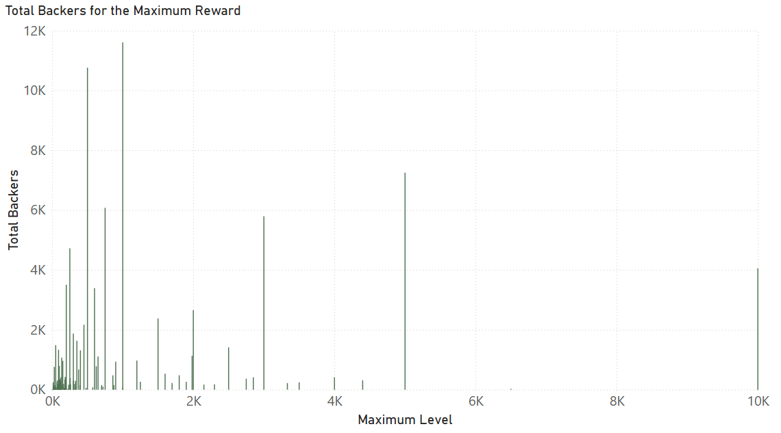
Reward Tier Pricing:

Slide 13
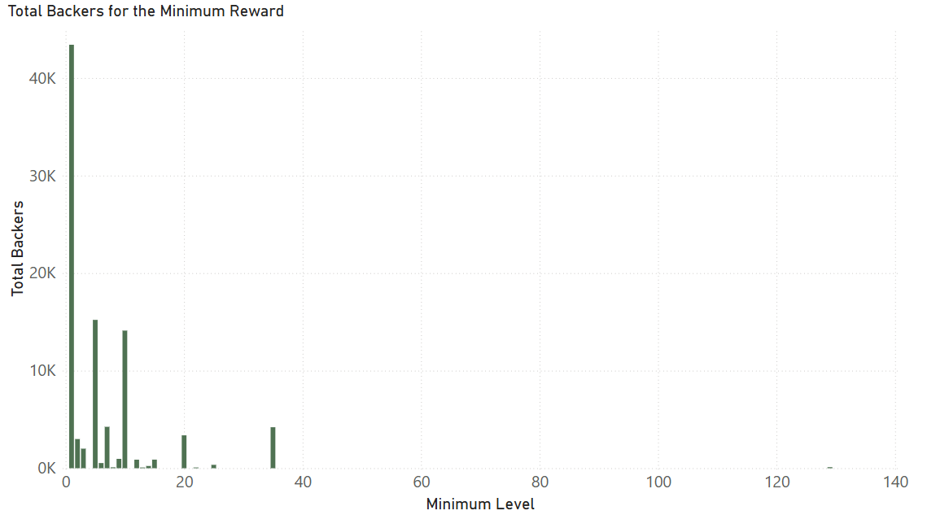
Reward Tier Pricing:

Slide 14
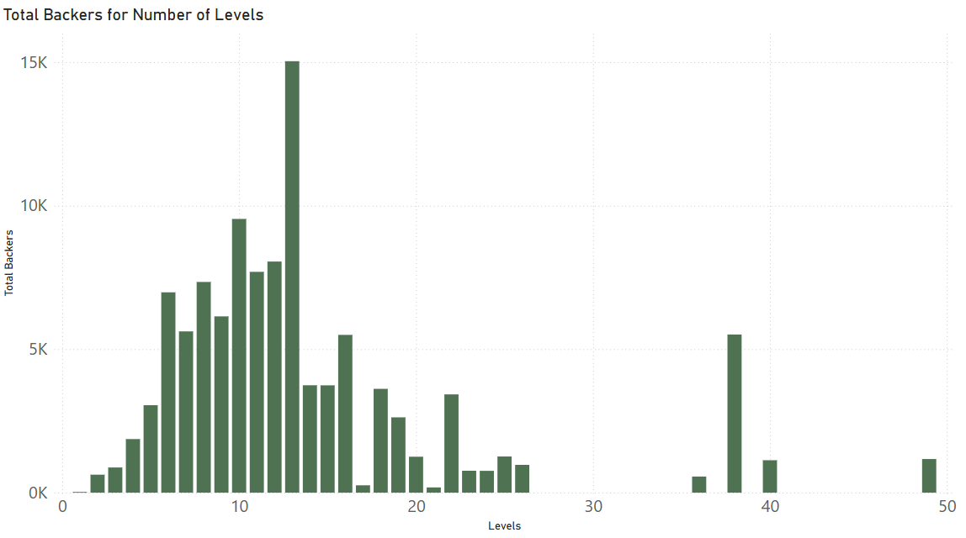
Reward Tier Pricing:

Slide 15
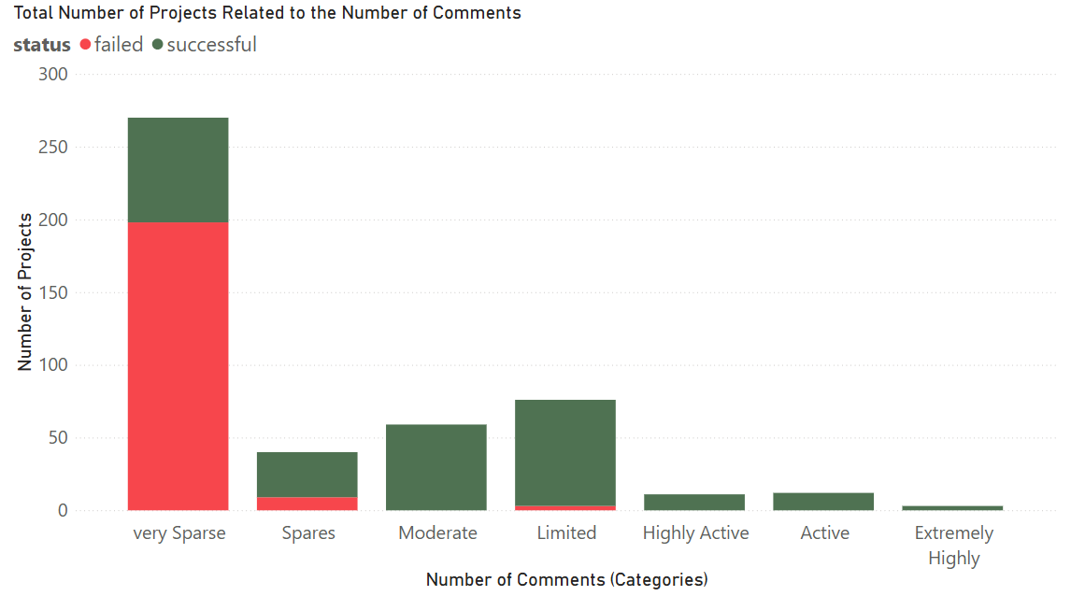
Engagement:

Slide 16
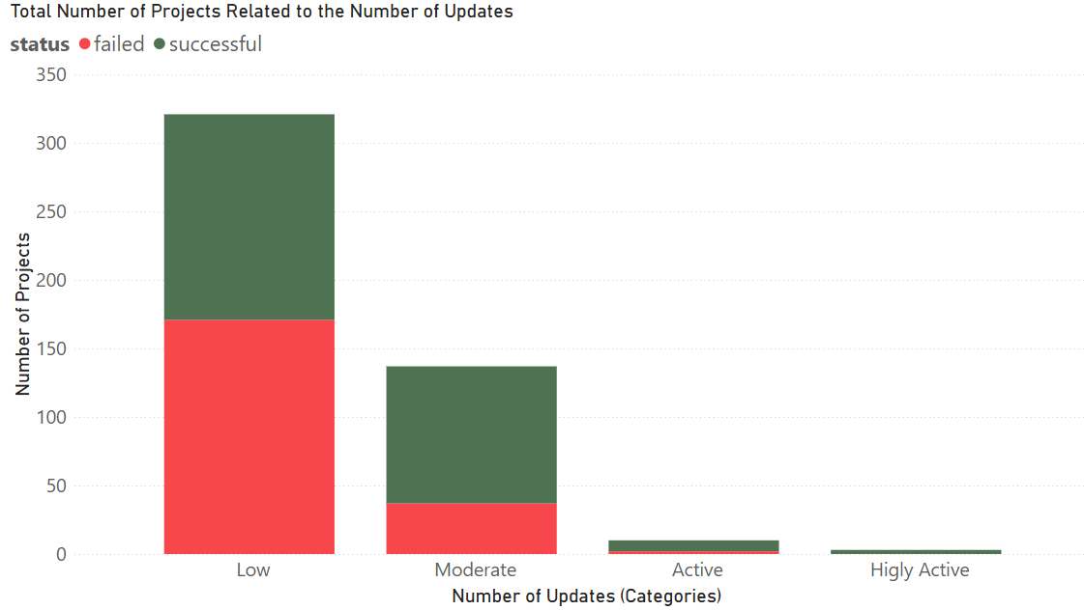
Engagement:

Slide 17
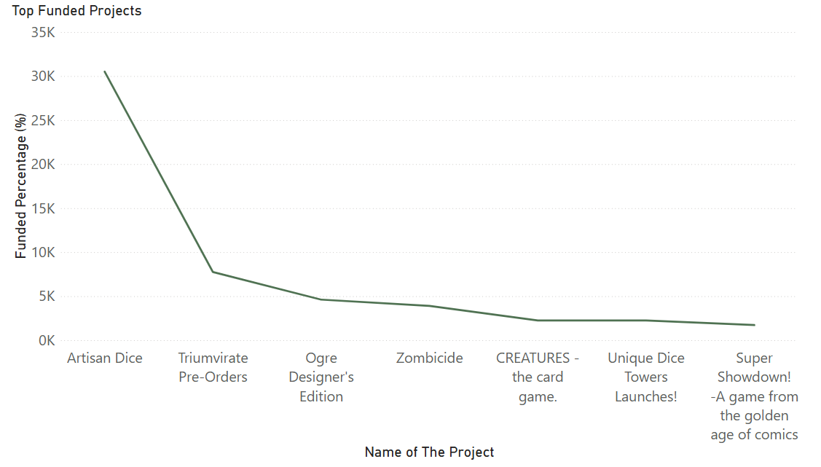
Example of high success:

Slide 18
Example of high success:

Slide 19
 | 1 |  |  |  | 5
 | 2 |  |  |  | 6
 | 3 |  |  |  | 7
 | 4
Recommendation:
Keep funding goal under $10,000
Offer higher-tier special editions for premium backers.
5 to 15 reward tiers recommended.
Minimum 10 updates throughout the campaign.
Start rewards at $10–$20 minimum.
Encourage > 20 comments through active communication.
Target duration between 21 to 45 days.

