Slide 1
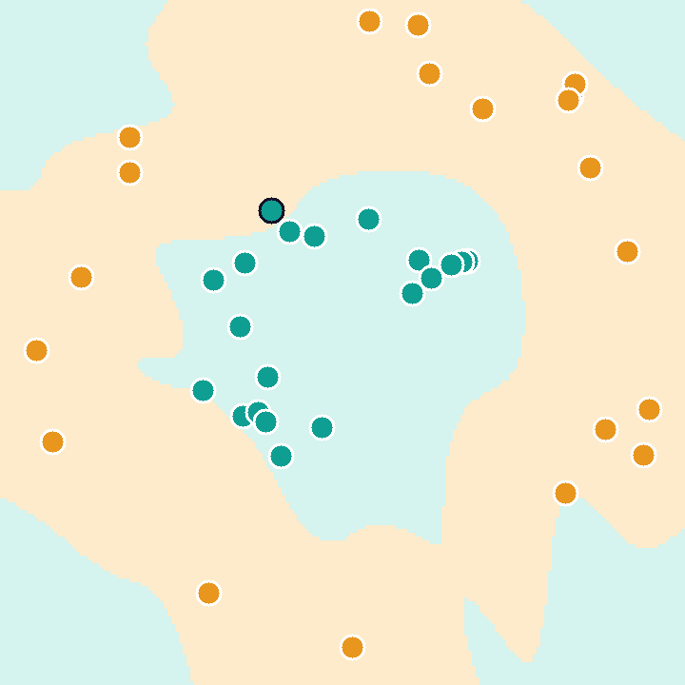
Classifying data with a quantum kernel
A basic use case of quantum computing for machine learning
What the classifier learns: two regions, one per ring
V. Anbuchelvan · Quantum Machine Learning · SRM IST
Notes:
Opening slide. The whole talk is one small example: a classifier whose similarity measure is computed by a two-qubit circuit.

Slide 2
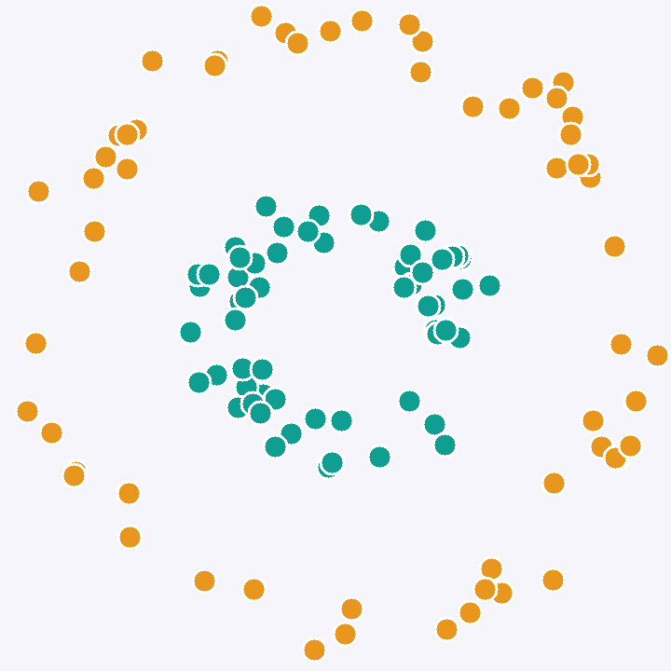
Two rings that no straight line can split
1
120 points, two classes
An inner ring and an outer ring. 80 points are used for training and 40 are held back for testing.
2
Two features per point
Both are scaled to the range 0 to π, so they can later be used directly as rotation angles.
3
A straight line fails
A linear support vector machine scores 60% on the test points, barely better than guessing.
Inner ring
Outer ring
Notes:
The task. Each point has two features. The label says which ring it is on. A linear classifier draws one straight line, so it cannot do better than a little over half.

Slide 3
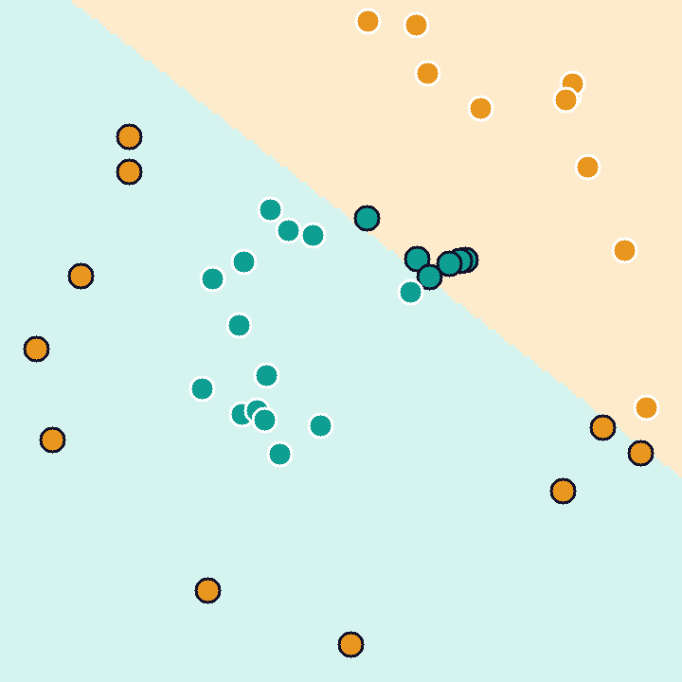
The kernel idea
A support vector machine only ever asks one question about the data:
How similar are x and y?
k(x, y) = one number per pair of points
Swap the similarity measure and the same algorithm draws a different boundary. A richer measure acts like lifting the data into a larger space where a flat cut is enough.
Plain dot product
Richer kernel
60% on test points
97.5% on test points
Dark-ringed points are misclassified.
Notes:
A support vector machine never needs the coordinates of the points, only how similar each pair is. That similarity function is the kernel. Changing the kernel changes the shape of the boundary.

Slide 4
Where the quantum computer fits
1
2
3
4
Data
Feature map
Kernel matrix
SVM training
→
→
→
Two numbers for every point
A circuit turns a point into a quantum state
Measure the overlap of every pair of states
Find the boundary from the matrix
CLASSICAL
QUANTUM
QUANTUM
CLASSICAL
Only steps 2 and 3 use qubits. The circuit is shallow, so it can run on the small, noisy machines that exist today.
Notes:
The pipeline is hybrid. Only the similarity measurement runs on the quantum device. Everything else is ordinary machine learning, which is why this is counted as a near-term use case.

Slide 5
Encoding a point in two qubits
1
Superpose
H
P(2x₁)
ZZ
(π−x₁)(π−x₂)
H puts each qubit in an equal mix of 0 and 1.
|0⟩
2
Write the features
x₁ and x₂ become phase angles.
|0⟩
H
P(2x₂)
3
Entangle
One layer of the feature map U(x)
ZZ links the qubits using both features.
|φ(x)⟩ = U(x)|00⟩ The point is now a state in a 4-dimensional space. Repeating the layer makes the map richer.
Notes:
This is the ZZ feature map from Havlicek et al. Hadamards create a superposition, single-qubit phase gates write in each feature, and the two-qubit ZZ phase entangles them with a product of the features.

Slide 6
Similarity is a measurement
P(00) = k(x, y)
|0⟩
U(x)
U†(y)
M
The share of runs that read 00 is the similarity of the two points.
|0⟩
M
0.95
0.22
Encode x, un-encode y, then measure both qubits
two points on the inner ring
one inner, one outer point
The same point twice always gives 1. The two values above are from the first training points of each ring.
Notes:
To compare two points, encode the first, then undo the encoding of the second. If the points are alike the circuit returns to all zeros. The fraction of runs that give 00 is the kernel value.

Slide 7
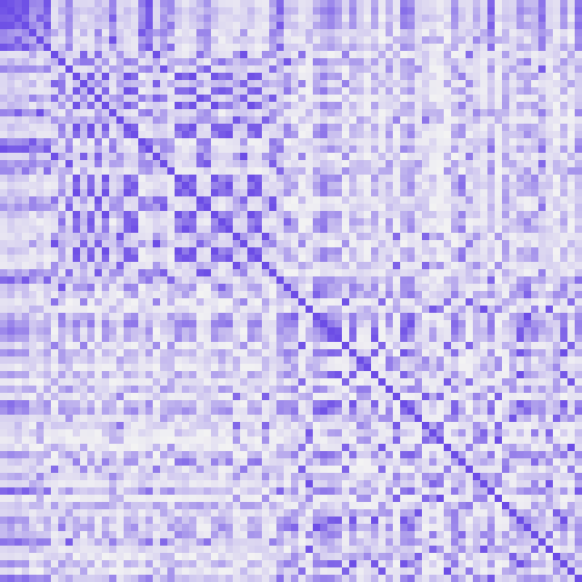
Training the classifier
80
3,160
42
training points
pairs, one circuit each
support vectors kept
The quantum circuit fills the matrix.
A classical solver then picks the points that sit near the boundary and weights them. Nothing about the solver is quantum.
To classify a new point
run the circuit against each support vector and add up the weighted similarities.
Points sorted by ring. Darker = more similar.
Notes:
Run the overlap circuit for every pair of training points to fill the kernel matrix, then hand the matrix to a standard SVM solver. The picture shows that matrix with the points sorted by ring; its pattern is all the solver gets to see.

Slide 8
Result on 40 unseen points
Quantum kernel, 2 layers: 39 of 40 test points correct
Notes:
The quantum kernel solves the task the straight line could not. The classical RBF kernel also solves it, slightly better. That is the honest reading of this experiment.

Slide 9
What this example does not show
1
2
3
No quantum advantage
An ideal simulation
Cost grows with pairs
A classical RBF kernel scores 100% on the same points. Two qubits are easy to simulate on any laptop.
These numbers are exact. Real hardware estimates each kernel value from repeated runs and adds noise.
n training points need n(n−1)/2 circuits. Large datasets get expensive quickly.
Where a benefit is expected: feature maps that are hard to simulate classically and that match the structure of the data. Finding real datasets like that is an open research question.
Notes:
Three limits to state plainly. Researchers expect a benefit only when the feature map is hard to simulate classically and suits the data. A two-qubit map is trivially easy to simulate.

Slide 10
Takeaways
1
A kernel is a similarity measure
Try the live demo
An SVM needs nothing else from the data.
zanyanbu.github.io/
quantum-kernel-classifier
2
A quantum circuit can compute one
Encode two points, measure the overlap, read off k(x, y).
References
Havlíček et al., “Supervised learning with quantum-enhanced feature spaces”, Nature 567 (2019).
Schuld and Killoran, “Quantum machine learning in feature Hilbert spaces”, Phys. Rev. Lett. 122 (2019).
3
The rest stays classical
A shallow, hybrid method that fits today’s small machines.
Notes:
Close on the three points, then show the live demo on the site.

