Slide 1
CS6501: Text Mining Course Policy
Hongning Wang
CS@UVa

Slide 2
Goal of this course
Discuss fundamental problems in text mining research
Building blocks of text mining algorithms
Wide coverage of many applications
Document classification/clustering
Topic modeling
Sentiment analysis/recommendation
Get hands-on experience by developing practical systems/components
Prepare students for doing cutting-edge research in text mining and related fields
Open the door to the amazing job opportunities in data science industry

Slide 3
Letters from former students
I wanted to catch up with you and let you know that I’ve been working on a variety of text mining projects, and that the knowledge and experience I gained in your class has been vital. I have your slides saved on my computer and I frequently revisit them. Most recently I reviewed the sections on sense signatures for an automated lexicography pipeline I’m working on. Thank you for the resources and for the wonderful instruction!

Slide 4
Letters from former students
I was a student in your Text Mining course in 2016. I have to say first that your
course has been my most marketable skill coming out of school. Companies are not impressed with the surface knowledge, but what I learned from your class sets me far above other candidates. I can't thank you enough for offering this course.

Slide 5
Structure of this course
Lecture based
Six major topics will be covered
E.g., NLP pipelines, classification/clustering models, and probabilistic topic models
Introduce state-of-the-art large-scale text analytics techniques
E.g., MapReduce framework, Apache Spark and GraphLab

Slide 6
Prerequisites
Programming skills – Important!
Basic data structures: CS 2150 or equivalent
Java is required for machine problems
Many open source packages in Java!
Any language you choose for the rest of this course
Math background
Probability
Discrete/continuous distributions, expectation, moments
Linear algebra
Vector, matrix, dot product, matrix factorization
Optimization
Gradient-based methods, optimality conditions

Slide 7
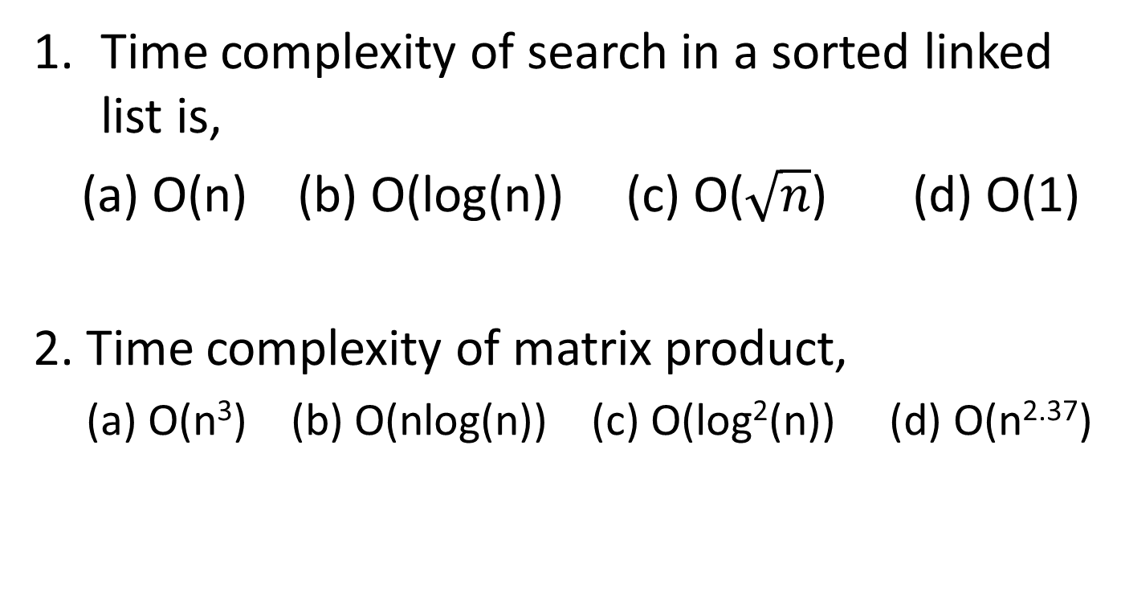
Pop-up quiz
Time complexity of search in a sorted linked list is,
(a) O(n) (b) O(log(n)) (c) O($\sqrt{n}$) (d) O(1)
2. Time complexity of matrix product,
(a) O(n³) (b) O(nlog(n)) (c) O(log²(n)) (d) O(n^{2.37})

Slide 8
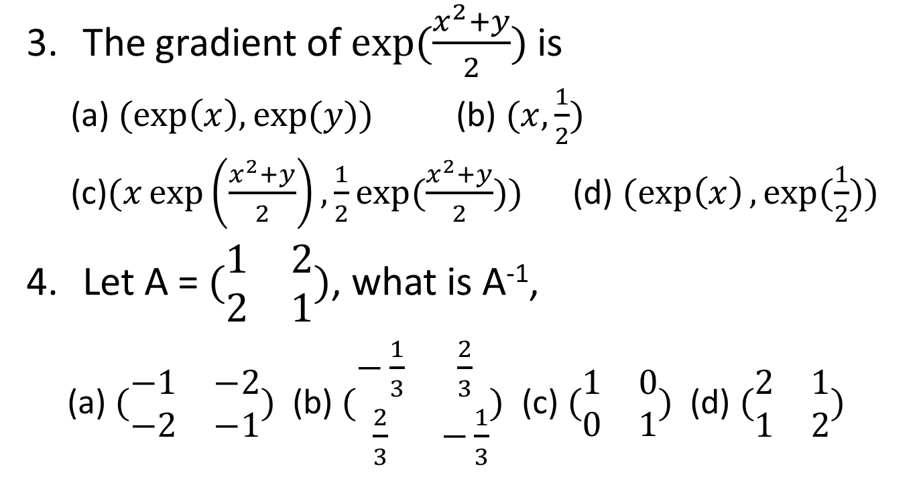
Pop-up quiz
The gradient of $exp⁡(\frac{x^{2}+y}{2})$ is
(a) $(exp\left(x\right),\exp{(y)})$ (b) $(x,\frac{1}{2})$
(c)$(x\exp\left(\frac{x^{2}+y}{2}\right),\frac{1}{2}exp{(\frac{x^{2}+y}{2})})$ (d) $(\exp\left(x\right),\exp{(\frac{1}{2}}))$
Let A = $(\begin{matrix}1 & 2 \\ 2 & 1\end{matrix})$, what is A⁻¹,
(a) $(\begin{matrix}−1 & −2 \\ −2 & −1\end{matrix})$ (b) $(\begin{matrix}−\frac{1}{3} & \frac{2}{3} \\ \frac{2}{3} & −\frac{1}{3}\end{matrix})$ (c) $(\begin{matrix}1 & 0 \\ 0 & 1\end{matrix})$ (d) $(\begin{matrix}2 & 1 \\ 1 & 2\end{matrix})$

Slide 9
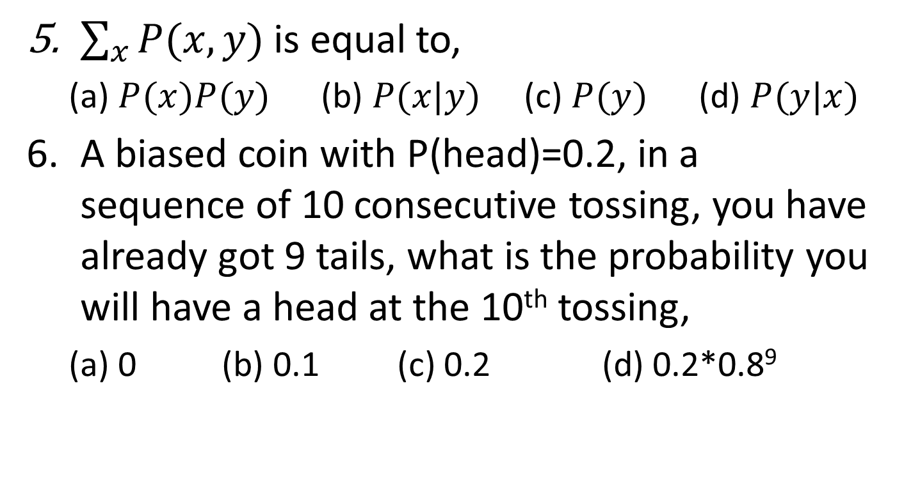
Pop-up quiz
$\sum_{x}{P(x,y)}$ is equal to,
(a) $P(x)P(y)$ (b) $P(x|y)$ (c) $P(y)$ (d) $P(y|x)$
A biased coin with P(head)=0.2, in a sequence of 10 consecutive tossing, you have already got 9 tails, what is the probability you will have a head at the 10th tossing,
(a) 0 (b) 0.1 (c) 0.2 (d) 0.2*0.8⁹

Slide 10
Pop-up quiz
Time complexity of search in a sorted linked list is,
(a) O(n) (b) O(log(n)) (c) O($\sqrt{n}$) (d) O(1)
2. Time complexity of matrix product,
(a) O(n³) (b) O(nlog(n)) (c) O(log²(n)) (d) O(n^{2.37})
(a)
(a)
(d)

Slide 11
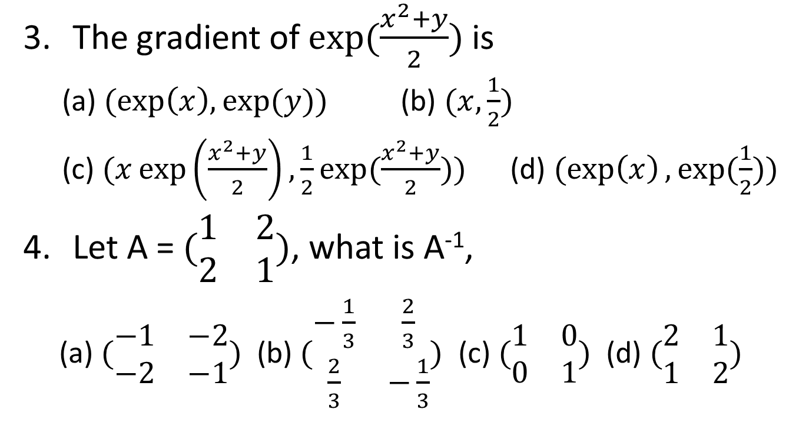
Pop-up quiz
The gradient of $exp⁡(\frac{x^{2}+y}{2})$ is
(a) $(exp\left(x\right),\exp{(y)})$ (b) $(x,\frac{1}{2})$
(c) $(x\exp\left(\frac{x^{2}+y}{2}\right),\frac{1}{2}exp{(\frac{x^{2}+y}{2})})$ (d) $(\exp\left(x\right),\exp{(\frac{1}{2}}))$
Let A = $(\begin{matrix}1 & 2 \\ 2 & 1\end{matrix})$, what is A⁻¹,
(a) $(\begin{matrix}−1 & −2 \\ −2 & −1\end{matrix})$ (b) $(\begin{matrix}−\frac{1}{3} & \frac{2}{3} \\ \frac{2}{3} & −\frac{1}{3}\end{matrix})$ (c) $(\begin{matrix}1 & 0 \\ 0 & 1\end{matrix})$ (d) $(\begin{matrix}2 & 1 \\ 1 & 2\end{matrix})$
(c)
(b)

Slide 12
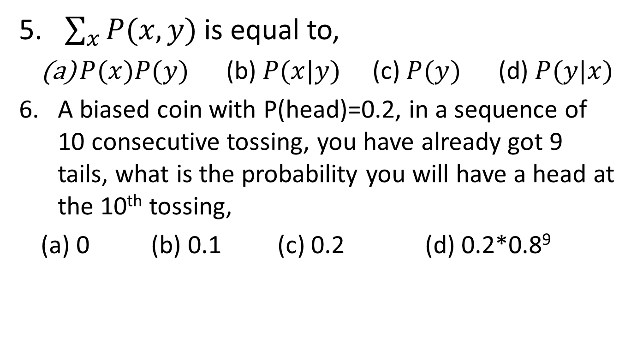
Pop-up quiz
$\sum_{x}{P(x,y)}$ is equal to,
$P(x)P(y)$ (b) $P(x|y)$ (c) $P(y)$ (d) $P(y|x)$
A biased coin with P(head)=0.2, in a sequence of 10 consecutive tossing, you have already got 9 tails, what is the probability you will have a head at the 10th tossing,
(a) 0 (b) 0.1 (c) 0.2 (d) 0.2*0.8⁹
(c)
(d)
(c)

Slide 13
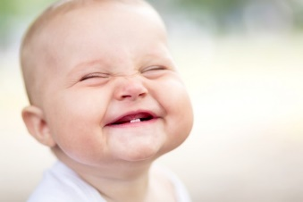
Grading policy
Homework (35%)
Machine problems (~3)
In-class quizzes (15%)
To review the learned concepts (~4)
Paper presentation (15%)
Graded by peer-review
Course project (35%)
Research/development-oriented
No midterm/final exams!
No curve will be applied in final grading!

Slide 14
Quizzes
Format
True/False questions
Multiple choice questions
Short answer questions
Schedule
In-class, after each major lecture topic
Will be informed one week before the quiz
Closed book and closed notes
No electronic aids or cheat sheets

Slide 15
Paper presentation
Let students present the state-of-the-art research related to text mining
Choosing from recommended readings, or your favorite paper outside the list
Should be related to your course project
12-mins presentation plus 2-mins Q&A
One paper per a group of students
Register your choice early, first come first serve
Will be graded by the instructor and other students

Slide 16
Course project
Appreciate research-oriented problems or “deliverables”
Work in groups (required)
Up to 4 students
Project proposal (20%)
Discuss your topic with peers or the instructor first
Written report
Project report (40%)
Due before the final presentation
Project presentation (40%)
10-mins in-class presentation
2-mins Q&A

Slide 17
Deadlines
Machine problems
Submit via Collab
Due in 2 weeks after posting
Paper presentation
Sign up is due by the end of 4th week
Presentation starts on the 6th week
Project
Proposal due by the end of 4th week
Presentation in the last week of Spring semester
Monthly email check-in

Slide 18
Late policy
Homework
Everyone will have one chance to ask for an extension (extra three days after deadline)
Request must be made before the deadline!
Quizzes
No make-up quizzes unless under emergency situation
Paper presentation
Must be presented on your selected date
Course project
Proposal due early in the semester (~4th week, no extension)
Final report due before presentation (no extension)

Slide 19

Late policy
If submit after the deadline without granted extension
15% late penalty will be applied within the first week of due date
30% late penalty thereafter
Fairness among all the students will be guaranteed!

Slide 20

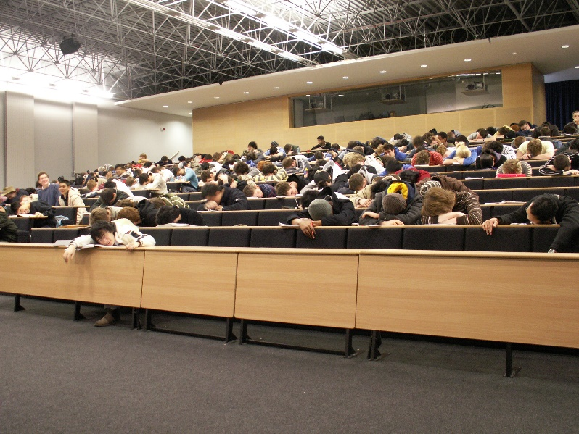

Classroom participation
HIGHLY APPRECIATED!
Helps me quickly remember your names
Reminds me what is still confusing
You can drive the lecture/discussion in this class!

Slide 21

TA
Lu Lin ll5fy@virginia.edu

Slide 22
Contact information
Lecture
Instructor: Hongning Wang
Time: Tuesday/Thursday 3:30pm to 4:45pm
Location: Olsson Hall 009
Office hour
Instructor’s
Time: Tuesday/Thursday 1:00pm to 2:00pm
Location: Rice Hall 408
TA’s
Time: Wednesday/Friday 1:00pm to 2:00pm
Location: Rice Hall 340
Course website
Website: http://www.cs.virginia.edu/~hw5x/Course/TextMining-2019Spring/_site/
Piazza: http://piazza.com/virginia/spring2019/cs6501/home

Slide 23
Questions?
Thank you!

