Slide 1
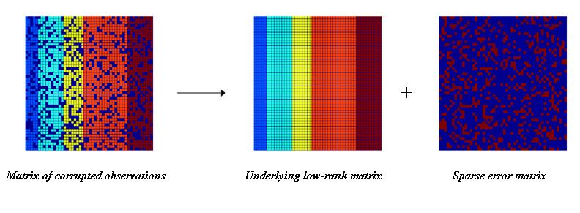
Recap: how to build such a space
Solution
Low rank matrix approximation
Imagine this is *true* concept-document matrix
Imagine this is our observed term-document matrix
Random noise over the word selection in each document

Slide 2
Recap: Latent Semantic Analysis (LSA)
Solve LSA by SVD
Procedure of LSA
Perform SVD on document-term adjacency matrix
Construct $C_{M×N}^{k}$ by only keeping the largest $k$ singular values in $Σ$ non-zero
Map to a lower dimensional space
$$\hat{Z}=\underset{Z|rank\left(Z\right)=k}{argmin}{{\left\|C−Z\right\|}_{F}}$$
$=\underset{Z|rank\left(Z\right)=k}{argmin}{\sqrt{\sum_{i=1}^{M}{\sum_{j=1}^{N}{{\left(C_{ij}−Z_{ij}\right)}^{2}}}}}$
$=C_{M×N}^{k}$

Slide 3
Introduction to Natural Language Processing
Hongning Wang
CS@UVa

Slide 4
What is NLP?
Arabic text
كلب هو مطاردة صبي في الملعب.
How can a computer make sense out of this string?
- What are the basic units of meaning (words)?
- What is the meaning of each word?
Morphology
Syntax
- How are words related with each other?
Semantics
- What is the “combined meaning” of words?
Pragmatics
- What is the “meta-meaning”? (speech act)
Discourse
- Handling a large chunk of text
Inference
- Making sense of everything

Slide 5

An example of NLP
A dog is chasing a boy on the playground.
Det
Noun
Aux
Verb
Det
Noun
Prep
Det
Noun
Lexical
analysis
(part-of-speech
tagging)
Noun Phrase
Noun Phrase
Complex Verb
Noun Phrase
Semantic analysis
Prep Phrase
Dog(d1).
Boy(b1).
Playground(p1).
Chasing(d1,b1,p1).
Verb Phrase
Syntactic analysis
(Parsing)
Verb Phrase
+
Sentence
Scared(x) if Chasing(_,x,_).
A person saying this may
be reminding another person to get the dog back…
Scared(b1)
Inference
Pragmatic analysis
(speech act)

Slide 6



If we can do this for all the sentences in all languages, then …
Automatically answer our emails
Translate languages accurately
Help us manage, summarize, and aggregate information
Use speech as a UI (when needed)
Talk to us / listen to us
BAD NEWS:
Unfortunately, we cannot right now.
General NLP = “Complete AI”

Slide 7
NLP is difficult!!!!!!!
Natural language is designed to make human communication efficient. Therefore,
We omit a lot of “common sense” knowledge, which we assume the hearer/reader possesses
We keep a lot of ambiguities, which we assume the hearer/reader knows how to resolve
This makes EVERY step in NLP hard
Ambiguity is a “killer”!
Common sense reasoning is pre-required

Slide 8
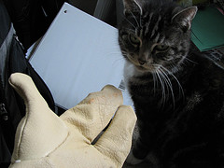


An example of ambiguity
Get the cat with the gloves.

Slide 9
Examples of challenges
Word-level ambiguity
“design” can be a noun or a verb (Ambiguous POS)
“root” has multiple meanings (Ambiguous sense)
Syntactic ambiguity
“natural language processing” (Modification)
“A man saw a boy with a telescope.” (PP Attachment)
Anaphora resolution
“John persuaded Bill to buy a TV for himself.” (himself = John or Bill?)
Presupposition
“He has quit smoking.” implies that he smoked before.

Slide 10

Despite all the challenges, research in NLP has also made a lot of progress…

Slide 11
A brief history of NLP
Early enthusiasm (1950’s): Machine Translation
Too ambitious
Bar-Hillel report (1960) concluded that fully-automatic high-quality translation could not be accomplished without knowledge (Dictionary + Encyclopedia)
Less ambitious applications (late 1960’s & early 1970’s): Limited success, failed to scale up
Speech recognition
Dialogue (Eliza)
Inference and domain knowledge (SHRDLU=“block world”)
Real world evaluation (late 1970’s – now)
Story understanding (late 1970’s & early 1980’s)
Large scale evaluation of speech recognition, text retrieval, information extraction (1980 – now)
Statistical approaches enjoy more success (first in speech recognition & retrieval, later others)
Current trend:
Boundary between statistical and symbolic approaches is disappearing.
We need to use all the available knowledge
Application-driven NLP research (bioinformatics, Web, Question answering…)
Deep understanding in
limited domain
Shallow understanding
Knowledge representation
Robust component techniques
Statistical language models
Applications

Slide 12
The state of the art
A dog is chasing a boy on the playground
POS
Tagging:
97%
Det
Noun
Aux
Verb
Det
Noun
Prep
Det
Noun
Noun Phrase
Noun Phrase
Complex Verb
Noun Phrase
Prep Phrase
Verb Phrase
Parsing: partial >90%
Semantics: some aspects
Entity/relation extraction
Word sense disambiguation
Anaphora resolution
Verb Phrase
Sentence
Inference: ???
Speech act analysis: ???

Slide 13
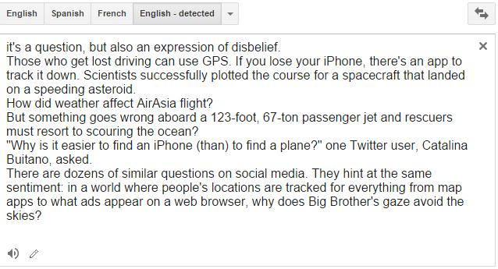

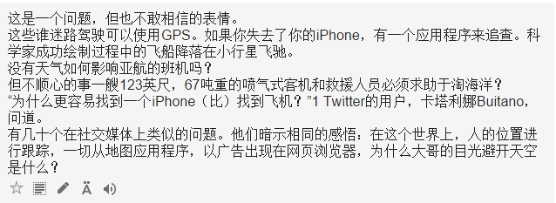
Machine translation

Slide 14
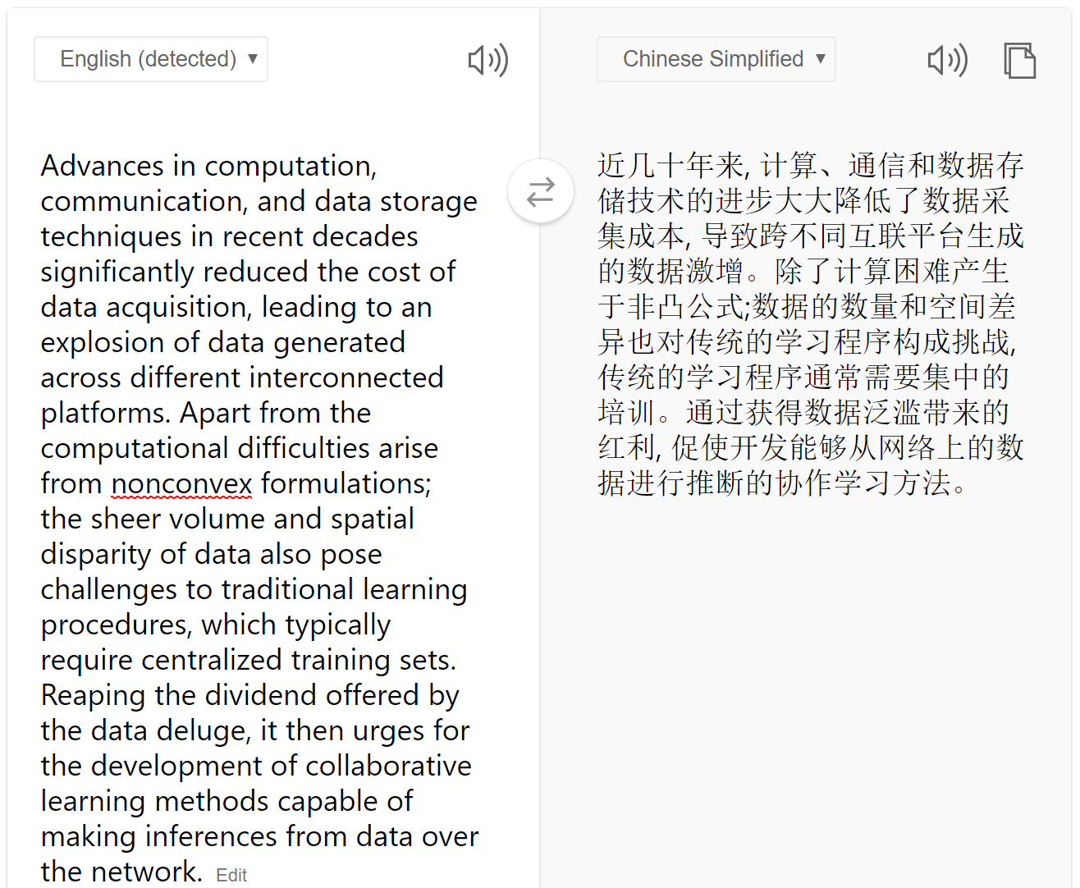

Machine translation

Slide 15
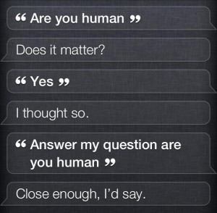
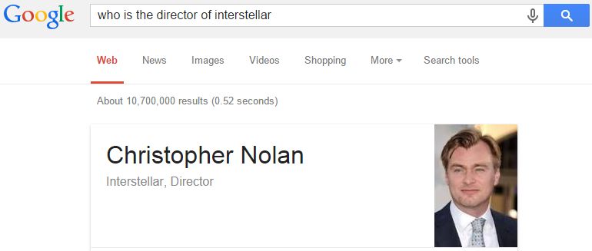
Dialog systems
Apple’s siri system
Google search

Slide 16
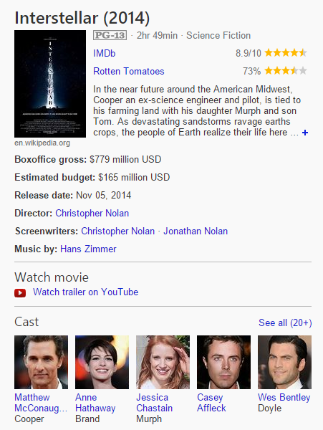

Information extraction
Google Knowledge Graph
Wiki Info Box

Slide 17
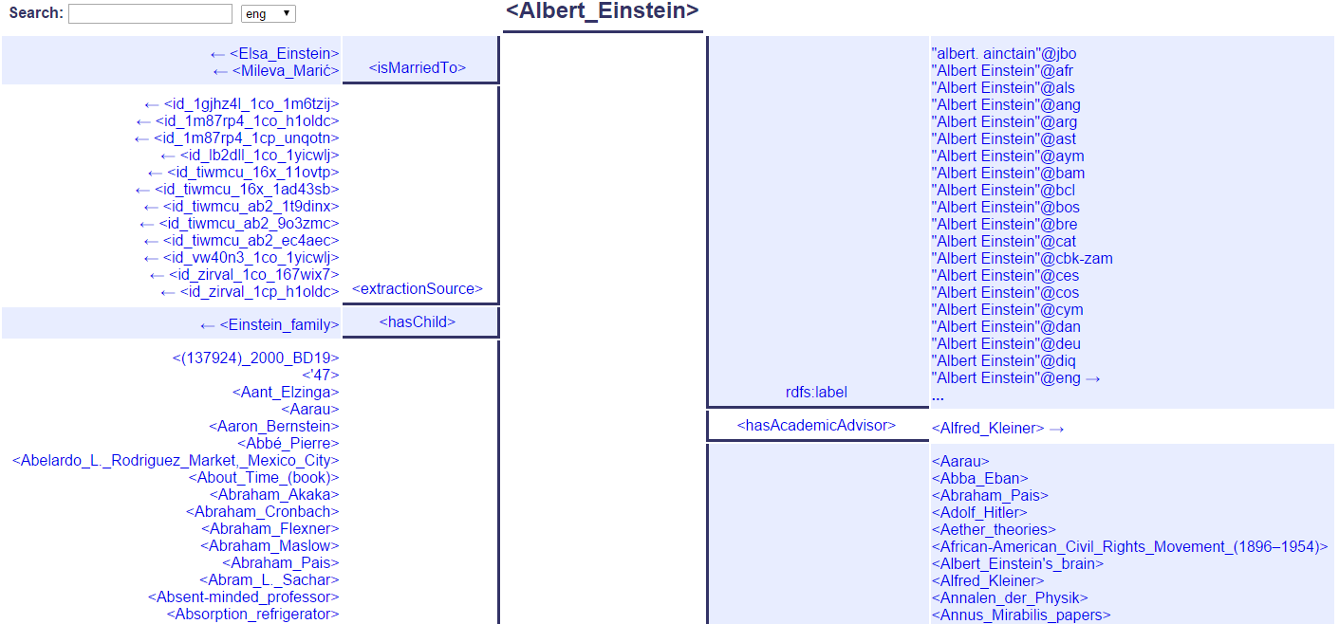
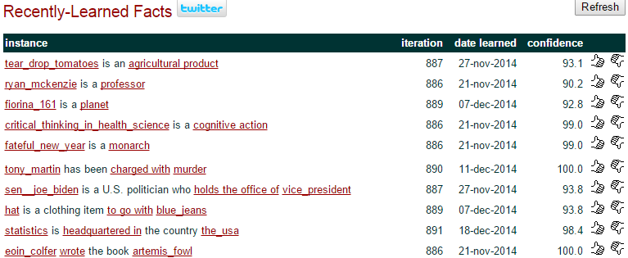
Information extraction
CMU Never-Ending Language Learning
YAGO Knowledge Base

Slide 18

Building a computer that ‘understands’ text: The NLP pipeline

Slide 19
Tokenization/Segmentation
Split text into words and sentences
Task: what is the most likely segmentation /tokenization?
There was an earthquake near D.C. I’ve even felt it in Philadelphia, New York, etc.
There + was + an + earthquake + near + D.C.
I + ve + even + felt + it + in + Philadelphia, + New + York, + etc.

Slide 20
Part-of-Speech tagging
Marking up a word in a text (corpus) as corresponding to a particular part of speech
Task: what is the most likely tag sequence
A + dog + is + chasing + a + boy + on + the + playground
A + dog + is + chasing + a + boy + on + the + playground
Det
Noun
Aux
Verb
Det
Noun
Prep
Det
Noun

Slide 21
Named entity recognition
Determine text mapping to proper names
Task: what is the most likely mapping
Its initial Board of Visitors included U.S. Presidents Thomas Jefferson, James Madison, and James Monroe.
Its initial Board of Visitors included U.S. Presidents Thomas Jefferson, James Madison, and James Monroe.
Organization, Location, Person

Slide 22
Syntactic parsing
Grammatical analysis of a given sentence, conforming to the rules of a formal grammar
Task: what is the most likely grammatical structure
A + dog + is + chasing + a + boy + on + the + playground
Det
Noun
Aux
Verb
Det
Noun
Prep
Det
Noun
Noun Phrase
Complex Verb
Noun Phrase
Noun Phrase
Verb Phrase
Prep Phrase
Verb Phrase
Sentence

Slide 23
Relation extraction
Identify the relationships among named entities
Shallow semantic analysis
Its initial Board of Visitors included U.S. Presidents Thomas Jefferson, James Madison, and James Monroe.
1. Thomas Jefferson Is_Member_Of Board of Visitors
2. Thomas Jefferson Is_President_Of U.S.

Slide 24
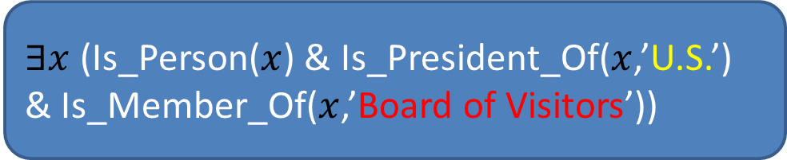
Logic inference
Convert chunks of text into more formal representations
Deep semantic analysis: e.g., first-order logic structures
Its initial Board of Visitors included U.S. Presidents Thomas Jefferson, James Madison, and James Monroe.
$∃x$ (Is_Person($x$) & Is_President_Of($x$,’U.S.’) & Is_Member_Of($x$,’Board of Visitors’))

Slide 25
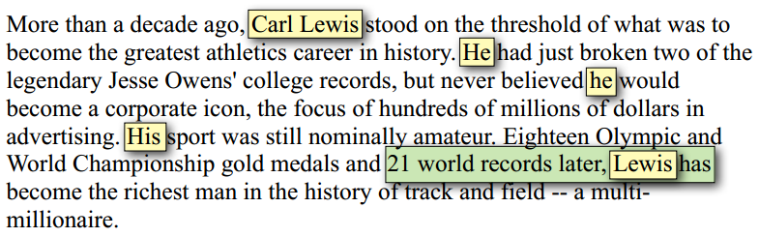
Towards understanding of text
Who is Carl Lewis?
Did Carl Lewis break any records?

Slide 26
Major NLP applications
Speech recognition: e.g., auto telephone call routing
Text mining
Text clustering
Text classification
Text summarization
Topic modeling
Question answering
Language tutoring
Spelling/grammar correction
Machine translation
Cross-language retrieval
Restricted natural language
Natural language user interface
Our focus

Slide 27

NLP & text mining
Better NLP => Better text mining
Bad NLP => Bad text mining?
Robust, shallow NLP tends to be more useful than deep, but fragile NLP.
Errors in NLP can hurt text mining performance…

Slide 28
How much NLP is really needed?
Tasks
Dependency on NLP
Scalability
Classification
Clustering
Summarization
Extraction
Topic modeling
Translation
Dialogue
Question
Answering
Inference
Speech Act

Slide 29
So, what NLP techniques are the most useful for text mining?
Statistical NLP in general.
The need for high robustness and efficiency implies the dominant use of simple models

Slide 30
What you should know
Different levels of NLP
Challenges in NLP
NLP pipeline

