Slide 1
Lexical Semantics and Word Senses
Hongning Wang
CS@UVa

Slide 2
Today’s lecture
Lexical semantics
Meaning of words
Relation between different meanings
WordNet
An ontology structure of word senses
Similarity between words
Distributional semantics
Similarity between words
Word sense disambiguation

Slide 3
What is the meaning of a word?
Most words have many different senses
dog = animal or sausage?
lie = to be in a horizontal position or a false statement made with deliberate intent
What are the relations of different words in terms of meaning?
Specific relations between senses
Animal is more general than dog
Semantic fields
Money is related to bank
“a set of words grouped, referring to a specific subject … not necessarily synonymous, but are all used to talk about the same general phenomenon ” - wiki

Slide 4
Word senses
What does ‘bank’ mean?
A financial institution
E.g., “US bank has raised interest rates.”
A particular branch of a financial institution
E.g., “The bank on Main Street closes at 5pm.”
The sloping side of any hollow in the ground, especially when bordering a river
E.g., “In 1927, the bank of the Mississippi flooded.”
A ‘repository’
E.g., “I donate blood to a blood bank.”

Slide 5
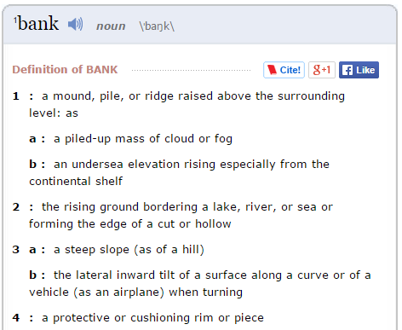
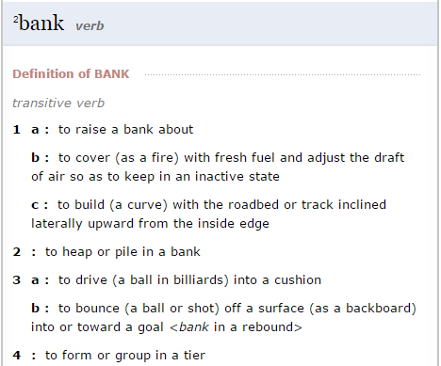
Lexicon entries
lemma
senses

Slide 6
Some terminologies
Word forms: runs, ran, running; good, better, best
Any, possibly inflected, form of a word
Lemma (citation/dictionary form): run; good
A basic word form (e.g. infinitive or singular nominative noun) that is used to represent all forms of the same word
Lexeme: RUN(V), GOOD(A), BANK¹(N), BANK²(N)
An abstract representation of a word (and all its forms), with a part-of-speech and a set of related word senses
Often just written (or referred to) as the lemma, perhaps in a different FONT
Lexicon
A (finite) list of lexemes

Slide 7
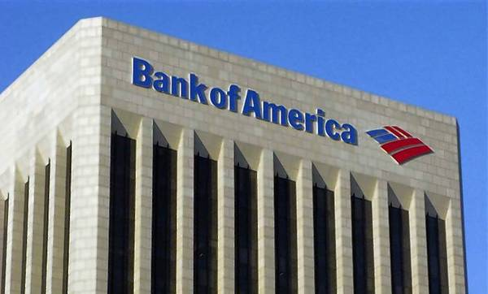

Make sense of word senses
Polysemy
A lexeme is polysemous if it has different related senses
bank = financial institution or a building

Slide 8
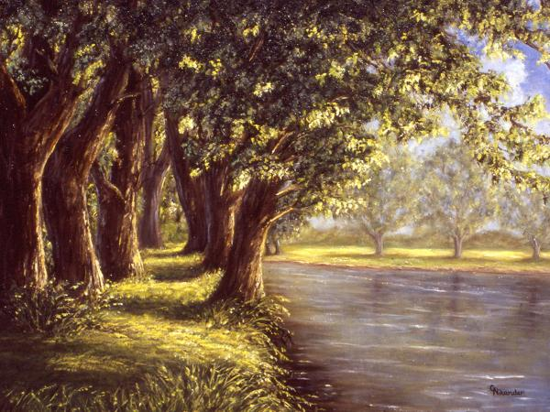
Make sense of word senses
Homonyms
Two lexemes are homonyms if their senses are unrelated, but they happen to have the same spelling and pronunciation
bank = financial institution or river bank

Slide 9
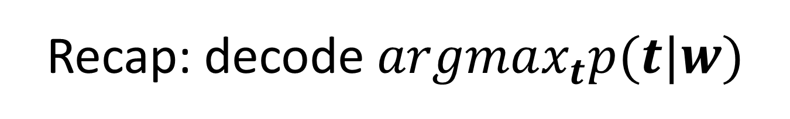
Recap: decode $argmax_{t}p(t|w)$
Take the highest scoring entry in the last column of the trellis
Keep backpointers in each trellis to keep track of the most probable sequence
$$T\left[j\right]\left[i\right]=P\left(w_{i} | t^{j}\right)Max_{k}\left(T\left[k\right]\left[i−1\right]P\left(t^{j} | t_{k}\right)\right)$$
 | $$w_{1}$$ | $$w_{2}$$ | $$w_{3}$$ | $$w_{4}$$ | $$w_{5}$$
$$t_{1}$$
$$t_{2}$$
$$t_{3}$$
$$t_{4}$$
$$t_{5}$$
$$t_{6}$$
$$t_{7}$$

Slide 10
Recap: comparing to traditional classification problems
Sequence labeling
Traditional classification
$t^{∗}=argmax_{t}p\left(t | w\right)$
$t$ is a vector/matrix
Dependency between both $(t_{i},w_{i})$ and $(t_{i},t_{j})$
Structured output
Difficult to solve the inference problem
$y=argmax_{y}p(y|x)$
$y$ is a single label
Dependency only within $(y,x)$
Independent output
Easy to solve the inference problem

Slide 11
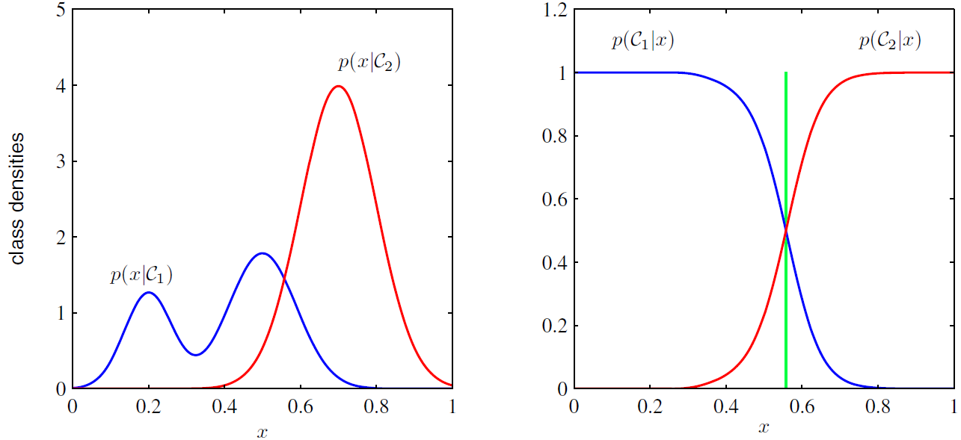
Recap: generative V.S. discriminative models
Binary classification as an example
Generative Model’s view
Discriminative Model’s view

Slide 12
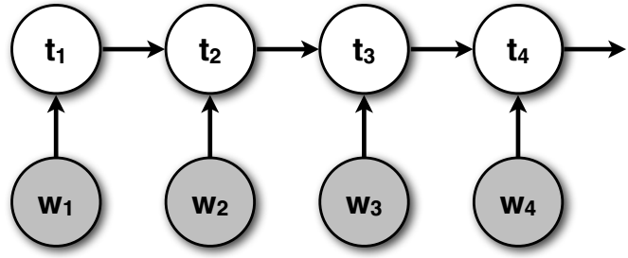
Recap: maximum entropy Markov models
MEMMs are discriminative models of the labels $t$ given the observed input sequence $w$
$p\left(t | w\right)=\prod_{i}{p(t_{i}|w_{i},t_{i−1})}$

Slide 13
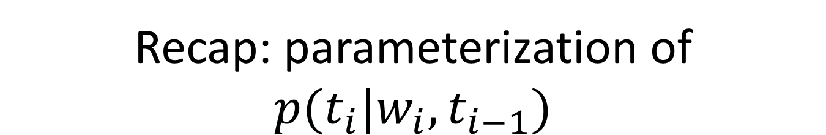
Recap: parameterization of $p(t_{i}|w_{i},t_{i−1})$
Associate a real-valued weight $λ$ to each specific type of feature function
$λ_{k}$ for f_{first-letter-capitalized-NNP}(w)
Define a scoring function $f\left(t_{i},t_{i−1},w_{i}\right)=\sum_{k}{λ_{k}f_{k}({t_{i},t_{i−1},w}_{i})}$
Naturally $p\left(t_{i} | w_{i},t_{i−1}\right)∝\exp{f\left(t_{i},t_{i−1},w_{i}\right)}$
Recall the basic definition of probability
$P(x)>0$
$\sum_{x}{p(x)}=1$

Slide 14
Recap: what is the meaning of a word?
Most words have many different senses
dog = animal or sausage?
lie = to be in a horizontal position or a false statement made with deliberate intent
What are the relations of different words in terms of meaning?
Specific relations between senses
Animal is more general than dog
Semantic fields
Money is related to bank
“a set of words grouped, referring to a specific subject … not necessarily synonymous, but are all used to talk about the same general phenomenon ” - wiki

Slide 15
Relations between senses
Symmetric relations
Synonyms: couch/sofa
Two lemmas with the same sense
Antonyms: cold/hot, rise/fall, in/out
Two lemmas with the opposite sense
Hierarchical relations:
Hypernyms and hyponyms: pet/dog
The hyponym (dog) is more specific than the hypernym (pet)
Holonyms and meronyms: car/wheel
The meronym (wheel) is a part of the holonym (car)

Slide 16
WordNet
George Miller, Cognitive Science Laboratory of Princeton University, 1985
A very large lexical database of English:
117K nouns, 11K verbs, 22K adjectives, 4.5K adverbs
Word senses grouped into synonym sets (“synsets”) linked into a conceptual-semantic hierarchy
82K noun synsets, 13K verb synsets, 18K adjectives synsets, 3.6K adverb synsets
Avg. # of senses: 1.23/noun, 2.16/verb, 1.41/adj, 1.24/adverb
Conceptual-semantic relations
hypernym/hyponym

Slide 17
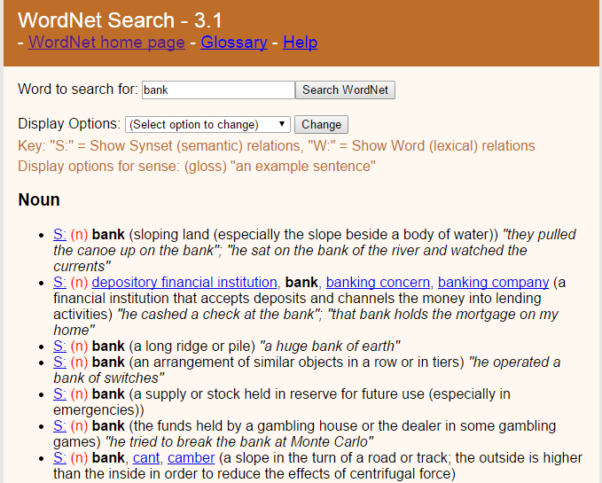
A WordNet example
http://wordnet.princeton.edu/

Slide 18
Hierarchical synset relations: nouns
Hypernym/hyponym (between concepts)
The more general ‘meal’ is a hypernym of the more specific ‘breakfast’
Instance hypernym/hyponym (between concepts and instances)
Austen is an instance hyponym of author
Member holonym/meronym (groups and members)
professor is a member meronym of (a university’s) faculty
Part holonym/meronym (wholes and parts)
wheel is a part meronym of (is a part of) car.
Substance meronym/holonym (substances and components)
flour is a substance meronym of (is made of) bread
Jane Austen, 1775–1817, English novelist

Slide 19
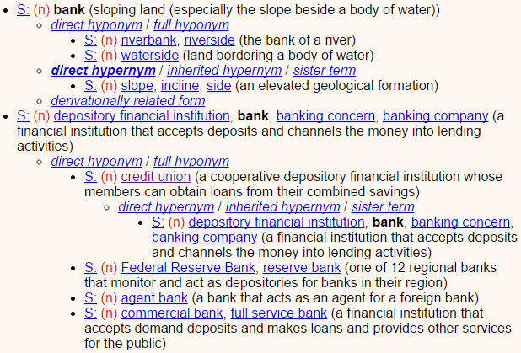
WordNet hypernyms & hyponyms

Slide 20
Hierarchical synset relations: verbs
the presence of a ‘manner’ relation between two lexemes
Hypernym/troponym (between events)
travel/fly, walk/stroll
Flying is a troponym of traveling: it denotes a specific manner of traveling
Entailment (between events):
snore/sleep
Snoring entails (presupposes) sleeping

Slide 21
WordNet similarity
Path based similarity measure between words
Shortest path between two concepts (Leacock & Chodorow 1998)
sim = 1/|shortest path|
Path length to the root node from the least common subsumer (LCS) of the two concepts (Wu & Palmer 1994)
sim = 2*depth(LCS)/(depth(w₁)+depth(w₂))
http://wn-similarity.sourceforge.net/
the most specific concept which is an ancestor of both A and B.

Slide 22
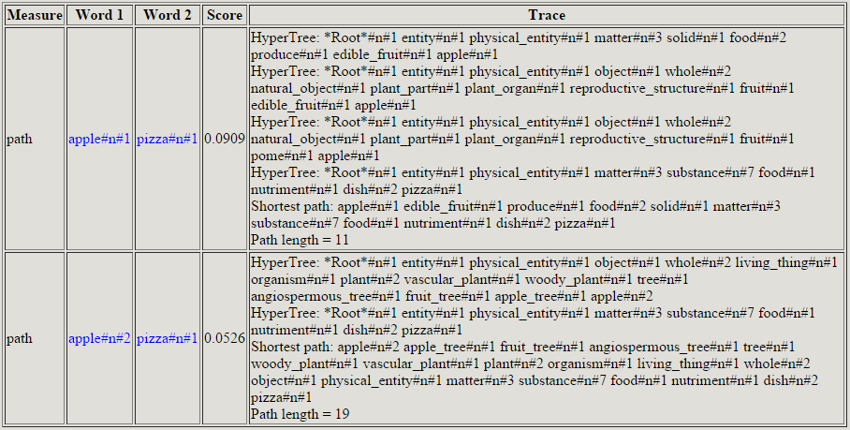
WordNet::Similarity

Slide 23
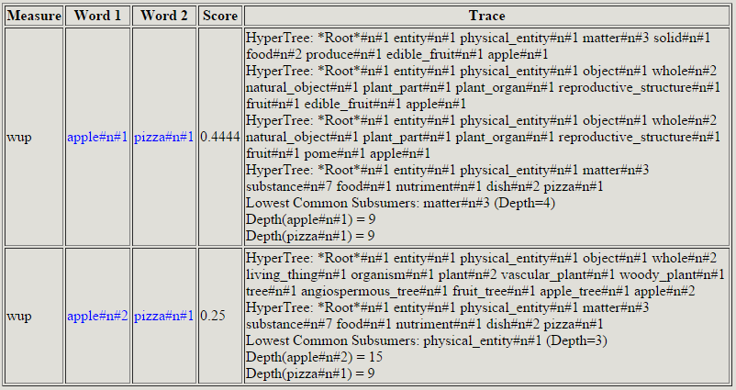
WordNet::Similarity

Slide 24
Distributional hypothesis
What is tezgüino?
A bottle of tezgüino is on the table.
Everybody likes tezgüino.
Tezgüino makes you drunk.
We make tezgüino out of corn.
The contexts in which a word appears tell us a lot about what it means

Slide 25
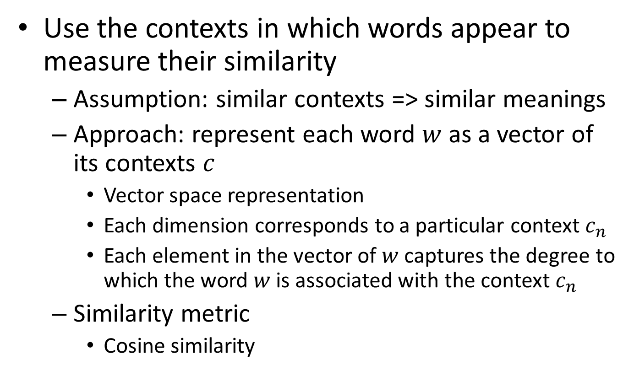
Distributional semantics
Use the contexts in which words appear to measure their similarity
Assumption: similar contexts => similar meanings
Approach: represent each word $w$ as a vector of its contexts $c$
Vector space representation
Each dimension corresponds to a particular context $c_{n}$
Each element in the vector of $w$ captures the degree to which the word $w$ is associated with the context $c_{n}$
Similarity metric
Cosine similarity

Slide 26
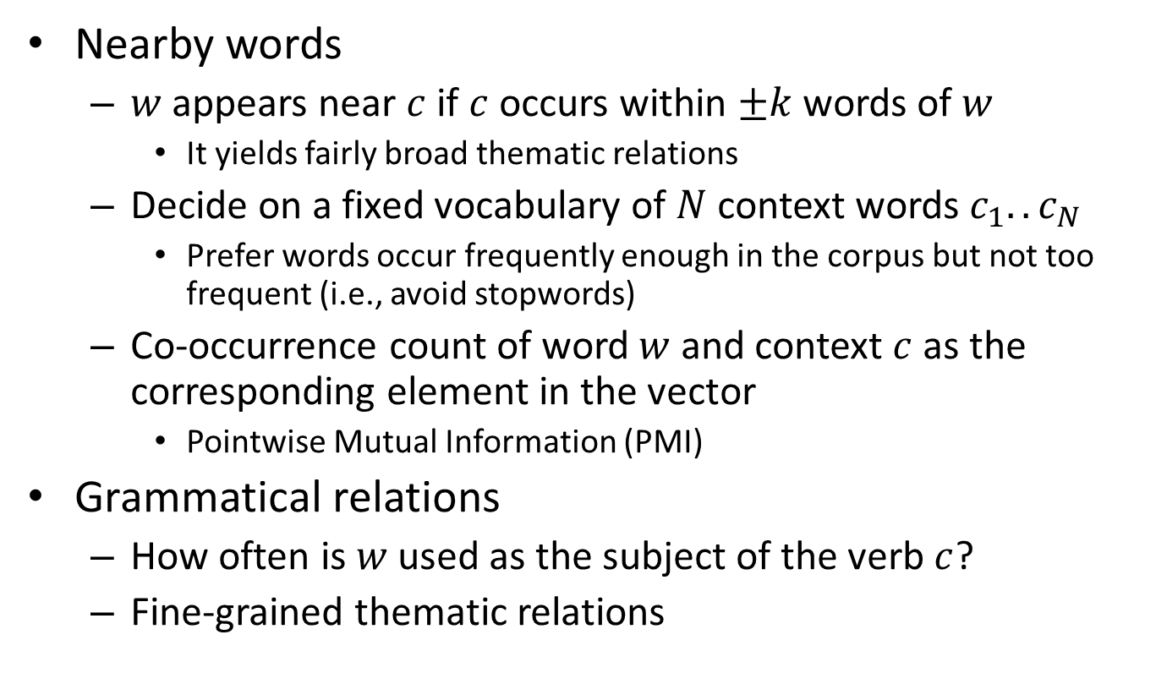
How to define the context
within a sentence
Nearby words
$w$ appears near $c$ if $c$ occurs within $±k$ words of $w$
It yields fairly broad thematic relations
Decide on a fixed vocabulary of $N$ context words $c_{1}..c_{N}$
Prefer words occur frequently enough in the corpus but not too frequent (i.e., avoid stopwords)
Co-occurrence count of word $w$ and context $c$ as the corresponding element in the vector
Pointwise Mutual Information (PMI)
Grammatical relations
How often is $w$ used as the subject of the verb $c$?
Fine-grained thematic relations

Slide 27
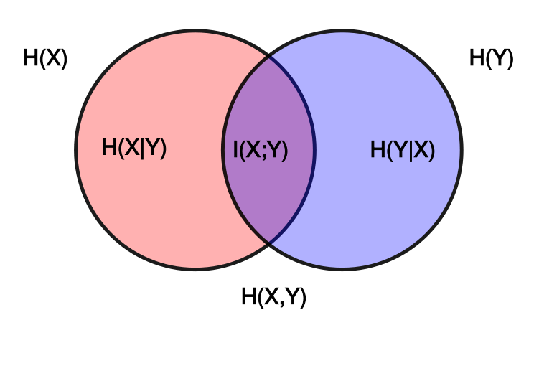

Mutual information
Relatedness between two random variables
$I\left(X;Y\right)=\sum_{y∈Y}{\sum_{x∈X}{p(x,y)}\log{(\frac{p(x,y)}{p\left(x\right)p(y)})}}$

Slide 28
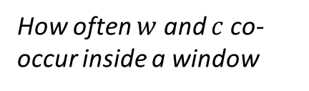



Pointwise mutual information
within a sentence
PMI between w and c using a fixed window of $±k$ words
$PMI\left(w;c\right)=p(w,c)\log{(\frac{p(w,c)}{p\left(w\right)p(c)})}$
How often $w$ and $c$ co-occur inside a window
How often $w$ occurs
How often $c$ occurs

Slide 29
Word sense disambiguation
What does this word mean?
This plant needs to be watered each day.
living plant
This plant manufactures 1000 widgets each day.
factory
Word sense disambiguation (WSD)
Identify the sense of content words (noun, verb, adjective) in context (assuming a fixed inventory of word senses)
watered
manufactures

Slide 30
Dictionary-based methods
A dictionary/thesaurus contains glosses and examples of a word
bank¹
Gloss: a financial institution that accepts deposits and channels
the money into lending activities
Examples: “he cashed the check at the bank”,
“that bank holds the mortgage on my home”
bank²
Gloss: sloping land (especially the slope beside a body of water)
Examples: “they pulled the canoe up on the bank”,
“he sat on the bank of the river and watched the current”

Slide 31
Lesk algorithm
Compare the context with the dictionary definition of the sense
Construct the signature of a word in context by the signatures of its senses in the dictionary
Signature = set of context words (in examples/gloss or in context)
Assign the dictionary sense whose gloss and examples are the most similar to the context in which the word occurs
Similarity = size of intersection of context signature and sense signature
context words

Slide 32
Sense signatures
bank¹
Gloss: a financial institution that accepts deposits and channels
the money into lending activities
Examples: “he cashed the check at the bank”,
“that bank holds the mortgage on my home”
bank²
Gloss: sloping land (especially the slope beside a body of water)
Examples: “they pulled the canoe up on the bank”,
“he sat on the bank of the river and watched the current”
Signature(bank¹) = {financial, institution, accept, deposit,
channel, money, lend, activity, cash, check, hold, mortgage, home}
Signature(bank¹) = {slope, land, body, water, pull, canoe, sit,
river, watch, current}

Slide 33
Signature of target word
“The bank refused to give me a loan.”
Simplified Lesk
Words in context
Signature(bank) = {refuse, give, loan}
Original Lesk
Augmented signature of the target word
Signature(bank) = {refuse, reject, request,... , give, gift, donate,... loan, money, borrow,...}

Slide 34
Learning-based Methods
Will be discussed in the lecture of “Text Categorization”
Basically treat each sense as an independent class label
Construct classifiers to assign each instance with context into the classes/senses

Slide 35
What you should know
Lexical semantics
Relationship between words
WordNet
Distributional semantics
Similarity between words
Word sense disambiguation

Slide 36
Today’s reading
Speech and Language Processing
Chapter 19: Lexical Semantics
Chapter 20: Computational Lexical Semantics

