Slide 1
Recap: WordNet
George Miller, Cognitive Science Laboratory of Princeton University, 1985
A very large lexical database of English:
117K nouns, 11K verbs, 22K adjectives, 4.5K adverbs
Word senses grouped into synonym sets (“synsets”) linked into a conceptual-semantic hierarchy
82K noun synsets, 13K verb synsets, 18K adjectives synsets, 3.6K adverb synsets
Avg. # of senses: 1.23/noun, 2.16/verb, 1.41/adj, 1.24/adverb
Conceptual-semantic relations
hypernym/hyponym

Slide 2
Recap: WordNet similarity
Path based similarity measure between words
Shortest path between two concepts (Leacock & Chodorow 1998)
sim = 1/|shortest path|
Path length to the root node from the least common subsumer (LCS) of the two concepts (Wu & Palmer 1994)
sim = 2*depth(LCS)/(depth(w₁)+depth(w₂))
http://wn-similarity.sourceforge.net/
the most specific concept which is an ancestor of both A and B.

Slide 3
Recap: distributional semantics
Use the contexts in which words appear to measure their similarity
Assumption: similar contexts => similar meanings
Approach: represent each word $w$ as a vector of its contexts $c$
Vector space representation
Each dimension corresponds to a particular context $c_{n}$
Each element in the vector of $w$ captures the degree to which the word $w$ is associated with the context $c_{n}$
Similarity metric
Cosine similarity

Slide 4
Recap: signature of target word
“The bank refused to give me a loan.”
Simplified Lesk
Words in context
Signature(bank) = {refuse, give, loan}
Original Lesk
Augmented signature of the target word
Signature(bank) = {refuse, reject, request,... , give, gift, donate,... loan, money, borrow,...}

Slide 5
Statistical Machine Translation
Hongning Wang
CS@UVa

Slide 6
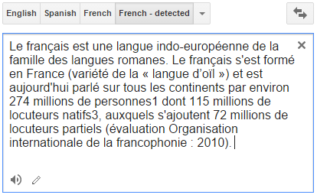

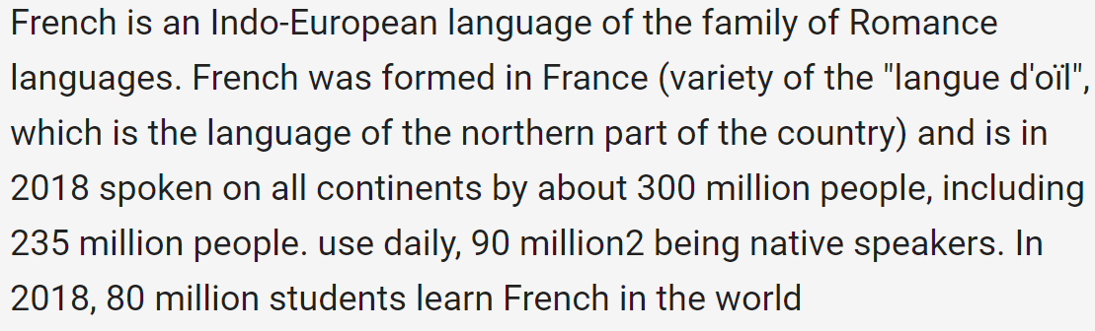
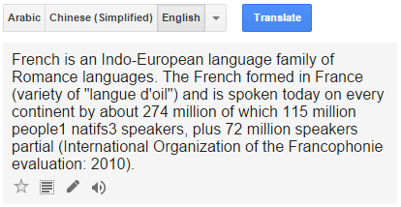
Machine translation

Slide 7
How do human translate languages?
Is a bilingual dictionary sufficient?
John loves Mary.
John told Mary a story.
Jean aime Marie.
Jean a raconté une histoire à Marie.
John is a computer scientist.
John swam across the lake.
Jean est informaticien.
Jean a traversé le lac à la nage.

Slide 8
Correspondences
A bilingual dictionary is clearly insufficient!
One-to-one
John = Jean, aime = loves, Mary=Marie
One-to-many/many-to-one
Mary = [à Marie]
[a computer scientist] = informaticien
Many-to-many
[swam across __] = [a traversé __ à la nage]
Reordering required
told Mary¹ [a story]² = a raconté [une histoire]² [à Marie]¹

Slide 9
Lexical divergences
Different senses of homonymous words generally have different translations
Different senses of polysemous words may also have different translations
English - German
(river) bank - Ufer
(financial) bank - Bank
I know that he bought the book: Je sais qu’il a acheté le livre.
I know Peter: Je connais Peter.
I know math: Je m’y connais en maths.

Slide 10
Syntactic divergences
Word order
SVO (Sbj-Verb-Obj), SOV, VSO,…
fixed or free?
Head-marking vs. dependent-marking
Dependent-marking (English): the man’s house
Head-marking (Hungarian): the man house-his
Pro-drop languages can omit pronouns
Italian (with inflection): I eat = mangio; he eats = mangia
Chinese (without inflection): I/he eat: chīfàn

Slide 11
Semantic divergences
Aspect
English has a progressive aspect
‘Peter swims’ vs. ‘Peter is swimming’
German can only express this with an adverb:
‘Peter schwimmt’ vs. ‘Peter schwimmt gerade’
Clearly, a bilingual dictionary is insufficient; and machine translation is difficult!

Slide 12
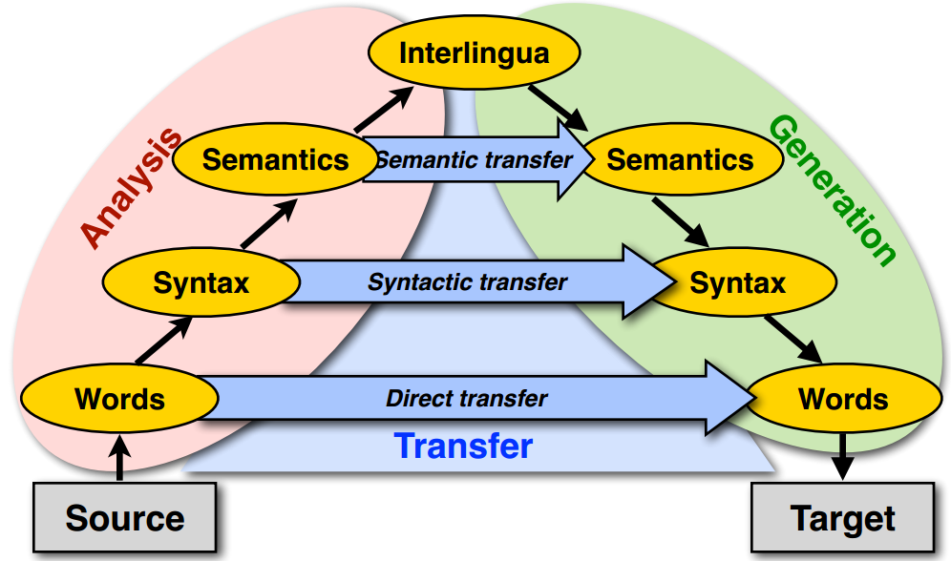
Machine translation approaches
The Vauquois triangle

Slide 13
Statistical machine translation
Main stream of current machine translation paradigm
The idea was introduced by Warren Weaver in 1949
Re-introduced in 1993 by researchers at IBM's Thomas J. Watson Research Center
Now it is the most widely studied/used machine translation method
1966: ALPAC report: human translation is far cheaper and better - kills MT for a long time

Slide 14
Noisy-Channel framework ^{[Shannon 48]}
Translating French to English
$$Eng^{∗}=argmax_{Eng}p(Eng|Fre)$$
Source
Transmitter
(encoder)
Noisy
Channel
Receiver
(decoder)
Destination
Eng
Fre
Eng’
P(Eng)
P(Fre|Eng)
P(Eng’|Fre)=?
Language model
Translation model
Observation
Guessed input

Slide 15
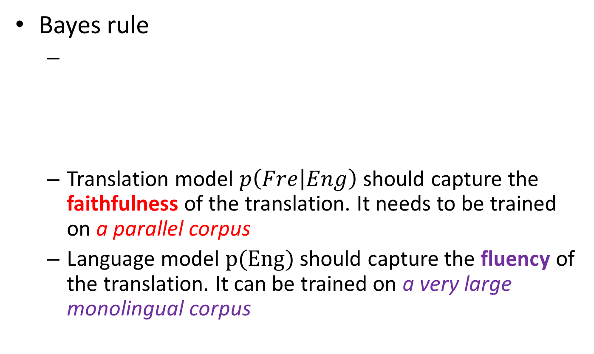
Translation with a noisy channel model
Bayes rule
Translation model $p\left(Fre | Eng\right)$ should capture the faithfulness of the translation. It needs to be trained on a parallel corpus
Language model $p(Eng)$ should capture the fluency of the translation. It can be trained on a very large monolingual corpus
$$Eng^{∗}=argmax_{Eng}p(Eng|Fre)$$
$$=argmax_{Eng}p\left(Fre | Eng\right)p(Eng)$$
Observed (given)
Translation Model
Language Model

Slide 16
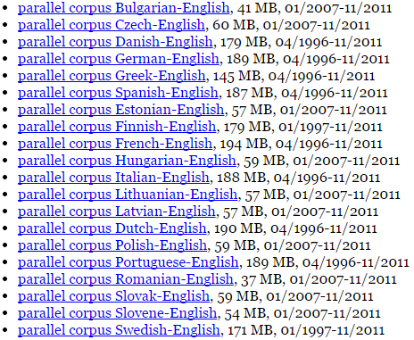
Parallel corpora
The same text in two (or more) languages
High-quality manually crafted translations
European Parliament Proceedings Parallel Corpus

Slide 17

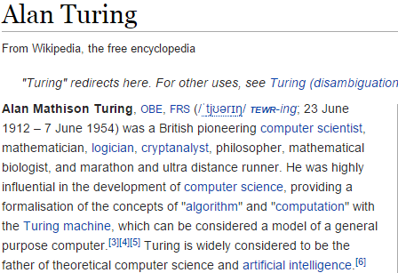
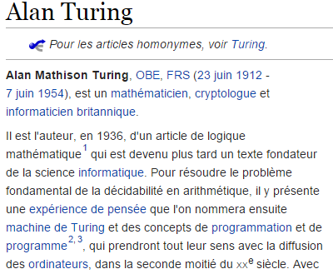
Parallel corpora
The same text in two (or more) languages
High-quality manually crafted translations

Slide 18

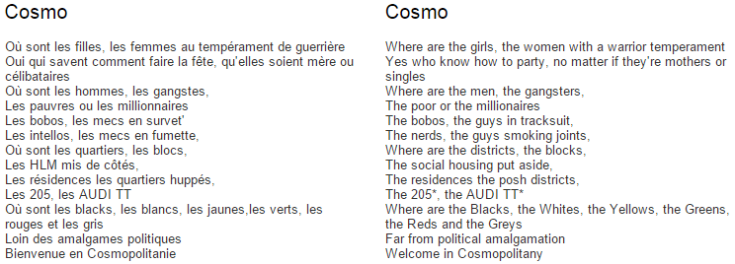
Parallel corpora
The same text in two (or more) languages
High-quality manually crafted translations

Slide 19
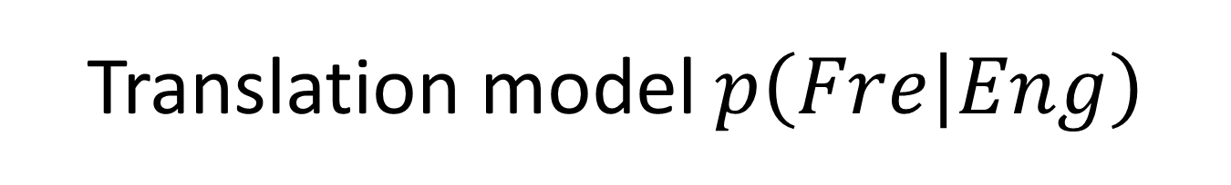
Translation model $p\left(Fre | Eng\right)$
Specifying translation probabilities
This probability needs word-alignment to estimate
English | French | Frequency
green witch | grüne Hexe | …
at home | zuhause | 10534
at home | daheim | 9890
is | ist | 598012
this week | diese Woche | …

Slide 20
Recap: machine translation approaches
The Vauquois triangle

Slide 21

Recap: translation with a noisy channel model
Bayes rule
Translation model $p\left(Fre | Eng\right)$ should capture the faithfulness of the translation. It needs to be trained on a parallel corpus.
Language model $p(Eng)$ should capture the fluency of the translation. It can be trained on a very large monolingual corpus.
$$Eng^{∗}=argmax_{Eng}p(Eng|Fre)$$
$$=argmax_{Eng}p\left(Fre | Eng\right)p(Eng)$$
Observed (given)
Translation Model
Language Model

Slide 22
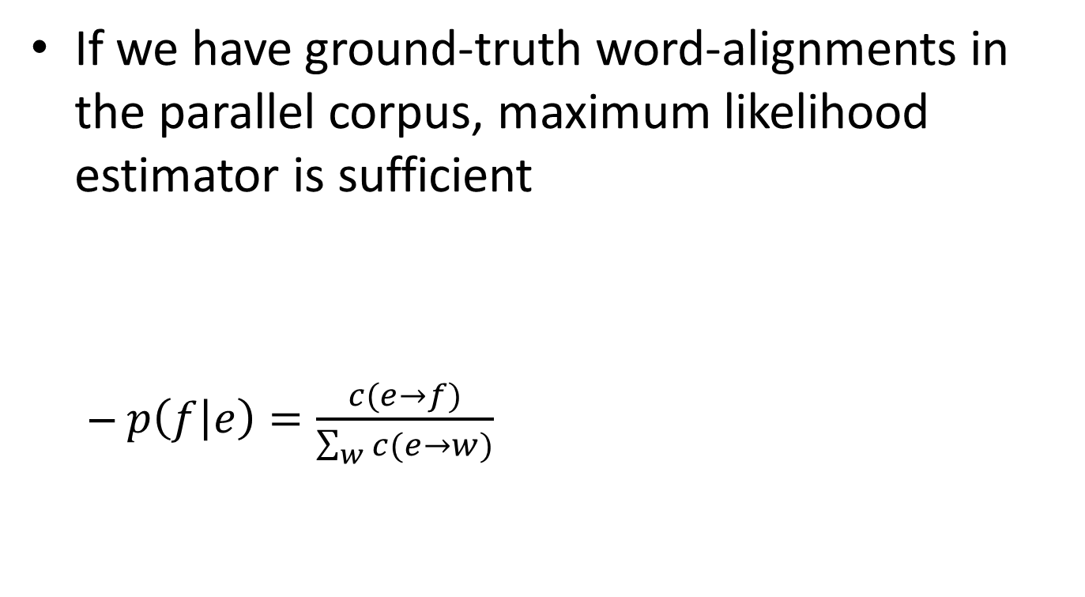
Estimation of translation probability
If we have ground-truth word-alignments in the parallel corpus, maximum likelihood estimator is sufficient
$p\left(f | e\right)=\frac{c(e→f)}{\sum_{w}{c(e→w)}}$
John told Mary a story.
Jean a raconté une histoire à Marie.

Slide 23
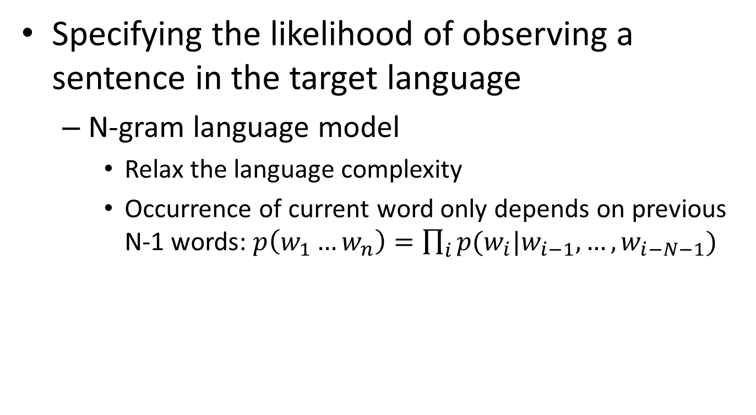

Language model $p(Eng)$
Specifying the likelihood of observing a sentence in the target language
N-gram language model
Relax the language complexity
Occurrence of current word only depends on previous N-1 words: $p\left(w_{1}…w_{n}\right)=\prod_{i}{p(w_{i}|w_{i−1},…,w_{i−N−1}) }$

Slide 24
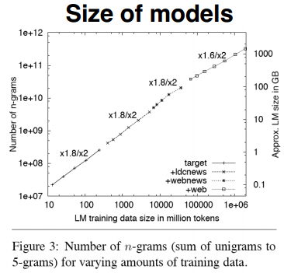
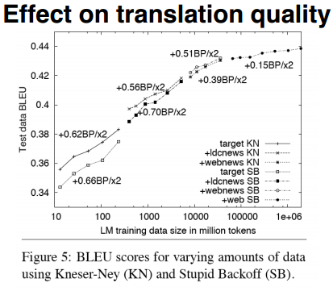
Language model $p(Eng)$
Specifying the likelihood of observing a sentence in the target language
Google (2007) uses 5-grams to 7-grams, which result in huge models, but the effect on translation quality levels off quickly

Slide 25
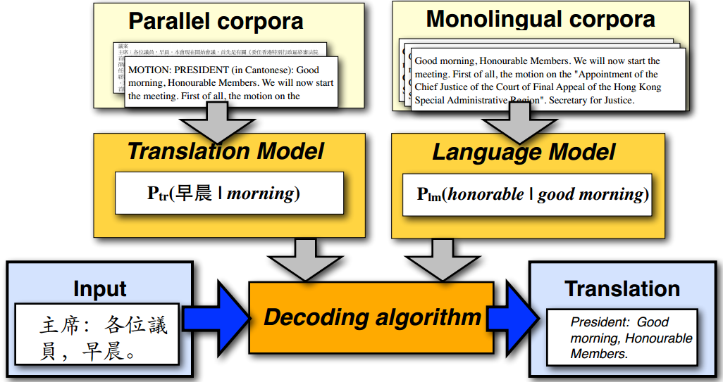
Statistical machine translation

Slide 26
IBM translation models
A generative model based on noisy channel framework
Generate the translation sentence e with regard to the given sentence f by a stochastic process
Generate the length of f
Generate the alignment of e to the target sentence f
Generate the words of f
$$Eng^{∗}=argmax_{Eng}p\left(Fre | Eng\right)p(Eng)$$

Slide 27

Word alignment
One to one, one to many and reordering
John told Mary a story.
___ _ ____ ___ ______ ____ ______.
John
told
Mary
a
story
Source sentence

Slide 28
Word alignment
One to one, one to many and reordering
John told Mary a story.
___ _ ____ ___ ______ ____ ______.
John
told
Mary
a
story
Source sentence

Slide 29
Word alignment
One to one, one to many and reordering
John told Mary a story.
___ _ ____ ___ ______ ____ ______.
John
told
Mary
a
story
Source sentence

Slide 30
Word alignment
One to one, one to many and reordering
John told Mary a story.
Target sentence
Jean a raconté une histoire à Marie.
 | Jean | a | raconté | une | histoire | à | Marie
John
told
Mary
a
Story
Source sentence

Slide 31
Word alignment
Many to one and missing word
John swam across the lake.
Jean a traversé le lac à la nage.
Target sentence
A special symbol
 | Jean | a | traversé | le | lac | à | la | nage
NULL
John
swam
across
the
lake
Source sentence

Slide 32
Representing word alignments
Alignment table
 |  | 1 | 2 | 3 | 4 | 5 | 6 | 7 | 8
 |  | Jean | a | traversé | le | lac | à | la | nage
0 | NULL
1 | John
2 | swam
3 | across
4 | the
5 | lake
Target Position | 1 | 2 | 3 | 4 | 5 | 6 | 7 | 8
Source Position | 1 | 3 | 3 | 4 | 5 | 0 | 0 | 2

Slide 33




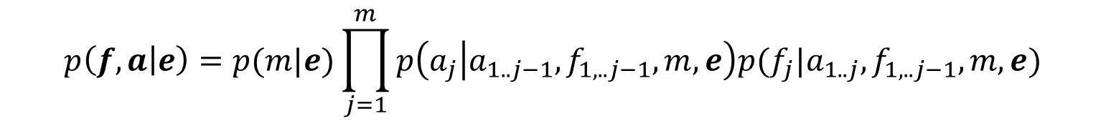
IBM translation models
Translation model with word alignment
$p\left(Fre | Eng\right)=\sum_{a∈A(Eng,Fre)}{p(Fre,a|Eng)}$
Generate the words of f with respect to alignment $a$
marginalize over all possible alignments $a$
$$p\left(f,a | e\right)=p(m|e)\prod_{j=1}^{m}{p\left(a_{j} | a_{1..j−1},f_{1,..j−1},m,e\right)p(f_{j}|a_{1..j},f_{1,..j−1},m,e)}$$
Length of target sentence f
Word alignment $a_{j}$
Translation of $f_{j}$

Slide 34
IBM translation models
Sequence of 5 translation models
Different assumptions and realization of the components in the translation models, i.e., length model, alignment model and translation model
Model 1 is the simplest and becomes the basis of follow-up IBM translation models

Slide 35
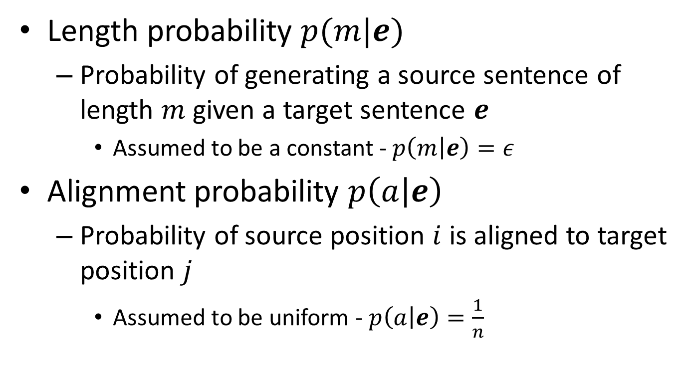
Parameters in Model 1
Length probability $p(m|e)$
Probability of generating a source sentence of length $m$ given a target sentence $e$
Assumed to be a constant - $p\left(m | e\right)=ε$
Alignment probability $p\left(a | e\right)$
Probability of source position $i$ is aligned to target position $j$
Assumed to be uniform - $p\left(a | e\right)=\frac{1}{n}$
length of source sentence

Slide 36
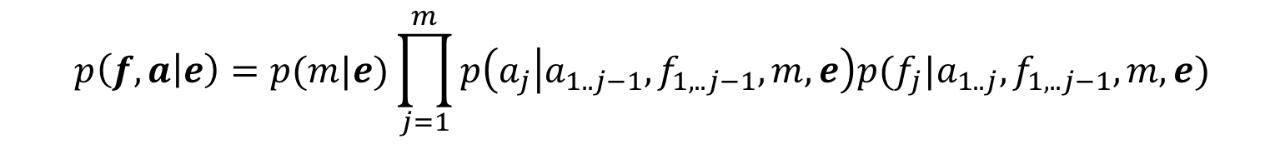

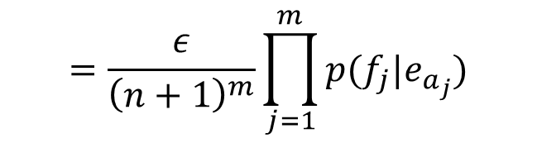
Parameters in Model 1
Translation probability $p\left(f | a,e\right)$
Probability of English word $e_{i}$ is translated to French word $f_{j}$ - $p\left(f_{j} | e_{a_{j}}\right)$
After the simplification, Model 1 becomes
$$p\left(f,a | e\right)=p(m|e)\prod_{j=1}^{m}{p\left(a_{j} | a_{1..j−1},f_{1,..j−1},m,e\right)p(f_{j}|a_{1..j},f_{1,..j−1},m,e)}$$
$$=\frac{ε}{{\left(n+1\right)}^{m}}\prod_{j=1}^{m}{p(f_{j}|e_{a_{j}})}$$
We add a NULL word in the source sentence

Slide 37

Generative process in Model 1
For a particular English sentence $e = e_{1}..e_{n}$ of length $n$
0 | 1 | 2 | 3 | 4 | 5
NULL | John | swam | across | the | lake
Source
1. Choose a length $m$ for the target sentence (e.g m = 8)
1 | 2 | 3 | 4 | 5 | 6 | 7 | 8
? | ? | ? | ? | ? | ? | ? | ?
Order of actions
2. Choose an alignment $a= a_{1}…a_{m}$for the source sentence
Target Position | 1 | 2 | 3 | 4 | 5 | 6 | 7 | 8
Source Position | 1 | 3 | 3 | 4 | 5 | 0 | 0 | 2
Transmitter
3. Translate each source word $e_{a_{j}}$into the target language
English | John | across | across | the | lake | NULL | NULL | swam
Alignment | 1 | 3 | 3 | 4 | 5 | 0 | 0 | 2
Encoded | Jean | a | traversé | le | lac | à | la | nage

Slide 38

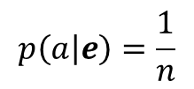


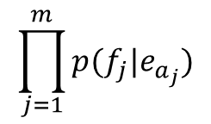

Decoding process in Model 1
$$p\left(e | f\right)=1e^{−55}$$
For a particular English sentence $e = e_{1}..e_{n}$ of length $n$
$$p(e)$$
0 | 1 | 2 | 3 | 4 | 5
NULL | John | flies | across | the | river
Search through all English sentences
1. Choose a length $m$ for the target sentence (e.g m = 8)
1 | 2 | 3 | 4 | 5 | 6 | 7 | 8
? | ? | ? | ? | ? | ? | ? | ?
Search through all possible alignments
$$p\left(m | e\right)=ε$$
2. Choose an alignment $a= a_{1}…a_{m}$for the source sentence
Order of actions
$$p\left(a | e\right)=\frac{1}{n}$$
Target Position | 1 | 2 | 3 | 4 | 5 | 6 | 7 | 8
Source Position | 1 | 2 | 4 | 5 | 5 | 2 | 0 | 3
$$\prod_{j=1}^{m}{p(f_{j}|e_{a_{j}})}$$
3. Translate each source word $e_{a_{j}}$into the target language
English | John | flies | the | river | river | flies | NULL | across
Alignment | 1 | 2 | 4 | 5 | 5 | 2 | 0 | 3
Encoded | Jean | a | traversé | le | lac | à | la | nage
Receiver

Slide 39

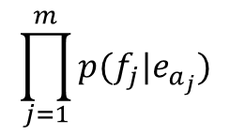

Decoding process in Model 1
$$p\left(e | f\right)=1e^{−15}$$
For a particular English sentence $e = e_{1}..e_{n}$ of length $n$
0 | 1 | 2 | 3 | 4 | 5
NULL | John | swam | across | the | lake
Search through all English sentences
$$p(e)$$
1. Choose a length $m$ for the target sentence (e.g m = 8)
1 | 2 | 3 | 4 | 5 | 6 | 7 | 8
? | ? | ? | ? | ? | ? | ? | ?
Search through all possible alignments
$$p\left(m | e\right)=ε$$
Order of action
2. Choose an alignment $a= a_{1}…a_{m}$for the source sentence
$$p\left(a | e\right)=\frac{1}{n}$$
Target Position | 1 | 2 | 3 | 4 | 5 | 6 | 7 | 8
Source Position | 1 | 3 | 3 | 4 | 5 | 0 | 0 | 2
$$\prod_{j=1}^{m}{p(f_{j}|e_{a_{j}})}$$
3. Translate each source word $e_{a_{j}}$into the target language
English | John | across | across | the | lake | NULL | NULL | swam
Alignment | 1 | 3 | 3 | 4 | 5 | 0 | 0 | 2
Encoded | Jean | a | traversé | le | lac | à | la | nage
Receiver

Slide 40
Decoding process in Model 1
Search space is huge
Presumably all “sentences” in English
English sentence length is unknown
All permutation of words in the vocabulary
Heuristics to reduce search space
Trade-off between translation accuracy and efficiency

Slide 41
Estimation of translation probability
If we do not have ground-truth word-alignments, appeal to Expectation Maximization algorithm
Intuitively, guess the alignment based on the current translation probability first; and then update the translation probability
EM algorithm will be carefully discussed in our later lecture of “Text Clustering”

Slide 42
Other translation models
IBM models 2-5 are more complex
Word order and string position of the aligned words
Phase-based translation in the source and target languages
Incorporate syntax or quasi-syntactic structures
Greatly reduce search space

Slide 43
What you should know
Challenges in machine translation
Lexical/syntactic/semantic divergences
Statistical machine translation
Source-channel framework for statistical machine translation
Generative process
IBM model 1
Idea of word alignment

Slide 44
Today’s reading
Speech and Language Processing
Chapter 25: Machine Translation

