Slide 1
CS510 Advanced Topics in Information Retrieval (Fall 2017)
Instructor: ChengXiang (“Cheng”) Zhai
Teaching Assistants (part time):
Chase Geigle, Shan Jiang
Shubhra (“Santu”) Karmaker, Dominic Seyler
Department of Computer Science
University of Illinois, Urbana-Champaign

Slide 2










Text data cover all kinds of topics
Topics:
People
Events
Products
Services, …
…
Sources:
Blogs
Microblogs
Forums
Reviews ,…
45M reviews
53M blogs
1307M posts
65M msgs/day
115M users 10M groups
…

Slide 3




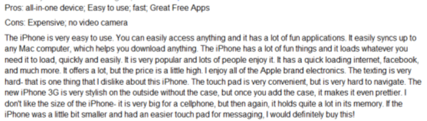

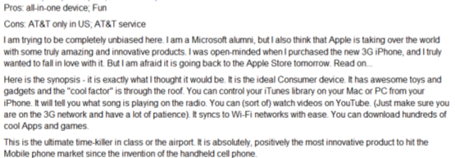
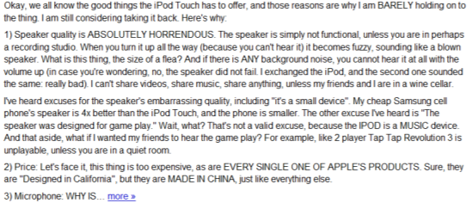
Humans as Subjective & Intelligent “Sensors”
Real World
Sense
Sensor
Report
Data
Weather
Thermometer
3°C , 15°F, …
Locations
Geo Sensor
41°N and 120°W ….
Network Sensor
01000100011100
Networks
Perceive
Express
“Human Sensor”

Slide 4
Unique Value of Text Data
Useful to all big data applications
Especially useful for mining knowledge about people’s behavior, attitude, and opinions
Directly express knowledge about our world: Small text data are also useful!
Data ➔ Information ➔ Knowledge
Text Data

Slide 5
However, NLP is difficult!
“A man saw a boy with a telescope.” (who had the telescope?)
“He has quit smoking” ➔ he smoked before.
How can we leverage imperfect NLP to
build a perfect general application?
Answer: Having humans in the loop!

Slide 6



TextScope to enhance human perception
TextScope
Microscope
Telescope
Intelligent Interactive Retrieval & Text Analysis
for Task Support and Decision Making

Slide 7
Examples of TextScope Applications
Search
Web search, enterprise search, desktop search, PubMed, …
Filtering/Recommender Systems
spam email filter, news/literature/movie recommender
Categorization
news categorization, help desk email routing, sentiment tagging, …
Topic mining
discovery of topical trends in scientific research
discovery of major complaints from customers
business intelligence, bioinformatics, …
Text-based Prediction
prediction of stock prices, voting results, …

Slide 8
Main Techniques for Building a TextScope: Text Retrieval + Text Analysis
Search engines
Clustering
Categorization
Medical/Health
Filtering
Text Retrieval
Text Analysis
Topic mining
Security
Recommender
Sentiment
Education
Business
Summarization
Prediction
… …
… …
Social Media
Big
Text Data
… …
Big Text Data
Small
Relevant Data
Small Relevant Data
Knowledge
Many Applications

Slide 9
This Course: Statistical Language Models
Search engines
Clustering
Categorization
Medical/Health
Filtering
Text Retrieval
Text Analysis
Topic mining
Security
Recommender
Sentiment
Education
Business
Summarization
Prediction
… …
… …
Social Media
Big
Text Data
… …
Big Text Data
Small
Relevant Data
Small Relevant Data
Knowledge
Many Applications

Slide 10
Assignment: MeTA Toolkit
Search engines
Clustering
Categorization
Medical/Health
Filtering
Text Retrieval
Text Analysis
Topic mining
Security
Recommender
Sentiment
Education
Business
Summarization
Prediction
… …
… …
Social Media
Big
Text Data
… …
Big Text Data
Small
Relevant Data
Small Relevant Data
Knowledge
Many Applications

Slide 11
Course Goal
Advanced (graduate-level) introduction to the field of information retrieval (IR), broadly including Text mining
Goal
Provide a systematic introduction to statistical language models and their applications in text retrieval and text analysis
Provide an opportunity for students to explore frontier topics via course projects (customized toward the interests of students)
Give students enough training for doing research in IR or applying advanced IR techniques to applications
Tangible outcome: research paper, open source code, and application system

Slide 12
Prerequisites
Basic concepts in CS410 Text Info Systems
Programming skills: CS225 or equivalent level
A good knowledge of basic probability and statistics
Knowledge of one or more of the following areas is a plus, but not required: Information Retrieval, Machine Learning, Data Mining, Natural Language Processing
Contact the instructor if you aren’t sure

Slide 13
Format
Lectures (mostly by instructor)
Short frequent written assignments (problem sets): ensure solid mastery of concepts, models, and algorithms
Programming assignments: ensure solid mastery of skills of implementation and experimentation
2 Midterms (75 min each, in class): mostly to verify your mastery of concepts, models, and algorithms as covered in the assignments
Course project: multiple options
In-depth study of a topic ➔ publication/submission
Implementation of a major algorithm ➔ open source
Development of a novel application ➔ useful application

Slide 14
Grading
Assignments: 30%
Midterm 1: 20%
Midterm 2: 20%
Project: 30%

Slide 15
Office Hours
Instructor:
Tue. 1:30pm-2:30pm; Thur. 3pm-4pm
2116SC
TA (0207SC)
Chase Geigle: 3-4pm, Fridays
Shan Jiang: 3-4pm, Mondays
Santu Karmaker: 1-2pm, Wednesdays
Dominic Seyler: 11am-12noon, Wednesdays
Post your question on Piazza as soon as you have it.

Slide 16
Schedule
Background, overview of text retrieval & analysis; relevant math
Overview of statistical language models (LMs)
N-gram LMs (applications: text retrieval, text categorization)
N-gram class LMs (applications: lexical relation discovery, text retrieval)
Mixture LMs (PLSA, LDA, topic discovery and analysis)
State-space LMs/Hidden Markov Models (applications: passage retrieval, sequential topic modeling)
=========================================================
Contextualized LMs (applications: text mining, text-based prediction)
Learning to rank
Neural language models (word embedding, deep learning for IR)

Slide 17
Your Work Load
Aug
Sept
Oct
Nov
Dec
First Day of
Instruction
Thanks-
giving
Last Day
of Instruction
Lectures/Readings
Written Assignments
Programming Assignments
Midterm
Project

Slide 18
Reference Book
ChengXiang Zhai, Chase Geigle, Statistical Language Models for Text Data Retrieval and Analysis, forthcoming.
Draft will be available online

Slide 19
Other readings: mostly research papers, survey articles, and book chapters
Synthesis Lectures Digital Library: http://www.morganclaypool.com/
Foundations & Trends in IR: http://www.nowpublishers.com/ir/
Recent papers from SIGIR, CIKM, WWW, WSDM, KDD, ACL, ICML,…

Slide 20
Questions?
Course website:
http://times.cs.uiuc.edu/course/510f17
Piazza:
https://piazza.com/class/j6u303bvs1ep

