Slide 1
Forest Cover Type
ML Prediction
Predicting forest cover from cartographic data
Roosevelt National Forest, Colorado
581K
54
7
96.1%
Samples
Features
Classes
Best Acc.

Slide 2
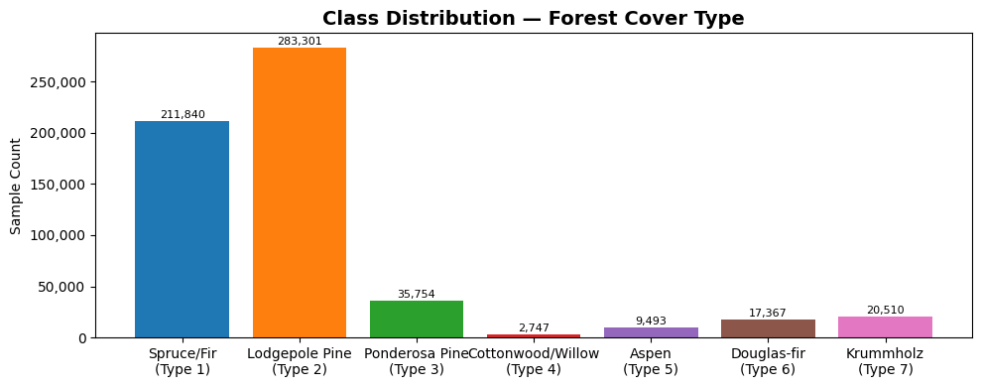
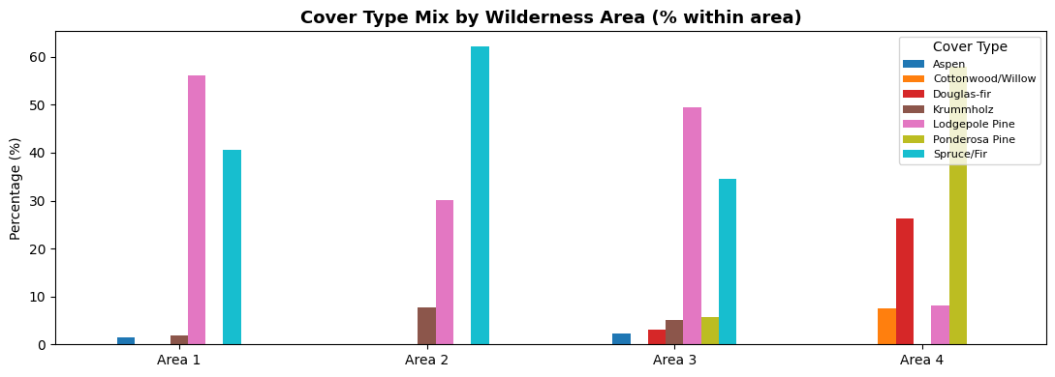
Dataset Overview
10 Continuous Features
Elevation, slope, distances,
hillshade, aspect
4 Wilderness Areas
One-hot encoded binary
(Rawah, Neota, Comanche, Cache)
40 Soil Types
One-hot encoded binary
(high-dimensional, low signal)
⚠ Class Imbalance
Cottonwood/Willow = 0.47% (2,747 samples)
Lodgepole Pine dominates at 48.76%

Slide 3
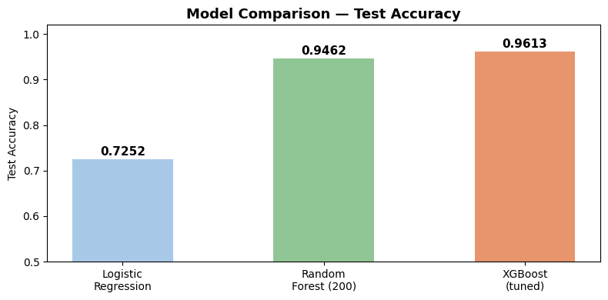
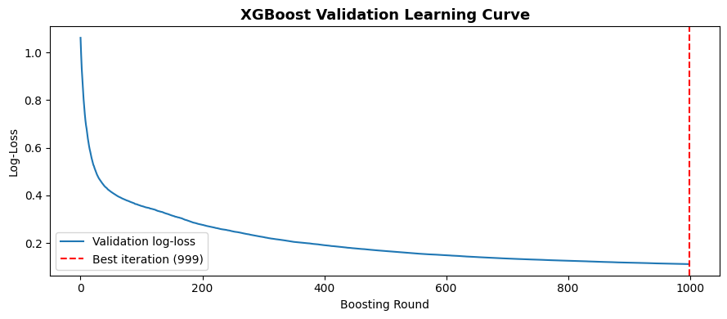
Model Comparison
XGBoost leads at 96.1%
Edges out Random Forest (94.6%) by ~1.5pp. Both tree methods far outperform Logistic Regression (72.5%).
Why LR falls behind
Class boundaries in elevation/terrain space are highly non-linear — beyond what a linear model can capture.
Model ran all 1000 rounds
Loss was still decreasing at round 999. Early stopping never triggered — more estimators could push accuracy higher.
Tree ensembles dominate
Mixed tabular data (continuous + binary features) strongly favors gradient boosting over linear approaches.

Slide 4
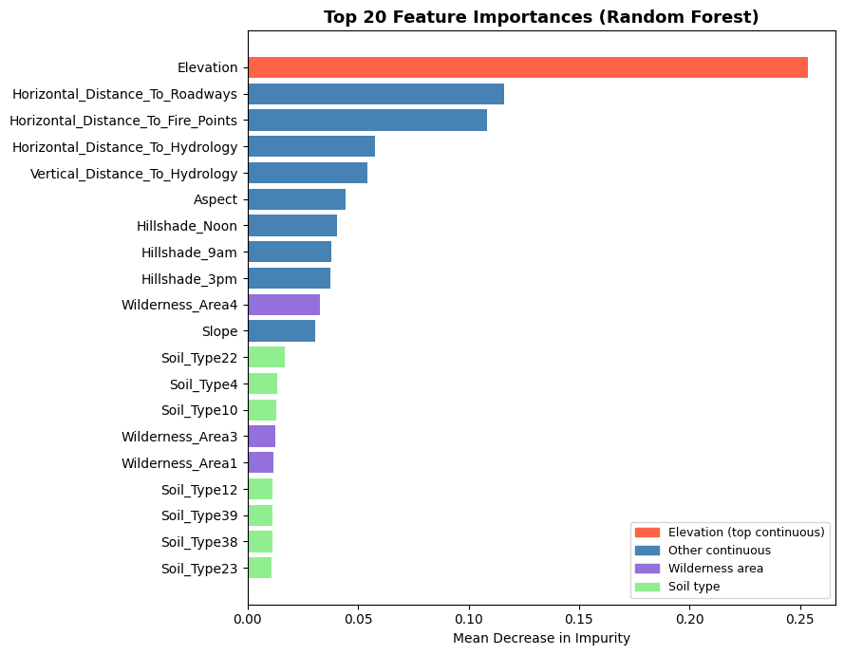
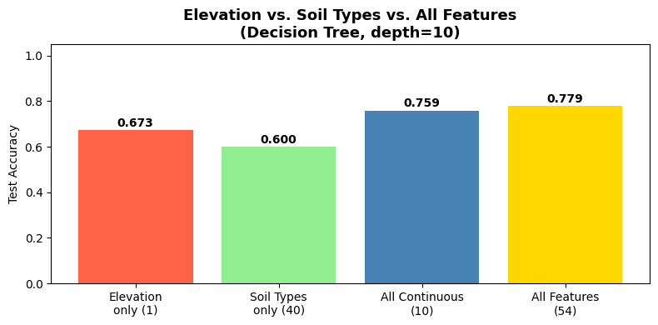
What Drives Predictions? Feature Importance
Key Insight
Elevation alone (67.3%) outperforms all 40 soil-type features combined (60.0%) — a gap of +7.3pp.
Distance to roadways and fire points rank 2nd and 3rd, showing infrastructure proximity matters more than soil classification.

Slide 5
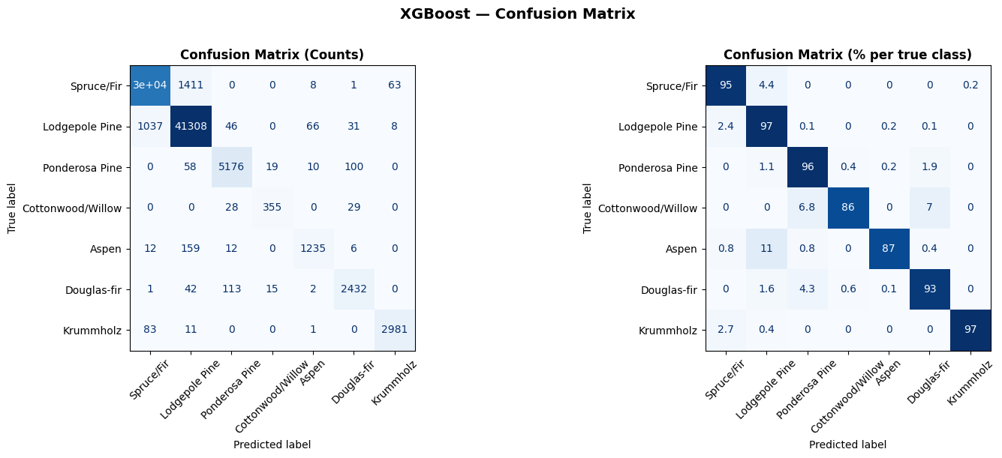
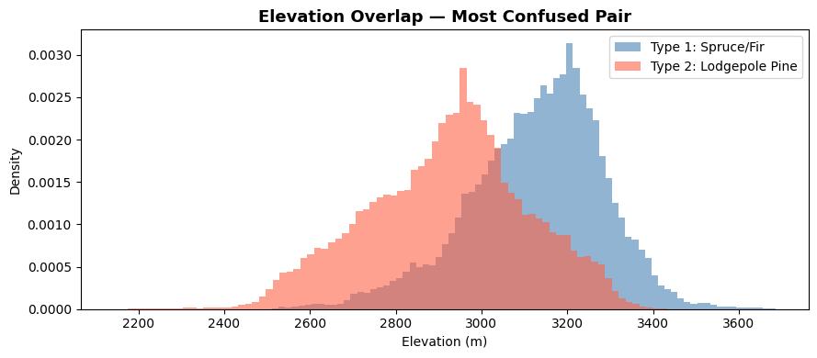
Confusion Matrix & Most Confused Pair
Why Spruce/Fir ↔ Lodgepole Pine?
1,411 Spruce/Fir samples misclassified as Lodgepole Pine — the most common error.
Both species share heavily overlapping elevation bands (~2800–3300m). With similar slope and aspect, even XGBoost struggles to draw a clean boundary.

Slide 6
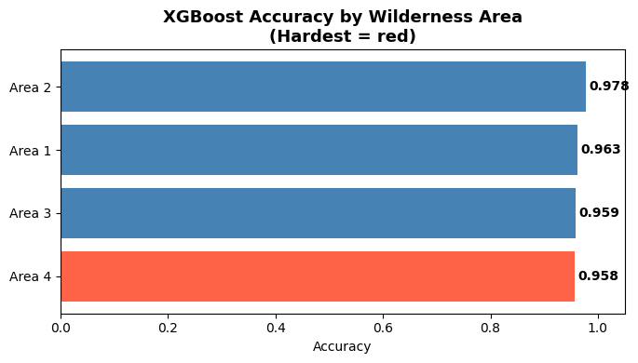
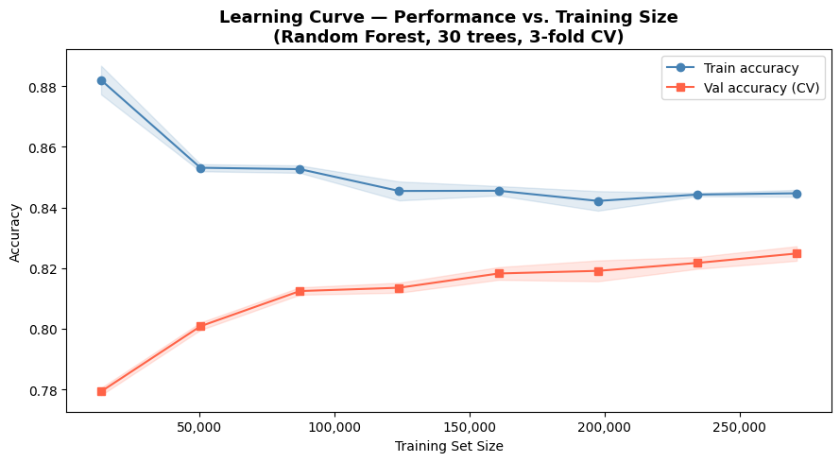
Wilderness Area Difficulty & Learning Curve
Area 4 is Hardest (barely)
Model is data-hungry
Cache la Poudre has the most diverse cover mix — Ponderosa, Douglas-fir, and Cottonwood alongside the dominant types. All areas perform within ~2% of each other (~96%), so difficulty differences are small.
Validation accuracy was still rising at 280K samples with no plateau visible. More training data would likely push accuracy beyond 96.1% — the model is not yet data-saturated.

Slide 7
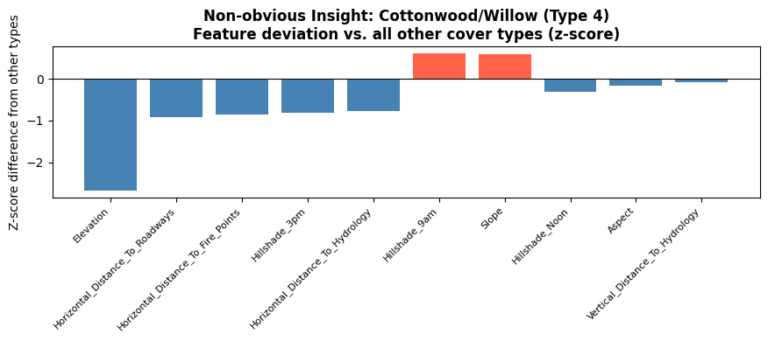
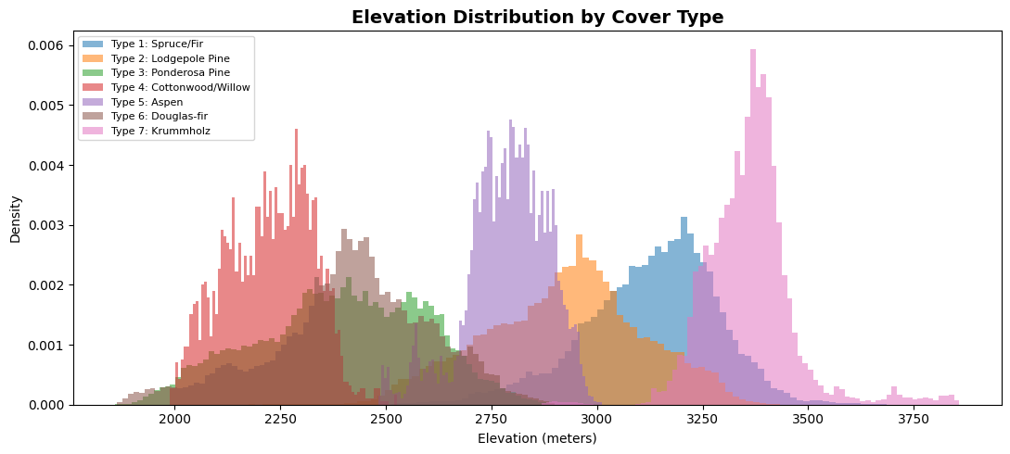
Non-obvious Insight: Cottonwood/Willow
↓ Lowest Elevation
Grows ~850m lower than Krummholz and far below the Spruce/Fir band. Most extreme elevation z-score of any feature (-2.68).
💧 Water Proximity
Closest to both horizontal and vertical water sources. Riparian species grow along waterways — this is its ecological fingerprint.
☀ Hillshade & Slope
Also deviates on Hillshade_3pm and Slope, consistent with valley/riparian terrain that receives different sun angles.
✓ Identifiable Despite Rarity
Only 0.47% of samples (2,747), yet unique feature profile gives it 86% recall — model can find it despite extreme class imbalance.

Slide 8
Key Conclusions
01
Elevation is the #1 predictor
02
XGBoost wins at 96.1%
Single feature (67.3%) beats all 40 soil types combined (60.0%). Geography outweighs geology.
Gradient boosting outperforms RF (94.6%) and LR (72.5%). Tree ensembles dominate tabular mixed-feature data.
03
Spruce/Fir ↔ Lodgepole Pine: hardest pair
04
Wilderness areas all classify well (~96%)
1,411 misclassifications driven by overlapping elevation ranges (~2800–3300m) and similar terrain profiles.
Area 4 (Cache la Poudre) is marginally hardest at 95.8% due to diverse cover mix, but all areas are within 2%.
05
Cottonwood/Willow: riparian specialist
06
Model is data-hungry — no plateau
Extreme low-elevation + water-proximity z-scores reveal its ecology. 86% recall despite being only 0.47% of data.
Learning curve still rising at 280K samples. More training data would likely push accuracy beyond 96.1%.

