Slide 1
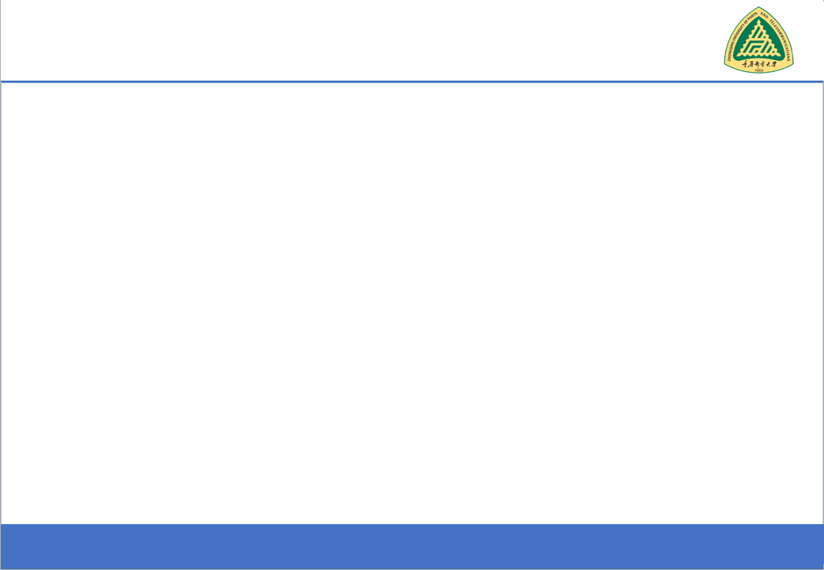
Data Structures and Algorithms
(CS221)
Queue (FIFO)

Slide 2
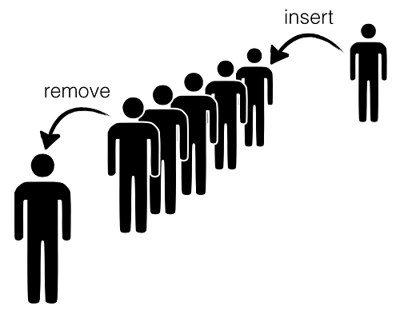

Slide 3
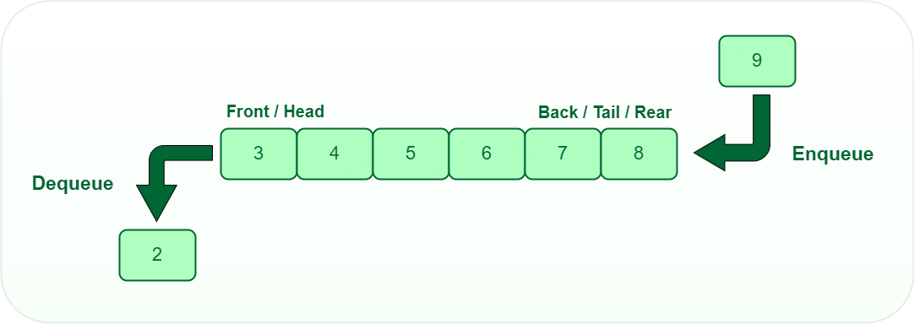

Slide 4
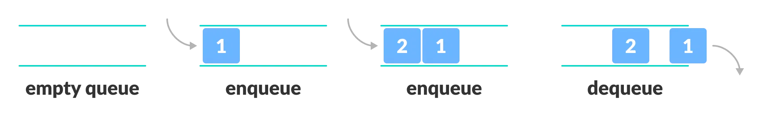

Slide 5
Queues
“A Queue is a special kind of list, where items are inserted at one end (the rear) And deleted at the other end (the front)”
Other Name:
First In First Out (FIFO)

Slide 6
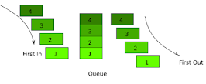
Difference from Stack:
Insertion go at the end of the list, rather than the beginning of the list.

Slide 7
Common Operations on Queues
MAKENULL(Q): Makes Queue Q be an empty list.
FRONT(Q): Returns the first element on Queue Q.
ENQUEUE(x,Q): Inserts element x at the end of Queue Q.
DEQUEUE(Q): Deletes the first element of Q.
EMPTY(Q): Returns true if and only if Q is an empty queue.
Example??

Slide 8
Applications of Queues
Operating system
multi-user/multitasking environments, where several users or task may be requesting the same resource simultaneously.

Slide 9
Implementation
Static
Queue is implemented by an array, and size of queue remains fix
Dynamic
A queue can be implemented as a linked list, and expand or shrink with each enqueue or dequeue operation.

Slide 10
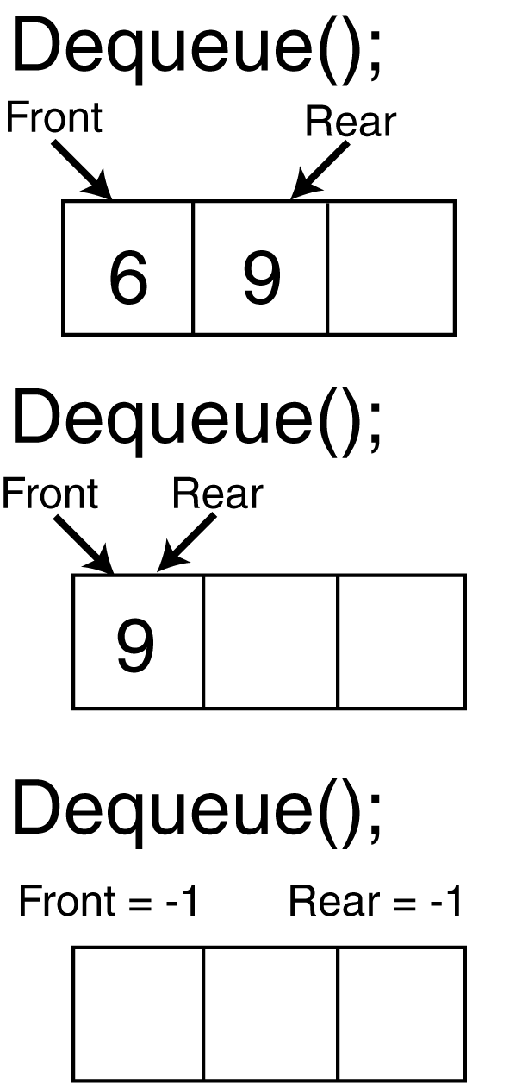
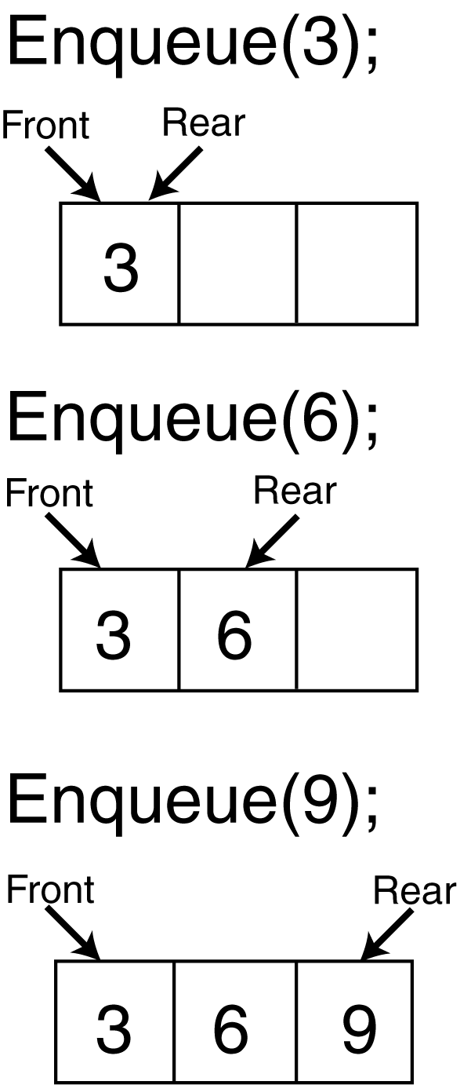
6 9
9

Slide 11
ENQUEUE(NEwdata,Queue)
1. if ( (front = 0 and rear = N-1) or (Front = Rear + 1) )
(Queue already full ? )
Print Overflow and return
2. Find the new value of Rear
if front = -1 ( i.e., queue is initially empty)
Front = 0 rear = 0
else If rear = N -1( rear is at the end)
Rear = 0 (Move around the rear to the start of the queue)
else
rear = rear +1
3. QUEUE[rear] = NEWDATA (Add the new data at the end)
4. return

Slide 12
Dequeue(Queue)
1. if front = -1 (queue already empty?)
Print underflow and return
2. DATATOREMOVE= QUEUE[front]
3. (Find the new value of front)
if front = rear (QUEUE has only one element)
front = -1
Rear = -1
else if front = N-1
front = 0
else
front = front + 1

Slide 13
Dequeue(Queue)
Case 1: Initially Empty Queue
Case 2: Normal Insertions
Front = -1, Rear = -1
Inserting 10:
Front = 0, Rear = 0
Queue: [10, _, _, _, _]
Inserting 20:
Rear = 1
Queue: [10, 20, _, _, _]
Inserting 30:
Rear = 2
Queue: [10, 20, 30, _, _]
Inserting 40:
Rear = 3
Queue: [10, 20, 30, 40, _]
Inserting 50:
Rear = 4
Queue: [10, 20, 30, 40, 50]
Case 3: Circular Wrap Around
If we delete two elements (10, 20), front moves forward:
Front = 2, Rear = 4
Queue: [_, _, 30, 40, 50]
Now, inserting 60:
Rear wraps around to 0 (Rear = 0)
Queue: [60, _, 30, 40, 50]

Slide 14
Dequeue(Queue)
Lets assume we have a circular queue of size N = 5, represented as:
Index: 0 1 2 3 4
Queue: [10] [20] [30] [40] [50]
Initially:
front = 0 (pointing to 10)
rear = 4 (pointing to 50)

Slide 15
Dequeue(Queue)
Dequeue the first element
Check if the queue is empty → No (front != -1)
.DATATOREMOVE = QUEUE[front] = 10
Update front:
front != rear (so not a single element case)
front != N-1, so move front forward.
front = front + 1 = 1

Slide 16
LINKED LIST IMPLEMENTATION OF QUEUE
struct queue {
int data;
queue *next;
} *head, *tail;

Slide 17
ENQUEUE(NEwdata,Queue)
1. Find the new value of tail
q = new queue;
if head == NULL ( i.e., queue is initially empty)
head = q; tail = q;
else
tail->next = q; tail = q;
2. tail->data = NEWDATA (Add the new data at the end)
3. return

Slide 18
Dequeue(Queue)
1. if head==NULL (queue already empty?)
Print underflow and return
2. DATATOREMOVE= head->data
3. (Find the new value of tail)
if head = tail (QUEUE has only one element)
head = NULL
tail = NULL
else
head=head->next

Slide 19
Input restricted Queue
The input can be taken from one side only(rear) and deletion of elements can be done from both sides(front and rear)
This queue is used in cases where the consumption of the data needs to be in FIFO order but if there is a need to remove the recently inserted data for some reason

Slide 20
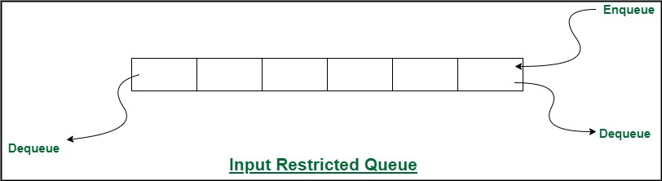
Input restricted Queue

Slide 21
Output restricted Queue
The input can be taken from both sides(rear and front) and the deletion of the element can be done from only one side(front).
This queue is used in the case where the inputs have some priority order to be executed and the input can be placed even in the first place so that it is executed first.

Slide 22
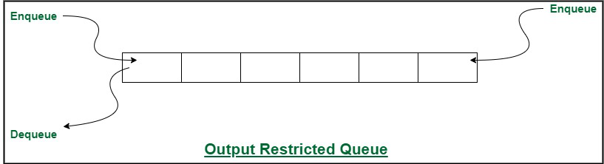
Output restricted Queue

Slide 23
Double Ended Queue
The insertion and deletion operations are performed at both the ends (front and rear)
Since Deque supports both stack and queue operations, it can be used as both

Slide 24
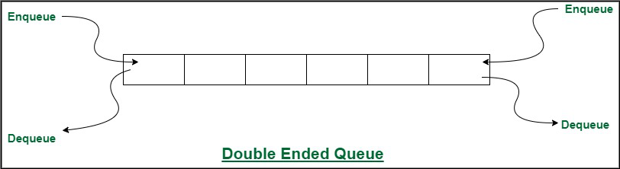
Double Ended Queue

Slide 25
Questions?
zahmaad.github.io

