Slide 1

Data Structures and Algorithms
(CS221)
HASHING

Slide 2
Hashing
A hash function is any algorithm or subroutine that maps large data sets, called keys, to smaller data sets.
Example: a single integer can serve as an index to an array.
The values returned by a hash function are called
hash values
hash codes
hash sums
Checksums, or
simply hashes.
Hash functions are mostly used to accelerate table lookup or data comparison tasks such as
finding items in a database,
detecting duplicated or similar records in a large file,
finding similar stretches in DNA sequences,
and so on.
2

Slide 3
Hash Table
Ideal hash table data structure
→ an array of some fixed size, containing the keys.
key →
a string with an associated value
for instance, salary information
H_SIZE → table size
part of a hash data structure
The table runs from 0 to H_SIZE-1
Each key is mapped into some number in the range 0 to H_SIZE - 1 and placed in the appropriate cell.
Each hash table entry is a unique ordered pair (Key, Information)
The mapping is called a hash function
3

Slide 4
Hashing Function
A hash function should be referentially transparent,
i.e. if called twice on input that is "equal" it should give the same result.
→ if two objects are equal their hash codes must be the same.
4

Slide 5
Hash Table
0
1
2
3 | John 25000
4 | Phil 31250
5
6 | Dave 27500
7 | Marry 28200
8
9
5

Slide 6
Hashing – Collision
Map two or more keys to the same hash value, causing a collision.
Although the idea was conceived in the 1950s,1 the design of good hash functions is still a topic of active research.
6

Slide 7
Hashing Function
The simplest hash function
key mod H_SIZE
Example 1
H_SIZE = 9, Key = 100
100 mod 9 = 1
H_SIZE = 9, Key = 80
80 mod 9 = 8
Example 2
H_SIZE = 10, Key = 100
100 mod 10 = 0
H_SIZE = 10, Key = 80
80 mod 10 = 0
What was wrong?
7

Slide 8
Hashing Function
A better idea →
Ensure that the table size is prime.
If the input keys are random integers
function is very simple to compute, and
distributes the keys evenly
Usually, the keys are strings
→ the hash function needs to be chosen carefully
8

Slide 9
Another Hash Function
Usually, the keys are strings;
→ the hash function needs to be chosen carefully
Add up the ASCII values of the characters in the string.
typedef unsigned int INDEX;
INDEX hash( char *key, unsigned int H_SIZE )
{
unsigned int hash_val = 0;
/*1*/ while( *key != '\0' )
/*2*/ hash_val += *key++;
/*3*/ return( hash_val % H_SIZE );
}
9

Slide 10
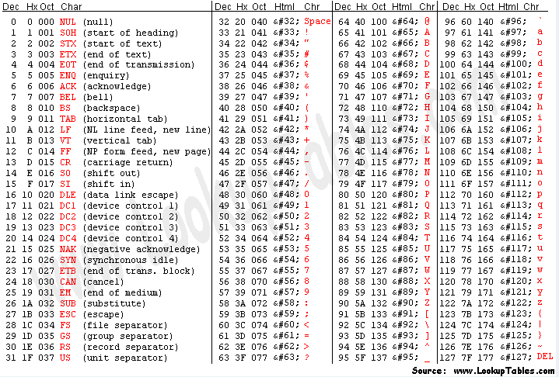

Slide 11
Another Hash Function
Usually, the keys are strings;
→ the hash function needs to be chosen carefully
Add up the ASCII values of the characters in the string.
typedef unsigned int INDEX;
INDEX hash( char *key, unsigned int H_SIZE )
{
unsigned int hash_val = 0;
/*1*/ while( *key != '\0' )
/*2*/ hash_val += *key++;
/*3*/ return( hash_val % H_SIZE );
}
Example:
H_SIZE = 100
Key = “abcdefgh”
hash_val= 97+ 98 +.. 104 =804
Index = 804%100 =4
Example:
H_SIZE = 100
Key = “bcdefghi”
hash_val= 98+ 98 +.. 105 =812
Index = 812%100 =12
11

Slide 12
Another Hash Function
Usually, the keys are strings;
→ the hash function needs to be chosen carefully
Add up the ASCII values of the characters in the string.
typedef unsigned int INDEX;
INDEX hash( char *key, unsigned int H_SIZE )
{
unsigned int hash_val = 0;
/*1*/ while( *key != '\0' )
/*2*/ hash_val += *key++;
/*3*/ return( hash_val % H_SIZE );
}
Example:
H_SIZE = 10,007
Key = 8 NULs
hash_val= 0 x 8 = 0
Index = 0% 10,007 = 0
Example:
H_SIZE = 10,007
Key = 8 DELs
hash_val= 127 x 8 = 1016
Index = 1016 % 10,007 = 1016
➔ the hash function can only assume
values between 0 and 1016
12

Slide 13
Open Hashing (Separate Chaining)
The first strategy, commonly known as either open hashing, or separate chaining, is to keep a list of all elements that hash to the same value.
For convenience, our lists have headers
For simplicity, only for this section, we assume that
the keys are the first 10 perfect squares, and
the hashing function is simply hash(x) = x mod 10
The table size is not prime, but is used here for simplicity

Slide 14
Open Hashing (Separate Chaining)
0
1
2
3
4
5
6
7
8
9
0
NULL
1
81
NULL
NULL
NULL
4
64
NULL
25
NULL
16
36
NULL
NULL
NULL
9
49
NULL

Slide 15
Open Hashing : Type Declarations
typedef int element_type;
struct list_node {
element_type element;
list_node * next;
};
typedef struct list_node *node_ptr;
typedef node_ptr LIST;
typedef node_ptr position;
/* LIST *the_list will be an array of lists, allocated later */
/* The lists will use headers, allocated later */
struct hash_tbl {
unsigned int table_size;
LIST * the_lists;
};
typedef struct hash_tbl *HASH_TABLE;

Slide 16
Open Hashing : Type Declarations
struct list_node {
int element;
list_node *next;
};
/* list_node **the_lists will be an array of list_node pointers, allocated later */
/* The lists will use headers, allocated later */
struct hash_tbl {
unsigned int table_size;
list_node **the_lists;
};
typedef struct hash_tbl *HASH_TABLE;

Slide 17
Questions?
zahmaad.github.io

