Slide 1

Secure Software Design and Development
(CY-321)
A Starter to Defensive Coding

Slide 2
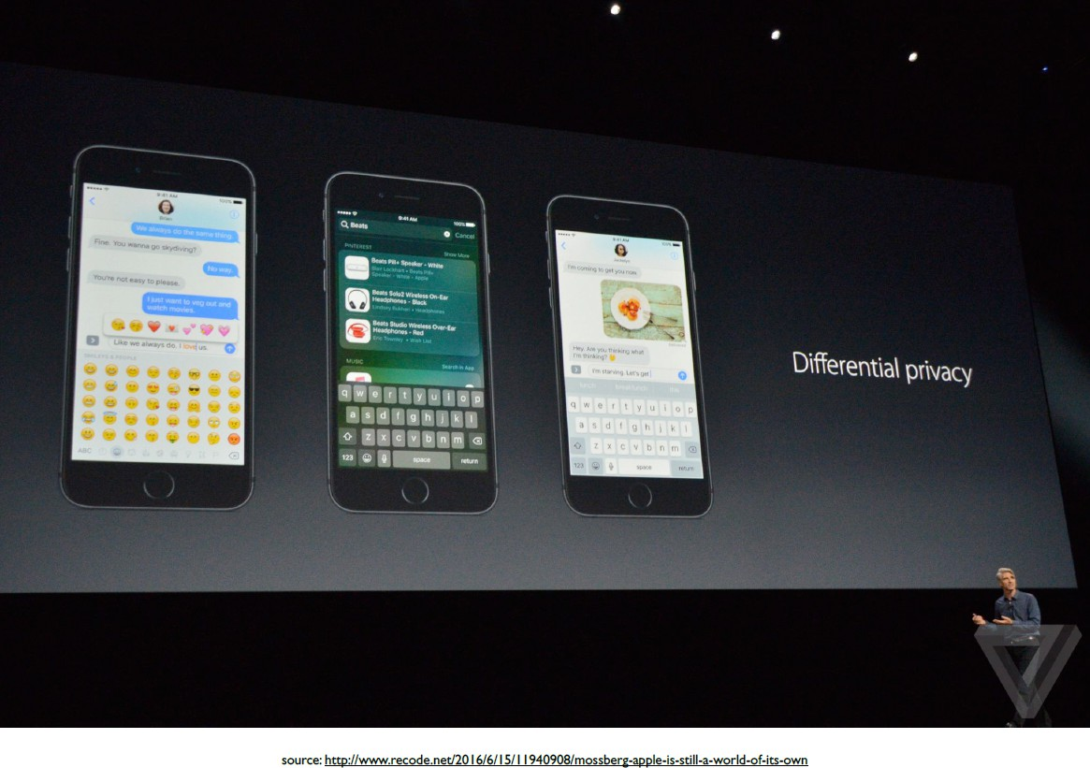

Slide 3
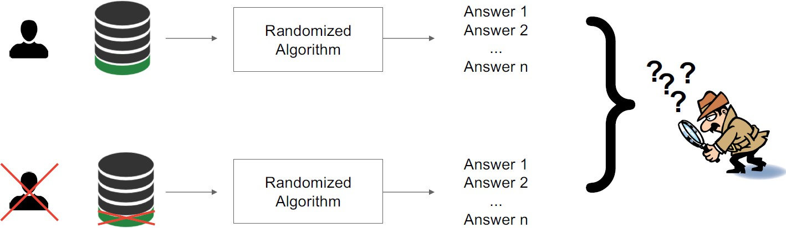
Differential Privacy
If nothing is learned about an individual then the individual cannot be harmed by the analysis.

Slide 4
Randomized Response
A technique developed in the social sciences to collect statistical information about embarrassing or illegal behavior
Study participants are told to report whether or not they have property P as follows:
Flip a coin.
If tails, then respond truthfully.
If heads, then flip a second coin and respond “Yes” if heads and “No” if tails.
Privacy comes from the plausible deniability of any outcome.
Half the time you’re honest, half the time you answer randomly, so no one can trust any single answer.”

Slide 5
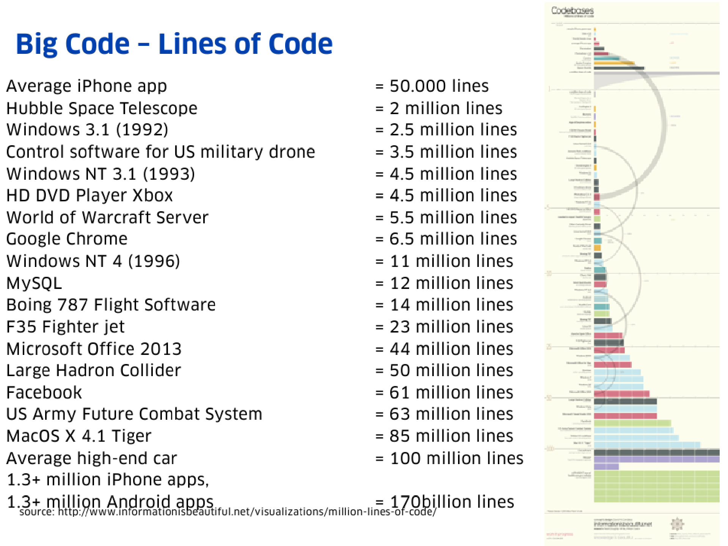

Slide 6
Software Crisis
difficult to write useful & efficient computer programs in the required time
Reason: rapid increases in computer power, complexity of problems that could be tackled
Consequences:
Projects running over-budget, over-time
Software inefficient, of low quality, not meeting requirements
Projects unmanageable, code difficult to maintain
Software was never delivered
Let's look at Alex's three rule of Defensive Programming

Slide 7
First Rule
The first rule of defensive programming is :
Never Assume Anything!
■ A lot of problems in applications can be attributed to unexpected input.
■ Another common source of error is the programmer assuming something about a programming language.

Slide 8
First Rule
Lets assume input expect an monetary value.
Is the amount numeric? 
Is the amount large enough or small enough?
Is it positive?  
How many decimal point does it have? (ex: 20.2555$) 

Slide 9
Second Rule
The second rule of defensive programming is to use Standards.
Proper coding standards address weaknesses in the language standard and/or compiler design.
They also defines a format or “style” used for writing code.
Every software development team should have an agreed-upon and formally documented coding standard.

Slide 10
Coding standards
Coding standards make code more coherent and easier to read.
Thus reduce the likelihood of bugs.
They cover a wide range of topics. 
Variable naming, indentation, position of brackets, content of header files, function declaration, etc.
Many different coding standards for every different programming language are available on the web. 
When working on an existing project, find out if a coding standard is used. If not, impose one.

Slide 11
Third Rule
■ The third rule of Defensive Programming is to keep your code as simple as possible.
Complexity breeds bugs
■ Software should only contain the features it needs.
■ Proper planning is key to keeping you application simple. Before coding, you should write down the major ideas of what you are trying to do (module names, files, etc. )

Slide 12
Refactoring
Refactoring is a disciplined technique for restructuring an existing body of code, altering its internal structure without changing its external behavior. -- www.refactoring.com
■ By itself, refactoring is not a bug-fixing technique.
■ However, refactoring is a good technique to battle feature creep: 
Features are often added during development. 
These features are more often the source of problems. 
Refactoring fights this by forcing the programmer to reevaluate the structure of his/her program
■ Refactoring can help you keep you application simple.

Slide 13
Third-party libraries
■ Code reuse is not just a smart-choice, it's a safe choice.
■ Odds are that the library has proven itself and is much more stable than anything you could build short-term.
■ Although code reuse is highly recommended, many questions must be addressed before using someone else's code: 
Do this do exactly what I need? 
How much will I need to change my design? 
How stable is it? What reputation does it have? 
How old is the code? 
Who built it? 
Are people still using it?
Can I get help? 
How much documentation is there?

Slide 14
Questions??
zubair.ahmad@giki.edu.pk
Office: G14 FCSE lobby

