Slide 1

Secure Software Design and Development
(CY-321)
Security through Obscurity (Code Obfuscation)

Slide 2
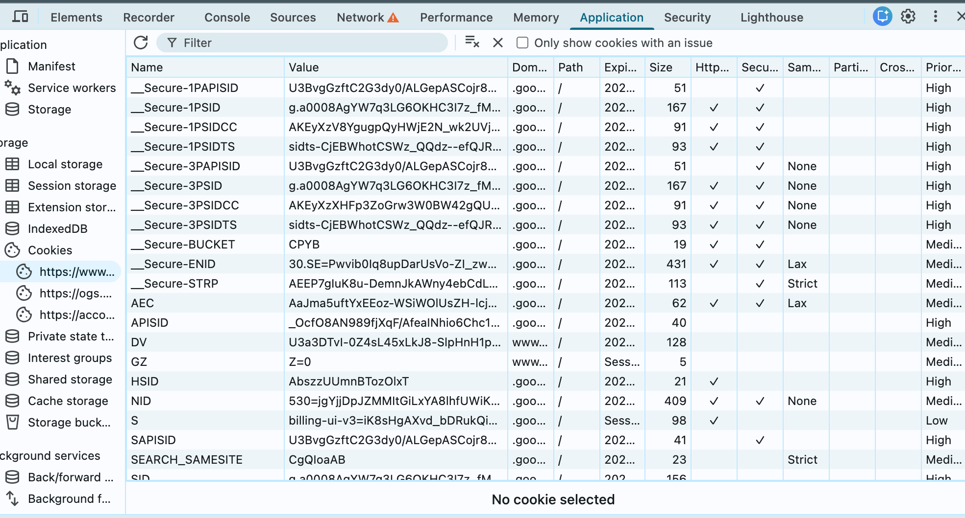

UID in Cookie Jar
Information Flow
Network Requests
Code Obfuscation
Hard to Detect

Slide 3
Informally, to obfuscate a program P means to transform it into a program P′ that is still executable but for which it is hard to extract information.
P = P′
“Hard?” ⇒ Harder than before!

Slide 4
Static obfuscation ⇒ obfuscated programs that remain fixed at runtime.
Dynamic obfuscators ⇒ transform programs continuously at runtime.

Slide 5
Obfuscating : Expression Equivalence
x+0→x
X*1→x
a×b
e^ln(a)+ln(b)

Slide 6
Obfuscating : Expression Equivalence
y = x + 1
temp = x * 2 - x
y = temp + 1
y = (x + 5) - 3;
y = x + (5 - 3);

Slide 7
Obfuscating : Expression Equivalence
y = x << 5;
y += x << 3;
y += x << 1;
y = x * 42;

Slide 8
Obfuscating : Splitting and Merging
int multiply(int a, int b) {
return a * b;
}
int difference(int a, int b) {
return a - b;
}
int compute(int x, int y) {
int part1 = multiply(x, y);
int part2 = difference(x, y);
return part1 + part2;
}
int compute(int x, int y) {
int result = (x * y) + (x - y);
return result;
}
Splitting

Slide 9
Obfuscating : Splitting and Merging
int modexp ( int y , int x [] , int w , int n ) {
int R , L ;
int k = 0;
int s = 1;
while (k < w ) {
f ( x [k ] , s , y , n , & R ); // Call to `f`
s = R * R % n ; // Square the result
L = R ;
k ++;
}
return L ;
}
void f ( int xk , int s , int y , int n , int * R) {
if ( xk == 1)
* R = ( s* y ) % n ;
else
* R = s ;
}
Splitting

Slide 10
Obfuscating : Splitting and Merging
int modexp ( int y , int x [] , int w , int n ) {
int R , L ;
int k = 0;
int s = 1;
while (k < w ) {
f ( x [k ] , s , y , n , & R ); // Call to `f`
s = R * R % n ; // Square the result
L = R ;
k ++;
}
return L ;
}
It takes four parameters:
y: the base
x[]: an array of binary exponent values
w: the number of bits in the exponent
n: the modulus
It initializes:
k = 0: index for looping through x[]
s = 1: stores intermediate results
L: stores the final computed value
Inside the while loop:
Calls f(x[k], s, y, n, &R), which modifies R
Computes s = R * R % n
Stores R in L
Increments k
When k == w, L holds the result and is returned.

Slide 11
Obfuscating : Splitting and Merging
void f ( int xk , int s , int y , int n , int * R) {
if ( xk == 1)
* R = ( s* y ) % n ;
else
* R = s ;
}
The function f takes the following parameters:
xk: A single bit from an exponent array (x[]) in the original modexp function.
s: An intermediate computation value (used in modular exponentiation).
y: The base of exponentiation.
n: The modulus for modular exponentiation.
R: A pointer to store the result.

Slide 12
Obfuscating : Splitting and Merging
int compute(int a, int b, int operation) {
if (operation == 0) {
return a + b;
} else if (operation == 1) {
return a * b;
}
return -1; // Invalid operation
}
int add(int a, int b) {
return a + b;
}
int multiply(int a, int b) {
return a * b;
}
Merging

Slide 13
Obfuscating : Splitting and Merging
float foo[100];
void f(int a, float b) {
foo[a] = b;
}
float g(float c, char d) {
return c * (float)d;}
int main() {
f(42, 42.0);
float v = g(6.0, 'a');
}
float foo[100];
float fg(int a, float bc, char d, int which) {
if (which == 1)
foo[a] = bc;
return bc * (float)d;
}
int main() {
fg(42, 42.0, 'b', 1); float v = fg(99, 6.0, 'a', 2); }
Merging

Slide 14
Obfuscating : Copying Code
Make the program larger by cloning pieces of it:
F
F
F
Make the copied code look different from the original:
F
F
F`
Now the attacker must examine all pairs of code blocks to see which ones are the same

Slide 15
Obfuscating : Copying Code
int compute(int x) {
int temp = x * 2;
int y = temp + 5;
return y;
}
int compute_alternative(int x) {int y = (x * 2);
return y + 5;
}
int compute(int x) {
return (x * 2) + 5;
}
Makes it harder to recognize identical logic.

Slide 16
Obfuscating : Interpretation
Add a level of interpretation
1 Define your own instruction set
2 Translate your program to this instruction set
3 Write an interpreter for the instruction set
Your program: 10-100x slower than before.

Slide 17
Obfuscating : Interpretation
int interpretBytecode(int *bytecode, int x) {
int result = 0;
for (int i = 0; i < 3; i++) { // Loop over bytecode instructions
if (bytecode[i] == 1) result = x * 2; // Instruction 1 = Multiply by 2
else if (bytecode[i] == 2) result += 5; // Instruction 2 = Add 5
}
return result;
}
int main() {
int bytecode[] = {1, 2}; // Encoded sequence of operations
int result = interpretBytecode(bytecode, 10);
printf("%d\n", result);
return 0;
}
int compute(int x) {
return (x * 2) + 5;
}

Slide 18
Obfuscating : Opaque Values from Array Aliasing
Opaque values: These are values that appear unpredictable to an adversary but are known at compile or runtime.
Array aliasing: This refers to using multiple references (aliases) to the same memory location in an array, making it difficult to track actual variable values.

Slide 19
Obfuscating : Opaque Values from Array Aliasing
Aliasing occurs in two pointers can refer to the same memory location
Two reference parameters can also alias each other
A reference parameter and a global variable
Two array elements indexed by different variables

Slide 20
Obfuscating : Opaque Values from Array Aliasing
Two Pointers Referring to the Same Memory Location
#include <stdio.h>
int main() {
int num = 42;
int *ptr1 = &num;
int *ptr2 = ptr1; // Both ptr1 and ptr2 point to 'num'
*ptr2 = 99; // Changing value using ptr2
printf("%d\n", *ptr1); // Output: 99 (ptr1 also sees the change)
return 0;
}

Slide 21
Obfuscating : Opaque Values from Array Aliasing
Two Reference Parameters Can Also Alias Each Other
#include <iostream>
void modify(int &a, int &b) {
a = 10; // Modifies b as well if they alias each other
b = 20;
}
int main() {
int x = 5;
modify(x, x); // x is passed twice, creating aliasing
std::cout << x << std::endl; // Output: 20 (last modification applies)
return 0;
}

Slide 22
Obfuscating : Opaque Values from Array Aliasing
A Reference Parameter and a Global Variable
#include <iostream>
int globalVar = 50;
void modifyGlobal(int &param) {
param = 100; // Modifies globalVar because param is an alias
}
int main() {
modifyGlobal(globalVar);
std::cout << globalVar << std::endl; // Output: 100
return 0;
}

Slide 23
Obfuscating : Opaque Values from Array Aliasing
Two Array Elements Indexed by Different Variables
#include <stdio.h>
int main() {
int arr[5] = {1, 2, 3, 4, 5};
int *ptr1 = &arr[2]; // Points to arr[2]
int *ptr2 = arr + 2; // Also points to arr[2] (same memory location)
*ptr1 = 99; // Modify arr[2]
printf("%d\n", *ptr2); // Output: 99
return 0;
}

Slide 24
Obfuscating : Opaque Values from Array Aliasing
Two Array Elements Indexed by Different Variables
#include <stdio.h>
int main() {
int arr[5] = {1, 2, 3, 4, 5};
int i = 1, j = 2; // Two different index variables
int *ptr1 = &arr[i]; // Points to arr[1]
int *ptr2 = &arr[j - 1]; // Also points to arr[1] (j - 1 = 1)
*ptr1 = 99; // Modify arr[1] using ptr1
printf("%d\n", *ptr2); // Output: 99 (because ptr2 also points to arr[1])
return 0;
}

Slide 25
Obfuscating : Opaque Values from Array Aliasing
#include <stdio.h>
int main() {
int arr[3] = {42, 99, 7};
int *ptr = arr; // Pointer aliasing the array
int x = ptr[1]; // Opaque value from aliasing
if (x == 99) {
printf("Secret branch!\n");
} else {
printf("Normal branch\n");
}
}
Instead of directly accessing arr[1], we retrieve its value through a pointer alias (ptr[1]).
The value 99 (retrieved via aliasing) determines whether the conditional executes.
Reverse engineers trying to analyze the control flow statically may not recognize that x == 99 is always true.
Instead of writing if (x == 99), the program retrieves 99 dynamically from the array

Slide 26
Obfuscating : Opaque Values from Array Aliasing
#include <stdio.h>
int main() {
int arr[3] = {10, 20, 30};
int *alias1 = arr;
int *alias2 = alias1 + 1; // Points to arr[1]
int x = *alias2; // Opaque value from aliasing
if (x == 20) {
printf("Access Granted!\n");
} else {
printf("Access Denied!\n");
}
}

Slide 27
Obfuscating : Renaming
int add(int a, int b) {
return a + b;
}
int main() {
int sum = add(5, 10);
return sum;
}
int x1(int x2, int x3) {
return x2 + x3;
}
int main() {
int x4 = x1(5, 10);
return x4;
}

Slide 28
Obfuscating : Code Flattening
void process(int x) {
if (x > 10)
printf("High\n");
else
printf("Low\n");
}
void process(int x) {
int state = (x > 10) ? 1 : 0;
switch (state) {
case 1:
printf("High\n");
break;
case 0:
printf("Low\n");
break;
}
}

Slide 29
Obfuscating : Junk Code Insertion
int add(int a, int b) {
return a + b;
}
int add(int a, int b) {
int noise = 42;
noise += 10;
return a + b;
}

Slide 30
Questions??
zubair.ahmad@giki.edu.pk
Office: G14 FCSE lobby

