Slide 1
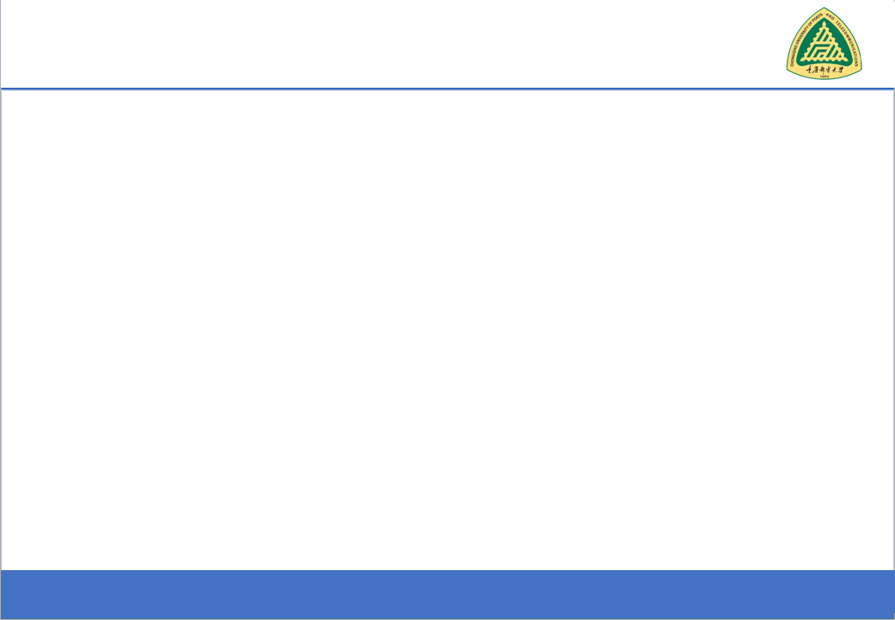
Secure Software Design and Development
(CY-321)
Program Verification

Slide 2
The Ariane 5 Rocket Disaster

Slide 3
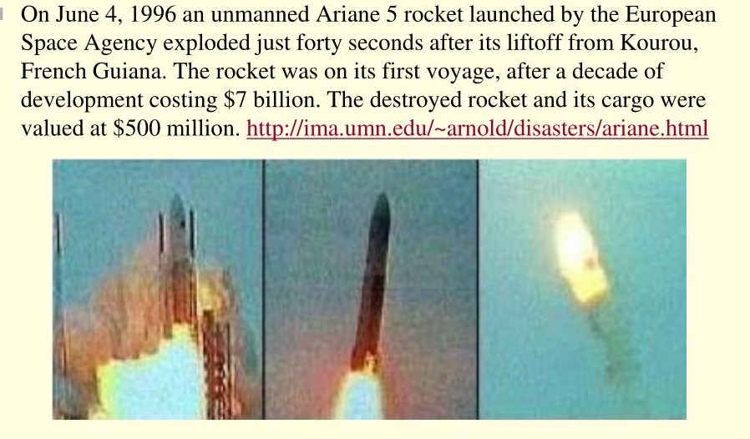
The Ariane 5 Rocket Disaster

Slide 4
Program Testing vs Program Verification
"Testing can show the presence of errors, never their absence."

Slide 5
Static Analysis
Static analysis perform the analysis without running the program
A syntactic analysis uses the code text but does not interpret statements
A semantic analysis interprets statements and updates facts based on statements in the code

Slide 6
Static Analysis
Static analysis tools parse the code and build internal representations such as:
Abstract Syntax Trees (ASTs) – represent the structure of the code.
Control Flow Graphs (CFGs) – show the order in which statements execute.
Data Flow Graphs (DFGs) – trace how data moves through the program

Slide 7
Static Analysis
Imagine you want to analyze a program without running it, to figure out things like:
Abstract interpretation
Could a variable be null?
Is it always positive?
Could this code ever divide by zero?
But instead of tracking real values, you track abstract values things like "positive", "zero", "negative", or "unknown"

Slide 8
Static Analysis (Abstract Interpretation)
To organize and combine all these abstract values. Thats where lattices come in.
A lattice is just a structure that tells you:
What values are possible,
Which are more general or more specific,
And how to merge values from different paths.

Slide 9
Static Analysis
Soundness
Completeness
A sound static analysis will not miss any real issues it reports everything that could possibly happen.
A complete static analysis will never report anything that isnt a real issue so it produces no false positives.
It may report false positives (things that aren't actual bugs) but wont miss actual problems
But it may miss some actual bugs (false negatives).

Slide 10
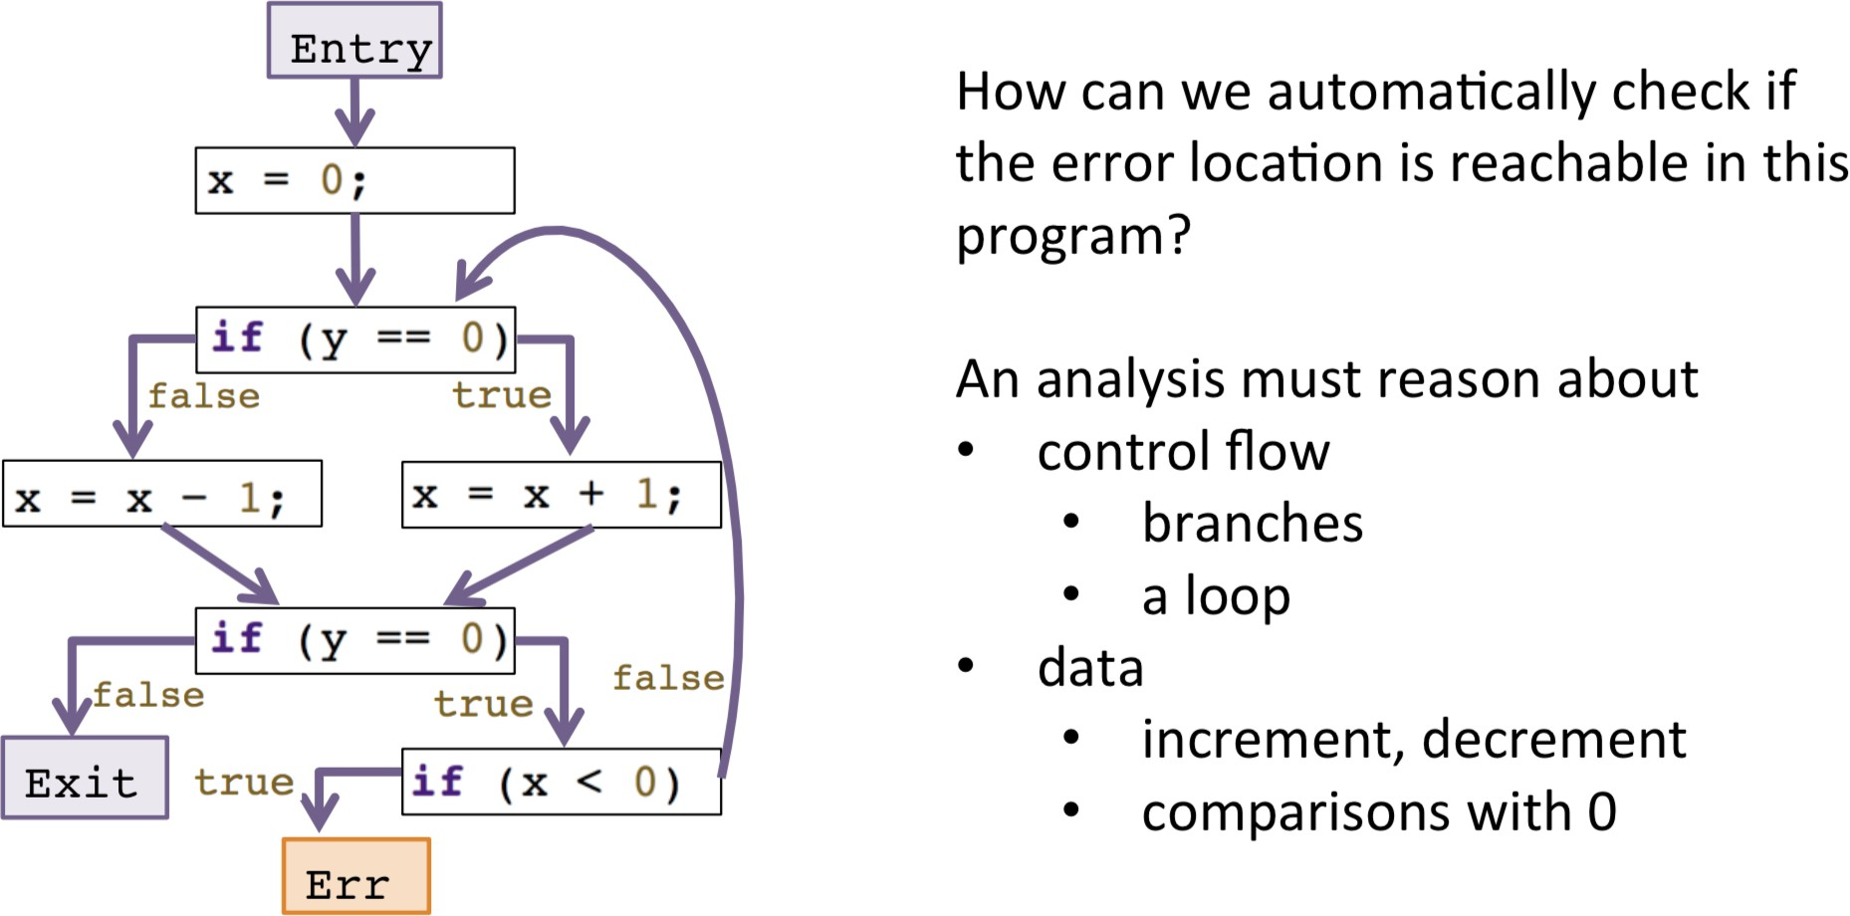
Example

Slide 11
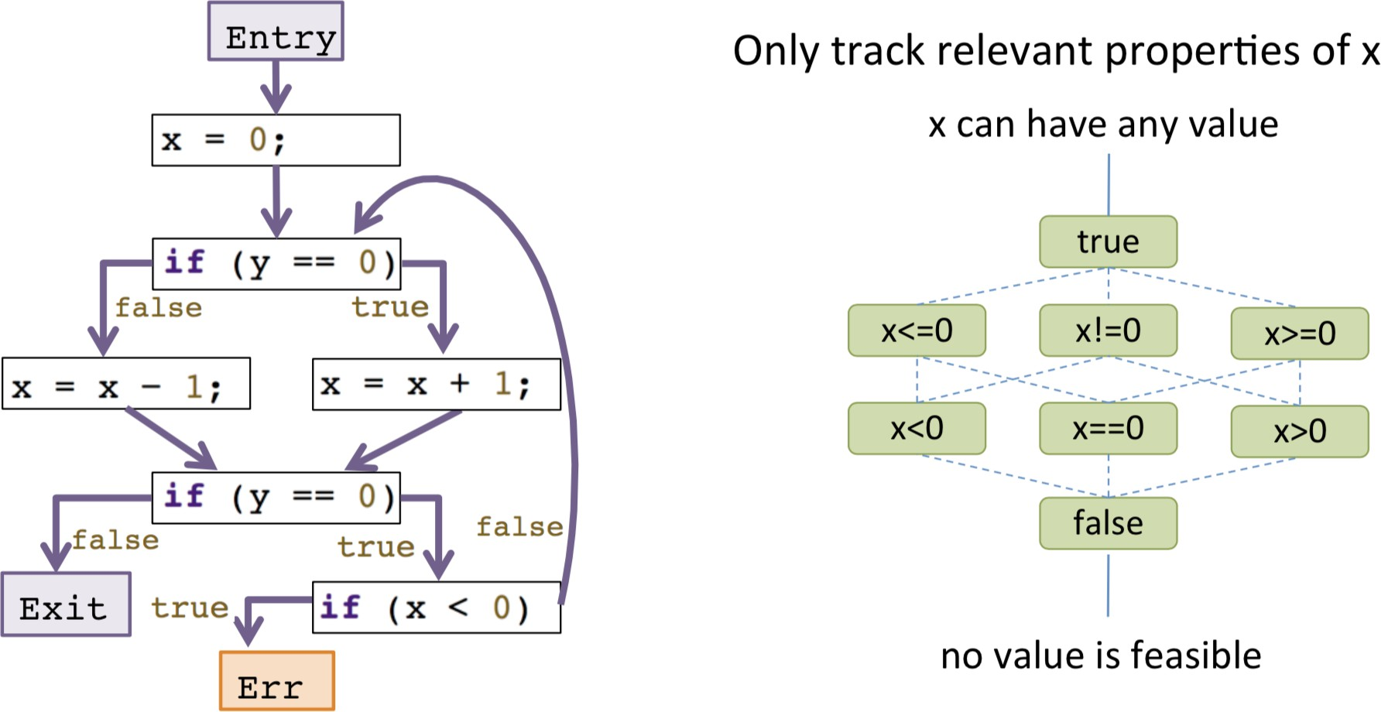

Slide 12
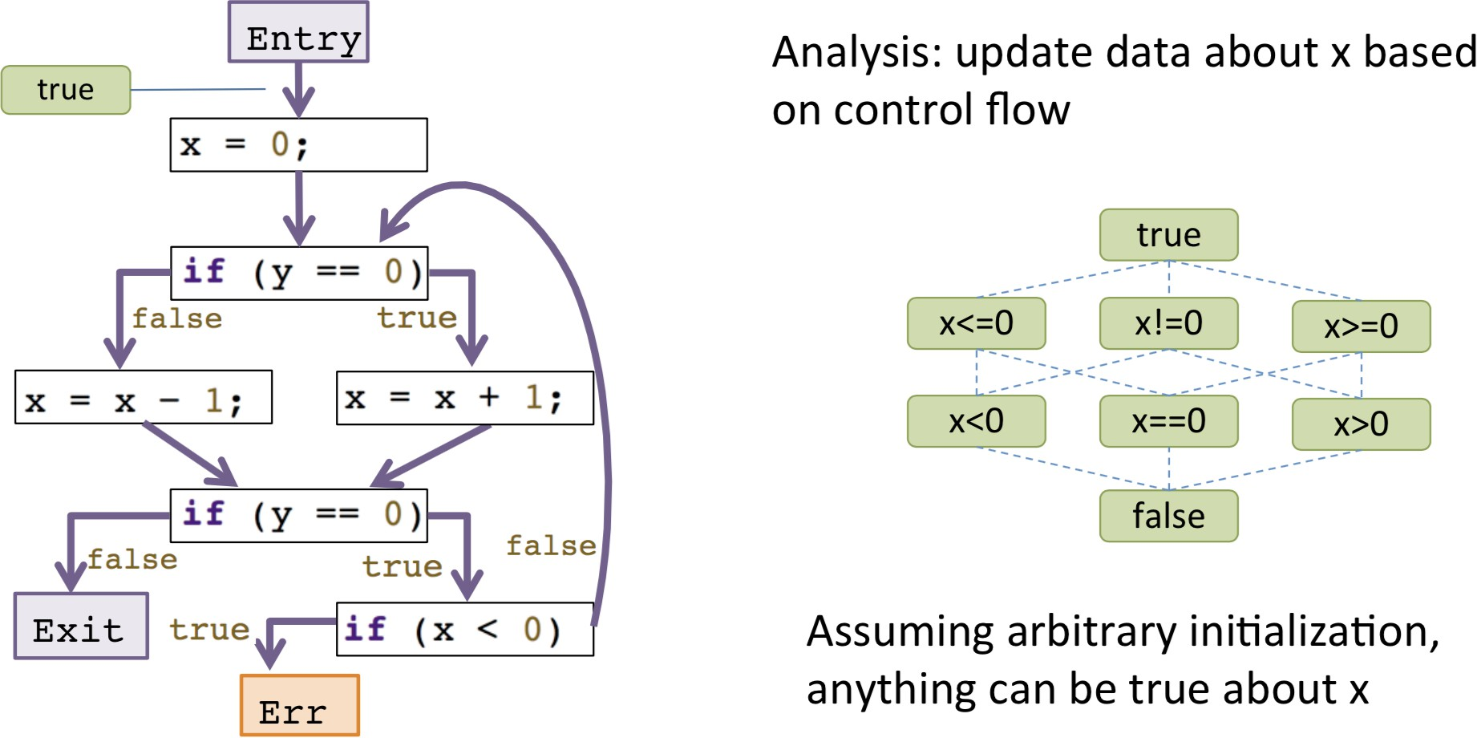
Sign Analysis (1)

Slide 13
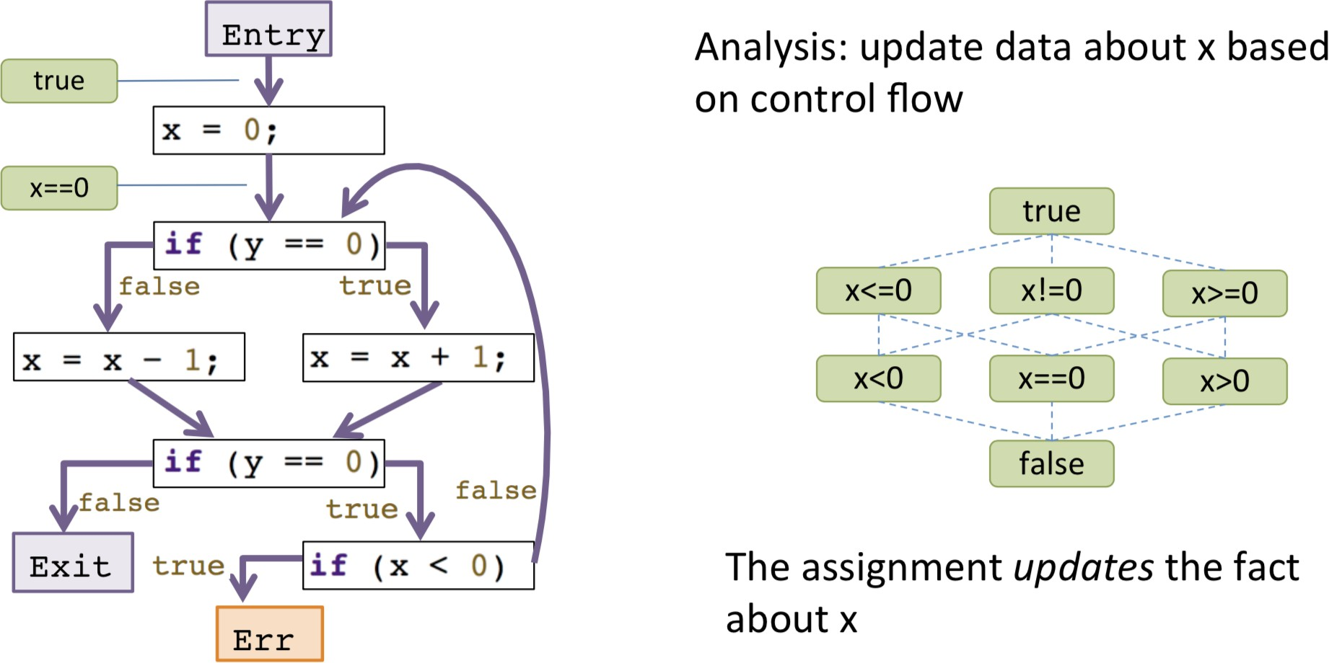
Sign Analysis (2)

Slide 14
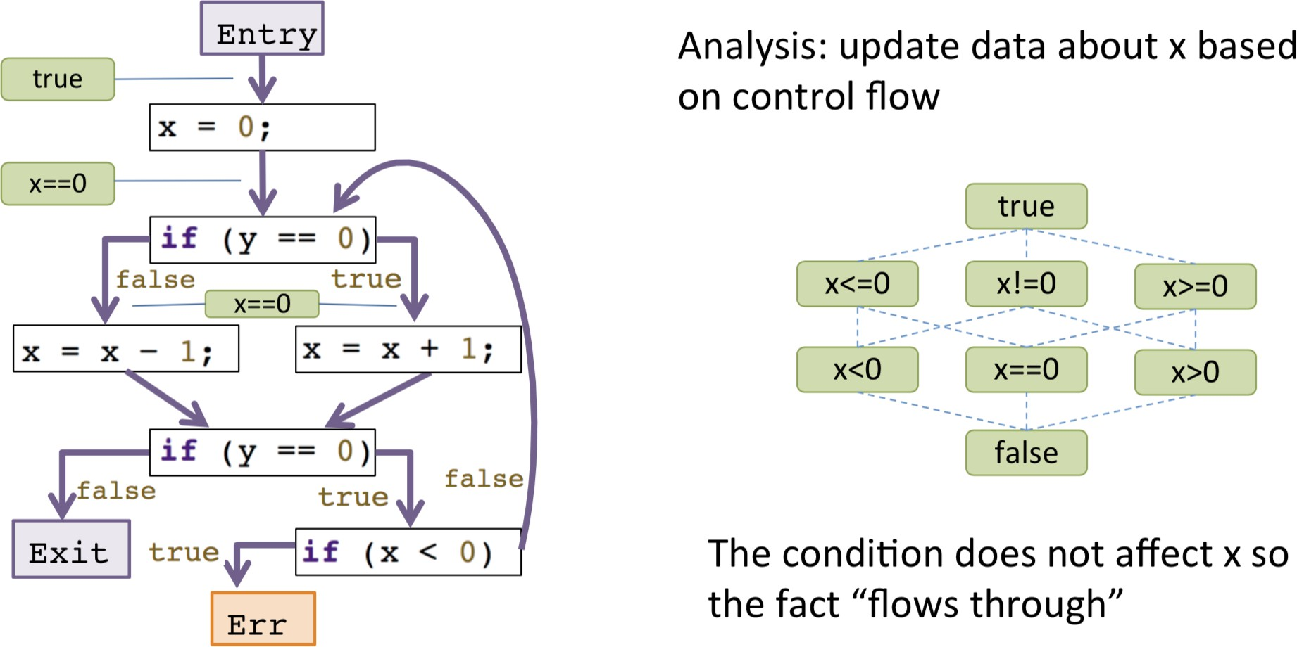
Sign Analysis (3)

Slide 15
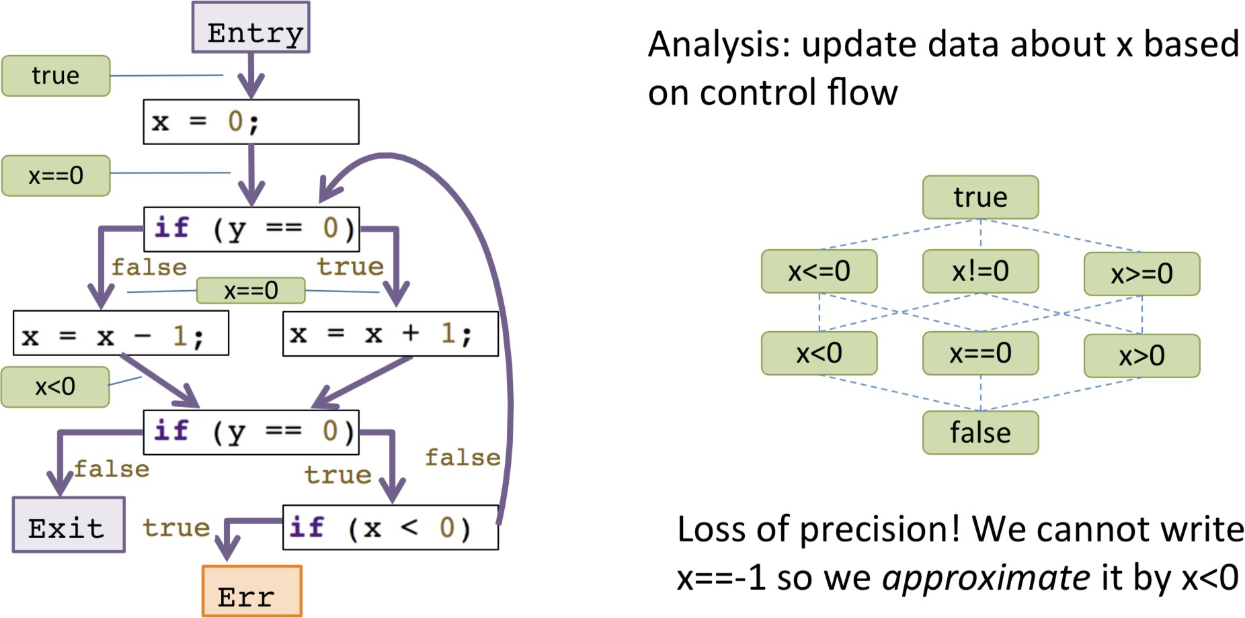
Sign Analysis (4)

Slide 16
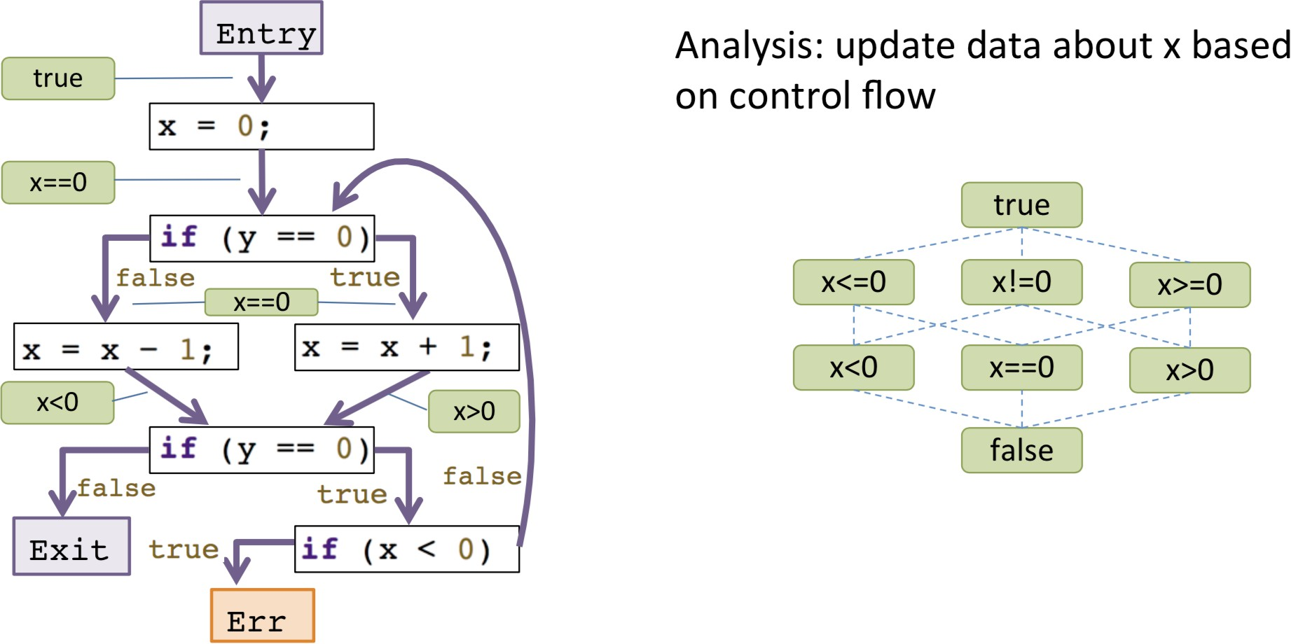
Sign Analysis (5)

Slide 17
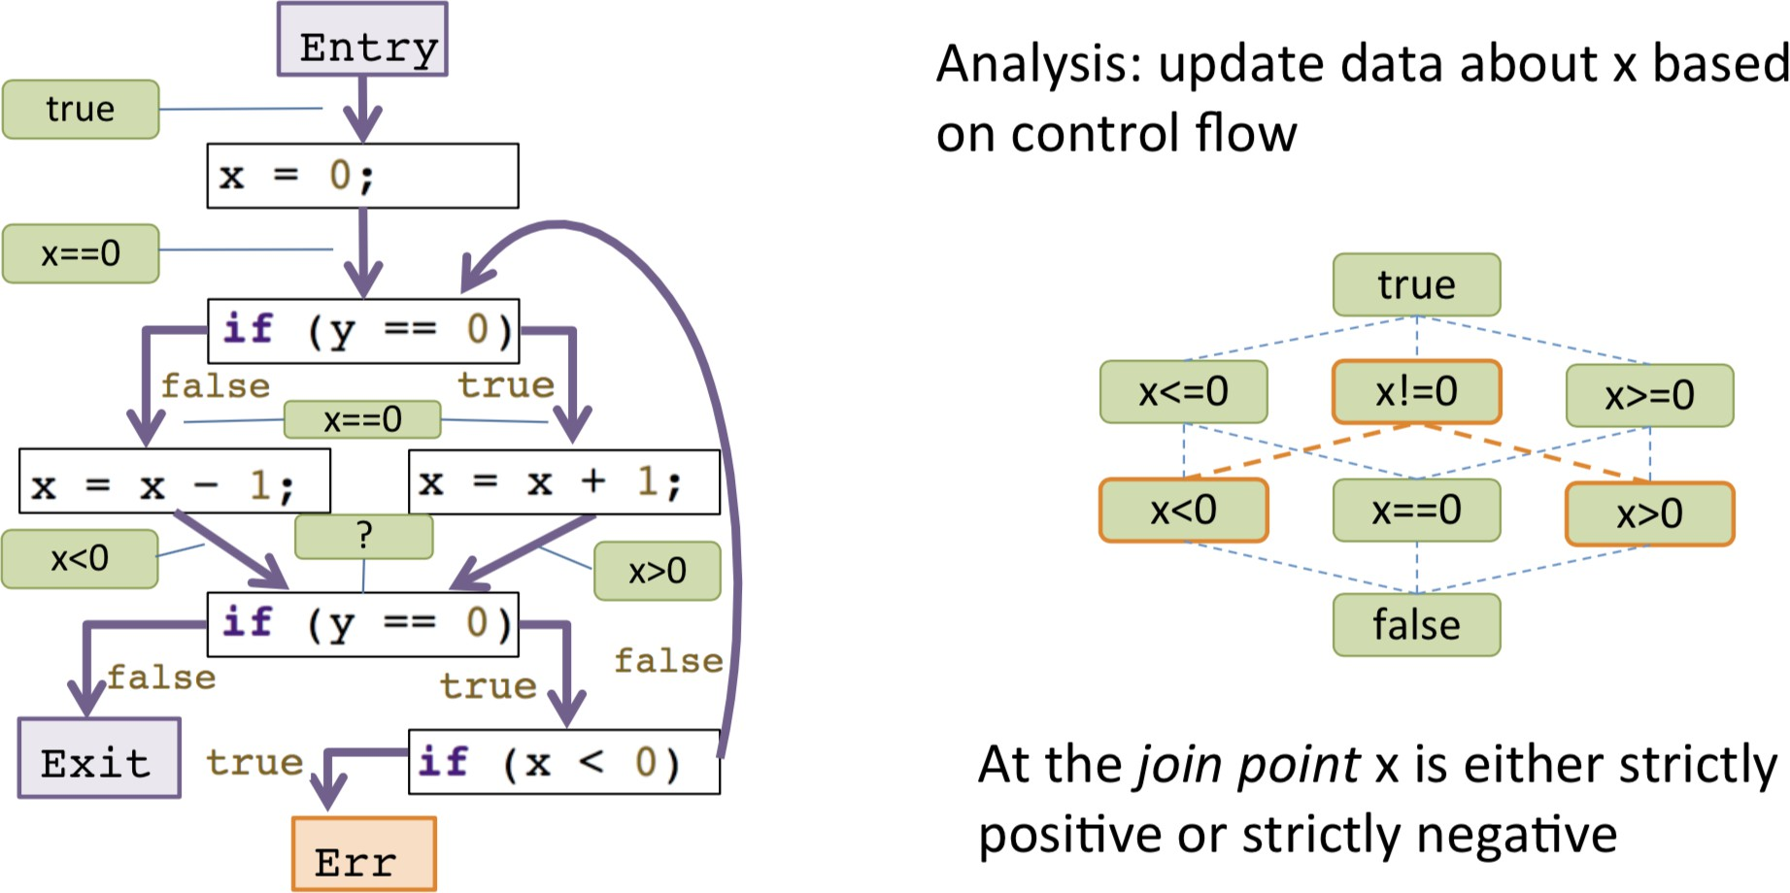
Sign Analysis (6)

Slide 18
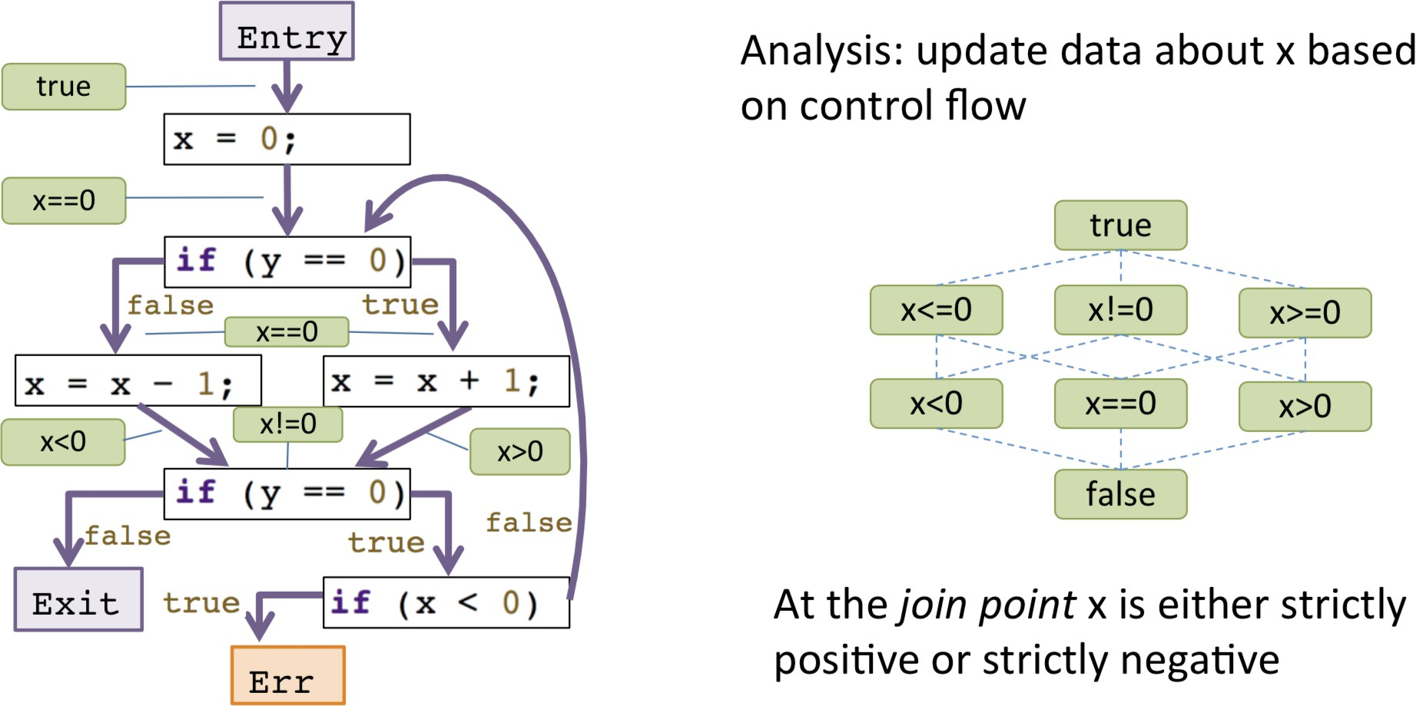
Sign Analysis (7)

Slide 19
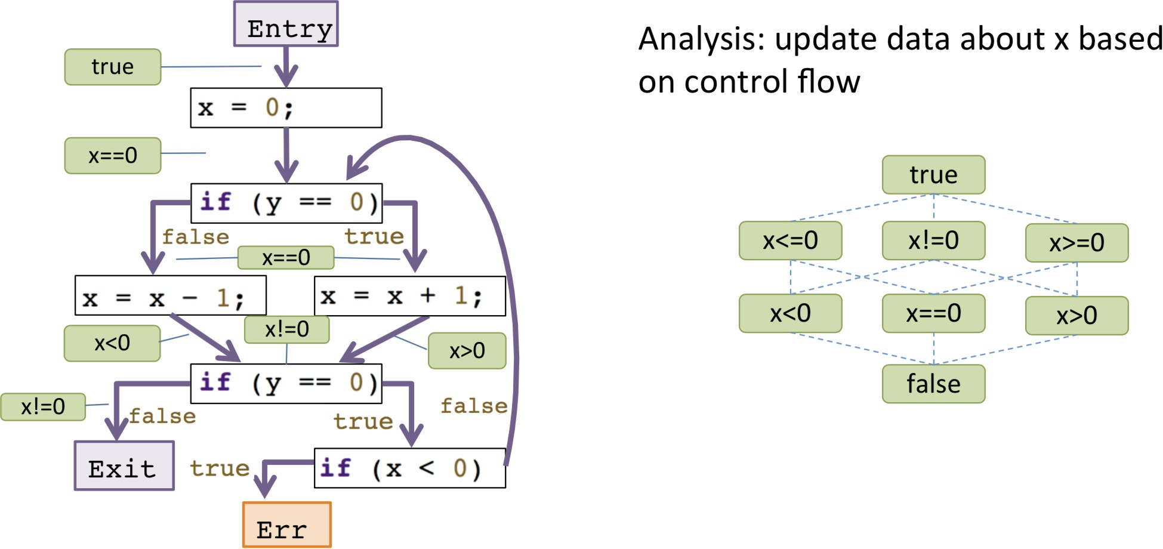
Sign Analysis (8)

Slide 20
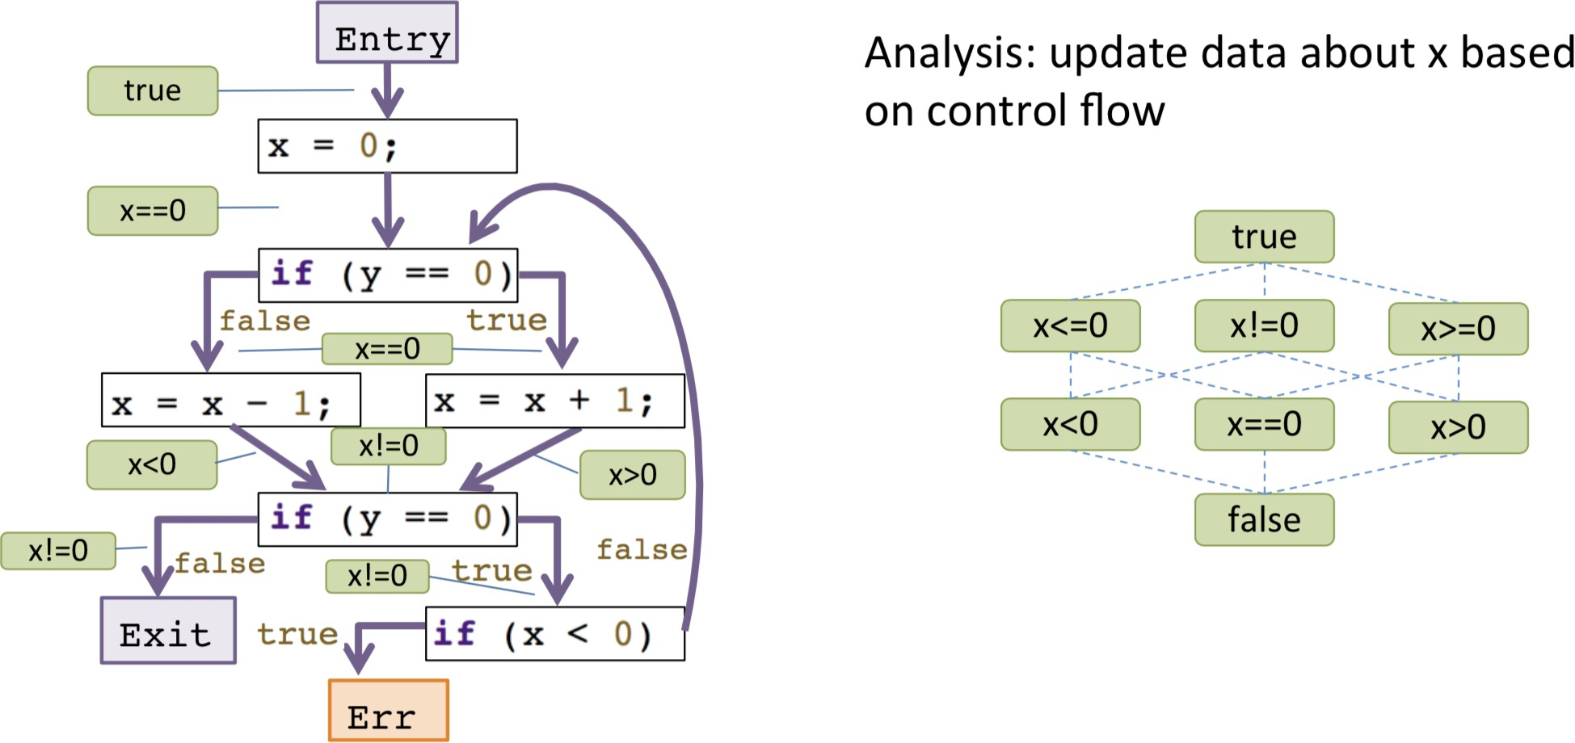
Sign Analysis (9)

Slide 21
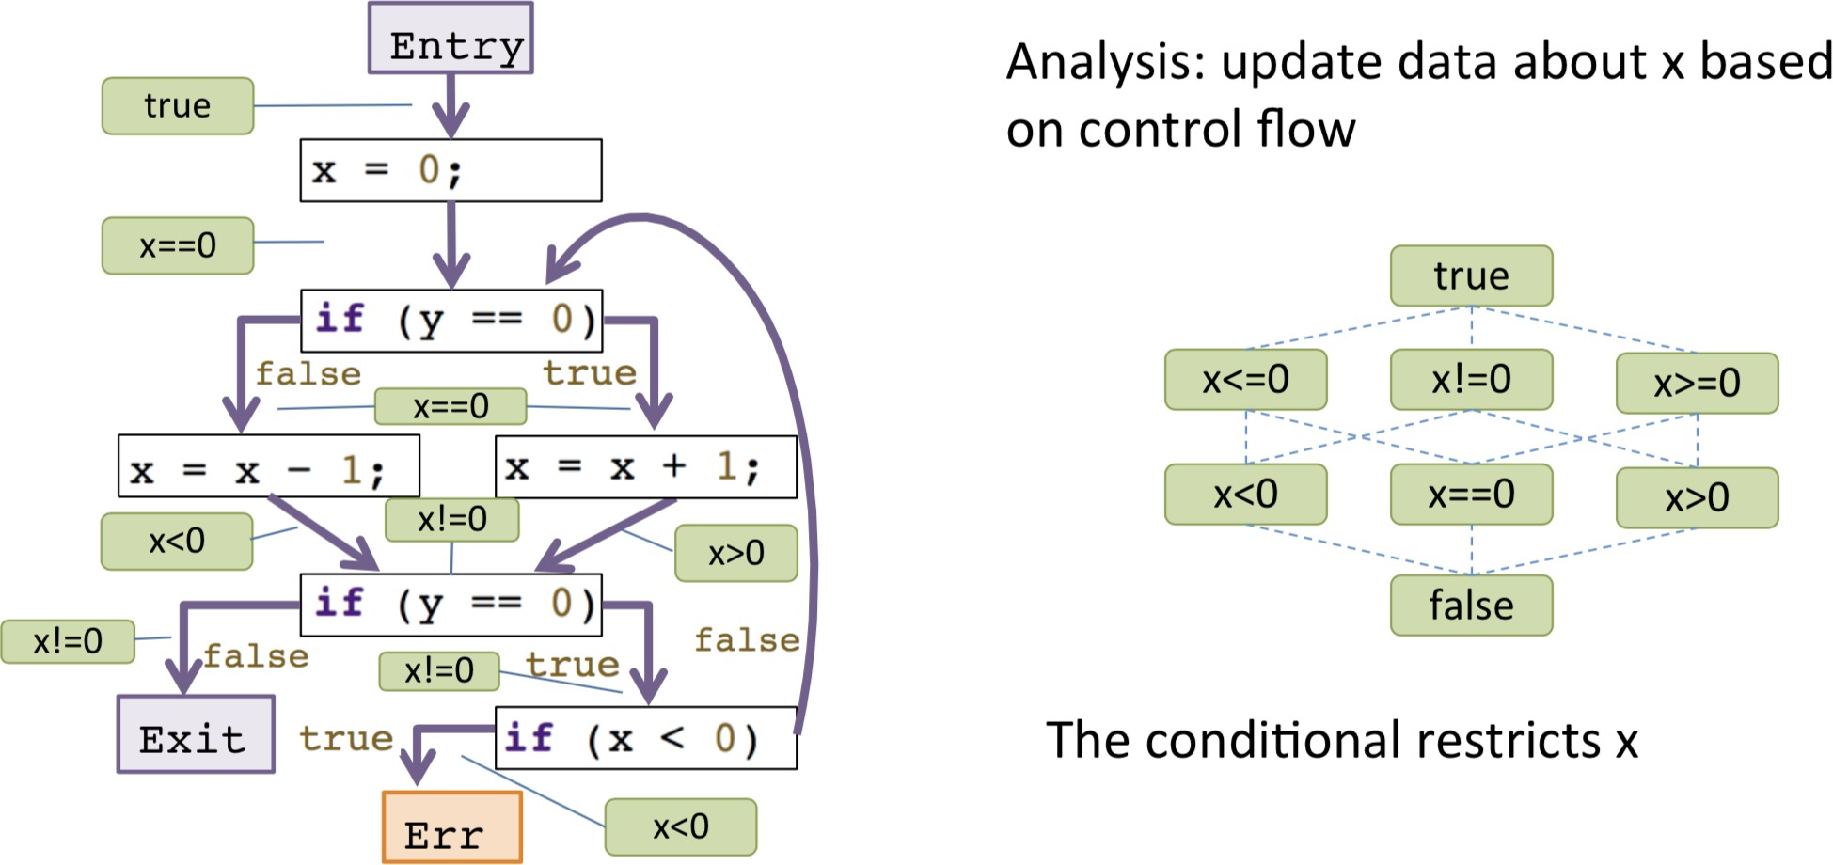
Sign Analysis (10)

Slide 22
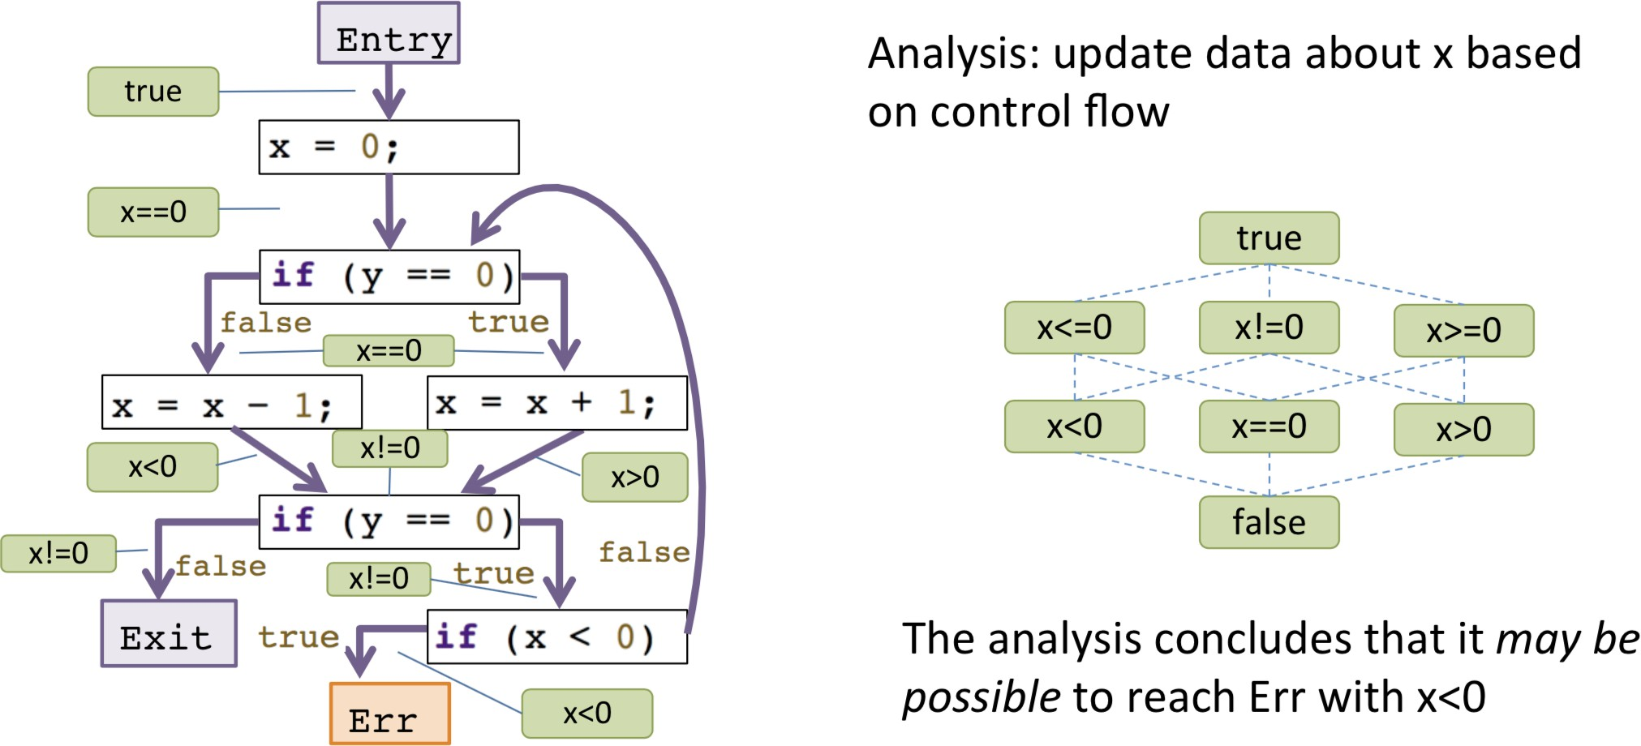
Sign Analysis (11)

Slide 23
Program Verification
Properties: true for every possible execution
Safety: nothing bad happens (e.g., buffer overﬂow)
Liveness: something good eventually happens
Program veriﬁcation in security
How to prove safety properties

Slide 24
Program Verification
Approach: build up conﬁdence on a function-by-function/module-by-module
basis
Modularity provides boundaries for our reasoning
Preconditions: what must hold for function to operate correctly
Postconditions: what holds after function completes
These basically describe a contract for using the module
Most basic contract? Argument number and types

Slide 25
Example
Memory access/dereference as a function
byte deref(byte *p) {
Return *p;
}
What is the precondition for the correctness of this function?

Slide 26
Example
How to proof the following function won't have buffer overﬂow?
int sum(int a[], size_t n) { int total = 0;
for(size_t i=0; i<n; i++) total += a[i];
return total;
}

Slide 27
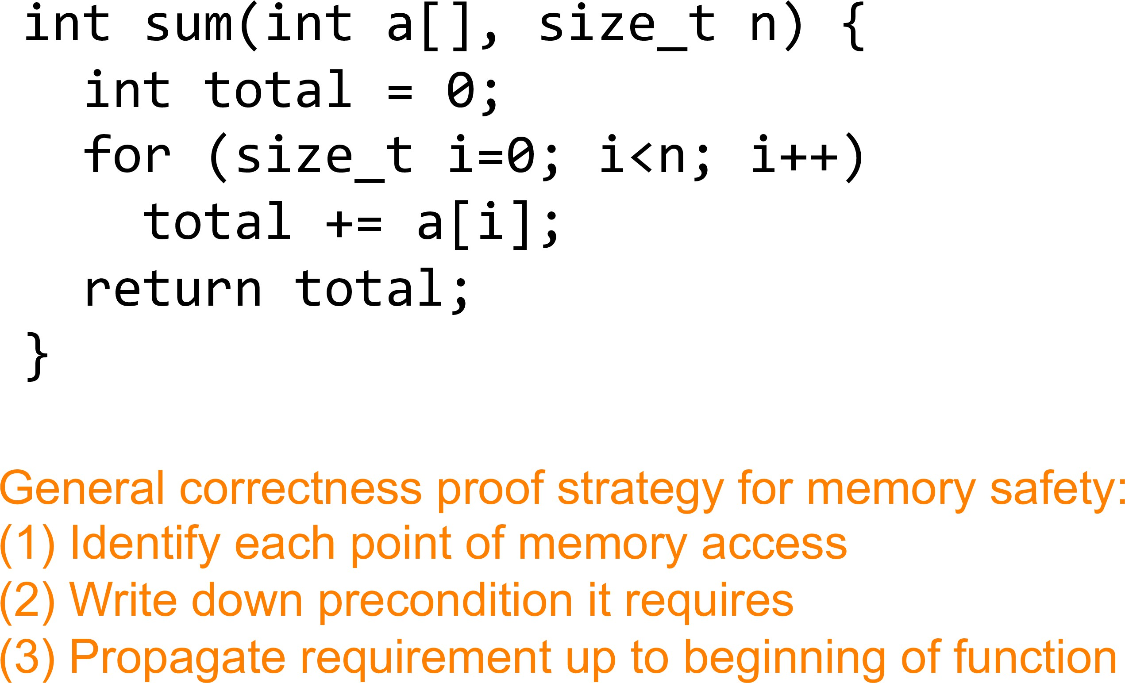
Example

Slide 28
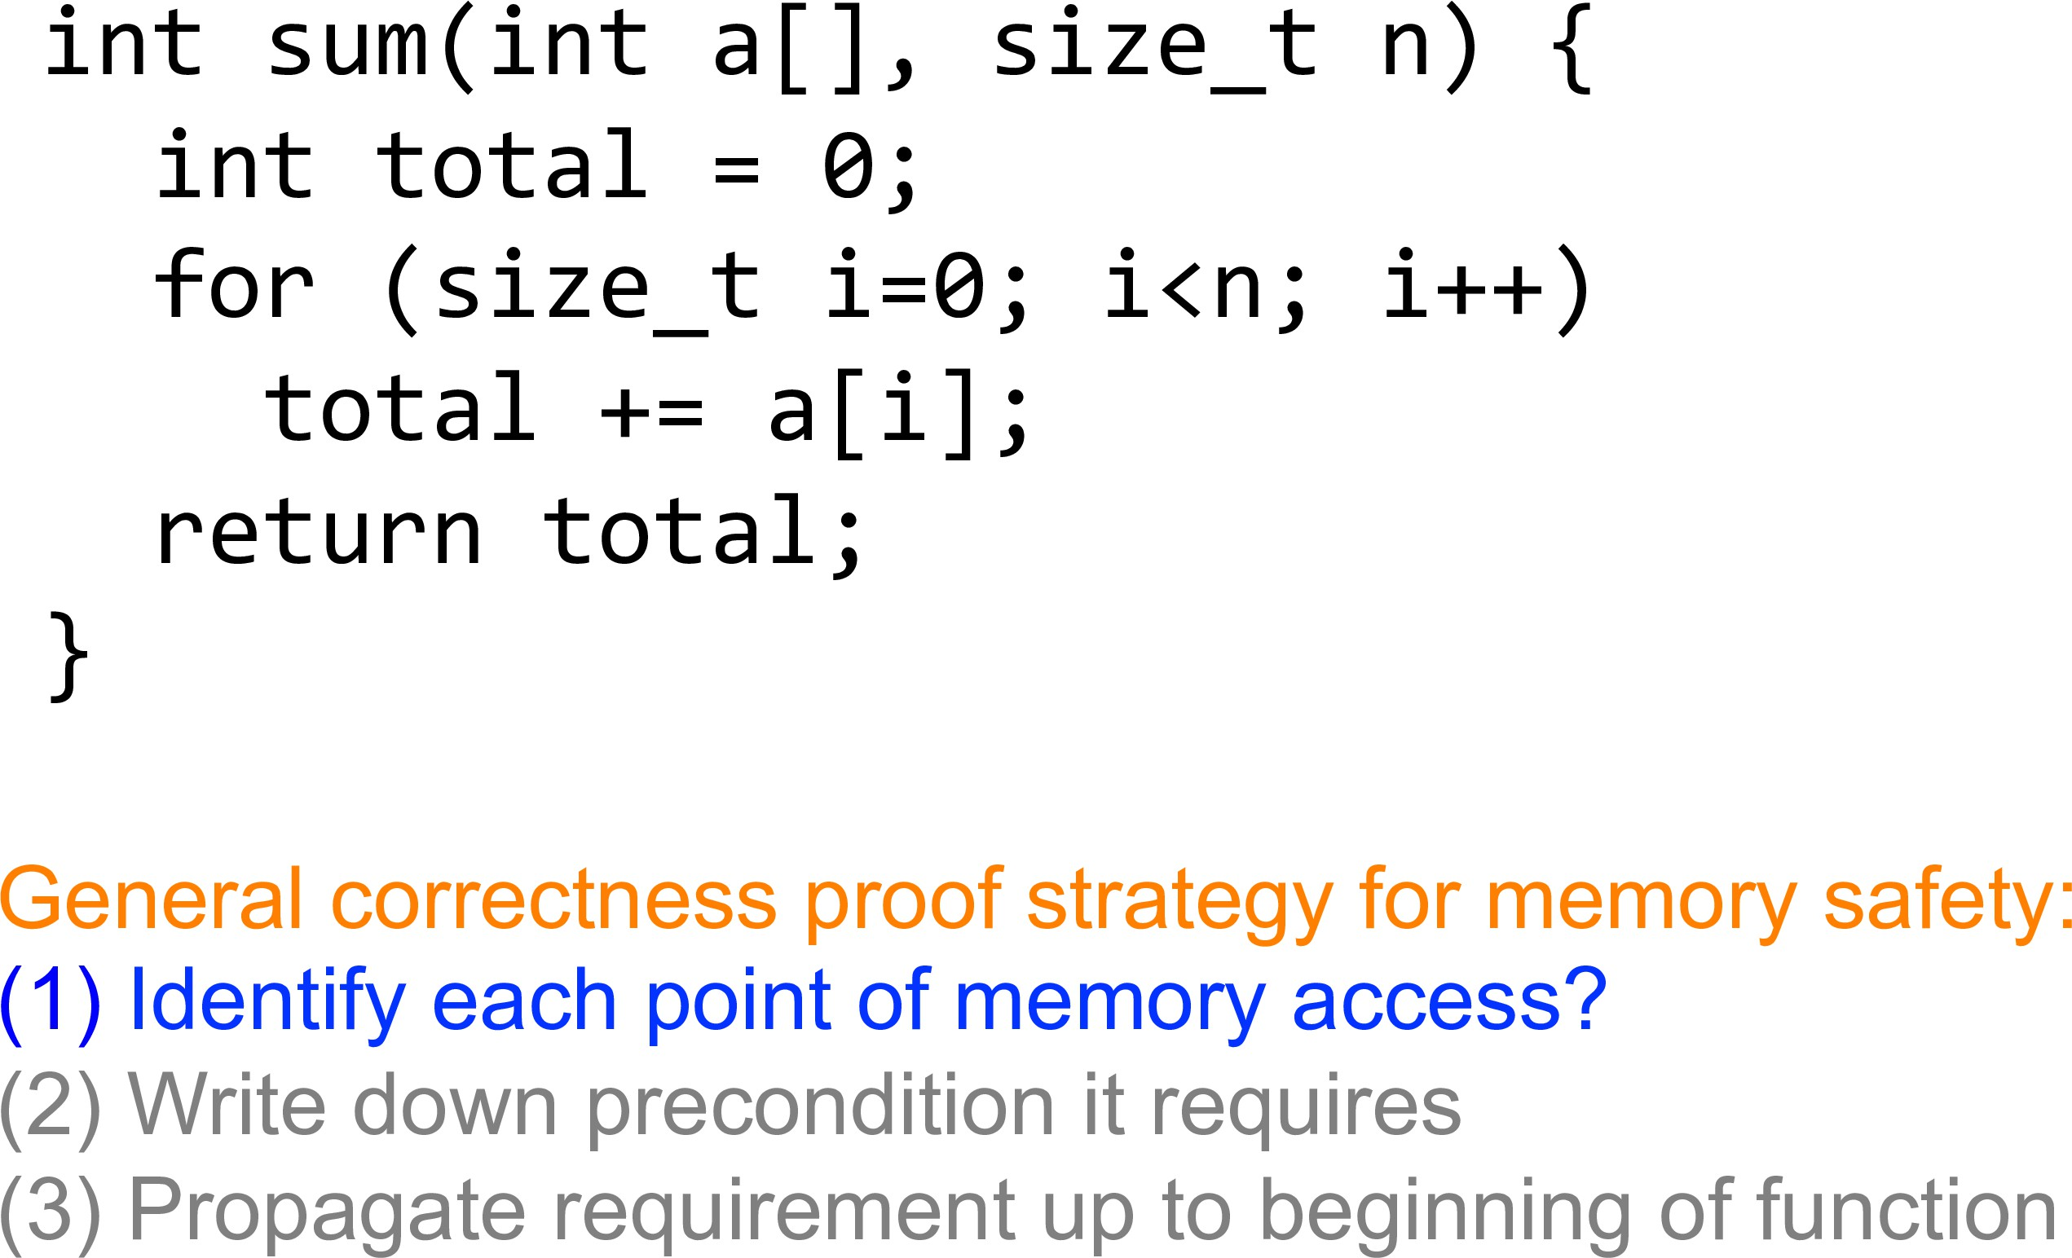
Example

Slide 29
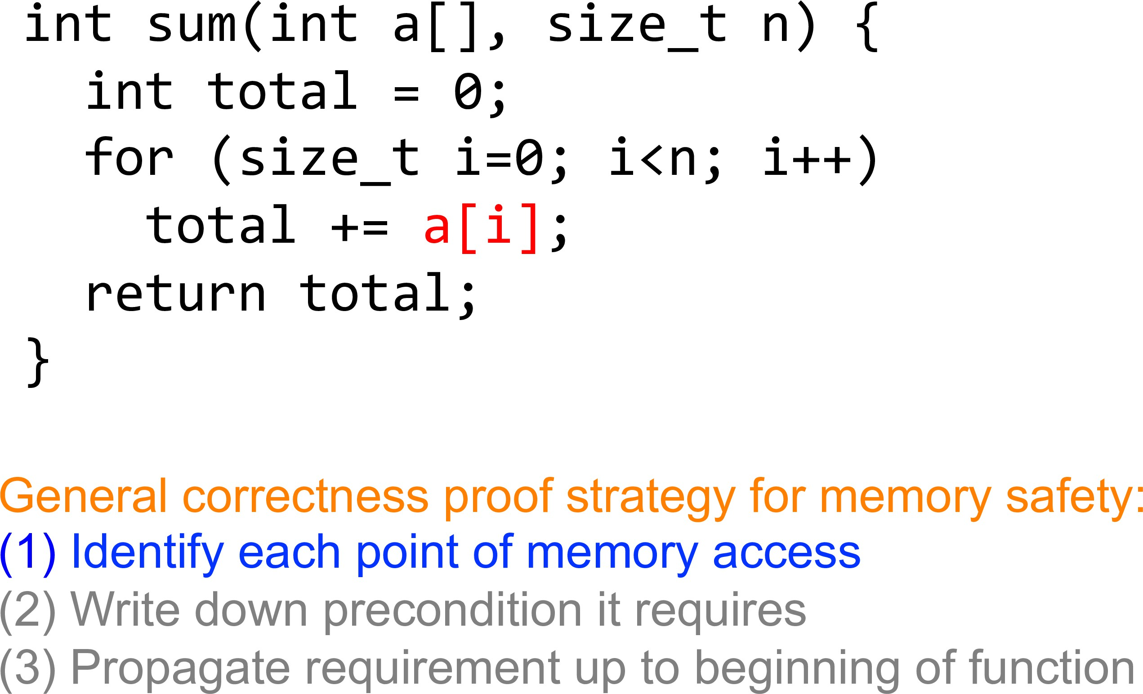
Example

Slide 30
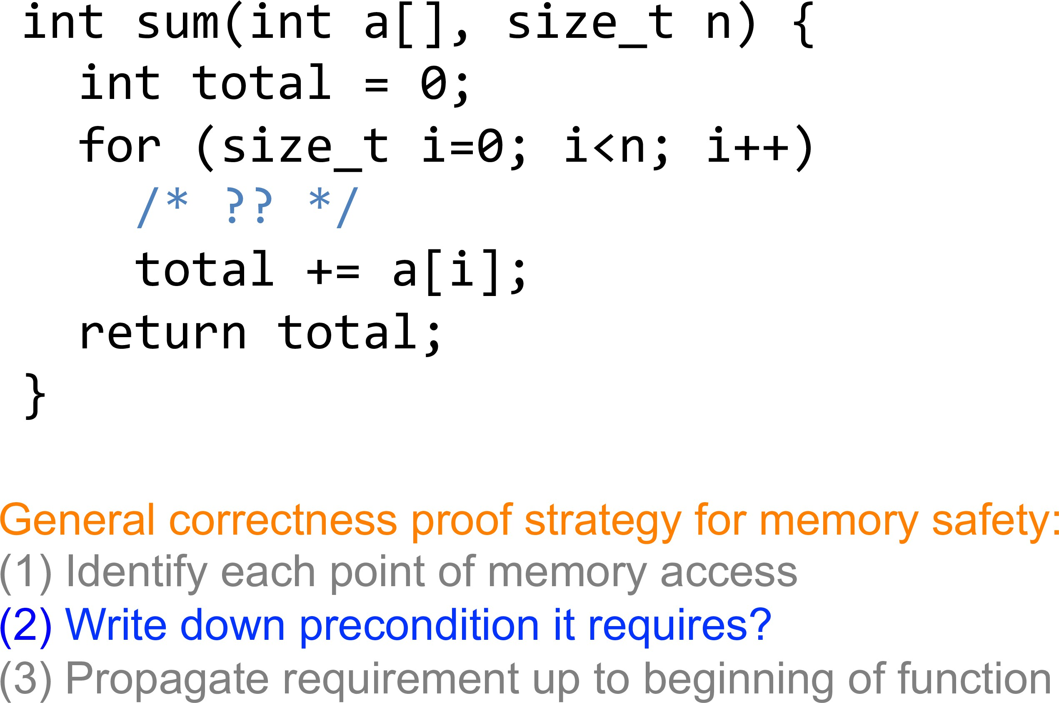
Example

Slide 31
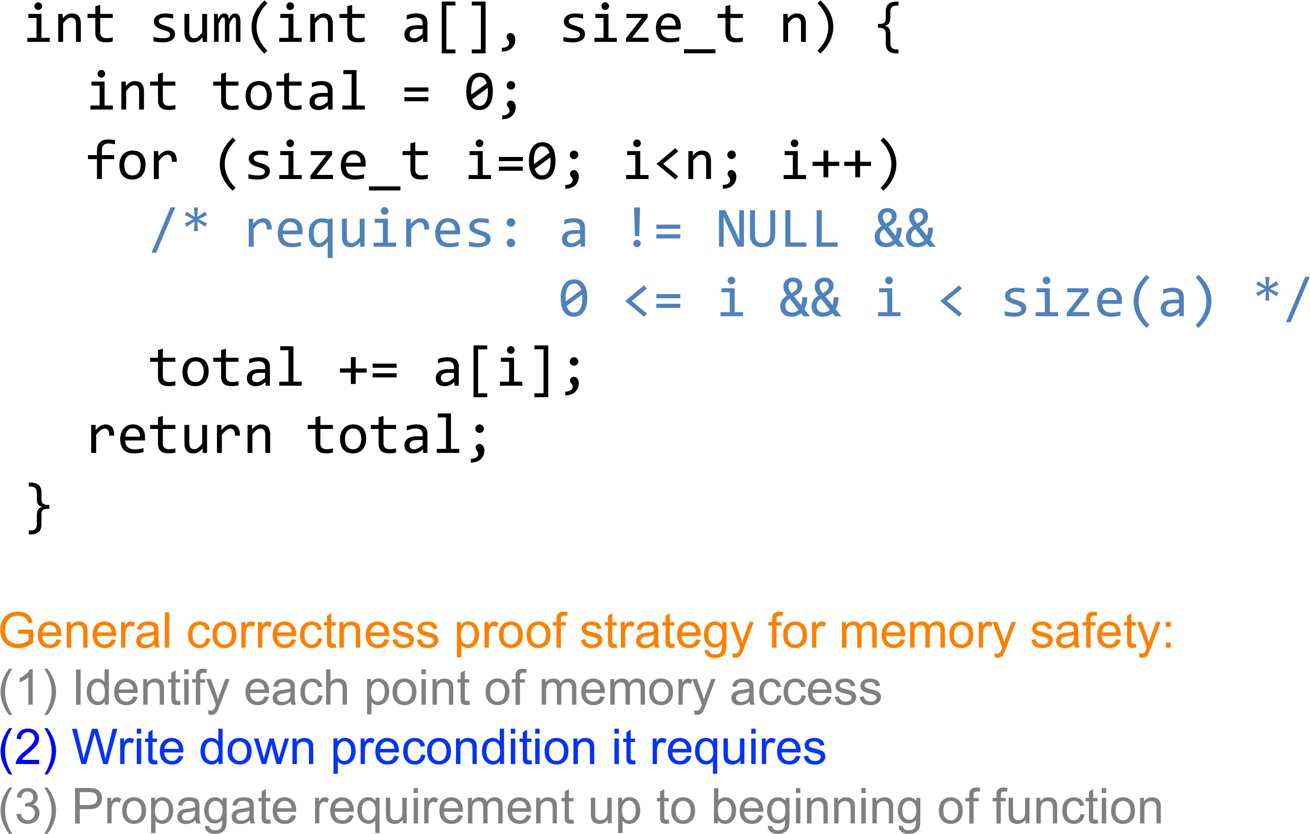
Example

Slide 32
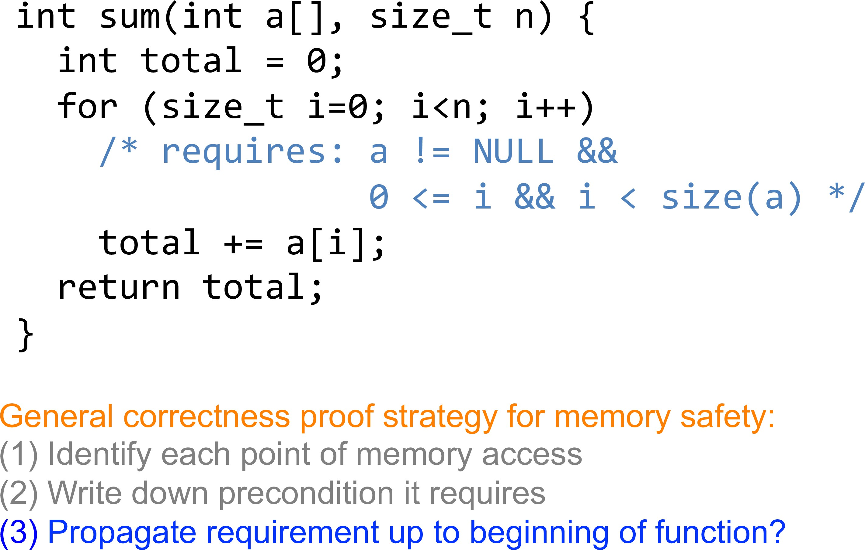
Example

Slide 33
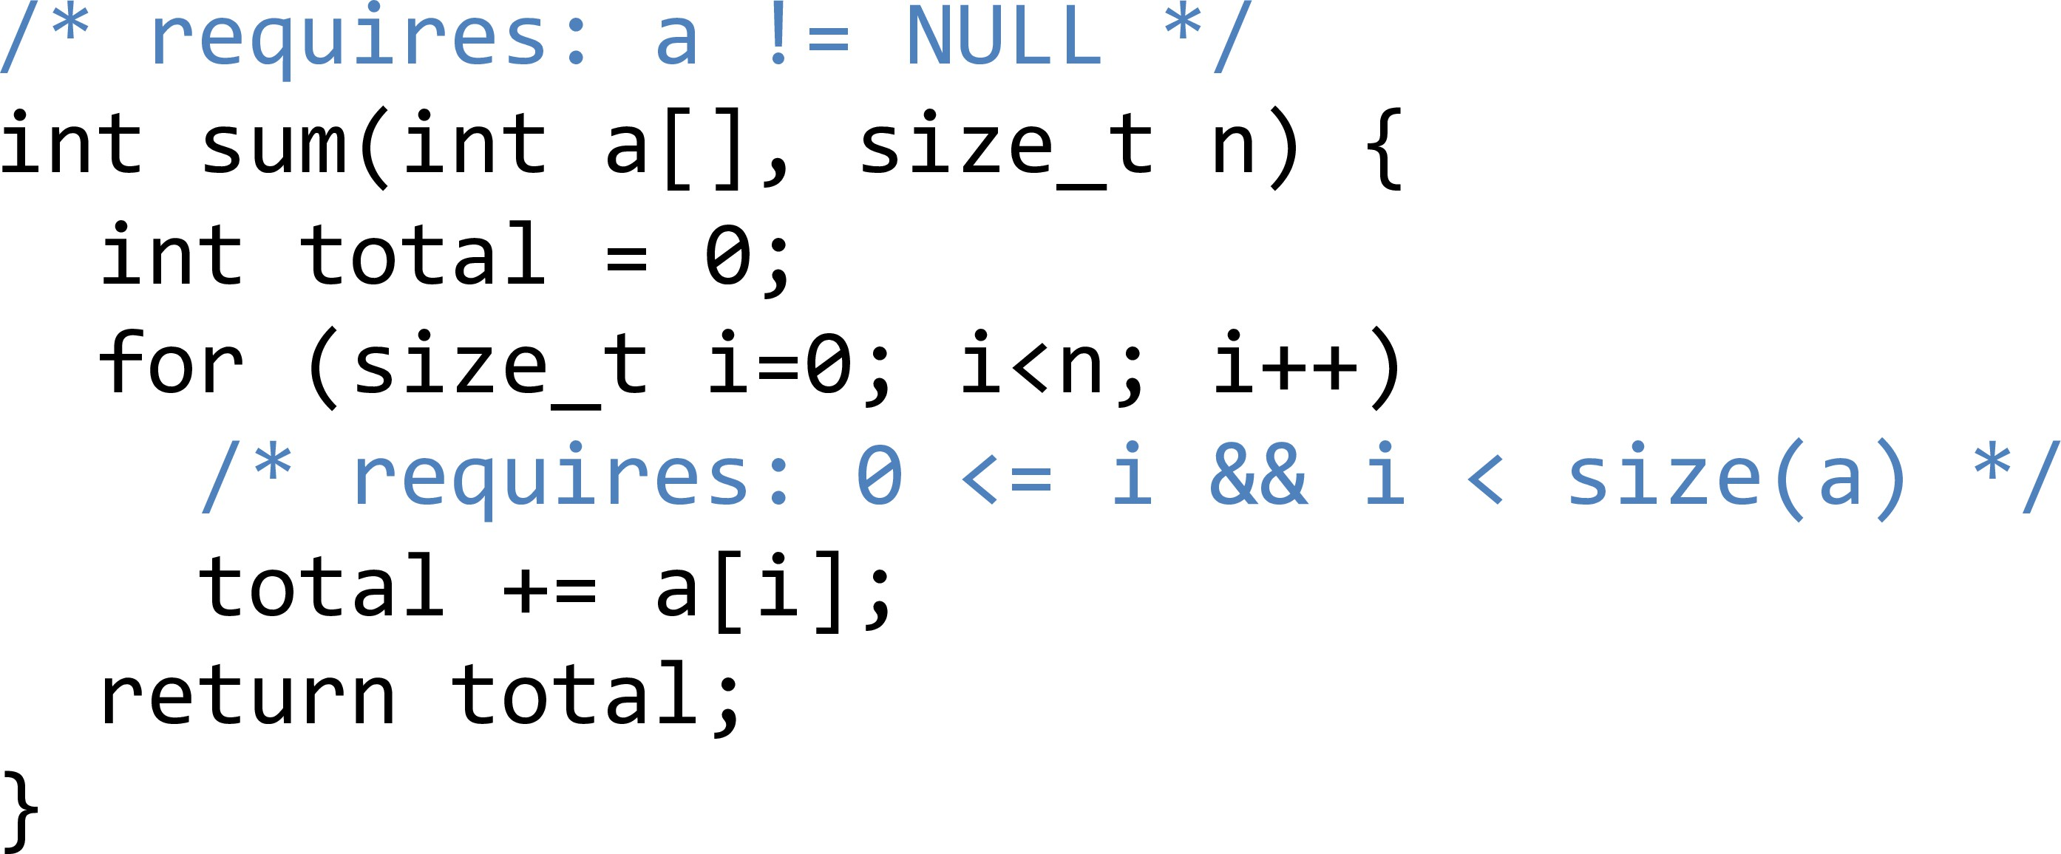
Example

Slide 34
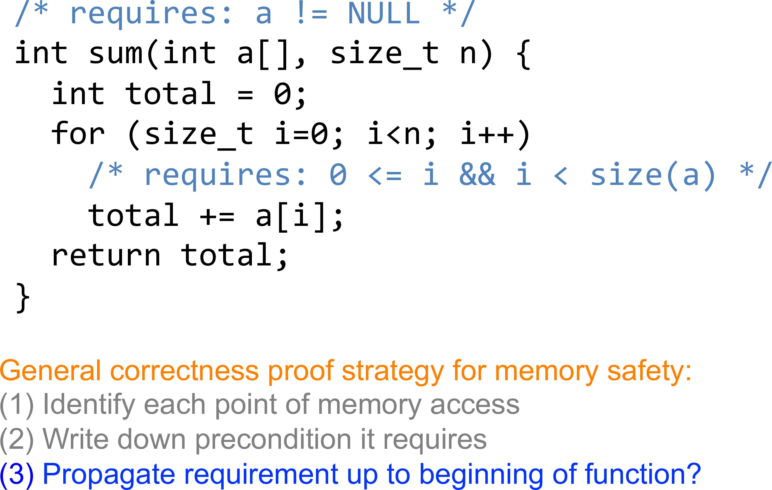
Example

Slide 35
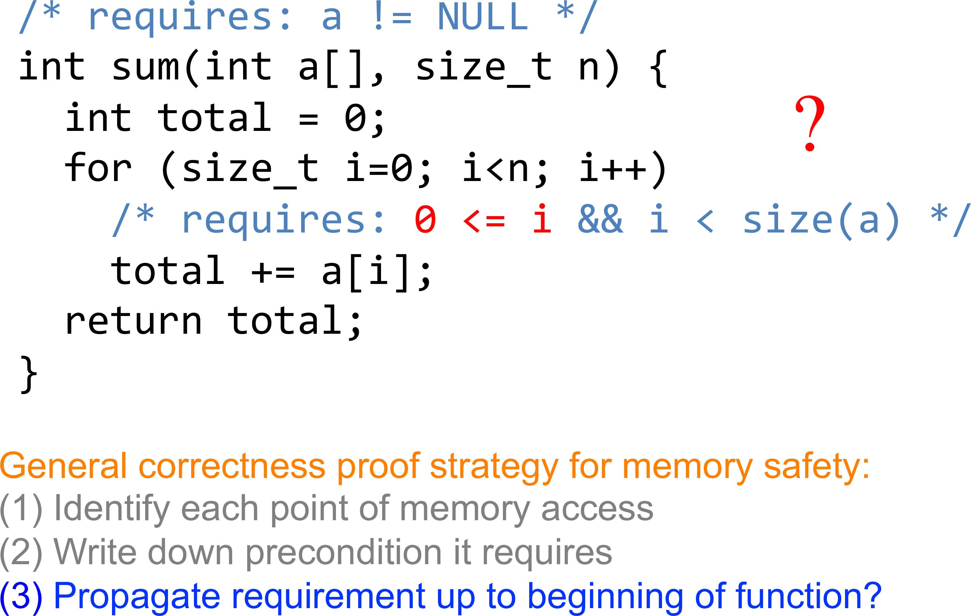
Example

Slide 36
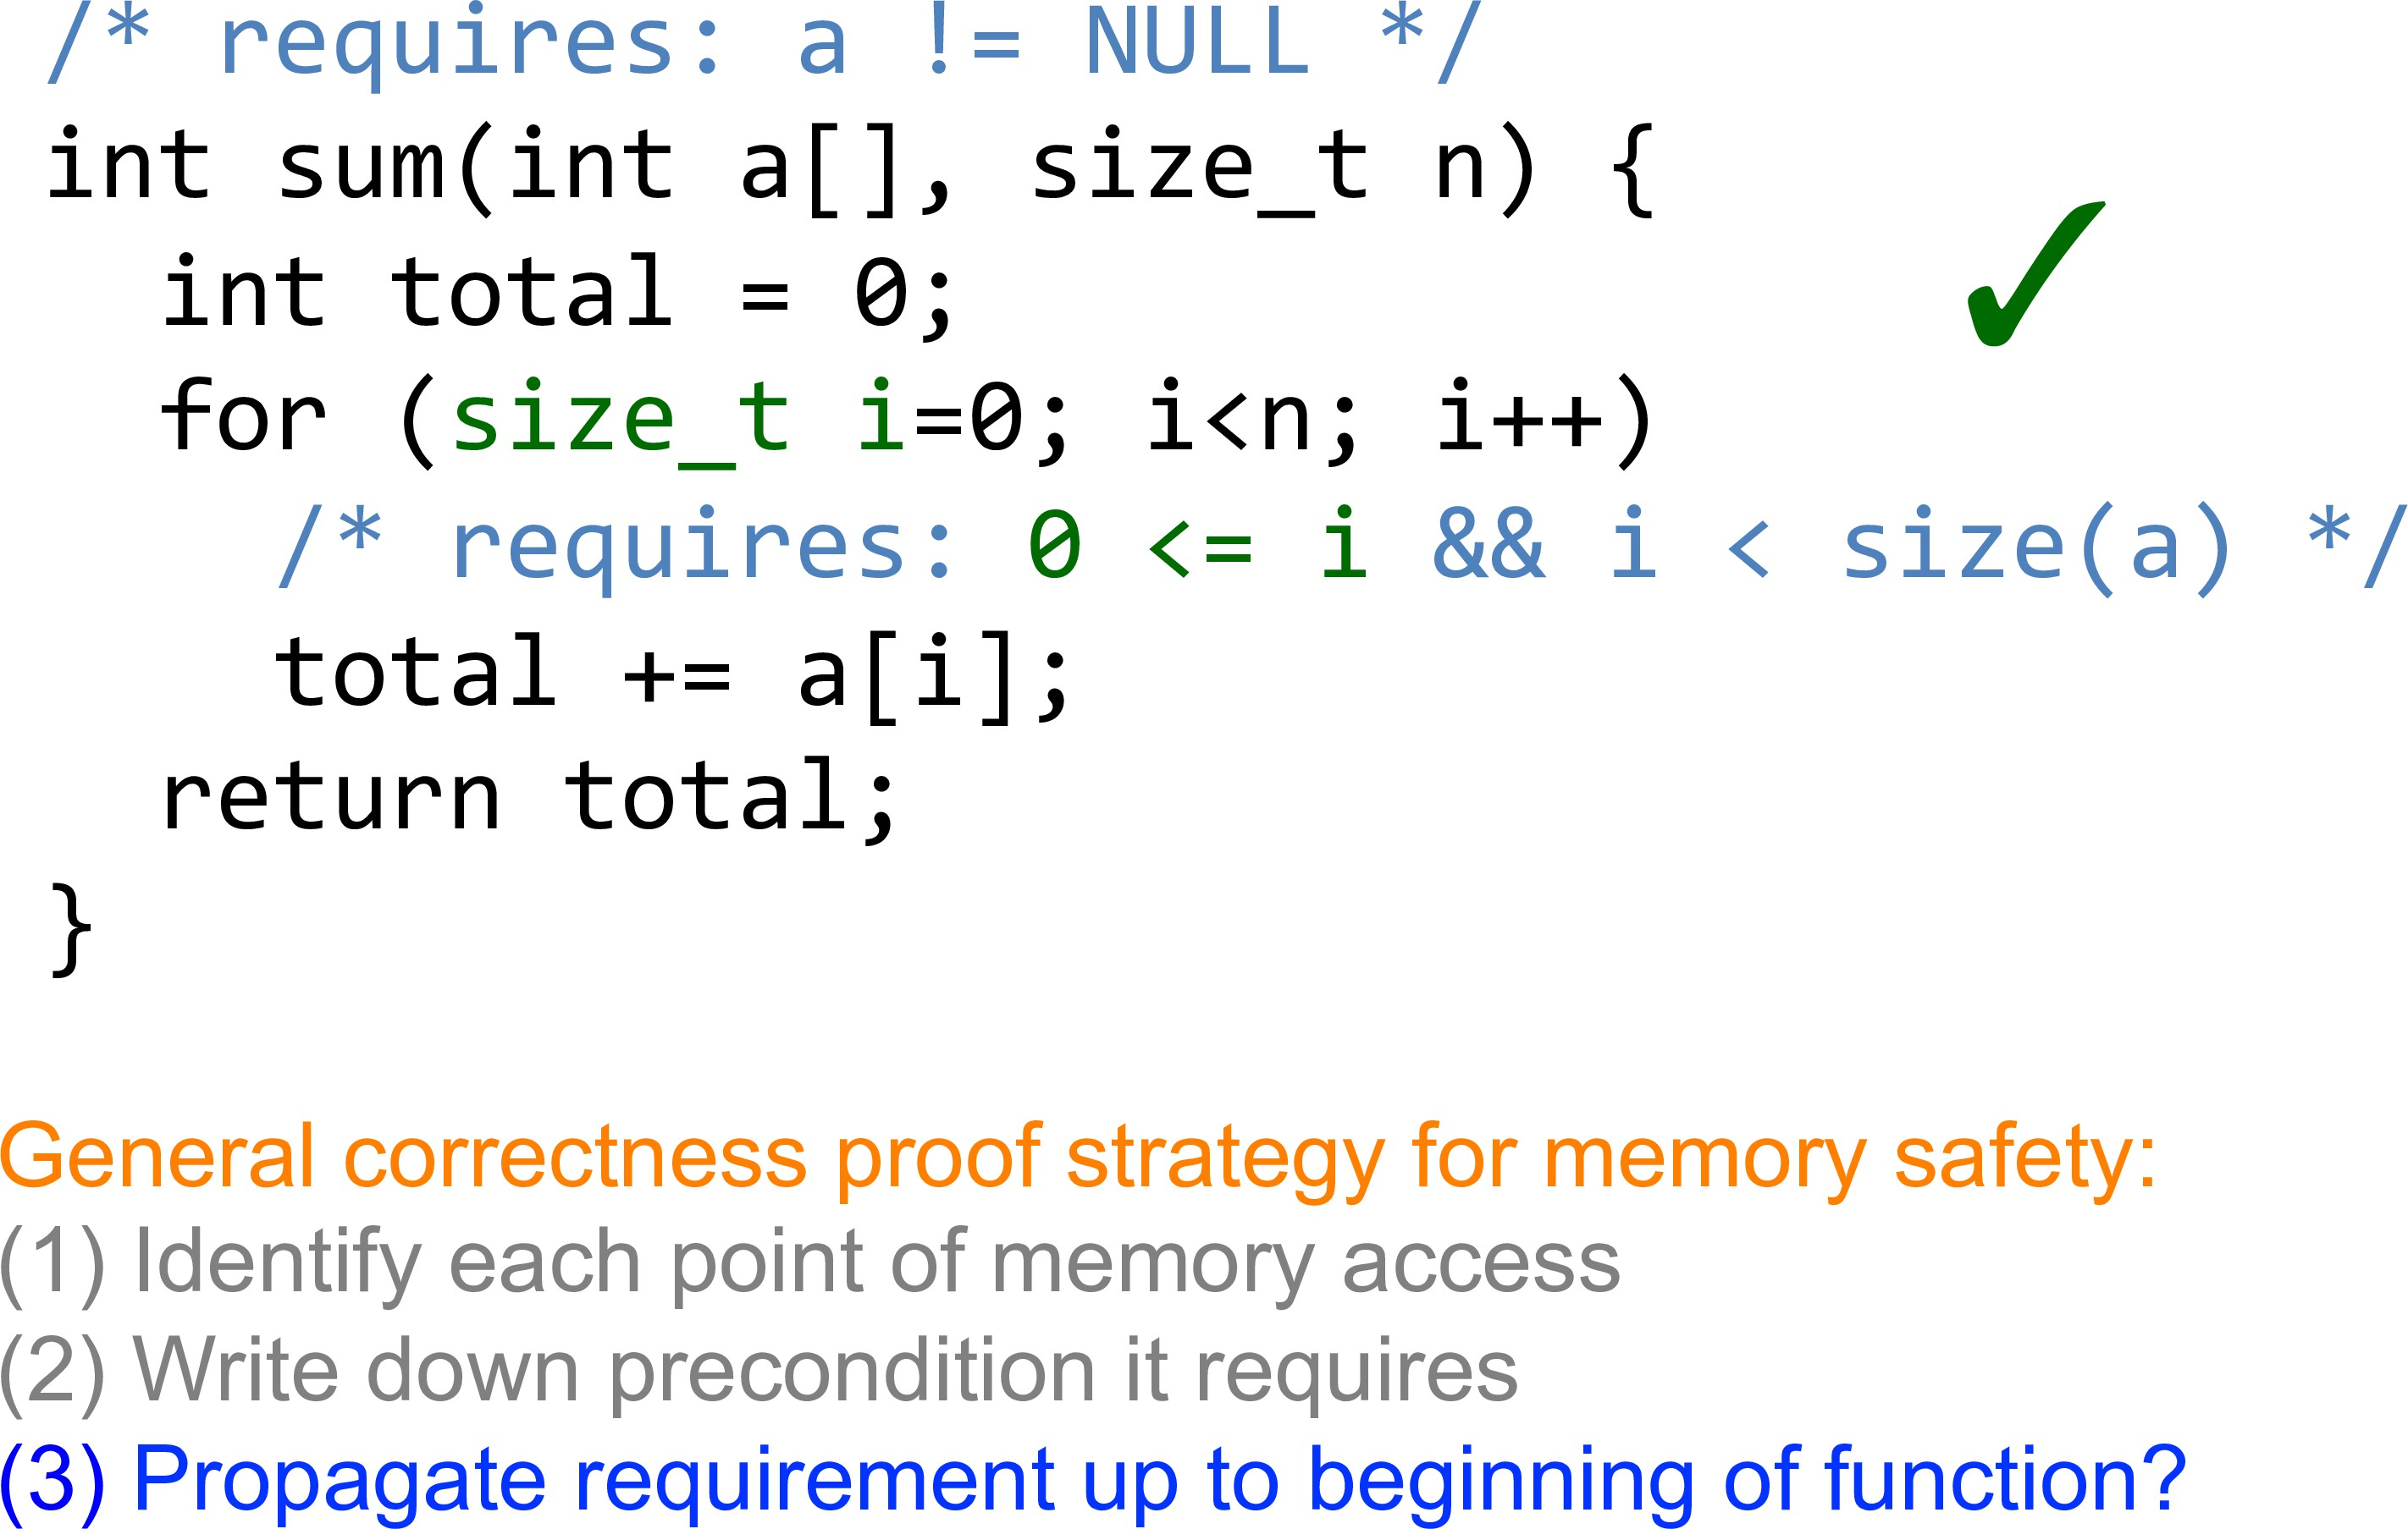
Example

Slide 37
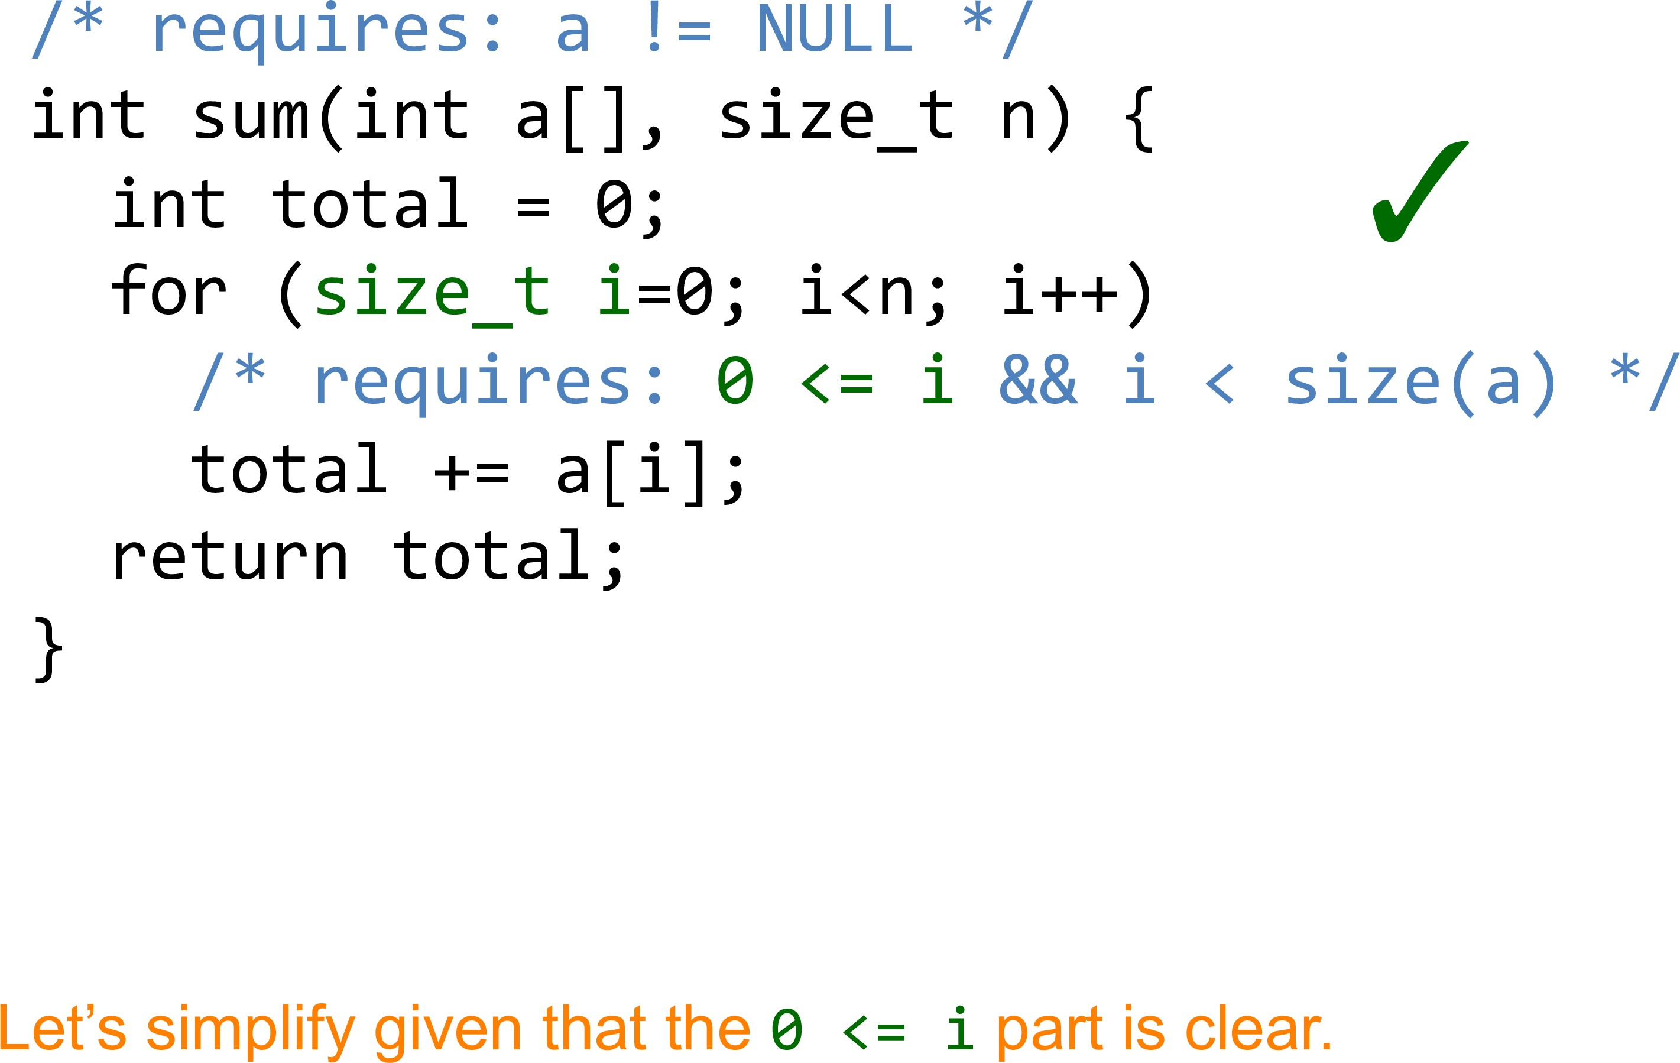
Example

Slide 38
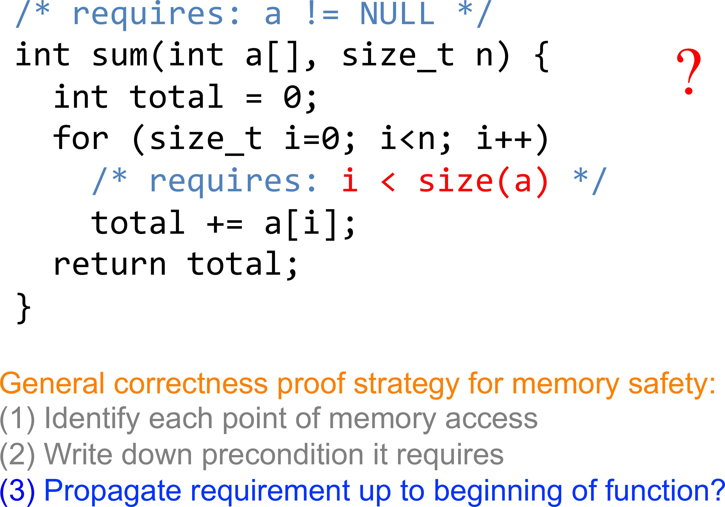
Example

Slide 39
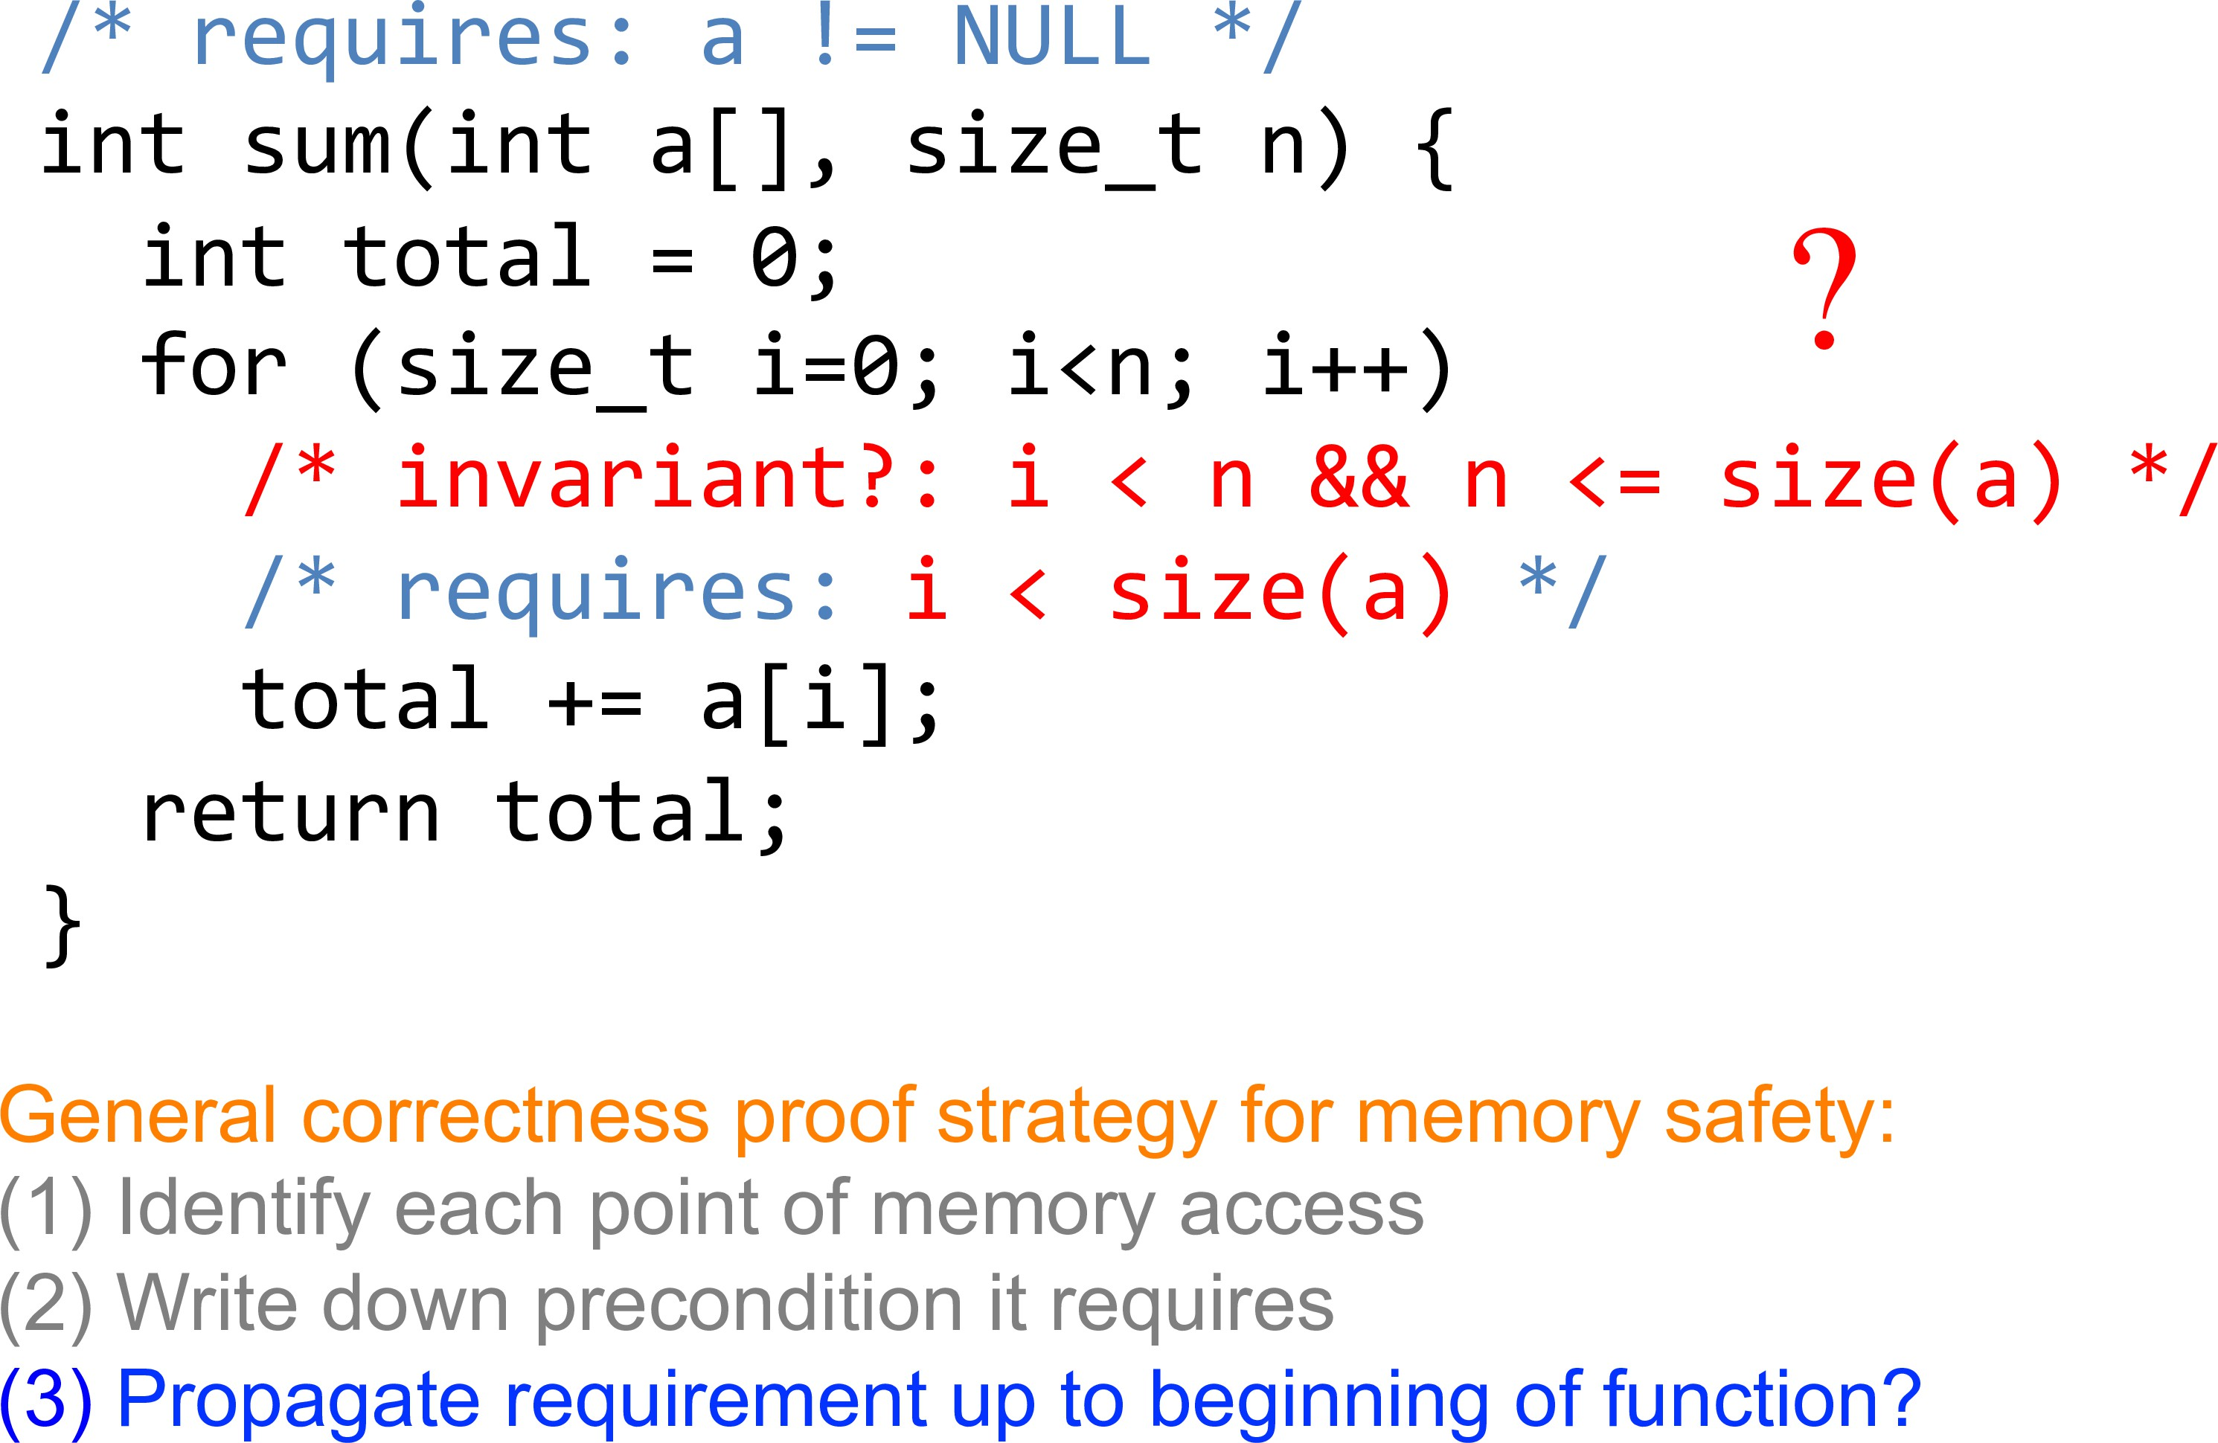
Example

Slide 40
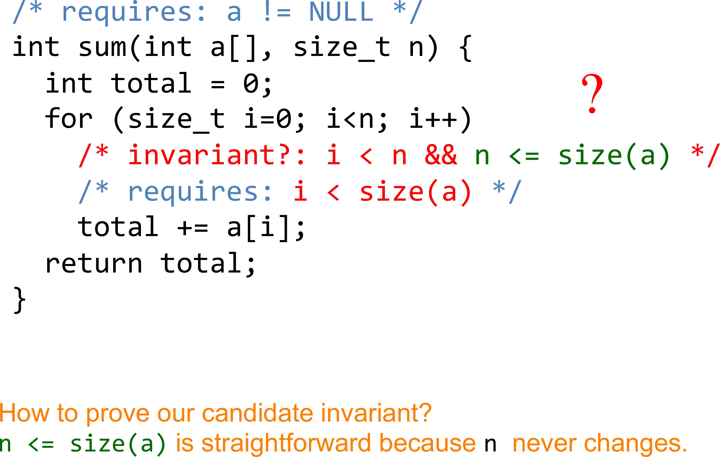
Example

Slide 41
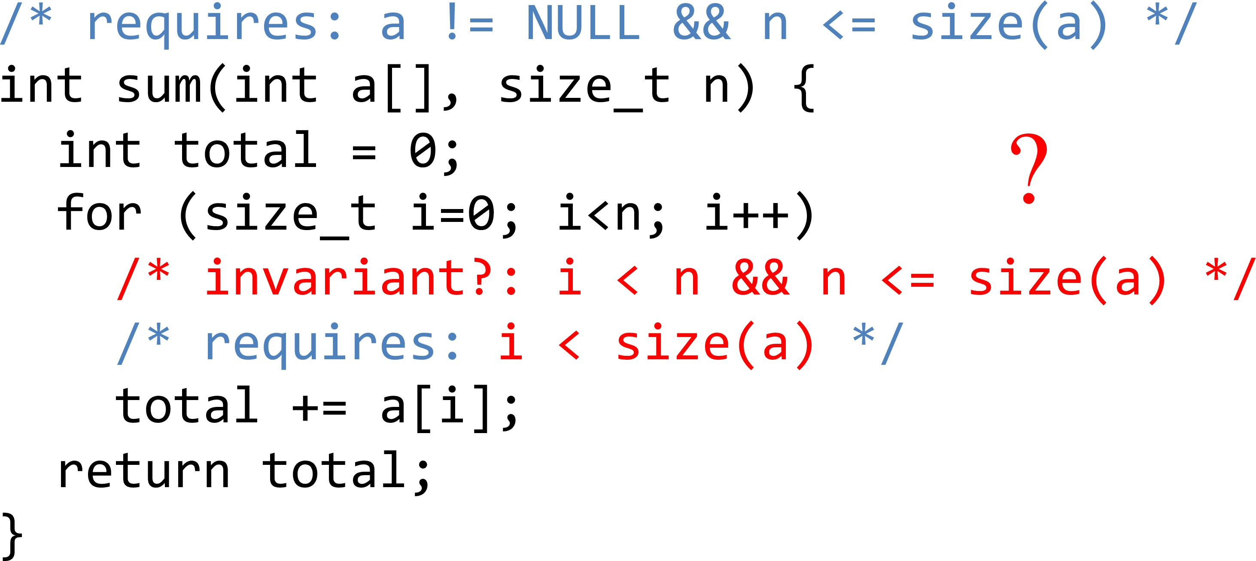
Example

Slide 42
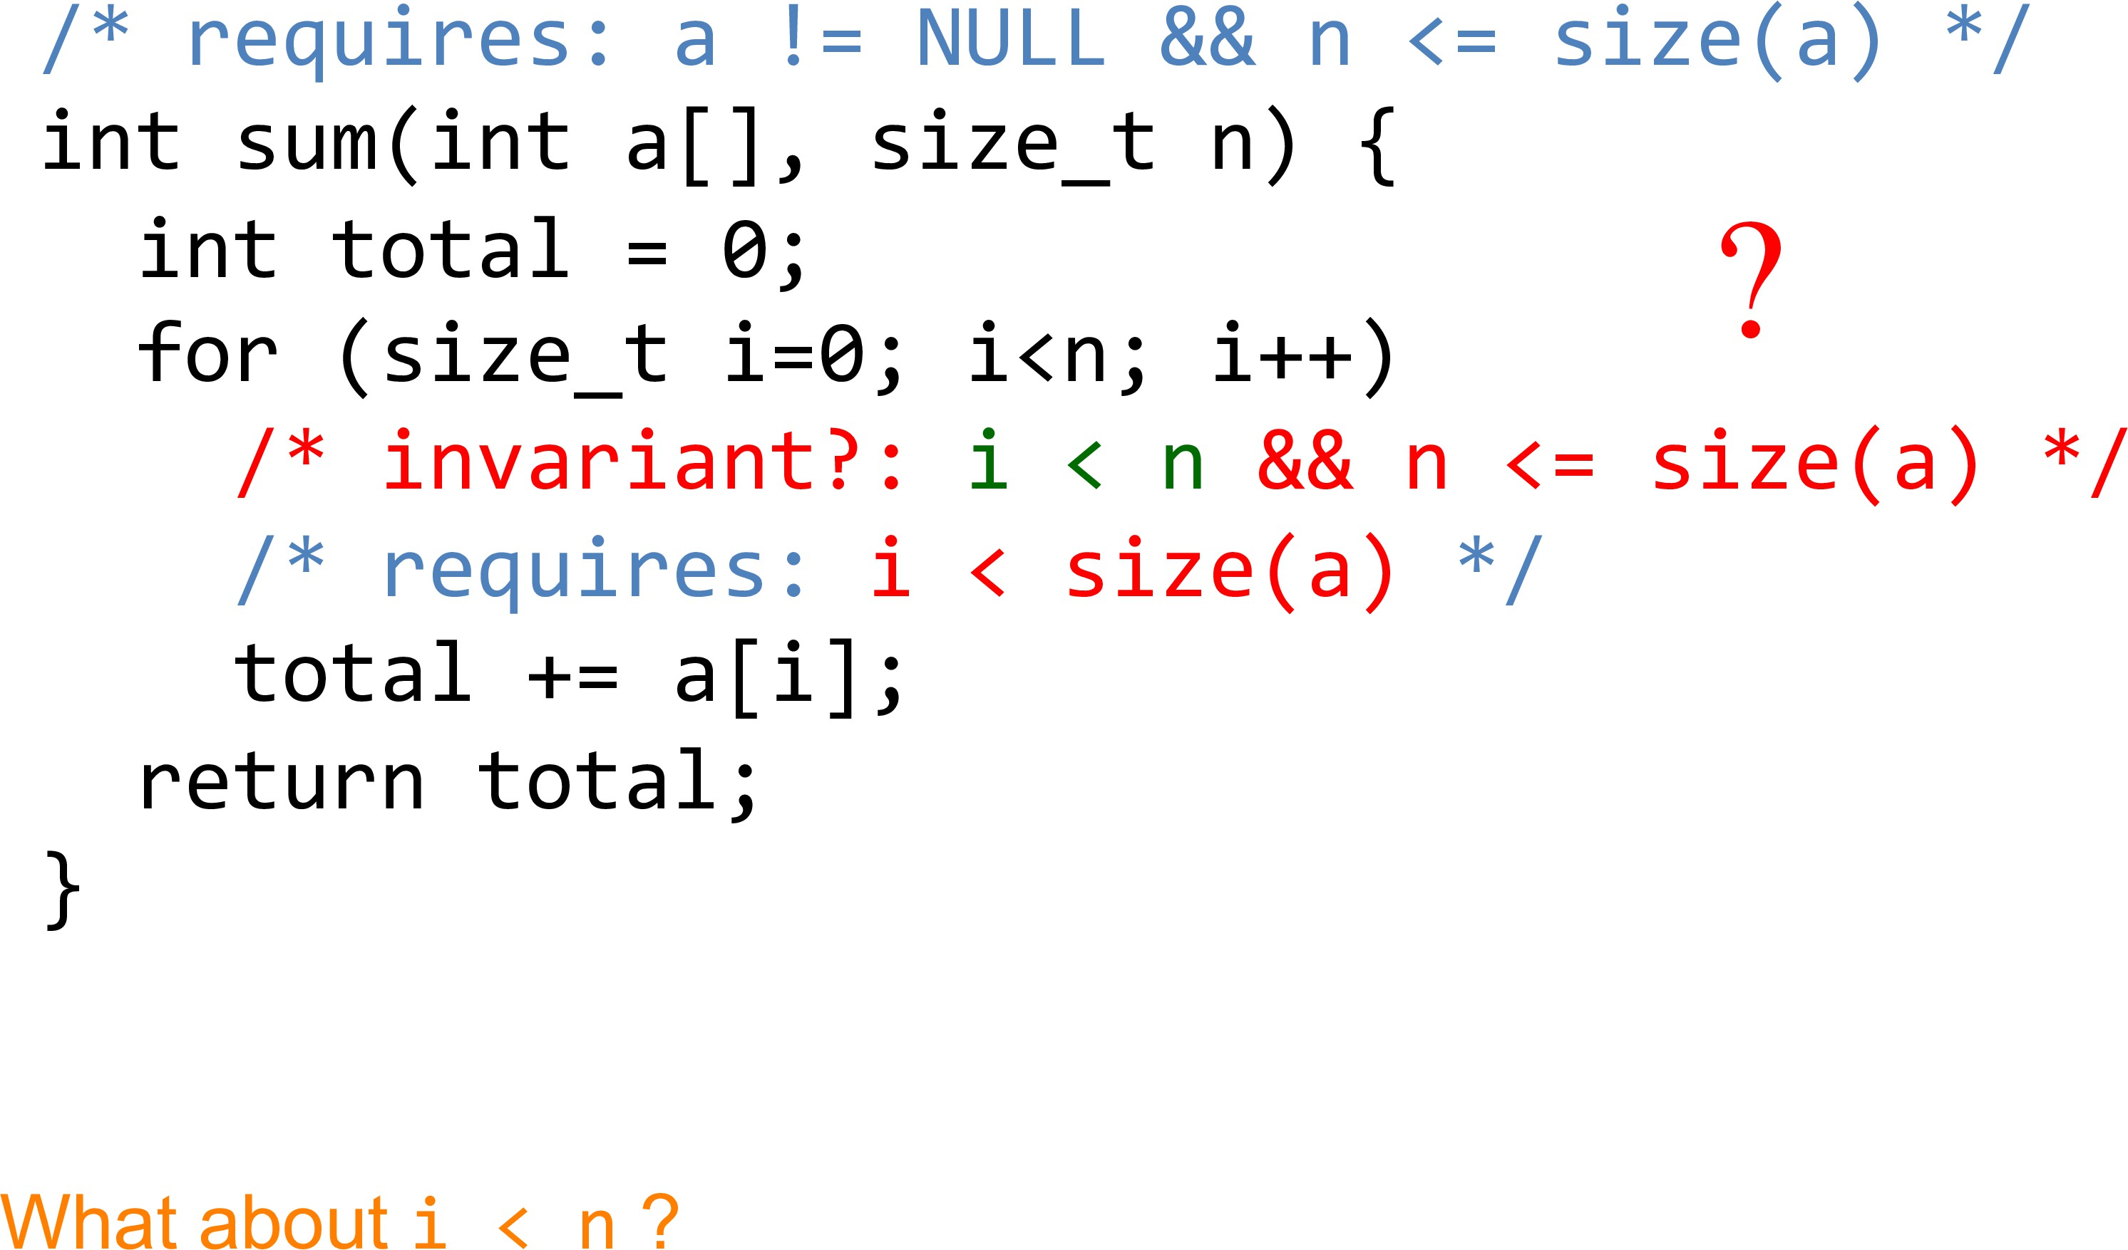
Example

Slide 43
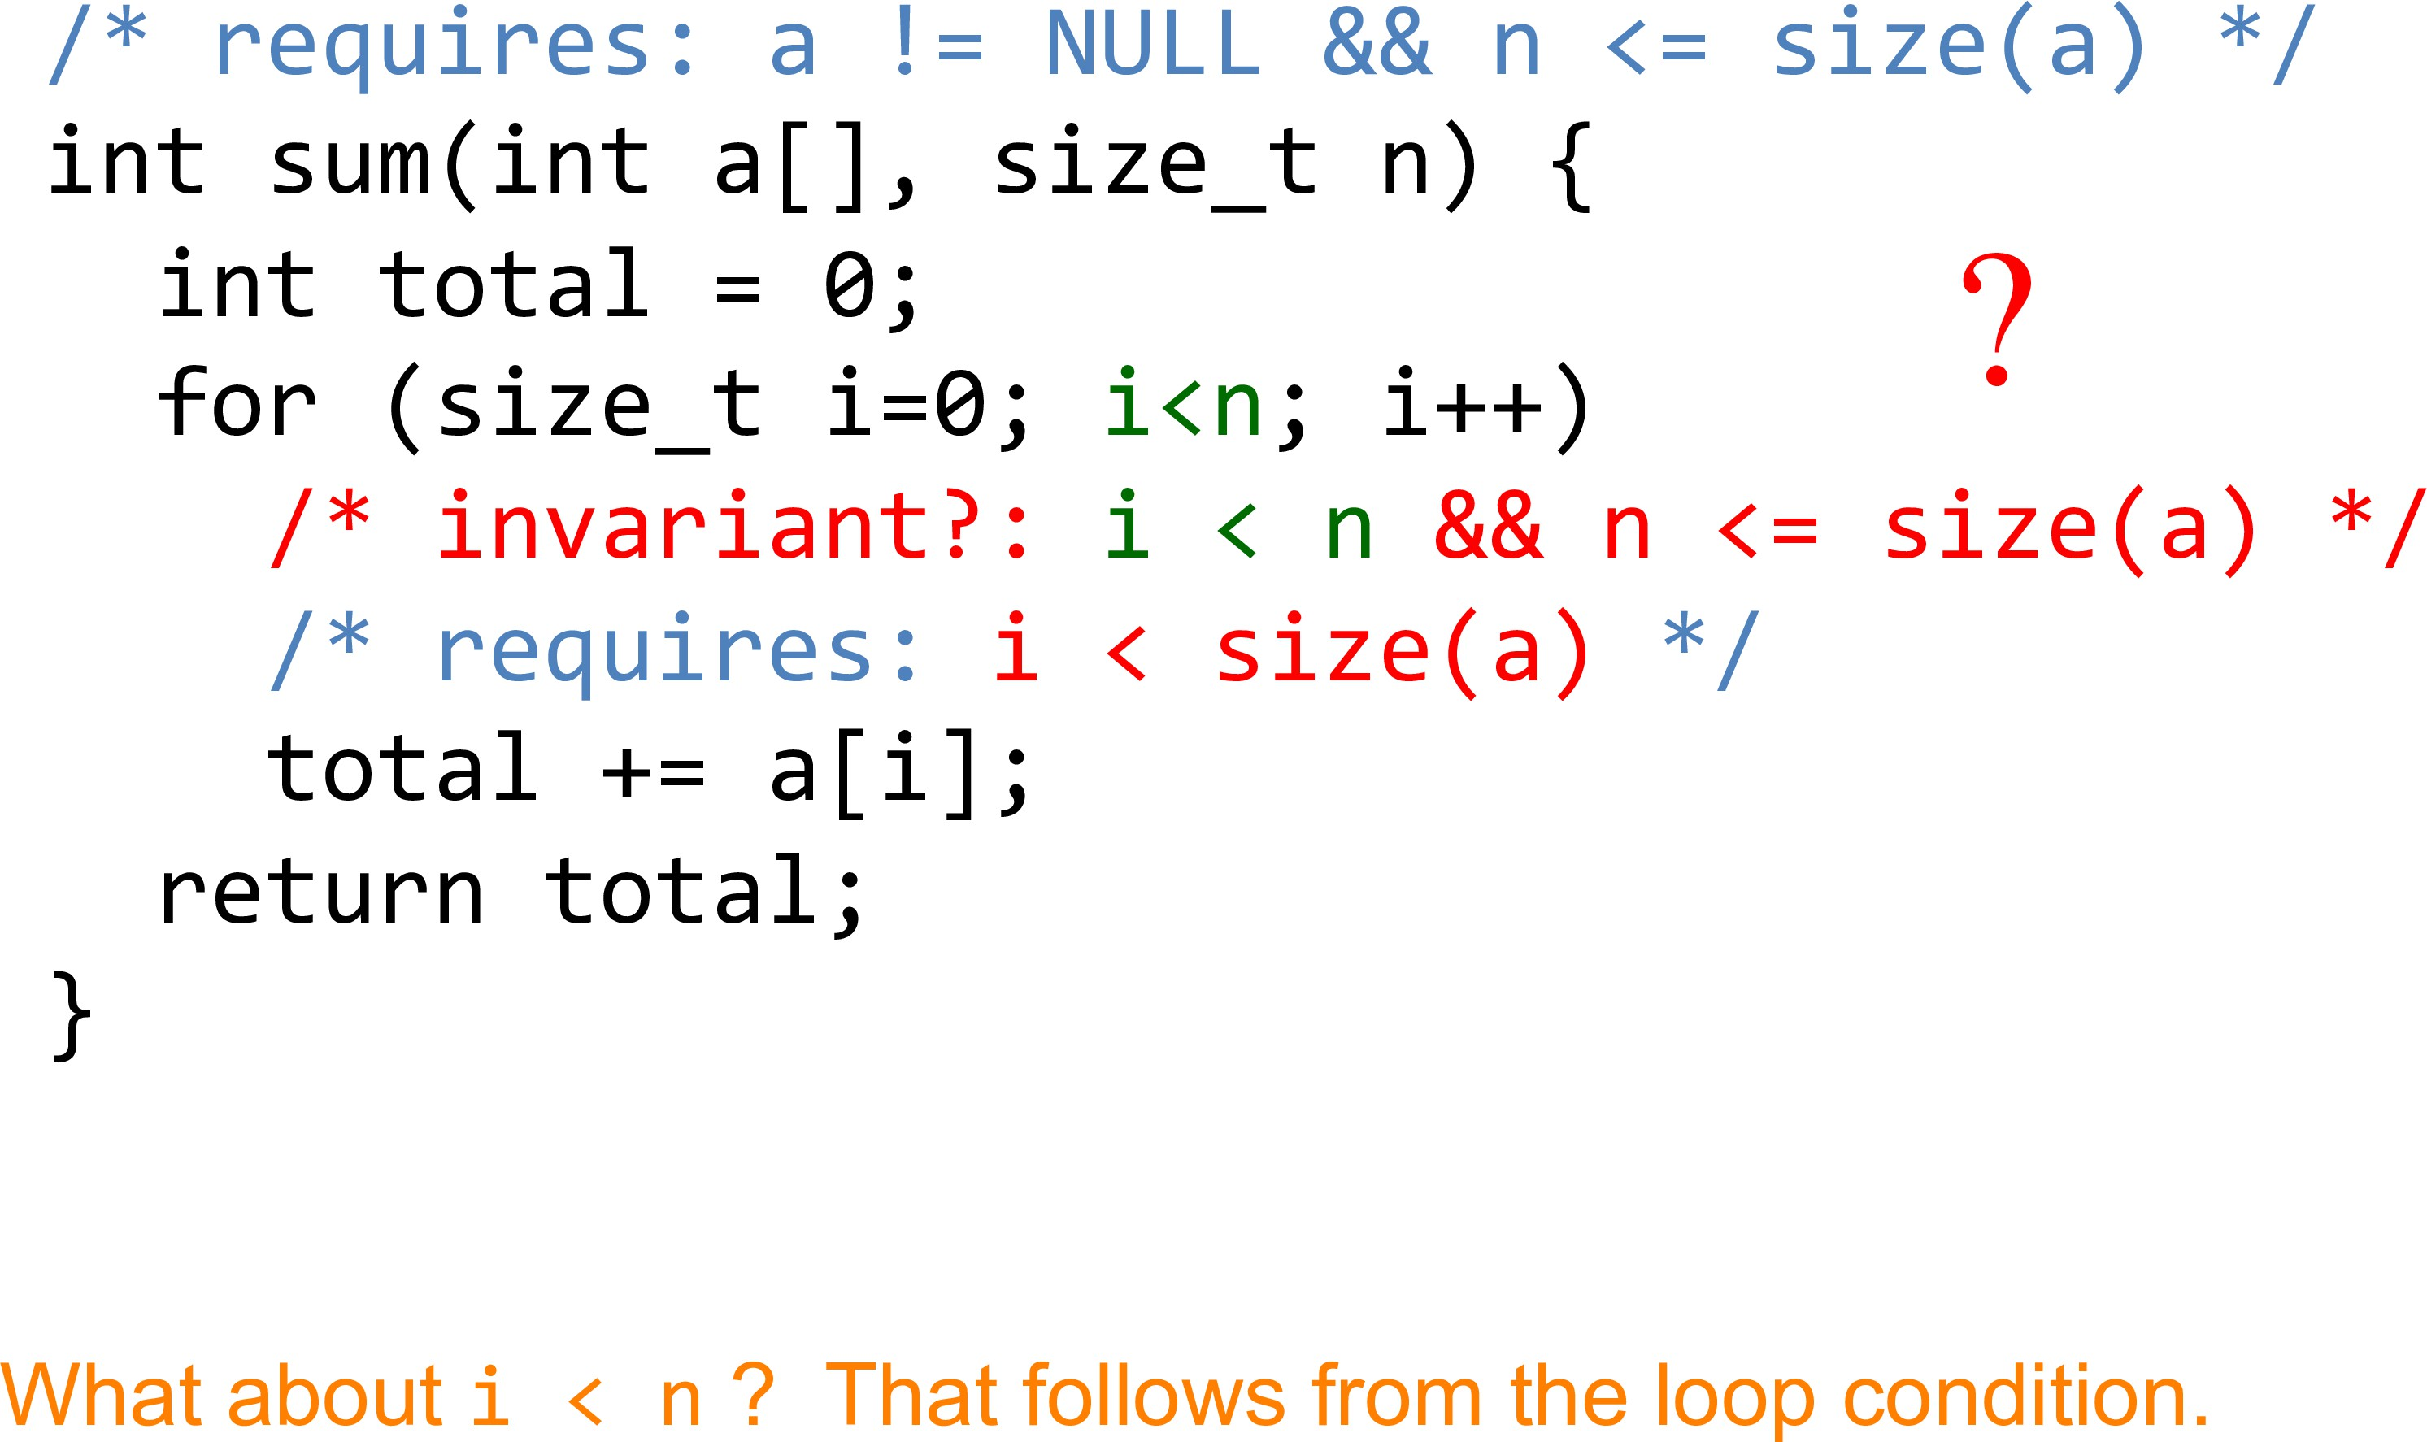
Example

Slide 44
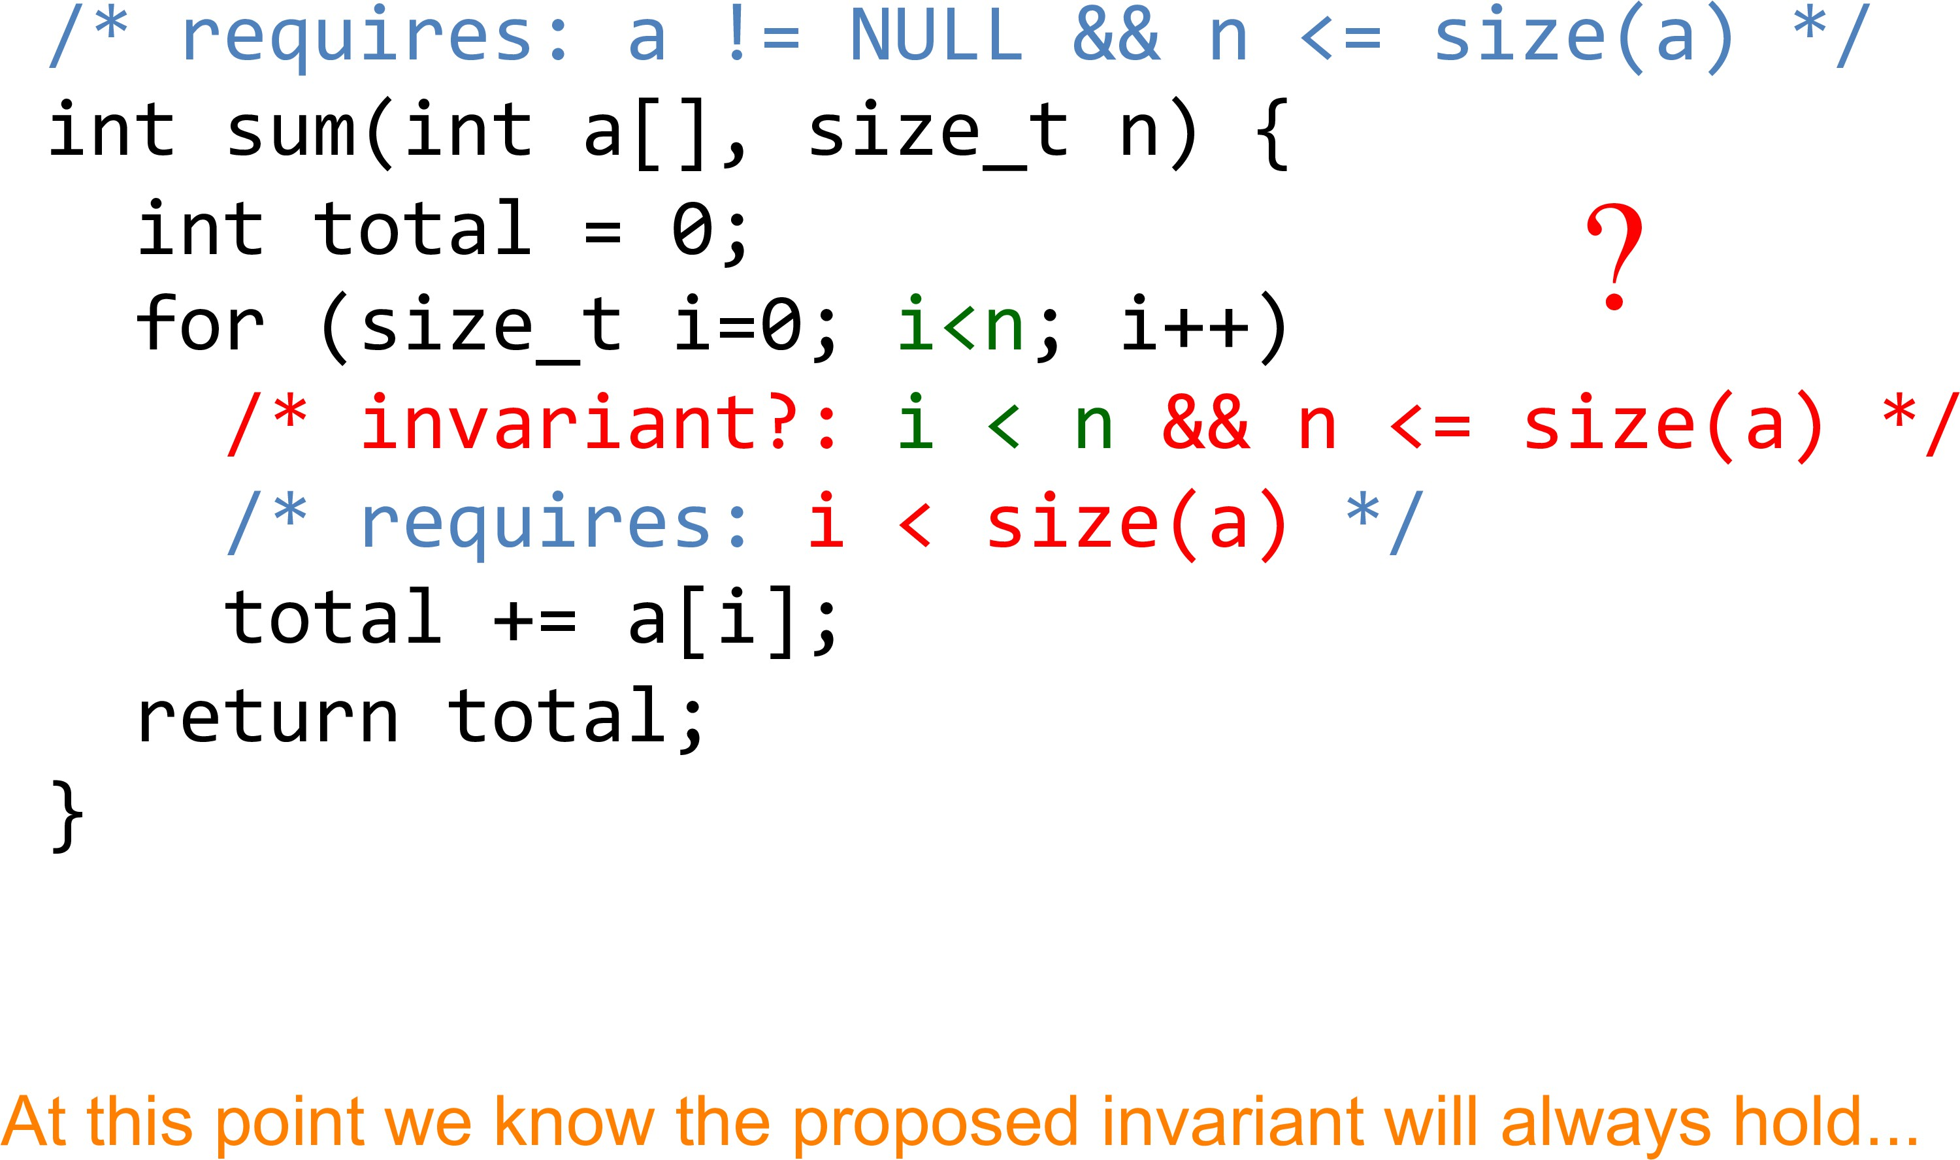
Example

Slide 45
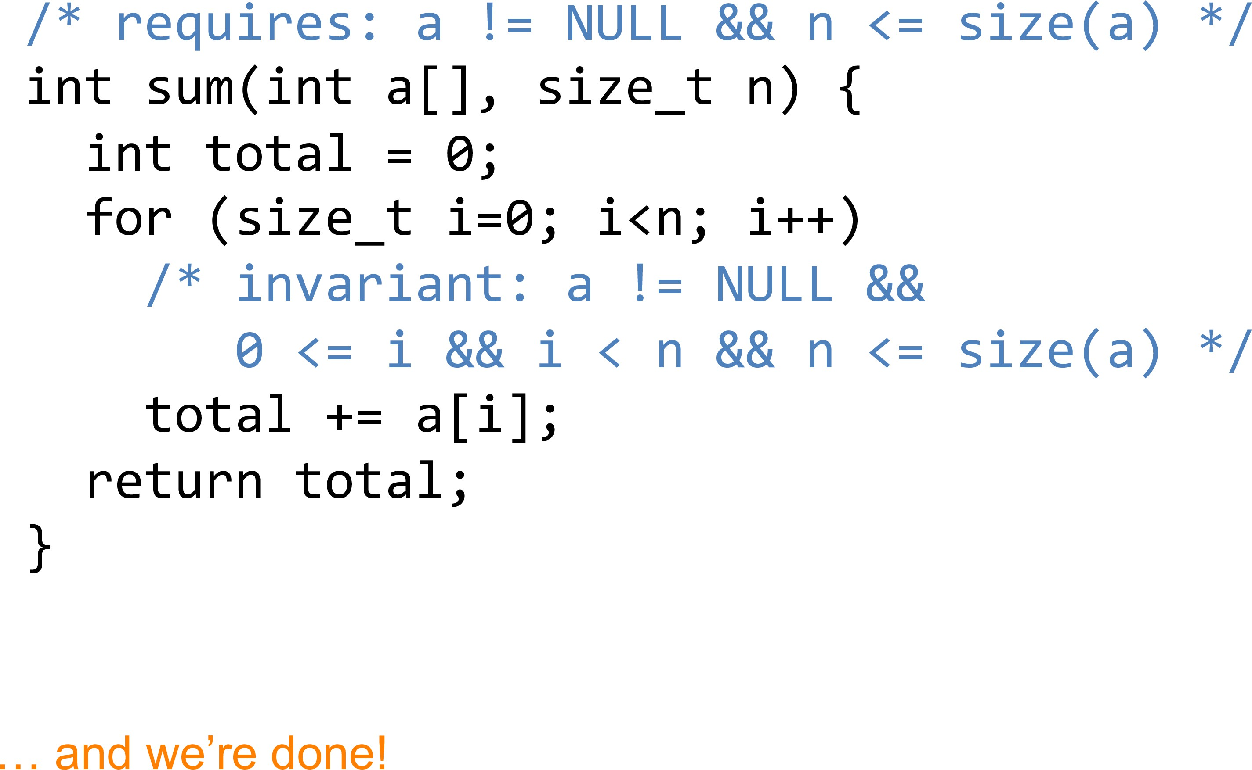
Example

Slide 46
Questions??
zubair.ahmad@giki.edu.pk
Office: G14 FCSE lobby

