Slide 1

Secure Software Design and Development
(CY-321)
Dynamic Taint Analysis: A Case/Research Study

Slide 2




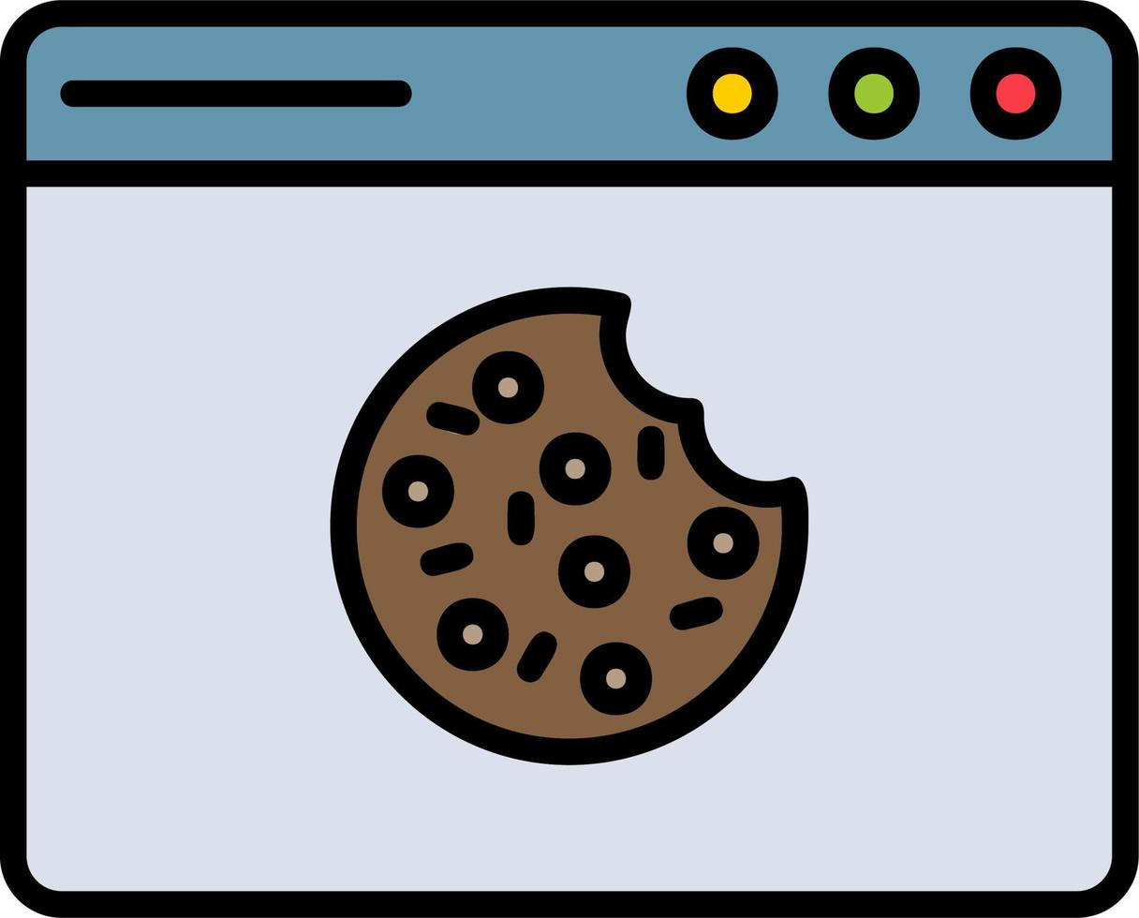
> 50%
localstorage.getitem
localstorage.setitem
document.cookie(read, write)

Slide 3
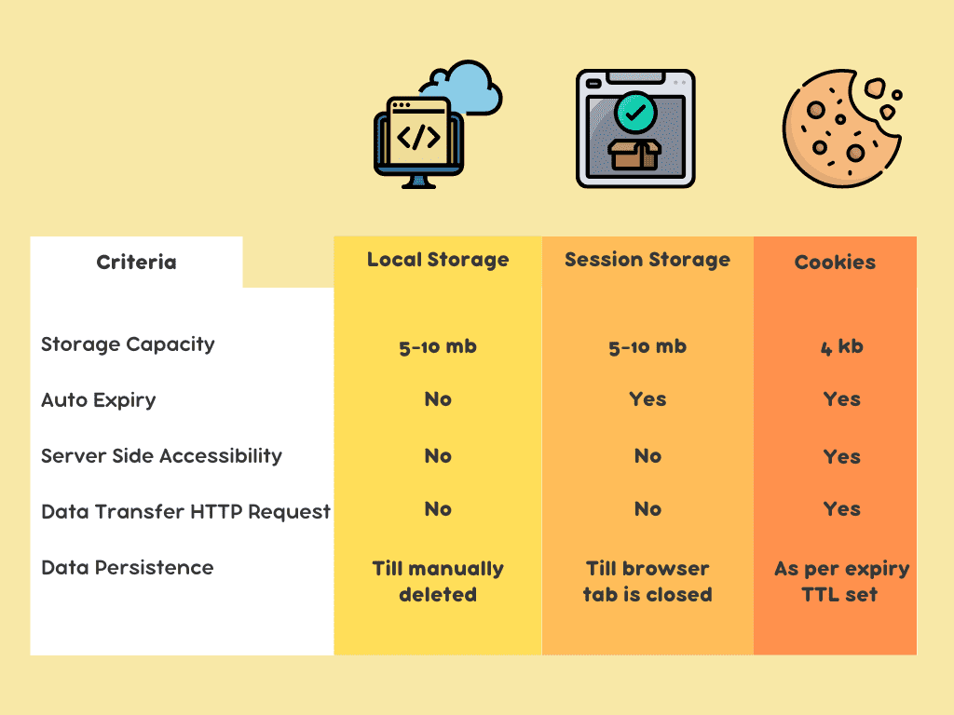

Slide 4
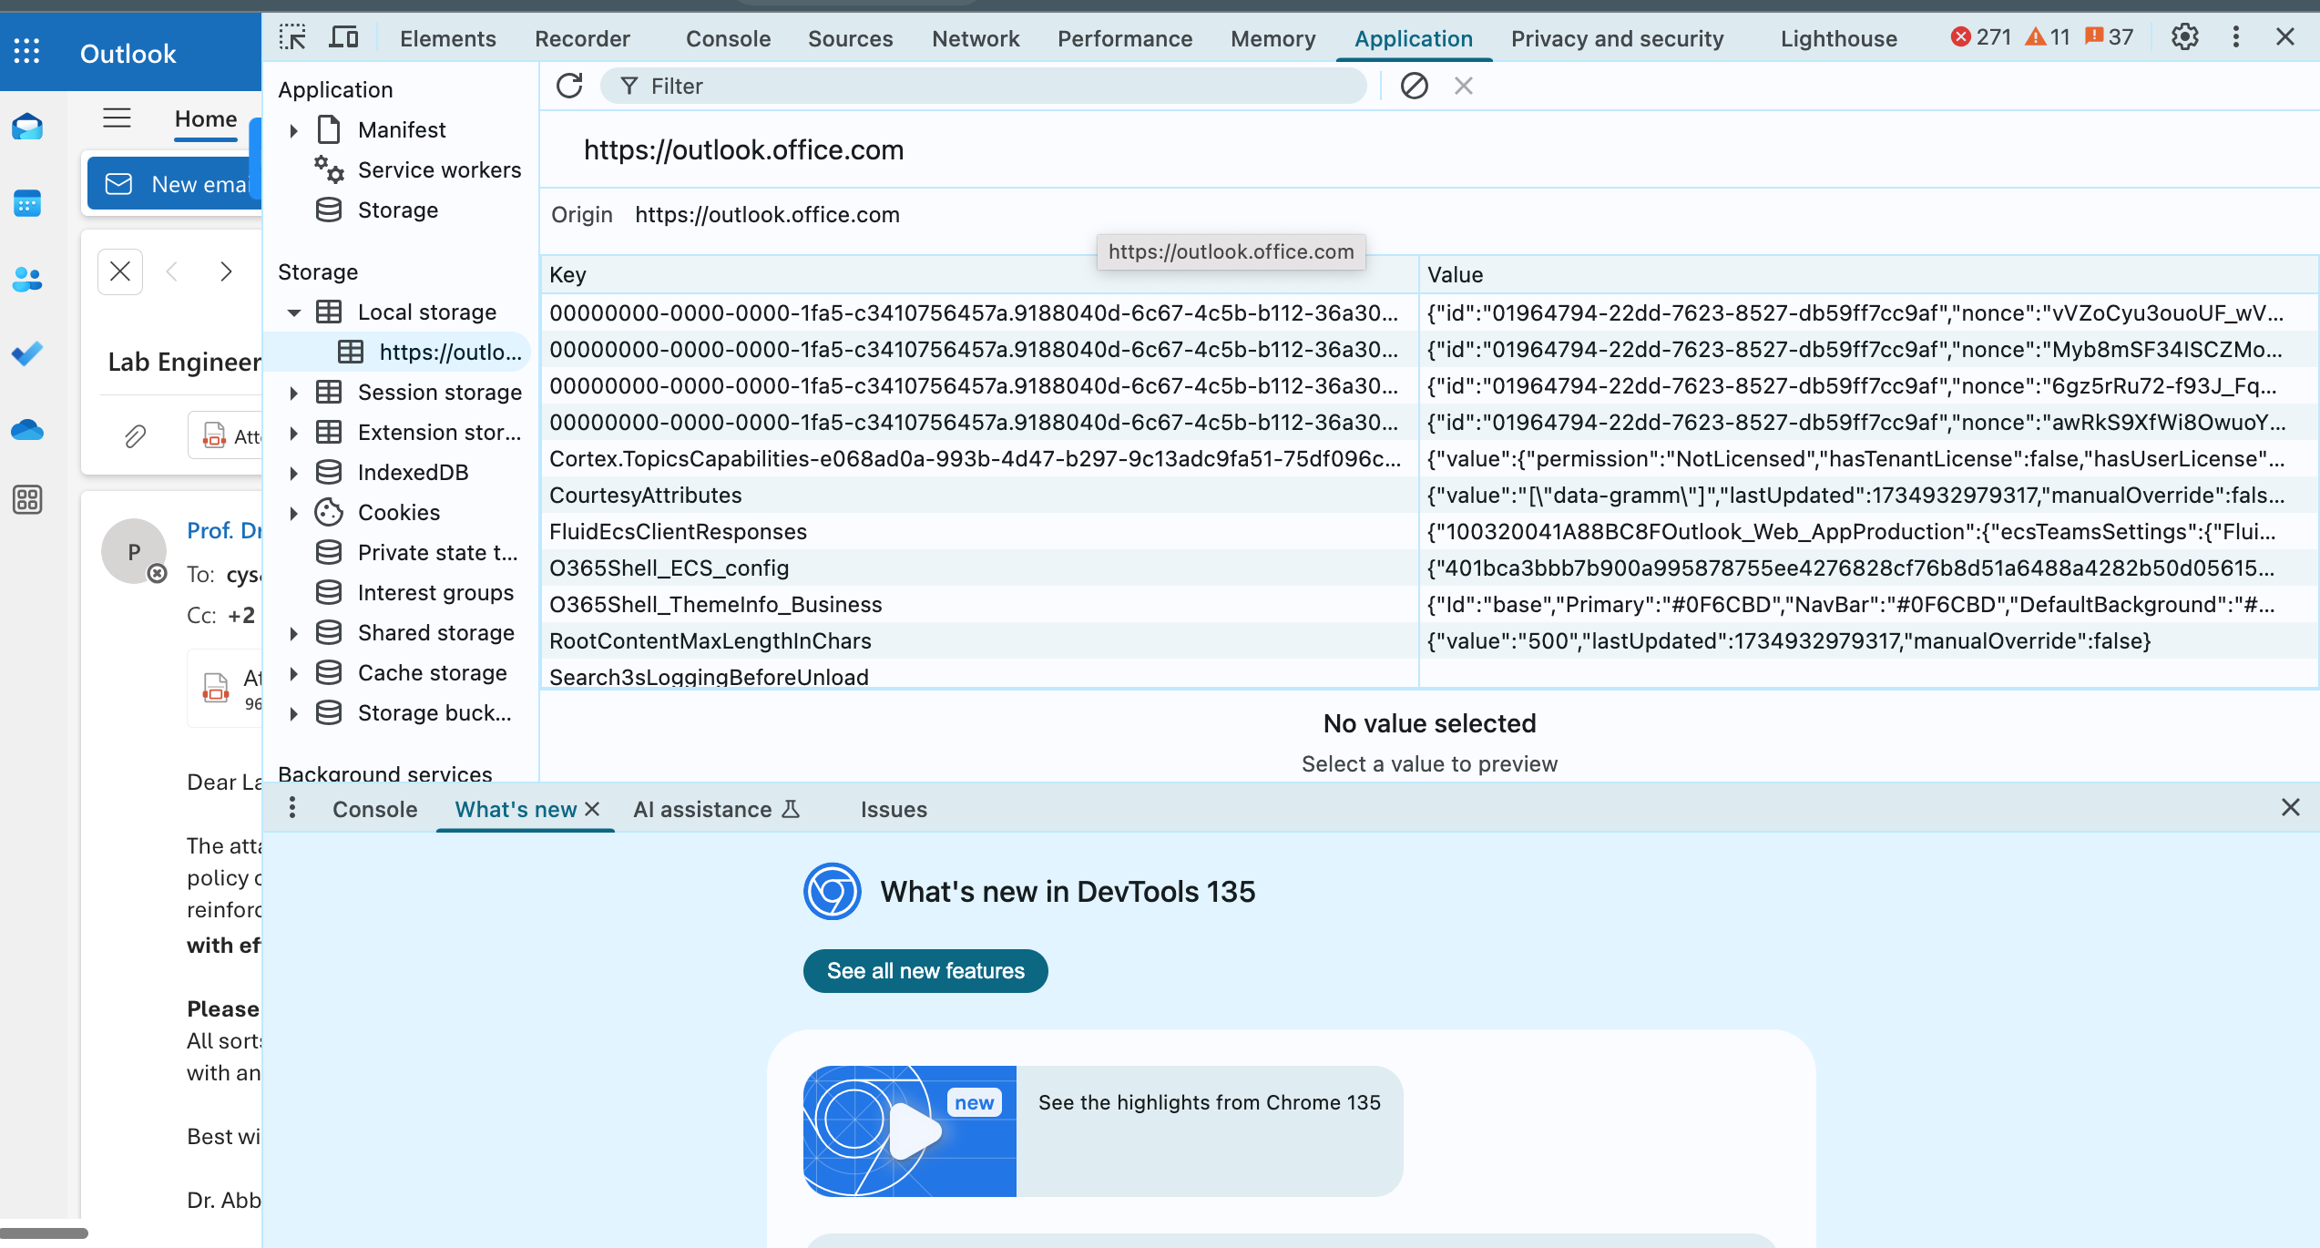
How Web Storage look like in Chrome?

Slide 5
Web Storage API
Only accessible via JavaScript
Key-value store model
getItem(k) gets the value associated with the key k
setItem(k,v) stores the string v bound to the key k
- Two types of storage
localStorage persists data indeﬁnitely
sessionStorage maintains data until the browser is closed
- Protected by the Same Origin Policy
sessionStorage.setItem('name', 'alice');
var n = sessionStorage.getItem('name');
console.log("My name is " + n);
// Output: My name is alice

Slide 6
Taint tracking
“Web Storage is only accessible via JavaScript.”
The most practical monitoring strategy for information ﬂow control. It detects only explicit ﬂows
Each value/variable is annotated with its taint, which is a set of labels.
localStorage.getItem('secret') → 'foo'^{{𝜏}}
A label is a triple (type,location,extra) and represents an executed instruction
- e.g., 𝜏 = (“getItem”, “https://www.foo.com/script.js:40:16”, [“localStorage”, “secret”])

Slide 7
Taint tracking
A source generates a tainted value (i.e., whose set of labels is not empty)
e.g., localStorage.getItem('secret') → 'foo'^{{𝜏}}
The taint propagates through data dependencies
e.g., 'foo'^{{𝜏}} + ' is the secret word'^{{𝜏’}} → 'foo is the secret word'^{{𝜏,𝜏’}}
When a value with taint t reaches a sink with label s, the monitor logs the information ﬂow as a pair (t,s)
e.g., sendToThirdPartySite('foo is the secret word'^{{𝜏,𝜏’}})
The monitor logs ({𝜏,𝜏’},(“sendToThirdPartySite”, …))

Slide 8
Sources and sinks
document.cookie document.URL, … XMLHttpRequest (input)
localStorage.getItem sessionStorage.getItem
SOURCES
document.cookie XMLHttpRequest (output) src attribute of HTML element
localStorage.setItem sessionStorage.setItem
SINKS

Slide 9
Jalangi – Dynamic Analysis Tool
frDeveloped by Samsung Research Group
code Instrumentation based framework
No need to modify of JavasScript Engine
Jalangi
Source code Instrumentation Based Framework
code Instrumentation based Instrumented Code is Portable

Slide 10
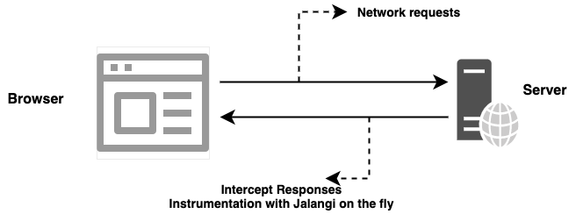
Jalangi

Slide 11
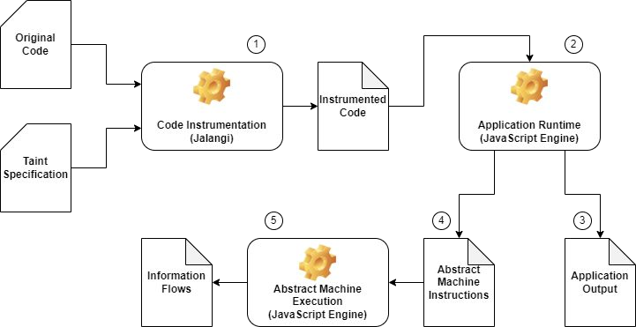
Jalangi
A platform-independent tool for dynamic taint tracking of JavaScript.
Based on code instrumentation, provided by Jalangi.

Slide 12
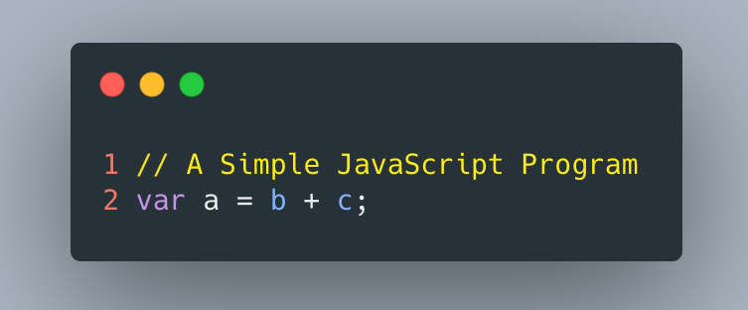
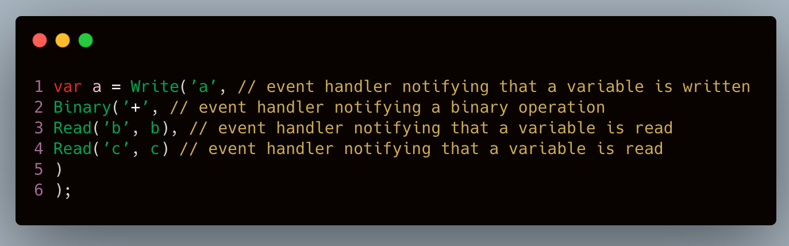
Jalangi – Source Code Instrumentation
Jalangi

Slide 13
Code instrumentation
Original code:
sendToThirdPartySite(localStorage.getItem('secret') + ' is the secret word');
Simpliﬁed instrumented code (provided by Jalangi): InvokeFun(Read('sendToThirdPartySite'), [
Binary('+',
InvokeFun(GetField(Read('localStorage'), 'getItem'), [ Literal('secret')
]),
Literal(' is the secret word')
)]);

Slide 14
Example

Slide 15
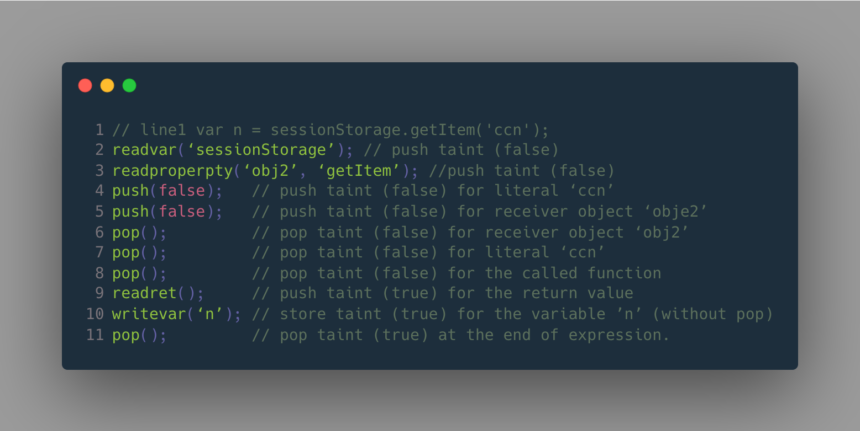
Generating Abstract Machine Instructions

Slide 16
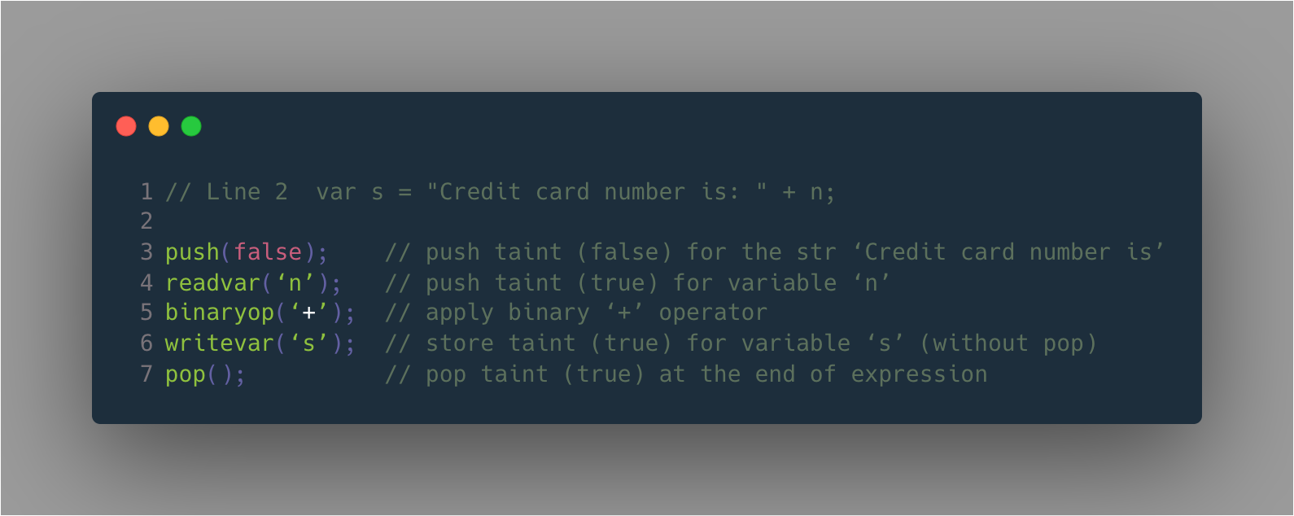
Generating Abstract Machine Instructions

Slide 17
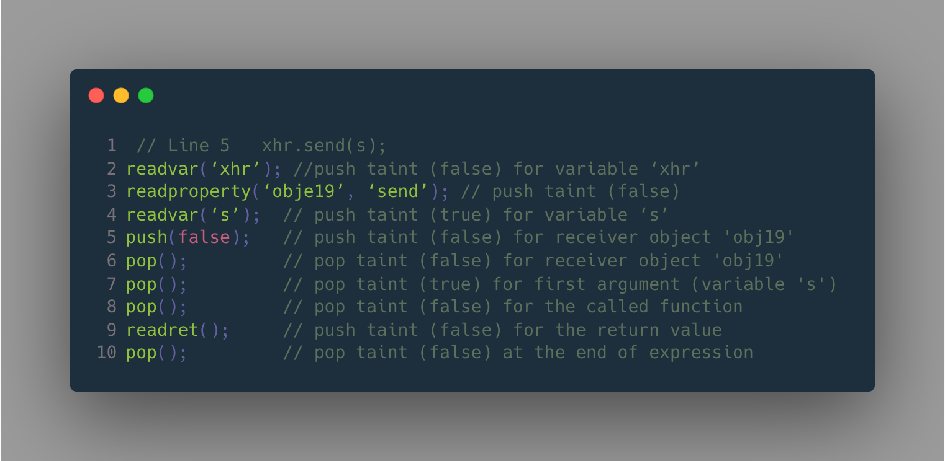
Generating Abstract Machine Instructions

Slide 18
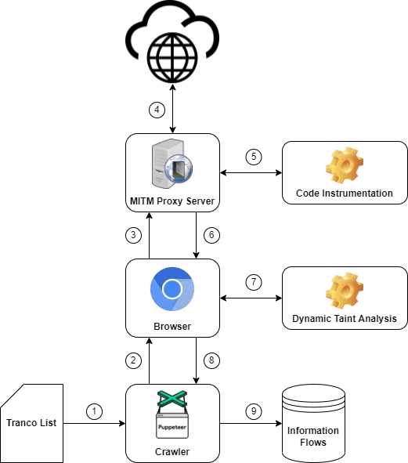
Web crawling
- Crawl the top 5k sites
- For each site, wait 60 seconds to complete loading.

Slide 19
Information ﬂow classiﬁcation
Security
Conﬁdentiality (reads from Web Storage, stored data may be leaked)
Integrity (writes to Web Storage, stored data may be tampered)
Conﬁnement
Internal (is stored data conﬁned to the ﬁrst-party domain?)
External (is stored data sent to/received from third-party domains?)
Tracking*:
Tracking vs Non-Tracking (is Web Storage used for tracking purposes?)
Persistence:
Local vs Session (what type of storage is involved?)
* We match the URL of the script where the operation has been executed against the popular EasyList/EasyPrivacy ﬁlter lists.

Slide 20
Measurement results
We just consider information ﬂows where Web Storage is accessed for either reading or writing.
Out of 5k sites only 651 domains With Web Storage API
3,207 information ﬂows involving the Web Storage API
531 conﬁdentiality ﬂows
2,676 integrity ﬂows

Slide 21
Measurement results
 | Class | # ﬂows | # domains
Conﬁdentiality | Cookies Network | 202 329 | 66 139
 | Cookies | 410 | 72
Integrity | Current URL Navigator | 1,582 979 | 353 204
 | Network | 913 | 238

Slide 22
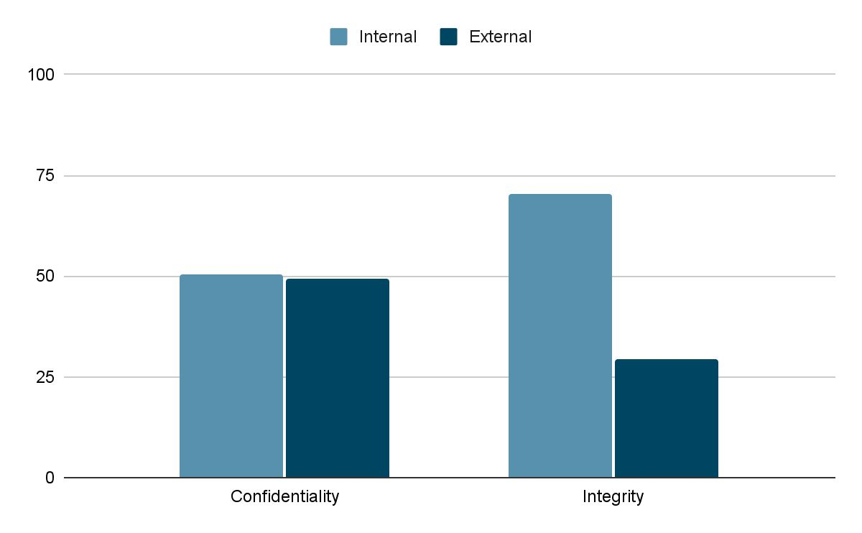
Security & Conﬁnement
It is more common to send
Web Storage content to third parties, rather than having third parties write information in the Web Storage.

Slide 23
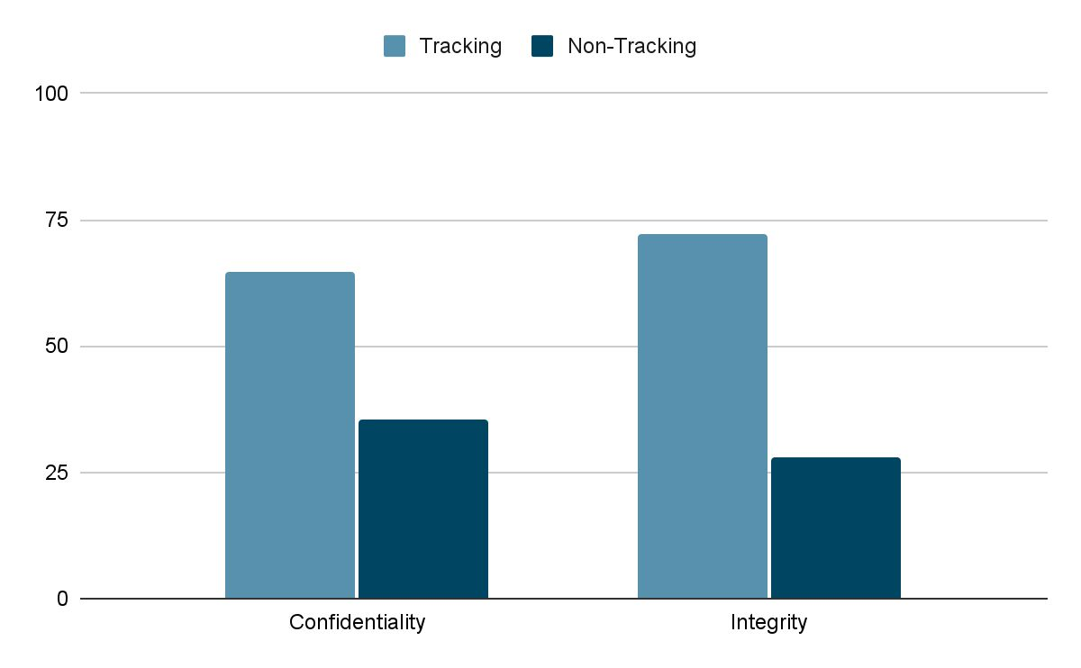
Security & Tracking
Trackers routinely both read and write Web Storage information in the wild.
This result is supported by previous research on web tracking.

Slide 24
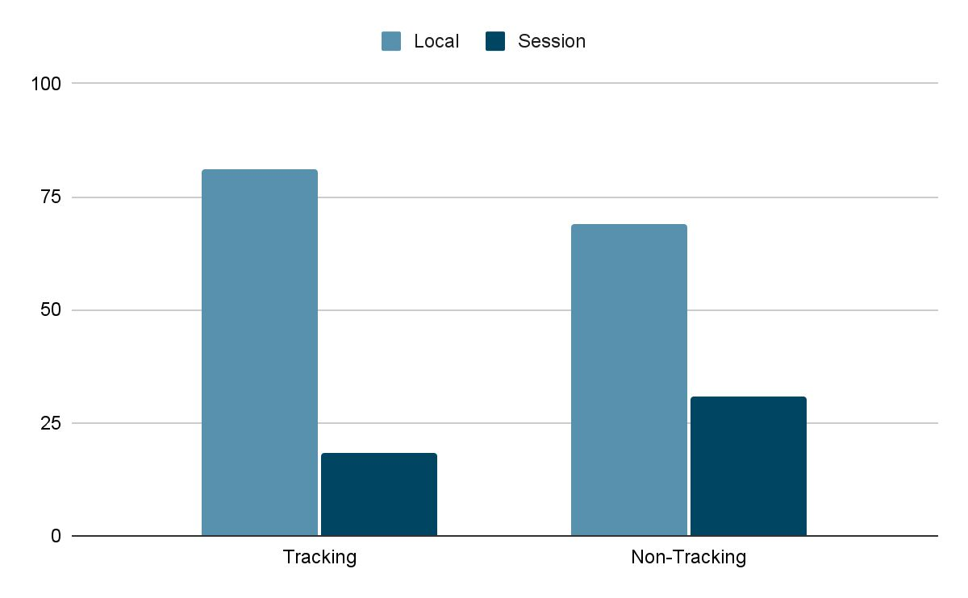
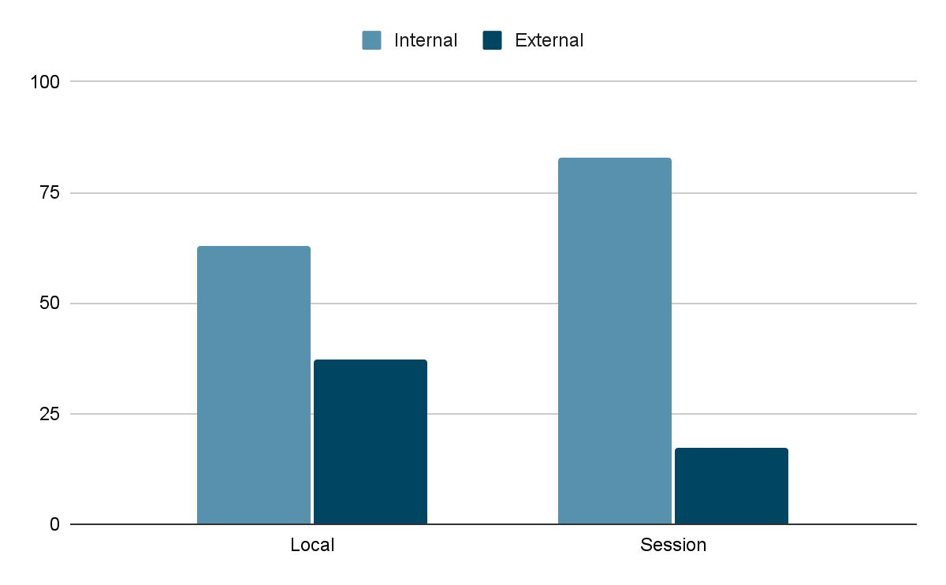
Persistence
localStorage is the prime target of trackers and sessionStorage is largely dedicated to internal use within a single origin.

Slide 25
External ﬂows
 | Same Site | Cross Site
Conﬁdentiality Integrity | 22 (8%) 30 (4%) | 241 (92%) 760 (96%)
Tracking Non-Tracking | 15 (2%) 37 (16%) | 809 (98%) 192 (84%)
Local Session | 33 (4%) 19 (16%) | 890 (96%) 103 (84%)
Site = eTLD+1
A request
from www.foo.com to api.foo.com
is same site
A request from www.foo.com to www.bar.com is cross site

Slide 26
Libraries
 | #ﬂows | #domains | Tracking?
https://static.chartbeat.com/js/chartbeat.js | 132 | 66 | YES
https://mc.yandex.ru/metrika/tag.js | 228 | 34 | YES
https://fast.wistia.com/assets/external/E-v1.js | 106 | 26 | NO
https://pagead2.googlesyndication.com/pagead/managed/js/adsen se/m202112060101/show_ads_impl_with_ama.js | 124 | 25 | YES
https://quantcast.mgr.consensu.org/tcfv2/cmp2.js | 24 | 24 | NO

Slide 27
Questions??
zubair.ahmad@giki.edu.pk
Office: G14 FCSE lobby

