Slide 1
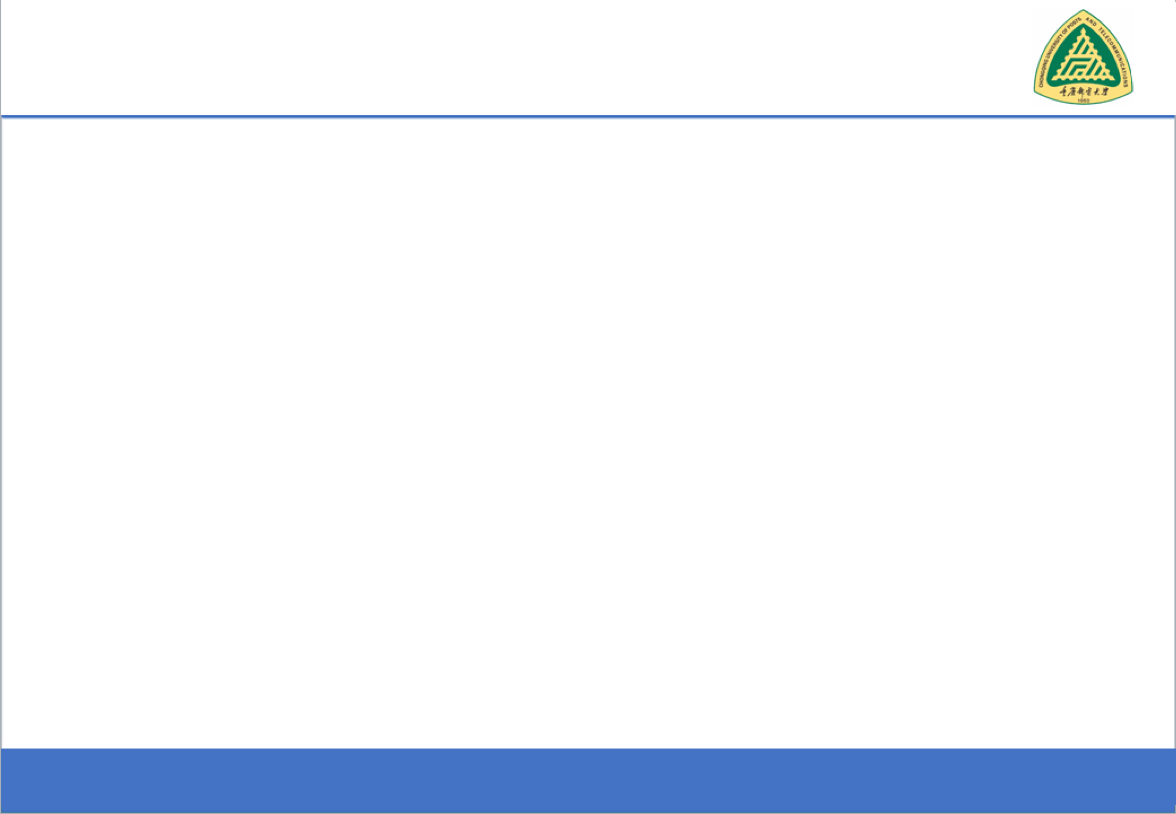

From Hello World to Hack-Proof
Secure Software Design and Engineering
(CY321)

Slide 2

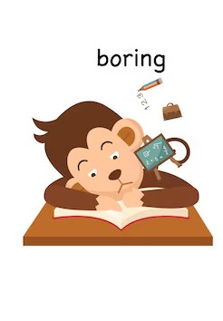
Life with Cybersecurity??
2

Slide 3

About me!
Zubair Ahmad
Education
Research Interests
Ph.D. in Computer Science (Cyber Security) - University of Venice Italy (2020-2024)
Visiting Research Scholar - CISPA Helmholtz Center for Information Security Germany
European Parliament – EU AI Act 2023
OPLSS Summer School Uni of Oregon and Boston Uni USA 2021
Web Security and Privacy
Data Privacy and Protection
Internet and Web Measurements
EU Compliance regulations, GDPR
Internet of Things
More about me -->https://zahmaad.github.io/

Slide 4
Schedule
When?
- Check your class schedule
Where?
Here!
LH9 AcB
What?
Lecturers
Quizzes/Project
Mid/Final Exams
Attendance?
Active Attendance
Dead Bodies.
Active Minds
Mobiles in hands -> Mark as absent
80% mandatory
5 minutes threshold

Slide 5
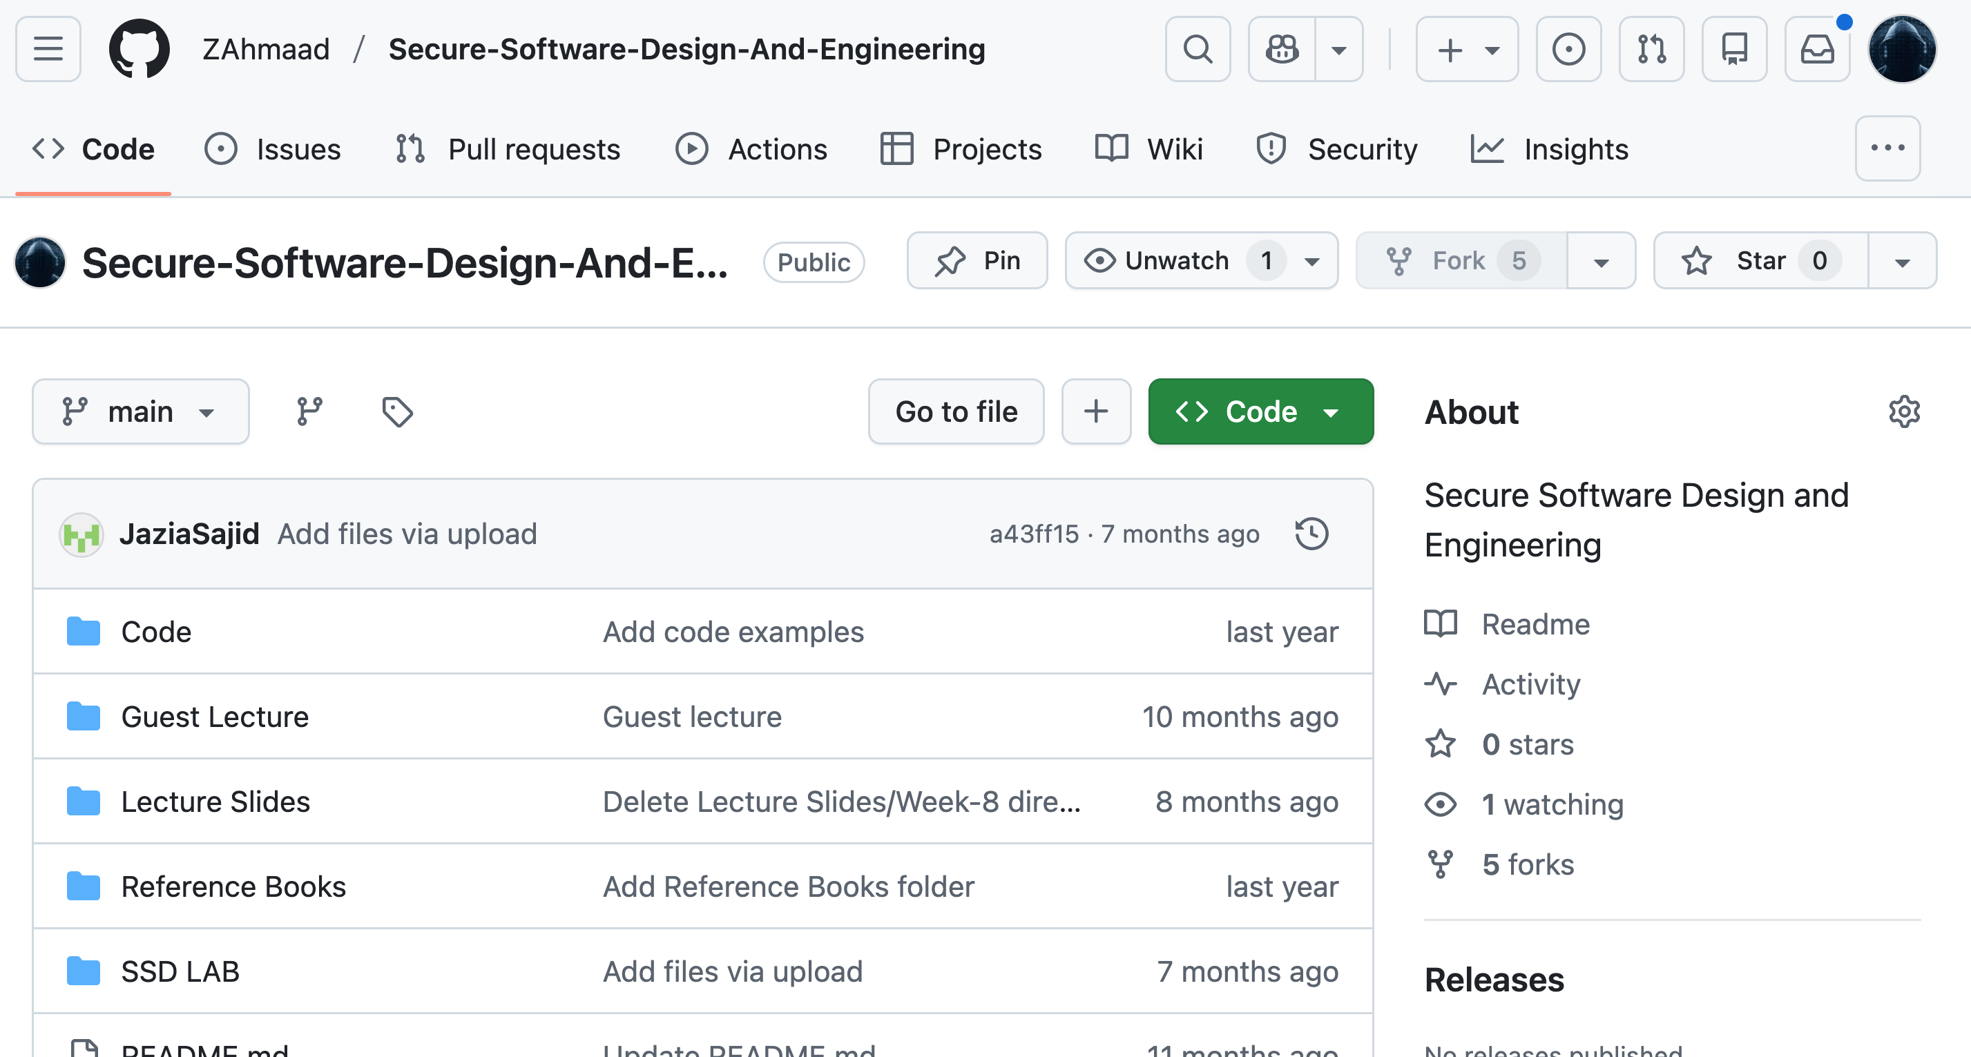
Webpage
Lectures/ Slides
Books
Project
Labs Material
https://github.com/ZAhmaad/Secure-Software-Design-And-Engineering

Slide 6
CLO – GA Mapping
Sr. No | Course Learning Outcomes (CLOs)⁺ | Graduate Attributes (GA) | Bloom’s Taxonomy level (Cognitive domain)
CLO 1 | Understand secure software development process and detect insecure programming practices and proficiently implement secure alternatives to enhance software security | GA-3 (Problem Analysis) | C2 (Understanding)
CLO 2 | Utilize frameworks for software security analysis and testing, with a clear grasp of their capabilities and limitations in practical applications | GA-5 (Modern Tool Usage) | C3 (Applying)
CLO 3 | Analyze and conduct security testing for real world applications. | GA-4 (Design/Development of Solutions) | C4 (Analyzing)

Slide 7
Grading Policy
Assessment Items | Percentage
Quizzes | 20%
Project | 10%
Midterm Exam | 30%
Final Exam | 40%

Slide 8
Grading Policy
Assessment tools | CLO_1 | CLO_2 | CLO_3
Quizzes | 50% | 50% | -
Project |  | - | 100%
Midterm Exam | 50% | - | -
Final Exam | - | 50% | -

Slide 9
Project-Quizzes
project and quizzes will be taken
Announced and/or unannounced quizzes
Github
Overleaf
Project

Slide 10
What Should you expect in this course?
Secure Software Development Process
Detect and Mitigate Insecure Programming Practices
Design and Conduct Security Testing

Slide 11
What We will learn?
1st Week
Introduction to Secure Software Concepts
Importance of secure software design
Overview of secure software principles
System issues and properties in secure software
Security in the Software Development Life Cycle (SDLC)
Security concepts integrated into SDLC phases
Secure software requirements: sources and types
2nd Week
Risk Management in Software Projects
Identifying, analyzing, and mitigating risks
Introduction to security standards (e.g.,
NIST, FIPS)
3° Week

Slide 12
What We will learn?
Security principles and secure design considerations
Designing secure design principles
Design processes and best practices (e.g.,
OWASP guides)
Security methodologies (e.g., STRIDE,
DREAD, OCTAVE)
4th Week
Secure Software Frameworks
Introduction to frameworks (e.g., Zachman, COBIT, SABSA)
Practical examples of applying
frameworks
5 Week
th
6° Week
Security Mechanism
Mechanism and Policy
How to regulate access

Slide 13
What We will learn?
7th Week
Common Software Vulnerabilities
Overview of vulnerabilities (e.g., buffer overflow, SQL injection)
Exploitation techniques and
impacts
Defensive Coding Practices
Concepts and techniques for defensive coding
Avoiding vulnerabilities and
polymorphic malware attacks
8 Week
th
Secure Software Implementation and Coding
Best practices for secure coding
Software development
methodologies
9° Week

Slide 14
What We will learn?
Secure Software Testing
Testing concepts: functional, non- functional, and security testing.
Security testing methodologies
and tools.
Static and Dynamic analysis
10th Week
Authentication Protocols
Common Pitfalls Ways to Analyze Protocols
Login-only protocols
Mutual authentication with Key Distribution Center
11th Week
API Security
12° Week

Slide 15
What We will learn?
Secure Modern Web Development Browser Security Mechanism
Building blocks for secure modern web applications.
The future of user authentication on the web
13th Week
Web security in the real world
Client-side attacks and defenses
Server-side attacks and
defenses
14th Week
Emerging trends in secure software engineering (e.g., AI security)
Final Q&A and discussions
15° Week

Slide 16
Reference books: Designing Secure Software: A Guide for Developers by Loren Kohnfelder (2023) Official (ISC)2 Guide to the CSSLP (latest) Software Security: Building Security In, 1st Edition by Gary McGraw Additional books: Ross Anderson. Security Engineering. Wiley. 2nd edition. Mathias Paye. Software Security Principles, Policies, and Protection. (January 2019, v0.33) Theodor Richardson & Charles Thies. Secure Software Design. Jones & Bartlett Learning. 2013 Secure by Design - Dan Bergh Johnsson, Daniel Deogun, Daniel Sawano – Manning 2019 Architecture Patterns with Python - Harry Percival, Bob Gregory – O’Reilly 2020

Slide 17
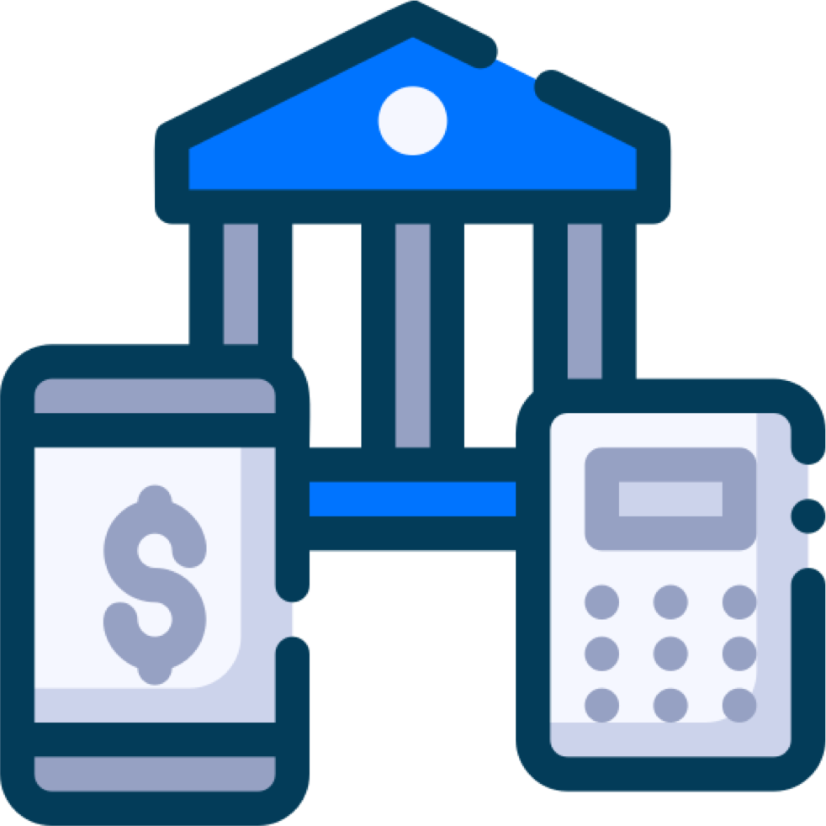
A Quick Starter Scenario (1)
High Value Messaging System
Bank Own Staff
ATM Machines
Physical Attack
Website and Mobile App

Slide 18
Why the problem is growing?
Connectivity
Trinity of Troubles
Extensibility
Complexity

Slide 19
Challenges
Navigating the Hurdles
Security Verus Usability
Iron Triangle Constraints
Security as an Afterthought

Slide 20
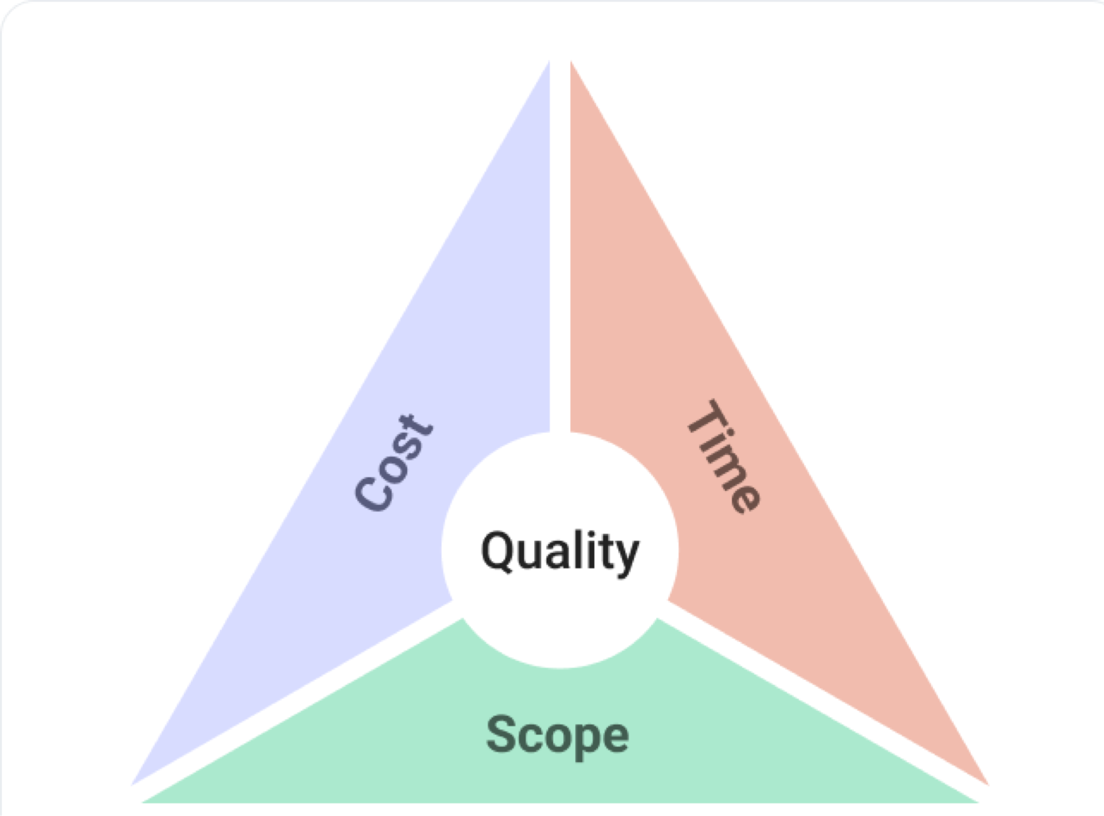
Iron Triangle Constraints
The attacker has the upper hand
Software development in and of itself is a resource, schedule (time) and budget intensive process
Resources (people) with appropriate skills and technical knowledge are not always readily available and are costly.

Slide 21
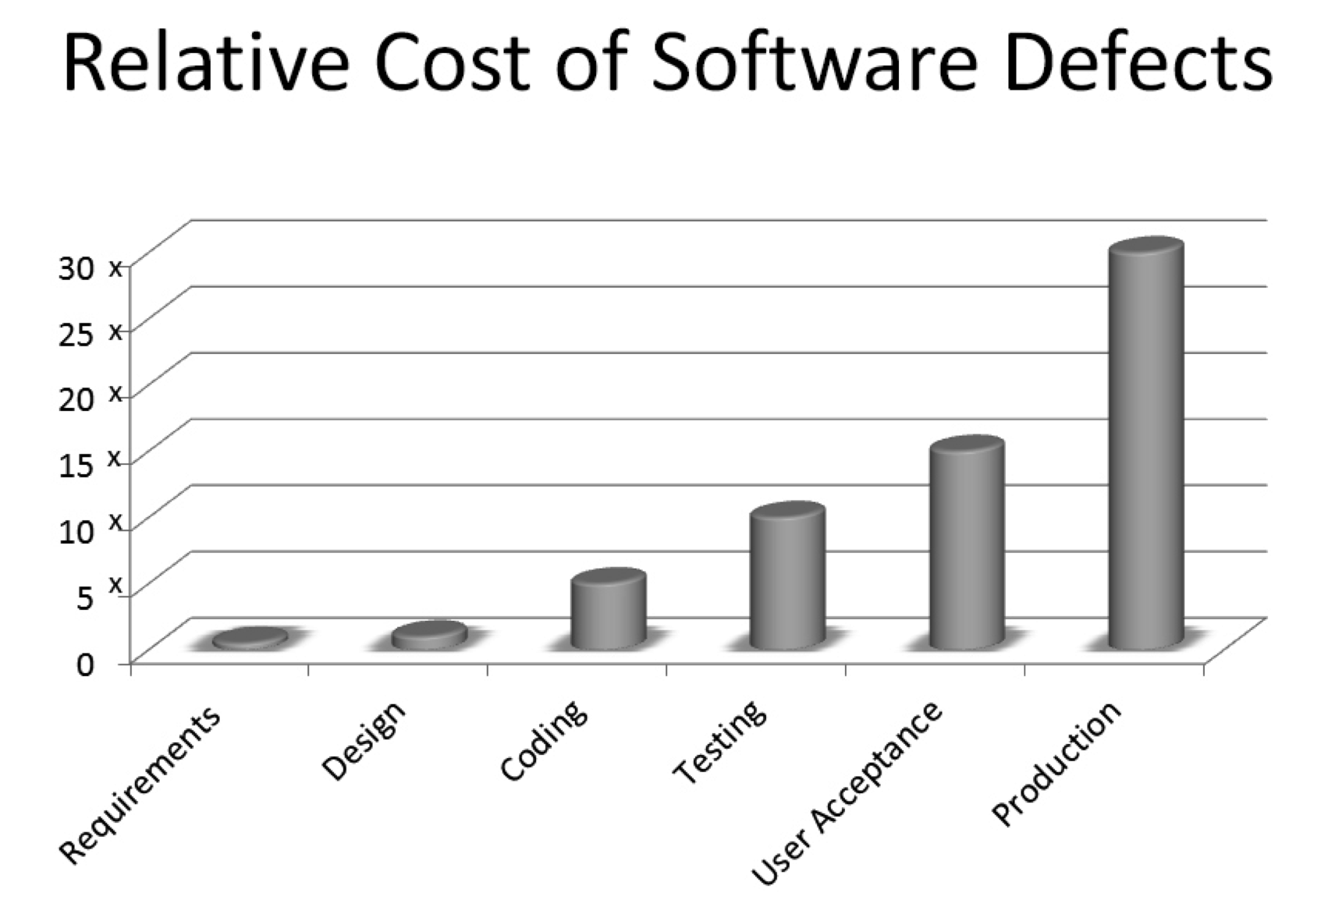
Security as an Afterthought
Security does not add any business value
Secure features are built into the software, instead of being added on at a later stage,

Slide 22
Security Versus Usabilty
More Security = Less Usability
Secure features is viewed as rendering the software to become very complex, restrictive and unusable

Slide 23
Quality = Security???
E-commerce Website
A software product that is secure will add to the quality of that software but the inverse is not always necessarily true
High-Quality but Not Secure: Imagine an e-commerce website that:
Loads pages quickly.
Has an intuitive user interface.
Processes orders without crashing.
But
Quality is high with lack of
Security
Passwords are stored in plaintext.
There's no HTTPS encryption for
data in transit.

Slide 24
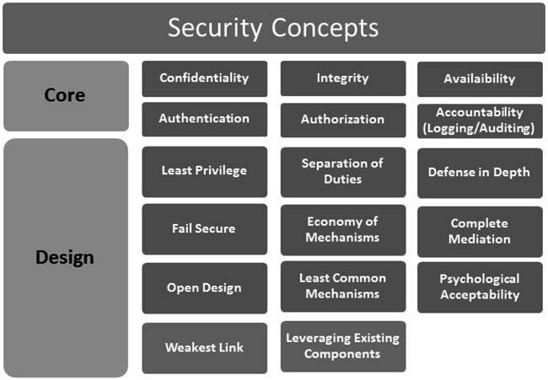
What makes Software Secure?

Slide 25

Questions?
zahmaad.github.io
22

