Slide 1

Secure Software Design and Engineering
(CY-321)
You, Me, Security and SDLC

Slide 2
Schedule
When?
- Check your class schedule
Where?
Here!
LH9 AcB
What?
Lectures
Quizzes/Project
Mid/Final Exams
Attendance?
Active Attendance
Dead Bodies.
Active Minds
Mobiles in hands -> Mark as absent
80% mandatory
5 minutes threshold
Dr. Zubair Ahmad
2

Slide 3
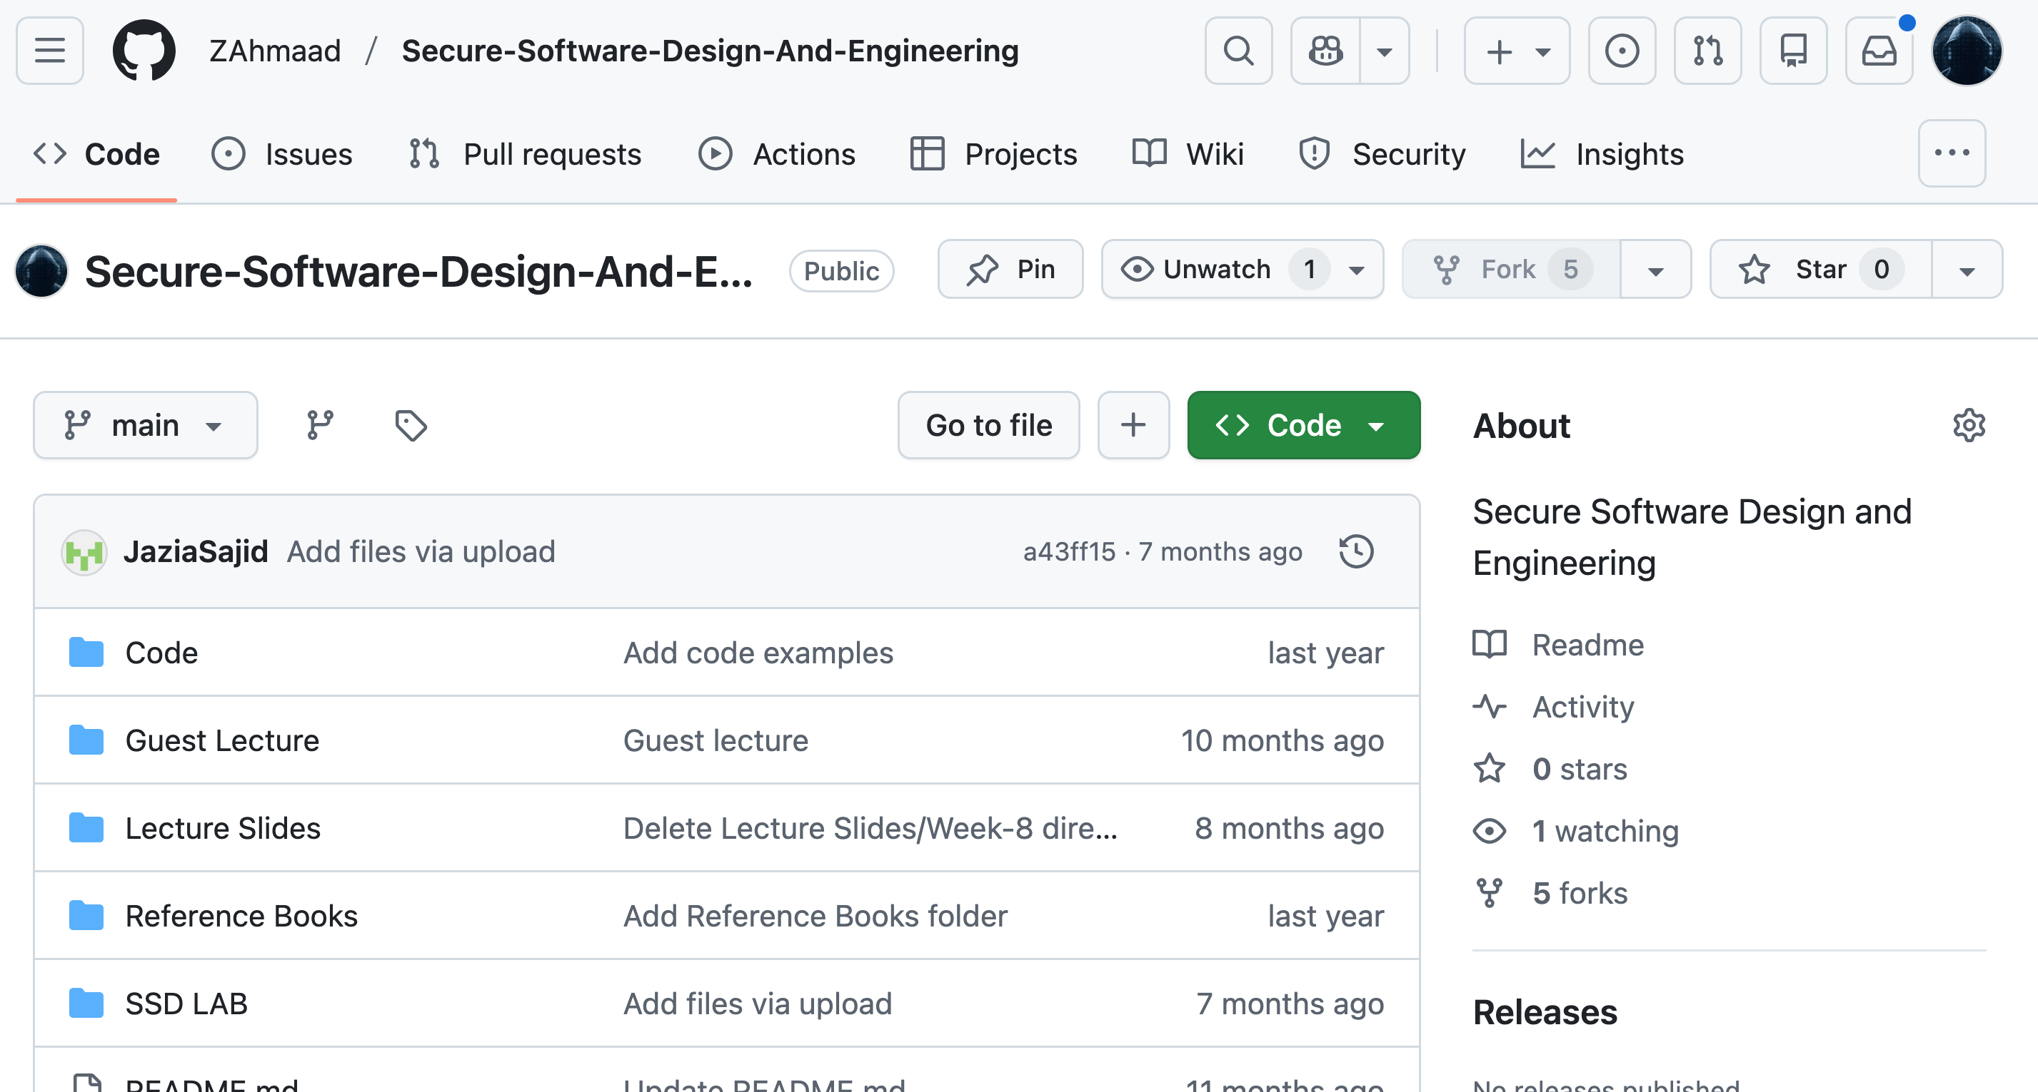
Webpage
Lectures/ Slides
Books
Project
Labs Material
https://github.com/ZAhmaad/Secure-Software-Design-And-Engineering
3

Slide 4
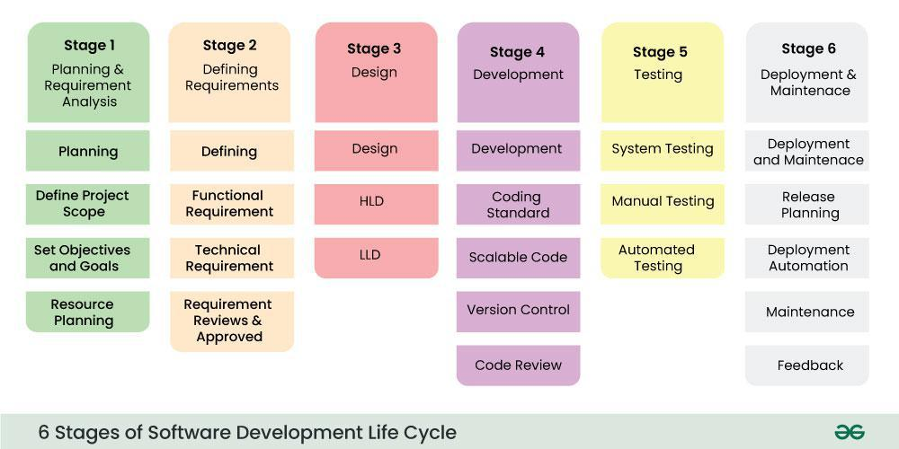
A Quick overview of SDLC

Slide 5
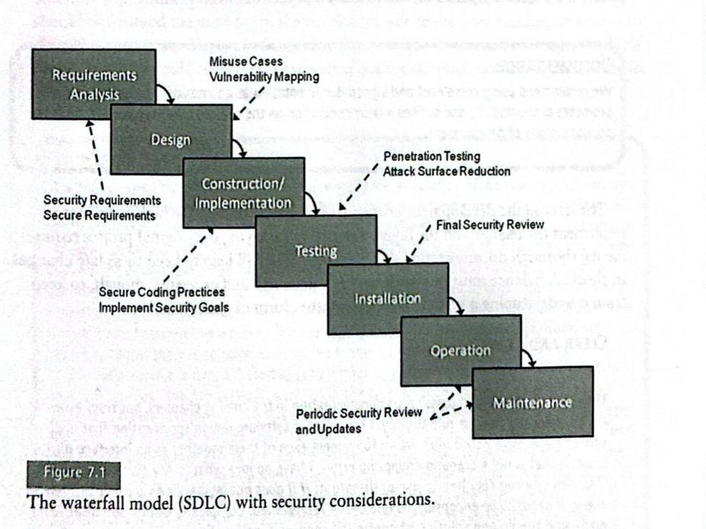
Waterfall Model (SDLC)
Tasks or activities into six to eight phases
Cultural Change to adopt Security planning
Scope of the project
Scope Creep
Functionality of the project
Requirements of the project (Data, environment, etc
Planning
Develop
Deploy

Slide 6
Why is Security Important in the SDLC?
Security related activities are deferred until the testing phase, which is late in the SDLC after most of the critical design and implementation has been completed
Shift Left
Shift Right

Slide 7
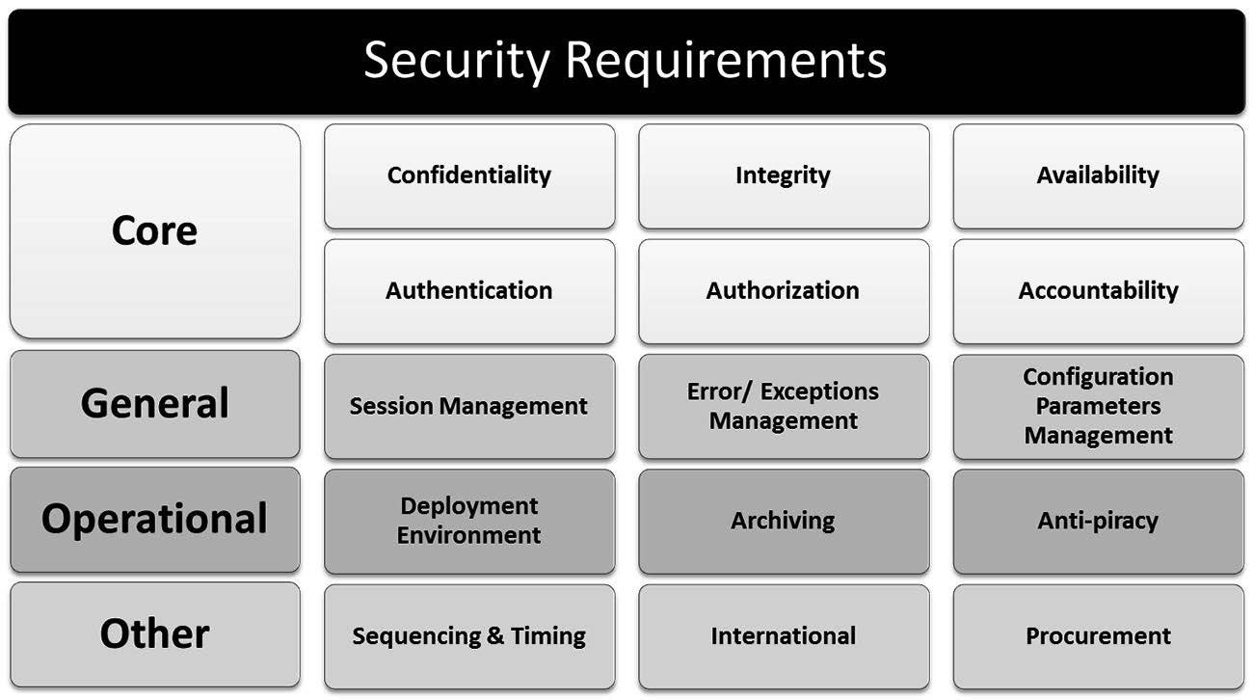
Planning and Requirement Stage

Slide 8
Planning and Requirement Stage
Why should this req be part of the system?
What are the constraints on this requirement?
What are the dependencies for this requirement?
What are the stakeholders for this requirement?
Fail Case
What if?
Result of Failure
Associated Risks

Slide 9
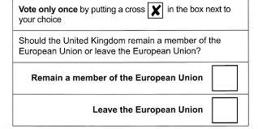
Scenario

Slide 10
Scenario
Network Interactions should follow a stateful pattern to allow traffic anomalies to be detected

Slide 11
Questions??
zubair.ahmad@giki.edu.pk
Office: G14 FCSE lobby

