Slide 1

Secure Software Design and Engineering
(CY-321)
Security Requirements in SDLC

Slide 2
Schedule
When?
- Check your class schedule
Where?
Here!
LH9 AcB
What?
Lectures
Quizzes/Project
Mid/Final Exams
Attendance?
Active Attendance
Dead Bodies.
Active Minds
Mobiles in hands -> Mark as absent
80% mandatory
5 minutes threshold
2

Slide 3
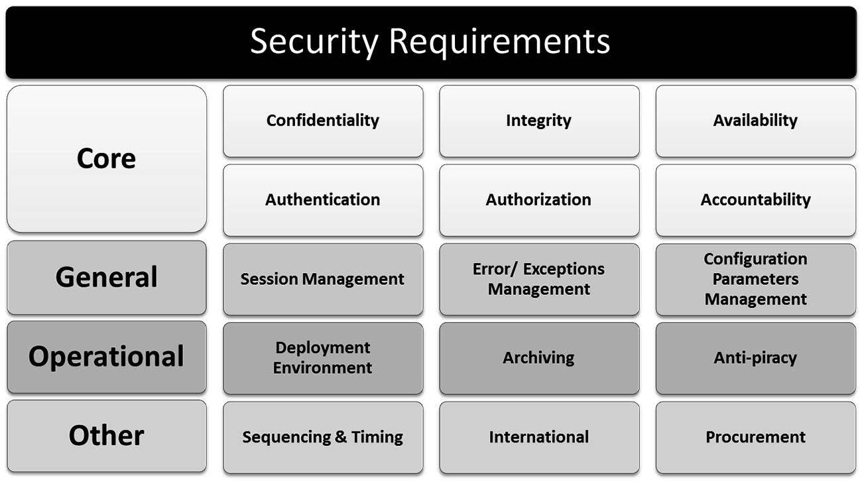
Planning and Requirement Stage

Slide 4
Planning and Requirement Stage
Confidentiality
Address protection against the unauthorized disclosure of data or information that are either private or sensitive in nature
Data can be broadly classified into public and non-public data or information.

Slide 5
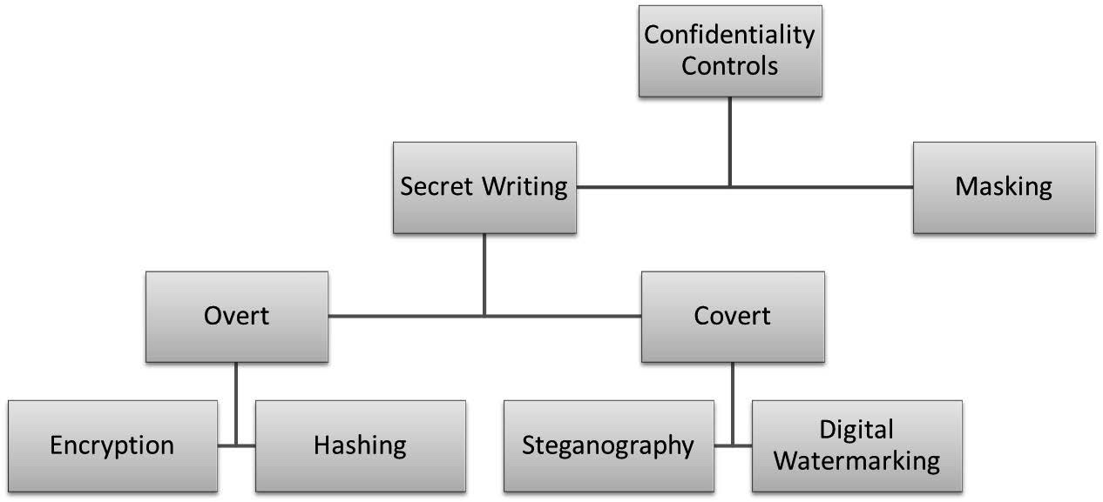
Planning and Requirement Stage
Confidentiality

Slide 6
Planning and Requirement Stage
Confidentiality
In Transit:
In Processing:
In Storage:

Slide 7
Planning and Requirement Stage
Integrity
Data Integrity
System Integrity
Reliability assurance and protection
Prevention against unauthorized modifications

Slide 8
Planning and Requirement Stage
Availability
Maximum Tolerable Downtime (MTD)
Recovery Time Objective (RTO)
Measure of the maximum amount of time that the software can be in a state of not providing expected service
Amount of time by which the system or software needs to be restored back to the expected state of business operations
MTD are sometimes are referred to as Maximum Tolerable Period of Disruption (MTPD)
Adverse effects of software downtime through Business Impact Analysis (BIA)

Slide 9
Planning and Requirement Stage
Authentication
The process of validating an entity claim

Slide 10
Planning and Requirement Stage
Layered upon authentication, authorization requirements are those that confirm that an authenticated entity has the needed rights and privileges to access and perform actions on a requested resource
CRUD operations, which stand for Create, Read, Update or Delete data
Impersonation and Delegation Model
Trusted Subsystem Model

Slide 11
Planning and Requirement Stage
Discretionary Access Control (DAC)
Non-Discretionary Access Control (NDAC)
Mandatory Access Control (MAC)
Role-Based Access Control (RBAC)
Resource-Based Access Control

Slide 12
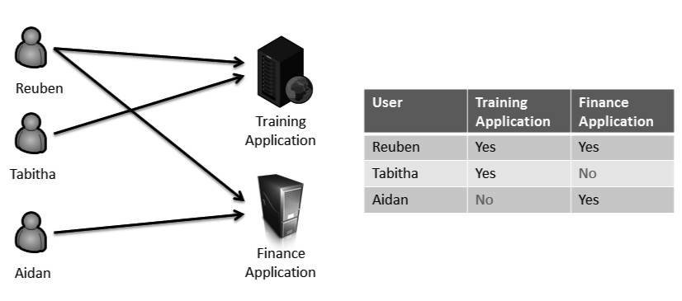
Planning and Requirement Stage
Discretionary Access Control (DAC)
Subject with a certain access permission is capable of passing that permission (perhaps indirectly) on to any other subject

Slide 13
Planning and Requirement Stage
Non-Discretionary Access Control
System enforcing the security policies
Does not rely on the subject compliance with security policies. it is unavoidably imposed on all subjects
The system security policies and mechanisms configured by the systems or security administrators are enforced and tamperproof

Slide 14
Planning and Requirement Stage
Mandatory Access Control (MAC)
Access to objects is restricted to subjects based on the sensitivity of the information contained in the object
The sensitivity is represented by a label

Slide 15
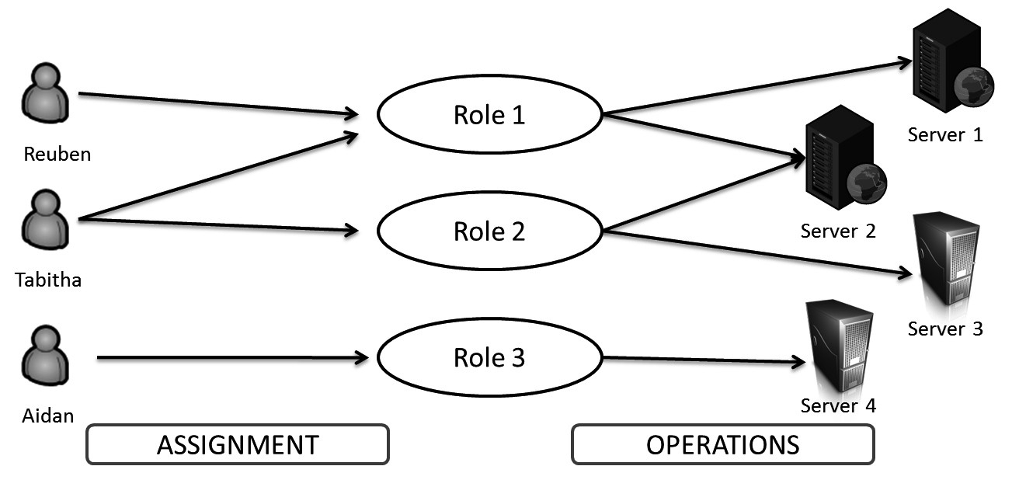
Planning and Requirement Stage
Role-Based Access Control (RBAC)
RBAC in Relation to Least Privilege and Separation of Duties
No individual can be assigned to two roles that are mutually exclusive in their permissions to perform operations

Slide 16
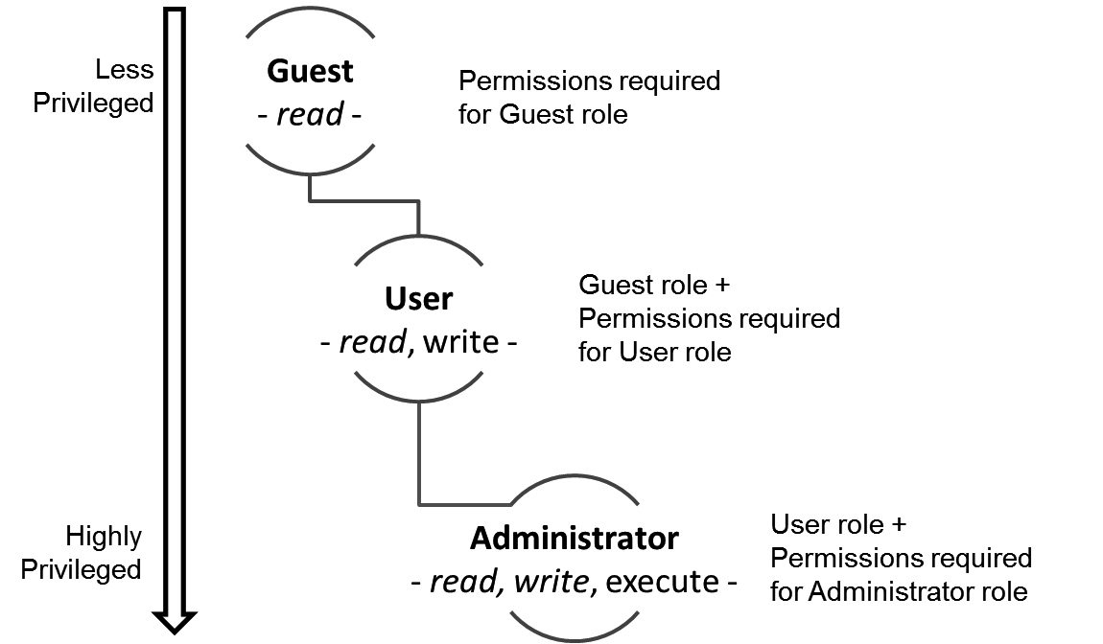
Planning and Requirement Stage
Role Hierarchies

Slide 17
Planning and Requirement Stage
Accountability
The identity of the subject (user or process) performing an action (who)
The action (what)
The object on which the action was performed (where)
The timestamp of the action (when)

Slide 18
Questions??
zubair.ahmad@giki.edu.pk
Office: G14 FCSE lobby

