Slide 1

Secure Software Design and Engineering
(CY-321)
Security Needs Elicitation

Slide 2
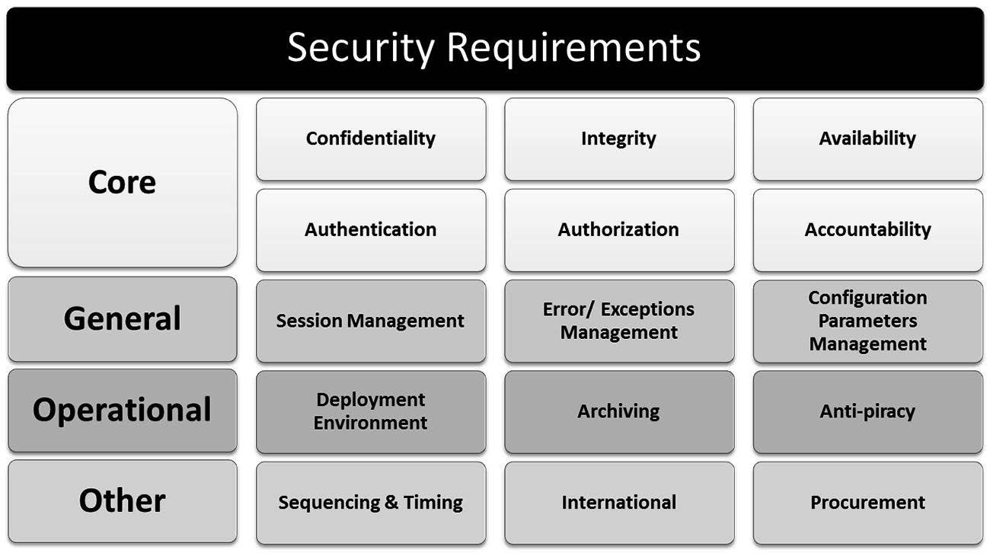
Planning and Requirement Stage

Slide 3
Planning and Requirement Stage
Session Management Requirements
Why we need session?
Since valid sessions can be potentially hijacked where an attacker takes control over an established session, it is necessary to plan for secure session management.
Related to which Secure Design concepts?
Complete Mediation
psychological acceptability

Slide 4
Planning and Requirement Stage
Errors & Exception Management Requirements
All about how you handle and structure the errors and exception
Can Errors & exceptions are potential sources of information disclosure?

Slide 5
Planning and Requirement Stage
Configuration Parameters Management Requirements

Slide 6
Planning and Requirement Stage

Slide 7
Planning and Requirement Stage
Operational Requirements
What we need for Operational Requirements?

Slide 8
Planning and Requirement Stage
Deployment Environment Requirements
Requirements about the environment in which the software will be deployed

Slide 9

Deployment Environment Requirements
Will the software be deployed in an Internet, Extranet or intranet environment?
Will the software be hosted in a Demilitarized Zone (DMZ)?
Can we leverage existing operating system event logging for auditing purposes?
Will the software need to support single sign-on (SSO) authentication?
Will the software be load balanced and how is clustering architected?
What ports and protocols are available for use?
What privileges will be allowed in the production environment?
Will the software be deployed in a web farm environment?
Will the software be transmitting sensitive or confidential information?

Slide 10
Planning and Requirement Stage
Archiving Requirements
conflict between the organizational policy and a regulatory requirement, then follow?
the location, duration and format of archiving information must be determined

Slide 11
Archiving Requirements
Where will the data or information be stored?
In what format will the data or information be stored? Clear text or cipher text?
How do we ensure that the media is not re-writable?
If the data or information is stored in cipher text, how is this accomplish and are there management processes in place that will ensure proper retrieval?
How long will we need to store the archives for?
Is there a regulatory requirement to store the data for a set period of time?
How will these archives themselves be protected?
Is our archival retention policy contradictory to any compliance or regulatory requirements?
11

Slide 12
Planning and Requirement Stage
Anti-Piracy Requirements
Code obfuscation, anti-tampering, licensing and IP protection mechanisms should be included

Slide 13
Planning and Requirement Stage

Slide 14
Planning and Requirement Stage
Sequencing and Timing Requirements
race conditions or Time of Check/Time of Use (TOC/TOU) attacks.

Slide 15
Planning and Requirement Stage
International Requirements
legal and technological.

Slide 16
Protection Needs Elicitation (PNE)
The Good question is How you gonna do it?
Surveys (Questionnaires and Interviews)
Use Case & Misuse Case Modeling
Policy Decomposition
PNE
Brainstorming
Subject-Object Matrix
Data Classification

Slide 17
Protection Needs Elicitation (PNE)
Policy Decomposition
What is the meaning of incorporating information security through the SDLC?
One of the sources for security requirements is internal organizational policies that the organization need to comply with
the decomposition process is objective and compliant with the security policy, and not merely someone’s opinion

Slide 18
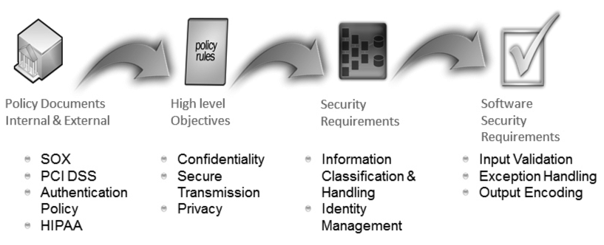
Protection Needs Elicitation (PNE)
Policy Decomposition

Slide 19
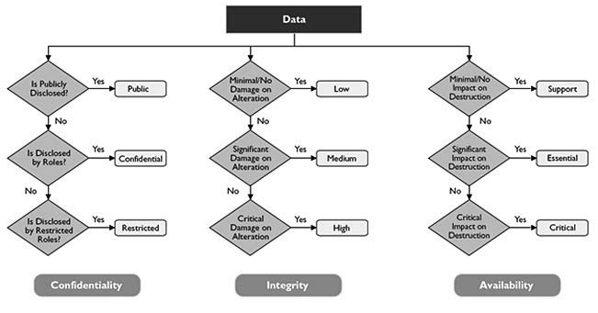
Protection Needs Elicitation (PNE)
Data Classification

Slide 20
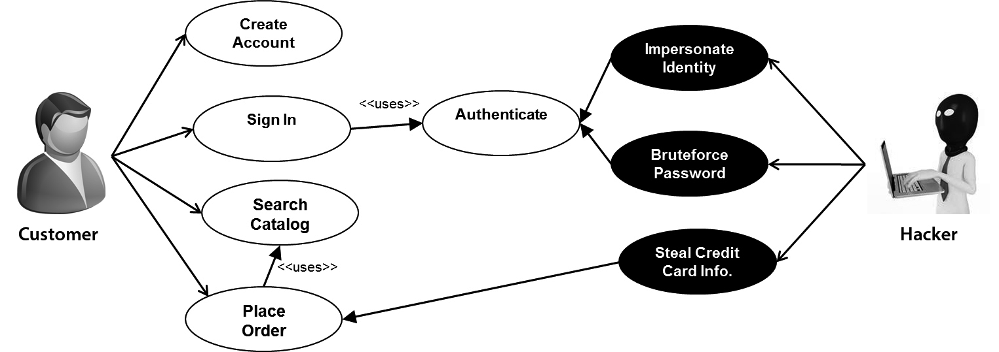
Protection Needs Elicitation (PNE)
Use Case & Misuse Case Modeling

Slide 21
Questions??
zubair.ahmad@giki.edu.pk
Office: G14 FCSE lobby

