Slide 1

Secure Software Design and Development
(CY-321)
Risk Management for Software

Slide 2
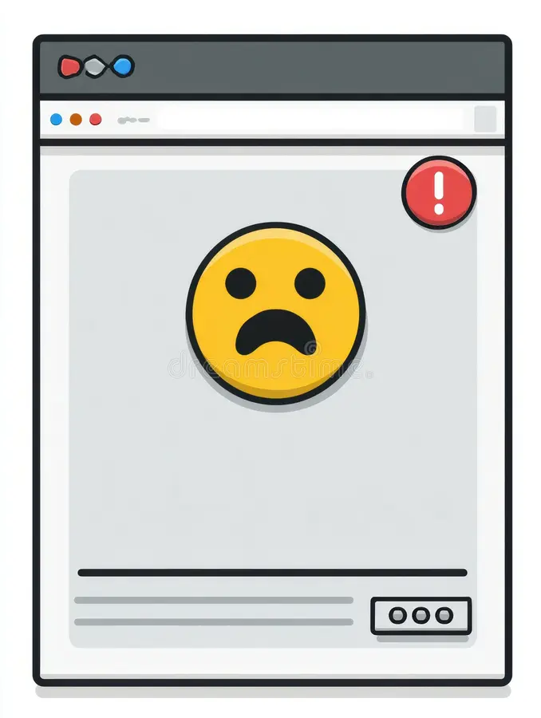
Handling Risk
Owners value assets (software) and wish to minimize risk to assets
All software has risks
Without risk management, small issues become disasters
Software risk management is not just about security, its about reliability, trust, and business success

Slide 3
Handling Risk
Mitigate the risk
Accept the risk
Ignore the risk
What If?
Transfer the risk
Avoid the risk

Slide 4
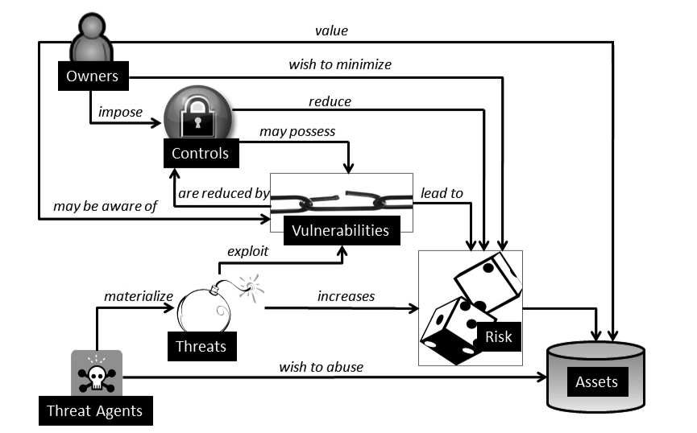
Risk Management – A View

Slide 5
Risk Management - Terminologies
Total Risk
Residual Risk
the likelihood of the occurrence of an unwanted, unintended or harmful event
Risk that remains after the implementation of mitigating security controls (countermeasures or safeguards)
This is the overall risk of the system, before any security controls are applied
This may be expressed qualitatively (e.g., High, Medium or Low) or quantitatively (using numbers or percentiles)

Slide 6
Risk Management - Terminologies
Calculation of Risk
Risk is conventionally expressed as the product of the probability of a threat- source/agent taking advantage of a vulnerability and the corresponding impact
Single Loss Expectancy (SLE)
Annual Rate of Occurrence (ARO)
Calculation of risk is not a black or white exercise, especially in the context of software security
Annual Loss Expectancy (ALE)
Estimation of both probability and impact are usually subjective and so quantitative measurement of risk is not always accurate.

Slide 7
Risk Management for Software
Technical security risk is only a portion of the overall state of secure software.
Software risk management is still maturing
Challenges
Data on the exposure factor, impact, and probability of software security breaches is lacking or limited.
Determination of software asset values is often subjective.

Slide 8
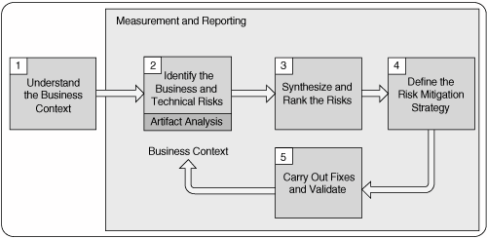
Risk Management - Five Stages

Slide 9
Risk Management - Five Stages
Understand the Business Context
The purpose of this stage is to gather data to answer the all-important "Who cares?" question.
Extract and describe business goals, priorities, and circumstances in order to understand what kinds of software risks to care about and which business goals are paramount

Slide 10
Risk Management - Five Stages
Identify the Business and Technical Risks
The ability to discover and describe technical risks and map them (through business risks) to business goals
The key to making risk management work for any business lies in tying technical risks to the business context in a meaningful way

Slide 11
Risk Management - Five Stages
Synthesize and Rank the Risks
"What shall we do first given the current risk situation?"
"What is the best allocation of resources, especially in terms of risk mitigation activities?"

Slide 12
Risk Management - Five Stages
Define the Risk Mitigation Strategy
Nobody wants to hear about their problems without hearing some suggested fixes. A risk analysis is only as good as the mitigation strategy it contains

Slide 13
Risk Management - Five Stages
Carry Out Fixes and Validate
Risk mitigation is carried out according to the strategy defined in stage 4

Slide 14
Security Policies
Legal and regulatory compliance has been evident as an important driver of information security spending and initiatives
The ‘What’ and ‘Why’ for Security?
‘What’ needs to be protected and the possible repercussions of non-compliance
functional.
Organizational
The Scope

Slide 15
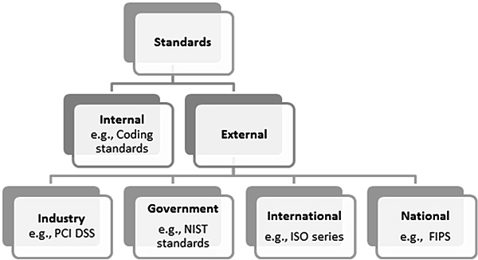
Security Standards

Slide 16
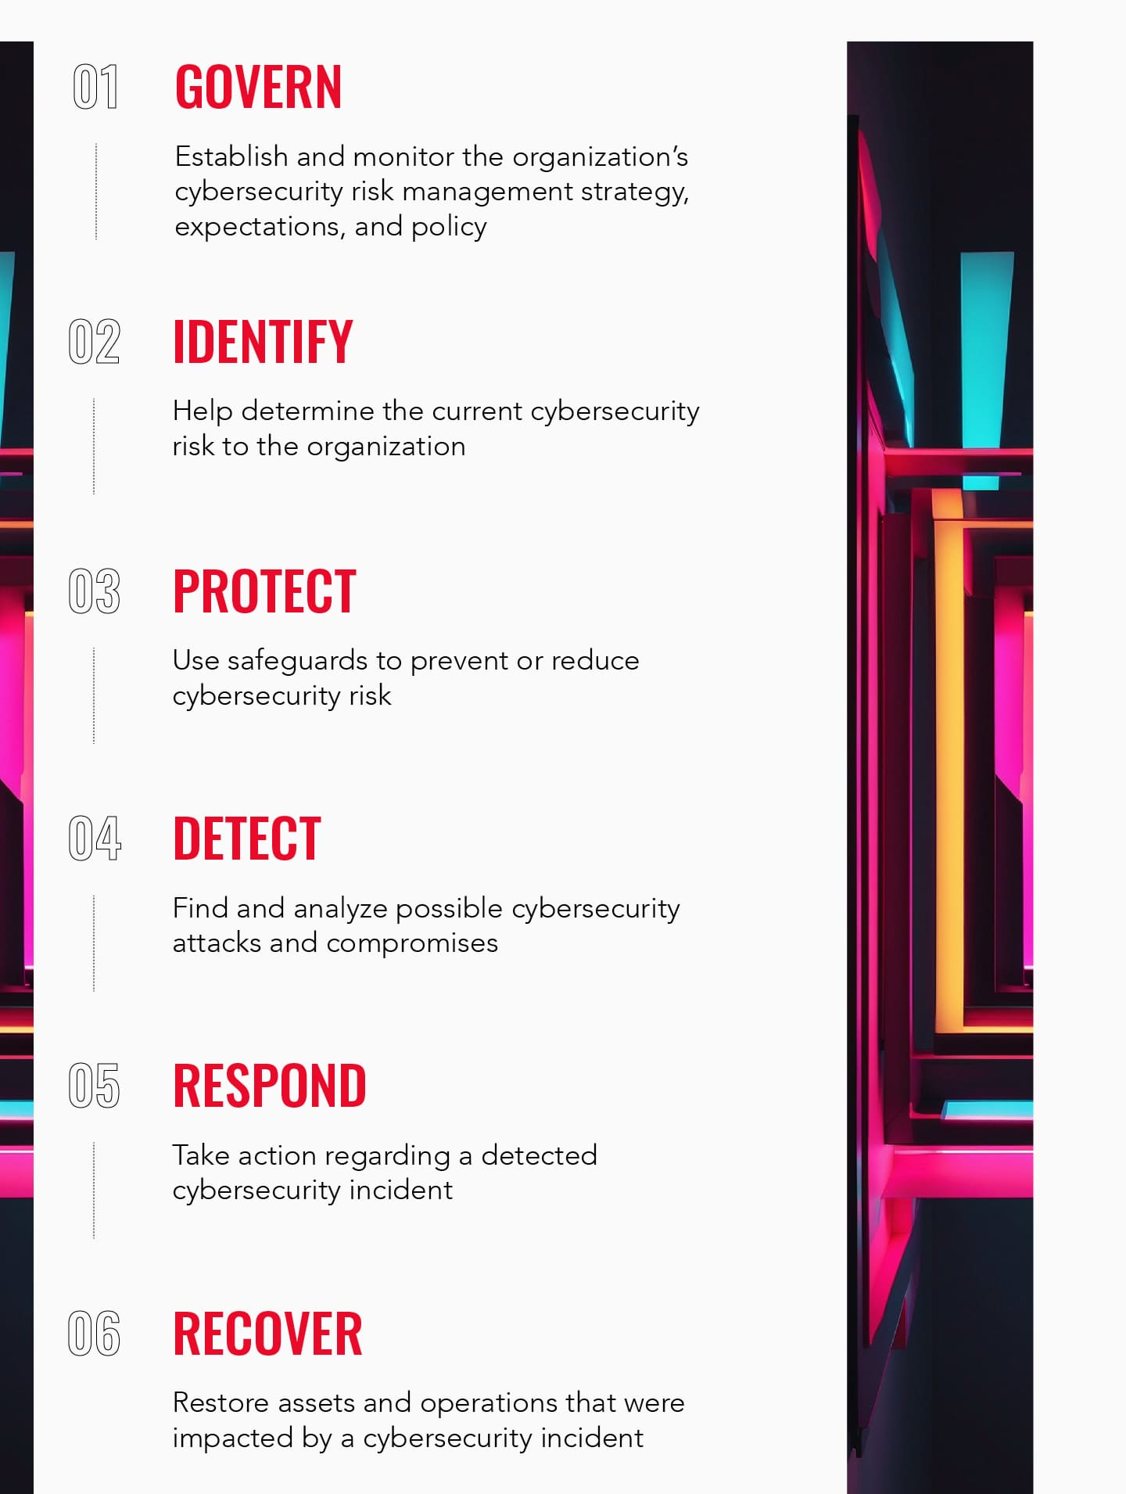
Security Standards
NIST Standard
The National Institute of Standards and Technology

Slide 17
Security Standards
Federal Information Processing (FIPS) standards
Developed by NIST for U.S. government agencies and contractors to ensure strong security and interoperability in information system
Level 1
Basic security, software-only encryption allowed
Includes role-based authentication and tamper-evidence
Level 2
Level 3
Requires physical tamper-resistance and identity-based authentication
Level 4
Offers highest security with environmental attack resistance.

Slide 18
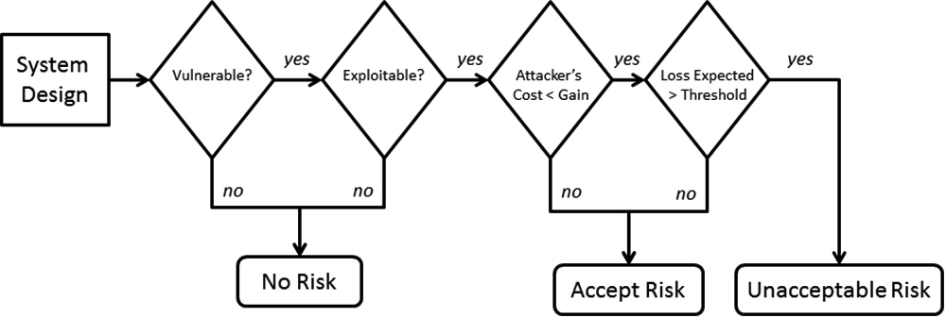
Security Standards
SP 800-30: Risk Management Guide for IT

Slide 19
Security Standards
ISO Standards
Primary body that develops International Standards for all industry sectors
Exception
ISO/IEC 15408 – Evaluating Criteria for IT Security (Common Criteria)
Electrotechnology
Telecommunications
The ISO/IEC 15408 Standard and Software Security
Electrotechnology standards are developed by International Electrotechnical Commission (IEC) and telecommunication standards are developed by the International Telecommunications Union (ITU)
ISO/IEC 21827:2008 – Systems Security Engineering Capability Maturity Model® (SSE-CMM®)
ISO/IEC 25000:2005 – Software Engineering Product Quality
ISO/IEC 27000:2009 – Information Security Management System (ISMS) Overview and Vocabulary

Slide 20
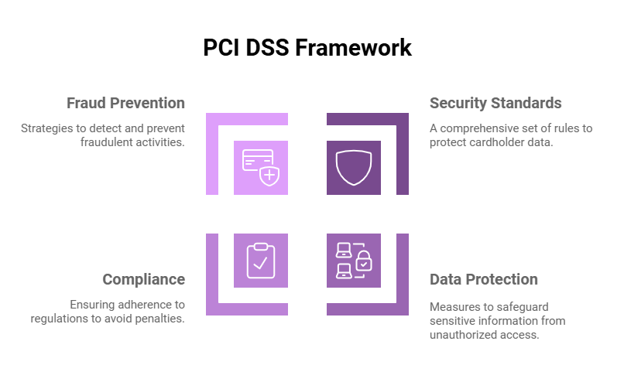

Slide 21
Security Standards
Payment Card Industry Data Security Standard (PCI DSS)
Build and Maintain a Secure Network
Requirement 1
Install and maintain a firewall configuration to protect cardholder data
Requirement 2
Do not use vendor-supplied defaults for system passwords & other security parameters
Protect Cardholder Data
Requirement 3
Protect stored cardholder data
Requirement 4
Encrypt transmission of cardholder data across open, public networks

Slide 22
Security Standards
Payment Card Industry Data Security Standard (PCI DSS)
Maintain a Vulnerability Management Program
Requirement 5
Use and regularly update anti-virus software
Requirement 6
Develop and maintain secure systems and applications
Implement Strong Access Control Measures
Requirement 7
Restrict access to cardholder data
Requirement 8
Assign a unique ID to each person with computer access
Requirement 9
Restrict physical access to cardholder data

Slide 23
Security Standards
Payment Card Industry Data Security Standard (PCI DSS)
Regularly Monitor and Test Networks
Requirement 10
Track and monitor all access to network resources and cardholder data
Requirement 11
Regularly test security systems and processes
Maintain an Information Security Policy
Requirement 12
Maintain a policy that addresses information security

Slide 24
Security Standards
Open Web Application Security Project (OWASP)
Worldwide free and open community that is focused on application security and predominantly web application security
The OWASP Development Guide
Comprehensive manual for designing, developing and deploying secure web applications and web services
The target audiences for this guide are architects, developers, consultants and auditors

Slide 25
Security Standards
Open Web Application Security Project (OWASP)
Importance
(Impact of the availability of the software to the business or its lack )
Code
(Programming Language )
OWASP Code Review Guide
Audience
(End-users)
Context
(Working knowledge of the software)

Slide 26
Security Standards
Open Web Application Security Project (OWASP)
The OWASP Testing Guide
Covers the procedures and tools that are necessary to validate software assurance
The target audiences for this guide are software developers, software testers and security specialists.

Slide 27
Security Standards
Internal Coding Standards

Slide 28
Questions??
zubair.ahmad@giki.edu.pk
Office: G14 FCSE lobby

