Slide 1

Secure Software Design and Development
(CY-321)
Risk Management for Software (2)

Slide 2
Handling Risk
The risk is left unhandled
This is highly ill-advised
Ignore the risk
What If?
The organization can find itself at the end of a class action law suit and regulatory oversight for not protecting the data that its customers have entrusted to it

Slide 3
Handling Risk
Discontinue the service/product
Replaced by a newer product
What If?
Avoid the risk
Risk may be avoided but it must never be ignored.

Slide 4
Handling Risk
Mitigate the risk
What If?
To implement security controls (safeguards and countermeasures) to reduce the risk

Slide 5
Handling Risk
Choose to this accept the residual risk that remains and continue business operations
Accept the risk
What If?
Or they can choose to continue to mitigate it

Slide 6
Handling Risk
The liability that is transferred and not necessarily the risk itself
By buying insurance and using disclaimers
What If?
Transfer the risk
Transfer the risk to the end user

Slide 7
Risk Management
Quantitative
Qualitative
the likelihood of the occurrence of an unwanted, unintended or harmful event
This is the overall risk of the system, before any security controls are applied
This may be expressed qualitatively (e.g., High, Medium or Low) or quantitatively (using numbers or percentiles)

Slide 8
Calculation of Risk
Single Loss Expectancy (SLE)
Annual Rate of Occurrence (ARO)
Annual Loss Expectancy (ALE)

Slide 9
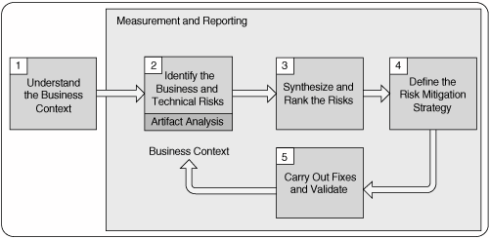
Risk Management
KillerAppCo has launched iWare 1.0, a web-based software for managing user accounts, payments, and confidential business data. The iWare server runs on Linux, is accessible over the internet, and stores sensitive user information including emails, passwords, and payment details.

Slide 10
Understand the Business Context
Rank | Business Goals | Description
H | iWare 1.0 Server must be released on Jan 1, 2027 | KillerAppCO desires to release iWare 1.0 on Jan 1, 2027, to achieve first-to-market status, which will enable KillerAppCo tosecure 25% of the market prior to competitor entry

Slide 11
Understand the Business Context
Rank | Definition
High (H)
Medium (M)
Low (L)
Guidelines for Business Goals Ranking

Slide 12
Business and Technical Risks
Business Risks | Business Risk Indicators | Likelihood | Impact | Estimated Cost | Impact
High (H)
Medium (M)
Low (L)
Business Risks

Slide 13
Business and Technical Risks
Business Risks | Technical Risk Indicators | Likelihood | Impact
Technical Risks

Slide 14
Goal to Risks Relationship Table
Business Goals | Business Risk | Technical Risk

Slide 15
Questions??
zubair.ahmad@giki.edu.pk
Office: G14 FCSE lobby

