Slide 1
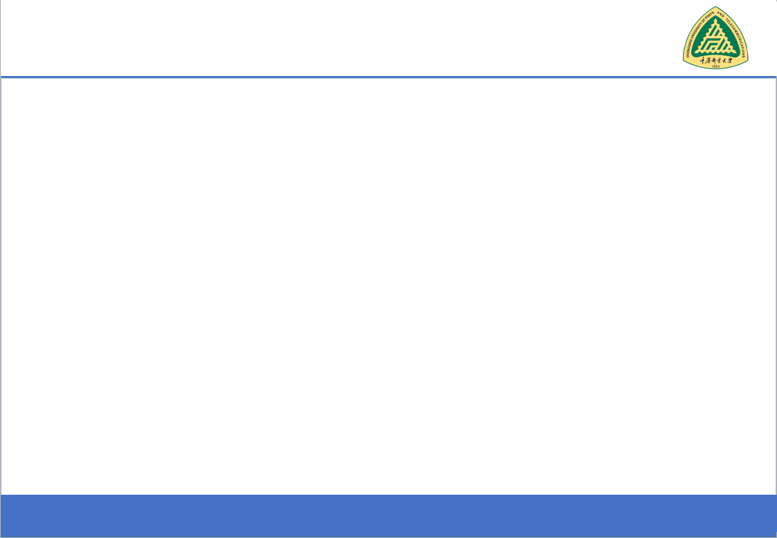
Secure Software Design and Development
(CY-321)
Secure Design Requirements

Slide 2
Secure Design Requirements
Software fails insecurely,
Improper implementation of least privilege
Insecure design issues
improper error handling
Weak input validation.

Slide 3
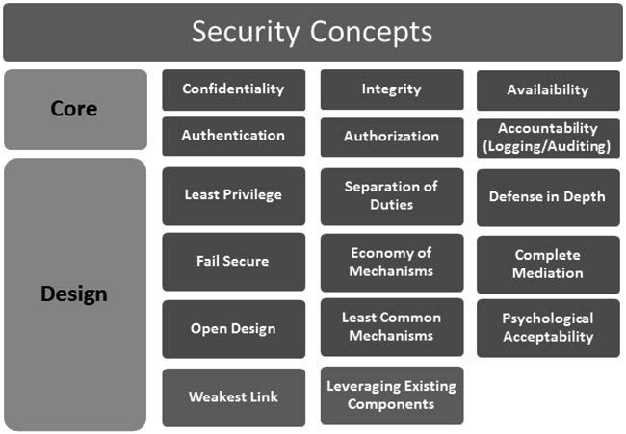
Secure Design Requirements

Slide 4
Secure Design Requirements
Least Privilege
Need-to-know
Limits the disclosure of sensitive information to only those who have been authorized to receive
A software design approach that breaks a system into smaller, reusable modules instead of writing one large program
Modular programming

Slide 5
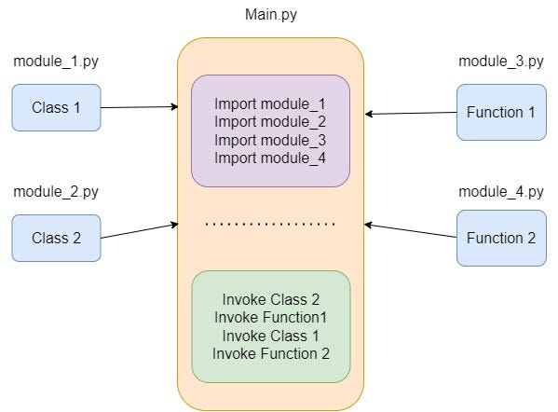
Secure Design Requirements
Least Privilege
Modular programming
High Cohesion
Loose Coupling

Slide 6
Secure Design Requirements
Modular programming
High Cohesion
Each module does one thing well and is strongly related to its purpose
A module for user authentication should handle login/logout but NOT database management.
Example??

Slide 7
Secure Design Requirements
Modular programming
Loose Coupling
Modules interact with each other as little as possible and communicate through well-defined interfaces
A payment processing module should work independently without needing to know how the shopping cart module is implemented
Example??

Slide 8
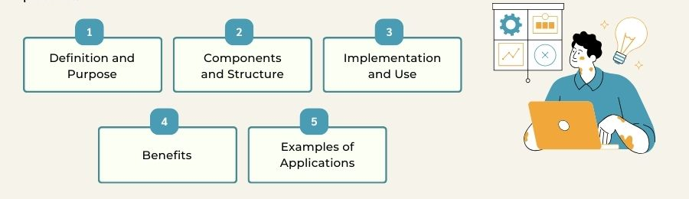
Secure Design Requirements
Separation of Duties
Software functionality into two or more conditions, all of which need to be satisfied before an operation can be completed
Software Deployment, Operations, Maintenance, and Disposal chapter.

Slide 9
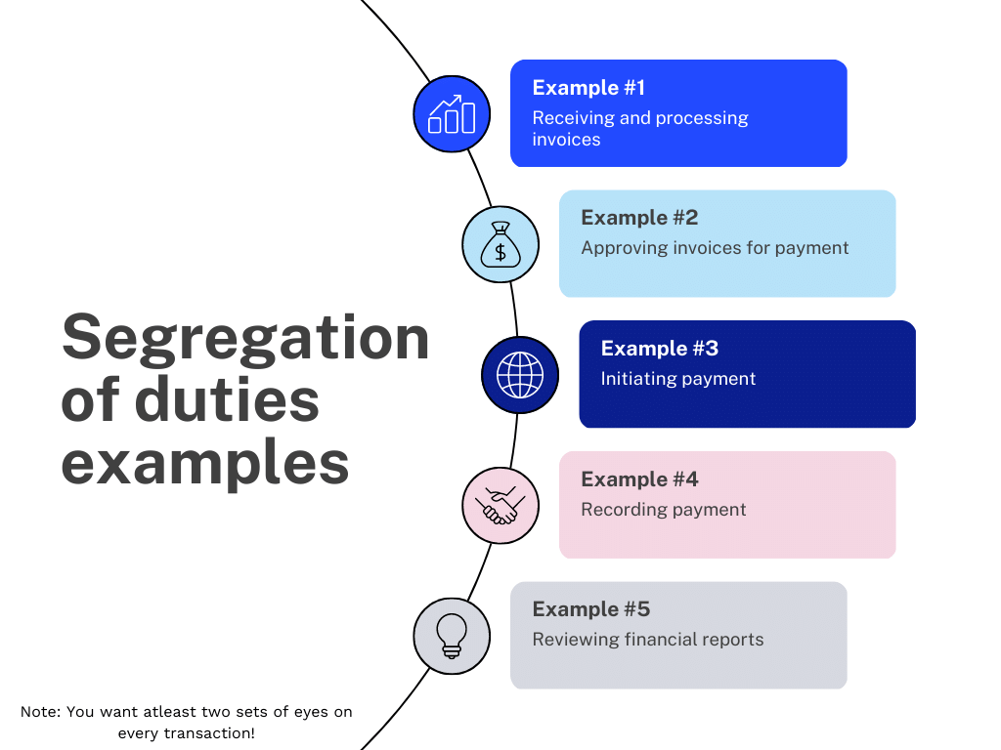
Secure Design Requirements
Separation of Duties

Slide 10
Secure Design Requirements
Defense in Depth
Not putting all the eggs in one basket
Use of Input Validation & Prepared Statements to Prevent Injection Attacks
Defending Against Cross-Site Scripting (XSS) with Output Encoding & Validation
Security Zones for Access Control

Slide 11
Secure Design Requirements
when attacked and is rapidly recoverable into a normal business
Fail Secure
The user is denied access by default and the account is locked out after the maximum number (clipping level) of access attempts is tried
Secure by Design,
Secure by Default
Secure by Deployment
Errors and exceptions are explicitly handled and the error messages are non-verbose in nature
Not designing the software to ignore the error and resume next operation

Slide 12
Secure Design Requirements
Fail Secure
Option Explicit
Dim objNetwork, strDrive, strRemotePath
strDrive = "J:"
strRemotePath = "\\FinServer\Software"
On Error Resume Next
Set objNetwork = CreateObject("WScript.Network")
objNetwork.MapNetworkDrive strDrive, strRemotePath
Wscript.Quit

Slide 13
Secure Design Requirements
Fail Secure
Option Explicit
Dim objNetwork, strDrive, strRemotePath
strDrive = "J:"
strRemotePath = "\\FinServer\Software"
Set objNetwork = CreateObject("WScript.Network")
objNetwork.MapNetworkDrive strDrive, strRemotePath
If Err.Number <> 0 Then
WScript.Echo "Error: " & Err.Description
Err.Clear
End If
Wscript.Quit

Slide 14
Secure Design Requirements
“bells-and-whistles”
Economy of Mechanisms
Unnecessary functionality or unneeded security mechanisms should be avoided.
Strive for simplicity
Strive for operational ease of use

Slide 15
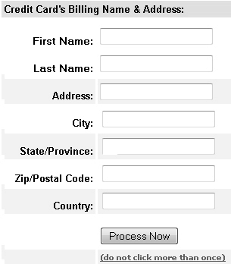
Secure Design Requirements
Complete Mediation
Whats wrong in this picture?

Slide 16
Secure Design Requirements
Complete Mediation
Not checking access rights each time a subject requests access to objects violates the principle of complete mediation
The complete mediation design principle also addresses the failure to protect alternate path vulnerability
Complete mediation also augments the protection against the weakest link

Slide 17
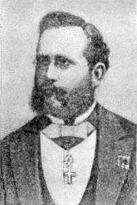
Secure Design Requirements
Open Design
Kerckhoff’s principle
All information about the crypto system is public knowledge except the key, and the security of the crypto system against cryptanalysis attacks is dependent on the secrecy of the key

Slide 18
Secure Design Requirements
Open Design
The Opposite??
The security of your software should not be dependent on the secrecy of the design
Security through obscurity should be avoided
The design of protection mechanisms should be open for scrutiny by members of the community

Slide 19
Secure Design Requirements
Least Common Mechanisms
The security principle by which mechanisms common to more than one user or process are designed not to be shared

Slide 20
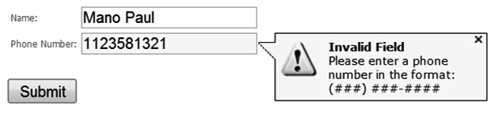
Secure Design Requirements
When user feel that security is usually very complex
Psychological Acceptability
are easy to use,
do not affect accessibility, and
are transparent to the user

Slide 21
Secure Design Requirements
“A chain is only as strong as its weakest links.”
Weakest Link
“Single Point of Failure”
Software must be architected so that there is no single source of complete compromise

Slide 22
Secure Design Requirements
Leveraging Existing Components
Service Oriented Architecture (SOA) is prevalent in today’s computing environment
Avoid custom implementations of cryptographic functionality are also determined often to be the weakest link.
the attack surface is not increased, and no newer vulnerabilities are introduced

Slide 23
Secure Design Requirements
Interface Design
User Interface
Abstractions using user interfaces are also a good defense against insider threats
The Clark and Wilson security model

Slide 24

Secure Design Requirements
Interface Design
Application Programming Interfaces (API)

Slide 25
Secure Design Requirements
Interface Design
Out-of-Band Interface
Log Interfaces
Security Management Interfaces (SMI)

Slide 26
Balancing Secure Design Principles
“SSO can heighten user experience and increase psychological acceptability, it contradicts the principle of complete mediation and so a business decision is necessary to determine the extent to which SSO is designed into the software or to determine that it is not even an option to consider "

Slide 27
Design Processes
When you are designing software with security in mind, certain security processes need to be established and completed
Attack surface evaluation
The measure of its exposure of being exploited by a threat agent

Slide 28
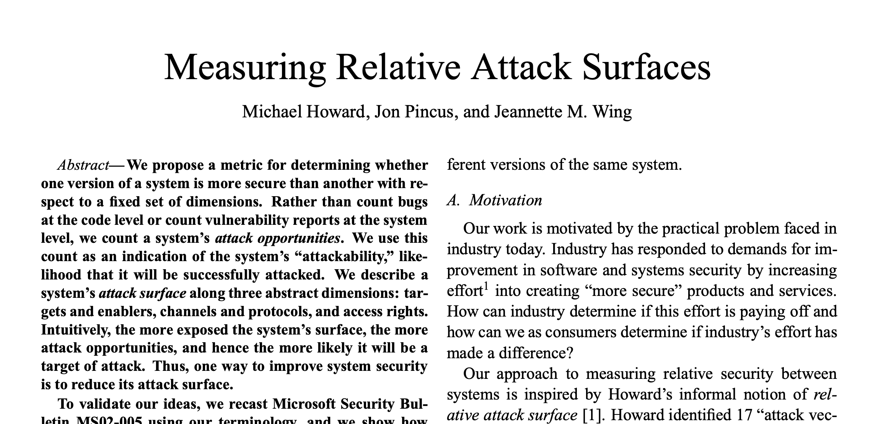
Design Processes
Relative attack surface quotient (RASQ)
Microsoft Cyber Security Program Manager Michael Howard
Not Isolation, But Comparsion

Slide 29
Design Processes
Relative attack surface quotient (RASQ)
It doesnt say “Is this system secure?” It says “Which one is more exposed to attacks and by how much?”
The relative attackability” or likely opportunities for attack against software in comparison to a baseline
“More doors in a house mean more places to lock.”

Slide 30
Questions??
zubair.ahmad@giki.edu.pk
Office: G14 FCSE lobby

