Slide 1

Secure Software Design and Development
(CY-321)
How Does Usable Security (Not) End Up in Software Products?

Slide 2
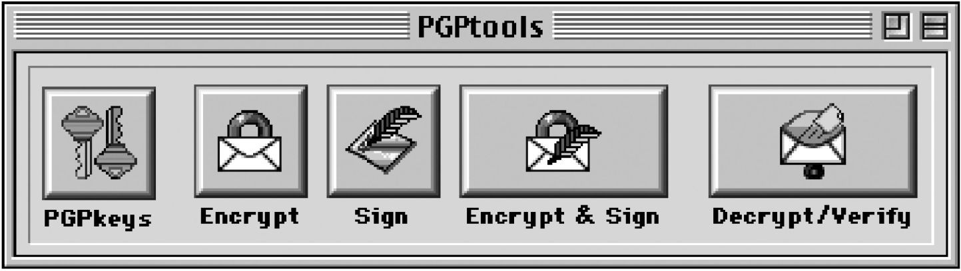
Motivation – Cryptography is Hard to Use
For more than 20 years:
Usable security problems with PGP [1]
And today?
0.06% encrypted emails [2]
Source: Whitten and Tygar [1]
→ Hard to use, low adoption!
2
A. Whitten and J. D. Tygar, “Why Johnny Can’t Encrypt: A Usability Evaluation of PGP 5.0,” in Proceedings of the 8th USENIX Security Symposium, Washington, D.C., 1999.
C. Stransky, O. Wiese, V. Roth, Y. Acar and S. Fahl, “27 Years and 81 Million Opportunities Later: Investigating the Use of Email Encryption for an Entire University,” in Proceedings of the 43rd IEEE Symposium on Security and Privacy (SP’22), San Francisco, CA, US, 2022.

Slide 3
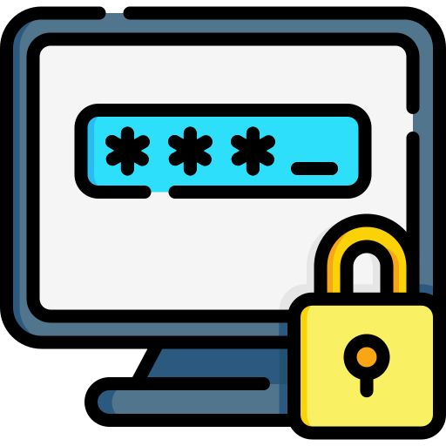
Motivation – Passwords and their Challenges
One of the oldest usable security fields and problems [3]
Password re-use
Written on post-its
Too short
Easily guessable
…
→ Human factors impact security.
[3] A. Adams and M. A. Sasse, “Users Are Not the Enemy,” Commun. ACM, vol. 42, no. 12, Art. no. 12, Dec. 1999.

Slide 4
Previous research showed…
To achieve effective security, security features need to be both usable and secure.

Slide 5

Lack of Usable Security Knowledge in Industry
Lots of research on usable security
Many insights, especially on end-user usable security
→ But: software still often has usable security issues!

Slide 6
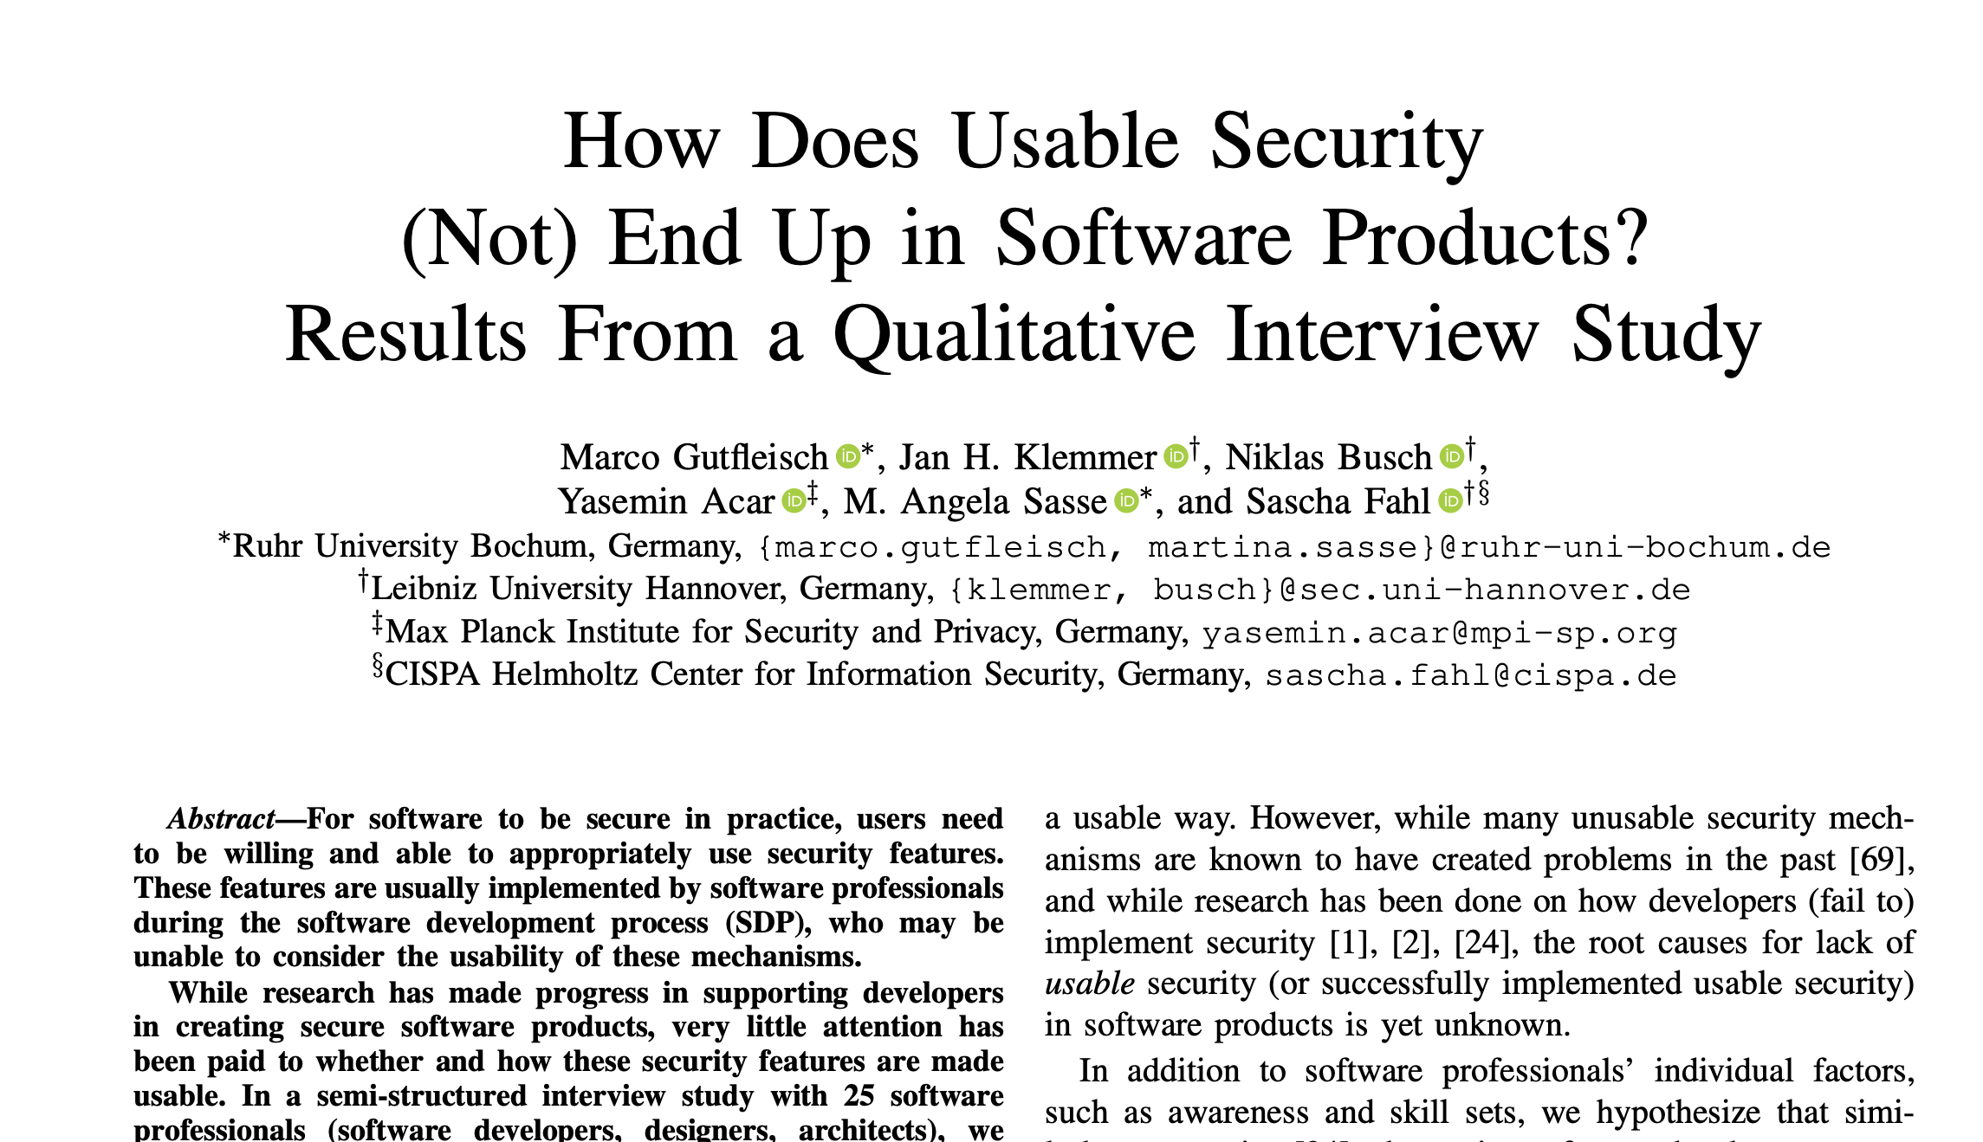
What They did
Gutfleisch, Marco, et al. "How does usable security (not) end up in software products? results from a qualitative interview study." 2022 IEEE Symposium on Security and Privacy (SP). IEEE, 2022.

Slide 7
Problem & Research Questions
It is unclear…
…whether companies/software teams take care of usable security.
…how processes for usable security look in the wild.
RQs:
Which factors in the software development process (SDP) and in companies influence usable security?
What are contributors and blockers for usable security in software development?
When and where in the SDP are important decisions made that influence usable security?

Slide 8



25 Interviews with Stakeholders
Getting insights from different software development teams
Interview important stakeholders in the software development process
25x
90-minute, semi-structured interviews

Slide 9
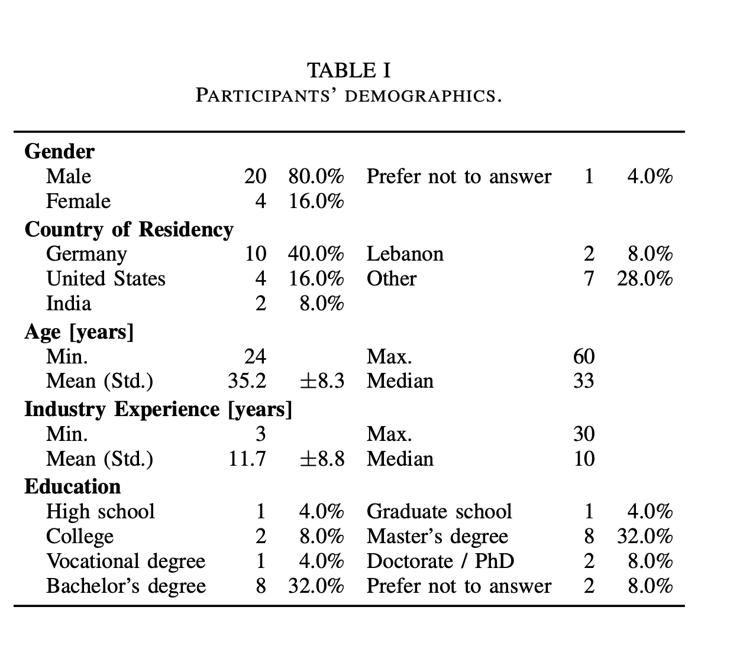

Slide 10
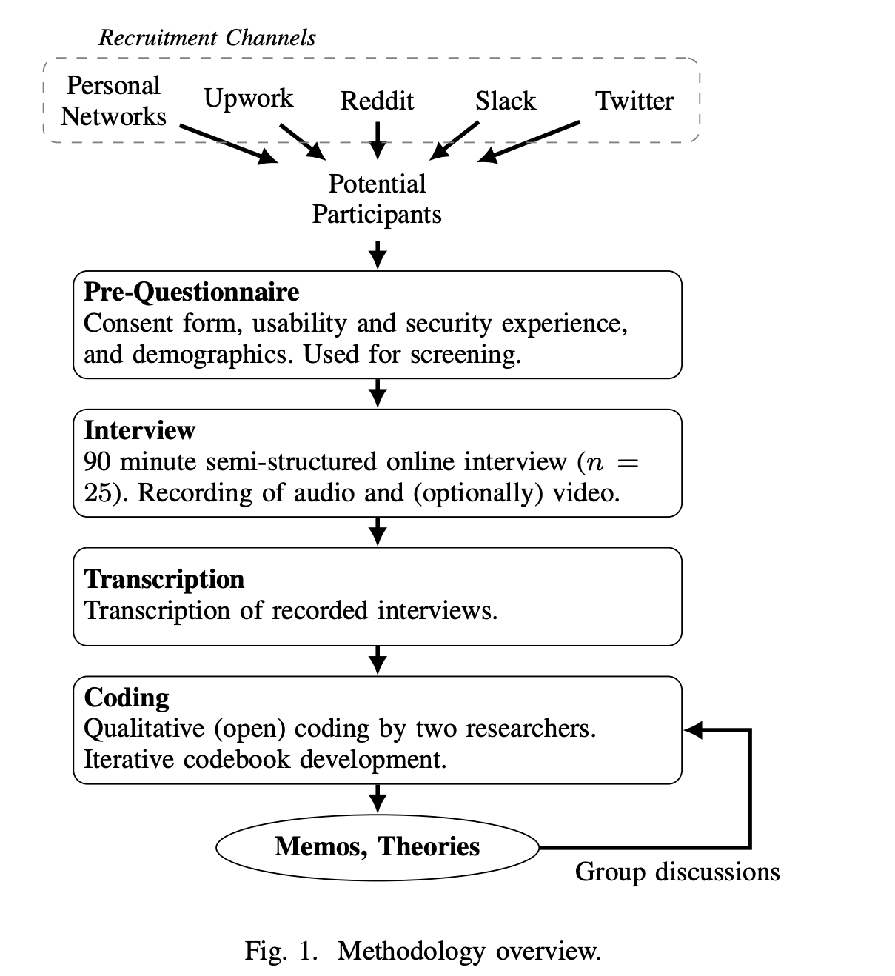

Slide 11
Interview Structure
Recruitment
25 participants: professional networks, Upwork freelancers, social media
Pre-Questionnaire
Consent, demographics, security & usability background

Slide 12
Interview Structure
Recruitment
25 participants: professional networks, Upwork freelancers, social media
Pre-Questionnaire
Consent, demographics, security & usability background
Intro & Individual Questions
Communication Modelling Planning Construction Deployment
Interview

Slide 13
Interview Structure
Recruitment
25 participants: professional networks, Upwork freelancers, social media
Pre-Questionnaire
Consent, demographics, security & usability background
Intro & Individual Questions
Communication Modelling Planning Construction Deployment Usable Security
Two sections in each interview:
Usability
Security
Interview
13

Slide 14
What they found

Slide 15
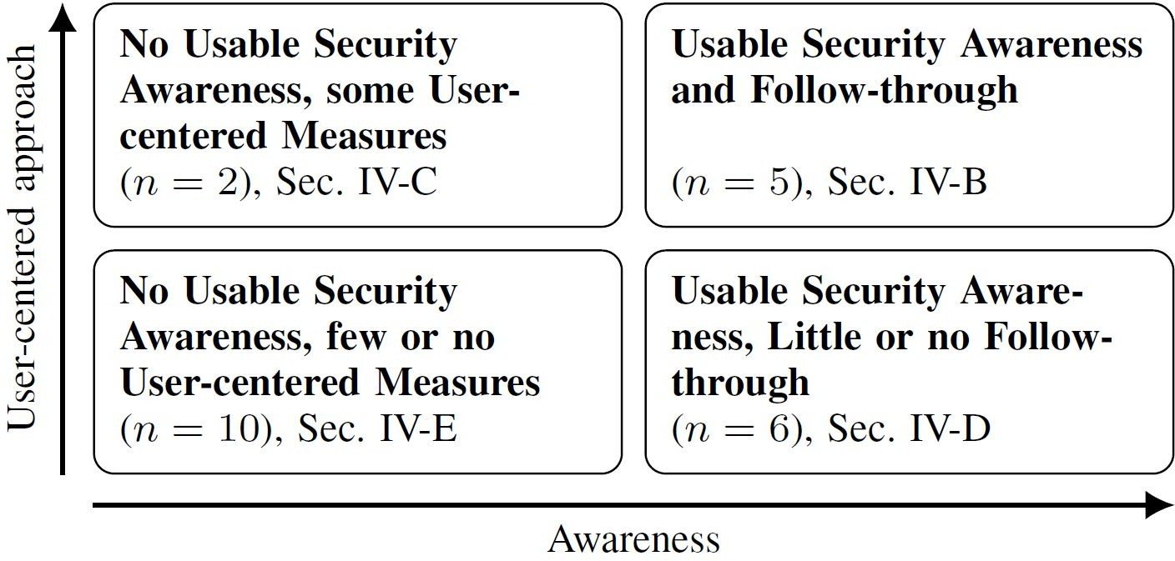
Key Findings

Slide 16
Key Findings

Slide 17
Key Findings

Slide 18
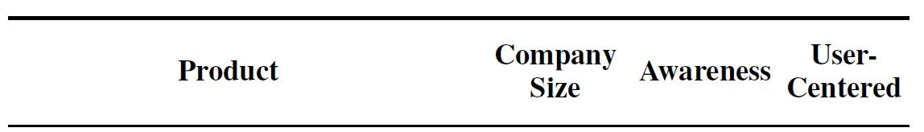
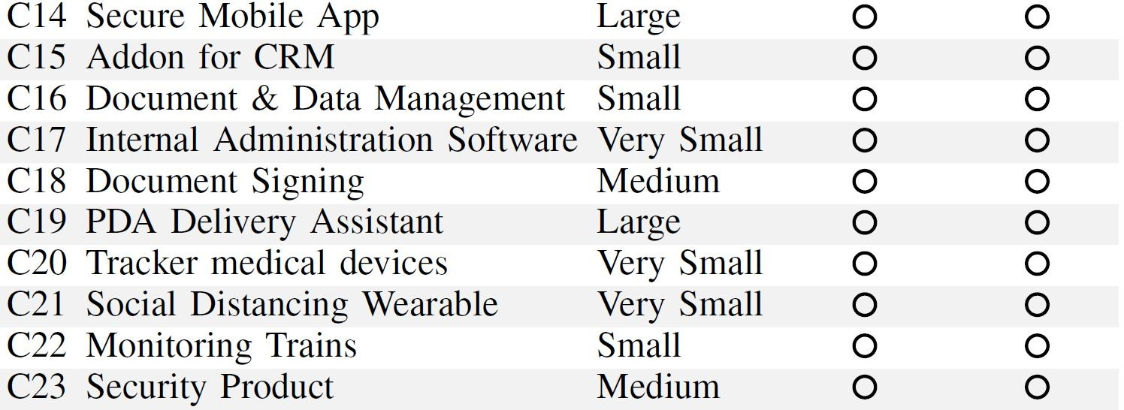
No Usable Security Awareness, few or no User-Centered Measures
Misconceptions & Misunderstandings of usable security
Rare availability of usability or UX experts or less involvement of those
“I don’t think there was a designer involved. [laughs] That’s how it developed over time – like a plant grows [...].” (C18)

Slide 19

No Usable Security Awareness, some User-Centered Measures
Focus on usability – security of lower priority
“Usability-Security” tradeoff
“They were more concerned about usability. Like I said, they even made decisions which sort of decreases security, develop the product just so that it is more usable.” (C6)

Slide 20
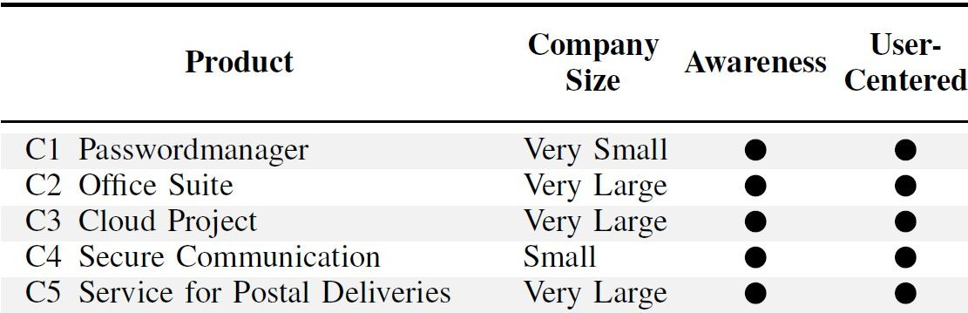
Usable Security Awareness & Follow-through
All had subject-matter experts
Often usable security was part of the business goals
Active user feedback gathering
“Actually, I think that the security issues should be solved as much as possible technically and should not bother the user.
Most of the time, the user is not an expert [...] That is, all the decisions that can be made for him, should be made in advance.”
At least one person actively strengthened the communication about usable security
(C1)

Slide 21
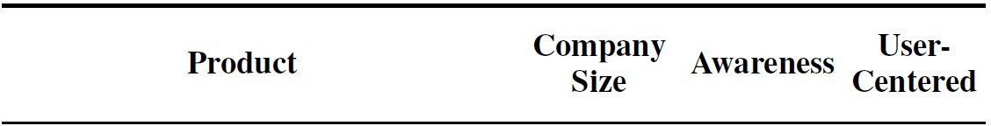
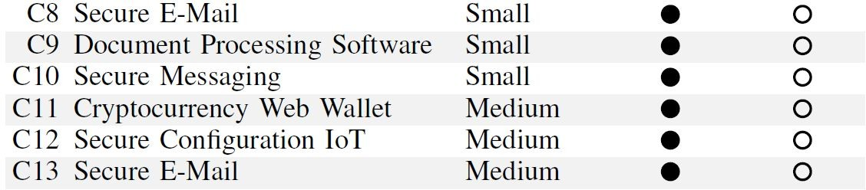
Usable Security Awareness, Little or no Follow-through
Five companies had a strong focus on security and had dedicated security experts
Only one company had a designer actively involved
“No, actually, we had for a very long time an open position for a UI/UX designer... but if you are looking for a UI/UX designer with additional qualification in the security environment… then, yes, you have to make
No specific measures for usability testing or user research
one yourself.” (C13)

Slide 22

Blockers
Limited Resources
- Lack of budget (n=8):
“If the customer doesn’t have enough budget for development, you can’t set up that kind of security. [...] They
have budget for main functionality but not for security or usability.” (P18)
Lack of time (n=10)
“Functionality first” attitude (n=8)

Slide 23
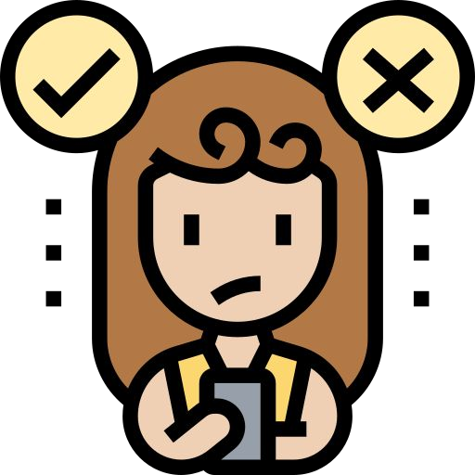
Blockers
- Blaming users:
“[This problem is] not related to usability, mostly it’s related to lack of technology skills. [...] we can’t do anything about [authentication].” (P21)
Limited Resources
Misconceptions
Misunderstanding usable security
Usability is not taken seriously

Slide 24





Blockers
- Communication problems or even no communication at all
“But what you wonder is if the designer was even able to grasp the front-end developer.” (P10)
Limited Resources
Misconceptions
Communication Barriers
Designers & UX Experts
Developers & Security Experts

Slide 25


Enablers
Communication Pivot
- Strong and efficient communication among subject-matter experts (security & UI/UX)
- Not necessarily a “usable security champion”
One team involved designers/UX experts in threat modeling activities

Slide 26

Enablers
- Usability was accepted and demanded by companies or customers
Communication
Pivot
Usability Commitment
- Often it was part of the business goals:
“The main and the most important request from the management was: they need an easy-to-use software or app or interface to compete with other competitors” (P21)

Slide 27

Enablers
Even if awareness is sufficient and access to the end users is available
At least a basic understanding of user-centered methods is needed
Communication
Pivot
Usability
Commitment
Usable Security Knowledge & Awareness
- Processes need to be adapted

Slide 28
Key Takeaways
Several factors impact usable security (e.g., limited resources, different decision makers, organizational commitment towards usability).
Usable security decisions are made by stakeholders in different stages of the SDP.
Usable security is interdisciplinary → need to combine usability, human factors, and security.

Slide 29
Implications for Industry
Create awareness for usable security
Improve communication among experts
Shift usable security left in the SDP
Measure & track usable security
- Use practices from human-computer interaction
“Usable security champions” may be helpful but rare

Slide 30

Implications for Research
Knowledge gap between industry and academia
Holistic view on SDPs needed, considering circumstances
→ “It’s not only about developers”
→ Decisions are made at many stages
Need for lightweight usable security measures

Slide 31
Finally!!
Role of Artificial Intelligence in Secure Software Design

Slide 32
Questions??
zubair.ahmad@giki.edu.pk
Office: G14 FCSE lobby

