Slide 1

Secure Software Design and Development
(CY-321)
Secure Design Processes

Slide 2
Threat Modeling?
Performed to identify security objectives of the software, threats to the software, vulnerabilities in the software being developed
Difference between Threat modeling and Risk Management?
Threat modeling is a subset of risk management that deals specifically with technical security risks in software design

Slide 3
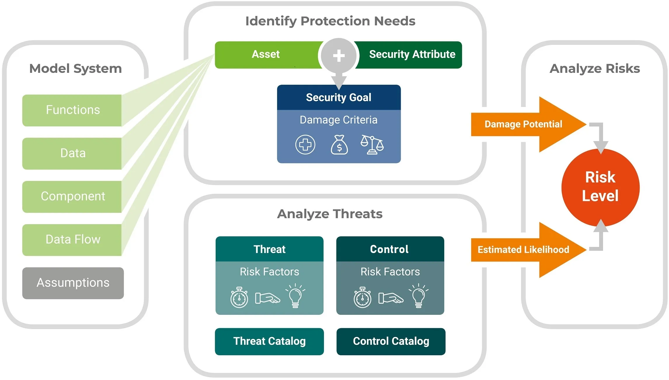

Slide 4
Design Processes
When you are designing software with security in mind, certain security processes need to be established and completed
These processes are to be conducted during the initial stages of the software development project
Attack surface evaluation
Threat modeling
documentation

Slide 5

Attack Surface Evaluation
A software or application’s attack surface is the measure of its exposure of being exploited by a threat agent
Weaknesses in its entry and exit points that a malicious attacker can exploit to his or her advantage

Slide 6
Attack Surface Evaluation
Targets and Enablers are resources that an attacker can leverage to construct an attack against the software.
The two kinds of targets and enablers are processes and data. Browsers, mailers, and servers are examples of process targets and enablers, while files, directories, and registries are examples of data targets and enablers
Channels and Protocols are mechanisms that allow for communication between two parties
Message-passing channels and Shared-memory channels

Slide 7
What Can We Threat Model?
Threat modeling is to be performed selectively, based on the value of the software as an asset to the company
Why?
It is particularly important to threat model legacy software
When there is a need to threat model legacy software, it is recommended to do so when the next version of the legacy software is being designed
We can also threat model interfaces (application programming interfaces, web services, etc.) and third-party components.
Threat modeling third-party software is often a behavioral Testing

Slide 8
“Security Vision” for the software in threat modeling
Document and Validate
Model Application Architecture
Threat Modeling Process
Identify, Prioritize and Implement Controls
Identify Threats

Slide 9
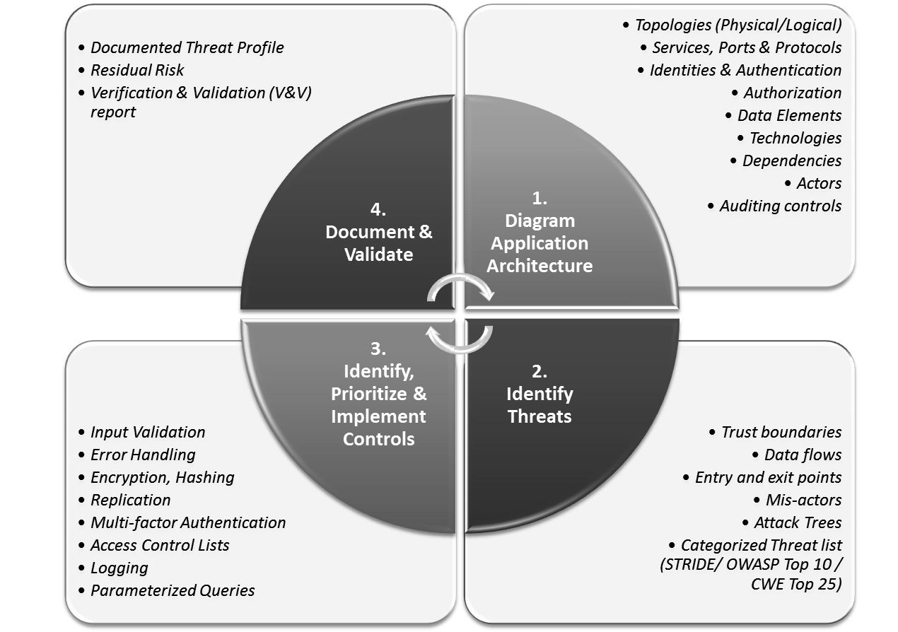
Threat Modeling Process

Slide 10
Threat Modeling Process
Model Application Architecture
Identify the software system, its components, and its interactions
Create Data Flow Diagrams (DFDs) or Architecture Diagrams to visualize data movement and trust boundaries.
Define assets that need protection (e.g., sensitive data, credentials, APIs).

Slide 11
Threat Modeling Process
Model Application Architecture
Identify the Physical Topology
Gives insight into where and how the applications will be deployed
Examples include forms based, certificate based, token based, biometrics, single sign-on, multi-factor,
Identify the Logical Topology

Slide 12
Threat Modeling Process
Model Application Architecture
Identify Human and Non-Human Actors of the System
Examples include customers, sales agents, system administrators, database administrators, etc.
Identify Data Elements
Examples include product information, customer information, etc.

Slide 13
Threat Modeling Process
Model Application Architecture
Generate a Data Access Control Matrix.
The rights and privileges that the actors will have on the identified data elements
Identify the technologies that will be used in building the application.
Identify external dependencies.

Slide 14
Threat Modeling Process
Identify Threats
This step involves thinking like an attacker and listing potential security threats based on the system design.
Identify Trust Boundaries
Identify actions or behavior of the software that is allowed or not allowed

Slide 15
Threat Modeling Process
Identify Threats
Identify Entry Points
Each entry point can be a potential threat source

Slide 16
Threat Modeling Process
Identify Threats
Identify Privileged Functionality
All administrator functions and critical business transactions are identified.
Data flow diagrams (DFDs) and sequence diagrams assist in the understanding of how the application will accept, process, and handle data
Identify Data Flows
Identify Exit Points
Exit points can be the source of information leakage and need to be equally protected

Slide 17
Threat Modeling Process
Identify Threats
This step involves thinking like an attacker and listing potential security threats based on the system design.
Data flow diagrams (DFDs) and sequence diagrams assist in the understanding of how the application will accept, process, and handle data
Identify Data Flows
Identify Privileged Functionality
All administrator functions and critical business transactions are identified.
Introduce Mis-Actors
Both human and non-human mis-actors

Slide 18
Threat Modeling Process
Identify Threats
This step involves thinking like an attacker and listing potential security threats based on the system design.
Determine Potential and Applicable Threats
To identify relevant threats that can compromise the assets

Slide 19
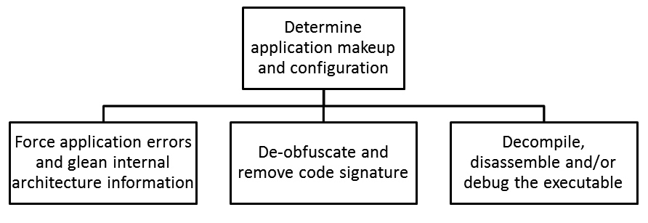
Threat Modeling Process
Breakdown of the Attack Tree

Slide 20
Threat Modeling Process
Breakdown of the Attack Tree
Root Node (Main Attack Goal)
"Determine application makeup and configuration"
The primary objective of the attacker, which means they aim to gather information about how the application is built, its internal structure, and its security mechanisms

Slide 21
Threat Modeling Process
Breakdown of the Attack Tree
Child Nodes (Attack Techniques)
Force application errors and glean internal architecture information
The attacker deliberately triggers errors in the application (e.g., malformed inputs, or unexpected requests).
Errors and debugging messages may reveal sensitive architecture details, API endpoints, database structures, or dependencies

Slide 22
Threat Modeling Process
Breakdown of the Attack Tree
Child Nodes (Attack Techniques)
De-obfuscate and remove code signature
If the application uses obfuscation to hide its logic, the attacker attempts to reverse-engineer it.

Slide 23
Threat Modeling Process
Breakdown of the Attack Tree
Child Nodes (Attack Techniques)
Decompile, disassemble, and/or debug the executable
Attackers use decompilers, disassemblers, and debuggers to extract source code or assembly instructions.
This allows them to understand how the application works, find vulnerabilities, and create exploits.

Slide 24
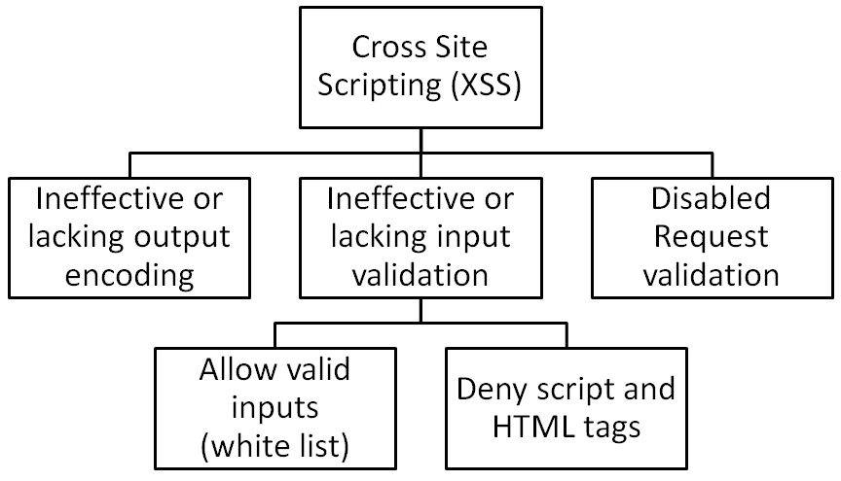
Threat Modeling Process
Breakdown of the Attack Tree (Example)

Slide 25
Threat Modeling Process
Breakdown of the Attack Tree (Example)

Slide 26
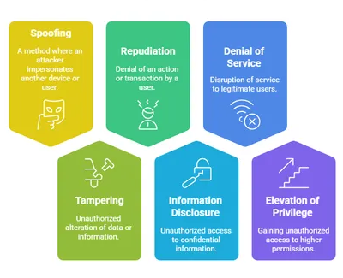
Threat Modeling Process
STRIDE
A threat modeling methodology that is performed in the design phase of software development in which threats are grouped and categorized

Slide 27
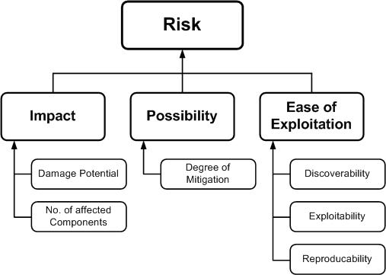
Threat Modeling Process
DREAD
Rating methodology that is often used in conjunction with STRIDE
Damage potential – What will be the impact upon exploitability?
Reproducibility – What is the ease of recreating the attack/exploit?
Exploitability – What minimum skill level is necessary to launch the attack/exploit?
Affected users – How many users will be potentially impacted upon a successful attack/exploit?
Discoverability – What is the ease of finding the vulnerability that yields the threat?

Slide 28
Threat Modeling Process
Document and Validate
The importance of documenting the threat model cannot be underestimated
Why?
because threat modeling is iterative and, through the life cycle of the project

Slide 29
Questions??
zubair.ahmad@giki.edu.pk
Office: G14 FCSE lobby

