Slide 1
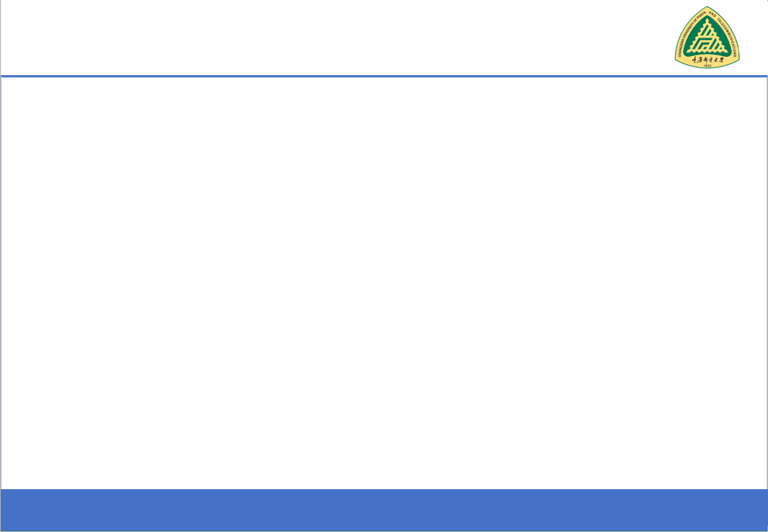
Secure Software Design and Development
(CY-321)
Software Vulnerabilities

Slide 2
Why Software Vulnerabilities Matter?
When a process reads input from attacker, the process may be exploited if it contains vulnerabilities.
When an attacker successfully exploits a vulnerability, he can
Crash programs: Compromises availability
Execute arbitrary code: Compromises integrity
Obtain sensitive information: Compromises confidentiality
Software vulnerability enables the attacker to run with privileges of other users, violating desired access control policy

Slide 3
Attacks Exploiting Software Vulnerabilities
Drive-by download (drive-by installation)
malicious web contents exploit vulnerabilities in browsers (or plugins) to download/install malware on victim system.
Email attachments in PDF, Word, etc.
Network-facing daemon programs (such as http, ftp, mail servers, etc.) as entry points.
Privilege escalation
Attacker on a system exploits vulnerability in a root process and gains root privilege

Slide 4
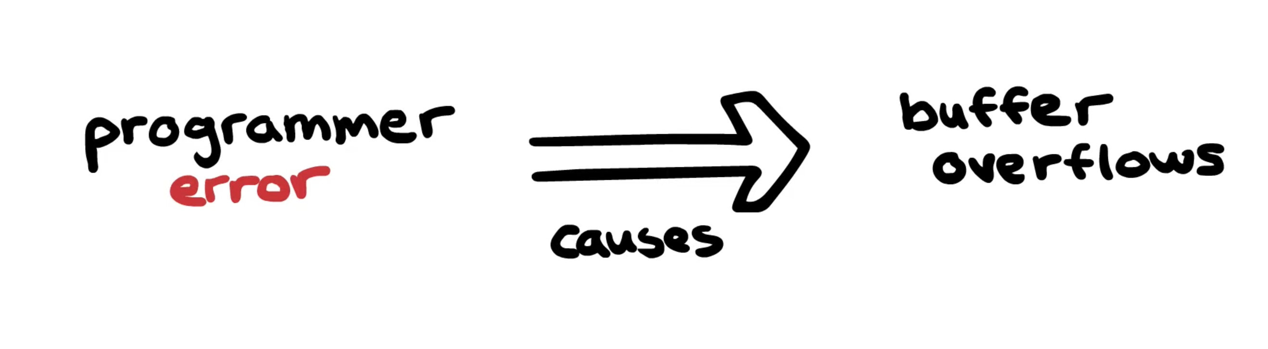
Buffer Overflow

Slide 5
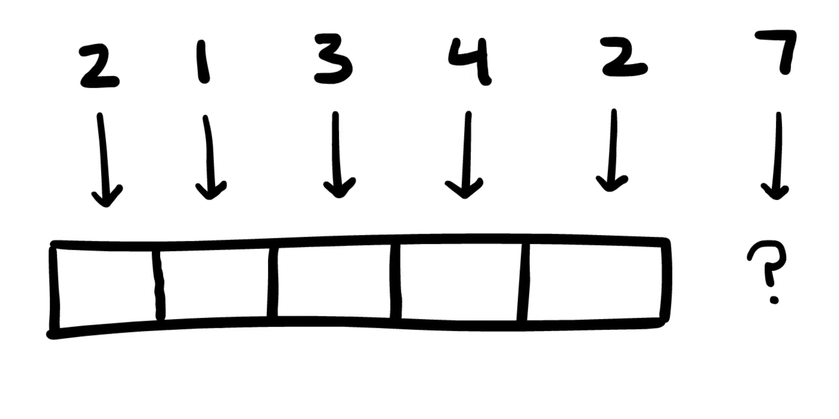
Buffer Overflow
Buffers are most often used during I/O (reading or writing).

Slide 6
Linux process memory layout
0xC0000000
User Stack
Shared libraries
0x40000000
Run time heap
0x08048000
Unused
0

Slide 7
Stack Frame
Parameters
Return address
Stack Frame Pointer
Local variables
Stack
Growth

Slide 8
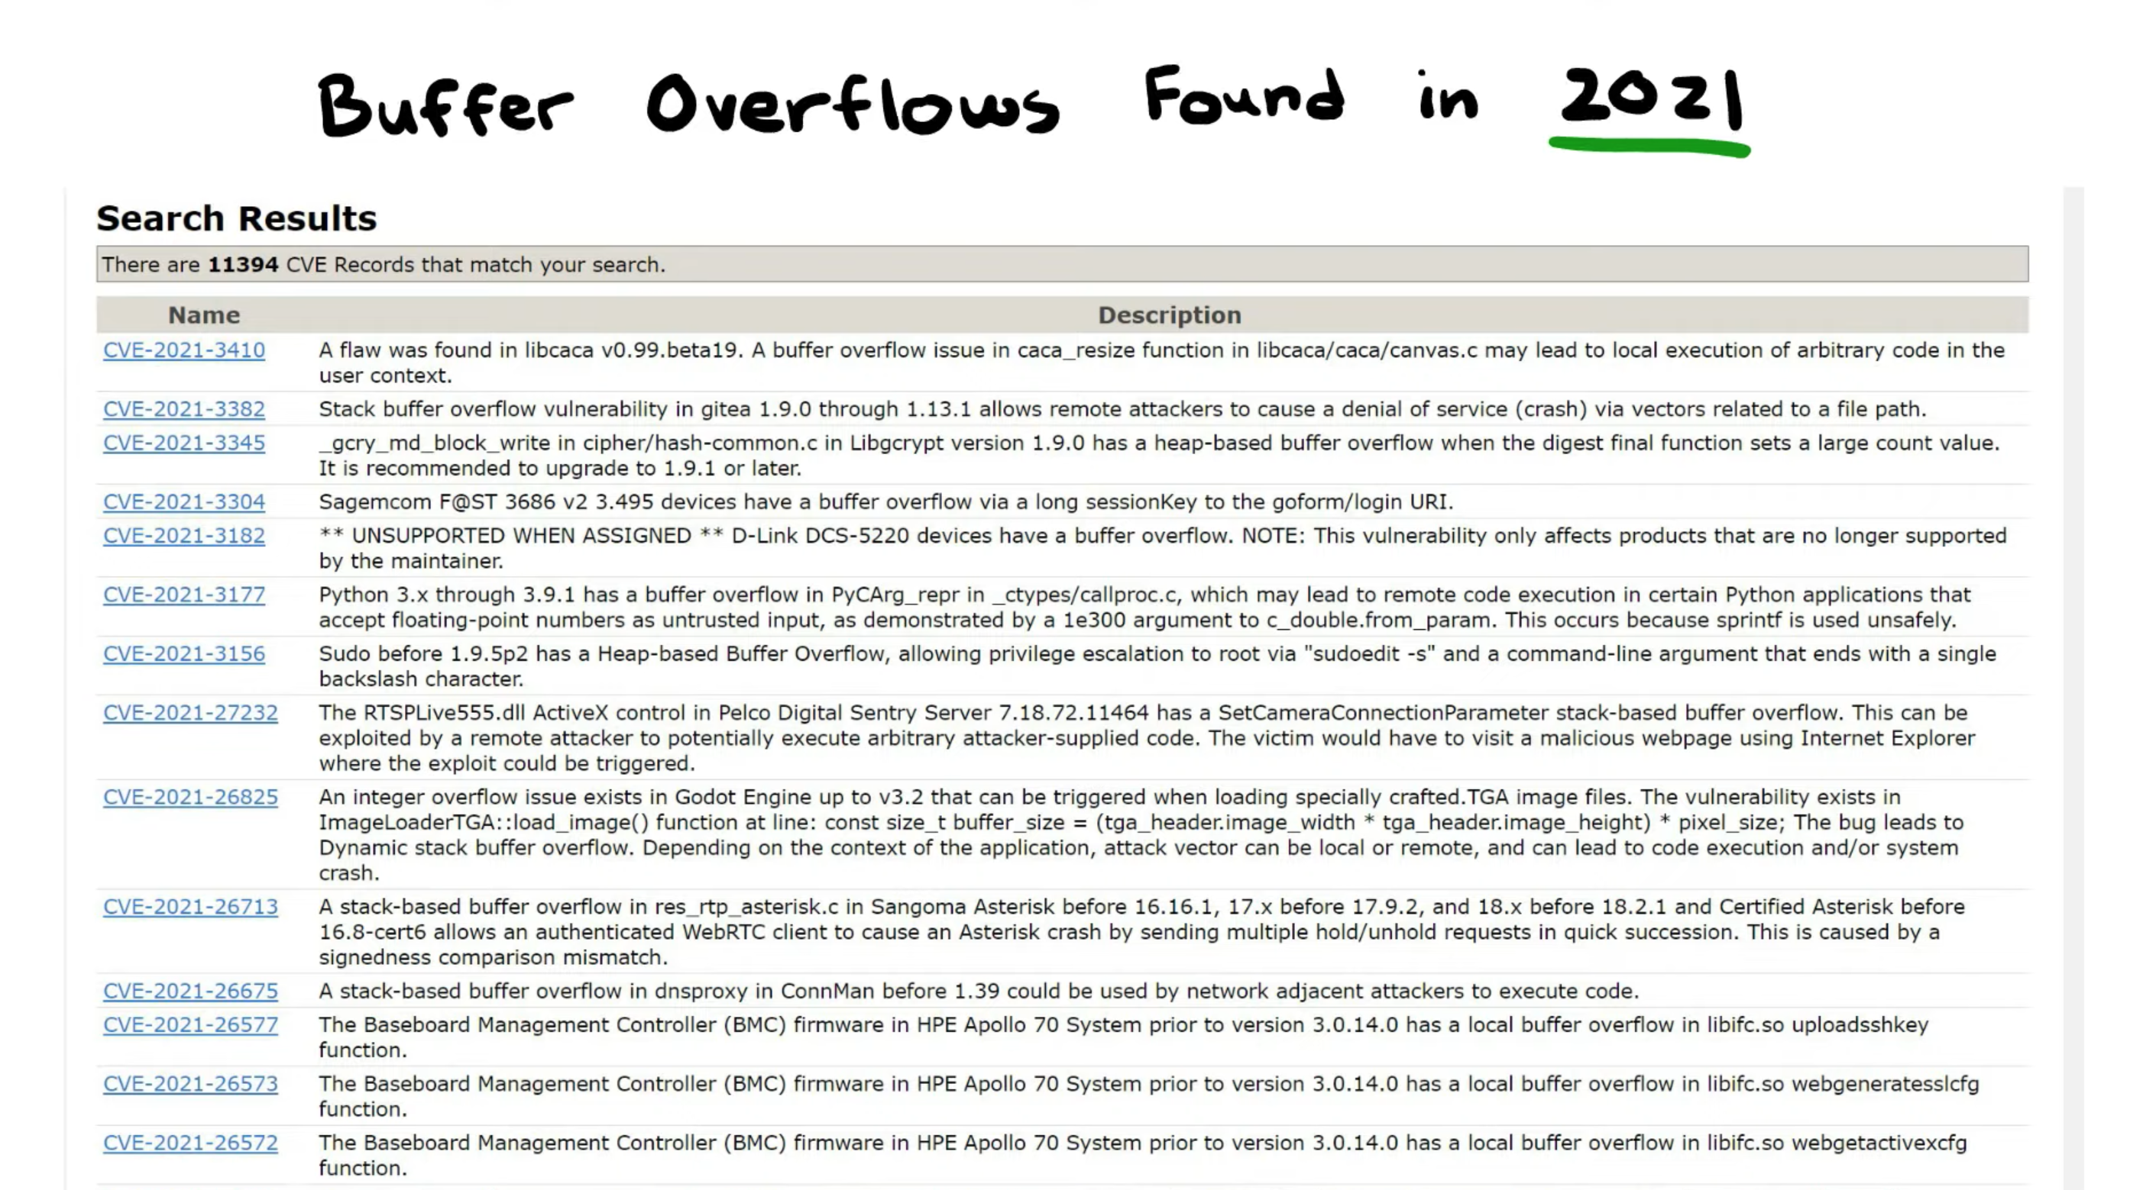
Buffer Overflow

Slide 9
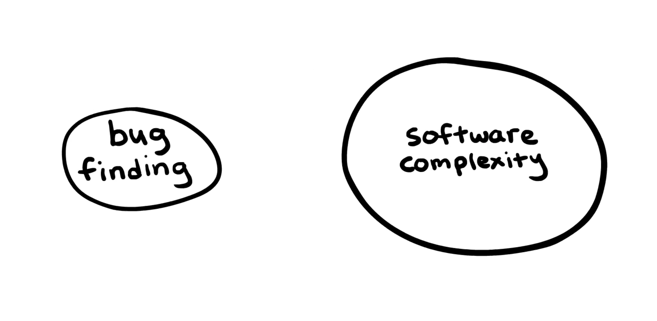
Buffer Overflow

Slide 10
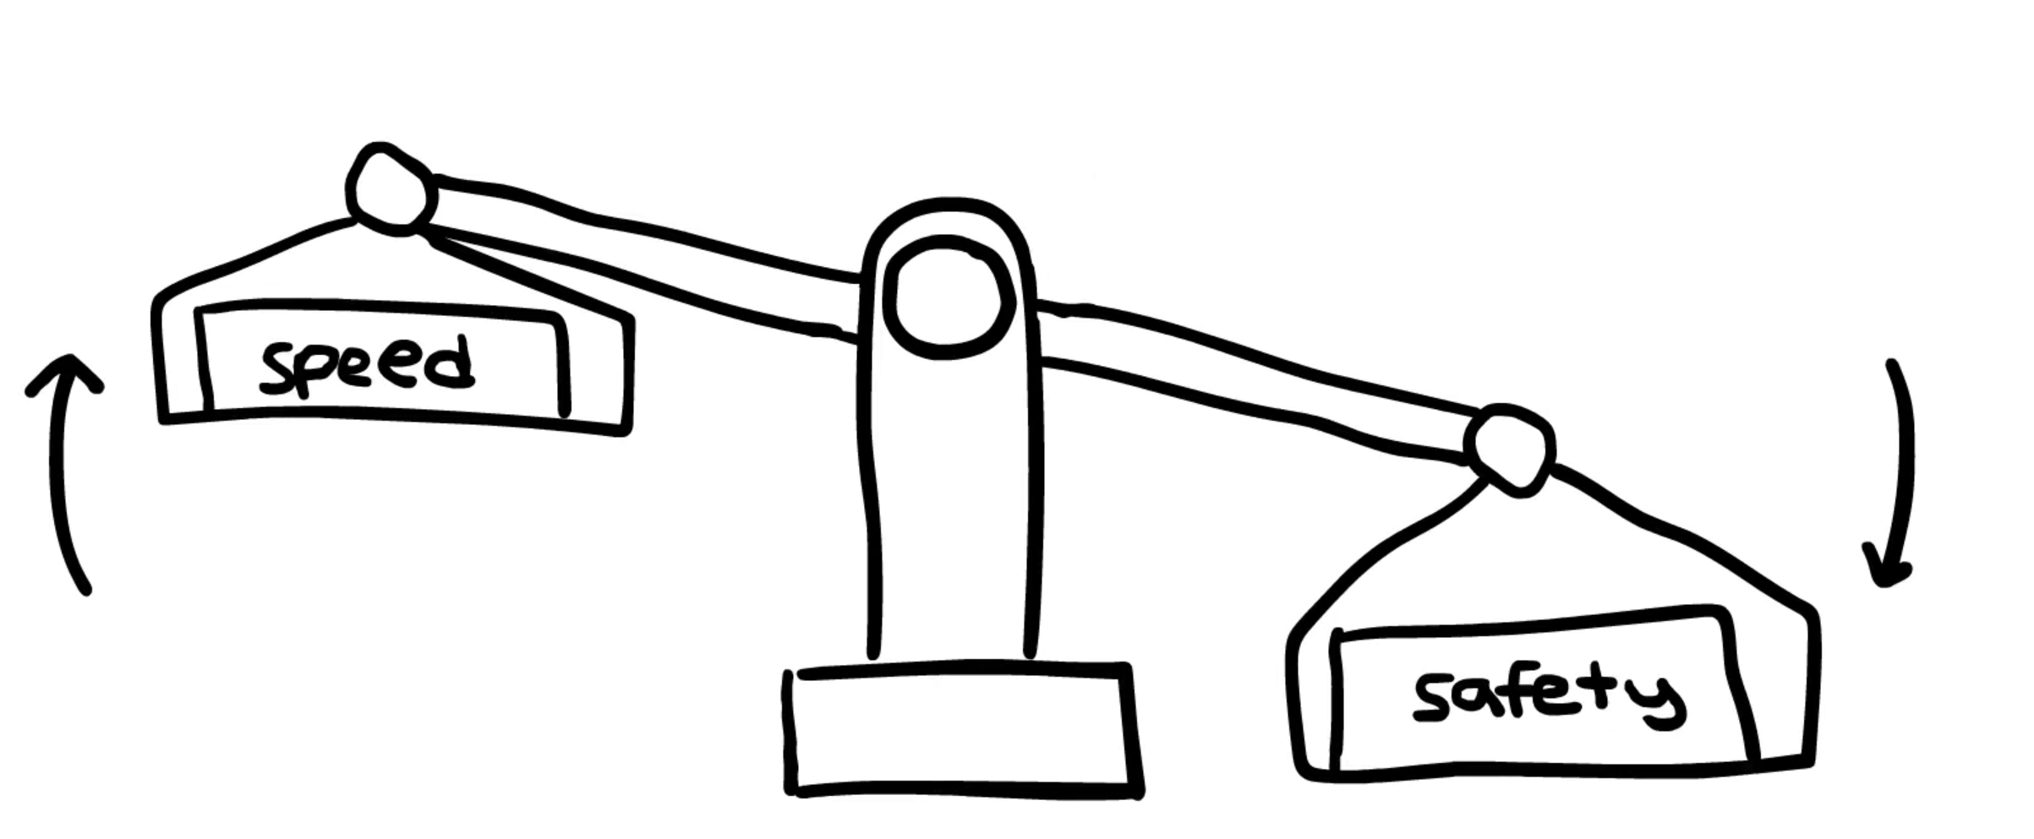
Buffer Overflow

Slide 11
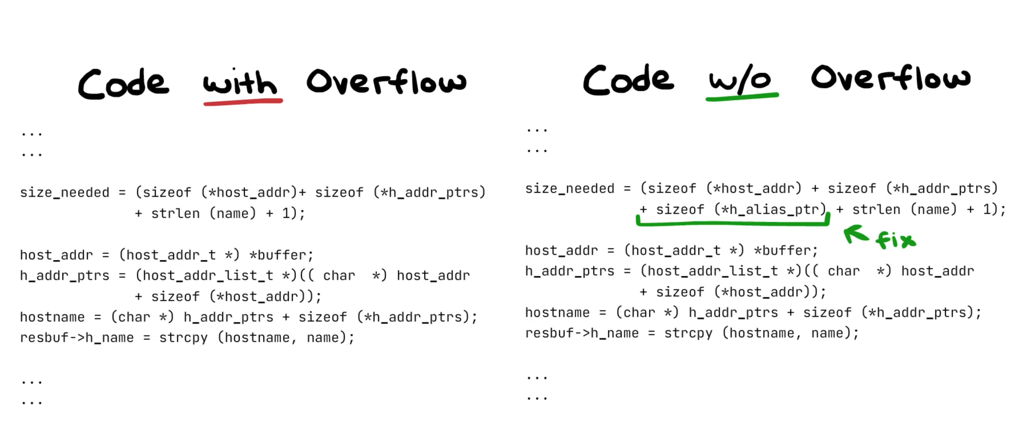
Buffer Overflow

Slide 12
Buffer Overflow

Slide 13
Why Buffer Overflow happens?
Copying of data into the buffer without checking the size of input
#include <string.h>
void copy me(const char *s) {
char copy[1024];
strcpy(copy, s);
}

Slide 14
Why Buffer Overflow happens?
Copying of data into the buffer without checking the size of input
#include <string.h>
void copy me(const char *s) {
char copy[1024];
strcpy(copy, s);
}

Slide 15
Why Buffer Overflow happens?
void secret() {
printf("Control Hijacked! We are inside secret()! ");
}
void vulnerable() {
char buffer[32];
printf("Enter input: ");
gets(buffer);
}
int main() {
vulnerable();
printf("Returned safely to main");
return 0;
}

Slide 16
Why Buffer Overflow happens?
void secret() {
printf("\n Control Hijacked! We are inside secret()!\n\n");
}
void vulnerable() {
char buffer[32];
printf("Enter input: ");
gets(buffer);
}
int main() {
vulnerable();
printf("Returned safely to main.\n");
return 0;
}

Slide 17
Why Buffer Overflow happens?
void secret() {
printf("\n Control Hijacked! We are inside secret()!\n\n");
}
void vulnerable() {
char buffer[32];
printf("Enter input: ");
gets(buffer);
}
int main() {
vulnerable();
printf("Returned safely to main.\n");
return 0;
}

Slide 18
Why Buffer Overflow happens?
void secret() {
printf("\n Control Hijacked! We are inside secret()!\n\n");
}
void vulnerable() {
char buffer[32];
printf("Enter input: ");
gets(buffer);
}
int main() {
vulnerable();
printf("Returned safely to main.\n");
return 0;
}

Slide 19
Why Buffer Overflow happens?
void secret() {
printf("\n Control Hijacked! We are inside secret()!\n\n");
}
void vulnerable() {
char buffer[32];
printf("Enter input: ");
gets(buffer);
}
int main() {
vulnerable();
printf("Returned safely to main.\n");
return 0;
}

Slide 20
Why Buffer Overflow happens?
void secret() {
printf("\n Control Hijacked! We are inside secret()!\n\n");
}
void vulnerable() {
char buffer[32];
printf("Enter input: ");
gets(buffer);
}
int main() {
vulnerable();
printf("Returned safely to main.\n");
return 0;
}

Slide 21
Why Buffer Overflow happens?
void secret() {
printf("\n Control Hijacked! We are inside secret()!\n\n");
}
void vulnerable() {
char buffer[32];
printf("Enter input: ");
gets(buffer);
}
int main() {
vulnerable();
printf("Returned safely to main.\n");
return 0;
}

Slide 22
Why Buffer Overflow happens?
Copying of data into the buffer without checking the size of input
#include <stdio.h>
#define BUFFER_SIZE 1024
void fill_buffer(char *buf, FILE *fp) {
fread(buf, 1, BUFFER SIZE, fp);
if (!ferror(fp))
buf[BUFFER SIZE] = ’\0’; /* Must null-terminate string */
}
10
void f() {
char buf[BUFFER SIZE];
fill buffer(buf, stdin);
}

Slide 23
Why Buffer Overflow happens?
Accessing the buffer with incorrect length values
#include <stdio.h>
#include <string.h>
void unsafe_copy() {
char buffer[10];
printf("Enter a string: ");
gets(buffer);
printf("You entered: %s\n", buffer);
}
int main() {
unsafe_copy();
return 0;
}

Slide 24
Why Buffer Overflow happens?
Improper validation of array (simplest expression of a buffer) index
#include <stdio.h>
void unsafe_access() {
int arr[5] = {1, 2, 3, 4, 5};
int index;
printf("Enter an index (0-4): ");
scanf("%d", &index);
printf("Array element at index %d: %d\n", index, arr[index]);
}
int main() {
unsafe_access();
return 0;
}

Slide 25
Why Buffer Overflow happens?
Incorrect calculation of buffer size before its allocation
#include <stdio.h>
#include <string.h>
void unsafe_allocation() {
char input[10];
printf("Enter a string: ");
fgets(input, 50, stdin);
printf("You entered: %s\n", input);
}
int main() {
unsafe_allocation();
return 0;
}

Slide 26
Why Buffer Overflow happens?
Integer overflows or wraparounds
#include <stdio.h>
int main() {
unsigned char x = 255;
printf("Initial value of x: %u\n", x);
// Adding 1 will cause an overflow
x = x + 1;
printf("Value of x after overflow: %u\n", x); return 0;
}

Slide 27
So Whats The Deal?
First, note that there is data as well as control flow information on the stack
If there is an automatic variable there that we can overflow, maybe we can overwrite the return address
If we can overwrite the return address, we can (usually) make the program execute code anywhere in the process address space
And if the variable we have overflowed is a buffer, why not fill the buffer with our code to execute?
This is what is meant “allows execution of arbitrary code”

Slide 28
Your Media Player application has a buffer overflow that is activated whenever an MP3 IDv3 tag is longer than anticipated

Slide 29
Making an Exploit
#include <stdio.h>
#include <string.h>
void vulnerableFunction(char *input) {
char buffer[16];
strcpy(buffer, input);
printf("Received: %s\n", buffer);
}
int main(int argc, char *argv[]) {
if (argc > 1) {
vulnerableFunction(argv[1]);
} else {
printf("Usage: %s <input>\n", argv[0]);
}
return 0;
}

Slide 30
Explanation of the Vulnerability
#include <stdio.h>
#include <string.h>
void vulnerableFunction(char *input) {
char buffer[16];
strcpy(buffer, input);
printf("Received: %s\n", buffer);
}
int main(int argc, char *argv[]) {
if (argc > 1) {
vulnerableFunction(argv[1]);
} else {
printf("Usage: %s <input>\n", argv[0]);
}
return 0;
}
The function vulnerableFunction defines a local buffer char buffer[16]; that can hold up to 16 characters.
The function uses strcpy to copy the contents of the input (provided by the user via argv[1]) into the buffer. However, strcpy does not check the length of the input, so if the input is larger than 16 characters, it will overflow the buffer and overwrite adjacent memory on the stack.

Slide 31
Potential Exploitation
#include <stdio.h>
#include <string.h>
void vulnerableFunction(char *input) {
char buffer[16];
strcpy(buffer, input);
printf("Received: %s\n", buffer);
}
int main(int argc, char *argv[]) {
if (argc > 1) {
vulnerableFunction(argv[1]);
} else {
printf("Usage: %s <input>\n", argv[0]);
}
return 0;
}
When more than 16 characters are passed to the program as an argument, the strcpy function will copy the excess characters into memory locations beyond the buffer. This can overwrite the return address or other critical data on the stack, potentially allowing the attacker to:
Execute arbitrary code (e.g., shellcode placed by the attacker).
Redirect the program's execution flow to malicious code (e.g., jumping to the attacker's payload).

Slide 32
Exploitation Example
#include <stdio.h>
#include <string.h>
void vulnerableFunction(char *input) {
char buffer[16];
strcpy(buffer, input);
printf("Received: %s\n", buffer);
}
int main(int argc, char *argv[]) {
if (argc > 1) {
vulnerableFunction(argv[1]);
} else {
printf("Usage: %s <input>\n", argv[0]);
}
return 0;
}
./vulnerable_program AAAAAAAAAAAAAAAAAAAA
Here, the input string has 18 A characters, which exceeds the size of buffer (16 characters)

Slide 33
Common Exploit Methods
#include <stdio.h>
#include <string.h>
void vulnerableFunction(char *input) {
char buffer[16];
strcpy(buffer, input);
printf("Received: %s\n", buffer);
}
int main(int argc, char *argv[]) {
if (argc > 1) {
vulnerableFunction(argv[1]);
} else {
printf("Usage: %s <input>\n", argv[0]);
}
return 0;
}
Stack Smashing: By overflowing the buffer and overwriting the return address, the attacker can cause the program to jump to a location where they have injected malicious code (such as shellcode).
Return-to-libc Attacks: In the absence of executable stack protections (like DEP - Data Execution Prevention), an attacker might use a return-to-libc attack. Instead of injecting shellcode, they may overwrite the return address with the address of a function like system() in the C standard library to execute arbitrary commands

Slide 34
Can it be a coincidence that Buffer Overflow and Body Odor have the same acronym? After all, they are very much alike: it happend, but nobody wants it.

Slide 35
Dynamic Checking
Compiler Support
Static Checking
Means to Avoid BO
Library Support
Operating System Support

Slide 36
Compiler Support
Products like MemGuard protect the return address on the stack by writing certain random values (canaries) on the stack in front of the return address and checking whether these values have changed just before returning.
Large performance impact
An attacker that can guess a canary value can attack the system
Doesnt help against buffer overflows that dont overwrite the return address

Slide 37
Operating System Support
Memory on the stack can be marked as non-executable by the Memory Management Unit (MMU), under control by the operating system.
When the processor fetches an instruction from a memory location that is not OK for execution, it raises a trap. The instruction is not executed
Helps, but not totally: The attacker can perhaps not execute arbitrary code that he wrote, but he can still execute arbitrary code that is already in the application, because he can still jump to any location in the code.

Slide 38
Library Support
One weakness of C is that strings carry no intrinsic length.
Therefore, operations like memcpy or strcpy can write beyond the end of the string.
That cant be changed, but libraries can find the extent of the stack frame the variable is in and refuse to copy more bytes than are in the stack frame.
Pros: works for a large class of stack smashing attacks.
Cons: buffer overflows happen not only through library functions (though most do); performance impact; removes the symptoms, not the illness.

Slide 39
Static Code Analysis (aka Grepping)
Some tools look at the source code to decide whether it is vulnerable.
A tool decomposes the source text into tokens and looks for patterns
Another tool computes slices to check dependencies between variables in a program
Still another tool makes symbolic bounds analyses for array and pointer accesses.
The general problem is uncomputable. Some partial success is possible for simple cases.

Slide 40
Dynamic Methods
Work by checking every array and pointer access at run time
Since C has such an unwieldy array model, this has a huge performance impact
Also, the program cannot meaningfully continue to run after a buffer pverflow has been detected ⇒ can be used only in development, not in production
Can only be used to find overflows as they occur (actual faults) as opposed to overflows that could occur (potential faults).

Slide 41
How to Write BO-Free Code
In practice, its hard to avoid them if they are at all possible
Its not enough simply to avoid certain functions (although that helps).
Its also not enough to make your source code open for peer review because most people simply dont do peer review:
• A buffer overflow was present for almost a decade in wu-ftpd, an FTP server program before it was finally noticed and removed.
. • Buffer overflows continue to be found in sendmail. Therefore:

Slide 42
Some Hard-And-Fast Rules
• Dont use C
• If you use C++, use smart buffers that do their own range checking
• Always include range checking code
• Never disable range checking code “for performance reasons”
• Use languages with managed memory like Java, Perl, Python
• Design your program so that it is secure from the start

Slide 43
Questions??
zubair.ahmad@giki.edu.pk
Office: G14 FCSE lobby

