Slide 1
Aazif
Ibraheem Mohsen
Ahmed Baaqeel
Ibraheem-Mohsen.okoul.com
Ahmad-Baaqeel.okoul.com
Ali Alsaihati
Fahd Al Sairafi
ali-swe.okoul.com
FD00.okoul.com
Ziad Al Reheily
zalreheily.okoul.com

Slide 2
Problem Description
Many clubs
No Centralized place
Hard to Manage
Hard to Find Events
Time consuming
Conflict of Events
Cluttered student email

Slide 3
Proposed Solution
Website Centralizing All Events
Quick Registration
Easy to Manage

Slide 4
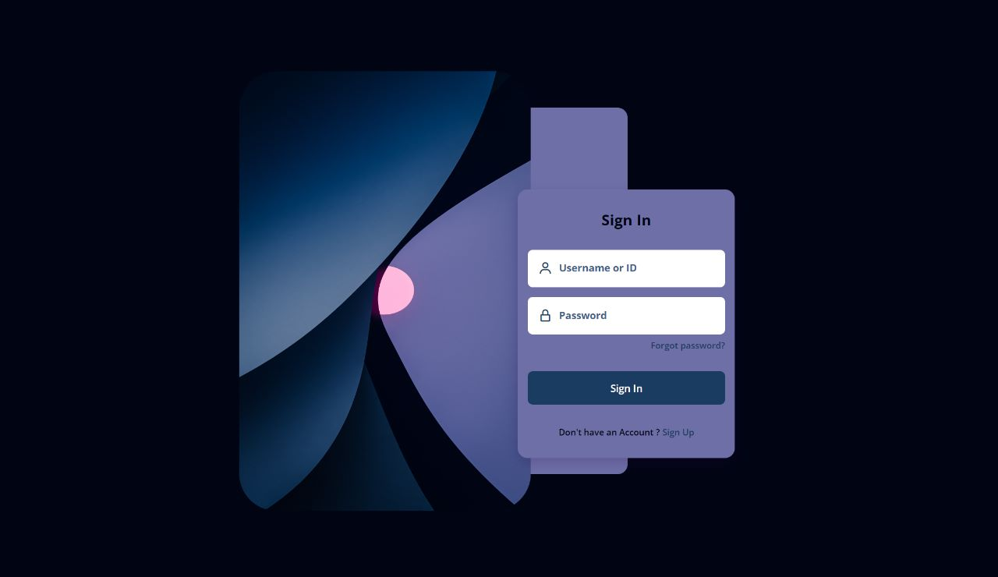

Slide 5
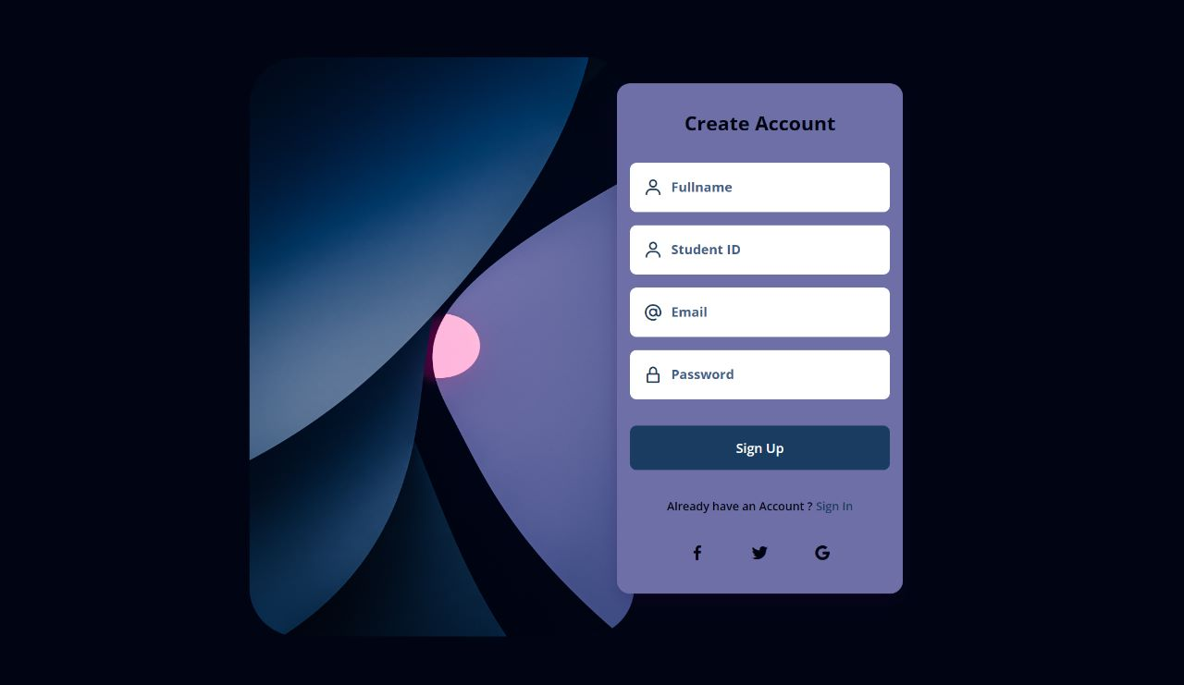

Slide 6
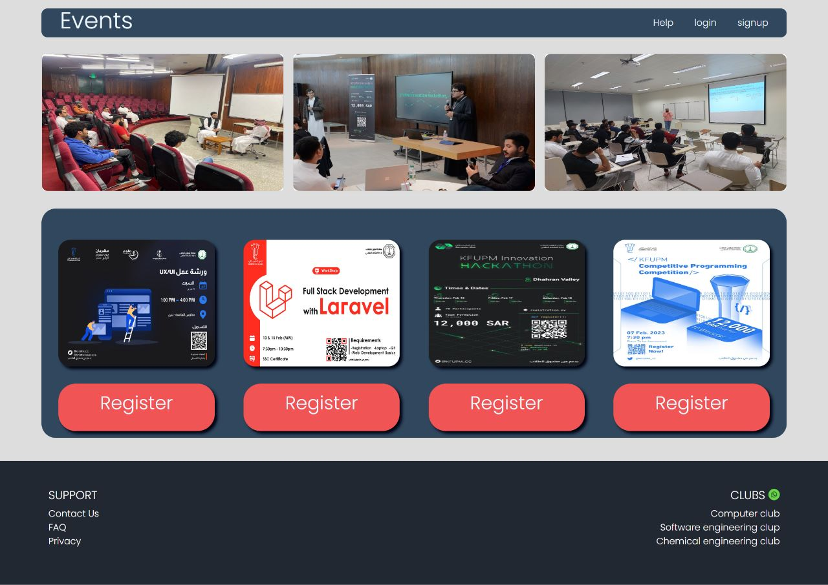

Slide 7
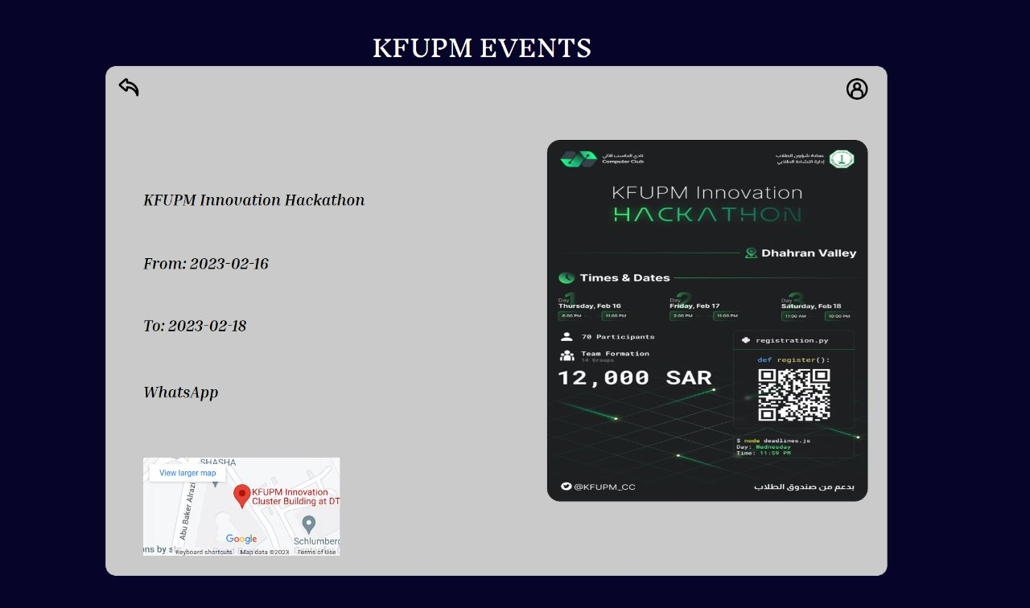

Slide 8
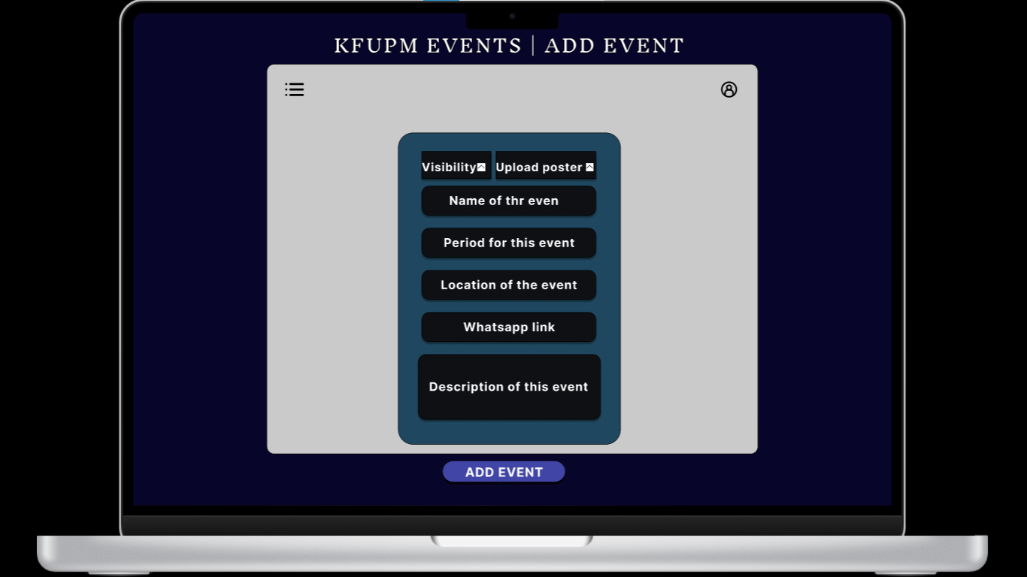

Slide 9
FUTURE
Time Selection Assistant
Notification
Data Analysis

Slide 10
THANKS!
Does anyone have any questions?
https://github.com/ZAlreheily/aazif-backend

