Slide 1
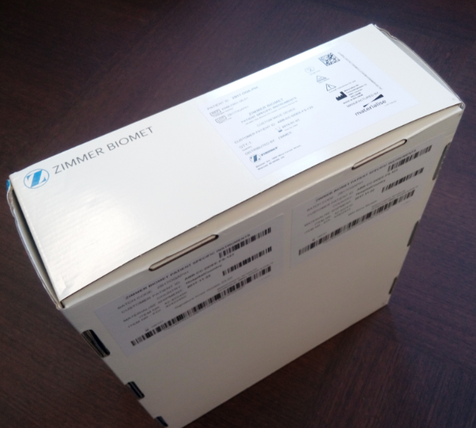
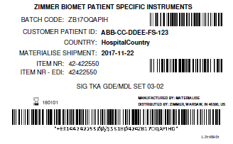
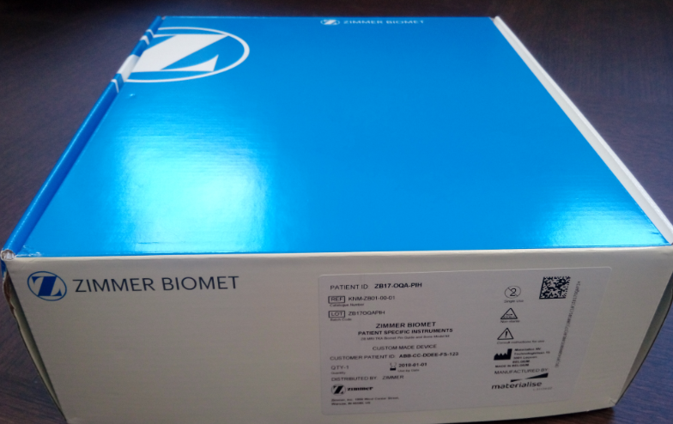
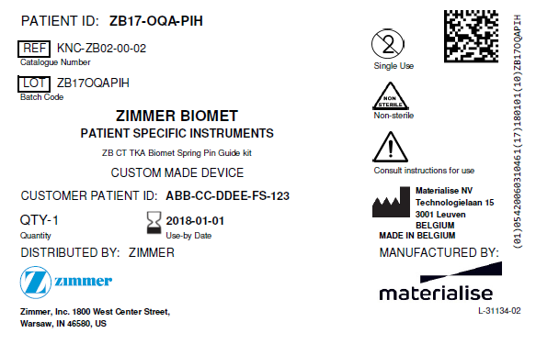
New Box & Same ZB Part #s
Zimmer Biomet inventory label at the bottom of the package
SCAN:
Top two barcodes for Signature products
Bottom barcode for PSI products
SAME legacy part #’s for PSI and Signature
Bar code
Part #, lot #, patient ID…
Materialise regulatory label on the front of the package

