Slide 1
Simple Multiplication App

Slide 2
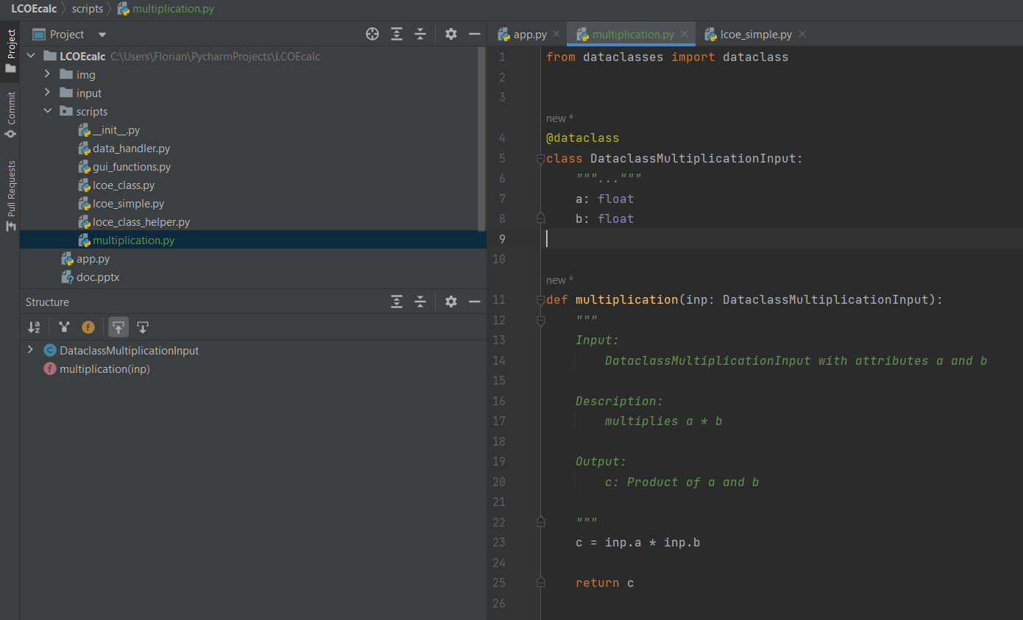
1. Create / Adjust Programm
Requirements
Input: dataclass

Slide 3
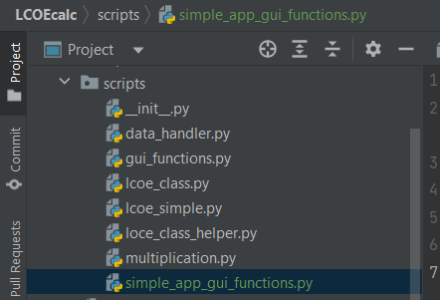
2. Style GUI
GUI Functions
Create adjusted gui functions
Here:

Slide 4
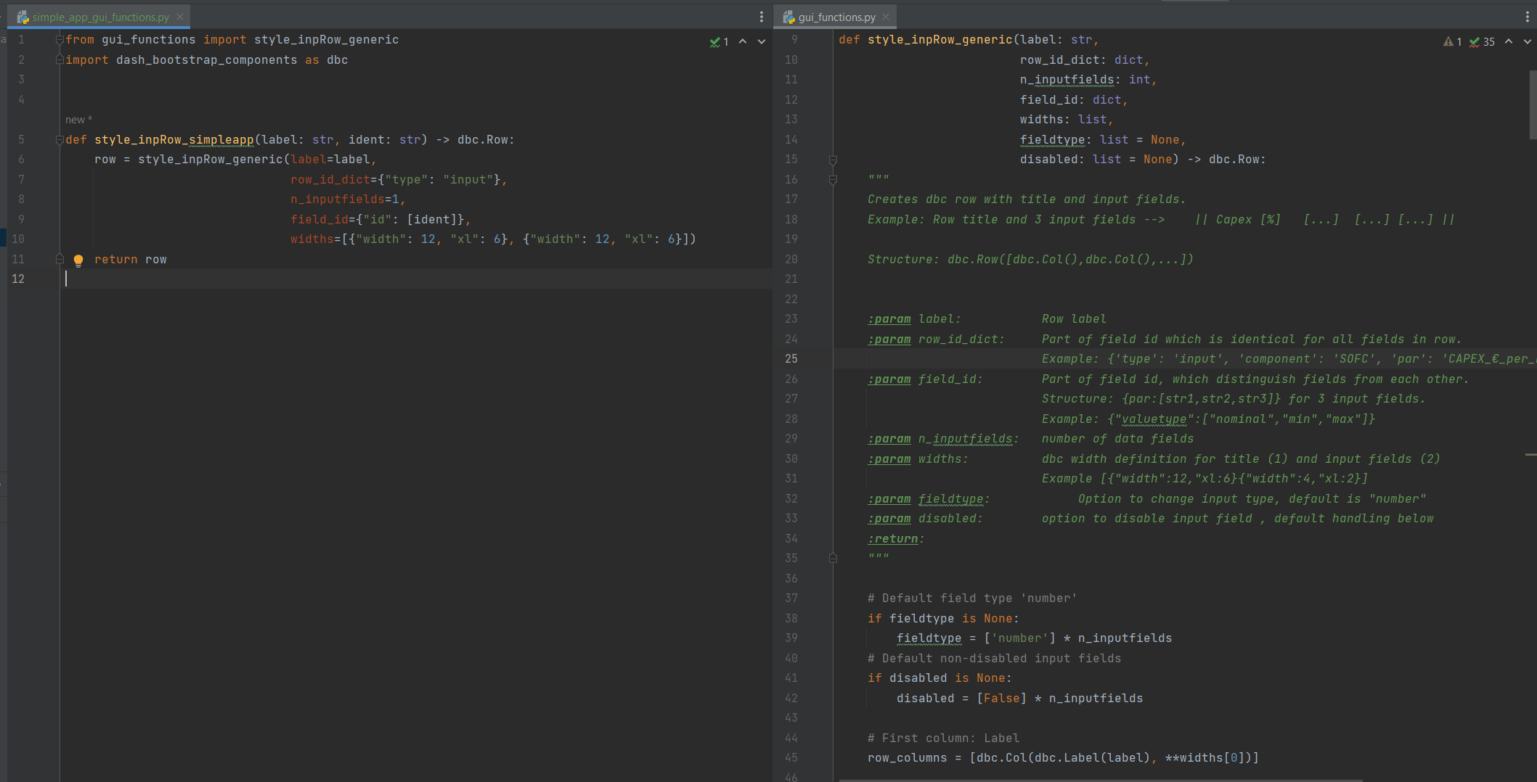

Slide 5
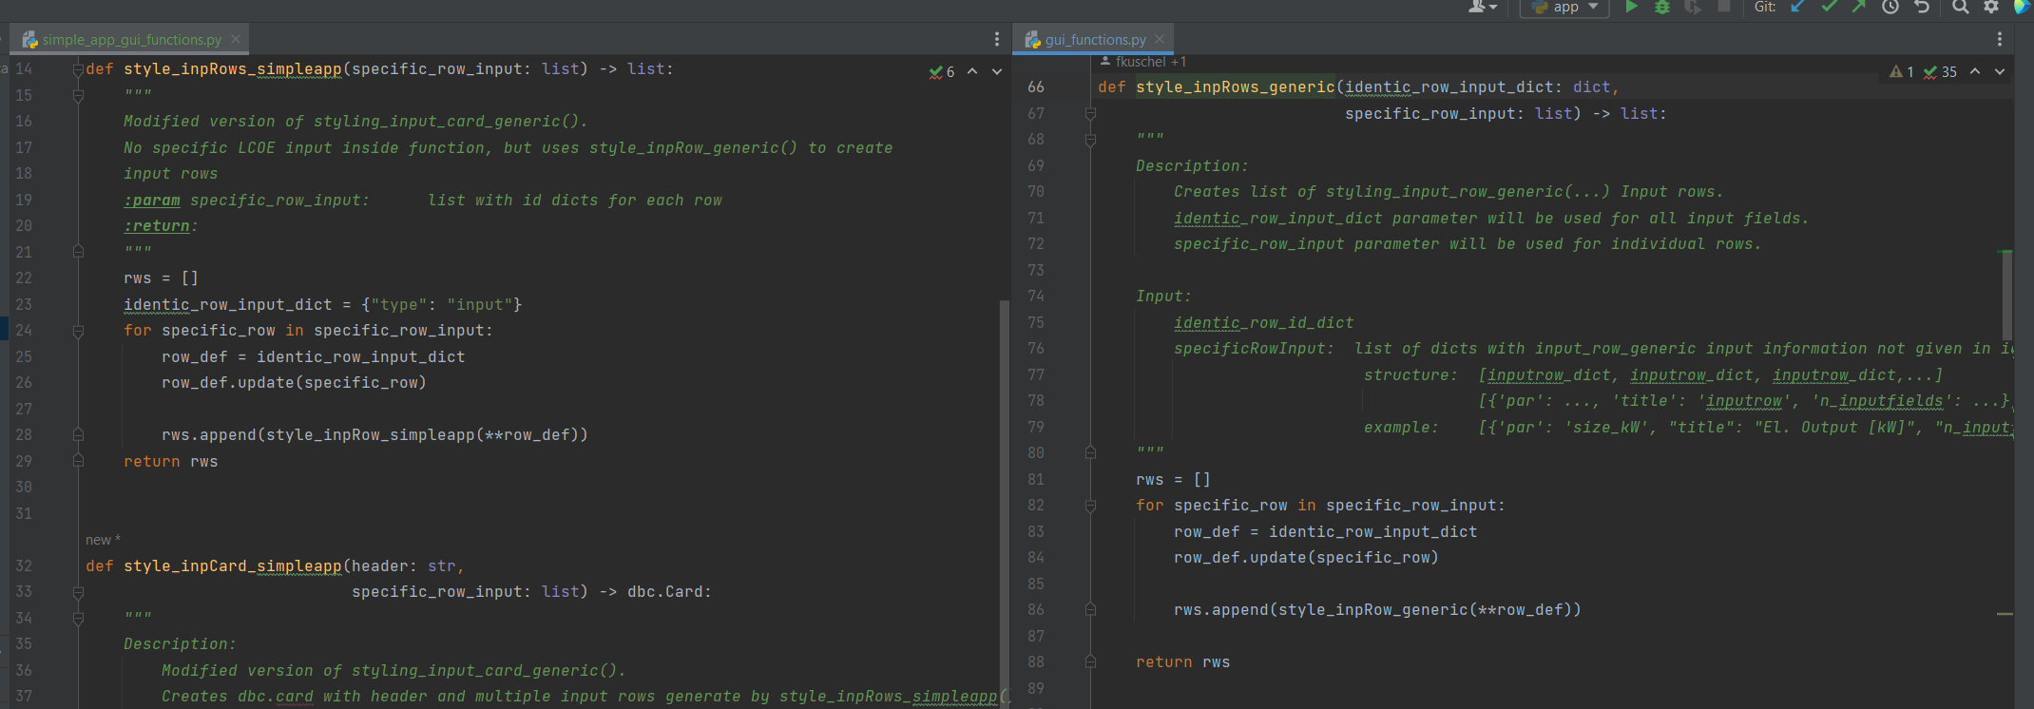

Slide 6
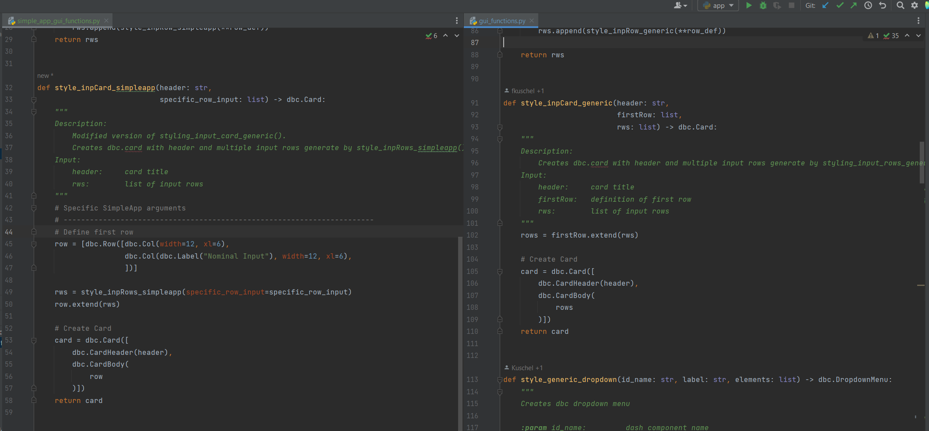

Slide 7
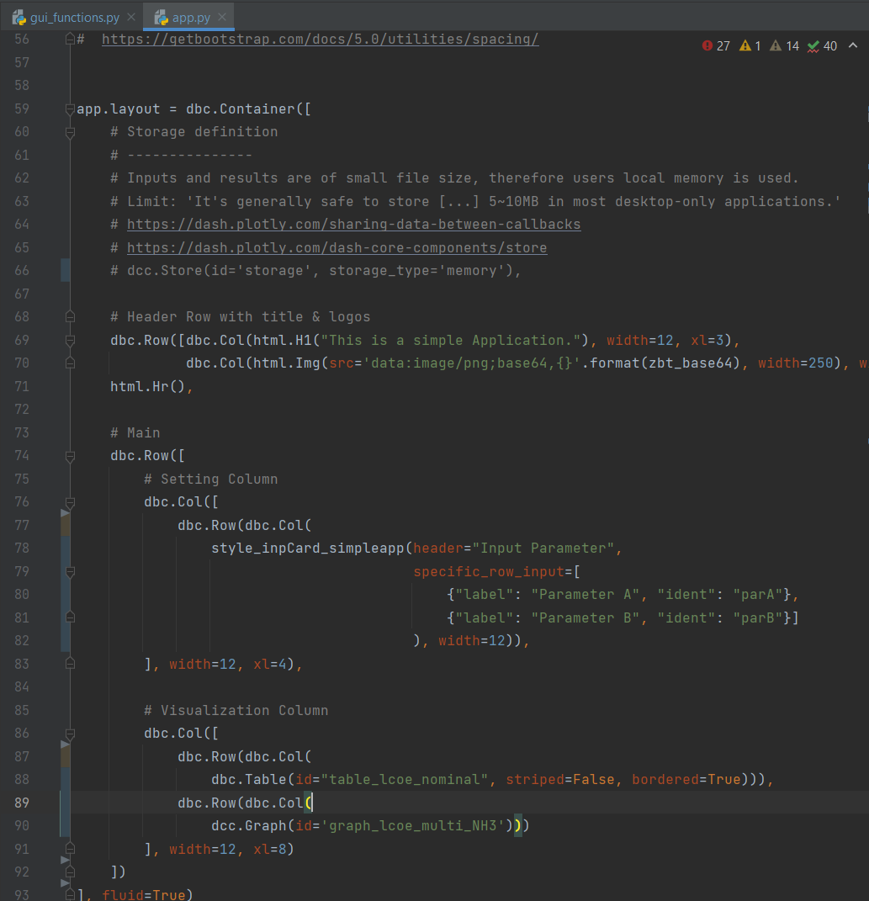
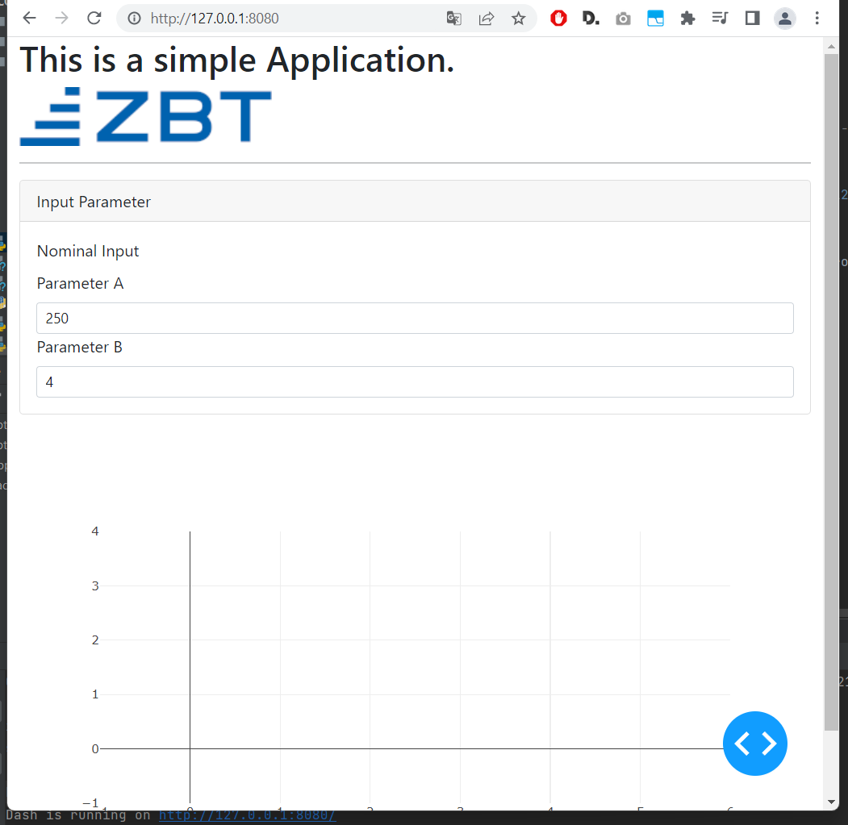
Define App Layout using gui finctions

Slide 8
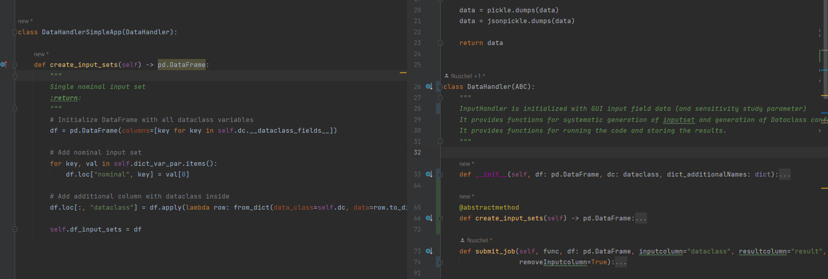
Create own DataHandler Class

Slide 9
Create Callbacks with GUI Tools and DataHandler Class

