Slide 1
Black Box Modelling for Web application
From basics to working simulation
Florian Dennewitz
Fuel Cell Conference
Chemnitz, 12-13th November, 2024

Slide 2
Overview
Introduction
Modeling Methods
Modeling Approach
Basics
Components
Web Based Simulation
Results
Conclusion / Further Development

Slide 3



Introduction
High Operating Costs
Many simulation software solutions come with substantial licensing fees and maintenance costs, impacting budgets.
Interoperability Issues
Integrating different software tools can be complex, leading to inefficiencies and data silos.
Real-Time Simulation in Python
Developing real-time simulations using python presents unique challenges, including performance optimization and system resource management.
Python-Logo: „https://www.python.org/“

Slide 4
Modelling Methods
Controlled Oriented Models (COM)
Mean Value Modelling (MVM)
Definition: Models that represent the input and output behavior of systems.
Definition: A modeling approach where time (t) is treated as the dependent variable.
Characteristics:
Incorporate all relevant transient processes.
Typically described by systems of nonlinear differential equations.
Characteristics:
Focuses on average behavior, neglecting discrete cycles of systems.
Simplifies analysis by smoothing out fluctuations over time
[1] Guzzella, Lino and Onder, Christopher (2009): „Introduction to Modeling and Control of Internal Combustion Engine Systems”, Berlin/Heidelberg Springer, 2ed 2010

Slide 5
Modelling Approach - Basics
Controlled Oriented Models (COM)
Lumped Parameter System (LPS)
Definition: Modeling of state variables by flows and reservoirs
Mean Value Modelling (MVM)
[1] Guzzella, Lino and Onder, Christopher (2009): „Introduction to Modeling and Control of Internal Combustion Engine Systems”, Berlin/Heidelberg Springer, 2ed 2010

Slide 6
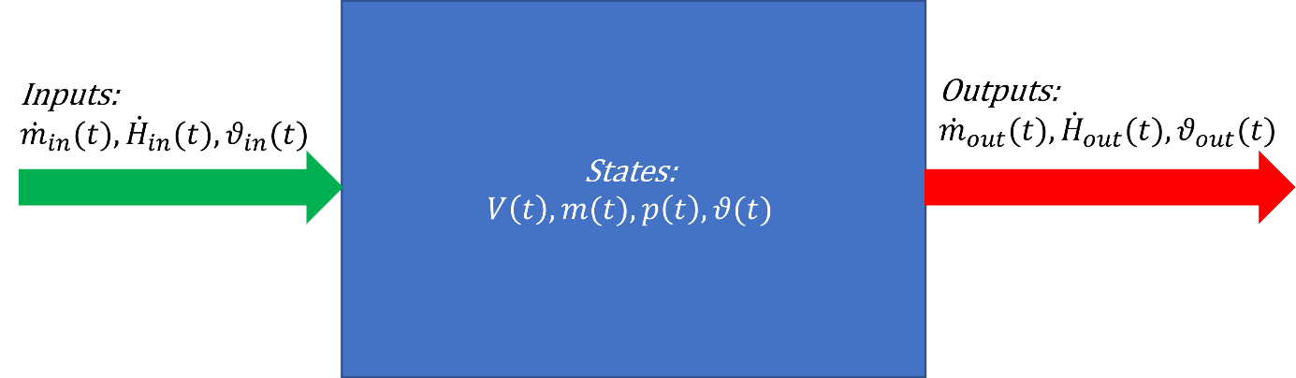
Modelling Approach - Basics
Lumped Parameter System (LPS)
Flow
Reservoir
1st Approach:
Assuming incompressible fluid due to constant pipe cross sections and low pressure drops [2]
New Approach:
Already changed due to integration of Gas composition [3]
In combination of mass flows and energy flows the state variables in the reservoir can be modeled
Fig. 1: Inputs, outputs and states of reservoir.
[2] Zahn, S.: Arbeitsspielaufgelöste Modellbildung und Hardware-in-the-Loop-Simulation von Pkw-Dieselmotoren mit Abgasturboaufladung, Fachbereich Elektrotechnik und Informationstechnik,Technische Universität Darmstadt, Darmstadt, 2012.
[3] Gößling, S.: 2-D + 1-D ortsaufgelöste Modellierung von PEM-Brennstoffzellen, Fakultät für Ingenieurwissenschaften, Abteilung Maschienenbau und Verfahrenstechnik, Universität Duisburg Essen, Duisburg, 2019.

Slide 7
Modelling Approach - Basics
Cathode Gas Path
FuelCell Model
FuelCell
Compressor Model
LPS
Reservoir
Reservoir
Flow

Slide 8
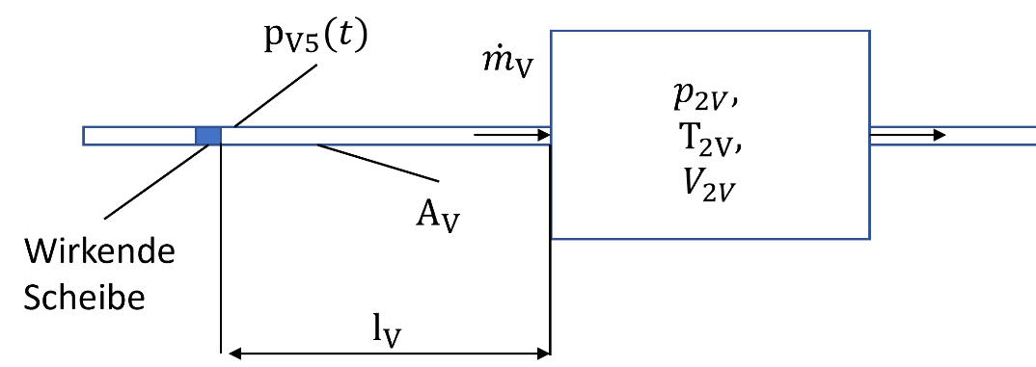

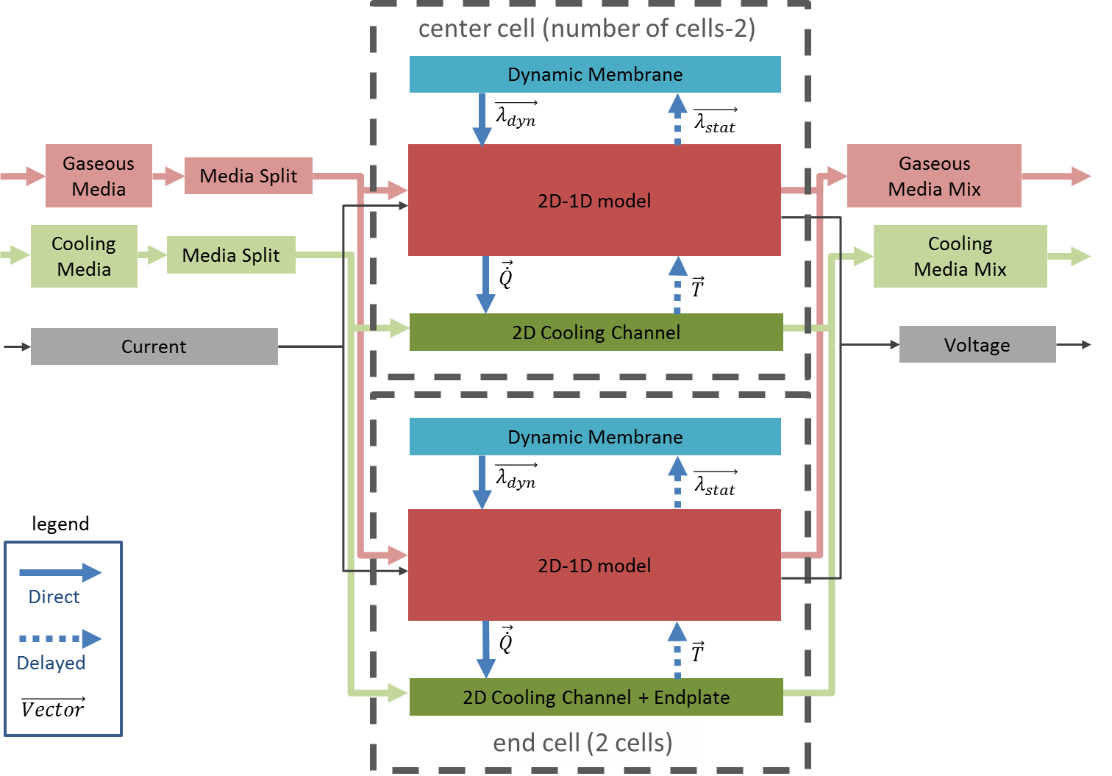

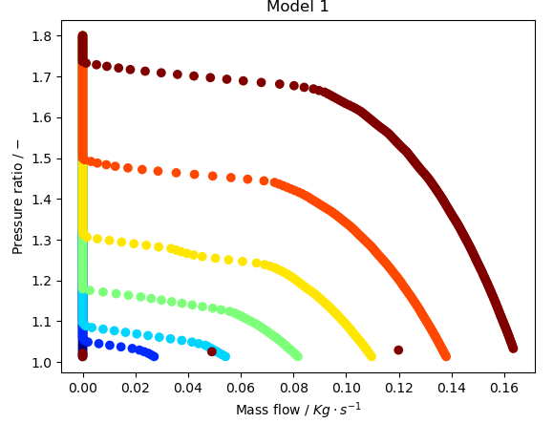
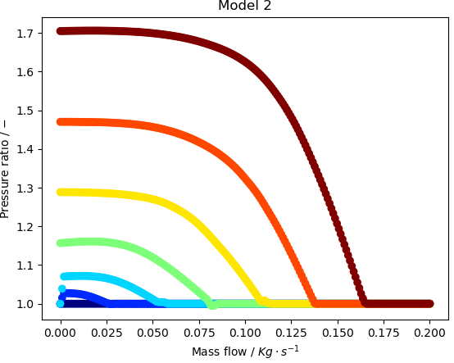
Modelling Approach - Components
Compressor Model
Fuel Cell Model
2-D + 1D spatially resolved Fuel Cell
Reduced Order Fuel Cell
Compressor mass flow calculation
Fitting compressor characteristics
Model of Stacks divided
into several cells
Modeling of different Fuel
Cell components
(Membrane, Channel etc.)
Reducing the 2-D + 1D spatially resolved fuel cell model to the voltage model
Reduction neglects the following sub models:
Segmentation
Water management
Dynamic membrane
Fig. 2: Modelling approach rotating disk, Modell II
Model 1
Model 2
Based on pressure ratio, compressor speed
Based on mass flow, compressor speed
Fig. 3: compressor characteristic diagram, Modell I
Fig. 4: compressor characteristic diagram, Modell II
Fig. 5: Sketch of the stack model
[2] Zahn, S.: Arbeitsspielaufgelöste Modellbildung und Hardware-in-the-Loop-Simulation von Pkw-
Dieselmotoren mit Abgasturboaufladung, Fachbereich Elektrotechnik und Informationstechnik,
Technische Universität Darmstadt, Darmstadt, 2012.

Slide 9
Modelling Approach - Components
Compressor Model
Fuel Cell Model
2-D + 1D spatially resolved Fuel Cell
Reduced Order Fuel Cell
Compressor mass flow calculation
Fitting compressor characteristics
Model of Stacks divided
into several cells
Modeling of different Fuel
Cell components
(Membrane, Channel etc.)
Reducing the 2-D + 1D spatially resolved fuel cell model to the voltage model
Reduction neglects the following sub models:
Segmentation
Water management
Dynamic membrane
Fig. 2: Modelling approach rotating disk, Modell II
Model 1
Model 2
Based on pressure ratio, compressor speed
Based on mass flow, compressor speed
Fig. 3: compressor characteristic diagram, Modell I
Fig. 4: compressor characteristic diagram, Modell II
Fig. 5: Sketch of the stack model
[3] Gößling, S.: 2-D + 1-D ortsaufgelöste Modellierung von PEM-Brennstoffzellen, Fakultät für Ingenieurwissenschaften, Abteilung Maschienenbau und Verfahrenstechnik, Universität Duisburg
Essen, Duisburg, 2019.

Slide 10
Modelling Approach - Components
Compressor Model
Fuel Cell Model
2-D + 1D spatially resolved Fuel Cell
Reduced Order Fuel Cell
Compressor mass flow calculation
Fitting compressor characteristics
Model of Stacks divided
into several cells
Modeling of different Fuel
Cell components
(Membrane, Channel etc.)
Reducing the 2-D + 1D spatially resolved fuel cell model to the voltage model
Reduction neglects the following sub models:
Segmentation
Water management
Dynamic membrane
Fig. 2: Modelling approach rotating disk, Modell II
Model 1
Model 2
Based on pressure ratio, compressor speed
Based on mass flow, compressor speed
Fig. 3: compressor characteristic diagram, Modell I
Fig. 4: compressor characteristic diagram, Modell II
Fig. 5: Sketch of the stack model
[3] Gößling, S.: 2-D + 1-D ortsaufgelöste Modellierung von PEM-Brennstoffzellen, Fakultät für Ingenieurwissenschaften, Abteilung Maschienenbau und Verfahrenstechnik, Universität Duisburg
Essen, Duisburg, 2019.

Slide 11
Web Based Simulation
Web Based Simulation
Backend
Frontend
Integration of the fuel cell cathode system
Based on the LPS (Reservoirs and flows)
Compressor Model I and Model II
Reduced order fuel cell model
Running system simulation
Integration of data management
Sending simulation data to the frontend
Saving data
Integration of graphical interface
Controlling simulation
Setting system power setpoints
Showing results
*Disclaimer
Part of the opensource code
Available on GitHub

Slide 12
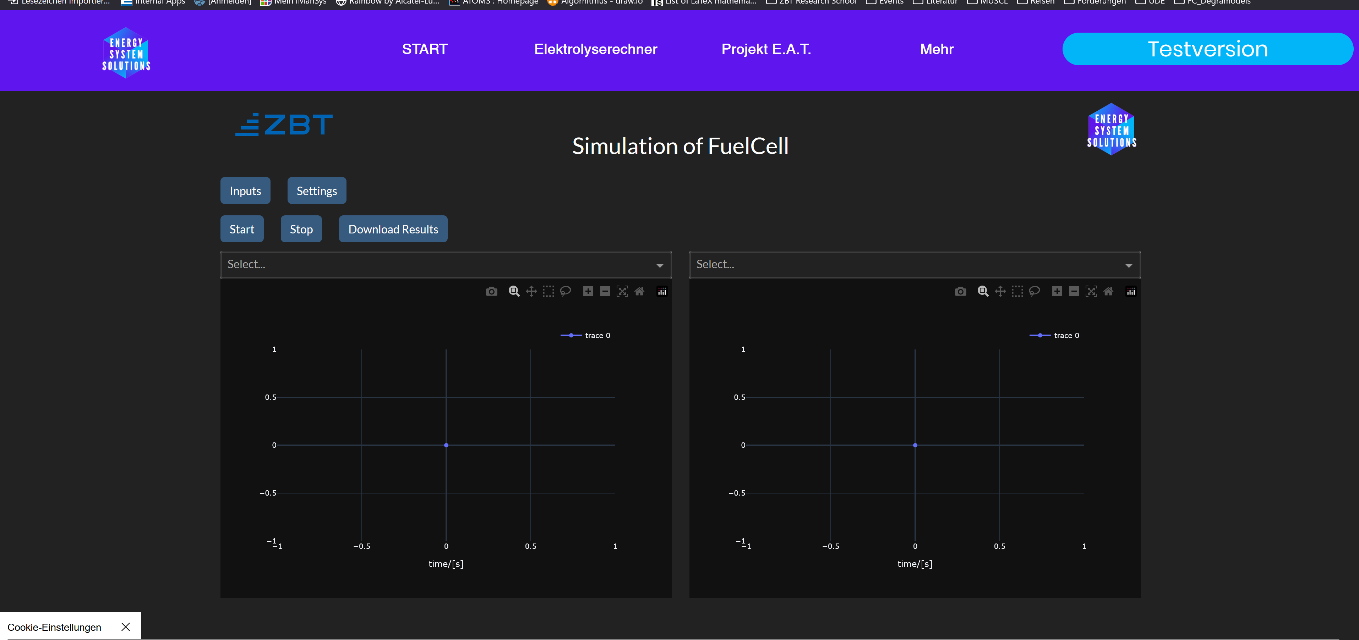
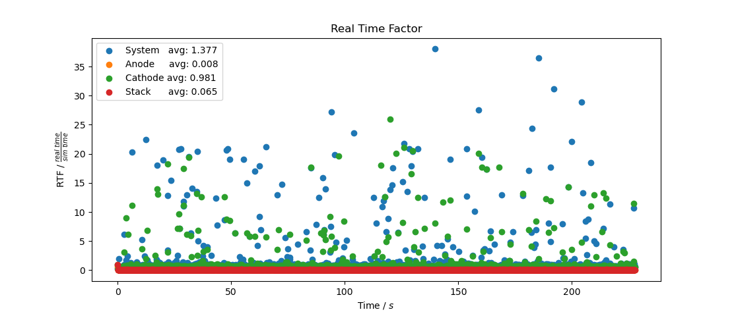
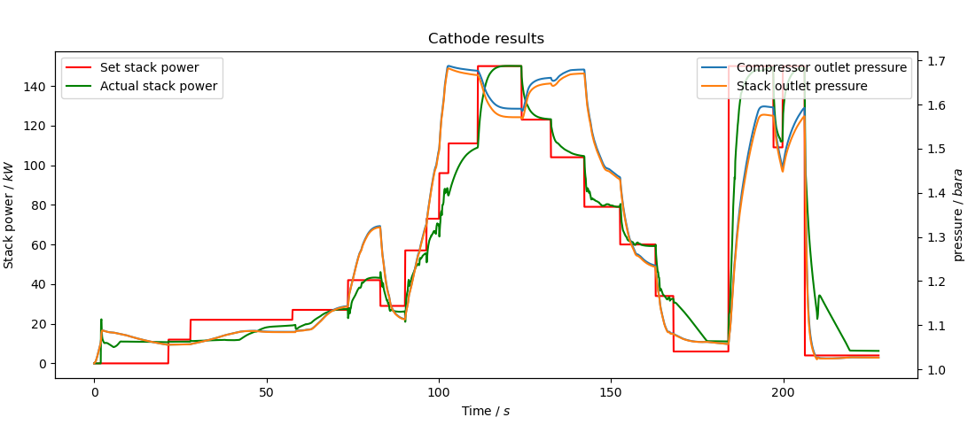
Results
Web Interface
Results of Simulation
Results of Simulation
Fig. 6: Web interface
Fig. 7: Real-Time-Factor of Simulation
Fig. 8: Results of simulating cathode gas path

Slide 13
Results
Web Interface
Results of Simulation
Results of Simulation
Fig. 6: Web interface
Fig. 7: Real-Time-Factor of Simulation
Fig. 8: Results of simulating cathode gas path

Slide 14
Results
Web Interface
Results of Simulation
Results of Simulation
Fig. 6: Web interface
Fig. 7: Real-Time-Factor of Simulation
Fig. 8: Results of simulating cathode gas path

Slide 15
Conclusion/ Further Development
Conclusion
Further Development
Developed python based simulation tool
Average cathode simulation in real-time
Integration of controller for FC-system needs optimization for python application
Overcoming high cost for simulation tools due to opensource access
Overcoming interoperability issues by open access to source code
Verification of simulation system by validating data on Tests
Integration of new components
Valves, electrolyzer
Building up community of developer

Slide 16





ZBT Kontakt
Florian Dennewitz, M.Sc.
Research Associate ZBT (October 2023)
Co-Founder, Energy System Solutions (April 2023)
PhD student (UDE, ZBT)
Topic: Simulation of degradation effects in fuel cells
M.Sc. Renewable Energies (TH Cologne)
B.Sc. Energy and Environmental Technology (HRW)
Link to Webtool:
Link to GitHub-Project:
+49 203 7598 – 3320
f.dennewitz@zbt.de

Slide 17




Thank you for your attention!
Florian Dennewitz
+49 203 7598 – 3320/ f.dennewitz@zbt.de

