Slide 1
Introduction to MongoDB
Dr. Pit Duwentäster
Duisburg
February 26th 2025

Slide 2
Content overview
What is MongoDB? - Document DB vs relational DB
MongoDB Compass – Connecting to our DB server
MongoDB user and permission management
Manually uploading data to the DB
Querying data
Exporting data

Slide 3

Introduction to MongoDB
MongoDB is a “NoSQL” database that stores data in a flexible, JSON-like format
Unlike traditional relational databases, it does not require tables or fixed schemas
Used for fast and scalable applications (We already have many millions of entries in our DB)
Why we use MongoDB:
Flexible – Easily adapt to changing data needs
Scalable – Handles large amounts of data efficiently
Fast – Optimized for quick data retrieval
Popular – Used by companies like Google, Facebook, Netflix and a wide community
It’s easy to find help online
Easy Integration - Works well with virtually all modern programming languages (E.g. Python)

Slide 4
Organization of MongoDB
Our MongoDB server hosts many different databases
Each database is divided into collections
Collections store the data in the form of documents. A database can have an arbitrary number of collections, but there are no sub-collections.
Documents are structured like JSON data. Individual entries in a document are called Fields
Unlike in a relational database, documents in the same collection can have wildly different structures. However, for practical purposes it is always a good idea to gather documents into the same collection only if they actually share similarities
📁 Database: OnlineStore
📂 Collection: Customers
📄 Document:
Fields:
{
"name": "Jane Doe",
"email": "jane@example.com",
"address": "Example street 123",
"purchases": ["Laptop", "Smartphone"]
}

Slide 5
MongoDB Compass – A graphical user interface for MongoDB
What is MongoDB Compass?
- A visual tool for managing and interacting with MongoDB
- Allows users to explore, query, and edit data without coding
Getting Started with Compass - Download & Install – Get MongoDB Compass from https://www.mongodb.com/try/download/compass - Connect to MongoDB – Enter the database connection string - Explore Databases & Collections – View data in a structured format - Run Queries Visually – Use filters to search for specific documents - Modify & Insert Data – Easily update or add new documents
Why Use Compass? - No coding required - Simple data visualization - Easy database management

Slide 6
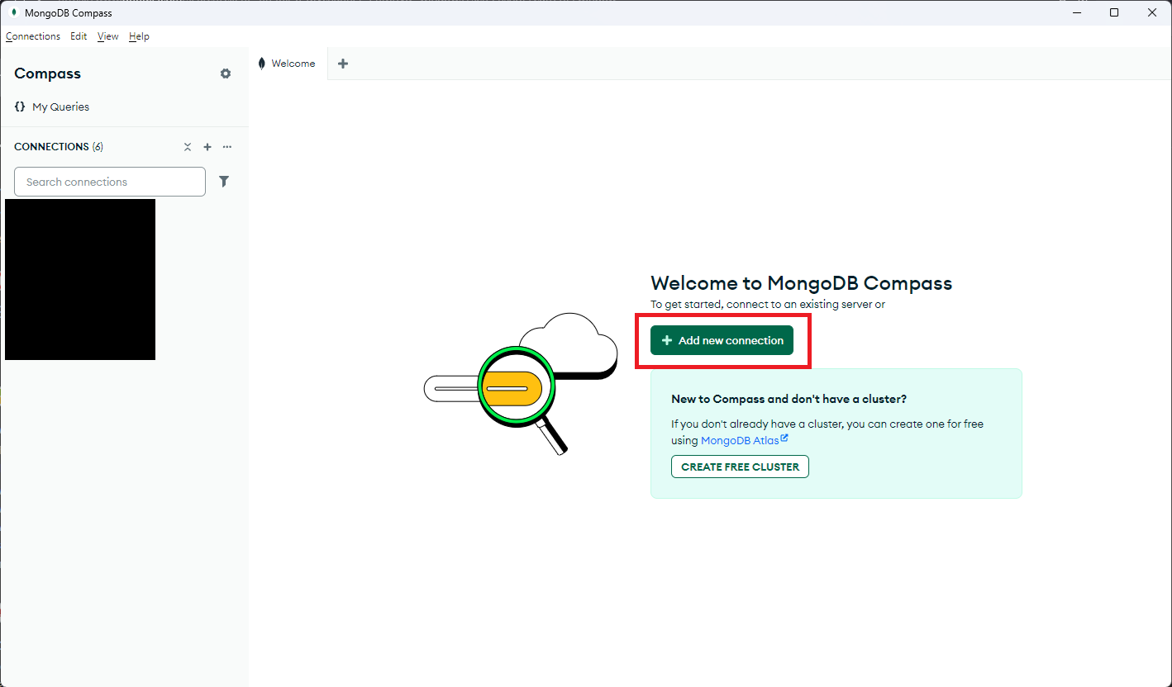
MongoDB Compass – Connecting to the server
Advanced connection options:
General
Host: 172.16.134.8:27017
✅ check direct connection
Authentication:
Username/Password: your three letter code
Authentication database: admin
Save
You should now see a connection and clicking it should show you an empty sample database

Slide 7
MongoDB Compass – Basic User Management
Changing your own password
In MongoDB Shell:
Creating a new user (Full users live on the admin database and are created by admins, but you can create users that exist only on a database where you have sufficient permissions, e.g. for students)
Creating a new role
Updating the user to assign a role
use admin
db.changeUserPassword("yourUsername", passwordPrompt())
use yourDB
db.createUser({user: "newUser", pwd: "newSecurePassword", roles: []})
db.createRole({role: "customRole",
privileges: [{
resource: {db: "testDB", collection: ""},
actions: ["find", "insert"]
}],
roles: []
})
db.updateUser("newUser", { roles: ["customRole"] })

Slide 8
MongoDB Compass – Importing data into the DB
As a basic example, we will use generic “customer” data
Create a collection “customers” and click “ADD DATA”.
“Insert document” allows you to type in a document manually
“Import JSON or CSV” allows you to select a file from your computer to upload.
If it is formatted as JSON or CSV, it will be parsed automatically, otherwise it will be treated as a singular block of text
When you create a document, MongoDB automatically adds an field “_id”, which contains a unique identifier for the document
Now import the example “customers.json” that we provided and inspect the resulting documents

Slide 9
MongoDB Compass – Querying data
Below are many basic CRUD (Create, Read, Update and Delete) queries, try them for yourselves:
Find all entries: db.customers.find().pretty()
Find entry by email: db.customers.findOne({ email: "jane.doe@example.com" })
Find customers by city: db.customers.find({ "address.city": "Chicago" })
Find customers over certain age: db.customers.find({ age: { $gt: 30 } })
Number of entries: db.customers.countDocuments()
Sort all entries newest first: db.customers.find().sort({ created_at: -1 })
Find the email addresses of all customers: db.customers.find({}, { email: 1, _id: 0 })
Delete entry by email: db.customers.deleteOne({ email: "michael.brown@example.com" })
Update a customer:
Add a new purchase:
In Compass, write only the part within parentheses into the query field
db.customers.updateOne({ email: "john.smith@example.com"},
{$set: {"address.city": "San Diego", "address.zip": "92101"}
})
db.customers.updateOne({ email: "alice.johnson@example.com" },
{ $push: { purchases: "Wireless Earbuds" }
})

Slide 10
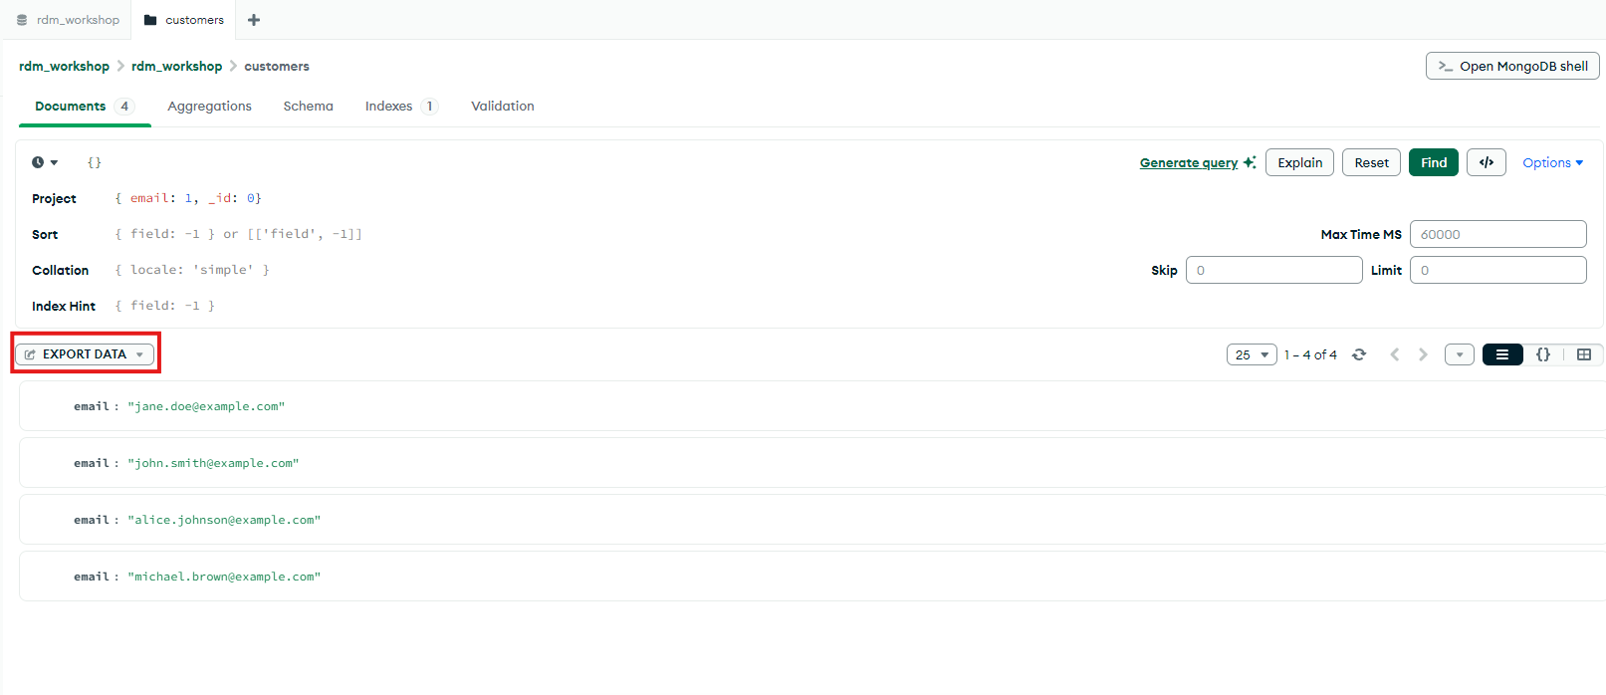
MongoDB Compass - Exporting query results

