Slide 1
How to make your data FAIR
Dr. Pit Duwentäster
Duisburg
March 12th 2025

Slide 2
Content overview
What is metadata?
What is FAIR data?
How do I make my data FAIR?
Metadata checklist
Naming of datasets

Slide 3
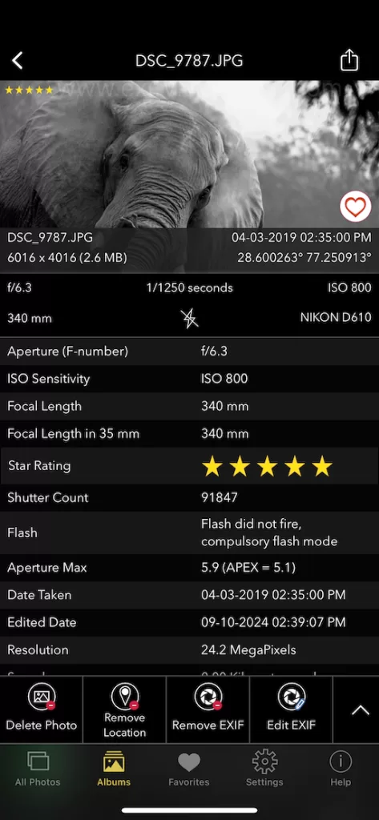
What is metadata?
Metadata is data about data
Metadata describes your data to help people using it understand what they are looking at
Good metadata ensures that your data can be reused and is reproducible
image: EXIF Viewer by Fluntro

Slide 4
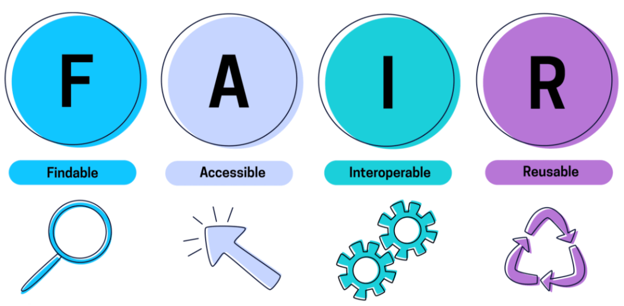
What is FAIR data?
FAIR stands for Findable, Accessible, Interoperable, Reusable
Making your data FAIR ensures that it can be used more than once:
FAIR principles ensure that you can find data you measured years ago
FAIR principles ensure that others can find your data
Your data can be reanalyzed, become part of larger meta-analyses, etc.
Adhering to FAIR principles is a part of Good Research Practice (GRP); Every scientific employee at ZBT has signed that they follow to the GRP rules of University Duisburg-Essen
Funding agencies like the DFG require FAIR data management if your want to be eligible for grants

Slide 5

How to make data FAIR?
Findable: Data can only be reused if it can be found.
Assign a unique identifier to each data set, so that you can refer to your data set in other places without any ambiguity
Data should be described by rich metadata to make searching through large collections of data possible (See also Reusability)
Metadata should include the identifier of the data (especially if metadata and actual data are stored in different places

Slide 6
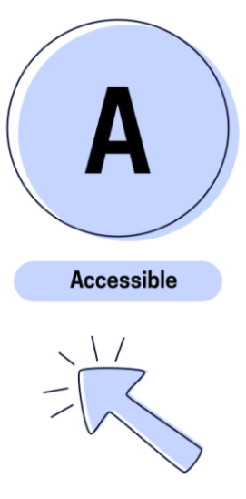
How to make data FAIR?
Accessible: Data can only be reused if it can be accessed.
Once the identifier of the data has been found, it should be clear how to access the data
Metadata should remain accessible, even if the data is no longer available
Accessibility is mainly ensured at the organizational level (e.g. through our database, eLabFTW, and similar infrastructure)

Slide 7

How to make data FAIR?
Interoperable: (Meta)data should be readable by humans and machines.
Metadata should be clearly readable; Not just by humans, but also by machines, i.e. it should be in a provided in a well structured format
Data itself may not always be readable, e.g. when it requires proprietary software, but the information how to read the data should be included in the metadata
Metadata should include references to other relevant metadata, e.g. the metadata of an experiment should include references to the measurement devices used to take the data

Slide 8
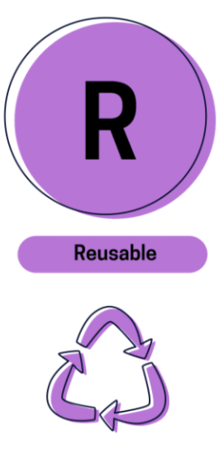
How to make data FAIR?
Reusable:
Metadata is released with ALL relevant attributes and all information should be accurate
Metadata is released with a clear usage license (see wiki entry: http://172.16.134.8:3000/research-software-engineering/Choosing-the-right-license )
Metadata includes full provenance of the data, i.e. how it was collected and how it has been preprocessed
Metadata should follow relevant community standards

Slide 9
Metadata checklist – Organizational metadata
Date of creation
Person responsible of the measurement and contact information
File formats and software / hardware required to access the data
Where to find the data
Data dictionary (explanation of data tables and their columns)
Rights and Licenses
Funding source
Unique identifier: See later slide for internal ZBT guidelines; If the data is published, assign a DOI (Digital Object Identifier)

Slide 10
Metadata checklist – Experimental metadata
Title of measurement
Type of measurement
Measured sample
Experimental setup (detailed description of equipment, materials, configuration, etc.)
Instrument details (model, manufacturer, calibration, etc.)
Measurement variables (Parameters measured and their units)
Relevant environmental conditions (external parameters like temperature, humidity, etc.)
Protocol of procedure (steps or methods followed in the experiment)
Data processing (is the data raw output from devices, or has it been preprocessed?)

Slide 11
General nomenclature
3 letters code of the person (or name as in egroupware): owner of the experiment
Number of the experiment (see next slides)
Optional additional tag / info
Project number from the dpt.
For preliminary research without a project: general project # of the dpt. followed by a „0“. Ex.: 71000_VCM_CCM_009_01
72102_VCM_CCM_009_001[_OPT]
Number of the repetition (see next slides)
3 letters code to categorize the kind of experiment. Other examples:
ECM (electrochemical experiments)
XRD
XRF
PTL
GDL
CAT (for catalyst preparation)

Slide 12
Number of experiment: example of a work flow
Preparation of an ink: it is used immediately for the preparation of 8 CCMs it doesn´t get an own name, but the CCMs are named:
72102_VCM_CCM_010_001
…
72102_VCM_CCM_018_001
2. Each CCM is used for an electrochemical experiment:
72102_VCM_ECM_021_001
…
72102_VCM_ECM_029_001
(In elabFTW in each new experiment there is information in the text about the CCM that is used in every case. Additionally, the experiments can be linked for more clarity)
3. While measuring 72102_VCM_ECM_029_001 the test bench crashed and only a portion of a measurement was recorded. After restarting the test bench, the measurement is restarted and called: 72102_VCM_ECM_029_002
4. If some ex-situ characterization techniques are measured, such as XRF, they should be called:
72102_VCM_XRF_013_001 and give the needed information in the elabFTW about sample + linking the experiment.

Slide 13
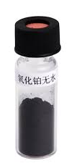
Number of experiment: example of using the repetition numbers
The last 2 digits can be used in case of a failed experiment + relaunching it, like mentioned in the previous slide.
2. Another case can be while preparing catalyst and getting two batches from the same synthesis (one part precipitated first, a second later):
72102_VCM_CAT_007_01 and 72102_VCM_CAT_007_02
3. Or for example we receive a complete PTL sheet from a project partner and we cut it into different pieces that we measure independently:
72102_VCM_PTL_085_01 and 72102_VCM_PTL_085_02

