Slide 1


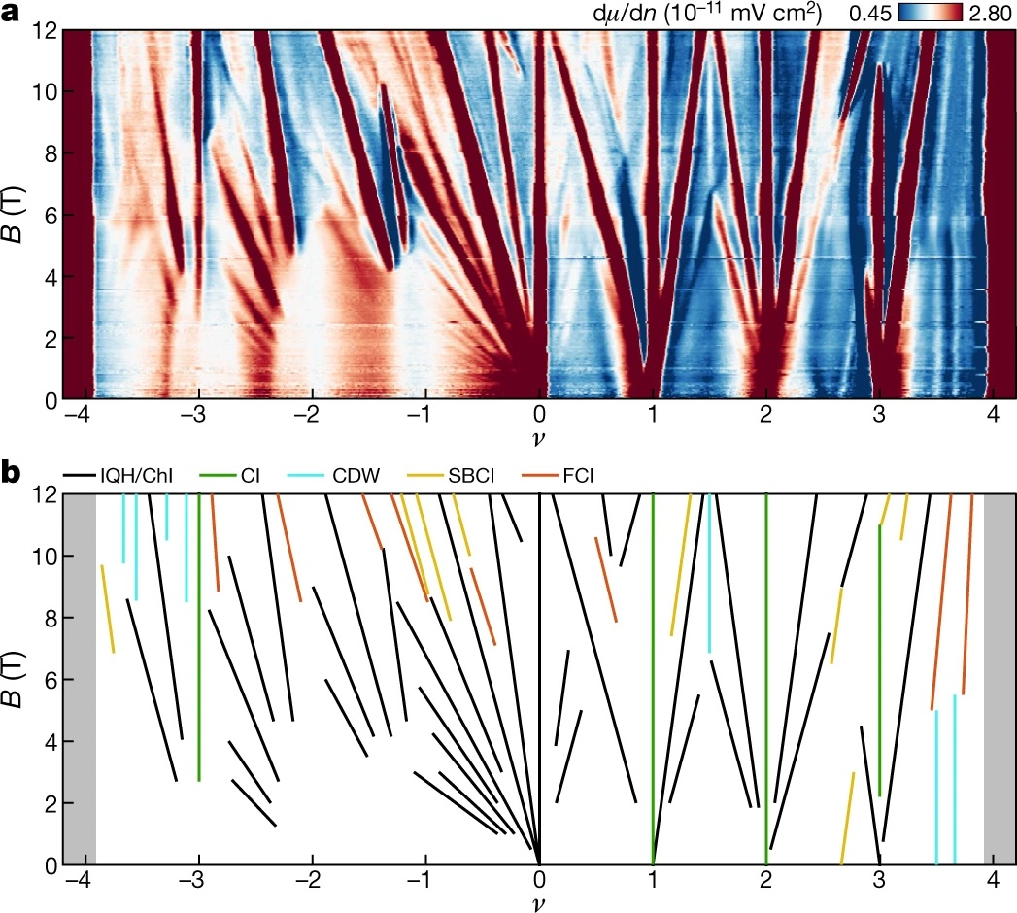
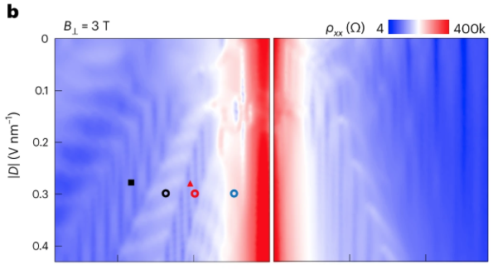
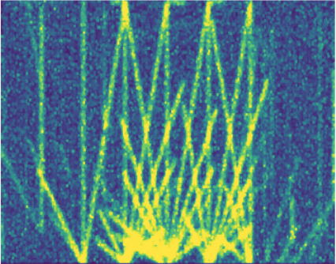
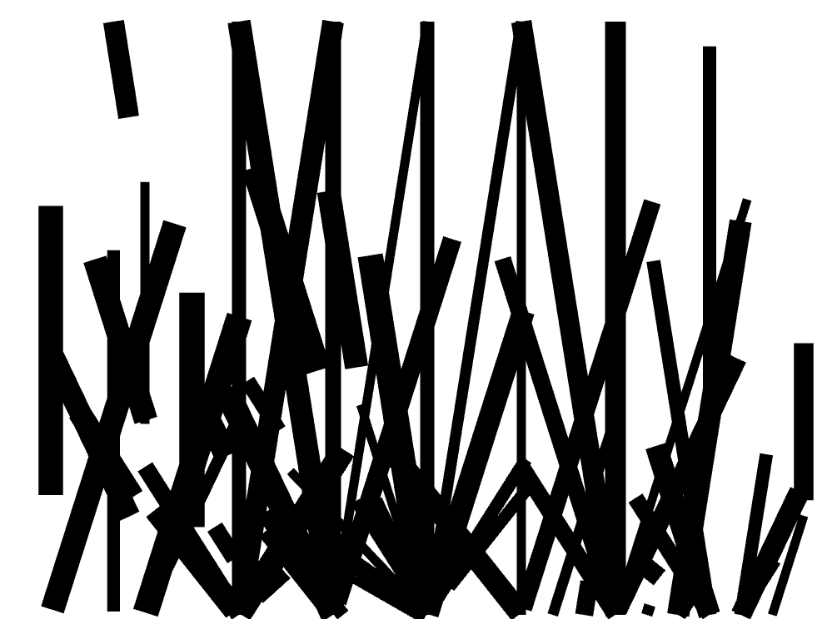
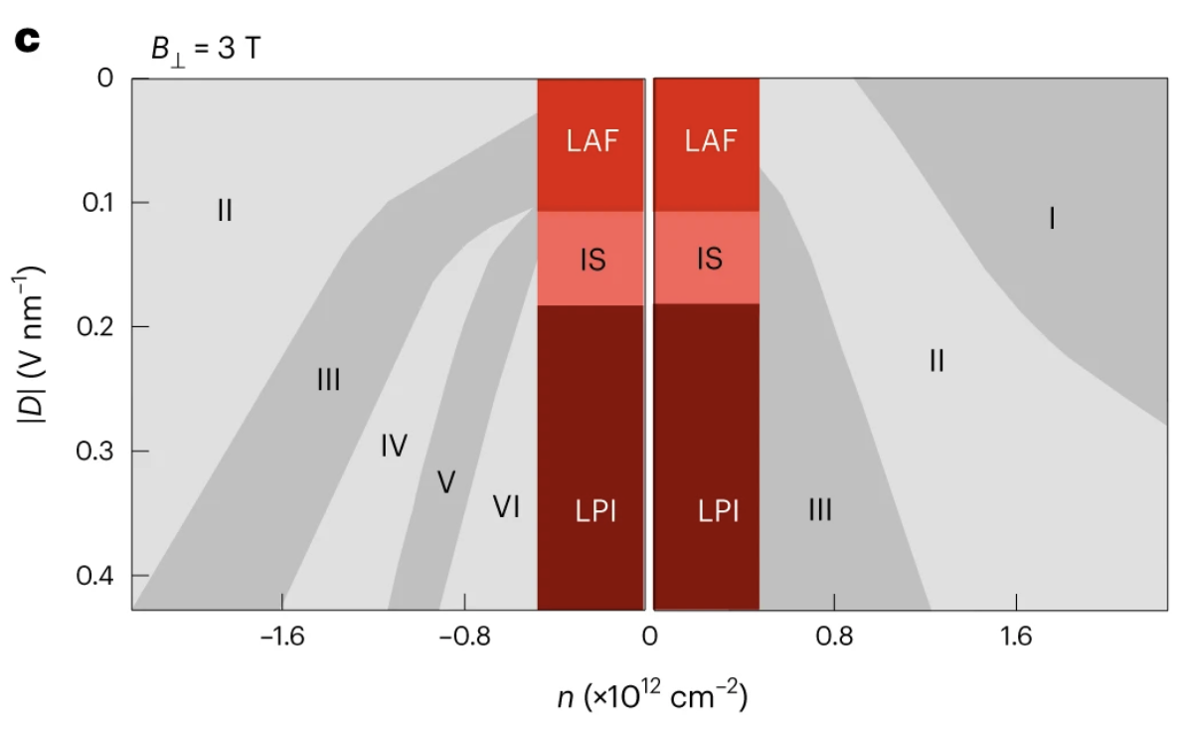
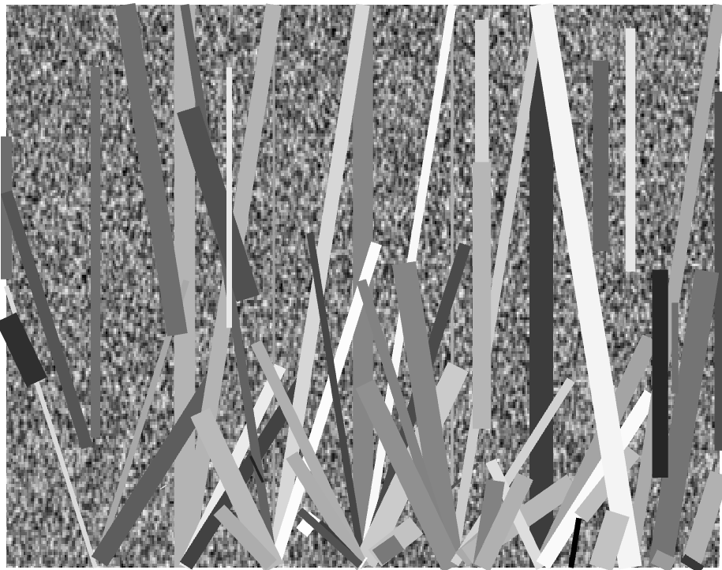
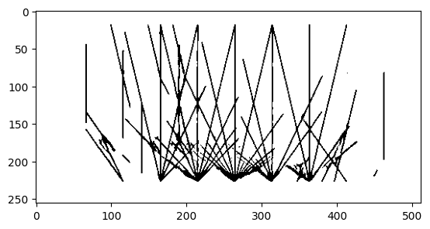
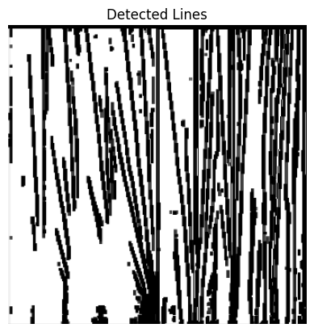
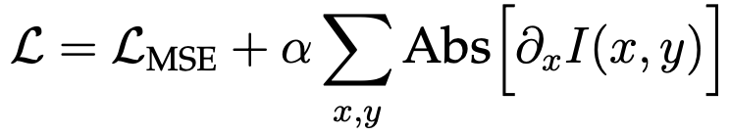
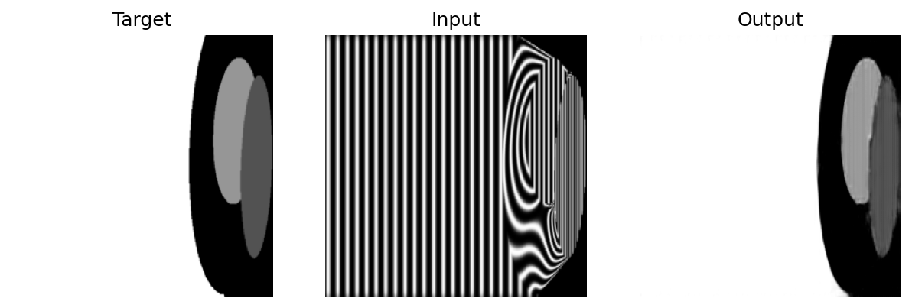
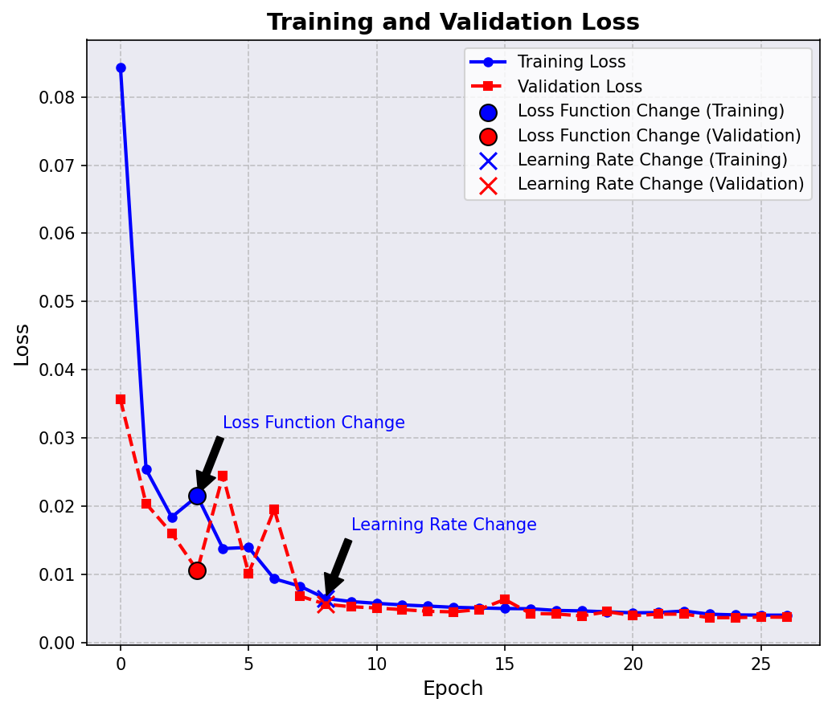
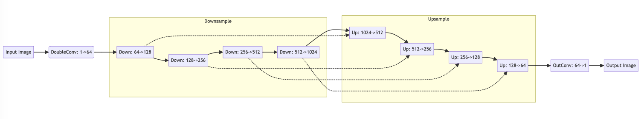
Machine Learning in Condensed Matter Data Processing
Zhaoyu Bai, Yaozhang Zhou, and Yiyang Jia
Weizmann Institute of Science, Department of Physics and Astrophysics
Introduction
Finding suitable Synthetic Streda Lines
We try to apply Machine Learning(ML) to identify:
First attempt: Add Gaussian and stripe noise into the synthetic thick lines from our immature understanding of the conditions in experiments.
Streda Lines, representing Landau Levels in materials.
Phases shown as different regions in material data.
Second attempt: Turning back into real data. The sharp edges of the thick Synthetic signals/lines might be necessary. —— Best One
Nature, 2021, 600(7889): 439-443.
Third attempt: Add some background noise, set random grayscales to signals
B: magnetic field. ν: carrier density.
Nature Nano 19: 188–195 (2024)
D: displacement field. n: carrier density.
ML not only reduces manual workload but also enhances the speed and accuracy of analysis, thus significantly advancing research in the field.
Getting Suitable synthetic data is the main difficulty.
We learned that non-signals are not random due to various effects.
To proceed, we need a better understanding of the non-signal background
Model Performance
Loss Function for Phase Recognition
Streda Lines:
1800 synthetic pictures
Train validation ratio: 4:1
Batch size:6
Optimizer: Adam
Learning rate 1e-3 3 epochs
Learning rate 1e-4 3 epochs
6 epochs in total
Hough Line detection
We applied binary thresholding filter
Due to the bright lines in the synthetic data, ordinary MSE does not work
Synthetic data performance
Data from the original paper
is the gray scale matrix
Phase Segmentation:
500 synthetic pictures
Train validation ratio: 4:1
Batch size:6
Optimizer: Adam
Modified Loss: 3 epochs
Learning rate 1e-3
Learning rate 1e-3 5 epochs
Learning rate 1e-3 20 epochs
First set as 1. Once the white line background is removed, turn it off.
Synthetic data performance
Turn-off around the epoch 3.
U-Net Model
Down: MaxPool(2)+DoubleCov
Up: ConvTranspose(2)+DoubleCov
Skip Connections
DoubleCov: (in, out, 5*5, padding=3) + (out,out, 3*3, padding=1)
OutCov: (in, out, 5*5, padding=3) + (out,out, 3*3, padding=1)

