Slide 1

Trade Bot Report
Zhaoyu Bai
2025 March

Slide 2
Exectutive Summary

Slide 3
Content
Introduction
Objectives
Methodology & Implementation
Results & Performance
Future works
Notes:
Implementation: v1, v2, v3

Slide 4
Introduction
Cryptocurrencies: high volatility, rapid price movements, and continuous market development --- opportunities and challenges for short-term trading.
Manual Trading: significant attention and constant market monitoring, workload and stress.
Scalability and Maintainability: to handle future expansions, e.g. new trading strategies and upgrading existing components --- Modular design
Notes:
Cryptocurrencies have emerged as a transformative financial asset class characterized by high volatility, rapid price movements, and continuous market development. These features provide unique opportunities but also pose substantial challenges for traders aiming to capitalize on short-term fluctuations. Manual trading, while effective, often requires significant attention and constant market monitoring, increasing both workload and stress, while potentially compromising timely decision-making.
To address these challenges, this project introduces a Python-based cryptocurrency trading bot leveraging the Binance API for automated data collection, preprocessing, and trade execution. Designed to operate at intervals ranging from 15 minutes to 4 hours, the bot enhances trading efficiency and accuracy by automating strategies previously implemented manually. Through the combination of traditional technical indicators, such as RSI and ADX, with advanced AI methods including Random Forest models, the bot aims to improve strategy precision, reduce emotional bias, and enable more punctual and consistent trade execution.
Furthermore, the project's modular design allows independent modules to handle distinct functions such as data processing, strategy evaluation, and risk management. This architecture significantly enhances scalability and maintainability and facilitates future expansions, such as integrating new trading strategies or upgrading existing components. The modular approach offers several advantages, including simplified debugging due to clearly defined module responsibilities, easier collaboration and code management, and improved system reliability by isolating potential issues. Moreover, it provides greater flexibility in testing and upgrading individual modules without disrupting the entire system, significantly reducing downtime and promoting continuous improvement. The necessity of using a modular approach becomes especially clear when considering long-term maintenance and upgrades, as it enables rapid identification and rectification of issues, smooth integration of updates, and efficient evolution of the system to adapt to market dynamics and technological advancements.
This report outlines the project's objectives, methodology, implementation, and performance evaluation, alongside insights gained from developing and deploying automated trading solutions. Additionally, it identifies potential directions for further enhancements and optimizations.

Slide 5
Objective
Develop a Python-based cryptocurrency trading bot integrating Binance API that does:
Data Handling
Feature/Indicator Engineering
Model Development
Signal Processing
Strategy Management
Risk Management
Backtesting
Live and Mock Trading
Logging and Reports
The tradebot has been trough two major upgrade, the previous two does not integrate the Live and Mock trading functionality.
Notes:
The primary objective of this project is to develop a Python-based cryptocurrency trading bot that automates market data collection, preprocessing, analysis, and trading execution through the Binance API. The bot is specifically designed to operate efficiently at trading intervals ranging from 15 minutes to 4 hours, enabling traders to capture timely opportunities in the fast-paced crypto market.

Slide 6
Methodology & Implementation

Slide 7
Data Handler
Data collection (historical/real-time), cleaning

Slide 8
Methodology: Data Handler Module
Purpose & Objectives:
Unified interface for managing, processing, and retrieving data (historical & real-time)
Designed for financial analysis and modeling
Core Principles:
Abstraction:
Base class with common functionalities (e.g., configuration loading, URL construction, parameter management)
Modularity:
Separates core functionalities from specialized tasks in derived classes (HistoricalDataHandler, RealTimeDataHandler)
Scalability & Flexibility:
Adapts to various data sources and formats using dynamic configuration (JSON files)

Slide 9
Methodology: Data Handler Module
Workflow Integration:
Configuration Management:
Loads source URLs, endpoints, and parameters consistently
Data Processing Pipeline:
Standardized methods for data retrieval, error handling, and transformation
Extensibility:
Derived modules extend the base functionality for specific data types and operations

Slide 10
implementation: Data Handler Module
Core Components
Configuration Loader:
Methods to load JSON configuration files for data sources, cleaning, and validation parameters
URL Builder & Data Fetching:
Constructs API endpoints and fetches data accordingly
Utility Methods:
Standardizes date formatting and file path generation for consistent data storage
Error Handling & Robustness
Implements retry loops with delays for API request failures
Uses progress monitoring (via tqdm) for long-running data downloads

Slide 11
implementation: Data Handler Module
Extensions via Derived Classes
HistoricalDataHandler
Loads pre-processed data from local files
Fetches data in chunks to manage API limits and memory usage
Integrates cleaning and rescaling routines (via DataCleaner and DataChecker)
RealTimeDataHandler
Streams live data feeds
Processes data in real time with rapid error handling and dynamic updates

Slide 12
Feature Engineering
Technical/Customize Indicator calculation and selection

Slide 13
Methodology: Feature module – Extraction
Data Transformation:
Convert raw input into a standardized format (e.g., Pandas DataFrame)
Clean, normalize, and structure data for uniform downstream processing
Modularity:
Modular design allows extension with new extraction techniques
Encourages reusability and customization based on data type/requirements
Integration:
Final output is a well-structured dataset for seamless integration with feature selection and modeling

Slide 14
Methodology: Feature module – Extraction
Technical Indicators: Utilized the TA library for traditional indicators (e.g., moving averages, RSI, MACD)
Incremental Updates: Developed an incremental update mechanism for technical indicators to efficiently process streaming or updated data
Custom Metrics: Domain-specific features capturing unique patterns

Slide 15
Methodology: Feature module – Selection
Evaluations:
Assess relevance via statistical correlations
Use machine learning techniques
Dimensionality Reduction:
Apply PCA or similar methods to reduce redundancy and feature space
Selection Criteria:
Use variance thresholds and mutual information to decide which features to retain
Optimization:
Produce a refined dataset focused on features with the highest predictive value
Reduce overfitting, lower computational cost, and enhance interpretability

Slide 16
implementation: Feature module
Modularity & Extensibility:
Clear separation of extraction methods allows for easy extension
Users can add new feature computations without disrupting the existing pipeline
Pipeline Integration:
Extracted features are formatted to integrate smoothly with subsequent modules

Slide 17
implementation: Feature module – Extractor
Pre-processing:
Cleaning and normalization methods
Computation Routines:
Functions for calculating statistical measures, technical indicators (leveraging the TA library), and custom metrics
Incremental Update:
Implements incremental updates for traditional technical indicators to handle data updates efficiently
Structured Output:
Organize computed features into a DataFrame for further use

Slide 18
Implementation (Future focus): Feature module – Selection
Evaluation Methods:
Compute statistical metrics and apply machine learning techniques for feature importance
Dimensionality Reduction Tools:
Implement algorithms (e.g., PCA) to retain essential information (ongoing)
Selection Algorithms:
Filter out less relevant features using dynamic or predefined thresholds
Output Optimization:
Produces a dataset containing only the most informative features for improved modeling performance

Slide 19
Model Development
Forcasting Model design and training

Slide 20
Methodology: Model module
Unified Modeling Framework:
Base Model provides common methods (train, predict, evaluate)
Specialized models to be developed for:
Machine Learning: Neural networks, decision trees, ensembles
Physics: Simulation-based, analytical models from physics inspiration
Statistical: Regression, time series, hypothesis testing
Model Trainer:
Centralized module for model training, evaluation, and integration

Slide 21
Implementation (Future Focus): Model module
Current State:
Machine learning/physics/statistical Modules are empty and serve as scaffolding
Planned Features:
Define common interfaces and shared methods in base_model.py
Extend specialized models from the base model
Implement model trainer to manage training loops and evaluation metrics
Parameter management, scalability, and extensibility as key design principles

Slide 22
Signal processing
Applications in time-series analysis, noise reduction

Slide 23
Methodology: Signal Processing module
Design Principles:
Modularity:
Separate modules for filtering, processing, and transformation
Scalability & Flexibility:
Designed to handle a wide range of signals and data formats
Integration:
Seamless pipeline from filtering through to feature extraction, and predictive models

Slide 24
Methodology: Signal Processing module
Core Components:
Signal Processor (signal_processor.py):
Coordinates the application of filters and transformations
Manages tasks like segmentation, normalization, and sequential processing
Filters (filters.py):
Remove noise and unwanted frequency components
Implements various filtering techniques (low-pass, high-pass, band-pass)
Transformation (transform.py):
Converts signals from the time domain to the frequency domain
Implements techniques such as Fourier and Wavelet Transforms for frequency analysis

Slide 25
Implementation: Signal Processing module
Signal Processor Module (signal_processor.py):
Supports processing of both batch and streaming data
Filters Module (filters.py):
Designs filters with configurable parameters (e.g., cutoff frequencies, order)
Dynamic configurability allows easy tuning for different signal types
Transformation Module (transform.py):
Provides functions for converting signals from time to frequency domain (e.g., FFT, Wavelet)
Enables feature extraction from transformed signals

Slide 26
Risk management
To Mitigate risk and protect capital at both single asset and portfolio levels

Slide 27
Methodology: Risk Management module
Single Asset Risk Management (single_risk.py):
Sets stop-loss and take-profit levels based on volatility and risk/reward ratios.
Adjusts position sizes to limit risk per trade.
Supports incremental risk updates with evolving market data.
Central Risk Manager (risk_manager.py):
Aggregates risk metrics across different strategies.
Provides a unified interface for monitoring and adjusting risk parameters.

Slide 28
Methodology: Risk Management module
Portfolio Risk Management (portfolio_manager.py):
Manages risk across multiple assets using diversification and rebalancing.
Monitors overall portfolio exposure and correlations.
Capital Allocation (capital_allocator.py):
Allocates capital based on risk-adjusted returns.
Dynamically adjusts allocations in response to market conditions.
Design Considerations:
Systematic and quantitative risk controls (e.g., using ATR for thresholds).
Customization via JSON configuration files for risk parameters.
Seamless integration with trading strategies and real-time data updates.

Slide 29
Implementation: Risk Management module
Single Asset Risk Management:
Implements functions for calculating stop-loss/take-profit levels.
Adjusts position sizes using predefined risk metrics.
Updates risk measures incrementally as new data arrives.
Central Risk Manager:
Consolidates individual risk metrics.
Provides utilities for enforcing risk limits and making adjustments.
Incorporates logging and error-handling for robust risk monitoring.

Slide 30
Implementation (Future Focus): Risk Management module
Portfolio Risk Management:
Evaluates asset correlations and implements diversification strategies.
Monitors overall portfolio exposure and triggers rebalancing when needed.
Capital Allocation:
Uses risk-adjusted metrics to distribute capital among assets.
Dynamically modifies allocations based on real-time risk and market changes.
Integrates with central and portfolio risk managers for comprehensive control.

Slide 31
Strategy Module
Realization of trading strategy

Slide 32
Methodology: Strategy module
Single Asset Strategy:
Focus on one asset using technical analysis and tailored risk management
Use chosen model to forecast and make buy and sell signals.
Multi Asset Strategy:
Aggregates signals from multiple assets for portfolio-level trading
Uses portfolio optimization, diversification, and dynamic rebalancing

Slide 33
Methodology: Strategy module
Customization via JSON Files:
Strategies can be customized using JSON configuration files (e.g., strategy.json)
Example configuration includes parameters for:
Model: e.g., Base_RSIwADX_type0 with custom indicator thresholds and parameters
Risk Manager: Stop-loss, take-profit, and position sizing parameters
Decision Maker: Decision rules such as threshold levels
Enables flexible, user-defined strategy adjustments for different assets

Slide 34
Implementation: Strategy module
Single Asset Strategy (single_asset_strategy.py):
Implements technical indicators and signal generation for one asset
Integrates risk management (stop-loss, take-profit) specific to single asset dynamics
Applies incremental updates to process evolving market data efficiently
Multi Asset Strategy (multi_asset_strategy.py):
Aggregates signals from individual asset strategies
Performs portfolio-level analysis for optimal capital allocation
Dynamically rebalances the portfolio based on market conditions

Slide 35
Implementation: Strategy module
Customization & Integration:
Loads and applies strategy configurations from JSON files
Allows user-defined customization for models, risk management, and decision-making parameters
Seamlessly integrates with data handling and execution systems for live trading
Additional Considerations:
Systematic signal generation through predefined rules and algorithms
Emphasis on modularity, enabling rapid iteration and testing of strategy rules

Slide 36
Backtesting Module
To Simulate historical trading performance to evaluate strategies/models

Slide 37
Methodology: Backtesting module
Backtester (backtester.py):
Simulates trade execution and virtual order management
Tracks performance metrics like cumulative returns and drawdowns
Model Evaluation (model_evaluation.py):
Computes performance metrics (accuracy, ROI, Sharpe ratio)
Compares predictive power of different models
Strategy Evaluation (strategy_evaluation.py):
Aggregates trade and model performance to assess overall strategy effectiveness
Supports optimization and parameter tuning

Slide 38
Methodology: Backtesting module
Design Principles:
Systematic simulation to mirror live market conditions
Modularity for independent development and testing of components
Customization via JSON Files:
strategy.json for multi-asset strategies: Configures model methods, risk manager parameters, and decision rules (e.g., Base_MACD_type0)
single_strategy.json for single-asset strategies: Defines specific parameters like start date, interval, and indicator thresholds (e.g., Base_RSIwADX_type0)
Data Handling Customization:
data_h.json sets data ingestion parameters such as file type, symbols, retry count, memory and log settings, and required data labels

Slide 39
Implementation: Backtesting module
Workflow Integration:
Sequential processing: Data ingestion → Trade simulation → Model & Strategy evaluation
Customization via JSON files allows flexible configuration of models, risk management, and data parameters
Backtester:
Loads and processes historical market data
Executes simulated trades based on generated signals
Records detailed performance statistics

Slide 40
Implementation: Backtesting module
Model Evaluation:
Calculates performance metrics to compare various predictive models
Provides statistical analysis for model validation
Strategy Evaluation:
Aggregates trade-level and model-level results to gauge overall strategy effectiveness
Supports tuning of strategy parameters based on backtest outcomes

Slide 41
Live/Mock Trading Module
Execution of orders, tracking of accounts in real time

Slide 42
Methodology: Real/Mock Trading module
Key Concepts:
Unified Trading Engine:
Shared core for order generation, risk controls, and connectivity
Real-Time Trading:
Executes live trades via Binance API
Mock Trading:
Simulates orders, account balance, and order status
Mimics Binance behavior for realistic testing
Customization:
Configurable via JSON files (e.g., API keys, account settings, order parameters)

Slide 43
Implementation: Real/Mock Trading module
Real-Time Dealer:
Connects directly to Binance for live market data and order execution
Implements order submission, modification, and cancellation
Mock Trading Modules:
Mock Real-Time Dealer:
Simulates live trading by generating mock order responses
Mock Order Manager:
Manages simulated orders and virtual account details

Slide 44
Implementation: Real/Mock Trading module
Common Features:
Integrated risk management (stop-loss, take-profit, position sizing)
Logging, error-handling, and consistent API compatibility with Binance
Configuration & Flexibility:
JSON-based settings allow easy switching and parameter tuning between real and mock environments

Slide 45
Results & Performance

Slide 46
Data Retrival & cleaning

Slide 47
Backtesting

Slide 48
Mock Trading

Slide 49
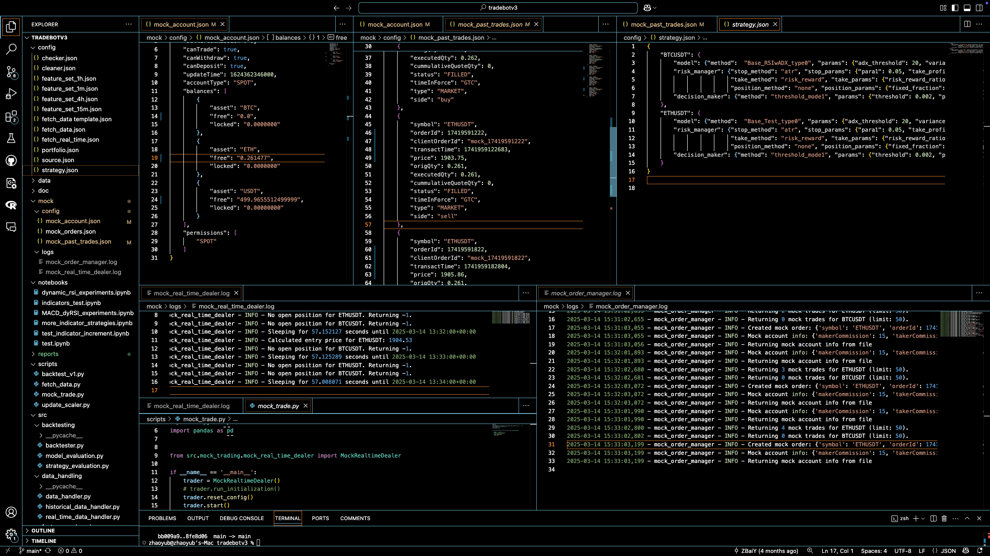
Testing with one minute timeframe.
Full position for each symbol
Equally distribution diversification
Trading fee 0.001 as in Binance

